Slide 1
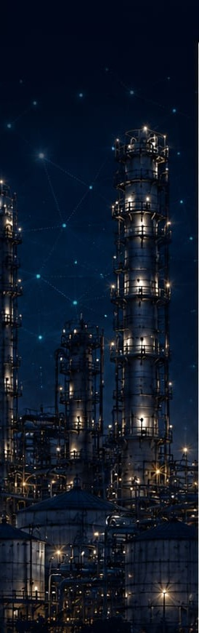

SMART INDIA HACKATHON 2026
TITLE PAGE
AURA.COST
AI-POWERED INDUSTRIAL COST OPTIMIZATION ASSISTANT
Optimize Today. Save Tomorrow.
A closed-loop AI assistant that detects cost-relevant equipment anomalies, explains their root cause, quantifies the savings opportunity, recommends a corrective action, and tracks whether the saving was actually realized.
PROBLEM STATEMENT ID
PROBLEM STATEMENT TITLE
[Add PS ID]
AURA.COST — AI-Powered Industrial Cost Optimization Assistant
THEME
PS CATEGORY
[Add Theme]
Software
TEAM ID
TEAM NAME
[Add Team ID]
[Add Team Name]
Team Name · SIH 2026 Idea Presentation

Slide 2
AURA.COST — CLOSED-LOOP COST INTELLIGENCE
IDEA TITLE
AURA.COST
THE PROBLEM
PROPOSED SOLUTION — AURA.COST
Plant costs (energy, material, downtime) are tracked in separate systems — ERP/Finance, MES/Production, IoT/Sensors, Maintenance/CMMS — reviewed on different cadences.
Conventional monitoring is reactive and threshold-based: it flags a reading but does not explain why it happened.
Root-cause investigation today is manual and slow, depending on institutional memory rather than data.
Fixes are rarely tied to a quantified, trackable saving — and almost never followed up to confirm it was real.
A single continuously-running app that ingests machine telemetry, detects cost-relevant anomalies, and automatically explains their likely root cause.
Every explained anomaly gets a recommended action with a projected rupee saving — implementable in one click from the dashboard, root-cause page, What-If sandbox, or an AI chat assistant.
The loop closes: implemented actions are tracked through a verification window and compared, projected vs. realised.
A Gemini-powered Co-Pilot answers questions in plain language and can trigger the same Implement action — one source of truth with the dashboard.
HOW IT WORKS — THE CLOSED LOOP
1
→
2
→
3
→
4
→
5
→
6
DETECT
EXPLAIN
QUANTIFY
ACT
TRACK
VERIFY
Live anomaly scoring on streaming telemetry
Ranked root-cause driver + confidence score
Projected saving & payback period
One-click implementation from any surface
Logged to the Action Tracker
Realised saving compared to projection
Genuinely closed-loop — not just alerting
Chat & dashboard share one source of truth
Every recommendation carries a confidence score
$0 running cost — free & open-source stack
AURA.COST — AI-Powered Industrial Cost Optimization Assistant
SIH 2026 | Idea Title | 02 / 06

Slide 3
AURA.COST — MOST IMPORTANT TECHNICAL SLIDE
TECHNICAL APPROACH
AURA.COST
ERP / Finance
MES / Production
IoT / Sensors
Maintenance / CMMS
Cost postings, purchase orders
Work orders, output volumes
Live telemetry (energy, temp.)
Maintenance event history
DATA INGESTION → UNIFIED INDUSTRIAL DATA MODEL → COST BASELINE (Activity-Based Costing + 90-day rolling baseline)
AI / ML ANALYTICS ENGINE
Cost Anomaly Detection
Root Cause Analysis
Cost Forecasting
What-If Optimization
Isolation Forest + z-score fallback
Maintenance + correlation, confidence score
Planned enhancement (see Feasibility)
PuLP 0/1-knapsack LP, CBC solver
ACTION RECOMMENDATION → SAVINGS QUANTIFICATION (₹ projected + payback) → ONE-CLICK IMPLEMENTATION → SAVINGS TRACKING & VERIFICATION
↺ Continuous Learning — verified action outcomes (Action Tracker) feed back into cost baselines and the AI/ML analytics engine.
TECHNOLOGY STACK (AS BUILT)
FRONTEND
BACKEND
AI & OPTIMIZATION
REALTIME & INFRA
React 18.3 + TypeScript, Vite 5.4
Tailwind CSS 3.4
Zustand 5.0 (state)
Recharts 2.13 (charts)
FastAPI 0.115 (Python 3.11)
SQLAlchemy 2.0 ORM
Pydantic 2.9 (validation)
PostgreSQL 16
scikit-learn — Isolation Forest
PuLP 2.9 (CBC solver)
Google Gemini gemini-2.5-flash
Function-calling Co-Pilot + fallback
APScheduler 3.10 (30s tick)
Native WebSockets (/ws/live, /ws/chat)
PBKDF2-HMAC-SHA256 auth
Docker Compose + nginx
AURA.COST — AI-Powered Industrial Cost Optimization Assistant
SIH 2026 | Technical Approach | 03 / 06

Slide 4
AURA.COST — PRACTICAL, ACHIEVABLE, HONEST
FEASIBILITY AND VIABILITY
AURA.COST
Technical Feasibility
Operational Feasibility
Economic Viability
Scalability
The full closed loop (detect → explain → recommend → implement → verify) runs end-to-end today.
Verified against a real, running PostgreSQL database and real browser sessions — not a mock-up.
Built entirely on a proven, mainstream open-source stack.
For a real plant, the missing pieces are a genuine telemetry connector and API-level authorization.
Both are scoped, localized changes, not redesigns — the code already marks where a real connector plugs in.
Every component is free/open-source or a free API tier — confirmed line-by-line across the stack.
$0 running cost today; no paid cloud service is called anywhere in the current implementation.
Current design (single Postgres instance, in-process WebSocket manager) fits a single-plant prototype.
Scaling to multiple plants/users needs a pub/sub layer, persisted models, and connection-pooling review — already scoped as near-term work.
CHALLENGES → MITIGATION
No API-level authorization — every backend endpoint is reachable without credentials today.
→ Add session/JWT-checked endpoints (a JWT_SECRET setting already exists, currently unused) before any real deployment.
Two frontend pages (What-If, Reports) are not yet wired to the live backend.
→ Wire What-If to the already-working, independently-verified api.runWhatIf(); add a backend aggregation endpoint for Reports.
No automatic savings-verification job — pending → verified is currently demo-seeded only.
→ Add a scheduled job that re-measures fct_cost / fct_sensor_reading after the verification window and closes the loop automatically.
Single plant, two machines — the data model currently hard-depends on this scope.
→ Generalize the machine-count assumptions in the join logic; extend the data model toward multi-plant support.
Validation scope: Tested locally against a real PostgreSQL database and browser sessions — 1 simulated plant, 2 machines, 36,920 sensor readings, 14 anomalies, 12 recommendations (5 implemented), over a 12-month seeded dataset. Not yet validated on real plant data or a production deployment.
AURA.COST — AI-Powered Industrial Cost Optimization Assistant
SIH 2026 | Feasibility and Viability | 04 / 06

Slide 5
AURA.COST — VALUE DELIVERED
IMPACT AND BENEFITS
AURA.COST
KEY BENEFITS
WHO BENEFITS
Continuous cost visibility — one dashboard instead of a periodic report.
Early anomaly detection — every new reading scored in near real time (30s cadence).
Explainable root causes — ranked driver + confidence score, drill-down to the machine.
Quantified savings — every recommendation ships with a projected saving & payback.
One-click corrective action from the dashboard, root-cause page, What-If, or AI Co-Pilot.
Closed-loop verification — realised savings tracked against what was projected.
Plant Operations Managers
Maintenance Engineers
See the live alert the moment a cost anomaly appears, with a likely cause already surfaced.
Get an automatically-ranked explanation instead of starting a manual investigation.
Production / Cost Analysts
Management / Leadership
Review the Action Tracker to see which past fixes actually delivered their projected savings.
Ask the AI Co-Pilot a plain-language question, backed by the same live dashboard numbers.
TRADITIONAL VS. AURA.COST
Dimension
Traditional / Status Quo
AURA.COST
Cadence
Periodic (weekly/monthly) reporting, reconciled after the fact
Continuous, near real-time (30-second telemetry ticks)
Data
Siloed across ERP / MES / IoT / CMMS
Unified industrial data model across all sources
Root cause
Manual investigation, institutional memory
Automatic, ranked driver + confidence score
Action
Ad-hoc, rarely quantified
Recommended action, projected saving & payback, one click
Verification
Rarely followed up
Closed loop — tracked, projected vs. realised
SAMPLE SYSTEM OUTPUT — an actual recommendation record generated by the prototype
ASSET
ACTION
PROJECTED SAVINGS
IMPLEMENTATION COST
PAYBACK
CONFIDENCE
Extruder 3A
Service cooling jacket circulation pump
₹1,76,000
₹6,000
1 day
79%
Figures above are a real sample output of the working system — not a claim of verified real-plant results (see Feasibility & Viability).
AURA.COST — AI-Powered Industrial Cost Optimization Assistant
SIH 2026 | Impact and Benefits | 05 / 06

Slide 6
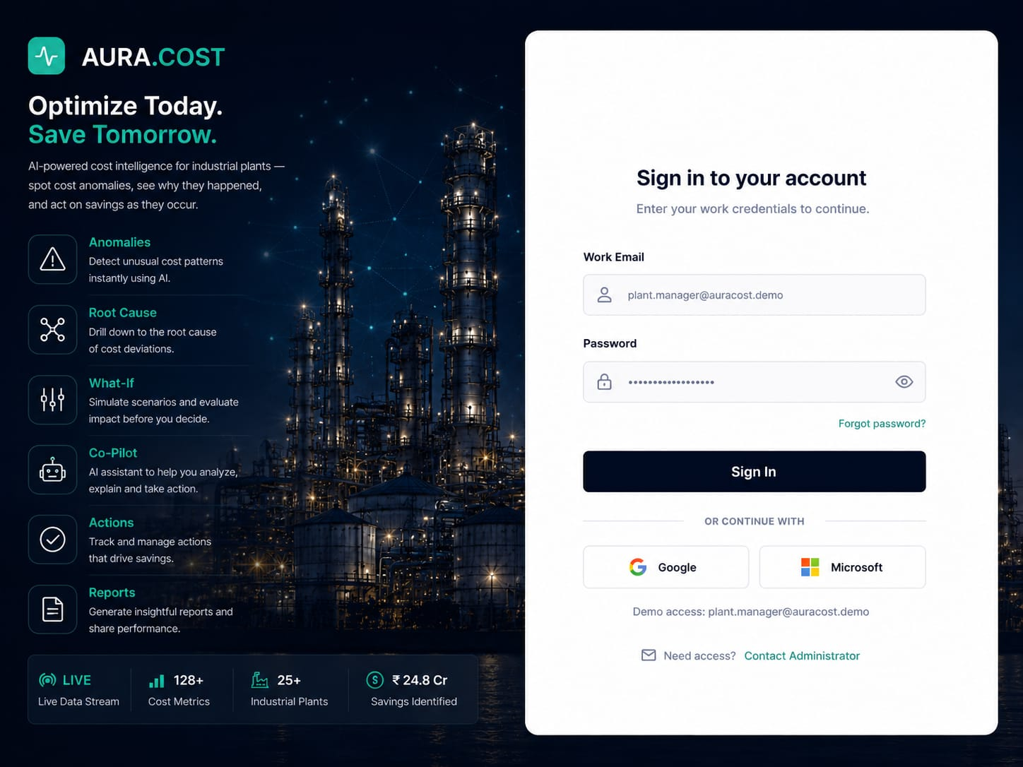
AURA.COST — GROUNDED IN THE PROJECT'S OWN DOCUMENTATION
RESEARCH AND REFERENCES
AURA.COST
EXISTING LANDSCAPE
PROTOTYPE EVIDENCE
Generic industry practice: cost variance is typically reviewed on a periodic (weekly/monthly) cadence — spreadsheets or a BI dashboard reconciled after the fact against ERP postings.
Condition-monitoring / predictive-maintenance tools, as a general product category, typically focus on equipment health and failure prediction — not on translating an anomaly directly into a cost figure and a trackable action.
Gap identified: the disconnect between real-time operational telemetry and financial cost visibility, and the absence of a closed verification loop on recommended actions.
No vendor-specific competitive audit was performed for this prototype — this section reflects the general, commonly understood landscape only.
HOW AURA.COST IS DIFFERENT
Actual login screen of the working AURA.COST prototype — real product logo, tagline, and module list (Anomalies, Root Cause, What-If, Co-Pilot, Actions, Reports).
Genuinely closed-loop, not just alerting — carries an anomaly through explanation, a quantified action, one-click implementation from four UI surfaces, and a tracked verification record.
Chat and dashboard share one source of truth — the AI Co-Pilot's tools call the exact same backend functions as the REST API, so they can never structurally disagree.
Zero running cost — every layer is free/open-source or a free tier, and the app degrades gracefully (not to a broken state) without a Gemini key.
Honest architecture — genuine general-purpose techniques (the PuLP linear program, PBKDF2 hashing) are explicitly distinguished from illustrative heuristics standing in for a fuller build.
REFERENCES
FastAPI — fastapi.tiangolo.com
React — react.dev
PostgreSQL — postgresql.org/docs
scikit-learn (Isolation Forest) — scikit-learn.org
PuLP — coin-or.github.io/pulp
Google Gemini API — ai.google.dev/gemini-api/docs
Only sources actually applicable to this project are listed — no fabricated citations or market studies.
AURA.COST — AI-Powered Industrial Cost Optimization Assistant
SIH 2026 | Research and References | 06 / 06

