Slide 1
Modeling

Slide 2
Data Modeling
Modeling in data science refers to the process of creating mathematical representations (models) that capture patterns, relationships, and insights from data to make predictions, classifications, or decisions.
Machine learning models are computer programs that are used to recognize patterns in data or make predictions.
Machine learning is a subset of artificial intelligence (AI) that focuses on building systems that learn from data and make decisions or predictions without being explicitly programmed for every task.
Instead of writing specific rules or algorithms for every task, machine learning models are trained on data and improve their performance based on experience.

Slide 3
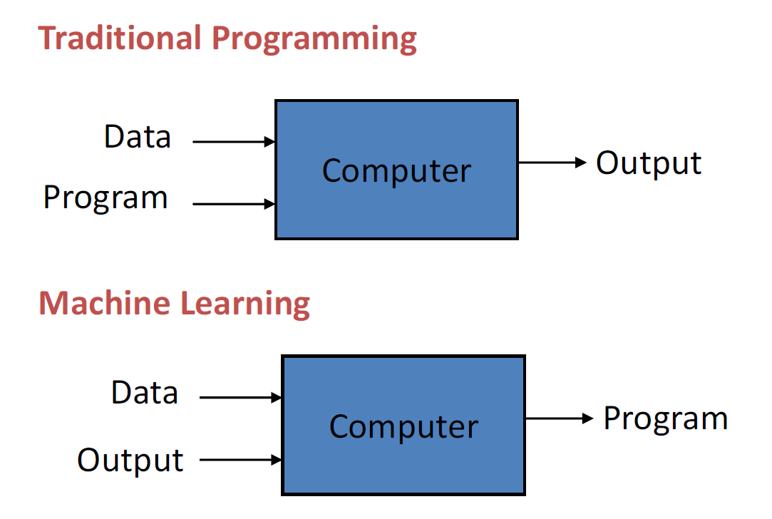
Machine Learning (ML)
“A computer program is said to learn from experience (E) with some class of tasks (T) and a performance measure (P) if its performance at tasks in T as measured by P improves with E”

Slide 4
Types
Supervised Learning
Unsupervised Learning
Semi supervised learning
Reinforcement Learning

Slide 5
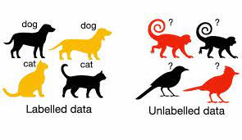
Supervised Learning
Two phases: training, testing
An algorithm learns to map input data to a desired output based on labeled examples (supervisor) provided in the training dataset.
The algorithm uses features from the dataset to determine relationship between the input and the target.
Terms
Training set, testing set
Model
Evaluation

Slide 6
Supervised Learning: Types
Regression
the model predicts a continuous output.
E.g. predicting house prices based on features like size, number of bedrooms, and location.
Classification
the model assigns data points to predefined classes.
E.g., classifying emails as spam or not spam.
Algorithms: Linear regression, decision trees, support vector machine

Slide 7
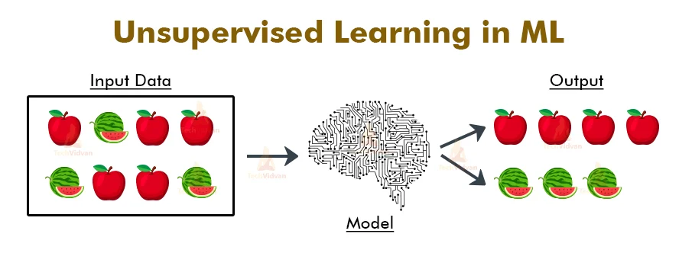
Unsupervised Learning
Algorithm is trained on unlabeled data to discover patterns within the data.
No predefined target outputs or labels.

Slide 8
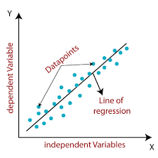
Linear Regression
Linear regression is used for modeling the relationship between a dependent variable (target) and one or more independent variables (predictors or features) by fitting a linear line to the observed data.
The aim is to find the best fitting line that describes the relationship.
Types
Simple Linear Regression
Multiple Linear Regression
Fig. Simple Linear Regression

Slide 9
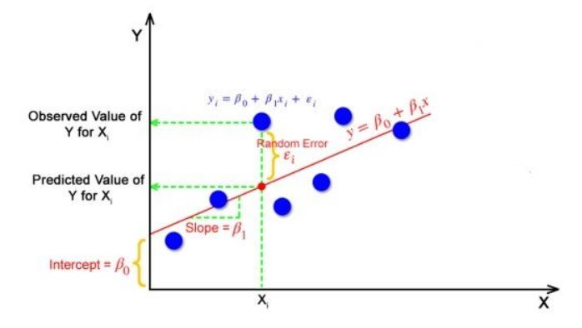
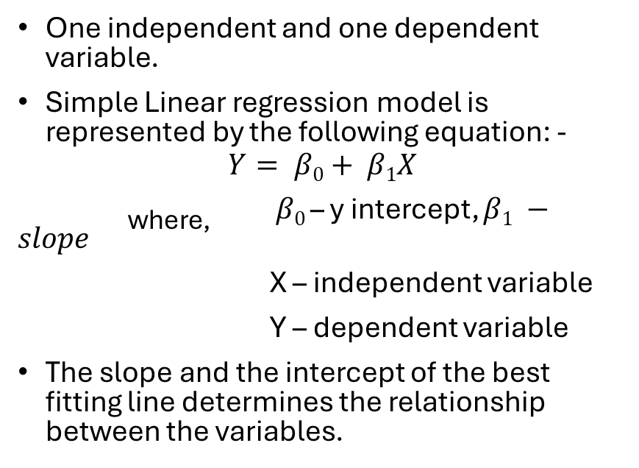
Simple Linear Regression
One independent and one dependent variable.
Simple Linear regression model is represented by the following equation: -
$$Y= β0+ β1X$$
_{where,} $β0$ – y intercept, $β1 −slope$
X – independent variable
Y – dependent variable
The slope and the intercept of the best fitting line determines the relationship between the variables.
Fig. Simple Linear Regression

Slide 10




Simple Linear Regression: How is the best fitting line found?
Y
Y
Y
X
X
X
Trial 1: $Y= β01+ β11X$
Trial 2: $Y= β02+ β12X$
Trial 3: $Y= β03+ β13X$
Y
Multiple trails of fitting a line are conducted, each time with a different line
Error between the actual and predicted value is computed. The line with the least error is the best fitting line.
Trial 4: $Y= β03+ β13X$
X

Slide 11
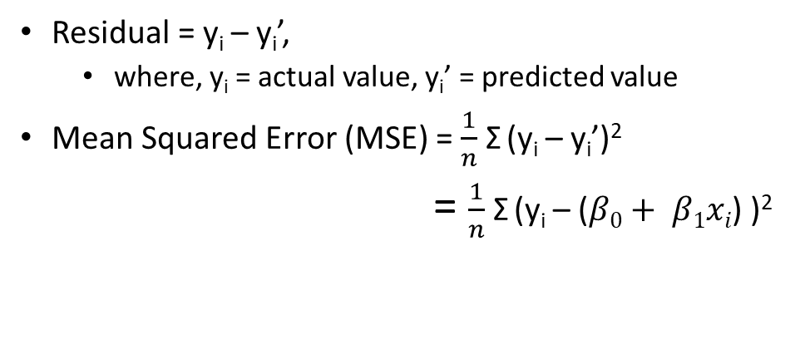
Simple Linear Regression: Residual Sum of Squares
Residual = y_{i} – y_{i}’,
where, y_{i} = actual value, y_{i}’ = predicted value
Mean Squared Error (MSE) = $\frac{1}{n}$ Σ (y_{i} – y_{i}’)²
= $\frac{1}{n}$ Σ (y_{i} – ($β0+ β1xi$) )²
Fig. Simple Linear Regression
Link to video: https://www.youtube.com/watch?v=owI7zxCqNY0&ab_channel=dataminingincae

Slide 12
Linear Regression: House Price Prediction
Area (sq. ft.) | Price (lakhs)
500 | 12
650 | 13.5
720 | 16.5
750 | 17
780 | 17.2
850 | 19
880 | 21
1050 | 24
1200 | 29
1550 | 41
Area (sq. ft.) | Price (lakhs)
500 | 12
650 | 13.5
720 | 16.5
750 | 17
780 | 17.2
850 | 19
880 | 21
1050 | 24
Training set is used for training (finding the best fit line).
80-20 split
Training set
Area (sq. ft.) | Price (lakhs)
1200 | 29
1550 | 41
Testing set is used for evaluating the trained model.
Data set
Testing set

Slide 13
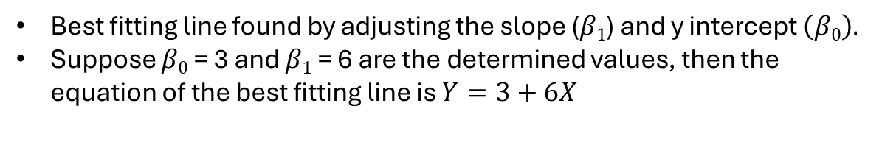
Linear Regression: House Price Prediction (Training)
Area (sq. ft.) | Price (lakhs)
500 | 12
650 | 13.5
720 | 16.5
750 | 17
780 | 17.2
850 | 19
880 | 21
1050 | 24
Training set
Best fitting line found by adjusting the slope ($β1$) and y intercept $\left(β0\right).$
Suppose $β0$ = 3 and $β1$ = 6 are the determined values, then the equation of the best fitting line is $Y=3+6X$

Slide 14
Linear Regression: House Price Prediction (Testing)
Predicted price
Area (sq. ft.) | Price (lakhs)
1200 | 29
1550 | 41
38 lakhs
Testing set
Actual price
1550 sq. ft.
Price for the examples in the testing set predicted using the regression line.

Slide 15
Linear Regression: House Price Prediction
Prediction phase
Area (sq. ft.) | Price (lakhs)
500 | 12
650 | 13.5
720 | 16.5
750 | 17
780 | 17.2
850 | 19
880 | 21
1050 | 24
1200 | 29
1550 | 41
Price of a house with area of 900 sq. ft.?
Data set

Slide 16
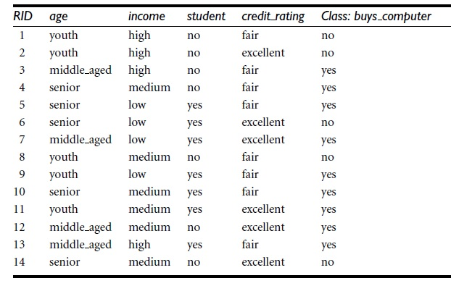
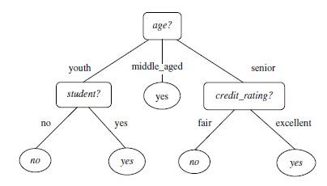
Decision Tree
A Decision Tree is a supervised learning algorithm used for both classification and regression tasks.
It works by splitting the data into subsets based on the most significant feature, creating a tree structure where each internal node represents a decision based on a feature, each branch represents the outcome of that decision, and each leaf node represents the final prediction.

Slide 17
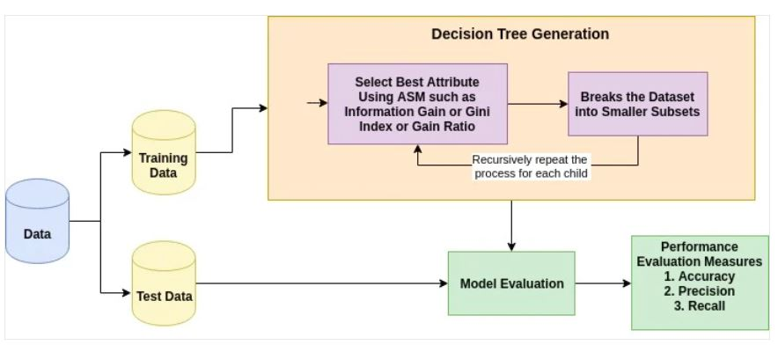
How does a Decision Tree work?

Slide 18
Training phase: Decision Tree Induction
Decision tree induction refers to the process of generating a decision tree from a given data set.
1. Select the Best Feature to Split:
Choose the feature that results in the largest gain in information.
2. Split the Dataset:
Divide the dataset into subsets based on the chosen feature and condition.
3. Repeat for Subsets
Apply the same process on each subset to create further decision nodes and leaf nodes, until:
All data points are correctly classified.
A stopping criterion is met (e.g., maximum depth, minimum samples in a leaf).

Slide 19
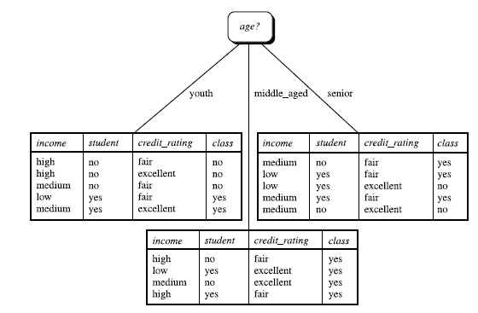
Training on the sample dataset
To generate a decision tree from the dataset, the following steps are followed: -
Select one of the features (age, income, student, credit_rating) to be placed at the root.
Based on the feature selected, create ‘x’ branches from the root, where x – number of unique values of the feature.
Follow the same process to place other features at the internal nodes.
The leaf nodes will have the target classes.
Fig. Dataset
Fig. Partially constructed decision tree with age as the root node

Slide 20
Training phase: Attribute selection measures
How was age selected to be placed at the root, out of the features (age, income, student, credit_rating)?
An attribute selection measure can be used to determine the best attribute.
Attribute selection measures that can be used: -
Information gain
Gain ratio
Gini index

Slide 21


Information Gain
Information gain is a metric that measures how much information is gained by splitting a data set on a particular feature.
Information gain is calculated by comparing the entropy of the original dataset to the entropy of the child sets. A higher information gain indicates that the feature is more effective at splitting the data.
The entropy of the original dataset (D) is given as follows: -
The entropy of the child set is given as follows: -
The information gain is given as follows: -
where, p_{i} – probability that that a tuple in D belongs to class C
where, |D_{j}| – number of samples in subset j
|D| - total number of samples in the dataset
Info(D_{j}) – entropy of subset D_{j}

Slide 22


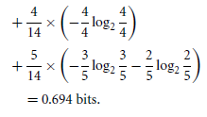
Information gain calculation
buys_computer: yes
buys_computer: no
Entropy of dataset
Entropy of the child set created when split on the attribute age
Information gain
age: youth
age: middle_aged
age: senior

Slide 23
Information gain calculation
The gain for the other attributes are
Gain(income) = 0.029 bits
Gain(student) = 0.151 bits
Gain(credit_ rating) = 0.048 bits
Since, age has the highest gain value, it is selected to be placed at the root.
The data is split as shown in the figure. The tuples for the partition middle_aged belong to the same category (class: yes), a pure partition. Hence a leaf node is created.
For the other two impure partitions (youth, senior), the same procedure is followed on the remaining features (income, student, credit_rating).

Slide 24
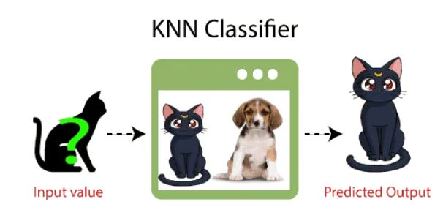
K Nearest Neighbor (KNN)
The K Nearest Neighbor (KNN) is an algorithm that can be used for both classification and regression (mostly used for classification).
It relies on the idea that similar data points tend to have similar labels or values.
Training phase: stores the entire dataset (lazy learner)
Testing phase: calculates distance between input data point to all the training examples using a distance metric (E.g. Euclidean dist., Manhattan dist., etc.)
Parameter tuning: value of ‘k’ determined.
Classify input value using the value of ‘k’.

Slide 25
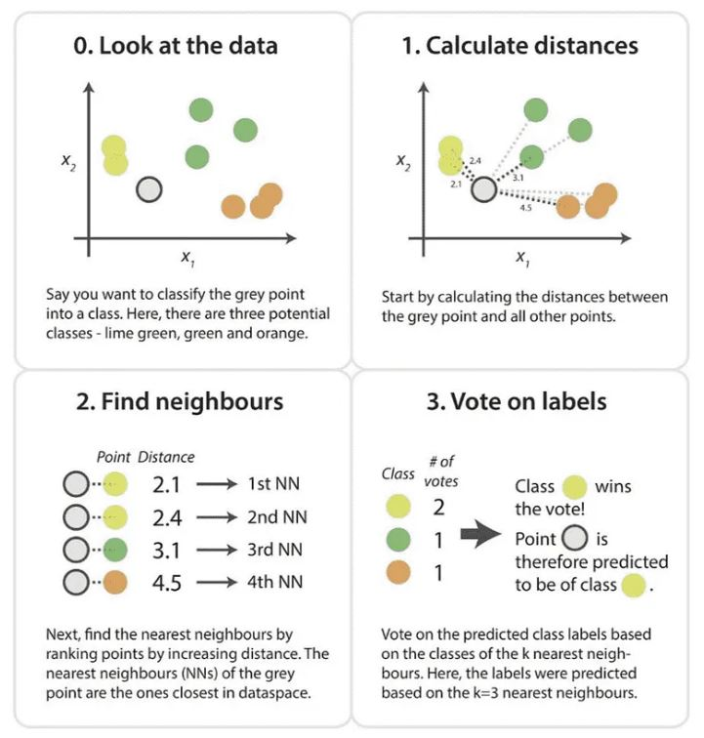
KNN
Step-1: Select the K number of the neighbors
Step-2: Calculate the Euclidean distance of K number of neighbors
Step-3: Take the K nearest neighbors as per the calculated Euclidean distance.
Step-4: Among these k neighbors, count the number of the data points in each category.
Step-5: Assign the new data points to that category for which the number of the neighbor is maximum.

Slide 26
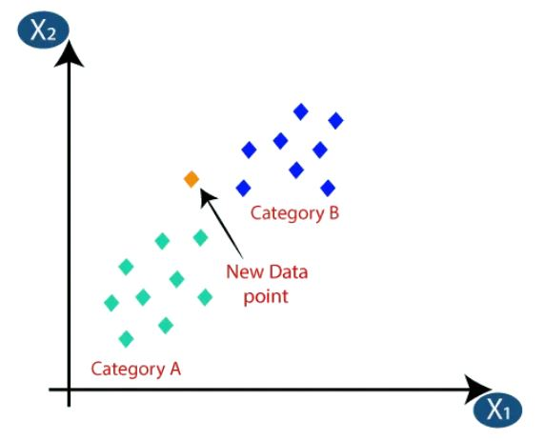
KNN - Example
There are two categories A and B, and we have a new data point to classify.
Select the K number of the neighbors. Here the chose value of K is 5.

Slide 27
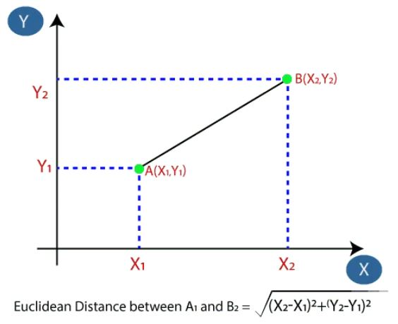
KNN - Example
Calculate the Euclidean distance of K number of neighbors.

Slide 28
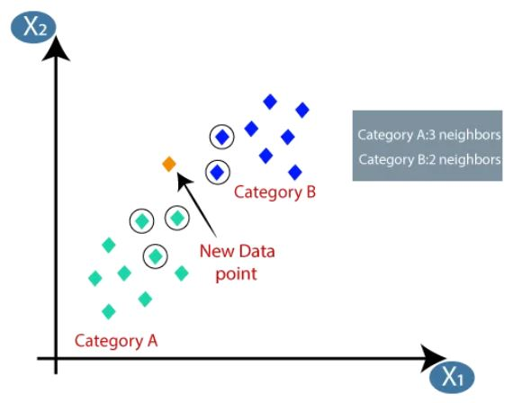
KNN - Example
Take the K nearest neighbors as per the calculated Euclidean distance.
Based on the Euclidean distance
Nearest neighbors in category A = 3
Nearest neighbors in category B = 2
Assign the new data points to that category for which the number of the neighbor is maximum.
The new data point is assigned to category A
https://medium.com/swlh/k-nearest-neighbor-ca2593d7a3c4

Slide 29
Determining value of ‘K’
The selection of the optimal ‘k’ value depends on the specific dataset and the characteristics of the problem, and it can significantly impact the performance of the algorithm.
Considerations
Odd value of ‘k’ more suitable.
Smaller value of ‘k’ can be noisy, while larger can have bias and is more computationally expensive.
Cross validation
K = sqrt(N), where N = no. of samples in the dataset.

Slide 30
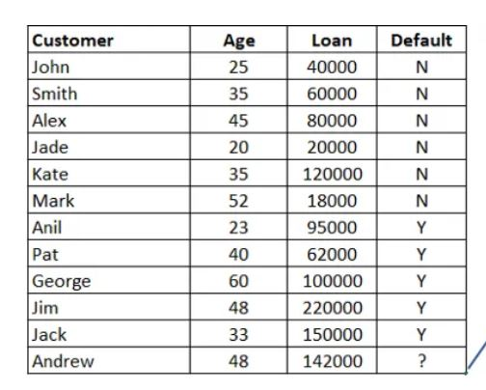
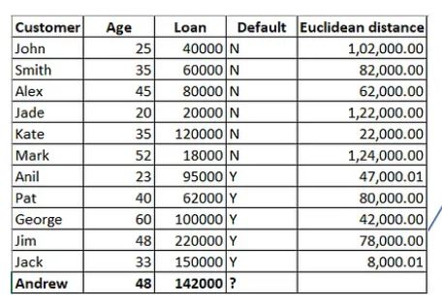
Example: Determine the ‘Default’ status for Andrew.
Training data
Step 1: Calculate the distance to all data points

Slide 31
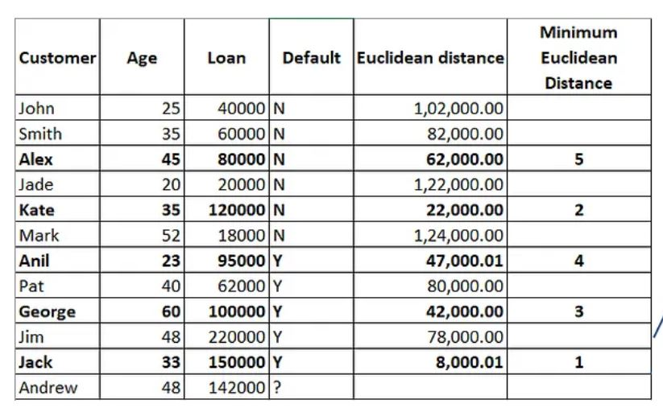
Example: Determine the ‘Default’ status for Andrew.
Step 2: Assume k = 5
Step 3: Find five minimum distance values.
Out of 5 chosen records there are three Ys and two Ns.
Andrew’s default status is taken as Y.

