Slide 1
DATA SCIENCE SEMINAR PRESENTATION
SEMINAR PRESENTATION
Mastering Advanced
Data Visualization
in Python
Subject: Essential of Data Science
Topic: Data Visualization
Presented By:
Guru Prakash A
Reg No: 25322011
Class: II MCA
Dept of Computer Science & Applications
Three-Dimensional Plotting • Geographic Data with Basemap • Visualization with Seaborn
Topic 01
Topic 02
Topic 03
3D Plotting
Basemap
Seaborn
01 / 35
Notes:
Welcome to the seminar on Data Visualization presented by Guru Prakash A, Reg No: 25322011, II MCA.

Slide 2
Table of Contents
01
Cover & Introduction
Slide 1
02
Datasets Used
Slides 3–4
03
Three-Dimensional Plotting in Matplotlib
Slides 5–14
04
Geographic Data with Basemap
Slides 15–22
05
Visualization with Seaborn
Slides 23–33
06
Seaborn vs Matplotlib Comparison
Slides 34–35
Data Visualization Seminar
02 / 35

Slide 3
Datasets Used in This Seminar
Three real-world benchmark datasets are used across all visualizations:
🌸 Iris Dataset
🍽️ Tips Dataset
✈️ Flights Dataset
150 rows × 5 columns
244 rows × 7 columns
144 rows × 3 columns
▸ sepal_length, sepal_width
▸ total_bill, tip, sex
▸ year (1949–1960)
▸ petal_length, petal_width
▸ smoker (Yes/No), day
▸ month (Jan–Dec)
▸ species (setosa/versicolor/virginica)
▸ time (Lunch/Dinner)
▸ passengers (count)
▸ Source: R.A. Fisher, 1936
▸ size (party size)
▸ Used in: Seaborn heatmap
▸ Used in: Seaborn pairplots, 3D scatter
▸ Used in: Seaborn catplot, lmplot
▸ Used in: 3D surface plot
Datasets Overview
03 / 35

Slide 4
Dataset Sample Values (First 5 Rows)
🌸 Iris Dataset
🍽️ Tips Dataset (sample)
sepal_length
sepal_width
petal_length
petal_width
species
total_bill
tip
sex
smoker
day
time
size
5.1
3.5
1.4
0.2
setosa
16.99
1.01
Female
No
Sun
Dinner
2
4.9
3.0
1.4
0.2
setosa
10.34
1.66
Male
No
Sun
Dinner
3
4.7
3.2
1.3
0.2
setosa
21.01
3.50
Male
No
Sun
Dinner
3
4.6
3.1
1.5
0.2
setosa
23.68
3.31
Male
No
Sun
Dinner
2
5.0
3.6
1.4
0.2
setosa
24.59
3.61
Female
No
Sun
Dinner
4
✈️ Flights Dataset (sample)
year
month
passengers
1949
January
112
1949
February
118
1949
March
132
1949
April
129
1949
May
121
Dataset Samples
04 / 35

Slide 5
TOPIC 01
mpl_toolkits.mplot3d
Three-Dimensional
Plotting in Matplotlib
05 / 35

Slide 6
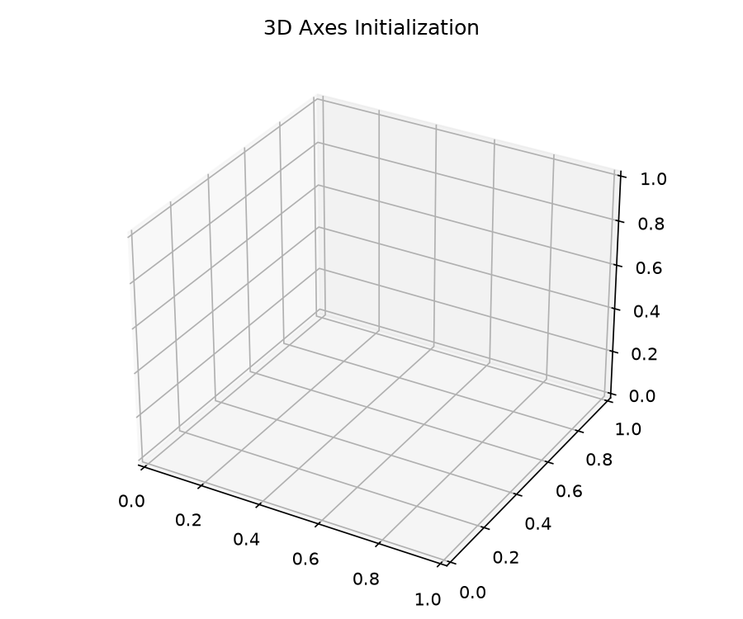
3D Axes & Coordinate Systems
Section 3.1 — mpl_toolkits.mplot3d projection registration
Core Definitions
• mplot3d: Standard Matplotlib 3D toolkit (no pip install needed)
• Registers 3D projection axes via fig.add_subplot(projection='3d')
• Maps (x, y, z) data triples through rotation matrices
• Supports elevation (elev) and azimuth (azim) camera angles
• ax.set_xlabel / ylabel / zlabel for 3-axis labels
Topic 01 · 3D Plotting
06 / 35

Slide 7
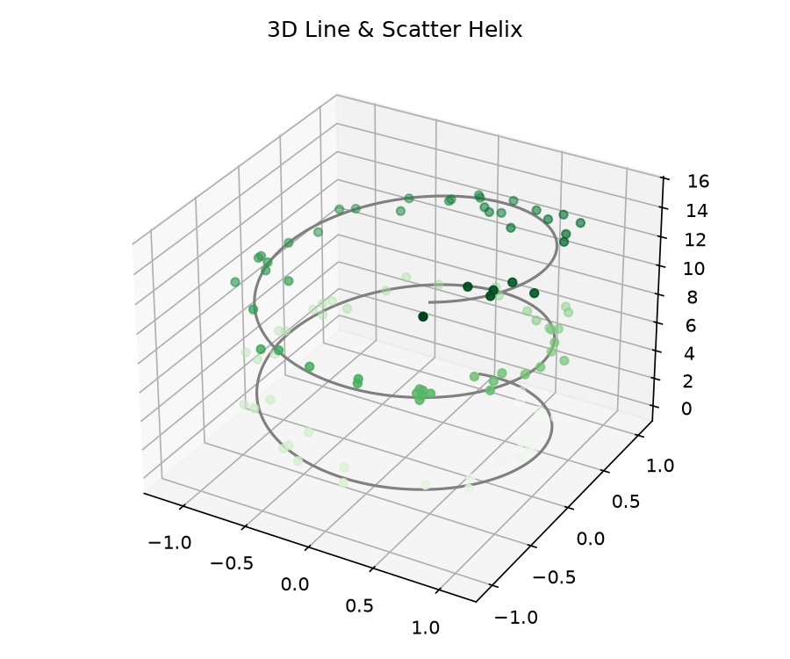
3D Helix — Scatter & Line Plot
Section 3.2 — ax.plot3D() and ax.scatter3D() with trigonometric spiral data
import numpy as np
import matplotlib.pyplot as plt
theta = np.linspace(-4*np.pi, 4*np.pi, 150)
z = np.linspace(-2, 2, 150)
r = z**2 + 1
x = r * np.sin(theta)
y = r * np.cos(theta)
ax = plt.axes(projection='3d')
ax.plot3D(x, y, z, 'grey') # line
ax.scatter3D(x, y, z, c=z, # scatter
cmap='Blues')
plt.show()
Topic 01 · 3D Plotting
07 / 35

Slide 8
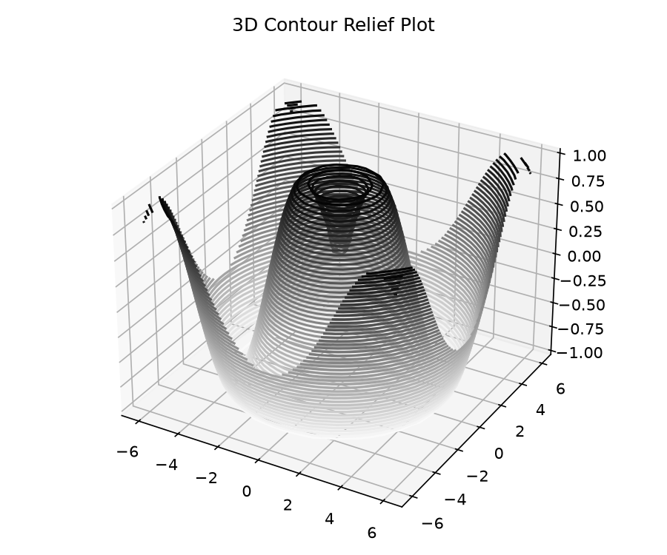
3D Contour Plots (contour3D / contourf3D)
Section 3.3 — Sinusoidal surface projection with filled contours
Key Points
• ax.contour3D() — Wireframe-style contour levels
• ax.contourf3D() — Filled smooth gradient contours
• Z = f(X,Y) — Must be a meshgrid-shaped 2D array
• cmap param: 'viridis', 'plasma', 'coolwarm'
• levels=40 controls number of contour bands
Topic 01 · 3D Plotting
08 / 35

Slide 9
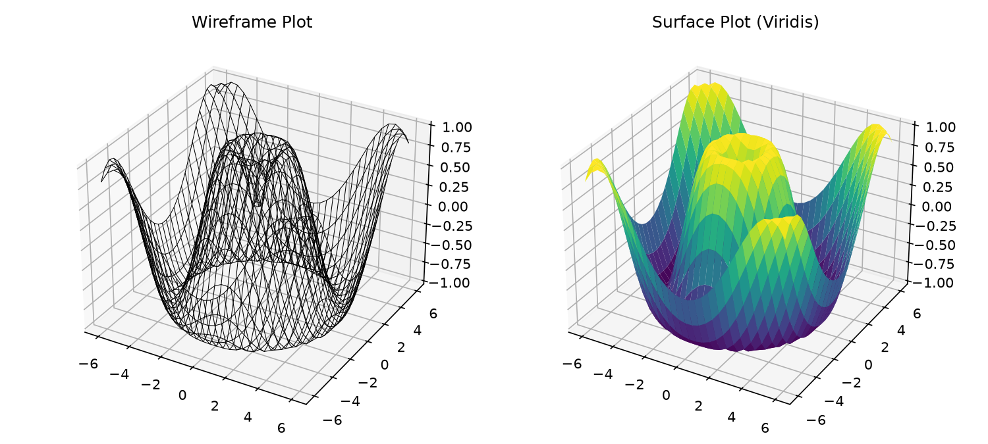
Wireframe & Surface Plots
Section 3.4 — plot_wireframe() and plot_surface() with colormaps
X = np.arange(-5, 5, 0.25)
Y = np.arange(-5, 5, 0.25)
X, Y = np.meshgrid(X, Y)
R = np.sqrt(X**2 + Y**2)
Z = np.sin(R)
# Wireframe
ax.plot_wireframe(X, Y, Z, color='black')
# Surface
ax.plot_surface(X, Y, Z, rstride=1, cstride=1,
cmap='viridis', edgecolor='none')
Topic 01 · 3D Plotting
09 / 35

Slide 10
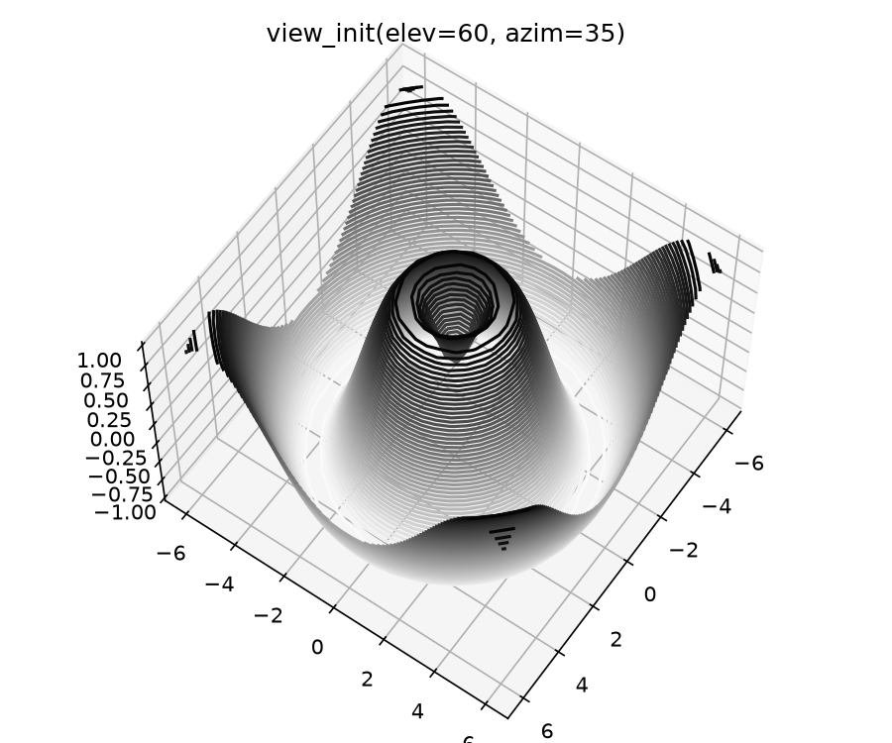
Camera Angle Control — view_init()
Section 3.5 — Elevation and Azimuth for perspective control
view_init() Parameters
• ax.view_init(elev=30, azim=60)
• elev: degrees above xy-plane (0° = flat, 90° = top-down)
• azim: horizontal rotation angle (0°–360°)
• Useful for creating animated GIFs by looping azim
• Can be called in a loop for rotation animations
• Default: elev=30, azim=-60 in most 3D plots
Topic 01 · 3D Plotting
10 / 35

Slide 11
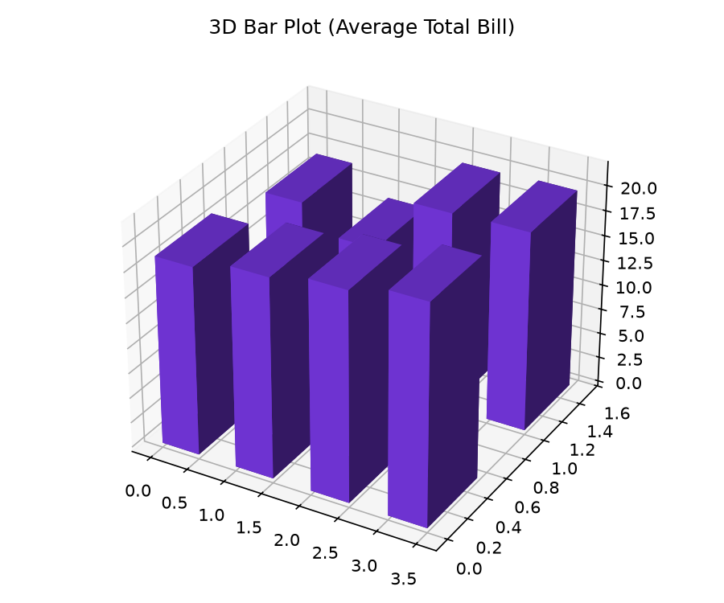
3D Bar Charts — bar3d()
Section 3.6 — Plotting categorical frequency data in 3D
fig = plt.figure()
ax = fig.add_subplot(111, projection='3d')
x = [1, 2, 3, 1, 2, 3]
y = [1, 1, 1, 2, 2, 2]
z = [0, 0, 0, 0, 0, 0]
dx = dy = [0.5]*6
dz = [20, 35, 15, 10, 25, 30]
ax.bar3d(x, y, z, dx, dy, dz,
color='royalblue', alpha=0.7)
ax.set_xlabel('X'); ax.set_ylabel('Y')
ax.set_zlabel('Z')
plt.show()
Topic 01 · 3D Plotting
11 / 35

Slide 12
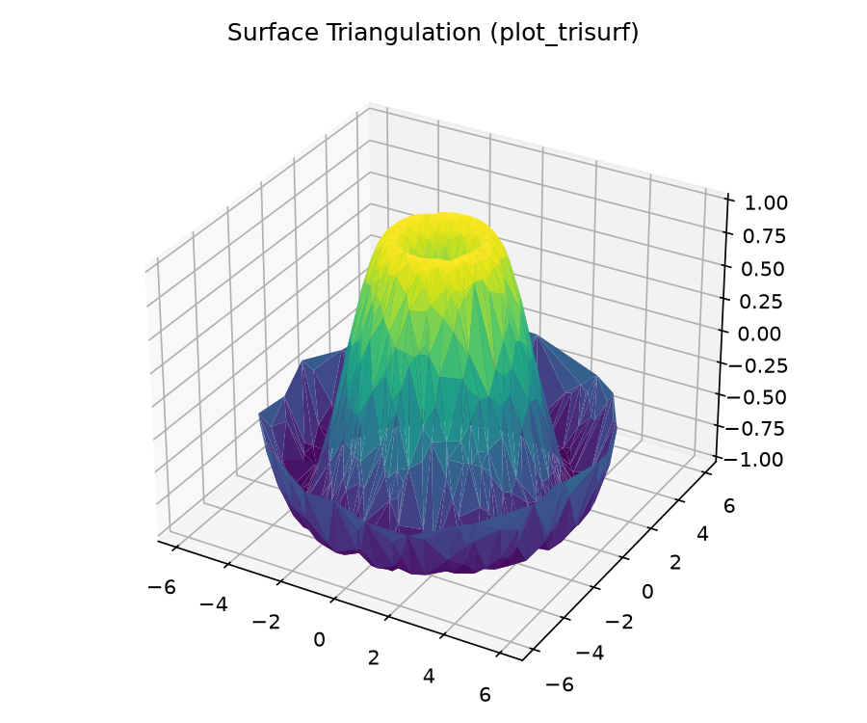
3D Triangulated Surface — plot_trisurf()
Section 3.7 — Unstructured point-cloud surface rendering
Triangulation Concepts
• plot_trisurf() — renders surface from scattered (x, y, z) points
• Internally applies Delaunay triangulation algorithm
• Ideal for non-uniform / irregular grid data
• cmap controls color gradient along Z-axis
• linewidth=0.2 adds subtle triangle edge lines
• antialiased=False improves performance on large datasets
Topic 01 · 3D Plotting
12 / 35

Slide 13
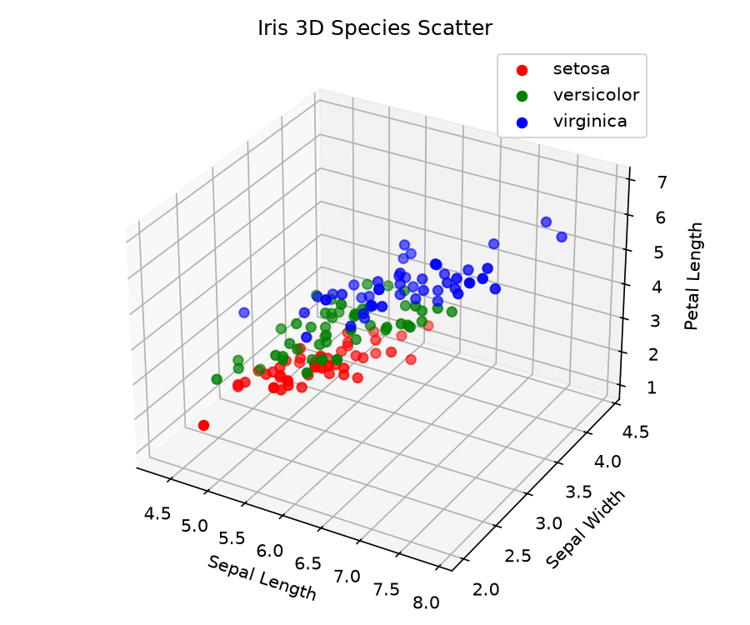
3D Iris Species Scatter Plot
Section 3.8 — Dataset: Iris (150 rows) — 3 species in 3D feature space
from mpl_toolkits.mplot3d import Axes3D
import seaborn as sns
iris = sns.load_dataset('iris')
fig = plt.figure(figsize=(10, 7))
ax = fig.add_subplot(111, projection='3d')
species = iris['species'].unique()
colors = ['#4f46e5', '#0d9488', '#e11d48']
for sp, col in zip(species, colors):
df = iris[iris['species'] == sp]
ax.scatter(df['sepal_length'],
df['petal_length'],
df['petal_width'],
c=col, label=sp, s=40)
ax.legend()
plt.show()
Topic 01 · 3D Plotting
13 / 35

Slide 14
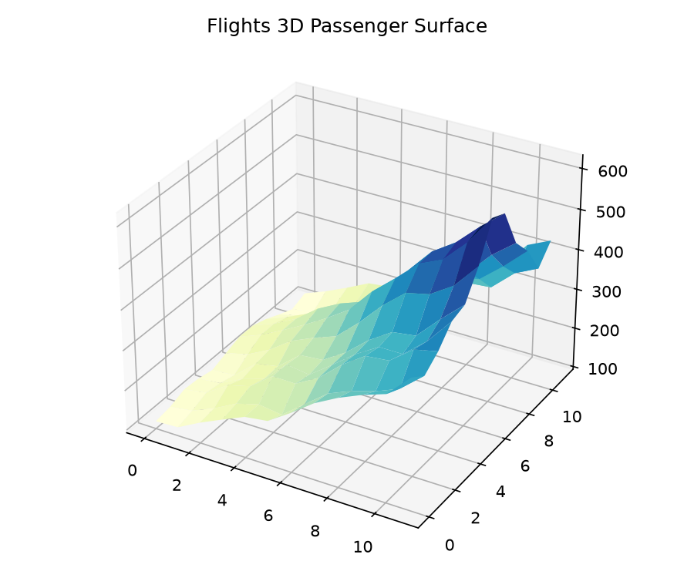
3D Surface — Flights Passenger Traffic
Dataset: Flights (144 rows) — Year × Month passenger heatmap in 3D
flights = sns.load_dataset('flights')
pivot = flights.pivot('month','year','passengers')
X = np.arange(len(pivot.columns))
Y = np.arange(len(pivot.index))
X, Y = np.meshgrid(X, Y)
Z = pivot.values
ax = plt.axes(projection='3d')
ax.plot_surface(X, Y, Z,
cmap='plasma',
edgecolor='none')
ax.set_xlabel('Year')
ax.set_ylabel('Month')
ax.set_zlabel('Passengers')
plt.show()
Topic 01 · 3D Plotting
14 / 35

Slide 15
TOPIC 02
mpl_toolkits.basemap / Cartopy
Geographic Data
with Basemap
15 / 35

Slide 16
What is Basemap?
Section 4.1 — Geographic projections and map overlay for Python
Definition & Purpose
▸ mill / Millerd Cylindrical
• Basemap is a Matplotlib toolkit for geographic maps
• Supports 25+ map projections (Mercator, Orthographic, Mollweide...)
▸ ortho / Orthographic Globe
• Draws coastlines, country borders, rivers, parallels, meridians
▸ moll / Mollweide Equal-Area
• Can overlay data points, filled regions, and contour lines
• Installation: pip install basemap basemap-data-hires
▸ lcc / Lambert Conformal Conic
• Modern Alternative: Cartopy (actively maintained by Met Office)
▸ merc / Mercator (Web Standard)
Topic 02 · Basemap
16 / 35

Slide 17
Basemap Installation & Setup
# Google Colab setup
!apt-get install -y libgeos-dev
!pip install basemap basemap-data-hires
from mpl_toolkits.basemap import Basemap
import matplotlib.pyplot as plt
import numpy as np
# Create a basic world map
fig = plt.figure(figsize=(12, 8))
m = Basemap(projection='mill',
llcrnrlat=-90, urcrnrlat=90,
llcrnrlon=-180, urcrnrlon=180,
resolution='c')
m.drawcoastlines()
m.drawcountries()
m.drawmapboundary(fill_color='aqua')
m.fillcontinents(color='coral',
lake_color='aqua')
m.drawparallels(np.arange(-90,90,30))
m.drawmeridians(np.arange(-180,180,60))
plt.title('World Map - Miller Cylindrical')
plt.show()
Section 4.2 — Google Colab environment setup commands
Topic 02 · Basemap
17 / 35

Slide 18
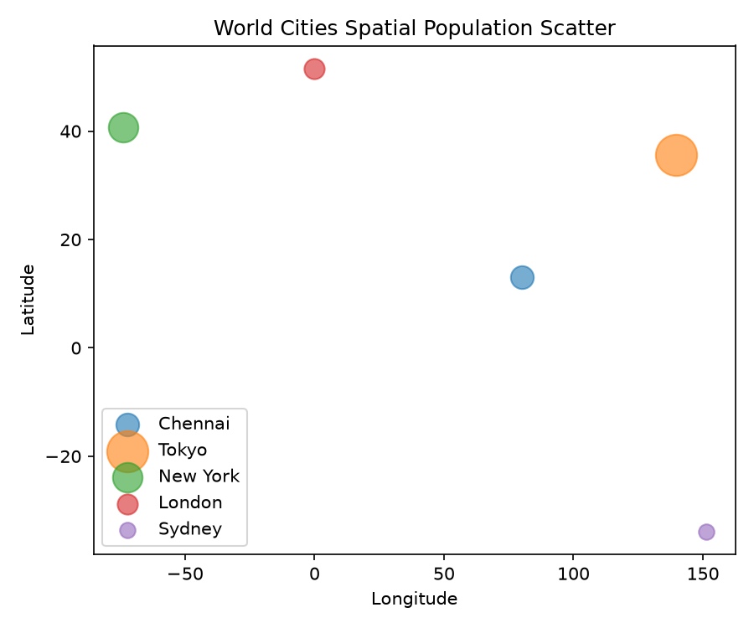
World Cities Population Map
Section 4.3 — Plotting city coordinates with population-scaled markers
Cities Dataset Structure
• Latitude, Longitude coordinates for 20+ major cities
• Population data (2020 estimates in millions)
• m(lon, lat) → converts geographic to projected coords
• plt.scatter(x, y, s=pop*10) → size ∝ population
• plt.annotate() adds city name labels
• Orthographic projection gives globe 3D effect
Topic 02 · Basemap
18 / 35

Slide 19
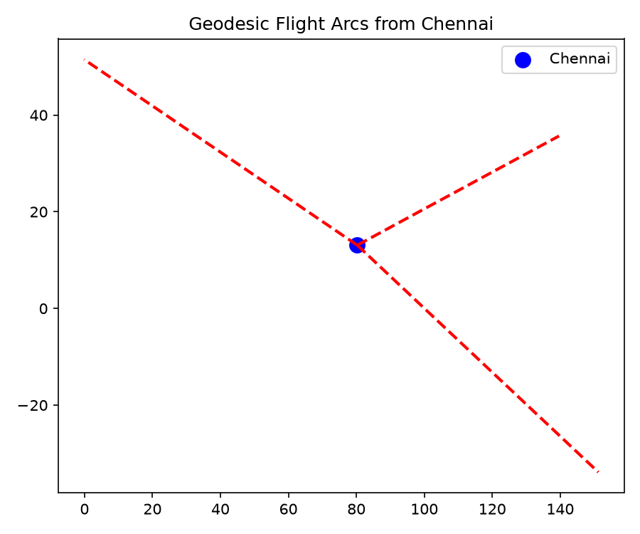
Great Circle Flight Routes
Section 4.4 — Shortest-path arcs on spherical Earth surface
m = Basemap(projection='robin',
lon_0=0, resolution='c')
m.drawcoastlines(linewidth=0.5)
m.fillcontinents(color='lightgray')
m.drawmapboundary(fill_color='#d0e8f8')
# Great Circle: NYC → London
m.drawgreatcircle(-74.0, 40.7, # New York
-0.12, 51.5, # London
linewidth=2, color='red',
label='NYC → LON')
# NYC → Tokyo
m.drawgreatcircle(-74.0, 40.7,
139.7, 35.7,
linewidth=2, color='blue',
label='NYC → TYO')
plt.legend()
plt.show()
Topic 02 · Basemap
19 / 35

Slide 20
Map Projections Comparison
Section 4.5 — Tradeoffs between area, shape, and distance
Mercator (merc)
Preserves angles/shapes. Area distortion near poles.
Orthographic (ortho)
Globe perspective view. Cannot show full sphere.
Mollweide (moll)
Equal-area. Distorts shapes but preserves areas.
Robinson (robin)
Compromise — moderate area and shape distortion.
Lambert Conformal (lcc)
Used for regional maps. Preserves shape locally.
Topic 02 · Basemap
20 / 35

Slide 21
Cartopy — Modern Basemap Alternative
Feature
Basemap
Cartopy
Section 4.6 — Actively maintained library from the UK Met Office
import cartopy.crs as ccrs
import cartopy.feature as cfeature
import matplotlib.pyplot as plt
fig = plt.figure(figsize=(12, 6))
ax = fig.add_subplot(1, 1, 1,
projection=ccrs.PlateCarree())
ax.add_feature(cfeature.COASTLINE)
ax.add_feature(cfeature.BORDERS,
linestyle=':')
ax.add_feature(cfeature.OCEAN,
facecolor='lightblue')
ax.add_feature(cfeature.LAND,
facecolor='wheat')
ax.set_global()
ax.gridlines()
plt.title('World Map with Cartopy')
plt.show()
Status
Deprecated (2020+)
Actively Maintained
Backend
mpl_toolkits
Shapely + Proj
CRS Support
25 projections
Full EPSG registry
OGC Services
No
Yes (WMS/WFS)
Topic 02 · Basemap
21 / 35

Slide 22
Basemap Topic Summary
Key takeaways from Geographic Data visualization
🗺️ Projections
25+ projections available; each has tradeoffs between area, shape, and distance preservation.
📍 Data Overlay
Convert lat/lon to projected (x,y) using m(lon, lat) before plotting.
✈️ Great Circles
drawgreatcircle() plots geodesic shortest paths on the spherical surface.
🌍 Cartopy
Use Cartopy for modern projects — better OGC support and active maintenance.
Topic 02 · Basemap
22 / 35

Slide 23
TOPIC 03
Statistical Data Visualization
Visualization with
Seaborn
23 / 35

Slide 24
What is Seaborn?
Section 5.1 — High-level statistical data visualization built on Matplotlib
sns.histplot() vs plt.hist()
Core Features
• Built on top of Matplotlib; uses Axes internally
Matplotlib (manual KDE):
• Native Pandas DataFrame integration (x='col', hue='group')
plt.hist(data, bins=30, density=True)
from scipy.stats import gaussian_kde
kde = gaussian_kde(data)
...
• Automatic KDE, regression lines, and confidence intervals
• Beautiful default color palettes (muted, deep, pastel...)
• Grid-level plots: FacetGrid, PairGrid for multi-panel figures
Seaborn (one line!):
• Functions: histplot, kdeplot, scatterplot, jointplot, pairplot
sns.histplot(data, kde=True, bins=30)
Topic 03 · Seaborn
24 / 35

Slide 25
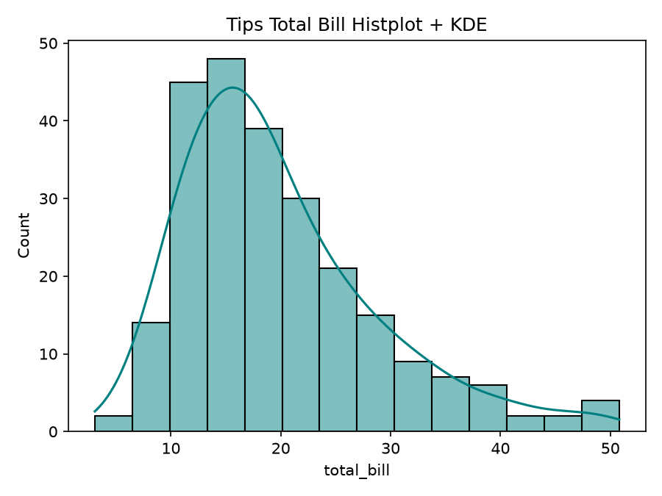
histplot & kdeplot — Distributions
Section 5.2 — Dataset: Tips (244 rows) — total_bill distribution
import seaborn as sns
import matplotlib.pyplot as plt
tips = sns.load_dataset('tips')
# Histogram with KDE overlay
fig, axes = plt.subplots(1, 2,
figsize=(12, 5))
# histplot with KDE
sns.histplot(data=tips, x='total_bill',
kde=True, bins=30,
color='#e11d48',
ax=axes[0])
axes[0].set_title('Histogram + KDE')
# Pure KDE plot
sns.kdeplot(data=tips, x='total_bill',
hue='sex', fill=True,
ax=axes[1])
axes[1].set_title('KDE by Sex')
plt.tight_layout()
plt.show()
Topic 03 · Seaborn
25 / 35

Slide 26
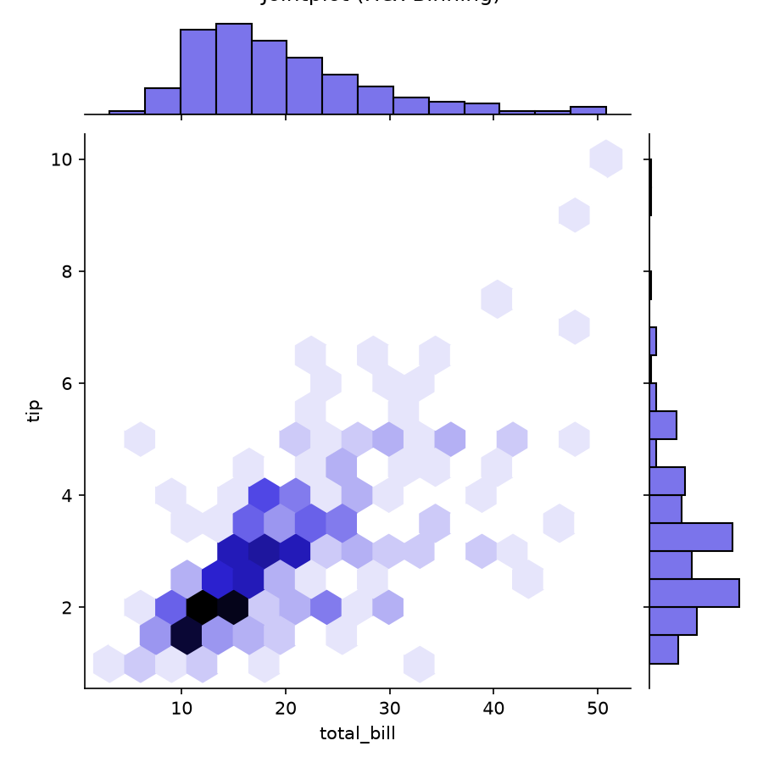
jointplot — Bivariate Distribution
Section 5.3 — Dataset: Tips — total_bill vs tip with marginal plots
jointplot() Parameters
• kind='scatter' — default scatter with marginal histograms
• kind='kde' — kernel density contours + marginal KDE
• kind='hex' — hexbin density heatmap
• kind='reg' — regression line with confidence band
• kind='resid' — regression residuals
• hue='col' — color-codes by category (adds legend)
Topic 03 · Seaborn
26 / 35

Slide 27
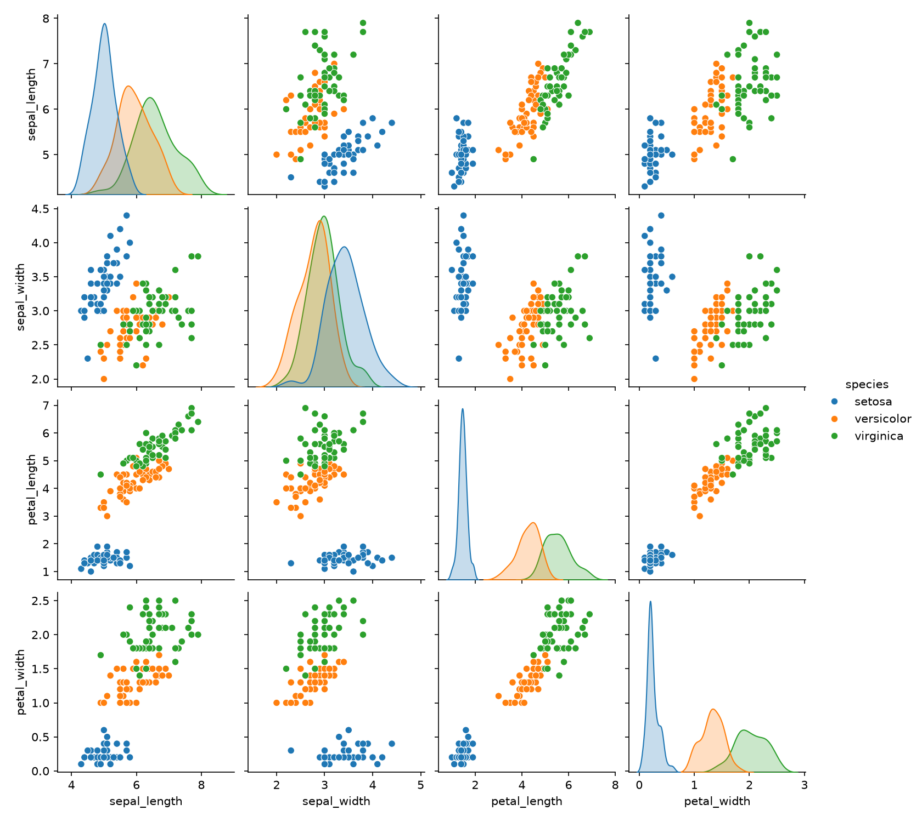
pairplot — Multi-Variable Grid
Section 5.4 — Dataset: Iris (150 rows) — 4×4 feature relationship matrix
iris = sns.load_dataset('iris')
sns.pairplot(iris,
hue='species',
diag_kind='kde',
plot_kws={'alpha': 0.6},
palette='tab10')
plt.suptitle('Iris Pairplot Matrix',
y=1.02)
plt.show()
# Custom pairplot
g = sns.PairGrid(iris,
hue='species')
g.map_upper(sns.scatterplot)
g.map_lower(sns.kdeplot)
g.map_diag(sns.histplot)
g.add_legend()
Topic 03 · Seaborn
27 / 35

Slide 28
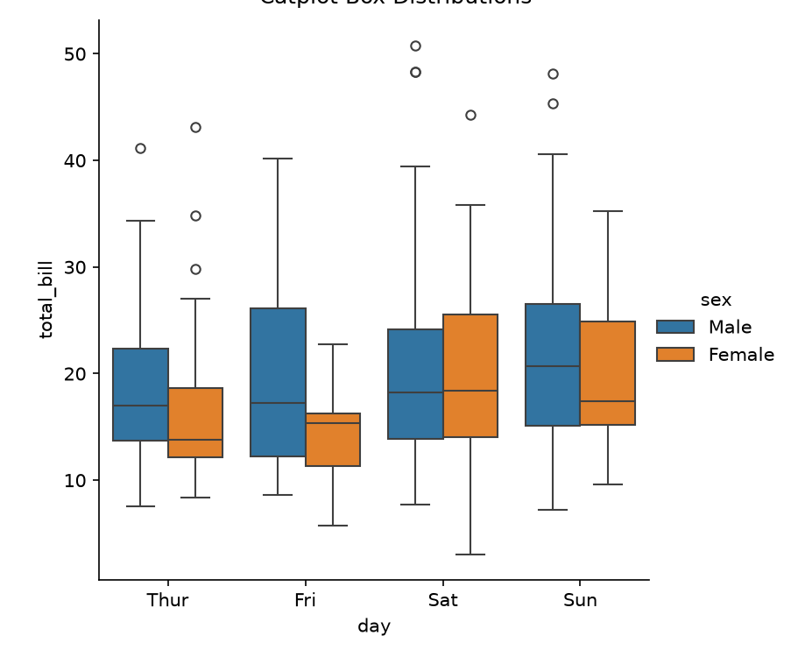
catplot — Categorical Distributions
Section 5.5 — Dataset: Tips — tip by day and sex
catplot() kind Options
• kind='strip' — individual data points (default)
• kind='swarm' — non-overlapping strip plot
• kind='box' — box-and-whisker with quartiles
• kind='violin' — KDE of distribution shape
• kind='bar' — aggregated bar with CI
• kind='point' — mean with error bars
Topic 03 · Seaborn
28 / 35

Slide 29
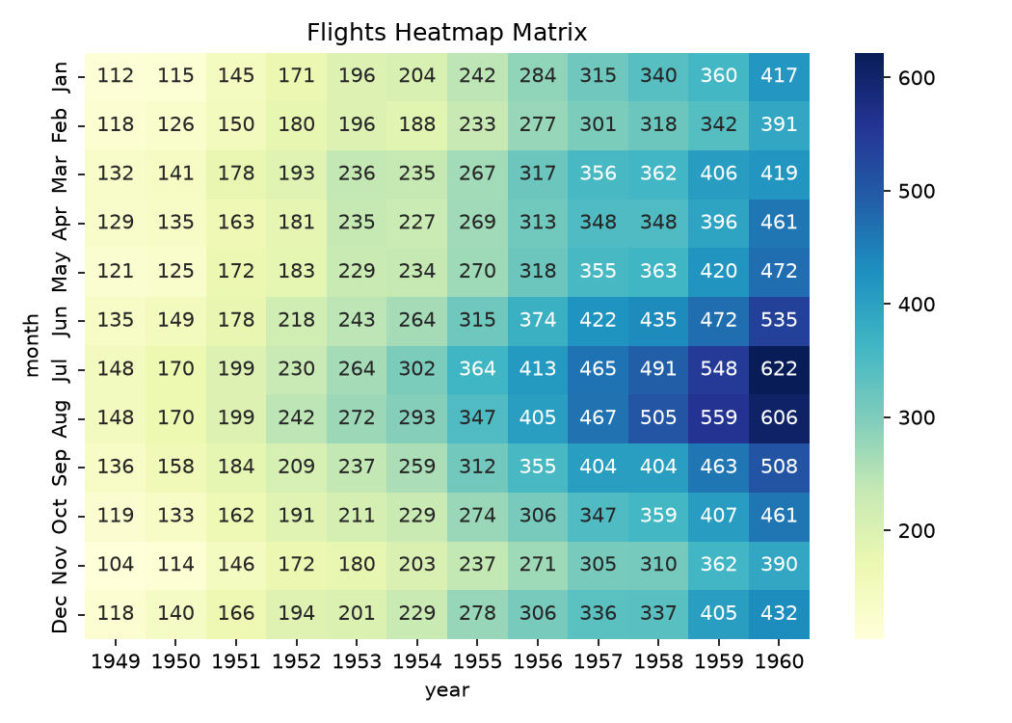
Heatmap — Flights Passenger Traffic
Section 5.6 — Dataset: Flights (144 rows) — year vs month matrix
flights = sns.load_dataset('flights')
# Pivot to matrix format
pivot = flights.pivot(
index='month',
columns='year',
values='passengers'
)
plt.figure(figsize=(12, 7))
sns.heatmap(
pivot,
annot=True, # show numbers
fmt='d', # integer format
cmap='YlOrRd', # Yellow-Orange-Red
linewidths=0.5, # cell borders
linecolor='white'
)
plt.title('Monthly Airline Passengers (1949-1960)')
plt.tight_layout()
plt.show()
Topic 03 · Seaborn
29 / 35

Slide 30
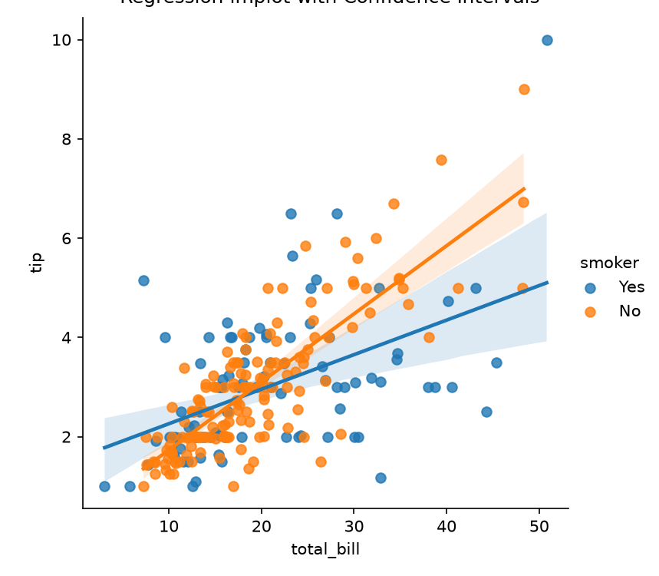
lmplot — Linear Regression Visualization
Section 5.7 — Dataset: Tips — linear trend of total_bill vs tip
lmplot() Key Parameters
• x, y — column names from DataFrame
• hue='col' — separate lines per category with colors
• col='col' — create facet columns per category
• row='col' — create facet rows per category
• order=2 — polynomial regression (quadratic)
• ci=95 — 95% confidence interval shading
• scatter_kws={'alpha': 0.5} — control point transparency
Topic 03 · Seaborn
30 / 35

Slide 31
Seaborn Color Palettes
Categorical Palettes
Section 5.8 — Categorical, sequential, and diverging palettes
deep
muted
pastel
bright
dark
colorblind
Sequential Palettes
Blues
Greens
Oranges
Purples
YlOrRd
viridis
Diverging Palettes
coolwarm
RdBu
seismic
bwr
PiYG
PRGn
# Setting a palette
sns.set_palette('muted')
sns.set_style('whitegrid')
with sns.color_palette('pastel'):
sns.scatterplot(...)
Topic 03 · Seaborn
31 / 35

Slide 32
Seaborn Plot Types Reference
Section 5.9 — Complete function taxonomy
Distribution Plots
Relational Plots
histplot · kdeplot · ecdfplot · rugplot
scatterplot · lineplot · relplot
Categorical Plots
Regression Plots
stripplot · swarmplot · boxplot · violinplot · barplot
lmplot · regplot · residplot
Matrix Plots
Grid Plots
heatmap · clustermap
pairplot · jointplot · FacetGrid · PairGrid
Topic 03 · Seaborn
32 / 35

Slide 33
Seaborn — Key Takeaways
Topic 03 Summary
📊 High-Level API
One-liner statistical charts with Pandas column names as arguments.
🎨 Beautiful Defaults
muted, deep, pastel palettes and whitegrid style work out-of-the-box.
📈 Statistical Intelligence
Automatic KDE, confidence intervals, and regression without extra code.
🔗 Grid Systems
FacetGrid, PairGrid, and jointplot for publication-ready multi-panel figures.
🏗️ Matplotlib Extensible
Every Seaborn plot returns Matplotlib Axes — full low-level customization possible.
Topic 03 · Seaborn
33 / 35

Slide 34
Seaborn vs Matplotlib — Full Comparison
Feature
Matplotlib
Seaborn
Why choose Seaborn? When to use Matplotlib directly?
Abstraction Level
Low-level (full manual control)
High-level (declarative)
Lines of Code
10–30 lines for a styled plot
1–3 lines for same plot
DataFrame Support
Indirect (via .values, .to_numpy)
Native (x='col', data=df)
Statistical Estimators
Manual calculation required
Built-in KDE, CI, regression
Color Palettes
Manual color arrays
Named palettes (muted, deep...)
Multi-Panel Grids
plt.subplots() + manual sizing
FacetGrid, PairGrid (auto)
Plot Types
Universal (any plot type)
Statistical charts only
Customization
Unlimited fine-grained control
Limited; falls back to Matplotlib
Performance
Faster for large custom plots
Slightly slower overhead
Deprecation Risk
None (active development)
Some functions deprecated (distplot → histplot)
Comparison · Seaborn vs Matplotlib
34 / 35

Slide 35



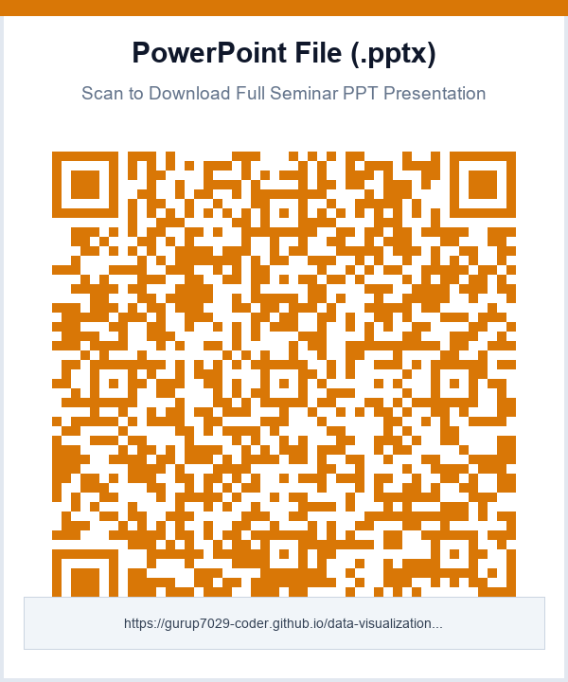
Scan QR Codes for Videos, Slides & PPT Download
Live public links hosted 24/7 on GitHub Pages — scan with any smartphone camera
Tanglish Video
English Video
Web Presentation
Download PPT
Stream Full Video in Tanglish
Full 7-min HD 3D Presentation
Interactive 3D Deck on Mobile
PowerPoint Presentation (.pptx)
35 / 35

Slide 36
THANK YOU
3
Topics Covered
Data Visualization Seminar
17
Three-Dimensional Plotting • Geographic Data with Basemap • Visualization with Seaborn
Visualization Types
3
Datasets Used
35
Questions & Discussion
Total Slides
36 / 35

