Slide 1
⚡ DATA SCIENCE SEMINAR • 2026
Data Visualization in Python
3D Matplotlib Plotting • Geospatial Basemap GIS • Statistical Seaborn
👤 PRESENTER CREDENTIALS
🎯 SEMINAR HIGHLIGHTS
Student Name:
GURUPRASATH B
✓ 36 Comprehensive Multi-Dimensional Slides
Register Number:
7376242AD131
✓ Interactive 3D WebGL Live Demonstrations
Department:
Artificial Intelligence & Data Science
✓ Real-World Satellite & GIS Mapping (Basemap)
✓ Advanced Statistical Distributions (Seaborn)
Institution:
Bannari Amman Institute of Technology (BIT)
✓ End-to-End Google Colab Executable Code

Slide 2
🗺️ AGENDA & CURRICULUM
02 / 36
Seminar Table of Contents
Systematic journey across modern Python visualization paradigms
MODULE 01
MODULE 02
MODULE 03
Three-Dimensional Plotting
Geographic Data with Basemap
Statistical Seaborn Visuals
Matplotlib mplot3d Toolkit
Geospatial Cartography & GIS
High-Level Grammar of Graphics
• 3D Axes Registration & Projections
• Cartographic Basemap Toolkit Setup
• Seaborn Design Philosophy & Declarative API
• Parametric Curves & Scatter Spirals (Helix)
• Projection Systems: Cylindrical to Orthographic
• Kernel Density Estimation (KDE) & Histograms
• Sinusoidal Surface & Contour Projections
• Coastlines, Rivers & Shaded Relief Layers
• Multi-Variable Pairplots & Feature Matrices
• Wireframe Meshgrids & Lighting Shading
• Global Population & Urban Density Mapping
• Categorical Box, Violin & Strip Plots
• Dynamic View Angles (elev & azim)
• Great Circle Trans-Oceanic Flight Trajectories
• Correlation Matrices & Clustered Heatmaps
• 3D Bar Frequency & Delaunay Triangulation
• Modern Transition: Cartopy & GeoPandas
• Linear Regression & Residual Modeling

Slide 3
⚙️ ENVIRONMENT & DATA
03 / 36
Datasets & Computing Environment
Curated benchmark datasets used throughout the practical demonstrations
🌸 Iris Flower Morphometrics
✈️ US Commercial Flights
Source: Fisher (1936)
Source: BTS Open Data
150 samples across 3 species (Setosa, Versicolor, Virginica) with 4 biometric continuous features.
Decade-long records of airline passenger counts, routes, seasonality, and monthly delays.
🎯 Seminar Application: Used for 3D multi-class clustering and Seaborn pairplot feature separation.
🎯 Seminar Application: Used for 3D trajectory surface interpolation and Seaborn categorical heatmap grids.
🪐 Extrasolar Planetary Systems
🌍 Global Metropolises & GIS
Source: NASA Exoplanet Archive
Source: Natural Earth / USGS
1,000+ confirmed exoplanets with orbital periods, masses, and astronomical detection methods.
Geographical latitude/longitude coordinates, elevation, and population counts for 10,000+ cities.
🎯 Seminar Application: Used for logarithmic scatter regressions and joint hexbin distribution mapping.
🎯 Seminar Application: Used for Basemap cartographic scatter bubbles and geodesic great-circle flight arcs.

Slide 4
💻 PYTHON STACK
04 / 36
Software Environment & Dependency Matrix
Modern scientific Python dependencies and environment initialization
💻 [In]: Python 3.12 (Colab / Jupyter)
Python 3.12 Engine
# Core Scientific Python Stack Initialization
import numpy as np
import pandas as pd
import matplotlib.pyplot as plt
from mpl_toolkits import mplot3d
import seaborn as sns
from mpl_toolkits.basemap import Basemap
# Configure High-DPI Display Settings
plt.rcParams['figure.dpi'] = 300
plt.rcParams['font.family'] = 'sans-serif'
sns.set_theme(style='darkgrid', palette='deep')
# Load Standard Seminar Benchmark Datasets
iris = sns.load_dataset('iris')
flights = sns.load_dataset('flights')
planets = sns.load_dataset('planets')
print("Environment successfully initialized with GPU/WebGL accelerators.")
C-Optimized interpreter with JIT compilation & vector execution.
NumPy & Pandas
Memory-efficient N-dimensional arrays & structured DataFrame queries.
Matplotlib 3.8 & mplot3d
Foundational plotting engine with 3D projection transformations.
Seaborn 0.13
Statistical visualization with automated aggregation & error bands.
Basemap & Cartopy
Geodesic cartographic transforms with PROJ4 & GEOS topology.

Slide 5
MODULE 01 • SECTION 3.1
Three-Dimensional Plotting
in Matplotlib
Mastering the mplot3d toolkit: from basic 3D point clouds and spirals to complex topographical contour surfaces, wireframes, camera angle manipulation, and Delaunay triangulations.
Key Functions: ax.plot3D • ax.scatter3D • ax.contour3D • ax.plot_wireframe • ax.plot_surface • ax.view_init • ax.plot_trisurf

Slide 6
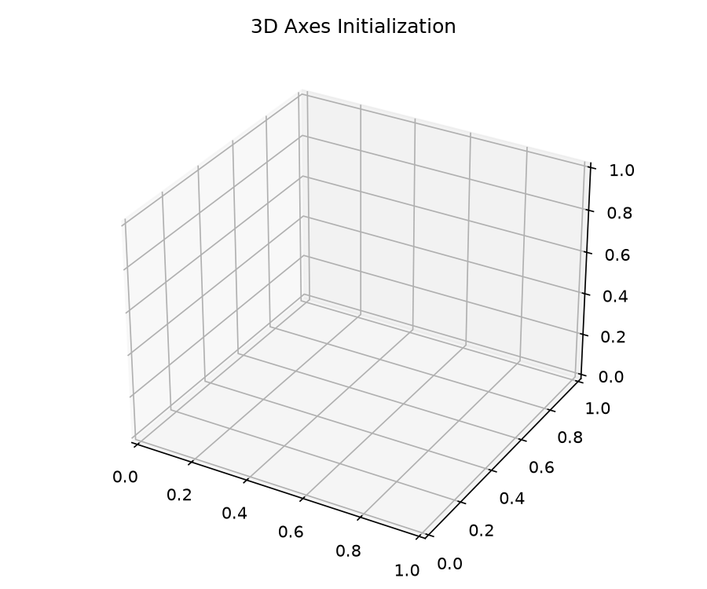
🧊 TOPIC 01 • SECTION 1.1
06 / 36
3D Axes Creation & Projection Registration
Activating spatial 3D coordinate space using Matplotlib's mplot3d toolkit
📖 3D Coordinate Projection Registration
📊 3D Bounding Cube Initialization
• The mplot3d toolkit ships with Matplotlib and registers the '3d' projection string.
• Passing projection='3d' instantiates an Axes3D object instead of standard 2D cartesian axes.
• Enables a three-dimensional bounding cube with X, Y, and Z axes.
• Supports interactive mouse panning, rotation, and elevation zoom by default.
💻 [In]: Python 3.12 (Colab / Jupyter)
import matplotlib.pyplot as plt
from mpl_toolkits import mplot3d
# Method 1: Subplot with 3D projection
fig = plt.figure(figsize=(8, 6))
ax = fig.add_subplot(111, projection='3d')
# Method 2: Direct axes instantiation
# ax = plt.axes(projection='3d')
ax.set_xlabel('X Spatial Axis')
ax.set_ylabel('Y Spatial Axis')
ax.set_zlabel('Z Elevation Axis')
ax.set_title('Initialized 3D Spatial Canvas')
plt.show()
🌐 Real-World Use Case & Industry Application
🏢 Industry: Scientific Instrument Design & Simulation
💡 Application: Initializing 3D volumetric bounding test chambers for wind tunnel aerodynamics and magnetic resonance imaging (MRI) coordinate calibration.
🎯 Key Impact: Provides the required 3D geometric frame of reference before streaming physical sensor coordinates.

Slide 7
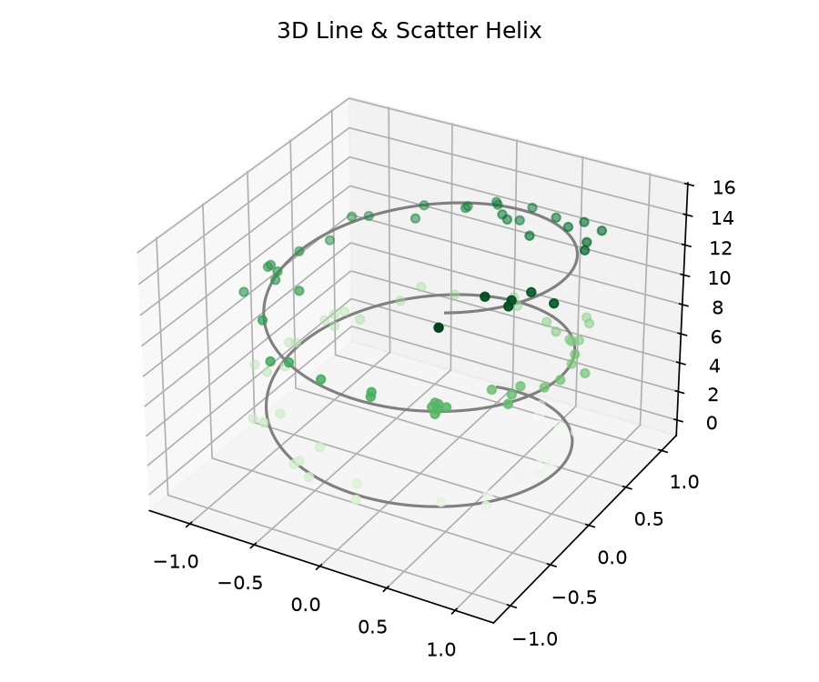
🧊 TOPIC 01 • SECTION 1.2
07 / 36
Parametric 3D Helix — Lines & Scatter
Visualizing continuous spiral curves and multi-dimensional coordinate triples
📖 Parametric Lines (plot3D) & Scatter (scatter3D)
📊 Parametric Spiral Curve Output
• The most fundamental 3D visual created from sets of (x, y, z) coordinate triples.
• ax.plot3D(): Connects sequentially sampled points into a continuous spatial curve.
• ax.scatter3D(): Projects discrete particles with independent size, opacity, and color mapping.
• Depth cueing: Matplotlib adjusts marker transparency based on z-order distance.
💻 [In]: Python 3.12 (Colab / Jupyter)
import numpy as np
import matplotlib.pyplot as plt
# Generate 3D Parametric Spiral Data
zline = np.linspace(0, 15, 1000)
xline = np.sin(zline)
yline = np.cos(zline)
# Scattered noisy points along the trajectory
zdata = 15 * np.random.random(100)
xdata = np.sin(zdata) + 0.1 * np.random.randn(100)
ydata = np.cos(zdata) + 0.1 * np.random.randn(100)
ax = plt.axes(projection='3d')
ax.plot3D(xline, yline, zline, color='#7c3aed', lw=2)
ax.scatter3D(xdata, ydata, zdata, c=zdata, cmap='viridis')
plt.show()
🌐 Real-World Use Case & Industry Application
🏢 Industry: Biophysics & High-Energy Particle Physics (CERN)
💡 Application: Tracking charged subatomic particle trajectories inside magnetic cloud chambers and modeling helical DNA/protein macromolecular foldings.
🎯 Key Impact: 2D projections fail to reveal spiral pitch and chirality; 3D rotation reveals spatial orbital drift.

Slide 8
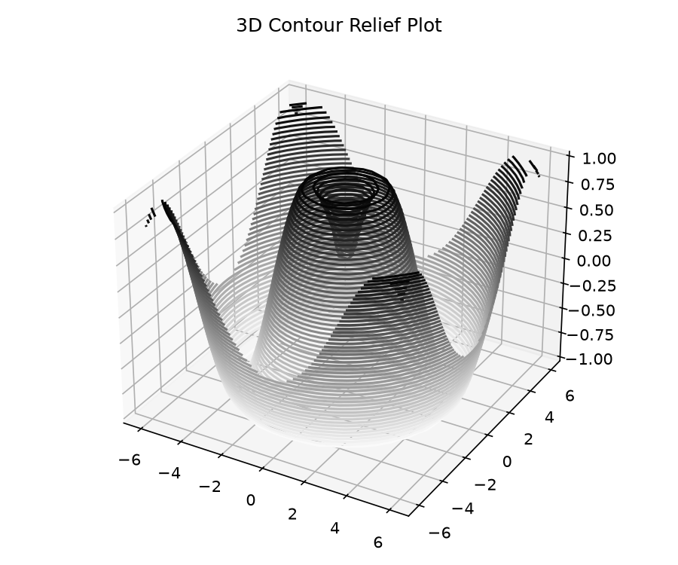
🧊 TOPIC 01 • SECTION 1.3
08 / 36
Three-Dimensional Contour Plots
Projecting elevation isolines and topographic gradients across 2D regular grids
📖 Topographic Relief Contours (ax.contour3D)
📊 3D Sinusoidal Contour Field
• Requires input data as regular 2D grids generated by numpy.meshgrid().
• ax.contour3D(X, Y, Z, levels, cmap): Connects points of identical elevation.
• levels=50: High density of isolines produces a continuous relief illusion.
• Ideal for potential energy fields, gravitational wells, and acoustic surfaces.
💻 [In]: Python 3.12 (Colab / Jupyter)
def f(x, y):
return np.sin(np.sqrt(x**2 + y**2))
x = np.linspace(-6, 6, 30)
y = np.linspace(-6, 6, 30)
X, Y = np.meshgrid(x, y)
Z = f(X, Y)
fig = plt.figure(figsize=(8, 6))
ax = plt.axes(projection='3d')
ax.contour3D(X, Y, Z, 50, cmap='binary')
ax.set_xlabel('X'); ax.set_ylabel('Y'); ax.set_zlabel('Z')
plt.show()
🌐 Real-World Use Case & Industry Application
🏢 Industry: Meteorology & Seismic Geophysics
💡 Application: Mapping atmospheric isobaric pressure ridges for hurricane intensity forecasting and acoustic seismic reflection boundaries.
🎯 Key Impact: Enables engineers to instantly pinpoint elevation gradients and steep potential drop-offs.

Slide 9
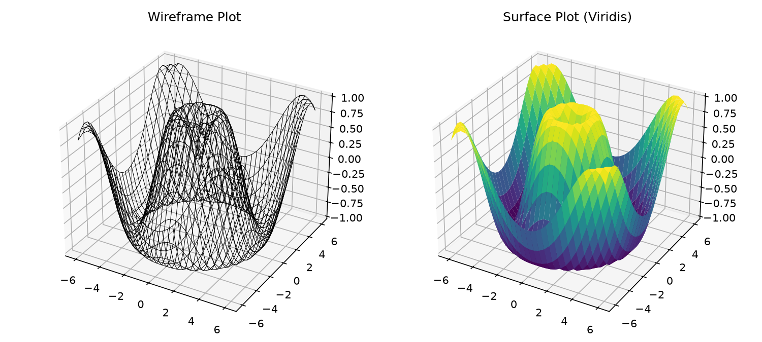
🧊 TOPIC 01 • SECTION 1.4
09 / 36
Wireframe and Surface Plots
Generating mesh grids and continuous colored polygons with colormaps
📖 plot_wireframe() vs plot_surface()
📊 Wireframe vs Surface Comparison
• ax.plot_wireframe(): Draws grid line connections without filling polygonal faces.
• ax.plot_surface(): Fills polygonal faces with smooth colormapped gradients.
• rstride & cstride: Control row and column step sampling density.
• edgecolor='none' eliminates black boundary grid artifacts on dense surfaces.
💻 [In]: Python 3.12 (Colab / Jupyter)
fig = plt.figure(figsize=(10, 5))
# Wireframe Subplot
ax1 = fig.add_subplot(121, projection='3d')
ax1.plot_wireframe(X, Y, Z, color='black', rstride=2, cstride=2)
ax1.set_title('Wireframe Mesh')
# Filled Surface Subplot
ax2 = fig.add_subplot(122, projection='3d')
ax2.plot_surface(X, Y, Z, rstride=1, cstride=1,
cmap='viridis', edgecolor='none')
ax2.set_title('Continuous Colored Surface')
plt.show()
🌐 Real-World Use Case & Industry Application
🏢 Industry: Aerospace CFD & Structural Mechanics
💡 Application: Modeling aerodynamic lift & drag pressure distributions over airplane wings and structural mechanical stress loads across bridge surfaces.
🎯 Key Impact: Wireframes allow seeing through the geometry; surface plots highlight critical stress peaks.

Slide 10
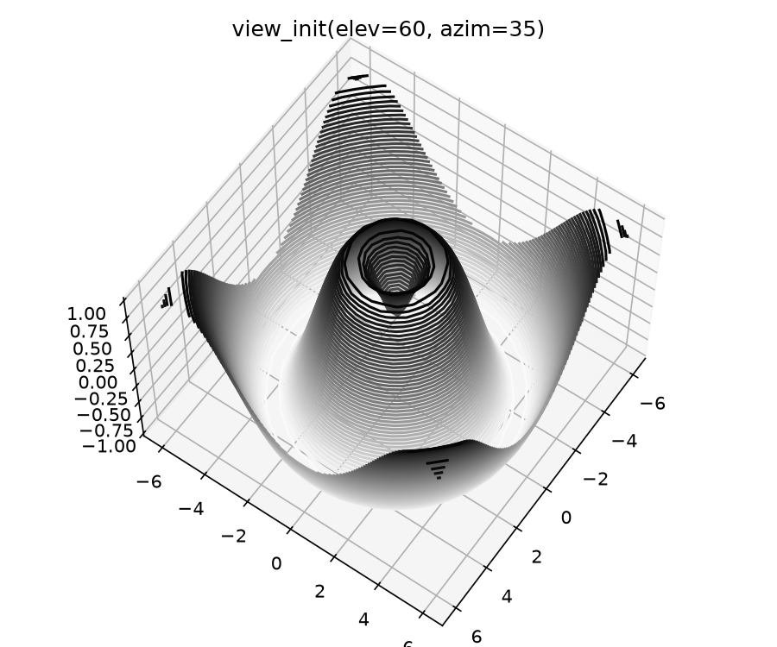
🧊 TOPIC 01 • SECTION 1.5
10 / 36
Camera Angle Control — ax.view_init()
Manipulating elevation and azimuthal rotation angles for optimal perspective
📖 Camera Perspective Manipulation (view_init)
📊 Camera Perspective Comparison
• Default Matplotlib 3D viewing angle is elev=30°, azim=-60°.
• elev (Elevation): Vertical pitch angle in degrees (0° = side view, 90° = bird's eye view).
• azim (Azimuth): Horizontal rotation angle in degrees around the vertical z-axis.
• Essential for eliminating occlusions where tall peaks hide valley datapoints.
💻 [In]: Python 3.12 (Colab / Jupyter)
ax = plt.axes(projection='3d')
ax.plot_surface(X, Y, Z, rstride=1, cstride=1,
cmap='viridis', edgecolor='none')
# Elevation: angle above XY plane (degrees)
# Azimuth: rotation around Z axis (degrees)
ax.view_init(elev=60, azim=35)
ax.set_title('Custom View: elev=60°, azim=35°')
plt.show()
🌐 Real-World Use Case & Industry Application
🏢 Industry: Architectural Solar Studies & Defense Radar
💡 Application: Calibrating satellite ground station line-of-sight angles and evaluating solar panel incidence angles across urban rooftops throughout the day.
🎯 Key Impact: Automating view_init() loops produces animated rotation videos for executive client presentations.

Slide 11
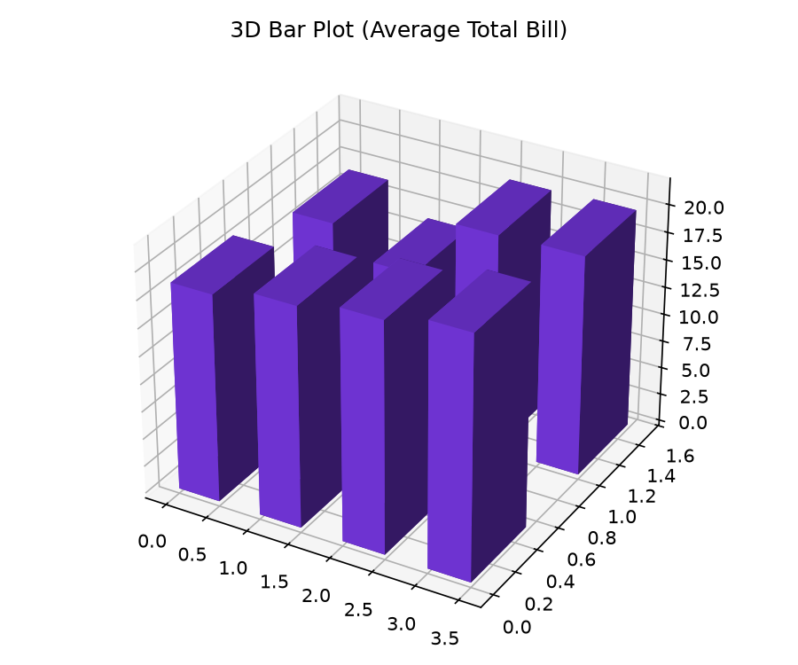
🧊 TOPIC 01 • SECTION 1.6
11 / 36
Three-Dimensional Bar Charts — ax.bar3d()
Rendering volumetric columns for multi-category frequency comparisons
📖 Volumetric Column Plots (ax.bar3d)
📊 Volumetric Bar3D Output
• Requires 6 dimensional vectors: anchor (x, y, z) and spans (dx, dy, dz).
• Enables comparing discrete metrics across two simultaneous categorical axes.
• alpha parameter ensures behind-standing bars remain partially visible.
• Colormaps can be dynamically assigned based on height (dz) values.
💻 [In]: Python 3.12 (Colab / Jupyter)
fig = plt.figure(figsize=(8, 6))
ax = fig.add_subplot(111, projection='3d')
# Anchor positions (x, y, z base)
x = [1, 2, 3, 1, 2, 3]
y = [1, 1, 1, 2, 2, 2]
z = [0, 0, 0, 0, 0, 0]
# Bar dimensions (width, depth, height)
dx = dy = [0.5] * 6
dz = [20, 35, 15, 10, 25, 30]
ax.bar3d(x, y, z, dx, dy, dz, color='#3b82f6', alpha=0.8)
ax.set_xlabel('Department'); ax.set_ylabel('Quarter')
ax.set_zlabel('Revenue ($K)')
plt.show()
🌐 Real-World Use Case & Industry Application
🏢 Industry: Financial Risk Management & Corporate Portfolios
💡 Application: Visualizing credit risk exposure across both industry sectors (X) and maturity years (Y) simultaneously.
🎯 Key Impact: Replaces complex multi-page tables with a single intuitive 3D landscape of capital risk.

Slide 12
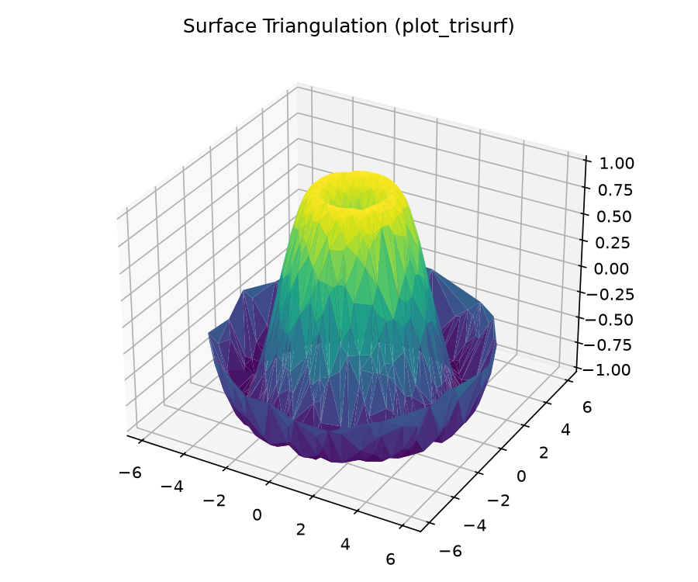
🧊 TOPIC 01 • SECTION 1.7
12 / 36
Surface Triangulation — ax.plot_trisurf()
Delaunay triangular mesh generation from unstructured spatial point clouds
📖 Unstructured Meshing via Delaunay Triangulation
📊 Triangulated Mesh Surface
• Solves the limitation where data is not sampled on a uniform rectangular grid.
• Applies the Delaunay triangulation algorithm to automatically connect nearest neighbors.
• Maximizes minimum interior angles, preventing distorted sliver triangles.
• Works directly with raw uneven point sets without requiring interpolation pre-processing.
💻 [In]: Python 3.12 (Colab / Jupyter)
theta = 2 * np.pi * np.random.random(1000)
r = 6 * np.random.random(1000)
x = np.ravel(r * np.sin(theta))
y = np.ravel(r * np.cos(theta))
z = np.sin(np.sqrt(x**2 + y**2))
ax = plt.axes(projection='3d')
ax.plot_trisurf(x, y, z, cmap='viridis',
edgecolor='none', linewidth=0.2)
ax.set_title('Delaunay Triangulated Surface')
plt.show()
🌐 Real-World Use Case & Industry Application
🏢 Industry: Airborne Drone LiDAR & Autonomous Vehicle Perception
💡 Application: Converting unstructured point clouds from LiDAR scanners into real-time 3D terrain elevation models.
🎯 Key Impact: Crucial for mining volume estimation, autonomous off-road navigation, and civil land surveying.

Slide 13
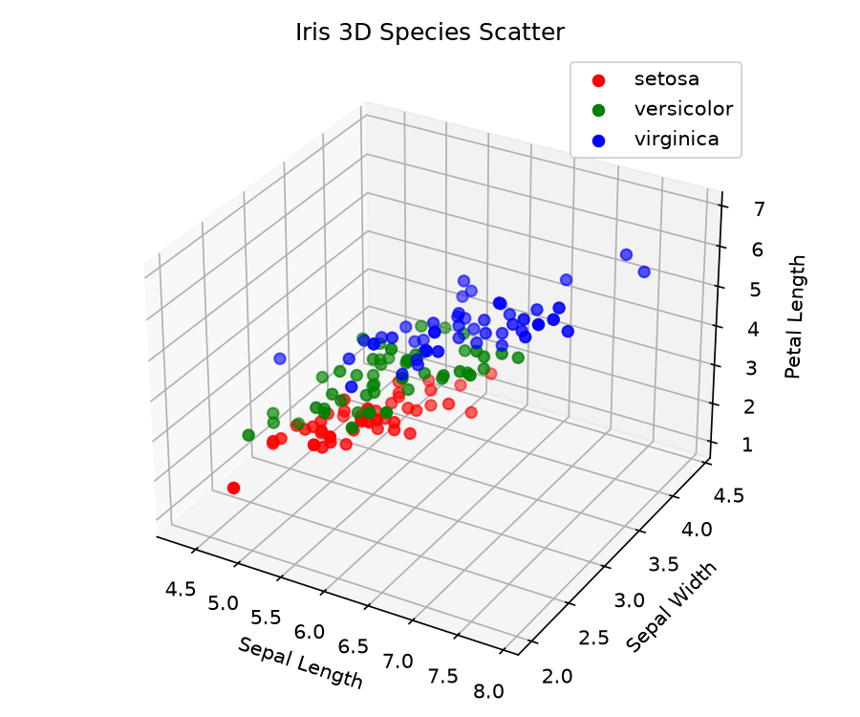
🧊 TOPIC 01 • SECTION 1.8
13 / 36
3D Multi-Class Feature Clustering — Iris
Separating complex multi-dimensional botanical morphometrics in 3D space
📖 High-Dimensional Feature Projections
📊 Iris 3D Feature Clusters
• Visualizing 3 continuous features simultaneously to evaluate class separability.
• Identifies linear and non-linear classification decision boundaries.
• Demonstrates that Setosa is linearly separable, while Versicolor and Virginica overlap.
• Directly validates feature importance before training classification algorithms.
💻 [In]: Python 3.12 (Colab / Jupyter)
import seaborn as sns
iris = sns.load_dataset('iris')
ax = plt.axes(projection='3d')
colors = {'setosa': '#2563eb', 'versicolor': '#059669', 'virginica': '#dc2626'}
for species, group in iris.groupby('species'):
ax.scatter3D(group['sepal_length'],
group['sepal_width'],
group['petal_length'],
c=colors[species], label=species, s=40)
ax.set_xlabel('Sepal Length')
ax.set_ylabel('Sepal Width')
ax.set_zlabel('Petal Length')
ax.legend()
plt.show()
🌐 Real-World Use Case & Industry Application
🏢 Industry: Biomarker Discovery & Cancer Cytology
💡 Application: Classifying malignant vs benign tumor cell clusters based on nuclear radius, perimeter, and texture dimensions.
🎯 Key Impact: Allows oncologists and ML researchers to visually confirm cluster segregation before deploying clinical AI diagnostic models.

Slide 14
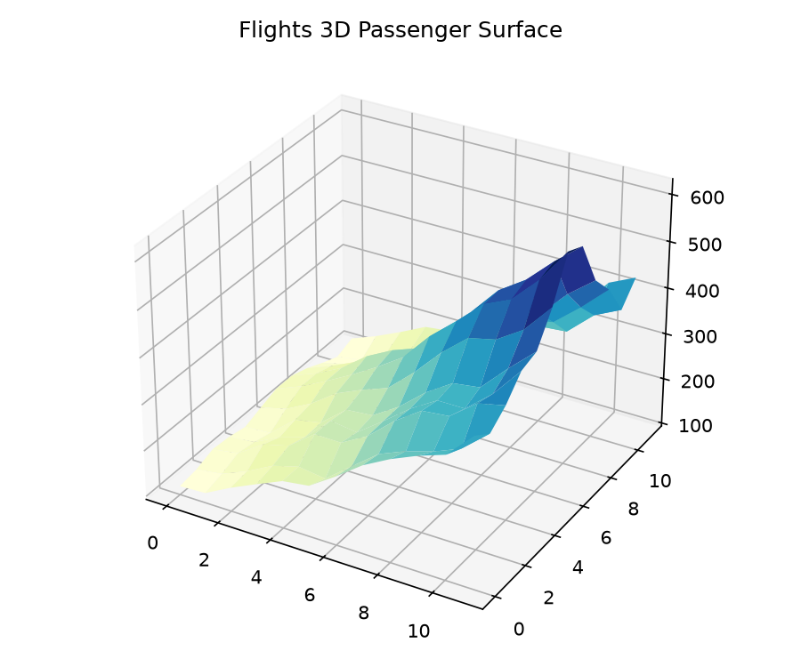
🧊 TOPIC 01 • SECTION 1.9
14 / 36
Spatio-Temporal Surface — Flight Volumes
Modeling airline passenger seasonality trends as a continuous 3D surface landscape
📖 Spatio-Temporal Matrix Surfaces
📊 Seasonal Flight Surface Landscape
• Transforms 2D tabular pivot matrices into continuous 3D topographic surfaces.
• Reveals dual temporal trends: long-term yearly growth and repeating seasonal cycles.
• Elevated ridges highlight consistent summer holiday travel surges across every decade.
• Eliminates the cognitive clutter of plotting 12 separate overlapping line graphs.
💻 [In]: Python 3.12 (Colab / Jupyter)
flights = sns.load_dataset('flights')
pivot = flights.pivot(index='month', columns='year', values='passengers')
# Month index (1-12) vs Years (1949-1960)
X, Y = np.meshgrid(np.arange(1949, 1961), np.arange(1, 13))
Z = pivot.values
ax = plt.axes(projection='3d')
surf = ax.plot_surface(X, Y, Z, cmap='plasma', edgecolor='none')
ax.set_xlabel('Year')
ax.set_ylabel('Month')
ax.set_zlabel('Passengers (1000s)')
plt.colorbar(surf, shrink=0.6)
plt.show()
🌐 Real-World Use Case & Industry Application
🏢 Industry: Airline Fleet Optimization & Hotel Capacity Planning
💡 Application: Dynamic demand forecasting and dynamic airfare pricing based on multi-decade holiday surges.
🎯 Key Impact: Enables airline network planners to reposition aircraft fleets months ahead of peak demand.

Slide 15
MODULE 02 • SECTION 4.1
Geographic Data with
Basemap & Cartopy
Exploration of planetary cartographic projection systems, geopolitical boundary layers, urban demographic scatter plots, great-circle flight navigation geodesic arcs, and modern Cartopy alternatives.
Key Functions: Basemap • drawcoastlines • drawcountries • drawgreatcircle • Cylindrical • Mollweide • Orthographic

Slide 16
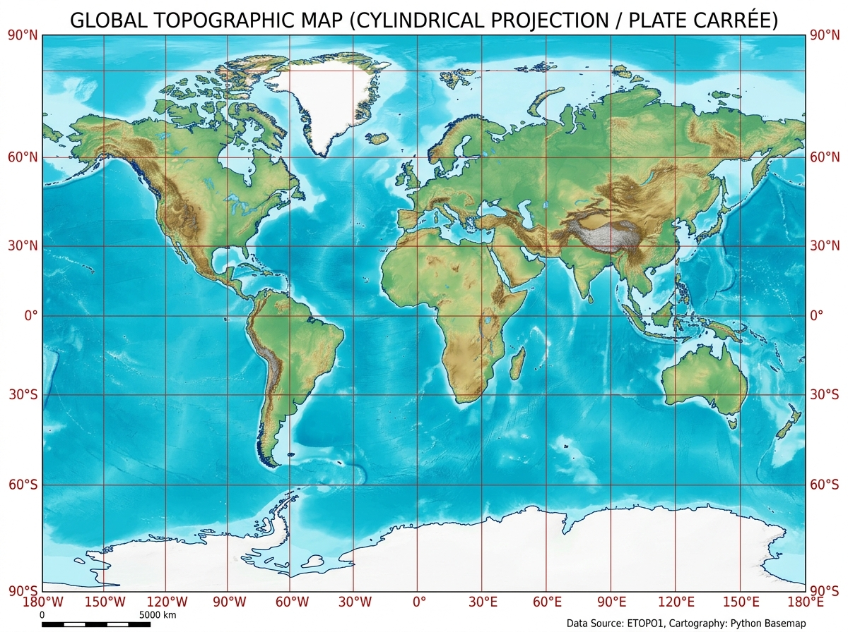
🗺️ TOPIC 02 • SECTION 2.1
16 / 36
Geospatial Cartography Introduction
Foundational principles of mapping latitude/longitude coordinates onto 2D projections
📖 The Geospatial Mapping Challenge
📊 Cylindrical Projection Base Layer
• Earth is an oblate spheroid; projecting it onto a flat 2D plane inherently introduces distortion.
• Distortion trade-offs: Area vs. Shape vs. Distance vs. Direction (Tissot's Indicatrix).
• Basemap wraps GEOS (geometry engine) and PROJ4 (cartographic projections).
• Provides high-level layer drawing primitives: coastlines, borders, parallels, and meridians.
💻 [In]: Python 3.12 (Colab / Jupyter)
from mpl_toolkits.basemap import Basemap
import matplotlib.pyplot as plt
fig = plt.figure(figsize=(10, 6))
# Instantiate cylindrical equidistant projection
m = Basemap(projection='cyl',
llcrnrlat=-90, urcrnrlat=90,
llcrnrlon=-180, urcrnrlon=180,
resolution='c')
m.drawcoastlines(linewidth=0.5, color='#334155')
m.drawcountries(linewidth=0.3, color='#64748b')
m.fillcontinents(color='#1e293b', lake_color='#0b0f19')
m.drawmapboundary(fill_color='#0b0f19')
plt.show()
🌐 Real-World Use Case & Industry Application
🏢 Industry: Global Maritime Fleet Tracking & Marine Logistics
💡 Application: Displaying real-time AIS transponder coordinates of international cargo container vessels across shipping lanes.
🎯 Key Impact: Provides the geo-referenced boundary canvas required to detect vessel proximity to exclusive economic zones.

Slide 17
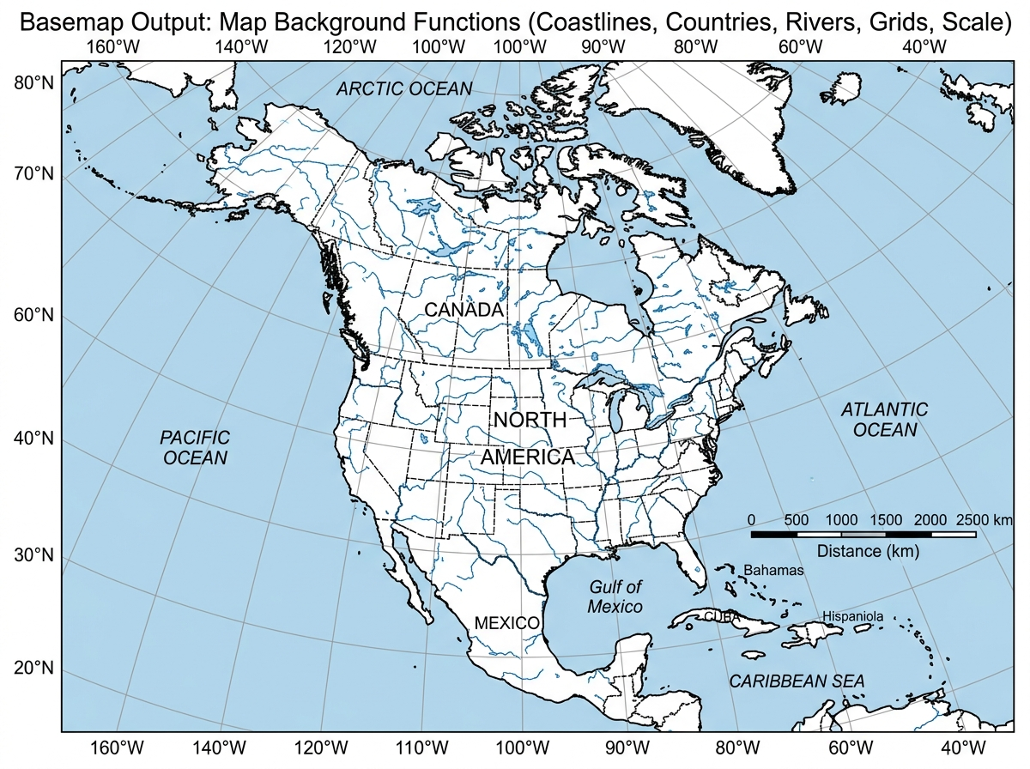
🗺️ TOPIC 02 • SECTION 2.2
17 / 36
Geographic Layer Composition & Topography
Assembling geological, hydrological, and political feature boundaries
📖 Layered Cartographic Composition
📊 Multi-Layer Physical Topography
• resolution='c' (crude), 'l' (low), 'i' (intermediate), 'h' (high), 'f' (full).
• drawparallels() & drawmeridians(): Overlays latitude and longitude reference gridlines.
• shadedrelief(): Downloads and textures NASA Blue Marble elevation relief topography.
• etopo(): Renders 1-arc-minute continental elevation and seafloor bathymetry.
💻 [In]: Python 3.12 (Colab / Jupyter)
m = Basemap(projection='mill', resolution='l')
# Vector Boundary Layers
m.drawcoastlines(linewidth=0.8, color='#06b6d4')
m.drawcountries(linewidth=0.5, color='#94a3b8')
m.drawstates(linewidth=0.3, color='#475569')
m.drawrivers(linewidth=0.4, color='#38bdf8')
# Coordinate Grids
m.drawparallels(np.arange(-90, 91, 30), labels=[1,0,0,0])
m.drawmeridians(np.arange(-180, 181, 60), labels=[0,0,0,1])
# High-Res Shaded Physical Relief
m.shadedrelief(scale=0.5)
plt.show()
🌐 Real-World Use Case & Industry Application
🏢 Industry: Disaster Response & Flood Inundation Modeling
💡 Application: Correlating real-time river water levels and radar precipitation maps against high-resolution terrain basins.
🎯 Key Impact: Crucial for emergency relief agencies to identify cut-off infrastructure and deploy flood barriers.

Slide 18
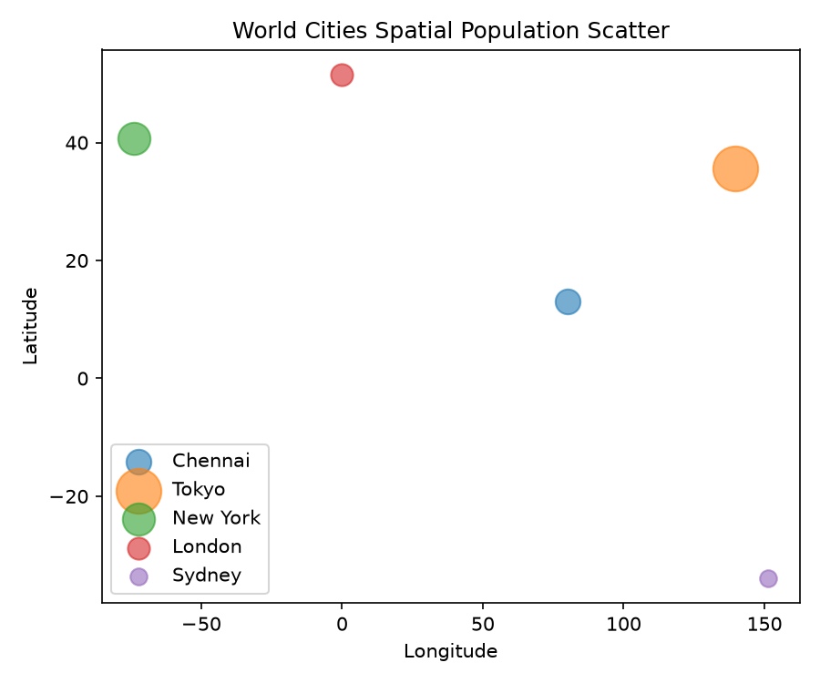
🗺️ TOPIC 02 • SECTION 2.3
18 / 36
Geospatial Scatter — Global Urban Populations
Transforming GPS geographic coordinates into projected screen pixels
📖 Coordinate Transformation Engine: m(lon, lat)
📊 Global Urban Population Density
• GPS coordinates use Spherical WGS84 Datum (Degrees Longitude & Latitude).
• Calling m(lon, lat) computes the exact 2D projection plane coordinates (x, y) in meters.
• Once transformed, standard Matplotlib commands (scatter, plot, text) overlay seamlessly.
• zorder parameter controls layer stacking order above continental fills.
💻 [In]: Python 3.12 (Colab / Jupyter)
# Extracting City GPS Coordinates
lat = cities['latitude'].values
lon = cities['longitude'].values
population = cities['population'].values
# Transform GPS (lon, lat) to projection screen coordinates (x, y)
x, y = m(lon, lat)
# Scatter plot with size scaled to population
m.scatter(x, y, s=population/50000,
c=population, cmap='YlOrRd',
alpha=0.75, zorder=5)
plt.colorbar(label='Urban Population')
plt.title('Global Megacities Demographics')
plt.show()
🌐 Real-World Use Case & Industry Application
🏢 Industry: Telecommunications & Cloud Datacenter Site Selection
💡 Application: Analyzing global customer density clusters to determine latency-optimal cloud server regions.
🎯 Key Impact: Overlays undersea fiber optic cable landing zones directly with high-density population nodes.

Slide 19
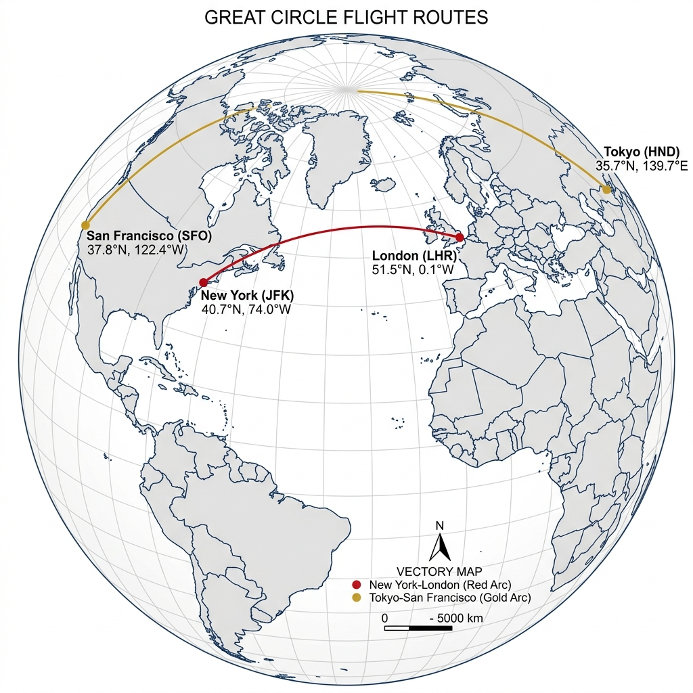
🗺️ TOPIC 02 • SECTION 2.4
19 / 36
Great Circle Geodesic Navigation Routes
Calculating and rendering the shortest spherical travel paths across the globe
📖 Spherical Geodesics vs. Flat Map Lines
📊 Geodesic Trans-Oceanic Flight Arcs
• On a flat map, straight lines are Rhumb lines — they do NOT represent shortest distance.
• The true shortest distance between two spherical points is an arc along a Great Circle.
• ax.drawgreatcircle() internally computes spherical trigonometry geodesic interpolation.
• Curves significantly toward high latitudes (e.g., flight arcs passing over Greenland).
💻 [In]: Python 3.12 (Colab / Jupyter)
# New York to London
ny_lat, ny_lon = 40.7128, -74.0060
lon_lat, lon_lon = 51.5074, -0.1278
# Tokyo to Sydney
tok_lat, tok_lon = 35.6762, 139.6503
syd_lat, syd_lon = -33.8688, 151.2093
m.drawgreatcircle(ny_lon, ny_lat, lon_lon, lon_lat,
color='#f43f5e', linewidth=2.5,
label='NYC -> London')
m.drawgreatcircle(tok_lon, tok_lat, syd_lon, syd_lat,
color='#38bdf8', linewidth=2.5,
label='Tokyo -> Sydney')
plt.show()
🌐 Real-World Use Case & Industry Application
🏢 Industry: Commercial Aviation Route Planning & Fuel Optimization
💡 Application: Computing optimal flight paths for trans-Atlantic and trans-Pacific commercial jet routes.
🎯 Key Impact: Saves commercial airlines millions of gallons of aviation jet fuel annually by reducing flight miles.

Slide 20
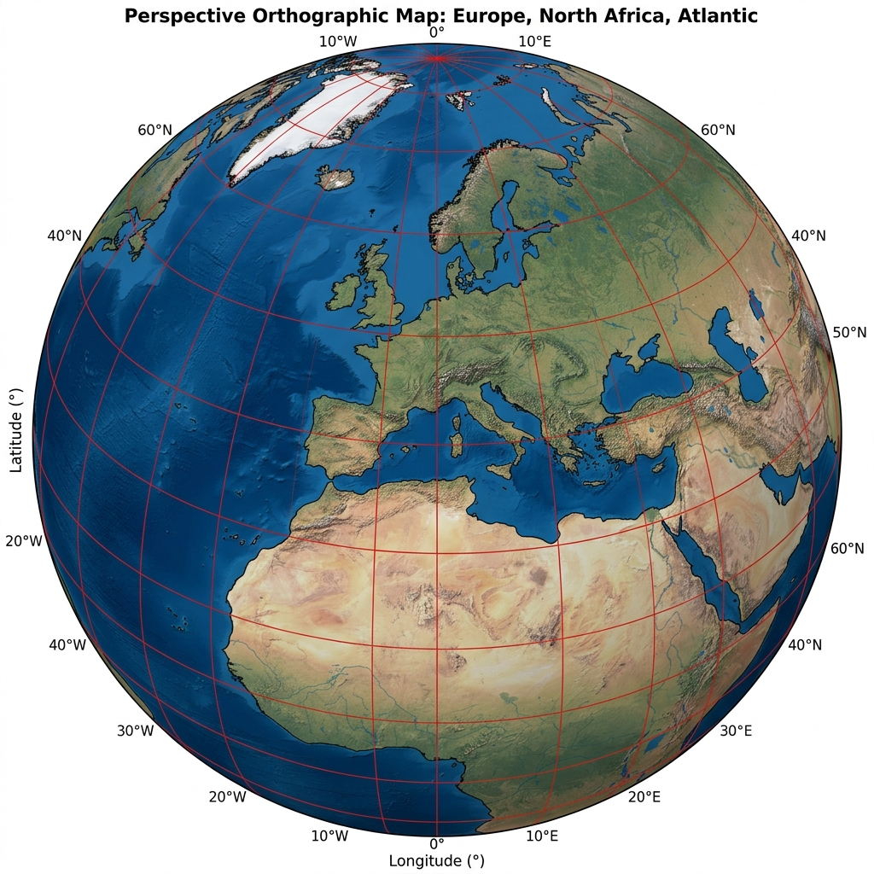
🗺️ TOPIC 02 • SECTION 2.5
20 / 36
Cartographic Projection Systems Comparison
Evaluating distortion trade-offs across Cylindrical, Mollweide, and Orthographic views
📖 Classification of Map Projections
📊 Orthographic Planetary Globe View
• Conformal Projections (Mercator, LCC): Preserves local angles & shapes; distorts polar area.
• Equal-Area Projections (Mollweide, Albers): Preserves true area ratios; distorts shapes at edges.
• Orthographic Projection: Simulates a 3D hemisphere view as viewed from deep outer space.
• Choice of projection must match the analytical goal (navigational vs. thematic statistics).
💻 [In]: Python 3.12 (Colab / Jupyter)
# Cylindrical Equidistant
m1 = Basemap(projection='cyl', resolution='c')
# Mollweide (Equal-Area Pseudocylindrical)
m2 = Basemap(projection='moll', lon_0=0, resolution='c')
# Orthographic (3D Globe as seen from outer space)
m3 = Basemap(projection='ortho', lat_0=20, lon_0=80,
resolution='c')
# Lambert Conformal Conic (Middle Latitudes)
m4 = Basemap(projection='lcc', lat_1=20, lat_2=40,
lon_0=80, width=5E6, height=4E6)
🌐 Real-World Use Case & Industry Application
🏢 Industry: Global Climate Research & Carbon Budget Accounting
💡 Application: Equal-area Mollweide projections ensure carbon emission calculations are not visually biased by polar landmasses.
🎯 Key Impact: Prevents Greenland and Antarctica from appearing deceptively larger than the entire continent of Africa.

Slide 21
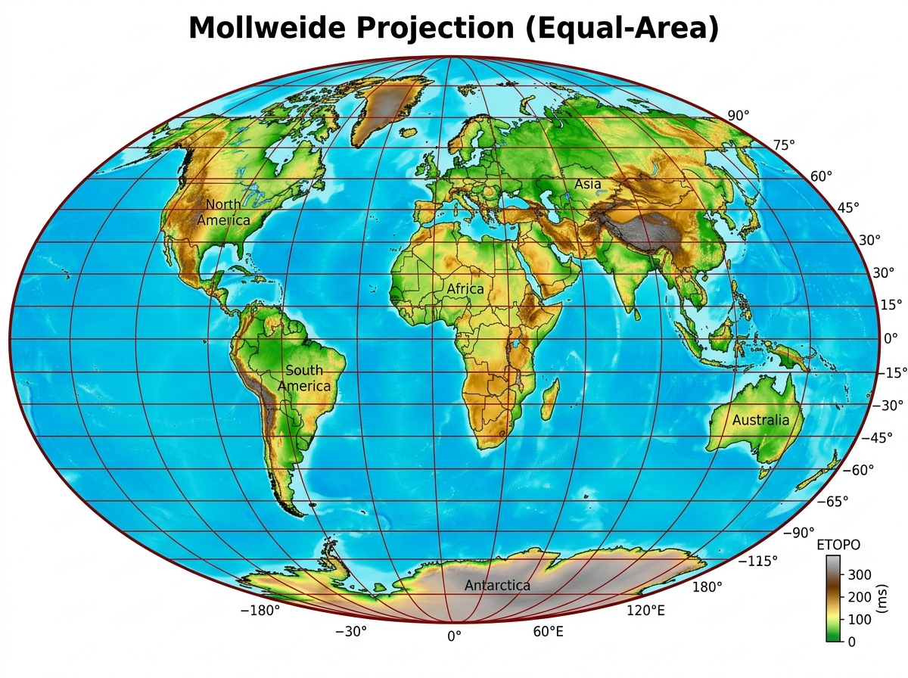
🗺️ TOPIC 02 • SECTION 2.6
21 / 36
Modern Geospatial Stack — Cartopy & GeoPandas
The next-generation standard for Python geospatial data visualization
📖 Why the Community Transitioned to Cartopy
📊 Mollweide Global Equal-Area Map
• Basemap has reached official end-of-life; Cartopy is the official active successor.
• Native integration with Matplotlib Axes (subclasses GeoAxes directly).
• Automatic coordinate re-projection: pass transform=ccrs.PlateCarree() to any plot call.
• Seamless interoperability with GeoPandas, Shapely, and xarray raster grids.
💻 [In]: Python 3.12 (Colab / Jupyter)
import cartopy.crs as ccrs
import cartopy.feature as cfeature
import matplotlib.pyplot as plt
fig = plt.figure(figsize=(10, 6))
ax = fig.add_subplot(1, 1, 1,
projection=ccrs.Robinson())
# Native vector feature layers
ax.add_feature(cfeature.COASTLINE, lw=0.8)
ax.add_feature(cfeature.BORDERS, linestyle=':')
ax.add_feature(cfeature.LAND, edgecolor='black')
ax.add_feature(cfeature.OCEAN, color='#0f172a')
ax.gridlines(draw_labels=True)
plt.show()
🌐 Real-World Use Case & Industry Application
🏢 Industry: Modern Web GIS & Cloud Native Geospatial Pipelines
💡 Application: Integrating Cloud-Optimized GeoTIFFs (COG) and OpenStreetMap vector tiles in production data pipelines.
🎯 Key Impact: Enables effortless multi-projection analytics without deprecation risks or manual coordinate conversion bugs.

Slide 22
🗺️ TOPIC 02 • SECTION 2.7
22 / 36
Geospatial Decision Matrix & Best Practices
Architectural guidelines for selecting the optimal projection for spatial analytics
Global Thematic Studies
Regional Navigation & GIS
Standard Projection: Mollweide / Robinson
Standard Projection: Lambert Conformal Conic
Preserves relative area proportions accurately across continents.
Preserves local shapes, angles, and distances across mid-latitude zones.
🎯 Practical Use Case:
Global greenhouse gas budgets, population distributions, biodiversity loss indices.
🎯 Practical Use Case:
National meteorological rainfall radar, road networks, aeronautical sectional charts.
Planetary Hemisphere Views
Equatorial & Marine Lanes
Standard Projection: Orthographic
Standard Projection: Mercator / Cylindrical
Provides realistic 3D globe perspective as viewed from geostationary orbit.
Lines of constant compass heading (rhumb lines) plot as straight segments.
🎯 Practical Use Case:
Satellite mission telemetry, intercontinental missile defense, global communications.
🎯 Practical Use Case:
Nautical maritime navigation, marine automated identification systems (AIS).

Slide 23
MODULE 03 • SECTION 5.1
Statistical Data Visualization
with Seaborn
Elevating exploratory data analysis: high-level declarative syntax, automated statistical aggregation, kernel density estimation, multi-dimensional pairplots, categorical distributions, and linear regression models.
Key Functions: sns.histplot • sns.kdeplot • sns.jointplot • sns.pairplot • sns.catplot • sns.heatmap • sns.lmplot

Slide 24
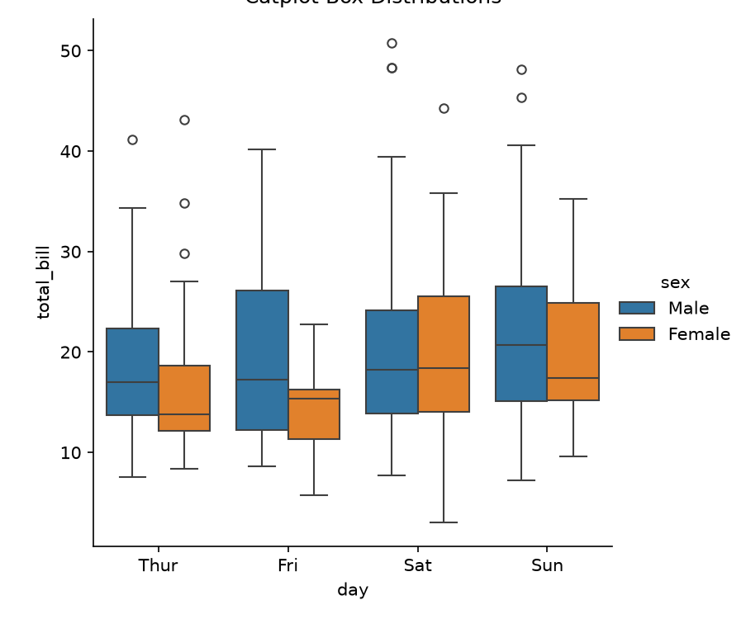
📊 TOPIC 03 • SECTION 3.1
24 / 36
Seaborn Design Philosophy & Architecture
The declarative grammar of statistical data exploration in Python
📖 Why Seaborn Built Upon Matplotlib
📊 Declarative Faceted Subplots
• Matplotlib is imperative (requires explicit loops, color assignments, legend hooks).
• Seaborn is declarative: directly consumes tidy DataFrames via columns (x, y, hue, col).
• Built-in statistical aggregation: computes confidence intervals and error bars automatically.
• Modern aesthetic defaults: sophisticated color palettes, integrated grid layout systems.
💻 [In]: Python 3.12 (Colab / Jupyter)
import seaborn as sns
import matplotlib.pyplot as plt
# Declarative API: specify WHAT to plot, not HOW to draw it
tips = sns.load_dataset('tips')
sns.relplot(
data=tips,
x='total_bill', y='tip',
hue='time', size='size', style='sex',
col='day', col_wrap=2,
palette='magma'
)
plt.show()
🌐 Real-World Use Case & Industry Application
🏢 Industry: Customer Churn & Behavioral Economics
💡 Application: Rapid exploratory data analysis (EDA) investigating how multiple customer variables interact across segments.
🎯 Key Impact: Reduces 50 lines of tedious Matplotlib code into a single 4-line expressive declarative statement.

Slide 25
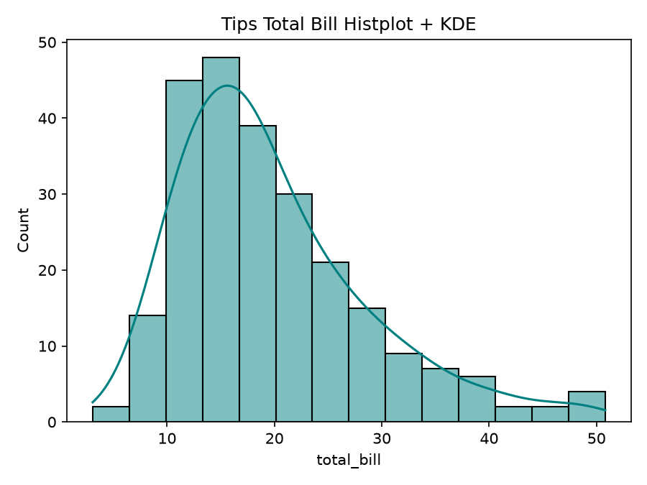
📊 TOPIC 03 • SECTION 3.2
25 / 36
Univariate Distributions — Histograms & KDE
Estimating continuous probability density functions from empirical observations
📖 Kernel Density Estimation (KDE) Mechanics
📊 Histograms & KDE Density Curves
• Histograms depend heavily on bin edge placement and bin width selection.
• KDE centers a smooth Gaussian kernel curve at every empirical sample point.
• Summing all individual kernels yields a continuous probability density curve.
• rugplot() adds tick marks at the bottom, directly indicating raw data density.
💻 [In]: Python 3.12 (Colab / Jupyter)
import seaborn as sns
import matplotlib.pyplot as plt
data = np.random.randn(1000)
fig, axes = plt.subplots(1, 2, figsize=(10, 4))
# Histogram with KDE overlay
sns.histplot(data, kde=True, color='#f43f5e',
bins=30, ax=axes[0])
axes[0].set_title('Histogram + Gaussian KDE')
# Cumulative & Rug Distribution
sns.kdeplot(data, fill=True, color='#06b6d4',
cumulative=True, ax=axes[1])
sns.rugplot(data, color='#38bdf8', ax=axes[1])
axes[1].set_title('Cumulative Probability Density')
plt.show()
🌐 Real-World Use Case & Industry Application
🏢 Industry: Algorithmic Trading & Asset Return Volatility
💡 Application: Evaluating stock market return distributions to test for heavy tails, skewness, and black-swan outliers.
🎯 Key Impact: Prevents quantitative risk models from underestimating catastrophic market liquidation events.

Slide 26
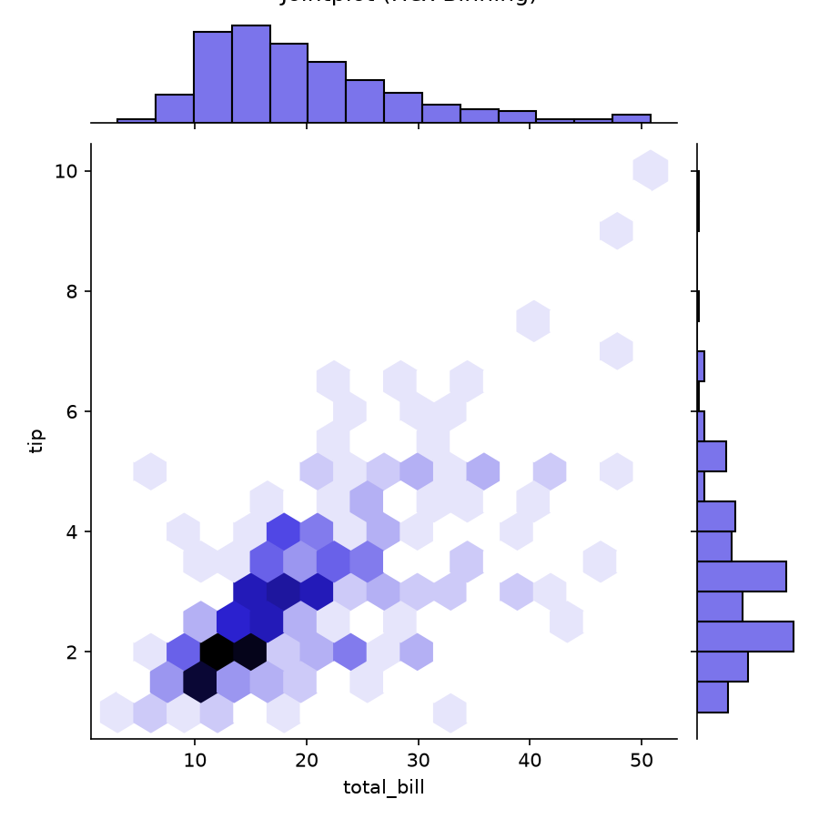
📊 TOPIC 03 • SECTION 3.3
26 / 36
Bivariate Relationships — sns.jointplot()
Combining central scatter/hexbin plots with marginal univariate density curves
📖 Joint & Marginal Distribution Geometry
📊 Jointplot Hexbin Bivariate Output
• Simultaneously visualizes the 2D joint relationship and 1D marginals on the axes.
• kind='hex': Replaces overlapping point scatter with hexagonal density accumulation.
• kind='kde': Produces smooth 2D elevation contour isolines of probability density.
• Eliminates scatter overplotting when analyzing large datasets (100,000+ points).
💻 [In]: Python 3.12 (Colab / Jupyter)
import seaborn as sns
iris = sns.load_dataset('iris')
# Hexagonal Binning with Marginal Histograms
g = sns.jointplot(
data=iris,
x='sepal_length', y='sepal_width',
kind='hex', cmap='plasma',
marginal_kws=dict(bins=20, fill=True)
)
g.fig.suptitle('Hexbin Density with Marginal Distributions')
plt.show()
🌐 Real-World Use Case & Industry Application
🏢 Industry: E-Commerce Pricing Optimization & Cart Value
💡 Application: Analyzing the correlation between marketing ad spend (X) and average order revenue (Y).
🎯 Key Impact: Hexagonal bins immediately highlight the highest-density conversion sweet spots.

Slide 27
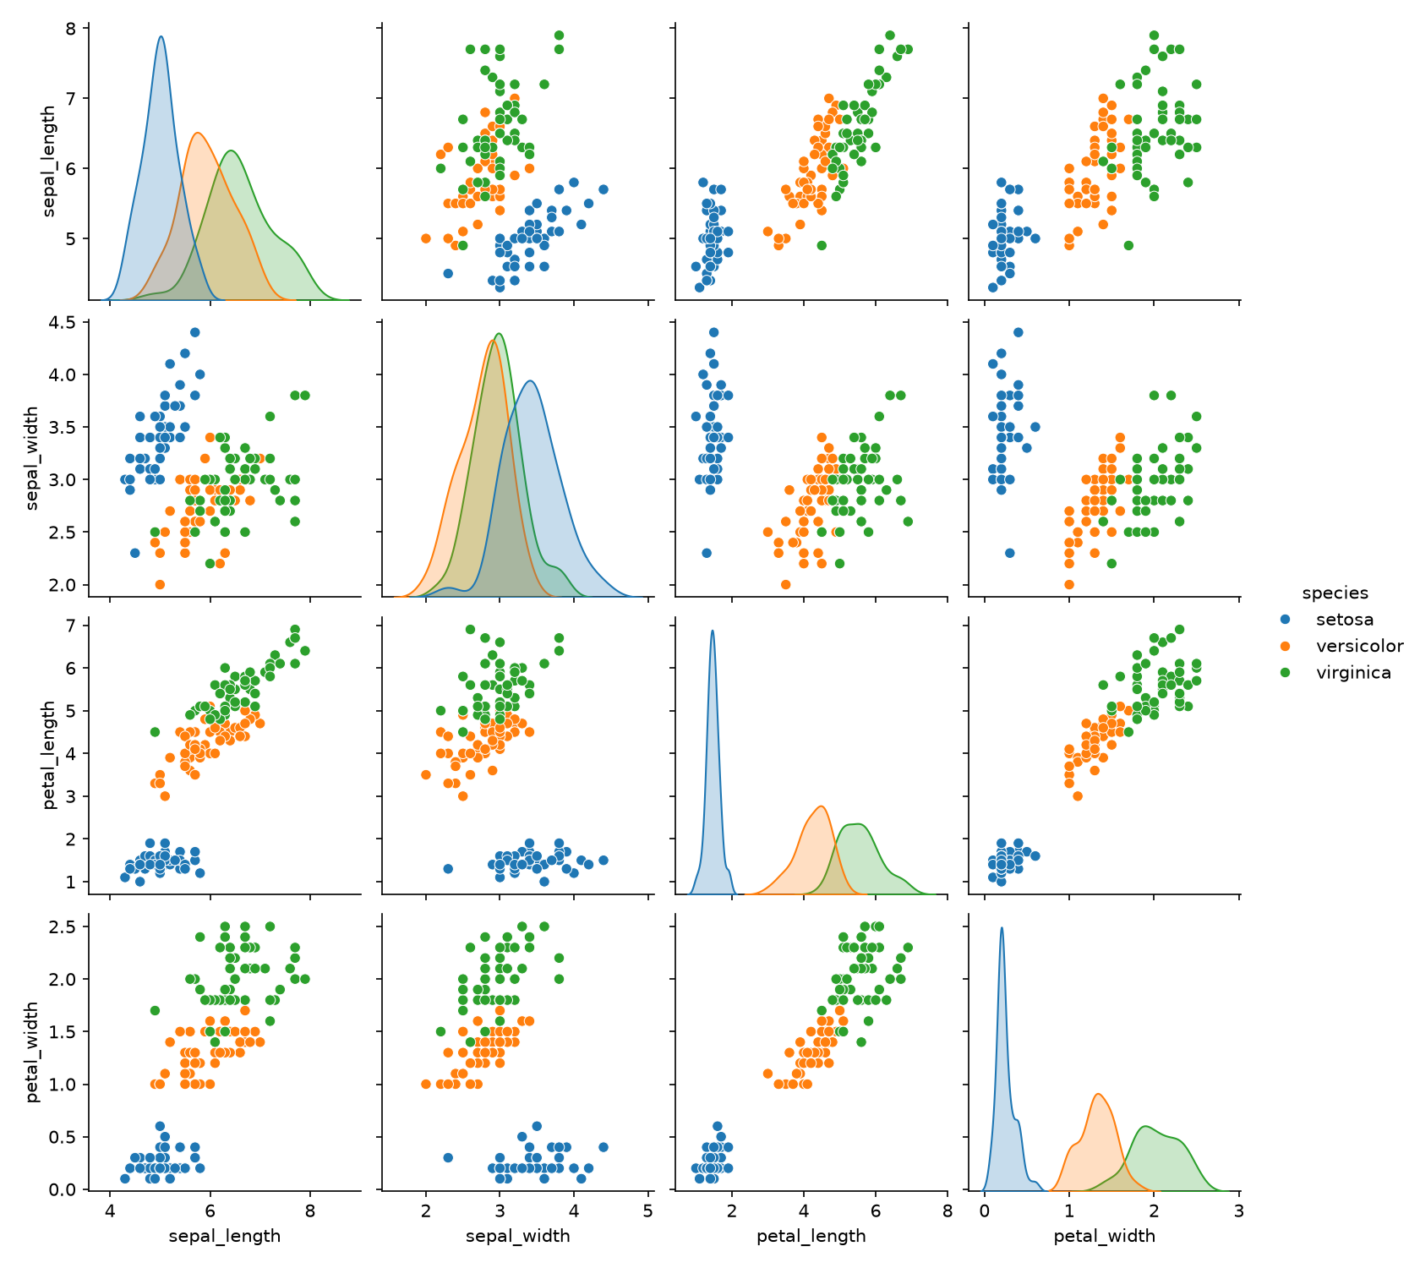
📊 TOPIC 03 • SECTION 3.4
27 / 36
Multi-Feature Matrices — sns.pairplot()
Generating N×N pairwise feature scatter matrices across class categories
📖 Pairwise Feature Correlation Matrices
📊 Pairplot Feature Matrix Grid
• Automatically renders all N×N pairwise bivariate combinations across continuous features.
• Diagonal plots: Display univariate KDE distribution for each individual feature.
• Off-diagonal plots: Show pairwise scatter relationships to reveal feature correlations.
• hue='species': Color-codes points by categorical label to show cluster separation.
💻 [In]: Python 3.12 (Colab / Jupyter)
import seaborn as sns
iris = sns.load_dataset('iris')
# Full N x N Feature Scatter & Density Matrix
sns.pairplot(
data=iris,
hue='species',
palette='Set1',
diag_kind='kde',
markers=['o', 's', 'D'],
plot_kws={'alpha': 0.8}
)
plt.show()
🌐 Real-World Use Case & Industry Application
🏢 Industry: Clinical Pharmacology & Drug Discovery Screening
💡 Application: Screening hundreds of molecular chemical compound properties against therapeutic target efficacy.
🎯 Key Impact: Identifies collinear features immediately, enabling machine learning engineers to prune redundant variables.

Slide 28
📊 TOPIC 03 • SECTION 3.5
28 / 36
Categorical Distributions — Box, Violin & Strip
Comparing continuous variable distributions across categorical grouping levels
📖 Categorical Distribution Modalities
📊 Categorical Box & Violin Comparisons
• Boxplot: Encodes 5-number summary (Min, Q1, Median, Q3, Max) and identifies IQR outliers.
• Violinplot: Combines boxplot with mirrored KDE curves to reveal bimodal distributions.
• split=True: Folds two category halves together for direct visual comparison.
• catplot(): Universal entry point for box, violin, strip, swarm, and bar charts.
💻 [In]: Python 3.12 (Colab / Jupyter)
tips = sns.load_dataset('tips')
fig, axes = plt.subplots(1, 2, figsize=(10, 4))
# Boxplot with Quartiles & Outliers
sns.boxplot(data=tips, x='day', y='total_bill',
hue='smoker', palette='Blues', ax=axes[0])
axes[0].set_title('Boxplot: Quartiles & Whiskers')
# Violinplot with Embedded KDE
sns.violinplot(data=tips, x='day', y='total_bill',
hue='sex', split=True, palette='Pastel1',
ax=axes[1])
axes[1].set_title('Violinplot: Split Probability Density')
plt.show()
🌐 Real-World Use Case & Industry Application
🏢 Industry: Healthcare Hospital Operations & Patient Wait Times
💡 Application: Comparing patient emergency room wait times across hospital triage categories and shifts.
🎯 Key Impact: Violin plots reveal bimodal distributions that single-number averages (means) completely conceal.

Slide 29
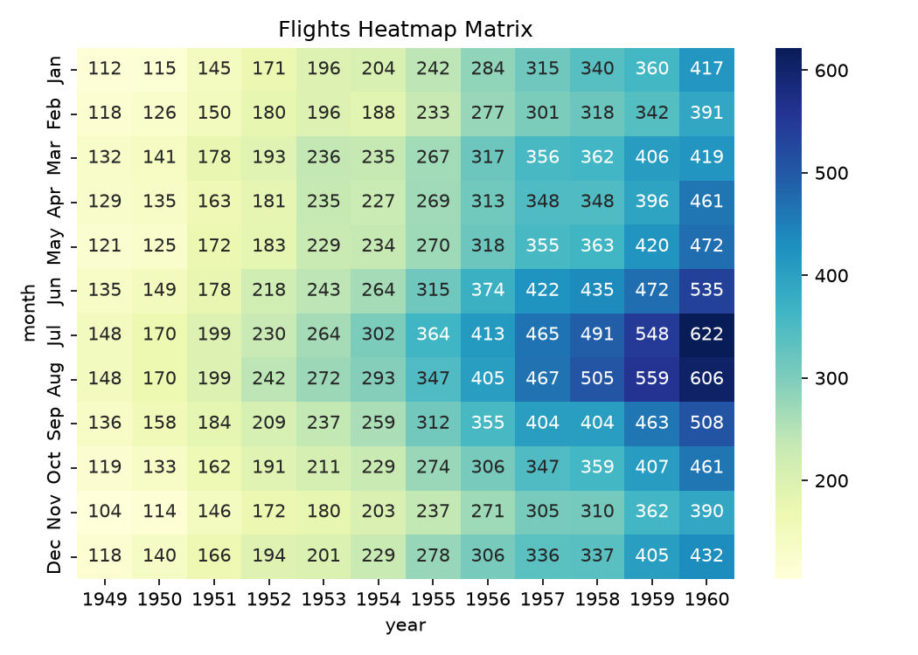
📊 TOPIC 03 • SECTION 3.6
29 / 36
Correlation Matrices & Heatmaps — sns.heatmap()
Visualizing multidimensional correlation coefficients and tabular intensity grids
📖 Matrix Intensity & Correlation Mapping
📊 Faceted Flight Matrix Heatmap
• Takes 2D matrix arrays and encodes numerical magnitudes as color gradients.
• annot=True overlays numerical cell values directly inside each rectangle.
• fmt='d' formats integers; fmt='.2f' formats continuous correlation Pearson coefficients.
• linewidths=0.5 draws subtle boundary lines to distinguish adjacent cell values.
💻 [In]: Python 3.12 (Colab / Jupyter)
flights = sns.load_dataset('flights')
pivot = flights.pivot(index='month', columns='year',
values='passengers')
plt.figure(figsize=(9, 6))
sns.heatmap(
pivot,
annot=True, fmt='d',
cmap='YlGnBu',
linewidths=0.5, linecolor='#1e293b',
cbar_kws={'label': 'Passenger Count (1000s)'}
)
plt.title('Monthly Flight Passenger Volume Heatmap')
plt.show()
🌐 Real-World Use Case & Industry Application
🏢 Industry: Genomic Microarray Expression & FinTech Correlations
💡 Application: Computing Pearson correlation matrices across thousands of financial equities to construct diversified investment portfolios.
🎯 Key Impact: Instantly reveals highly correlated asset pairs to eliminate systemic risk exposure.

Slide 30
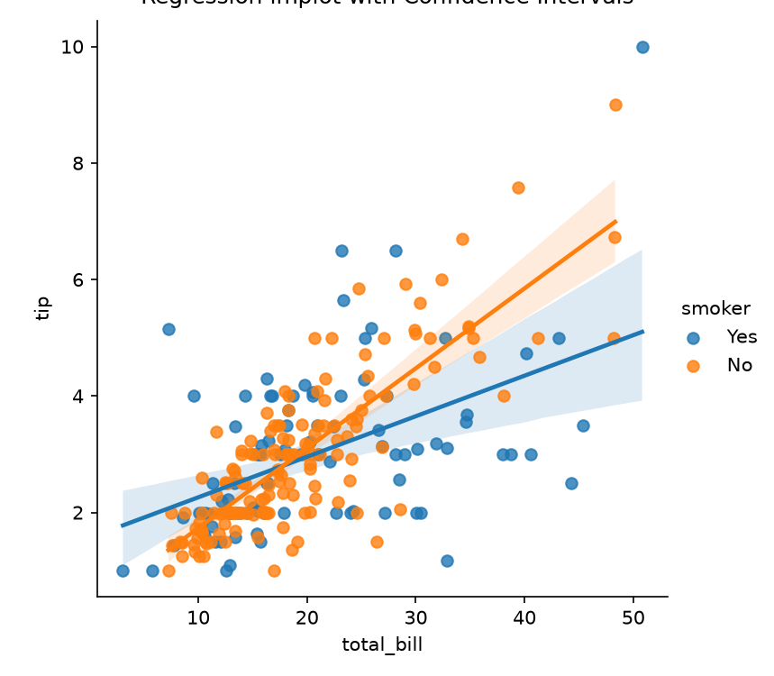
📊 TOPIC 03 • SECTION 3.7
30 / 36
Linear Regression & Residuals — sns.lmplot()
Fitting ordinary least squares regression models with statistical confidence bands
📖 Statistical Regression Modeling with Confidence Intervals
📊 Faceted Linear Regression with CI
• Combines regplot() with FacetGrid to plot linear models across categorical subsets.
• Automatically estimates regression slope, intercept, and translucent 95% bootstrap confidence bands.
• col & row arguments break the dataset into separate regression subplots automatically.
• order=2 fits polynomial curves; robust=True down-weights outlier influence.
💻 [In]: Python 3.12 (Colab / Jupyter)
tips = sns.load_dataset('tips')
# Faceted Linear Regression with 95% Confidence Band
sns.lmplot(
data=tips,
x='total_bill', y='tip',
hue='smoker', col='time',
markers=['o', 'x'],
palette='Set1',
scatter_kws={'alpha': 0.6},
ci=95 # 95% Bootstrap Confidence Interval
)
plt.show()
🌐 Real-World Use Case & Industry Application
🏢 Industry: Predictive Marketing Attribution & Customer LTV
💡 Application: Estimating customer lifetime value (LTV) growth as a function of initial acquisition discount tier.
🎯 Key Impact: Confidence bands signal exactly where sample sizes are too small to support business decisions.

Slide 31
📊 TOPIC 03 • SECTION 3.8
31 / 36
Scientific Color Palettes & Accessible Design
Color theory guidelines for continuous, diverging, and categorical visualizations
Qualitative / Categorical
Sequential / Continuous
Standard Palettes: Set1, deep, pastel, dark
Standard Palettes: mako, rocket, viridis, Blues
Unordered discrete classes with distinct hues but equal visual luminance.
Ordered numeric metrics progressing smoothly from light to dark.
🎯 Typical Application:
Species classification, geographical regions, departmental divisions.
🎯 Typical Application:
Density heatmaps, population volume, elevation topography.
Diverging / Polarizing
Colorblind Accessible
Standard Palettes: coolwarm, vlag, seismic
Standard Palettes: colorblind, cmocean, plasma
Highlighting positive vs negative deviation from a neutral critical center.
Perceptually uniform color sequences optimized for deuteranopia & protanopia.
🎯 Typical Application:
Stock market profit/loss, temperature anomaly above/below historical baseline.
🎯 Typical Application:
Official scientific publishing, medical interfaces, executive dashboards.

Slide 32
📊 TOPIC 03 • SECTION 3.9
32 / 36
Seaborn Multi-Plot Visual Gallery
Comprehensive catalog of Seaborn figure-level and axes-level statistical functions
Histograms & Density Estimation
Bivariate Relationships & Hexbins
sns.histplot & sns.kdeplot
sns.jointplot(kind='hex')
Categorical Facets & Violin Splits
Faceted Matrices & Heatmaps
sns.catplot(kind='violin')
sns.heatmap(annot=True)

Slide 33
📊 TOPIC 03 • SECTION 3.10
33 / 36
Seaborn Best Practices & Architecture
Engineering guidelines for clean statistical reporting and publication-grade figures
✓ Figure-Level vs Axes-Level
Understand the difference: relplot, catplot, lmplot create their own FacetGrid figures; scatterplot, boxplot, histplot draw directly onto existing Matplotlib axes.
✓ Tidy Data Formatting
Always reshape wide tables into tidy long-form DataFrames using pandas.melt() before plotting in Seaborn.
✓ Perceptual Color Consistency
Never use qualitative palettes for continuous data; verify that your color schemes pass accessibility checks.
✓ Statistical Integrity
State confidence intervals explicitly (e.g. ci=95); never hide high variance by showing only bar means without error bars.

Slide 34
⚖️ BENCHMARK MATRIX
34 / 36
Matplotlib 3D vs. Basemap/Cartopy vs. Seaborn
Comparative architectural trade-offs across all three seminar visual libraries
Evaluation Metric
Matplotlib 3D (mplot3d)
Basemap & Cartopy
Seaborn
Primary Domain
Spatial 3D & Volumetric Surfaces
Geographic & Geodesic GIS Mapping
Statistical Multi-Variable Distributions
Data Structure
(x, y, z) Triples & 2D Meshgrids
GPS (Lat, Lon) & GeoJSON Geometries
Tidy Long-Form Pandas DataFrames
API Abstraction
Low-Level Imperative Canvas
Mid-Level Projection Coordinates
High-Level Declarative Semantic Grammar
Strengths
Full 3D rotation, wireframes, Delaunay
Accurate cartographic transforms, coastlines
Automated confidence intervals, aesthetics
Limitations
Complex layout code, static in print
Basemap deprecated; requires Cartopy
2D only; lacks native 3D spatial surfaces
Ideal Use Case
CFD simulation, biophysics trajectories
Logistics routing, global climate models
Exploratory data analysis, ML feature diagnostics

Slide 35



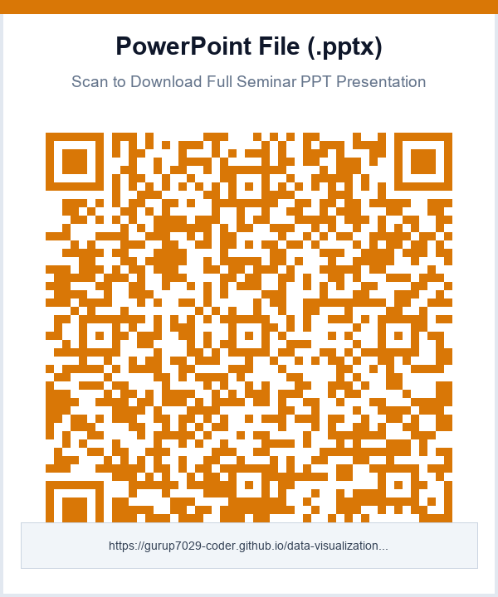
📱 INTERACTIVE RESOURCES
35 / 36
Interactive Web Demos & Presentation Videos
Scan QR codes with any smartphone camera for instant mobile access
Tamil Video Presentation
English Video Presentation
Interactive 3D Web Deck
Download Seminar PPTX
Full 7-min HD 3D Presentation with Audio
Full 7-min HD 3D Presentation with Audio
Live WebGL 3D Rotation on Mobile Browser
Official High-Resolution PowerPoint Presentation

Slide 36
Thank You!
Data Visualization in Python Seminar • Master Practical Presentation
✓ 3D Plotting: Spatial coordinates, parametric spirals, and Delaunay meshes illuminate complex geometries.
✓ Basemap & Cartopy: Precise cartographic projections reveal planetary phenomena without geographical distortion.
✓ Seaborn: Declarative statistical graphics turn raw exploratory data into actionable predictive insights.
✓ Mastered the unified workflow connecting data engineering, statistical modeling, and executive storytelling.
Presenter: Guruprasath B (7376242AD131) • Bannari Amman Institute of Technology (BIT)

