Slide 1
● MASTER OF COMPUTER APPLICATIONS | SEMINAR PRESENTATION ●
Elliptic Curve Arithmetic
Mathematical Foundations, Group Laws, and Finite Field Cryptography
Network Security | Semester 3 | Reference: William Stallings, Chapter 10
PRESENTED BY
Guru Prakash A
Class: II - MCA | Register No: 25322011

Slide 2
02 Agenda & Overview
Following William Stallings' Cryptography and Network Security (Chapter 10)
📘 1. Foundations & Concepts
• Motivation: The RSA Scaling Problem
• What is an Elliptic Curve? (Smooth Cubic Plane)
• Why are Elliptic Curves Used in Cryptography?
• Abelian Group Axioms (A1 to A5)
📐 2. Real Curves & Geometric Rules
• Elliptic Curves over Real Numbers R
• The 5 Fundamental Geometric Addition Rules
• Point Doubling via Tangent Line Construction
• Algebraic Addition & Doubling Formulas
🔢 3. Prime Curves over Z_p
• Two Families: Prime vs. Binary Curves
• Curves over Z_p, Hasse's Theorem & Condition
• 4 Formal Addition Rules & Slope Formulas
• Worked Example 1: Point Addition (P+Q)
• Worked Example 2: Point Doubling (2P)
💻 4. Binary Curves & Scalability
• Curves over Binary Fields GF(2^m)
• 4 Addition Rules & Slope Formulas in GF(2^m)
• Master Comparison: Z_p vs. GF(2^m)
• Scalar Multiplication & Double-and-Add Algorithm
Elliptic Curve Arithmetic | Presented by: Guru Prakash A (II-MCA, Reg No: 25322011) | William Stallings Ch. 10

Slide 3
03 Motivation — Why ECC?
The need for scalable, efficient public-key cryptography (Stallings Sec 10.3)
The RSA Scaling Problem
• Exploding Key Lengths: RSA keys must grow exponentially to maintain security against factorization attacks (2048 to 15360 bits).
• Server Bottlenecks: Massive computational latency on high-volume cloud servers handling concurrent SSL/TLS handshakes.
• Constrained Environments: Severe battery drain and memory starvation on mobile phones, smart cards, and IoT embedded devices.
• William Stallings' Assessment: 'The principal attraction of ECC, compared to RSA, is that it appears to offer equal security for a far smaller key size, thereby reducing processing overhead.'
NIST Key Size Equivalence (SP 800-57)
Security Level | RSA Key | ECC Key | Ratio
80 bits | 1024 bits | 160 bits | 6 : 1
112 bits | 2048 bits | 224 bits | 9 : 1
128 bits ★ | 3072 bits | 256 bits | 12 : 1
192 bits | 7680 bits | 384 bits | 20 : 1
256 bits | 15360 bits | 512 bits | 30 : 1
★ 128-bit Commercial Standard: ECC achieves the exact same security with 256 bits that RSA requires 3072 bits to reach (12× smaller key size!).
Elliptic Curve Arithmetic | Presented by: Guru Prakash A (II-MCA, Reg No: 25322011) | William Stallings Ch. 10

Slide 4
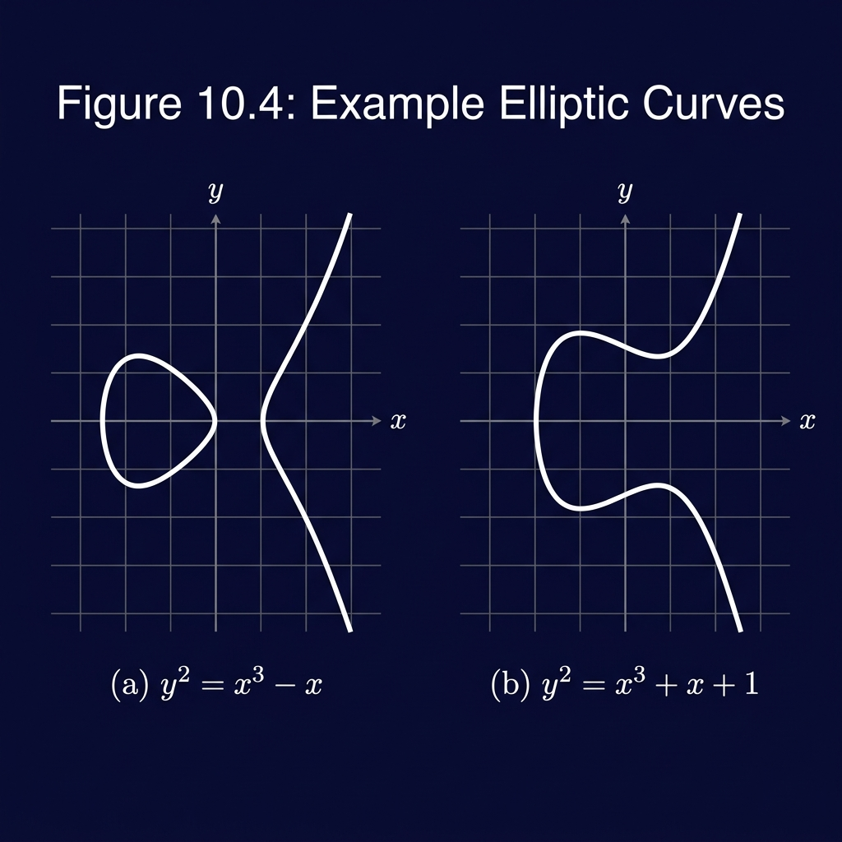
04 What is an Elliptic Curve?
A non-singular cubic plane curve with smooth geometry (Stallings Sec 10.3)
Definition & Geometric Properties
y² = x³ + ax + b
• Cubic Equation (Degree 3): The highest power is 3. Any straight line intersects the curve at exactly THREE points (counting multiplicity).
• Not an Ellipse: Named after elliptic integrals historically used to calculate the arc length of an ellipse.
• Point at Infinity O: A single conceptual zero point lying along every vertical line; serves as group additive identity.
• Horizontal Symmetry: Symmetrical about the x-axis: y = ±√(x³ + ax + b).
• Non-Singularity Condition: Discriminant 4a³ + 27b² ≠ 0 guarantees no cusps or self-intersections, so tangents always exist.
Continuous Elliptic Curve Shapes over Real Numbers R
Elliptic Curve Arithmetic | Presented by: Guru Prakash A (II-MCA, Reg No: 25322011) | William Stallings Ch. 10

Slide 5
05 Why are Elliptic Curves Used in Cryptography?
Exponential hardness and maximum security per bit
1. Natural Abelian Group Structure
• Group Operations: Points on an elliptic curve naturally form an Abelian group under chord-and-tangent addition.
• Closure Guaranteed: Adding any two valid curve points always produces another point that is guaranteed to lie on the curve.
• Associative & Commutative: The order and grouping of operations do not matter: (P + Q) + R = P + (Q + R) and P + Q = Q + P.
• Identity & Inverses: The point at infinity O serves as identity, and reflection across the x-axis provides exact point negation -P.
2. No Sub-Exponential Attacks
• The Weakness of RSA: In regular integers modulo p (RSA/Diffie-Hellman), Index Calculus attacks solve discrete logs in sub-exponential time O(exp(c (ln p)^{1/3})).
• No Prime Factors on Curves: Elliptic curve points have NO analogue to prime factors! Index calculus does NOT apply to general elliptic curves.
• Strictly Exponential Hardness: The fastest known attack is Pollard's rho, which requires fully exponential time O(√p).
• 12× Key Size Advantage: A 256-bit ECC key offers the exact same mathematical security as a 3072-bit RSA key.
Elliptic Curve Arithmetic | Presented by: Guru Prakash A (II-MCA, Reg No: 25322011) | William Stallings Ch. 10

Slide 6
06 Abelian Groups — Mathematical Foundation
A set G with binary operation satisfying 5 axioms (Stallings Sec 10.3)
(A1) Closure: For all a, b in G, the combination a • b is also in G.
(A2) Associativity: For all a, b, c in G, (a • b) • c = a • (b • c). Grouping does not affect result.
(A3) Identity Element: There exists an element e in G such that a • e = e • a = a.
(A4) Inverse Element: For each a in G, there exists a unique a' such that a • a' = e.
(A5) Commutativity: For all a, b in G, a • b = b • a. (The distinctive Abelian property!)
ECC Analogy: Group operation = Point Addition (+). Identity = Point at Infinity O. Inverse = -P = (x, -y).
Elliptic Curve Arithmetic | Presented by: Guru Prakash A (II-MCA, Reg No: 25322011) | William Stallings Ch. 10

Slide 7
07 Elliptic Curves over Real Numbers R
Weierstrass cubic equation and non-singularity condition (Stallings Sec 10.3)
Cubic Weierstrass Form
y² = x³ + ax + b
• Set of Points E(a, b): Comprises all real coordinate pairs (x, y) satisfying the cubic equation, plus the single point at infinity O.
• Vertical Symmetry: The curve is completely symmetric about the horizontal axis y = 0.
• Non-Singularity (Eq. 10.2): Discriminant condition: 4a³ + 27b² ≠ 0.
• Geometric Consequence: Ensures the polynomial x³ + ax + b has three distinct roots, preventing cusps or self-intersections so tangent lines are defined everywhere.
Stallings Fig 10.4: Curve Shapes for (a) y²=x³-x and (b) y²=x³-x+1
Elliptic Curve Arithmetic | Presented by: Guru Prakash A (II-MCA, Reg No: 25322011) | William Stallings Ch. 10

Slide 8
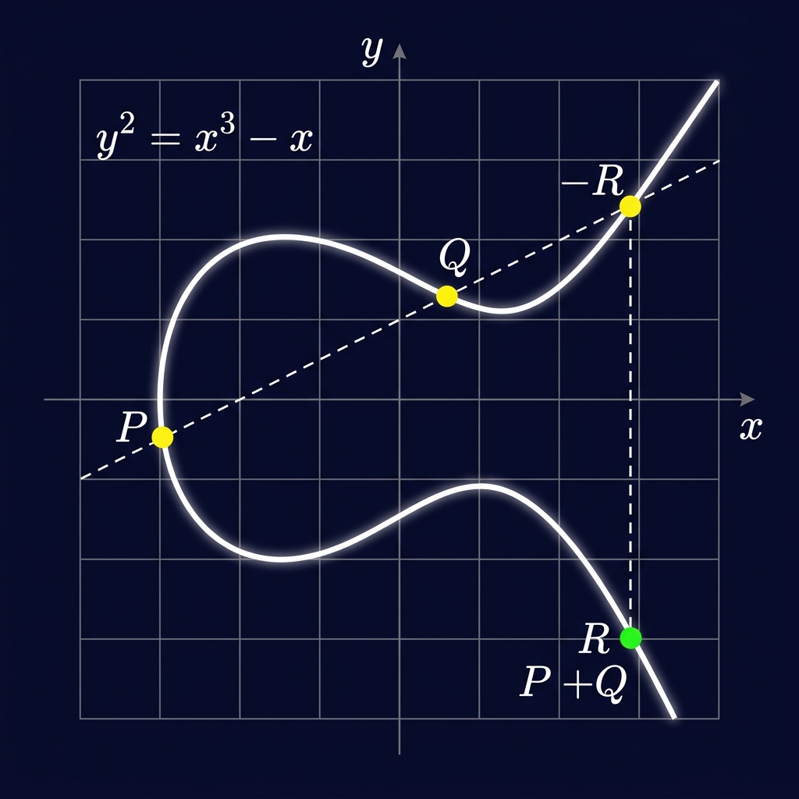
08 Geometric Addition — The 5 Fundamental Rules
Chord-and-Tangent Law: If 3 points lie on a straight line, P + Q + R = O
Rule 1: Identity Element
O serves as additive identity: P + O = P. By definition, O = -O.
Rule 2: Point Negation
Negative of P=(x,y) is -P=(x,-y). Vertical line joins them. P + (-P) = O.
Rule 3: Distinct Points (P ≠ Q)
Draw secant line through P and Q. Third intersection is R. Sum P + Q = -R (reflect R across x-axis).
Rule 4: Vertical Line Case
Two points with same x-coord (P and -P) lie on a vertical line intersecting at O. P + (-P) = O.
Rule 5: Point Doubling (2Q)
Draw tangent line at Q. It intersects curve at S. Doubled point 2Q = Q + Q = -S.
Secant Line Construction for P + Q = -R
Elliptic Curve Arithmetic | Presented by: Guru Prakash A (II-MCA, Reg No: 25322011) | William Stallings Ch. 10

Slide 9
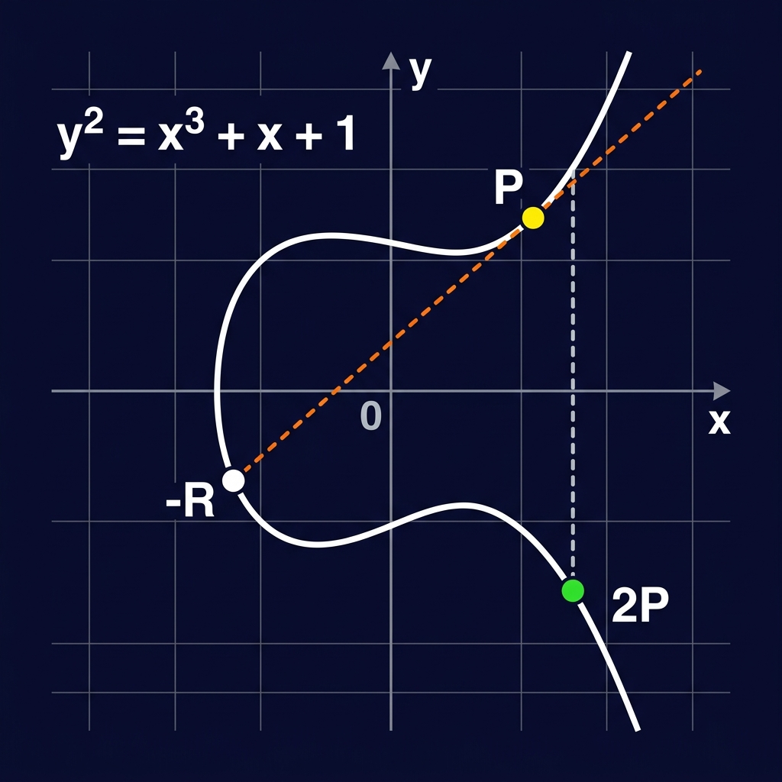
09 Point Doubling — Tangent Construction 2P
Adding a point to itself via tangent slope (Stallings Sec 10.3)
Tangent Line Construction
• Secant turns into Tangent: As point Q approaches P along the curve, the secant line approaches the tangent line to the curve at P.
• Slope via Implicit Derivative: Differentiating y² = x³ + ax + b yields 2y(dy/dx) = 3x² + a, so tangent slope λ = (3x_P² + a) / (2y_P).
• Second Intersection Point S: The tangent line intersects the cubic curve at exactly one second point S.
• Reflection across x-axis: The reflection of S across the x-axis gives the doubled point: 2P = -S.
• Vertical Tangent Case: If y_P = 0, the tangent line is vertical, meaning it intersects only at infinity: 2P = O.
Tangent Line Construction for Point Doubling 2P = -S
Elliptic Curve Arithmetic | Presented by: Guru Prakash A (II-MCA, Reg No: 25322011) | William Stallings Ch. 10

Slide 10
10 Algebraic Formulas over Real Numbers R
Converting geometric secants and tangents to closed-form equations
Point Addition (P ≠ Q)
Secant Slope λ:
λ = (y_Q - y_P) / (x_Q - x_P)
Intersection Coordinate x_R:
x_R = λ² - x_P - x_Q
Reflected Coordinate y_R:
y_R = λ(x_P - x_R) - y_P
Vertical Condition:
If x_P = x_Q and y_P = -y_Q, then P + Q = O.
Point Doubling (2P = P + P)
Tangent Slope λ (via dy/dx):
λ = (3x_P² + a) / (2y_P)
Intersection Coordinate x_R:
x_R = λ² - 2x_P
Reflected Coordinate y_R:
y_R = λ(x_P - x_R) - y_P
Vertical Condition:
If y_P = 0, tangent is vertical, so 2P = O.
Elliptic Curve Arithmetic | Presented by: Guru Prakash A (II-MCA, Reg No: 25322011) | William Stallings Ch. 10

Slide 11
11 Two Cryptographic Families — Z_p vs GF(2^m)
Finite fields eliminate floating-point rounding errors (Stallings Sec 10.3)
1. Prime Curves over Z_p
• Field Elements: Restricted to integers {0, 1, ..., p-1} modulo a large prime p.
• Curve Equation: y² ≡ x³ + ax + b (mod p).
• Non-Singularity: (4a³ + 27b²) mod p ≠ 0.
• Ideal for Software: Standard microprocessors (Intel, ARM, AMD) have optimized 64-bit integer ALUs that compute modular operations with maximum efficiency.
• No Bit-Level Overhead: Does NOT require complex polynomial carry manipulation.
2. Binary Curves over GF(2^m)
• Field Elements: Polynomials with binary coefficients {0, 1} of degree < m.
• Curve Equation: y² + xy = x³ + ax² + b.
• Non-Singularity: b ≠ 0 (ensures curve is non-singular).
• Ideal for Hardware: Addition in GF(2^m) is simple bitwise XOR without any carry propagation delays!
• Ultra-Compact Silicon: Requires very few logic gates, making it the premier choice for smart cards, ASICs, and FPGAs.
Elliptic Curve Arithmetic | Presented by: Guru Prakash A (II-MCA, Reg No: 25322011) | William Stallings Ch. 10

Slide 12
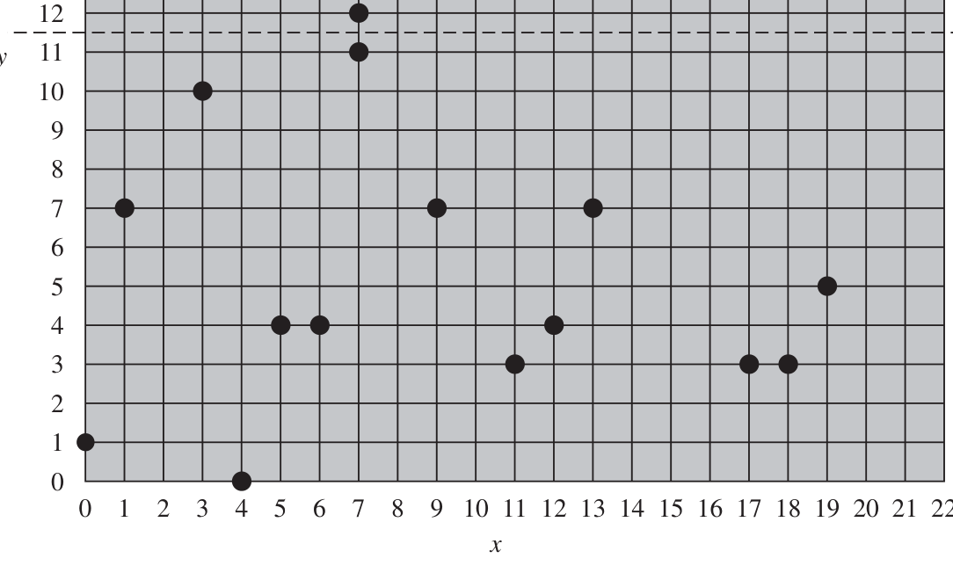
12 Elliptic Curves over Prime Field Z_p
Set of points E_p(a, b) and Hasse's Theorem (Stallings Section 10.3)
Definition & Group Size Bounds
• Modular Equation: y² mod p = (x³ + ax + b) mod p, where a, b ∈ Z_p.
• Non-Singularity: (4a³ + 27b²) mod p ≠ 0.
• Hasse's Theorem (Stallings p. 8): The number of points N on E_p(a, b) satisfies:
p + 1 - 2√p ≤ N ≤ p + 1 + 2√p
• Worked Count for p = 23: For E₂₃(1, 1), Hasse's theorem bounds N between 15 and 33. The actual count is N = 28 (27 points from Table 10.1 plus O).
• Symmetry Property: Symmetric about the horizontal line y = p / 2 = 11.5.
Stallings Fig 10.5 — Scatter Plot of E₂₃(1, 1) Points (Symmetric about y=11.5)
Elliptic Curve Arithmetic | Presented by: Guru Prakash A (II-MCA, Reg No: 25322011) | William Stallings Ch. 10

Slide 13
13 Arithmetic Rules & Slope Formulas over Z_p
The 4 formal rules for E_p(a, b) (Stallings p. 7-8)
Rule 1: Additive Identity
P + O = P for all points P on the curve. Point O is its own inverse: O = -O.
Rule 2: Point Negation
If P = (x_P, y_P), -P = (x_P, -y_P mod p) = (x_P, p - y_P). P + (-P) = O.
Example on E₂₃(1, 1): P = (13, 7) gives -P = (13, 23 - 7) = (13, 16) ∈ E₂₃(1, 1).
Rule 3: Point Addition (P ≠ Q)
λ = [(y_Q - y_P) × (x_Q - x_P)^{-1}] mod p
x_R = (λ² - x_P - x_Q) mod p
y_R = [λ(x_P - x_R) - y_P] mod p
Rule 4: Point Doubling (P = Q)
λ = [(3x_P² + a) × (2y_P)^{-1}] mod p
x_R = (λ² - 2x_P) mod p
y_R = [λ(x_P - x_R) - y_P] mod p
Elliptic Curve Arithmetic | Presented by: Guru Prakash A (II-MCA, Reg No: 25322011) | William Stallings Ch. 10

Slide 14
14 Worked Numerical Example 1 — Point Addition P + Q
Evaluated on curve E₂₃(1, 1): y² ≡ x³ + x + 1 (mod 23)
Step 1: Compute Slope λ
Points on Curve E₂₃(1, 1):
P = (3, 10), Q = (9, 7)
Secant Slope Formula:
λ = (y_Q - y_P) / (x_Q - x_P) mod 23
Coordinate Substitution:
λ = (7 - 10) / (9 - 3) = -3 / 6
Numerator & Denom:
λ = -1 / 2 ≡ -3 × 6⁻¹ mod 23
Step 2: Modular Inverse
Extended Euclidean Algorithm:
Need 6⁻¹ mod 23: 6 × 4 = 24 ≡ 1
Inverse Value Found:
6⁻¹ ≡ 4 (mod 23)
Multiply by Inverse:
λ = (-3) × 4 = -12 mod 23
Positive Slope Result:
λ = 23 - 12 = 11 (mod 23) ✔
Step 3: Point Coordinates
Compute x_R Coordinate:
x_R = (11² - 3 - 9) mod 23 = 17
Compute y_R Coordinate:
y_R = [11(3 - 17) - 10] = 20
Point Addition Result:
P + Q = (17, 20) ∈ E₂₃(1, 1) ✔
Table 10.1 Confirmation:
Point verified in Stallings book
Verification: LHS = 20² mod 23 = 400 mod 23 = 9. RHS = (17³ + 17 + 1) mod 23 = 4931 mod 23 = 9. LHS = RHS = 9 ✔
Elliptic Curve Arithmetic | Presented by: Guru Prakash A (II-MCA, Reg No: 25322011) | William Stallings Ch. 10

Slide 15
15 Worked Numerical Example 2 — Point Doubling 2P
Evaluated on curve E₂₃(1, 1): y² ≡ x³ + x + 1 (mod 23)
Step 1: Compute Tangent Slope λ
Point on Curve E₂₃(1, 1):
P = (3, 10), so x_P = 3, y_P = 10
Tangent Slope Formula:
λ = (3x_P² + a) / (2y_P) mod 23
Coordinate Substitution:
λ = (3(3²) + 1) / (2 × 10) mod 23
Numerator & Denom:
λ = (27 + 1) / 20 = 28 / 20 mod 23
Step 2: Modular Inverse
Modulo Reduction:
28 mod 23 = 5 => λ = 5/20 = 1/4
Inverse Value Found:
4 × 6 = 24 ≡ 1 => 4⁻¹ ≡ 6 (mod 23)
Multiply by Inverse:
λ = 1 × 6 ≡ 6 (mod 23) ✔
Alternative Check:
20⁻¹ ≡ 15 => 28 × 15 = 420 ≡ 6
Step 3: Point Coordinates
Compute x_R Coordinate:
x_R = (6² - 2(3)) mod 23 = 7
Compute y_R Coordinate:
y_R = [6(3 - 7) - 10] = 12
Point Doubling Result:
2P = (7, 12) ∈ E₂₃(1, 1) ✔
Table 10.1 Confirmation:
Point verified in Stallings book
Verification: LHS = 12² mod 23 = 144 mod 23 = 6. RHS = (7³ + 7 + 1) mod 23 = 351 mod 23 = 6. LHS = RHS = 6 ✔
Elliptic Curve Arithmetic | Presented by: Guru Prakash A (II-MCA, Reg No: 25322011) | William Stallings Ch. 10

Slide 16
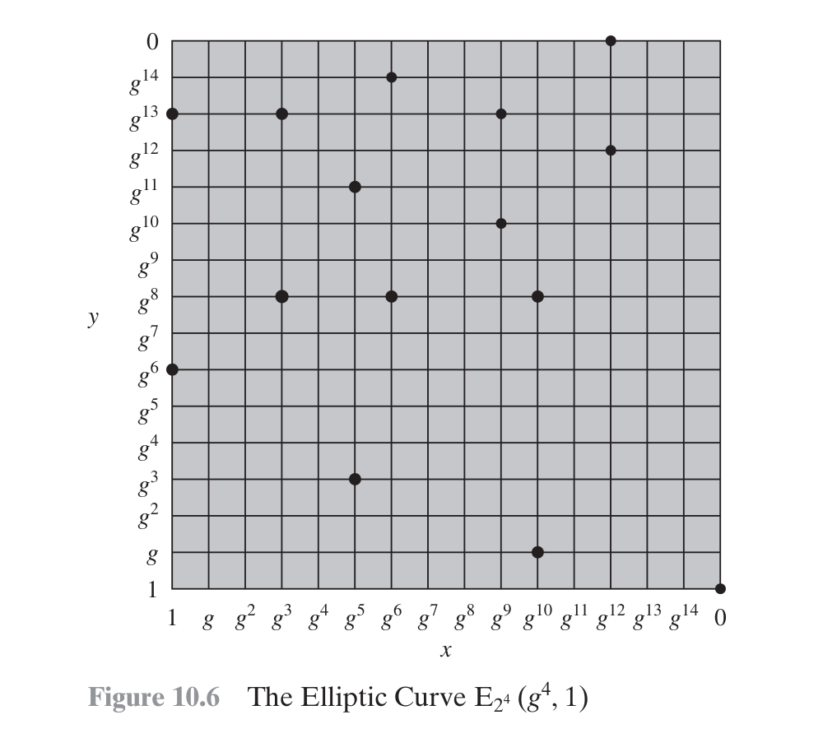
16 Elliptic Curves over Binary Fields GF(2^m)
Polynomial representation in characteristic 2 (Stallings Section 10.3)
Binary Curve Equation
y² + xy = x³ + ax² + b
• Non-Singularity Condition: b ≠ 0 (guarantees no singular points or cusps).
• Concrete Galois Field: GF(2^4) with irreducible reduction polynomial f(x) = x⁴ + x + 1.
• Generator Root g: Satisfies f(g) = 0 => g⁴ = g + 1 = 0011₂ in standard bit representation.
• Book Curve E_{2^4}(g⁴, 1): Parameters: a = g⁴, b = 1.
• Worked Verification for (g⁵, g³): LHS = (g³)² + (g⁵)(g³) = g⁶ + g⁸ = 1100₂ ⊕ 0101₂ = 1001₂.
RHS = (g⁵)³ + g⁴(g⁵)² + 1 = g¹⁵ + g¹⁴ + 1 = 0001₂ ⊕ 1001₂ ⊕ 0001₂ = 1001₂.
LHS = RHS = 1001₂ ✔ Point verified on the curve!
Stallings Fig 10.6 — The Elliptic Curve E_{2^4}(g^4, 1) (16 Points)
Elliptic Curve Arithmetic | Presented by: Guru Prakash A (II-MCA, Reg No: 25322011) | William Stallings Ch. 10

Slide 17
17 Arithmetic Rules & Slope Formulas over GF(2^m)
The 4 addition rules for E_{2^m}(a, b) (Stallings p. 9-10)
Rule 1: Identity Element
P + O = P for all points P in E_{2^m}(a, b).
Rule 2: Point Negation in Char 2
If P = (x_P, y_P), -P = (x_P, x_P + y_P). P + (x_P, x_P + y_P) = O.
Crucial distinction: In characteristic 2, +1 = -1, so negation is (x_P, x_P + y_P), NOT (x, -y)!
Rule 3: Point Addition (P ≠ Q)
λ = (y_Q + y_P) / (x_Q + x_P)
x_R = λ² + λ + x_P + x_Q + a
y_R = λ(x_P + x_R) + x_R + y_P
Rule 4: Point Doubling (P = Q)
Tangent Slope λ = x_P + (y_P / x_P)
x_R = λ² + λ + a
y_R = x_P² + (λ + 1)x_R
Elliptic Curve Arithmetic | Presented by: Guru Prakash A (II-MCA, Reg No: 25322011) | William Stallings Ch. 10

Slide 18
18 Master Comparison — Z_p vs. GF(2^m)
Side-by-side feature and formula matrix (Stallings Table 10.1 & 10.2)
Feature / Property | Prime Curves Z_p | Binary Curves GF(2^m)
Field Elements | Integers {0, 1, ..., p-1} | Polynomials in {0,1} of degree < m
Curve Equation | y² ≡ x³ + ax + b (mod p) | y² + xy = x³ + ax² + b
Non-Singularity | (4a³ + 27b²) mod p ≠ 0 | b ≠ 0
Point Negation -P | (x_P, p - y_P) | (x_P, x_P + y_P)
Addition Slope λ | [(y_Q - y_P)/(x_Q - x_P)] mod p | (y_Q + y_P)/(x_Q + x_P)
Doubling Slope λ | [(3x_P² + a)/(2y_P)] mod p | x_P + (y_P / x_P)
Addition x_R | (λ² - x_P - x_Q) mod p | λ² + λ + x_P + x_Q + a
Doubling x_R | (λ² - 2x_P) mod p | λ² + λ + a
Primary Target | Software Implementations (CPUs) | Hardware Logic Gates (ASICs, Smart Cards)
Elliptic Curve Arithmetic | Presented by: Guru Prakash A (II-MCA, Reg No: 25322011) | William Stallings Ch. 10

Slide 19
19 Scalar Multiplication & Double-and-Add Algorithm
Computing kP = P + P + ... + P efficiently in O(log k) steps
Algorithm Comparison
• Naïve Method: Add point P to itself (k - 1) times. For 256-bit keys, performing k ≈ 2^{256} point additions is physically impossible!
• Double-and-Add Method: Scan bits of multiplier k from MSB to LSB. For every bit, double the accumulator. If bit = 1, add P.
• Logarithmic Complexity: Requires only ~256 point doublings and ~128 point additions (approx. 384 operations total instead of 2^{256}!).
• Constant-Time Mitigation: Montgomery Ladder execution pattern protects against side-channel timing analysis attacks.
Worked Example: 21P (21 = 10101₂)
Bit Scanned | Operation Performed | Accumulator State
Bit 1 (MSB) | Initialize | P
Bit 0 | Double | 2P
Bit 1 | Double + Add P | 4P + P = 5P
Bit 0 | Double | 10P
Bit 1 (LSB) | Double + Add P | 20P + P = 21P ✔
Efficiency: Only 4 Doublings + 2 Additions (6 total operations) instead of 20 additions! Yields a 70% computational savings.
Elliptic Curve Arithmetic | Presented by: Guru Prakash A (II-MCA, Reg No: 25322011) | William Stallings Ch. 10

Slide 20
20 Summary & Conclusion
Key Takeaways from Chapter 10
✔ 1. Unrivaled Efficiency: ECC achieves 128-bit commercial security with just 256 bits compared to 3072 bits in RSA (12× smaller key size).
✔ 2. Rigorous Group Theory: Point addition forms an Abelian group satisfying Closure, Associativity, Identity (O), Inverse (-P), and Commutativity.
✔ 3. Dual Finite Field Architectures: Prime curves over Z_p target software ALUs on general CPUs; Binary curves over GF(2^m) target logic gates in ASICs & smart cards.
✔ 4. Precise Discrete Formulas: Slope and coordinate formulas for secant addition and tangent doubling eliminate all floating-point rounding errors.
✔ 5. The ECDLP Trapdoor: Scalar multiplication Q = kP is efficiently computed in O(log k) steps via Double-and-Add, while computing k given Q and P is intractable.
✔ 6. The Gold Standard for Modern Cryptography: Absence of sub-exponential index calculus algorithms ensures ECC remains the cornerstone of modern network protocols (TLS 1.3, SSH, IPsec).
Thank You! Questions & Discussion
Reference: Cryptography and Network Security — William Stallings (Chapter 10)
Elliptic Curve Arithmetic | Presented by: Guru Prakash A (II-MCA, Reg No: 25322011) | William Stallings Ch. 10

