Slide 1
Autonomous Data Warehouse agents

Slide 2
Enterprises manage large volumes of data distributed across cloud platforms, databases, and business applications. Although enterprise data catalogs provide metadata management, data discovery, and lineage capabilities, several challenges remain:
Data discovery: Finding relevant, trusted data products requires knowledge of technical metadata and business terminology.
Impact analysis: Understanding the downstream consequences of schema changes can be time-consuming.
Schema drift: Changes between registered and incoming schemas require identification, assessment, and governance approval.
Disconnected workflows: Users often need to perform these activities separately and manually combine the results.
Problem Statement

Slide 3
Solution
Build an intelligent, agentic metadata assistant that automates these workflows, enables collaboration between specialized AI agents, and maintains human control over catalog modifications.
Benefit
Build an intelligent, agentic metadata assistant that automates these workflows, enables collaboration between specialized AI agents, and maintains human control over catalog modifications.
Potential benefits include reduced manual analysis, faster identification of relevant data products, improved change-impact visibility, and stronger governance through human approval.

Slide 4
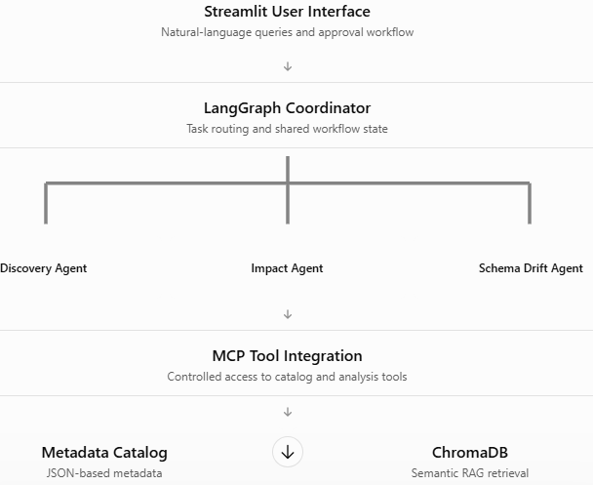
The solution demonstrates how AI agents can augment existing enterprise catalogs such as Informatica EDC or Google Cloud's metadata catalog capabilities, rather than replace them.
Tech stack: LangGraph, MCP, ChromaDB
Implementation
Technology Architecture

Slide 5
Agent Orchestration
Agents do not communicate directly over a messaging protocol. Instead, the Coordinator passes their findings through LangGraph's shared execution state. The output of one agent becomes contextual input to the next.
The Streamlit interface displays the execution plan, agent handoffs, MCP tool calls, and execution times.
Architectural distinction: The Coordinator uses deterministic keyword-based routing, while specialist agents use LLM-powered reasoning. This provides predictable orchestration and an auditable handoff sequence.

Slide 6
Memory Management
Our implementation primarily uses short-term conversational memory and workflow-scoped shared state
Short-term memory - LangGraph InMemorySaver - Maintains conversational context for each specialist agent
Shared workflow state - LangGraph StateGraph - Transfers findings between agents during execution
Persistent user preferences and past decisions are not stored

Slide 7
Guardrails
Tool-level restrictions: Agents receive only the MCP tools required for their permitted operations. The resolve_schema_change tool is excluded from the LLM-accessible tool list.
Role-specific instructions: Discovery, Impact, and Schema Drift agents have specialized prompts describing their responsibilities.
Human approval: Schema Drift can propose changes, but catalog modifications require a separate approval action.
The current Streamlit reviewer-name field is demonstration-only and is not a production authentication mechanism.
Forbidden SQL operations: Blocks DROP, DELETE, UPDATE, ALTER, TRUNCATE, and other restricted operations.

Slide 8
Future enhancement
Add persistent, user-scoped memory for preferences and previous decisions, with appropriate access controls.
Integrate the agents with Enterprise data catalog tool like Dataplex universal catalog on Google Cloud Platform.
Integrate with IAM roles for Authorization

Slide 9
Q&A

Slide 10
Thank You

