Slide 1


covid-19 using cognos
The project involves analyzing covid-19 cases and deaths using IBM COgnos

Slide 2
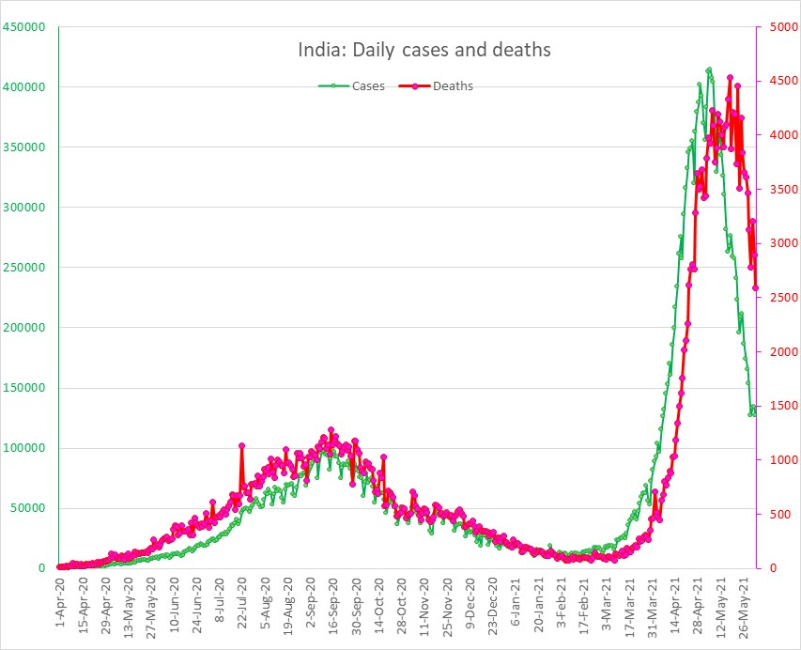
Covid-19 cases analysis:
1.Overall cases Trend:
Analyze the trend of COVID-19 cases over time, highlighting peaks, troughs, and any patterns.
2. Geographical Distribution:
Explore how cases are distributed across different regions, countries, or continents.
3. Demographics and Age Groups:
Break down cases by age groups to understand the impact on different demographics.
4.Testing and Positivity Rate:
Discuss testing efforts and how they correlate with the number of positive cases.

Slide 3
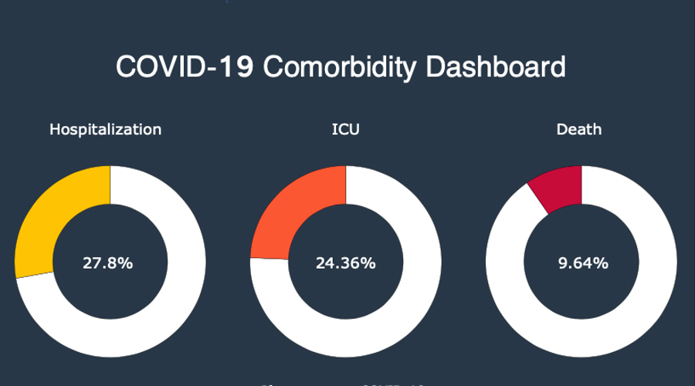
COVID-19 Deaths Analysis:
Death Rate Trend:
Analyze the trend of COVID-19 death rates over time and identify any variations.
2. Comorbidity Factors:
Investigate underlying health conditions and how they influence mortality rates.
3.Age and Mortality:
Examine how age affects the mortality rate and the vulnerability of different age groups
4.Healthcare System Impact:
Discuss how the capacity and efficiency of the healthcare system correlate with the number of COVID-19 deaths.

Slide 4
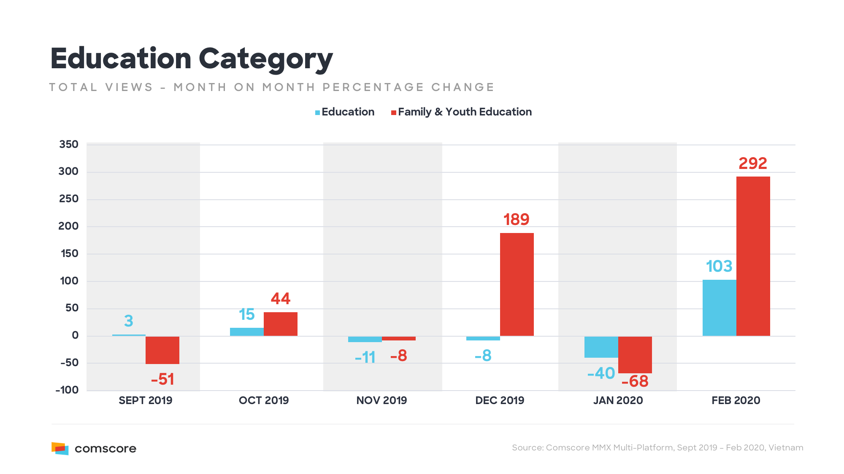
Education:
1.Shift to Remote Learning: - The closure of schools and universities led to a rapid shift to online and remote learning. Educational institutions had to adapt quickly to deliver lessons and coursework through digital platforms.
2. Disruption in Academic Calendar: - School closures disrupted academic calendars, affecting examination schedules, graduations, and overall progress for students.
3. Impact on Practical Learning: - Fields that require hands-on experience, such as laboratory work or vocational training, were significantly impacted, posing challenges for students in those disciplines.

Slide 5
conclusion:
understanding the patterns, demographics, and impacts on both cases and deaths is vital for effective pandemic management, response strategies, and healthcare resource allocation. Tailored measures considering these factors are essential to mitigate the spread of COVID-19 and reduce its associated mortality.

