Slide 1
DART Analytics Report
Generated on November 05, 2025 at 11:54 AM
Total Charts: 1

Slide 2
Executive Summary
Key Findings:
• Total Charts Analyzed: 1
• Charts with Recent Anomalies: 1
• Total Anomalies Detected: 17
• Recent Anomalies (Last Half): 8
Charts are ordered by recent anomaly count (highest first) for priority review.

Slide 3
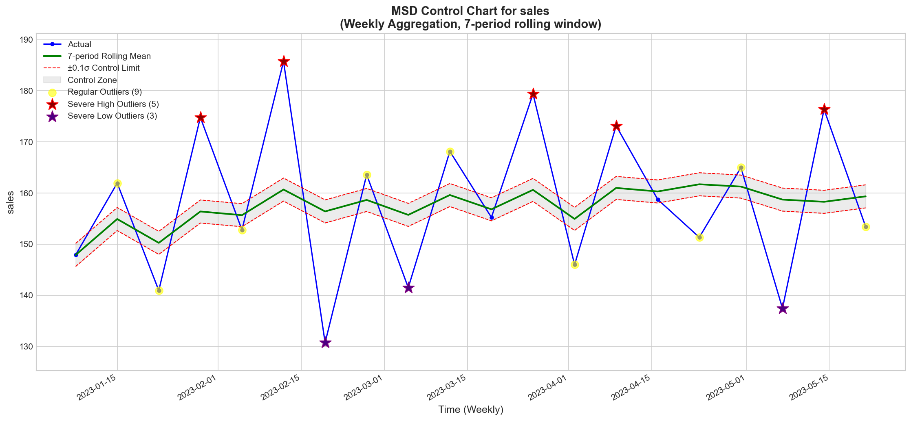
1. Chart for sales
High Priority Chart
Statistics:
Data Points: 20 | Total Outliers: 17 | Recent Outliers: 8 | Zero Values: 0 (0.0%)
Mean: 158.215 | Std Dev: 15.128 | Min: 130.750 | Max: 185.750
Note: Charts are prioritized by recent anomaly count.

