Slide 1
Hackathon Project Presentation
Smart Parking System | CodeX

Slide 2
Problem & Solution
Problem: Parking congestion in urban areas leads to time wastage, fuel consumption, and frustration due to the lack of real-time slot availability. This IoT-based Smart Parking System uses ultrasonic sensors, LEDs, an LCD, and a buzzer to detect and display parking slot occupancy, improving efficiency and reducing traffic congestion.
Importance: With 30% of urban traffic caused by drivers searching for parking and wasting up to 20 minutes per trip, inefficient parking leads to congestion, fuel waste, and pollution. This Smart Parking System optimizes space usage, reduces search time, and enhances urban mobility, making cities more efficient and eco-friendly.
Solution: This IoT-based Smart Parking System uses ultrasonic sensors to detect real-time slot occupancy, LEDs for visual indication, and an LCD display for live updates, ensuring seamless parking management. A buzzer alerts when parking is full, reducing search time, congestion, and fuel wastage, making urban parking smarter and more efficient.

Slide 3
Technology & Implementation
Tech Stack: Tech Stack for Smart Parking System
Hardware: Arduino Uno, Ultrasonic Sensors (HC-SR04), LEDs, LCD (I2C 16x2), Buzzer Programming Language: C++ (Arduino IDE) Libraries & Frameworks: Wire.h, LiquidCrystal_I2C.h Simulation & Prototyping: Tinkercad (for virtual circuit testing)
System Architecture:
1. Overview of Components :
Ultrasonic Sensors (HC-SR04): Detects vehicle presence in each parking slot.
Arduino Uno: Processes sensor data and controls LEDs, LCD, and buzzer.
LED Indicators: Displays real-time slot availability
LCD Display (16x2, I2C): Shows parking status updates.
Buzzer: Alerts when all slots are occupied.

Slide 4
Technology & Implementation
2. Data Flow:
Ultrasonic sensors measure distance → Detects vehicle presence.
Arduino processes sensor data → Determines slot availability.
LEDs update status → Green (available), Red (occupied).
LCD displays real-time parking info.
Buzzer activates if parking is full.
Key Features:
Real-Time Parking Detection – Ultrasonic sensors monitor slot occupancy dynamically.
LED Indicators – Green (Available), Red (Occupied) for quick visual status.
Live LCD Display – Shows parking slot availability updates.
Buzzer Alert – Sounds when all slots are occupied.
Automated & Efficient – Reduces search time, congestion, and fuel wastage.

Slide 5
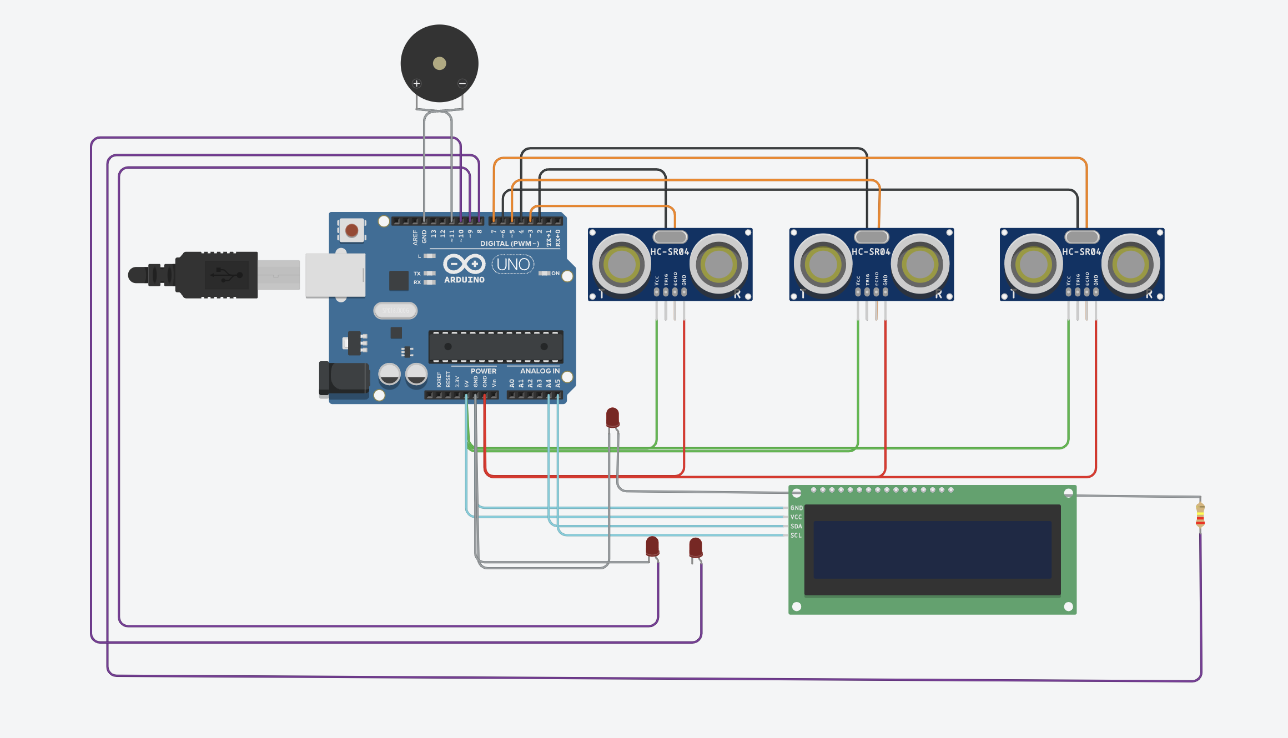
Demo & Features
Fig. Circuit Diagram

Slide 6
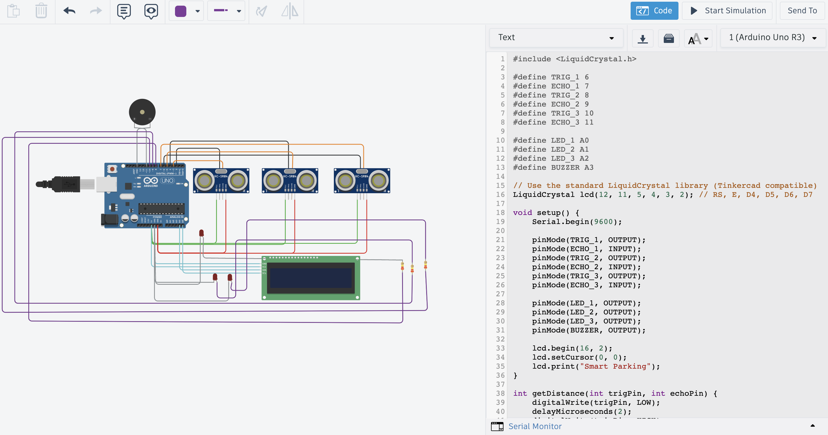
Demo & Features
Fig. Virtual Stimulation

Slide 7
Demo & Features
Key functionalities and user experience highlights
Automated Slot Detection: Ultrasonic sensors accurately detect vehicle presence in each parking slot.
Instant Availability Updates: LED indicators (Green = Available, Red = Occupied) provide a quick visual status.
Live LCD Display: Shows real-time parking slot availability, ensuring seamless user interaction.
Buzzer Alert System: Notifies users when the parking lot is full, preventing unnecessary entry.
Efficient & User-Friendly: Reduces parking search time, minimizes traffic congestion, and enhances the overall parking experience.

Slide 8
Demo & Features
Unique aspects that differentiate our solution
1. Multi-Sensor Accuracy: Uses three ultrasonic sensors for precise real-time parking slot detection.
2. Automated Visual & Audio Alerts: Combines LED indicators, LCD display, and a buzzer for instant user feedback.
3. Seamless IoT Integration: Can be scaled to connect with a mobile app for remote monitoring.
4. Energy-Efficient Design: Uses low-power components to ensure sustainability.
5. Cost-Effective & Easy to Implement: Simple Arduino-based solution with minimal hardware requirements.

Slide 9
Challenges & Future Scope
Challenges Faced
Sensor Accuracy & Interference – Ultrasonic sensors can misread distances due to obstacles or environmental factors.
Hardware Limitations – Arduino Uno has limited GPIO pins, restricting large-scale implementations.
Power Management – Ensuring low-power consumption while running multiple sensors and components.
Real-Time Data Processing – Optimizing code for fast and accurate parking slot detection.
Lessons Learned
Optimising Sensor Placement – Proper sensor alignment is crucial for accurate readings.
Efficient Coding & Power Management – Reducing delays and optimizing power usage enhances performance.
User-Friendly Interface Matters – Clear LED and LCD indicators improve user experience.
Future Scope & Scalability
Mobile App Integration – Real-time parking status updates accessible via smartphones.
Cloud Connectivity – Storing and analyzing parking data for predictive analytics.
Automated Payment System – Integrating RFID/NFC for contactless parking fee payments.
AI-Based Smart Parking – Using machine learning to optimize space utilization and predict availability trends.

Slide 10
Conclusion & Call to Action
Why This Project is Valuable and Impactful
This Smart Parking System addresses the growing issue of urban parking congestion by providing a real-time, automated, and efficient solution. It reduces time wasted searching for parking, lowers fuel consumption, minimizes traffic congestion, and enhances user convenience. The system also promotes eco-friendly urban mobility by cutting down unnecessary emissions from idling vehicles.
Potential Impact on Users, Businesses, and Industries
Users: Saves time, reduces frustration, and provides a seamless parking experience with instant slot availability updates.
Businesses: Shopping malls, office complexes, and commercial spaces can improve parking efficiency, leading to better customer satisfaction and increased foot traffic.
Industries: Smart cities and urban planners can integrate this system into IoT-based infrastructure to optimize space utilization, reduce congestion, and improve overall traffic flow.
By leveraging IoT technology, this project contributes to smart city initiatives, improving transportation efficiency and sustainability in urban environments.

