Slide 1


AVATAR: A VARIABLE-RETENTION TIME AWARE REFRESH for DRAM
DSN-45
06/24/2015
Rio de Janeiro, Brazil
Moinuddin Qureshi, Georgia Tech
Dae-Hyun Kim
Prashant Nair
Samira Khan
Onur Mutlu

Slide 2
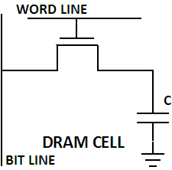
DRAM Background
Dynamic Random Access Memory (DRAM) stores data as charge on capacitor
DRAM Chip
1
Leakage
DRAM is a volatile memory → charge leaks quickly
Notes:
DRAM has been the building blocks for main memory for several decades.
in DRAM, Data is stored by placing charge on a capacitor
#@ The presence of charge in a DRAM cell represents a one and absence a zero.
Cells are further organized in rows and columns, and then banks and channels.
#@ Unfortunately, DRAM is volatile memory, which means charge leaks away quickly
When charges leak away, the value is destructed, and next request to the cell will read the wrong value.

Slide 3
DRAM Refresh
Retention Time: The time for which cell/memory retains data
DRAM maintains data by “refresh” operations at row granularity
DRAM Chip
Refresh
Refresh
Refresh
Refresh
Refresh period determined by “worst-case” cell: 64ms (JEDEC)
DRAM relies on refresh (64ms) for data integrity

Slide 4
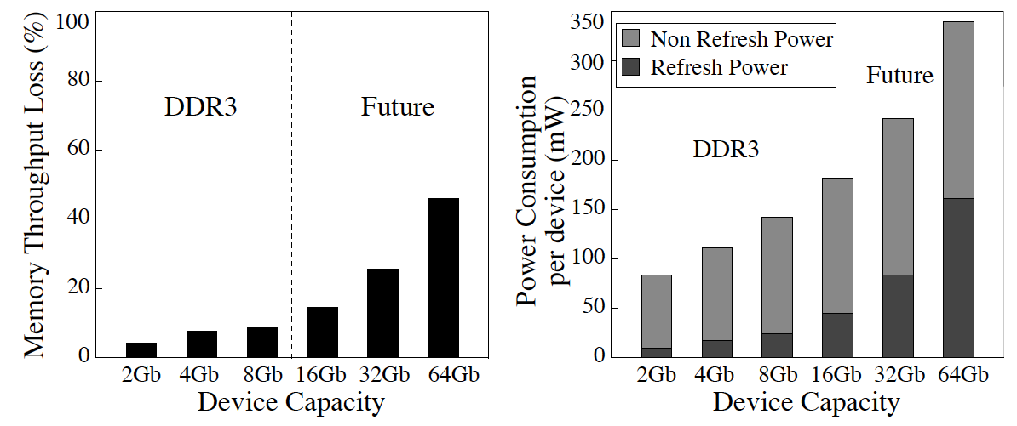
“Refresh WALL” FOR DRAM SYSTEMS
Refresh cost proportional to capacity ➔ Exponentially increasing
47%
46%
15%
8%
Refresh consumes significant time and energy
*Liu et al., “RAIDR: Retention-Aware Intelligent DRAM Refresh,” ISCA 2012.

Slide 5

NOT ALL RETENTION TIME IS CREATED EQUAL
Retention time of cells vary significantly: most cells >> 64ms
Exploit variability in retention time ➔ Multirate Refresh
Normal Refresh (64ms) & Slow Refresh (e.g. 256ms+)
Row contains a cell with retention time < period of Slow Refresh
Yes
No
Use Normal Refresh
Use Slow Refresh
Efficient DRAM refresh by exploiting variability
*Liu et al., “RAIDR: Retention-Aware Intelligent DRAM Refresh,” ISCA 2012.
Notes:
However, lowering refresh rate comes with a cost.
it introduces some bit errors, since charges in some cells are not restored timely.
And we call those errors refresh errors.
In the figure, we show the function of bit error rate to the refresh rate.
The y-axis is the bit error rate corresponding to the refresh rate in the x-axis.
All axis are in log scale.
#@ When refresh rate is 64ms, the bit error rate is 10^-9, which means one of the billion bits will have refresh errors.
These errors are fixed at the testing phase by using spare rows and columns.
If we keep lowering refresh rate, the bit error rate increases pretty fast.
#@ When refresh rate is 1s, the bit error rate is in the range between 10^-4 and 10^-5.
At this scale, the refresh errors cannot be mitigated by the spare rows, due to the expensive cost of spare rows.
#@ Thus, lowering refresh rate saves energy, but introduces bit errors.
What can we do about it?
Is there anyway we can tolerate those errors?

Slide 6
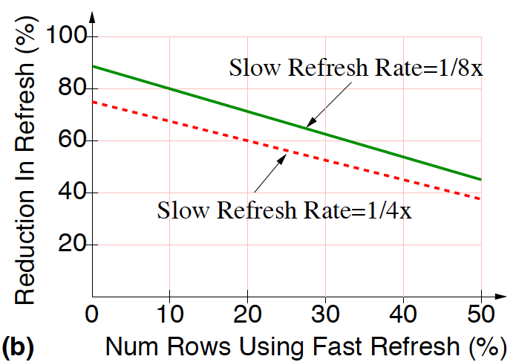
MULTI RATE REFRESH: DESIGN & EFFECTIVENESS
DRAM Rows
Ref. Rate Table
A
0
B
Weak Cell
0
C
1
D
RETENTION
PROFILING
0
E
0
F
0
G
1
H
0
0: Slow Refresh
1: Normal Refresh
Multi rate refresh can reduce refresh by 70%+
Notes:
However, lowering refresh rate comes with a cost.
it introduces some bit errors, since charges in some cells are not restored timely.
And we call those errors refresh errors.
In the figure, we show the function of bit error rate to the refresh rate.
The y-axis is the bit error rate corresponding to the refresh rate in the x-axis.
All axis are in log scale.
#@ When refresh rate is 64ms, the bit error rate is 10^-9, which means one of the billion bits will have refresh errors.
These errors are fixed at the testing phase by using spare rows and columns.
If we keep lowering refresh rate, the bit error rate increases pretty fast.
#@ When refresh rate is 1s, the bit error rate is in the range between 10^-4 and 10^-5.
At this scale, the refresh errors cannot be mitigated by the spare rows, due to the expensive cost of spare rows.
#@ Thus, lowering refresh rate saves energy, but introduces bit errors.
What can we do about it?
Is there anyway we can tolerate those errors?

Slide 7

VARIABLE RETENTION TIME (VRT): The NEMESIS
Multirate refresh relies on retention time to remain unchanged
Retention time can vary at runtime due to VRT
DRAM Rows
Ref. Rate Table
A
0
B
Weak Cell
0
C
1
D
RETENTION
PROFILING
0
E
0
data error
at runtime
F
0
G
1
H
0
VRT renders multi-rate refresh unusable in practice

Slide 8
GOALS
VRT considered one of the biggest impediment to DRAM scaling
-- [Samung & Intel, Memory Forum 2014]
Our study investigates the following questions:
Can we analyze VRT using architecture level models?
Can we overcome VRT simply by using ECC DIMM?
If not, what is a low cost solution to mitigate VRT?
Notes:
However, lowering refresh rate comes with a cost.
it introduces some bit errors, since charges in some cells are not restored timely.
And we call those errors refresh errors.
In the figure, we show the function of bit error rate to the refresh rate.
The y-axis is the bit error rate corresponding to the refresh rate in the x-axis.
All axis are in log scale.
#@ When refresh rate is 64ms, the bit error rate is 10^-9, which means one of the billion bits will have refresh errors.
These errors are fixed at the testing phase by using spare rows and columns.
If we keep lowering refresh rate, the bit error rate increases pretty fast.
#@ When refresh rate is 1s, the bit error rate is in the range between 10^-4 and 10^-5.
At this scale, the refresh errors cannot be mitigated by the spare rows, due to the expensive cost of spare rows.
#@ Thus, lowering refresh rate saves energy, but introduces bit errors.
What can we do about it?
Is there anyway we can tolerate those errors?

Slide 9
OUTLINE
Background
VRT: mechanism, measurement, model
Can’t we fix VRT by simply using ECC DIMM?
AVATAR
Results
Summary
Notes:
However, lowering refresh rate comes with a cost.
it introduces some bit errors, since charges in some cells are not restored timely.
And we call those errors refresh errors.
In the figure, we show the function of bit error rate to the refresh rate.
The y-axis is the bit error rate corresponding to the refresh rate in the x-axis.
All axis are in log scale.
#@ When refresh rate is 64ms, the bit error rate is 10^-9, which means one of the billion bits will have refresh errors.
These errors are fixed at the testing phase by using spare rows and columns.
If we keep lowering refresh rate, the bit error rate increases pretty fast.
#@ When refresh rate is 1s, the bit error rate is in the range between 10^-4 and 10^-5.
At this scale, the refresh errors cannot be mitigated by the spare rows, due to the expensive cost of spare rows.
#@ Thus, lowering refresh rate saves energy, but introduces bit errors.
What can we do about it?
Is there anyway we can tolerate those errors?

Slide 10
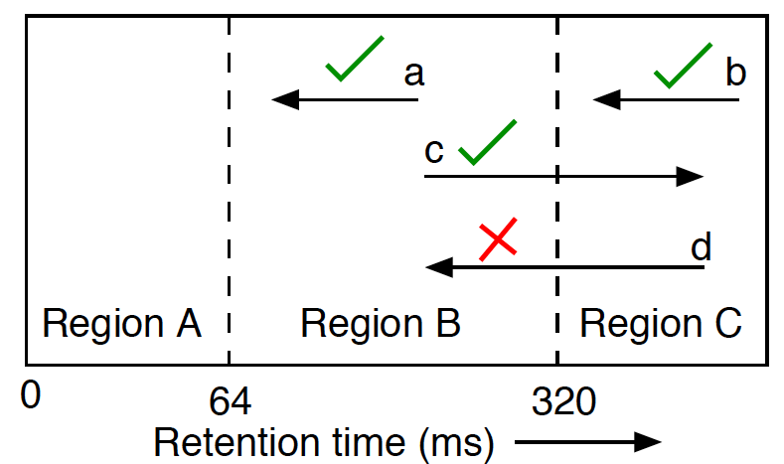
WHY DOES VRT OCCUR? WHEN IS IT HARMFUL?
VRT caused by fluctuations in Gate Induced Drain Leakage.
External factors: mechanical stress, high temperature etc.
Not all VRT is harmful
FAULTY CELL
WEAK CELL
STRONG CELL
VRT problematic when strong cell becomes weak
Notes:
However, lowering refresh rate comes with a cost.
it introduces some bit errors, since charges in some cells are not restored timely.
And we call those errors refresh errors.
In the figure, we show the function of bit error rate to the refresh rate.
The y-axis is the bit error rate corresponding to the refresh rate in the x-axis.
All axis are in log scale.
#@ When refresh rate is 64ms, the bit error rate is 10^-9, which means one of the billion bits will have refresh errors.
These errors are fixed at the testing phase by using spare rows and columns.
If we keep lowering refresh rate, the bit error rate increases pretty fast.
#@ When refresh rate is 1s, the bit error rate is in the range between 10^-4 and 10^-5.
At this scale, the refresh errors cannot be mitigated by the spare rows, due to the expensive cost of spare rows.
#@ Thus, lowering refresh rate saves energy, but introduces bit errors.
What can we do about it?
Is there anyway we can tolerate those errors?

Slide 11
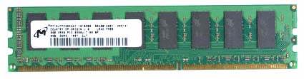
EXPERIMENTAL SETUP
Test platform: DDR3 testing platform Xilinx ML605 FPGA development board in temperature controlled setting
Slow Refresh: Studied refresh of 4s at 45C, corresponds to 328ms at 85C [khan+ SIGMETRICS’14, Liu+ ISCA’13]
Test: Write specific pattern, read pattern, log id of erroneous cell
Statistics collected every 15 minutes, over 7 days (672 rounds)
A
B
C
Three (2GB) modules, one each from different DRAM vendor
Notes:
However, lowering refresh rate comes with a cost.
it introduces some bit errors, since charges in some cells are not restored timely.
And we call those errors refresh errors.
In the figure, we show the function of bit error rate to the refresh rate.
The y-axis is the bit error rate corresponding to the refresh rate in the x-axis.
All axis are in log scale.
#@ When refresh rate is 64ms, the bit error rate is 10^-9, which means one of the billion bits will have refresh errors.
These errors are fixed at the testing phase by using spare rows and columns.
If we keep lowering refresh rate, the bit error rate increases pretty fast.
#@ When refresh rate is 1s, the bit error rate is in the range between 10^-4 and 10^-5.
At this scale, the refresh errors cannot be mitigated by the spare rows, due to the expensive cost of spare rows.
#@ Thus, lowering refresh rate saves energy, but introduces bit errors.
What can we do about it?
Is there anyway we can tolerate those errors?

Slide 12
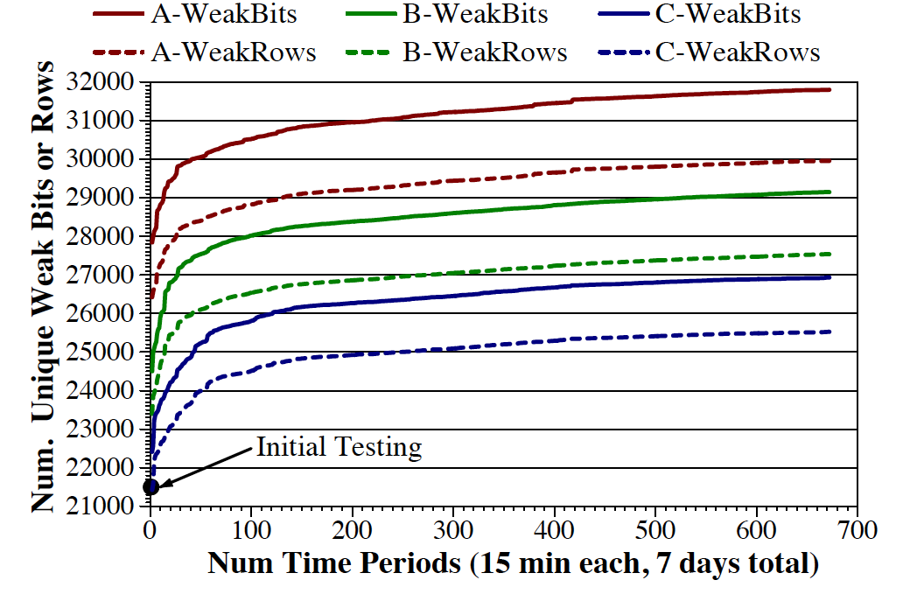
1: Population of Weak Cells Increases
Even after several days of testing, VRT causes new (previously unidentified) cells to cause failures
Notes:
However, lowering refresh rate comes with a cost.
it introduces some bit errors, since charges in some cells are not restored timely.
And we call those errors refresh errors.
In the figure, we show the function of bit error rate to the refresh rate.
The y-axis is the bit error rate corresponding to the refresh rate in the x-axis.
All axis are in log scale.
#@ When refresh rate is 64ms, the bit error rate is 10^-9, which means one of the billion bits will have refresh errors.
These errors are fixed at the testing phase by using spare rows and columns.
If we keep lowering refresh rate, the bit error rate increases pretty fast.
#@ When refresh rate is 1s, the bit error rate is in the range between 10^-4 and 10^-5.
At this scale, the refresh errors cannot be mitigated by the spare rows, due to the expensive cost of spare rows.
#@ Thus, lowering refresh rate saves energy, but introduces bit errors.
What can we do about it?
Is there anyway we can tolerate those errors?

Slide 13
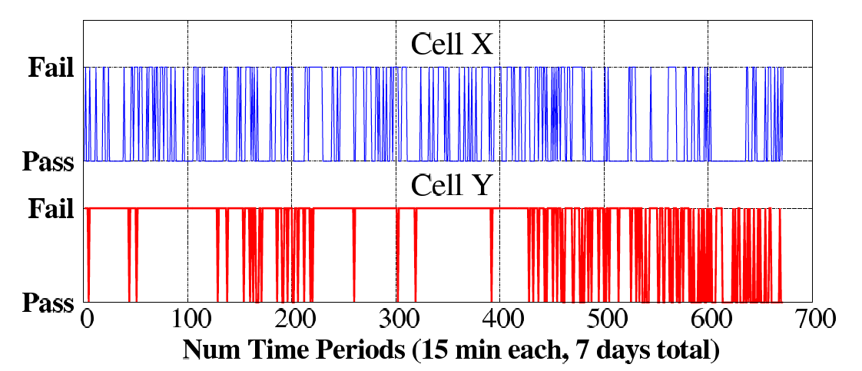
2: VRT-CELLS CAN SWITCH RANDOMLY
Cell with retention time < 328ms ➔ Weak Cell, else Strong Cell
WEAK
STRONG
WEAK
STRONG
A VRT cell can randomly and frequently transition between strong and weak states

Slide 14
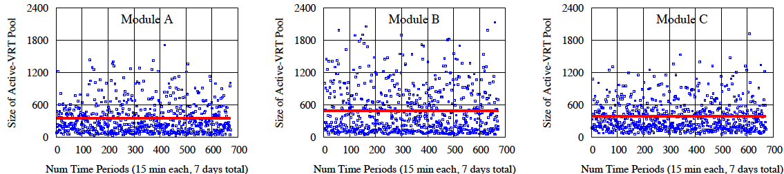
3: SIZE OF ACTIVE-VRT POOL VARIES
Active-VRT Cell: Cell that failed during the given 15-min round
Active-VRT Pool (AVP): Group of Active VRT Cells
Avg=347
Avg=492
Avg=388
The size of AVP varies dynamically for all modules
Notes:
However, lowering refresh rate comes with a cost.
it introduces some bit errors, since charges in some cells are not restored timely.
And we call those errors refresh errors.
In the figure, we show the function of bit error rate to the refresh rate.
The y-axis is the bit error rate corresponding to the refresh rate in the x-axis.
All axis are in log scale.
#@ When refresh rate is 64ms, the bit error rate is 10^-9, which means one of the billion bits will have refresh errors.
These errors are fixed at the testing phase by using spare rows and columns.
If we keep lowering refresh rate, the bit error rate increases pretty fast.
#@ When refresh rate is 1s, the bit error rate is in the range between 10^-4 and 10^-5.
At this scale, the refresh errors cannot be mitigated by the spare rows, due to the expensive cost of spare rows.
#@ Thus, lowering refresh rate saves energy, but introduces bit errors.
What can we do about it?
Is there anyway we can tolerate those errors?

Slide 15
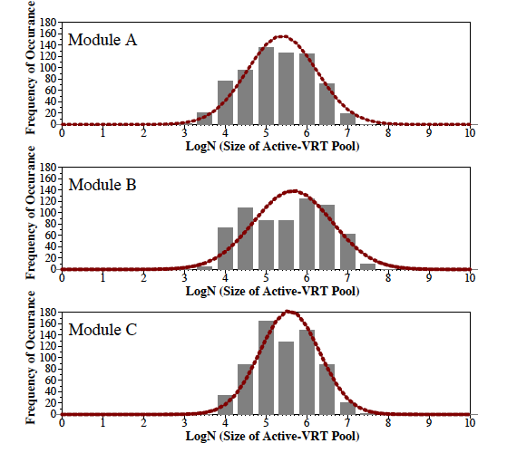
MODELING THE DYNAMIC SIZE OF AVP
Predicting the exact AVP size is difficult, but it can be modeled
Observation:
AVP size tends to follow
lognormal distribution
AVP size modeled using lognormal distribution
Notes:
However, lowering refresh rate comes with a cost.
it introduces some bit errors, since charges in some cells are not restored timely.
And we call those errors refresh errors.
In the figure, we show the function of bit error rate to the refresh rate.
The y-axis is the bit error rate corresponding to the refresh rate in the x-axis.
All axis are in log scale.
#@ When refresh rate is 64ms, the bit error rate is 10^-9, which means one of the billion bits will have refresh errors.
These errors are fixed at the testing phase by using spare rows and columns.
If we keep lowering refresh rate, the bit error rate increases pretty fast.
#@ When refresh rate is 1s, the bit error rate is in the range between 10^-4 and 10^-5.
At this scale, the refresh errors cannot be mitigated by the spare rows, due to the expensive cost of spare rows.
#@ Thus, lowering refresh rate saves energy, but introduces bit errors.
What can we do about it?
Is there anyway we can tolerate those errors?

Slide 16
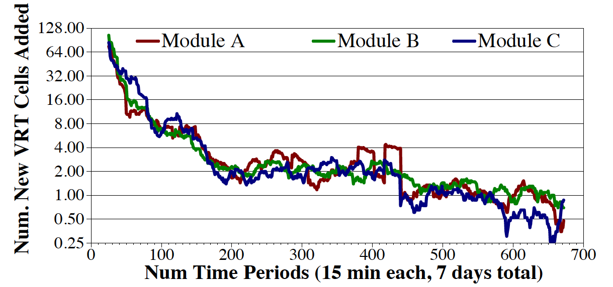
4: RATE OF NEW VRT CELLS STEADIES
Active-VRT Injection (AVI) Rate The rate at which new cells become Active-VRT cells
AVP reduces to ~1 new cell per 15-min period
Notes:
However, lowering refresh rate comes with a cost.
it introduces some bit errors, since charges in some cells are not restored timely.
And we call those errors refresh errors.
In the figure, we show the function of bit error rate to the refresh rate.
The y-axis is the bit error rate corresponding to the refresh rate in the x-axis.
All axis are in log scale.
#@ When refresh rate is 64ms, the bit error rate is 10^-9, which means one of the billion bits will have refresh errors.
These errors are fixed at the testing phase by using spare rows and columns.
If we keep lowering refresh rate, the bit error rate increases pretty fast.
#@ When refresh rate is 1s, the bit error rate is in the range between 10^-4 and 10^-5.
At this scale, the refresh errors cannot be mitigated by the spare rows, due to the expensive cost of spare rows.
#@ Thus, lowering refresh rate saves energy, but introduces bit errors.
What can we do about it?
Is there anyway we can tolerate those errors?

Slide 17
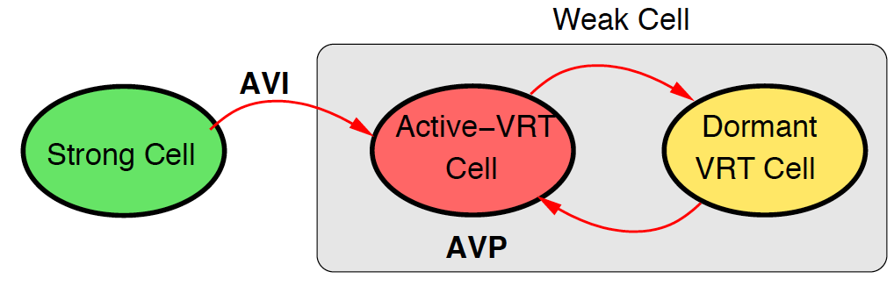
ARCHITECTURE MODEL FOR CELL UNDER VRT
Two key parameters:
Active-VRT Pool (AVP): How many VRT cells in this period?
Active-VRT Injection (AVI): How many new (previously undiscovered) cells became weak in this period?
Model has two parameters: AVP and AVI
Notes:
However, lowering refresh rate comes with a cost.
it introduces some bit errors, since charges in some cells are not restored timely.
And we call those errors refresh errors.
In the figure, we show the function of bit error rate to the refresh rate.
The y-axis is the bit error rate corresponding to the refresh rate in the x-axis.
All axis are in log scale.
#@ When refresh rate is 64ms, the bit error rate is 10^-9, which means one of the billion bits will have refresh errors.
These errors are fixed at the testing phase by using spare rows and columns.
If we keep lowering refresh rate, the bit error rate increases pretty fast.
#@ When refresh rate is 1s, the bit error rate is in the range between 10^-4 and 10^-5.
At this scale, the refresh errors cannot be mitigated by the spare rows, due to the expensive cost of spare rows.
#@ Thus, lowering refresh rate saves energy, but introduces bit errors.
What can we do about it?
Is there anyway we can tolerate those errors?

Slide 18
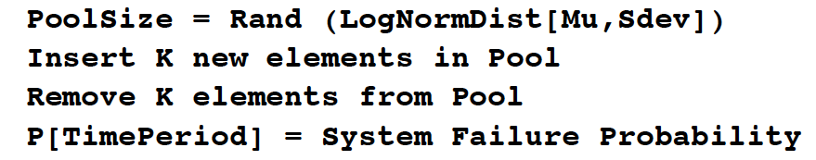

ARCHITECTURE MODEL FOR VRT
Parameter scaling for larger systems: 2GB DIMM to 8GB DIMM
AVP size increased by 4x: from ~400 to ~1600
AVI rate increased by 4x: from 1 to 4

Slide 19
OUTLINE
Background
VRT: mechanism, measurement, model
Can’t we fix VRT by simply using ECC DIMM?
AVATAR
Results
Summary

Slide 20
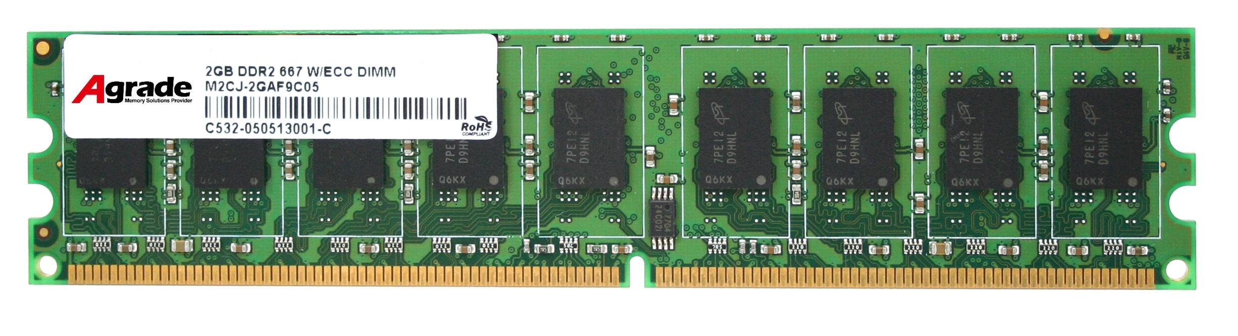
BACKGROUND ON ECC DIMM
ECC DIMM can tolerate 1 error per word (8 bytes)
Typically used to tolerate soft error but can also be used to fix a bit error due to VRT
A multi-bit error per word ➔ uncorrectable error
What is time to double error per word under VRT?

Slide 21
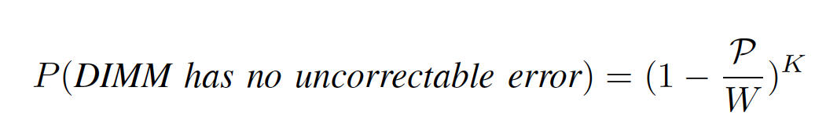
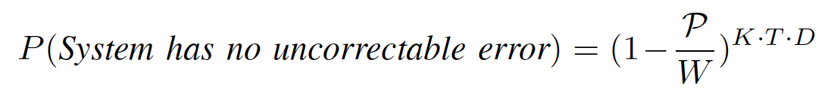
ANALYTICAL MODEL FOR ECC DIMM
W words in memory (strong rows only)
P words have 1 bit error already (AVP)
K new weak cells get injected in given time quanta
For T time quanta, and D DIMMS

Slide 22
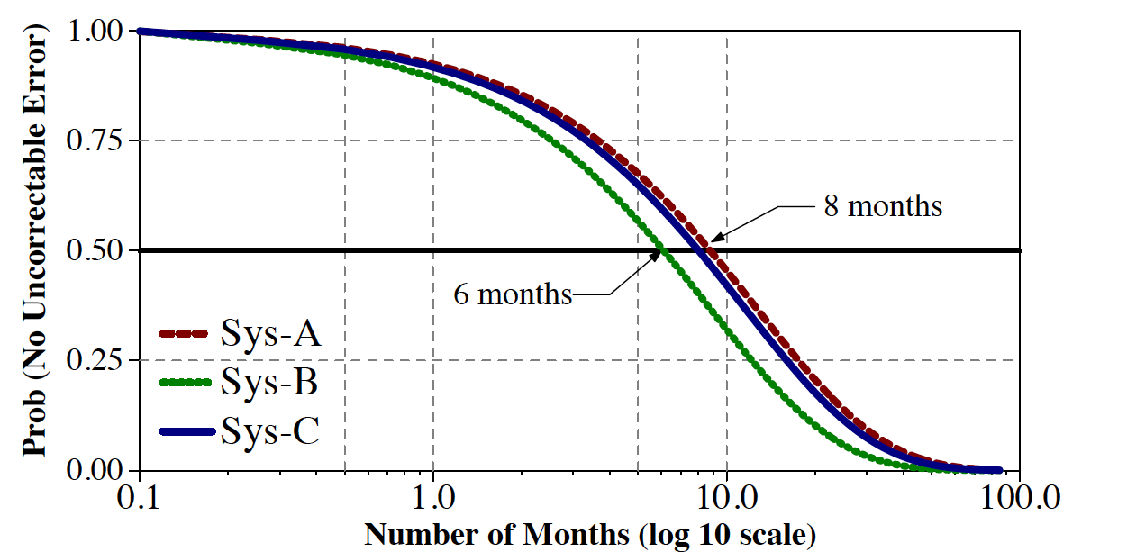
EVEN WITH ECC-DIMM, ERROR RATE is HIGH
System: Four channels, each with 8GB DIMM
VRT still causes an error every ~6-8 months

Slide 23
OUTLINE
Background
VRT: mechanism, measurement, model
Can’t we fix VRT by simply using ECC DIMM?
AVATAR
Results
Summary
Notes:
However, lowering refresh rate comes with a cost.
it introduces some bit errors, since charges in some cells are not restored timely.
And we call those errors refresh errors.
In the figure, we show the function of bit error rate to the refresh rate.
The y-axis is the bit error rate corresponding to the refresh rate in the x-axis.
All axis are in log scale.
#@ When refresh rate is 64ms, the bit error rate is 10^-9, which means one of the billion bits will have refresh errors.
These errors are fixed at the testing phase by using spare rows and columns.
If we keep lowering refresh rate, the bit error rate increases pretty fast.
#@ When refresh rate is 1s, the bit error rate is in the range between 10^-4 and 10^-5.
At this scale, the refresh errors cannot be mitigated by the spare rows, due to the expensive cost of spare rows.
#@ Thus, lowering refresh rate saves energy, but introduces bit errors.
What can we do about it?
Is there anyway we can tolerate those errors?

Slide 24
AVATAR
Insight: Avoid forming Active VRT Pool ➔ Upgrade on ECC error
Observation: Rate of VRT >> Rate of soft error (50x-2500x)
Scrub
(15 min)
DRAM Rows
Ref. Rate Table
ECC
A
0
ECC
B
Weak Cell
0
ECC
C
1
ECC
D
RETENTION
PROFILING
0
Row protected from future
retention failures
ECC
E
0
ECC
F
0
ECC
G
1
1
ECC
H
0
AVATAR mitigates VRT by breaking AVP Pool

Slide 25
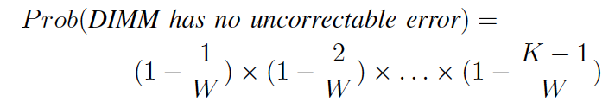
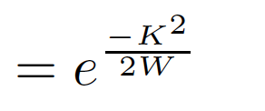
AVATAR: ANALYTICAL MODEL
Only errors injected between scrub can clash with each other
Instead of 1000+ weak cells (AVP), deal with 4 errors (AVI)
W words in memory, K errors in time quanta (AVI Rate)
For, T time quanta, and D DIMMS

Slide 26
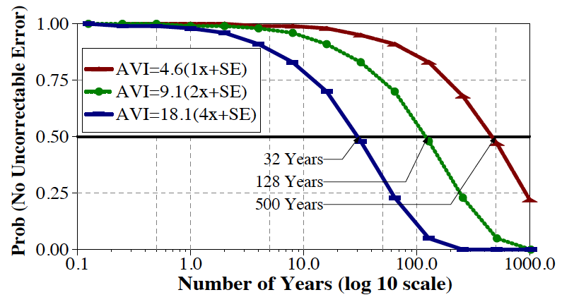
AVATAR: TIME TO FAILURE
System: Four channels, each with 8GB DIMM
AVI = 1x
AVI = 2x
2x
AVI = 4x
4x
32 Years
128 Years
500 Years
AVATAR increases time to failure to 10s of years
* We include the effect of soft error in the above lifetime analysis (details in the paper)

Slide 27
OUTLINE
Background
VRT: mechanism, measurement, model
Can’t we fix VRT by simply using ECC DIMM?
AVATAR
Results
Summary

Slide 28
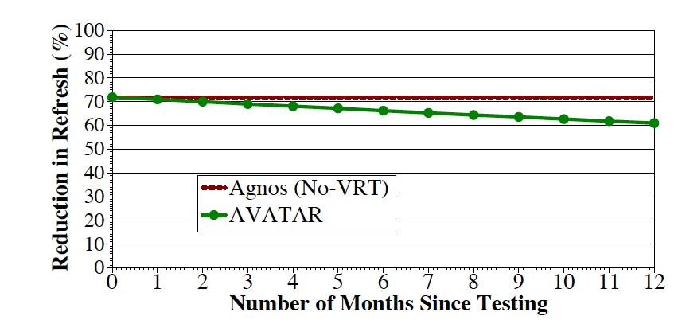
RESULTS: REFRESH SAVINGS
Retention Testing Once a Year can revert refresh saving from 60% to 70%
No VRT
AVATAR
AVATAR reduces refresh by 60%-70%, similar to multi rate refresh but with VRT tolerance

Slide 29
SPEEDUP
Speedup
AVATAR gets 2/3rd the performance of NoRefresh. More gains at higher capacity nodes

Slide 30
ENERGY DELAY PRODUCT
Energy Delay Product
AVATAR reduces EDP,
Significant reduction at higher capacity nodes

Slide 31
OUTLINE
Background
VRT: mechanism, measurement, model
Can’t we fix VRT by simply using ECC DIMM?
AVATAR
Results
Summary
Notes:
However, lowering refresh rate comes with a cost.
it introduces some bit errors, since charges in some cells are not restored timely.
And we call those errors refresh errors.
In the figure, we show the function of bit error rate to the refresh rate.
The y-axis is the bit error rate corresponding to the refresh rate in the x-axis.
All axis are in log scale.
#@ When refresh rate is 64ms, the bit error rate is 10^-9, which means one of the billion bits will have refresh errors.
These errors are fixed at the testing phase by using spare rows and columns.
If we keep lowering refresh rate, the bit error rate increases pretty fast.
#@ When refresh rate is 1s, the bit error rate is in the range between 10^-4 and 10^-5.
At this scale, the refresh errors cannot be mitigated by the spare rows, due to the expensive cost of spare rows.
#@ Thus, lowering refresh rate saves energy, but introduces bit errors.
What can we do about it?
Is there anyway we can tolerate those errors?

Slide 32
Summary
Multirate refresh ➔ retention profiling to reduce refresh Variable Retention Time ➔ errors with multirate refresh
Architecture model of VRT based on experiments
We show ECC DIMM alone is not enough
AVATAR (upgrade refresh rate of row on ECC error)
AVATAR increase the time to failure from 0.5 years to 500 years and incurs the same storage as ECC DIMM

