Slide 1



Reducing Read Latency of Phase Change Memory via Early Read and Turbo Read
Feb 9th 2015
HPCA-21 San Francisco, USA
Prashant Nair - Georgia Tech
Chiachen Chou - Georgia Tech
Bipin Rajendran – IIT Bombay
Moinuddin Qureshi - Georgia Tech
Notes:
Hello everyone, I am Prashant Nair from georgia tech.
I will be talking about Reducing Read Latency
of Phase Change Memory via Early Read and Turbo Read
This is a work that I did with my labmate Chiachen, my collaborator at IITBombay Bipin Rajendran and my advisor Moin Qureshi

Slide 2

INTRODUCTION TO PCM
Phase Change Memory (PCM) promises higher density and better scalability
Key Challenges:
Limited Endurance (10-100M writes/cell)
Wear Leveling, Error correction, Graceful degradation
High Write Latency (4X-8X higher than PCM read)
PreSET, Write Cancellation, Write Pausing
High Read Latency (2X of DRAM)
Hybrid Memory, combining PCM and DRAM
PCM
$
DRAM
Cache
Hybrid Memory
Goal ➔ Reduce the high read latency of PCM
2
Notes:
PCM promises higher density and better scalability
However PCM systems have several key challenges which prior works have tried to address
The limited endurance of PCM systems was addressed by Wear leveling, Error Correction and Graceful degradation
High write latency of PCM was addressed by PreSET, Write cancellation and Write Pausing
PCM read latency continues to be a problem, prior work has proposed using a hybrid memory system that consists of a DRAM cache and PCM.
However misses from DRAM cache still take longer latency to be serviced from PCM. Our analysis shows that even for a hybrid memory system, PCM read latency continues to be a bottleneck.
The goal of this work is to overcome the high read latency of PCM systems

Slide 3
Outline
Background
Early Read
Turbo Read
Early+Turbo Read
Results
Summary
Notes:
Let me tell you how read works in PCM

Slide 4
STORING DATA IN PCM CELLS
Low (SET) and High (RESET) resistance states
Cell states are compared to reference resistance
The states correspond to binary values of 0 and 1
Prob. Of Cell
R_{ref}
SET
RESET
Resistance
PCM stores binary values by varying resistance of cells
4
Notes:
To understand more on read latency let us look at how PCM stores data
PCM devices store data in low and high resistance states.
These states correspond to the SET and RESET resistance state
These cell states are compared to a reference resistance
Based on the comparison, in a single level PCM, these states correspond to binary 0 and 1
Thus PCM stores binary values by varying the resistance of cells

Slide 5
READ PROCESS IN PCM
Three step process to read a PCM cell
Precharge
Enable
Wordline
Enable
Sense Amplifier
Enable
PCM Cells
V_{DD}
0
time
V
RC discharging
Sense
RC charging
Sense Amplifiers
time
The discharging time determines the sensing time
5
Notes:
Reading from a PCM cell is a 3 step process
The bitlines are precharged to a higher voltage
The wordlines are enabled selecting a row of PCM cells
This causes the precharged voltage to discharge through PCM Cells
The rate of discharge is determined by the resistance of the cell and the bitline capacitance
After some time the value is sensed by enabling the sense amplifier
The discharging time determines the sensing time for PCM

Slide 6
SENSING DATA FOR READ
RESET
Capacitive Discharge and compare against V_{ref}
Variation in SET and RESET distributions
V
B
V_{ref}
SET
RESET
Prob. Of Cell
A
A
B
SET
time
Sense
Resistance
Sensing time is determined by worst case cells
Notes:
To differentiate between set and reset states
After a fixed amount of time, the discharged voltage is compared against a reference voltage and the value is sensed
Due to this capacitive discharge, sensing time dominates the read operation
Furthermore, PCM cells show a huge variation
Due to this, the worst case cells, say A and B are compared to the reference voltage
Thus sensing time for PCM is determined by the worst case cells

Slide 7
REDUCE READ LATENCY : SENSE EARLIER
Sense data earlier than the provisioned time
Lower Resistance ➔ Lower RC time to discharge
RESET
V
SET
time
Sense
Reduce time to sense by lowering the RC time
7
Notes:
We can reduce read latency by sensing data earlier
This lower sensing point corresponds to a lower resistance and this low resistance takes lower RC time to discharge
Thus we can lower the sensing time by lowering the RC time

Slide 8
EFFECT OF SENSING EARLIER
SET
Errors
RESET
R_{ref}
Prob. Of Cell
X
X
Resistance
Sensing earlier causes errors while reading higher resistances
8
Notes:
Unfortunately, we cannot naively sense earlier
Sensing values that correspond to lower resistances causes errors while detecting higher resistances

Slide 9
REDUCE READ LATENCY: HIGHER VOLTAGE
Increase bitline voltage more than the provisioned value
Higher Voltage ➔ Higher Current ➔ Low Read Latency
RESET
V*
V
SET
time
Sense
Increase bitline voltage and reduce sensing time
9
Notes:
We can also reduce read latency by applying a higher bitline voltage
A higher voltage results in higher current and enables us to read with low latency
Thus we can increase bitline voltage and reduce sensing time

Slide 10
EFFECT OF HIGH BITLINE VOLTAGE
RESET
V*
Errors
V
SET
RESET
Prob. Of Cell
SET
time
Sense
Resistance
Increasing bitline voltage causes errors
10
Notes:
However, we cannot simply increase the bitline voltage
While increasing the bitline voltage enables lower latency, it also causes errors, called read disturb errors

Slide 11
GOAL
Reduce read latency by
Exploiting variability in PCM cells ➔ Early Read
Higher voltage to read PCM cells ➔ Turbo Read
11
Notes:
The goal of this paper is to reduce PCM read latency.
We have two low cost proposals to reduce the read latency of PCM
First proposal called early read exploits the variability in PCM cells
Second proposal called turbo read uses a higher bitline voltage to read PCM cells

Slide 12
Outline
Background
Early Read
Turbo Read
Early+Turbo Read
Results
Summary
Notes:
Let us look at our 1st proposal is Early Read

Slide 13
SENSING EARLY: OBSERVATION
RESET
PCM Cells
V
SET
time
Sense
Sense Early
Sense Amplifiers
Sensing early causes errors in sense amplifiers
The cells in PCM substrate have no error
13
Notes:
Early Read is based on the observation that sensing time is determined by worst case resistance in the SET state.
We can try to come up with a better than worst case read scheme where we can read earlier than the worst case and still have correct result in the common case.
Unfortunately this would mean that we get some errors sometimes. Note that these errors do not change the state of the cell, these are just sensing errors.
We need a low cost solution to fix these errors.

Slide 14
ECC TO CORRECT LATCHING ERRORS
PCM Cells
Sense Amplifiers
ECC
ECC
Lower sensing time ➔ more errors ➔ stronger ECC
Strong ECC ➔ Huge area overheads
14
Notes:
“One can simply use ECC to correct errors”
Ideally we will have to reduce latency as much as possible, however this will result in a large number of errors, which means this will require stronger ECC
However, a strong ECC will incur significant cost.
We want to mitigate high error rate without paying a significant cost

Slide 15
INSIGHT: USE RETRY FOR CORRECTION
Sense Data Early
Read Line
Correct errors
Detect errors
Retry with normal latency on error detection
PCM Cells
Memory Controller
Sense Amplifiers
Early Read ➔ detect and retry to read correctly at lower latency
15
Notes:
The insight that makes our solution low cost is that we do not need to correct errors using ECC, if we can detect errors, we can simply correct errors by retrying the line with normal latency
We reads the line with a lower latency, such that most times we do not get an error
On getting an error, since these are sensing errors, we don’t need to correct them
We only detect errors
Error correction can be performed easily, all you need to do is to detect and retry with normal latency.
Therefore to use a scheme like this, we need a memory system that has two latencies, short latency and long latency
Now the key question is how do you detect errors at low cost?

Slide 16
INSIGHT: ERRORS ARE UNIDIRECTIONAL
RESET
Errors
V
SET
RESET
Prob. Of Cell
SET
Sense
time
Resistance
Sense Earlier
Sensing errors➔Unidirectional➔SET classified as RESET
16
Notes:
The key insight that makes it possible to detect errors efficiently is that errors with early read are unidirectional
SET can be classified as RESET, but not the other way around.
And fortunately,

Slide 17
UNIDIRECTIONAL ERROR DETECTION
All unidirectional errors can be detected using Berger Code
For a 512 bit cache line, only 10 bits are needed
PCM Cells
Detect Errors
Sense Amplifiers
(512 bits)
Berger Code
(10 bits)
Berger Code detects unidirectional errors with low cost
17
Notes:
There is a code called berger code that can detect any number of unidirectional errors at low cost
For a 512 bit cache line, only additional 10 bits are needed for storing Berger Code
Berger code is space efficient and provides 100% guarantee of error detection.
Let me quickly explain how berger code works

Slide 18
BERGER CODES: HOW AND WHY
Sum the number of 1’s in data, invert and store
+
Data
Berger Code
+
=
1➔ 0 error
?
Data
Berger Code
+
Berger code provides guaranteed detection of all unidirectional errors
18
Notes:
Berger code is computed by adding the number of 1s in Data, inverting and storing them
The number of 1s in data are compared to the inverted value stored in berger code and errors are detected.
The reason why berger code works is because
On a unidirectional error from 1 to 0. The number of 1s in the data will only go down. Similarly the value of berger code can either remain the same or go down.
Which means that the inverted value of berger code will remain the same or go up. The only point where these two values are same is when there is no error.
Berger code provides guaranteed detection of all unidirectional errors.
So what ER does is that it reads early, detects potential errors using berger code and retries in case of an error.
We do not want the probability of retry to be high, infact we do not what this to be higher than 1%.
So what is the target resistance that can keep the probability of retry to be less than 1%

Slide 19
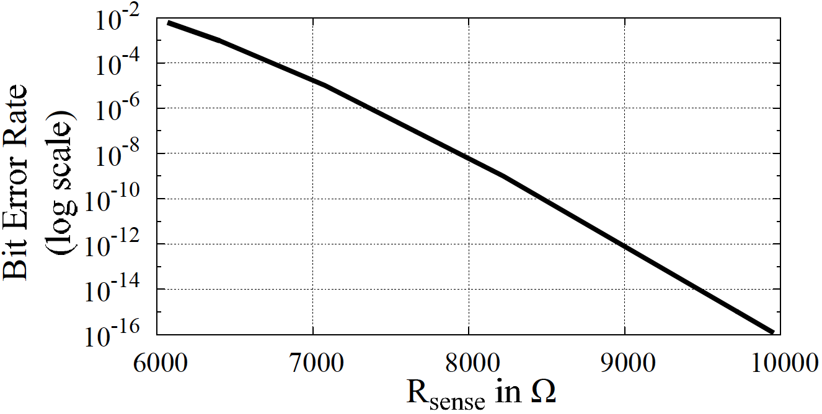
EARLY READ: DESIGN
Latency=48ns
Latency=55ns
Retry=0.5%
Retry=0%
Latency=69ns
Retry=0%
Early Read reduces R_{sense} from 10KΩ to 7KΩ
The BER increases from 10⁻¹⁶ to 10⁻⁵
Detect using Berger Code, retrying 0.5% times
25% reduction in read latency using Early Read
19
Notes:
This graph shows the raw BER for different value of rsense.
For the baseline rsense is of 10Kohm, we reduce rsense from 10Kohm
At 7Kohm, the ber increases from 10^-16 to 10^-5
Since the cache line has 512 bits, at BER of 10^-5, we get a probability of retry < 0.5%
If we use this rsense we reduce the sensing time from 69ns in the baseline to 48ns
Overall, we get a 25% reduction in read latency using early read

Slide 20
Outline
Introduction and Background
Early Read
Turbo Read
Early+Turbo Read
Results
Summary
Notes:
Let us look at our second proposal TR which increases bitline voltage and does not require bimodal read latency

Slide 21
READING WITH HIGHER VOLTAGE
PCM writes data by passing current through cell
PCM reads data by passing current through cell
Read current << Write current
Higher read current can reduce read latency
Read Disturb ➔ Causes PCM cells to accidently flip
Write Current
SET
RESET
Few
cells
Current
Read Current
Read Current
Prob. Of Cell
Time
Resistance
Higher bitline voltage causes Read Disturb
21
Notes:
PCM writes data by passing current through the cells
PCM also reads data by passing current through the cells
Then why doesn’t reads become writes? This is because the read current is kept to be much lesser than the write current
If we can increase the read current slightly, we can get lower latency, but this may accidently cause some bits to flip. A phenomenon which is called as read disturb.
Thus, a higher bitline voltage causes read disturb

Slide 22
READ DISTURB: OBSERVATION
RESET
V*
PCM Cells
V
SET
Sense
time
Increase bitline voltage
Reading with higher voltage ➔ Read Disturb ➔ causes errors in PCM cells
22
Notes:
Let us look at read disturb more closely
As we increase the bitline voltage, and PCM cells are read
The state of PCM cells may directly be affected even if the correct value is sensed.
Which means it will give an error the next time the cell is written
Thus, unlike early read which causes only sensing errors, reading with higher current cause the state of the cell to flip, so retry based mechanism will not work.

Slide 23
ECC FOR READ DISTURB ERRORS
Incorrect value may be read
Read disturb errors can be corrected with Error Correcting Codes (ECC)
PCM Cells
Sense
Amplifiers
ECC
Correcting read disturb with ECC allows low latency read
23
Notes:
Let us look at how we can correct read disturb errors
Read disturb causes incorrect value to be read
Read disturb can be corrected using error correcting codes
Correcting read disturb with ECC allows low latency read

Slide 24
TURBO READ
PCM Cells
Read with higher bitline voltage
If read disturb errors
ECC to correct errors
Memory Controller
Sense Amplifiers
ECC
Turbo Read ➔ Read with higher bitline voltage and use ECC to correct read disturb errors
24
Notes:
Our 2nd solution turbo read reads with a higher btline voltage
If there are read disturb errors
It uses the ECC associated with the line to correct these errors
Thus turbo read simply reads with a higher bitline voltage and uses ECC to correct read disturb errors
The next step is to determine how much read disturb error rate can be tolerate

Slide 25
TURBO READ: DESIGN
Systems are typically designed for failure rate < 10⁻¹⁶
Fix with a small amount of budget ➔ DECTED
Probabilistic Scrub (PRS) to mitigate latent faults
BER Read Disturb | Probability Line has 3 Errors | Latency
10⁻⁹ | < 10⁻¹⁹ | 57ns
ECC can mitigate read disturb errors in Turbo Read
25
Notes:
Systems are typically designed for failure rate < 10^-16 and we need to
see what we can fix within a small storage budget of say DECTED.
We will not be able to correct 3 bit errors, so what is raw BER we can
tolerate with DECTED so that system BER is less than 10^-16?
And this is what gives us a read disturb BER of 10^-9,
So we will increase the bitline voltage such
that target BER from read disturb will be no more than 10^-9
ECC can fix errors in the line being read, but turbo read may cause errors in neighboring lines of the same row that are not read for a long time.
We have come up with a scheme probabilistic row scrub that can fix these errors.

Slide 26
Outline
Background
Early Read
Turbo Read
Early+Turbo Read
Results
Summary
Notes:
We can also combine ER and TR

Slide 27
WHY COMBINE EARLY AND TURBO READ
Early read➔Error➔Retry
Bimodal Read Latency
Turbo read➔Error➔No Retry
Read Latency Fixed
48ns
No Error
69ns
57ns
Error
No Error/Error
Provisioned Read Latency
Provisioned Read Latency
Combine Early and Turbo Reads ➔ Get benefits of both without bimodal latency
Notes:
ER and TR are combined synergistically to get the better of both worlds
ER requires provisioning of bimodal read latency
The read latency for no error is lower than read latency for reading an erroneous line
On the other hand, turbo read requires only a single latency memory system
Thus ER and TR can be combined to get benefits of both without provisioning bimodal latency

Slide 28
CHALLENGES IN EARLY+TURBO READ
PCM Cells
PCM Cells
Early Read➔Sensing Errors
Error Detection
Turbo Read➔PCM Cell Errors
Error Correction
Early+Turbo Read will have PCM cell errors and require Error Correcting Codes
Notes:
However, we need to address some challenges while combining ER and TR
ER causes sensing errors, that can use error detection codes
TR causes Cell errors that require error corerction codes
Thus an Early turbo read will have PCM cell errors and require error correcting codes

Slide 29
EARLY+TURBO READ
PCM Cells
Read with higher bitline voltage + Sense early
If read disturb errors + sensing errors
ECC to correct errors
Memory Controller
Sense Amplifiers
ECC
Early+Turbo Read ➔ Read with higher bitline voltage and sense early ➔ Use ECC to correct errors
29
Notes:
Early+Turbo read reads with a higher bitline voltage and senses data early
This might result in a combination of read disturb and sensing errors
It uses the ECC associated with the line to correct these errors
Thus Early+turbo reads with a higher bitline voltage and also senses early, using ECC to correct read disturb errors and sensing errors

Slide 30
EARLY+TURBO READ: DESIGN
 | Early Read | Turbo Read | Early+Turbo Read
BER | 10⁻⁵ | 10⁻⁹ | 2x10⁻⁹
Sensing Latency | 48ns or 69ns (Bimodal) | 57ns (Fixed) | 45ns (Fixed)
Storage Overhead | 10 bits/line | 20 bits/line | 20 bits/line
2x10⁻⁹ BER ➔ DECTED ➔ System Failure Rate < 10⁻¹⁹
Sensing Latency Fixed ➔ 45ns
Early+Turbo Read reduces read latency by 30%
Notes:
The fact that we can have both sensing errors and read disturb errors and we are using ECC to correct them means that we cannot be as aggressive.
We cannot tolerate a BER of 10^-5, we need to lower it close to 10^-9.
So for the combination, ER targets only BER of 2x10^-9 and not 10^-5.
We use DECTED to mitigate errors such that the system Failure Rate is below 10-19
and the sensing latency to a fixed 45ns
We show that ETR can reduce read latency by 30%

Slide 31
Outline
Background
Early Read
Turbo Read
Early+Turbo Read
Results
Summary
Notes:
Let us look at the key results

Slide 32
SYSTEM CONFIGURATION
Parameter | Configuration
Cores | 8 cores @ 3Ghz
L1-L2-L3 Cache | 32KB-256KB-1MB (Private)
L4 Cache | 128MB (Shared) @ 15ns latency
PCM System
Channels | 4 Channels @ 8GB/Channel
Read Latency | 80ns ➔ 69ns sensing time*
Write Latency | 250ns*
Spec Benchmarks with read MPKI from DRAM Cache > 1
* ISSCC 2012 [PCM-Samsung]
Notes:
We use an 8 core system operating at 3Ghz
We use a hybrid memory system with a DRAM cache of 128MB at 15ns latency
The PCM system has 4 channels at 8GB per channel.
Its read latency is 80ns and write latency is 250ns, modeled after from a recently published industry prototype chip
We use spec benchmarks that have a read MPKI of > 1 out of the DRAM cache
We execute these benchmarks in rate

Slide 33
PERFORMANCE
Speedup
33
Notes:
The graphs show the speedup for early read,
The y axis is speedup, and the X axis represents the benchmarks
ER provides a speedup of upto 26% for some benchmarks and 18% on an average

Slide 34
PERFORMANCE
Speedup
34
Notes:
Turbo read provides a speedup of upto 12% and 9% on a average

Slide 35
PERFORMANCE
Speedup
Our proposals improve performance by upto 21%
35
Notes:
A combination of early and turbo read can provide a speedup of upto 31%.
Our proposals improve performance by upto 21% on an average

Slide 36
ENERGY AND EDP
4%
7%
2%
Normalized to Baseline
Our proposals reduce energy by 7%
36
Notes:
The y axis is normalized to baseline.
The graphs show the memory energy
As ER senses data early, it requires 7% lower energy
As TR uses higher current, it consumes 4% higher energy
However the combination of ER and TR consumes almost similar current to that of the baseline.

Slide 37
ENERGY AND EDP
25%
14%
Normalized to Baseline
28%
Our proposals reduce energy by 7%
Our proposals reduce EDP by 28%
37
Notes:
The graphs shows the System EDP.
EDP follows a trend similar to energy, as the execution time is also reduced proportionately
Our proposals reduce EDP by 28%

Slide 38
Outline
Background
Early Read
Turbo Read
Early+Turbo Read
Results
Summary
Notes:
To summarize

Slide 39
Summary
Goal ➔ Reduce the read latency of PCM
Two low cost solutions
Early Read: Better-than-worst-case sensing using Berger Codes to detect errors and retry
Turbo Read: Read with higher current and fix read disturb errors with ECC
Proposed solutions reduce read latency by 30% ➔ Performance improves by 21%, EDP by 28%
39
Notes:
We address the goal to reduce the read latency of PCM
We propose 2 low cost solutions to reduce read latency
Our 1st solution ER uses better that worst case sensing and uses berger codes to detect errors and retry
Our 2nd solution TR reads with a higher current and fixes read disturb errors with ECC
Our proposed solutions reduce read latency by 30%
We improve performance by 21% and reduce EDP by 25%

Slide 40

Thank You
You could do
so much more by thinking of
“Better-Than-the-Worst-Case”!
40

Slide 41
BACKUP

Slide 42
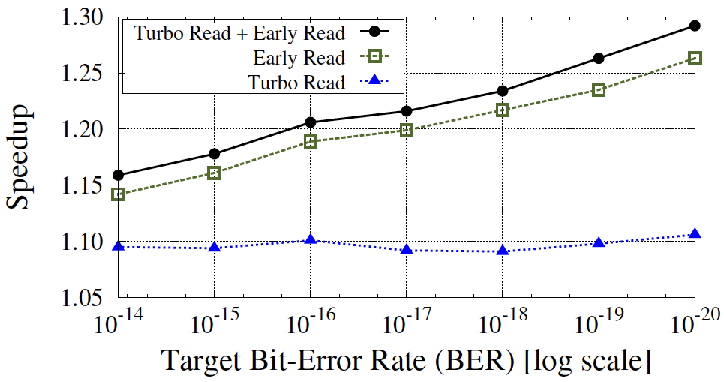
SENSITIVITY TO TARGET ERROR RATES
Our proposals become even more effective at higher target design error rates
42

Slide 43
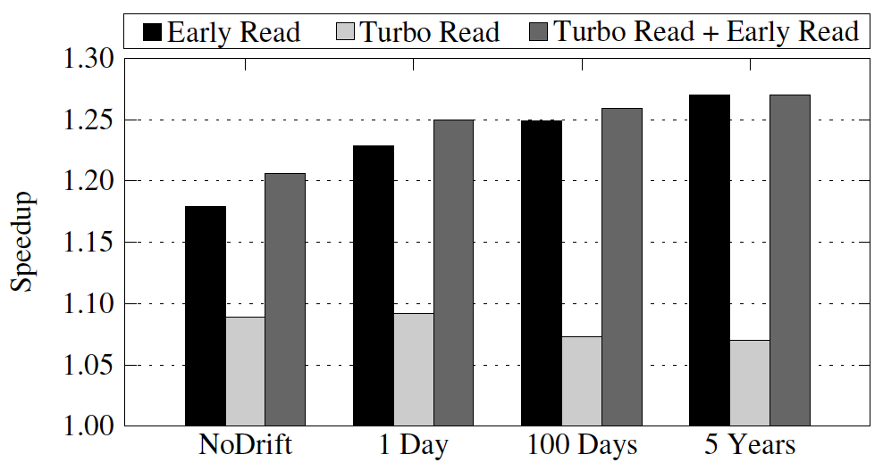
SENSITIVITY TO DRIFT
Our proposals become even more effective when drift margins are taken into account
43

Slide 44
MLC PCM LATENCY
Prob. Of Cell
00
01
10
11
if
Worst Case Latency
yes
<
no
yes
<
<
no
no
yes
00
01
11
10
Latency determined by highest resistance states
44

Slide 45
LATENCY TREND WITH SCALING
PCM stores values by varying resistance
Higher resistance causes more read latency
With Technology Scaling:
Resistance = (Resistivity x Length )/Area
PCM Read
Latency
80ns
(58nm node)
120ns
(20nm node)
78ns
(90nm node)
2007
Years
2011
2012
PCM read latency increases with scaling
45
Notes:
Infact the problem of read latency in PCM becomes even worse due to scaling
PCM stores values by varying its resistance. A higher resistance will result in higher read latency.
Since resistance can be described by the formula.
With technology scaling, length of PCM devices will reduce. The area of PCM devices will reduce even further and the resistance
of PCM devices will increase
Infact prototype PCM devices published in ISSCC from 2007 to 2012 shows this trend
Therefore the read latency of PCM will increase even further with technology scaling.
Now there are several solutions that try to address PCM latency by reducing write latency.

Slide 46
REDUCING READ LATENCY MATTERS
Read requests tend to halt execution
Write requests can be buffered/paused/cancelled
Phase Change Memory System
Write Cancellation/Write Pausing
A
Write Queue/Buffer
Write A
Read B
B
B
time
Read Latency =1.5X to 2.5X DRAM Latency
Read Latency = DRAM Latency
Low read latency improves performance directly
46
Notes:
However the key insight is that reducing read latency matters the most
Write requests are off the critical path and can be buffered, paused or cancelled
Let us look at this stream of memory requests
--
We can conclude that a low read latency memory system will improve performance directly
To understand the read process better let us look at how data is stored in PCM

Slide 47
LATENT FAULTS FROM READ DISTURB
Adversarial read sequences can cause latent faults
PCM Row
Line B
Line A
Latent Faults
Read Line A
Read Line A
Read Line A
Read Line B
4 Errors!
System Failure
time
Need a low cost solution to mitigate latent faults
47

Slide 48

OUR SOLUTION: PROBABILISTIC SCRUB
Scrub the entire row with low probability (say 1%)
PCM Row
Line B
Line A
Latent Faults
Read Line A
Read Line A
Read Line A
Read Line B
2 Errors!
Can be corrected
time
Don’t scrub!
Scrub!
Probabilistic Scrub improves reliability by 10⁵ times with negligible impact on performance
48

Slide 49
END OF BACKUP

