Slide 1
PreSET: Improving PCM performance
by exploiting asymmetry in write times
Moinuddin K. Qureshi
ECE, Georgia Tech
Michele Franceschini, Ashish Jagmohan, Luis Lastras
IBM T. J. Watson Research Center
ISCA 2012

Slide 2
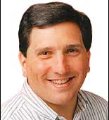
In Memoriam
John P. Karidis (1958-2012)
IBM Distinguished Engineer
Initiator & Tech Lead of PCM Project at IBM
Exceptionally Versatile Researcher
Butterfly Laptop Design (now in MOMA/NYC)
Worlds fastest robotic probing arm
PCM: material, devices, architecture, OS
Great Human Being, Mentor, Colleague

Slide 3
Outline
The Slow-Write Problem
PreSET: Exploiting Write Asymmetry
Experimental Results
Discussion and Summary
Notes:
Give a brief overview of the presentation. Describe the major focus of the presentation and why it is important.
Introduce each of the major topics.
To provide a road map for the audience, you can repeat this Overview slide throughout the presentation, highlighting the particular topic you will discuss next.

Slide 4
Challenges for PCM Memories
DRAM scaling is challenging ➔ PCM promises better scaling
Key Challenges with PCM:
Limited Endurance (10-100M writes/cell)
- Wear Leveling, Error correction, Graceful degradation
High Read Latency (2X-4X of DRAM)
-Hybrid Memory, combining PCM and DRAM
High Write Latency (4X-8X higher than PCM read)
PCM
$
DRAM
Cache
Hybrid Memory
Write performance remains one of the key bottleneck for PCM

Slide 5
Problem: Contention from Slow Writes
Typical response: Writes not latency critical, use buffers/scheduling
Once write gets scheduled, later arriving read request to bank waits
RD1
WR
RD0
Wait
RD0
WR
RD1
Our previous solution: Adaptive Write Cancellation [HPCA’10]
RD1
WR
RD0
RD0
WR
RD1
WR (redone)
Contention from slow writes increase read latency, lowers performance

Slide 6
Slow Write Problem: Quantified
Baseline: 256MB DRAM$ + 32 PCM banks each with 32-entry WRQ
PCM read latency 500 cycles, write latency 4000 cycles
Effective Read Latency
Speedup
Baseline
AWC
No Writes
Baseline
AWC
No Writes
Our Goal: Get performance close to “No Writes”, without large WRQ

Slide 7
Outline
The Slow-Write Problem
PreSET: Exploiting Write Asymmetry
Experimental Results
Discussion and Summary
Notes:
Give a brief overview of the presentation. Describe the major focus of the presentation and why it is important.
Introduce each of the major topics.
To provide a road map for the audience, you can repeat this Overview slide throughout the presentation, highlighting the particular topic you will discuss next.

Slide 8
Not All Writes are Created Equal
For typical PCM, write transitions have widely different latencies
SET: Long Latency (~8x of read) RESET: Low Latency (similar to read)
RESET
Power
SET
time
Writes are slow only in one direction

Slide 9
Insight: Exploit Write Asymmetry
Typical memory operation writes many bits (512) ➔ Both transitions
If memory writes constrained to only RESET, writes as fast as read
Our Proposal: PreSET (Do SET operations off-the-critical path)
0xDEADBEEF
PreSET
0xDEADBEEF
0xFADEDACE
0xFADEDACE
0x00000000
With PreSET, the write only does RESET operations ➔ Low Latency
PreSET: Slow operation off-the-critical-path

Slide 10
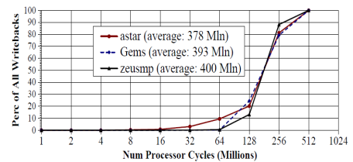
When to do PreSET?
As soon as the line is read ➔ Data corruption (if no write)
When the write reaches memory system ➔ Too late
Solution: When line gets first write in DRAM$, initiate PreSET
Eviction to memory
DRAM$ Install
writes
PreSET Window
Initiating PreSET at 1st write to line in DRAM$ ➔ large PreSET window

Slide 11
Architecture Support for PreSET
PI= PreSET Initiated
PD= PreSET Done
V
D
PI
PD
TAG
DATA
PCM
Memory
DRAM $
WRQ
WR
To Processor
RD
RDQ
PreSET (Address only)
PSQ
PCM memory arrays needs to support bimodal writes: short and long
Scheduling: PreSET are low priority, non-blocking for read requests
PreSET requires small changes, PSQ is much simpler than WRQ

Slide 12
Working of PreSET
PI=1
PD=1
V
D
PI
PD
TAG
PCM
DRAM $
WRQ
WR
To Processor
RD
RDQ
PreSET (Address only)
PSQ

Slide 13
Outline
The Slow-Write Problem
PreSET: Exploiting Write Asymmetry
Experimental Results
Discussion and Summary
Notes:
Give a brief overview of the presentation. Describe the major focus of the presentation and why it is important.
Introduce each of the major topics.
To provide a road map for the audience, you can repeat this Overview slide throughout the presentation, highlighting the particular topic you will discuss next.

Slide 14
Read Latency and Speedup
Baseline
AWC
PreSET
PreSET+AWC
No Writes
35%
Effective Read Latency
Speedup
PreSET is more effective than AWC
PreSET+AWC obtains performance very close to No Writes

Slide 15
Impact on Write Queue Size
No Writes
PreSET+AWC
Speedup
AWC
Baseline
1K Entries Total
8
16
32
64
128
256
8
(32KB)
(64KB)
(128KB)
(256KB)
(512KB)
(1MB)
Number of Entries in WRQ (per bank, 32 banks)
AWC is reliant on having large WRQ, but (PreSET+AWC) is not

Slide 16
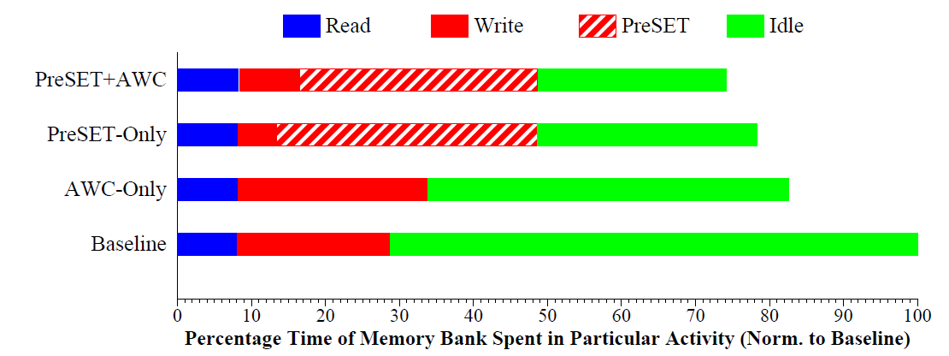
Where do the cycles go?
Static/Dynamic throttling schemes for reduce overheads (in paper)
PreSET increases memory utilization ➔ Power/Lifetime overheads

Slide 17
Power and Energy-Delay-Product
AWC
PreSET
PreSET+AWC
-24%
Normalized Power
Normalized EDP
PreSET based schemes increase power but improve EDP significantly

Slide 18
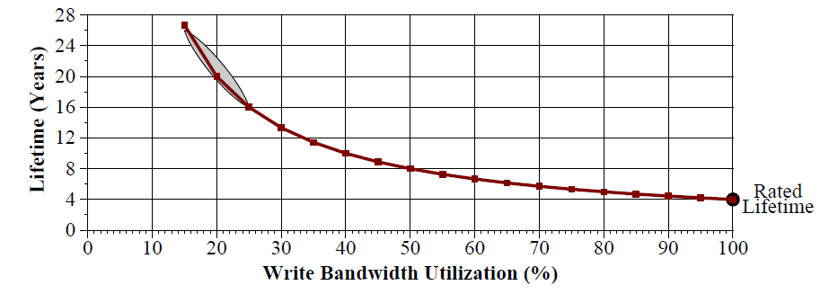
Lifetime Impact
Our workloads
Lifetime Depends on Write Traffic Utilization (PreSET uses idle cycles)

Slide 19
Lifetime Impact
Baseline
AWC
PreSET
PreSET+AWC
System Lifetime (in Years)
Rated
Average Lifetime
Worst-Workload Lifetime
PreSET based schemes have lifetime of 5+ years, higher than rated

Slide 20
Outline
The Slow-Write Problem
PreSET: Exploiting Write Asymmetry
Experimental Results
Discussion and Summary
Notes:
Give a brief overview of the presentation. Describe the major focus of the presentation and why it is important.
Introduce each of the major topics.
To provide a road map for the audience, you can repeat this Overview slide throughout the presentation, highlighting the particular topic you will discuss next.

Slide 21
Isn’t PreSET Similar to Flash ERASE?
Yes: Both exploit asymmetry in write operations
No:
PreSET is optional, ERASE mandatory
PreSET at same granularity as write, ERASE at 64x-128x
PreSET is “in-place”, ERASE “out-of-place”
Out-of-place writes ➔ indirection tables (area, latency)
For PCM, table needs to be per-line (~10MB for 32GB)
Limited “out-of-place” PreSET for latency-critical writes: (database-commit, persistent memory, power failure)
PreSET is optional and obviates the (bulky) indirection tables of ERASE

Slide 22
Summary
PCM “Slow-Write” problem: Write blocks read, causes slowdown
We exploit asymmetry in PCM writes: SET is slow, RESET is fast
We propose PreSET, which performs SET ahead of actual write
Starting PreSET on first-write on DRAM$ write is effective
PreSET improves performance by 35% (No-Writes: 39%)
Unlike AWC, PreSET does not rely on large WRQ
(In paper: PreSET throttling for reduced overheads)

Slide 23
Questions

Slide 24
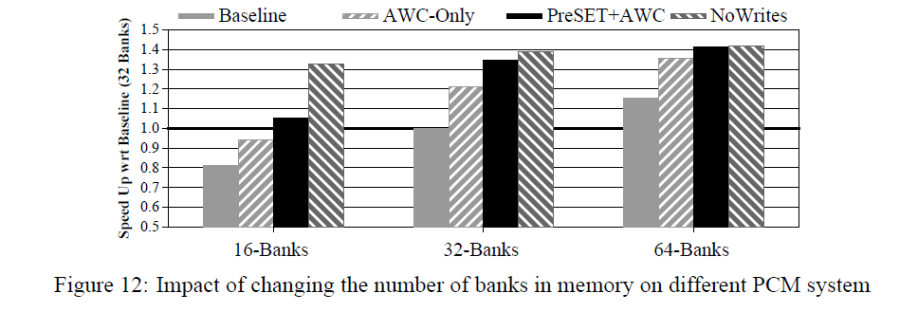
Sensitivity to Banks

Slide 25
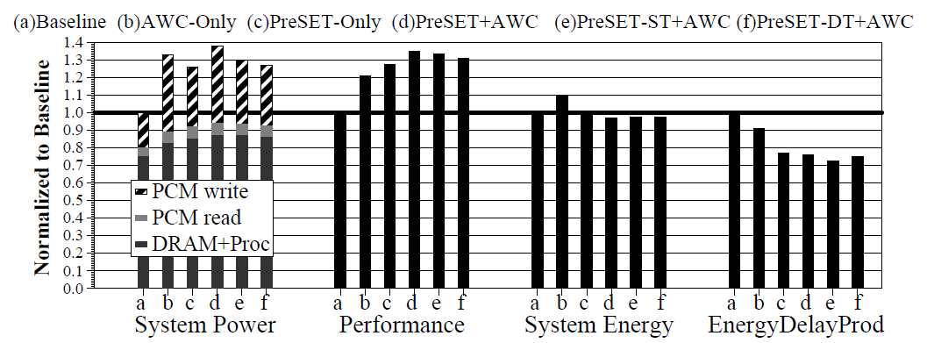
Power Breakdown

Slide 26
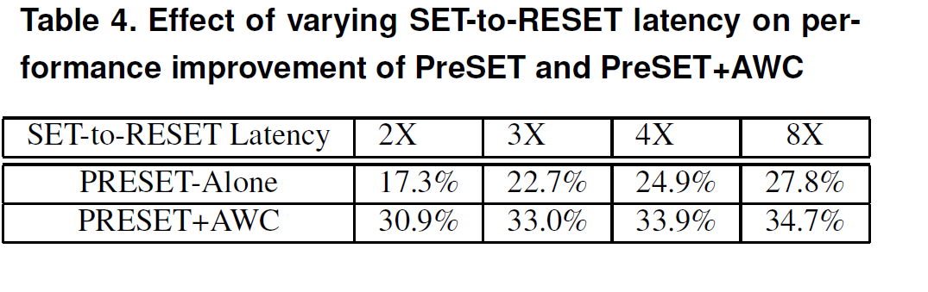
SET to RESET Ratio

