Slide 1

ArchShield: Architectural Framework for Assisting DRAM Scaling By Tolerating High Error-Rates
Prashant Nair
Dae-Hyun Kim
Moinuddin K. Qureshi

Slide 2
Introduction
DRAM: Basic building block for main memory for four decades
DRAM scaling provides higher memory capacity. Moving to smaller node provides ~2x capacity
Shrinking DRAM cells becoming difficult ➔ threat to scaling
Efficient Error
Mitigation
Scaling (Feasibility)
Technology node (smaller ➔)
Efficient error handling can help DRAM technology scale

Slide 3
Why DRAM Scaling is Difficult?
Scaling is difficult. More so for DRAM cells.
Volume of capacitance must remain constant (25fF)
Scaling: 0.7x dimension, 0.5x area ➔ 2x height
With scaling, DRAM cells not only become narrower but longer

Slide 4
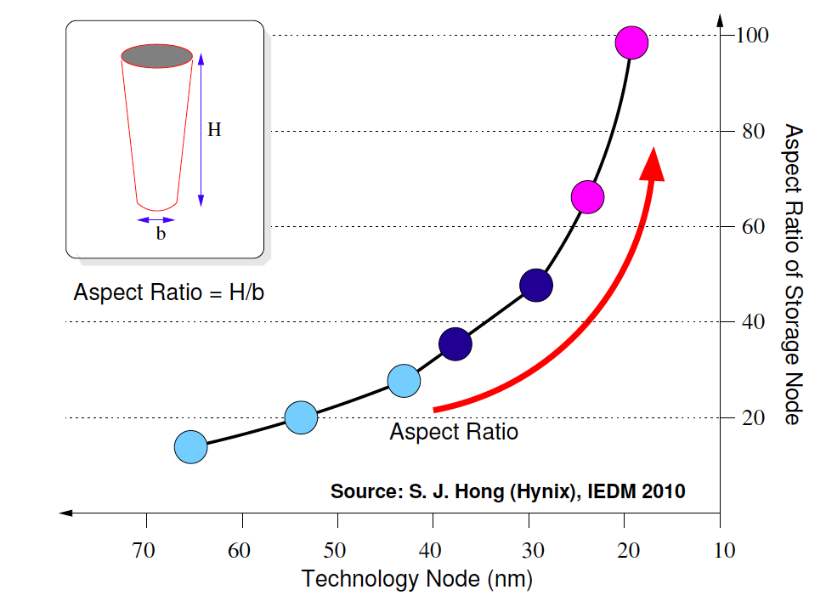
DRAM: Aspect Ratio Trend
Narrow cylindrical cells are mechanically unstable ➔ breaks

Slide 5
More Reasons for DRAM Faults
Unreliability of ultra-thin dielectric material
In addition, DRAM cell failures also from:
Permanently leaky cells
Mechanically unstable cells
Broken links in the DRAM array
DRAM Cells
Q
DRAM Cell Capacitor
(tilting towards ground)
DRAM
Cell Capacitor
Charge
Leaks
Permanently
Leaky Cell
Mechanically
Unstable Cell
Broken Links
Permanent faults for future DRAMs expected to be much higher
(we target an error rate as high as 100ppm)

Slide 6
Outline
Introduction
Current Schemes
ArchShield
Evaluation
Summary

Slide 7
Row and Column Sparing
DRAM chip (organized into rows and columns) have spares
Laser fuses enable spare rows/columns
Entire row/column needs to be sacrificed for a few faulty cells
Deactivated Rows
and Columns
Replaced Columns
Spare Columns
Faults
Spare Rows
Replaced Rows
DRAM Chip:
Before Row/Column Sparing
DRAM Chip:
After Row/Column Sparing
Row and Column Sparing Schemes have large area overheads

Slide 8
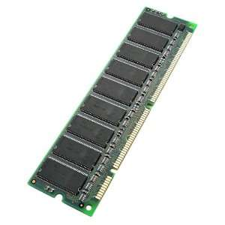
Commodity ECC-DIMM
Commodity ECC DIMM with SECDED at 8 bytes (72,64)
Mainly used for soft-error protection
For hard errors, high chance of two errors in same word (birthday paradox)
For 8GB DIMM ➔ 1 billion words
Expected errors till double-error word
= 1.25*Sqrt(N) = 40K errors ➔ 0.5 ppm
SECDED not enough for high error-rate (+ lost soft-error protection)

Slide 9
Strong ECC Codes
Strong ECC (BCH) codes are robust, but complex and costly
Each memory reference incurs encoding/decoding latency
For BER of 100 ppm, we need ECC-4 ➔ 50% storage overhead
Memory Controller
Strong ECC
Encoder
+
Decoder
DRAM Memory System
Memory
Requests
Memory
Requests
Strong ECC codes provide an inefficient solution for tolerating errors
Notes:
Strong ECC
ArchShield
How it works
Architecture
Components

Slide 10
Dissecting Fault Probabilities
At Bit Error Rate of 10⁻⁴ (100ppm) for an 8GB DIMM (1 billion words)
Faulty Bits per word (8B) | Probability | Num words in 8GB
0 | 99.3% | 0.99 Billion
1 | 0.007 | 7.7 Million
2 | 26 x 10⁻⁶ | 28 K
3 | 62 x 10⁻⁹ | 67
4 | 10⁻¹⁰ | 0.1
Most faulty words have 1-bit error ➔ The skew in fault probability can be leveraged to develop low cost error resilience
Goal: Tolerate high error rates with commodity ECC DIMM while retaining soft-error resilience

Slide 11
Outline
Introduction
Current Schemes
ArchShield
Evaluation
Summary

Slide 12
ArchShield: Overview
Inspired from Solid State Drives (SSD) to tolerate high bit-error rate
Expose faulty cell information to Architecture layer via runtime testing
Replication Area
Fault Map
ArchShield
Main Memory
Most words will be error-free
1-bit error handled with SECDED
Multi-bit error handled with replication
Fault Map
(cached)
ArchShield stores the error mitigation information in memory

Slide 13
ArchShield: Runtime Testing
When DIMM is configured, runtime testing is performed. Each 8B word gets classified into one of three types:
No Error
1-bit Error
Multi-bit Error
(Replication not needed)
SECDED can correct soft error
SECDED can correct hard error
Need replication for soft error
Word gets decommissioned
Only the replica is used
(Information about faulty cells can be stored in hard drive for future use)
Runtime testing identifies the faulty cells to decide correction

Slide 14
Architecting the Fault Map
Fault Map (FM) stores information about faulty cells
Per word FM is expensive (for 8B, 2-bits or 4-bits with redundancy) ➔ Keep FM entry per line (4-bit per 64B)
FM access method
Table lookup with Lineaddr
Avoid dual memory access via
Caching FM entries in on-chip LLC
Each 64-byte line has 128 FM entries
Exploits spatial locality
Faulty Words
Main Memory
Fault Map
Replicated
Words
Replication Area
Fault Map – Organized at Line
Granularity and is also cachable
Line-Level Fault Map + Caching provides low storage and low latency

Slide 15
Architecting Replication Area
Faulty cells replicated at word-granularity in Replication Area
Fully associative Replication Area? Prohibitive latency
Set associative Replication Area? Set overflow problem
Faulty Words
Set 1
Set 1
Main Memory
Set 2
Set 2
Fault Map
Replicated
Words
Replication Area
Fully Associative Structure
Set Associative Structure
Chances of Set Overflowing!

Slide 16
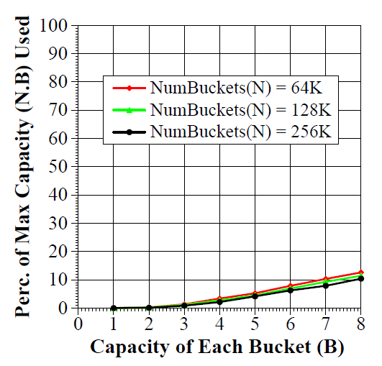

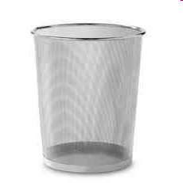
Overflow of Set-Associative RA
There are 10s/100s of thousand of sets ➔ Any set could overflow
How many entries used before one set overflows? Buckets-and-Balls
6-way table only 8% full when one set overflows ➔ Need 12x entries

Slide 17
Scalable Structure for RA
Replication Area Entry
OFB
1
PTR
16-Sets
OFB
1
PTR
TAKEN BY SOME OTHER SET
16-overflow sets
With Overflow Sets, Replication Area can handle non uniformity

Slide 18
ArchShield: Operation
Check R-Bit
R-Bit Set, write to 2 locations
Else 1 location
OS-usable
Mem(7.7GB)
Last Level Cache Miss!
Read Transaction
Write Request
R-bit
R-bit
Fault Map Line
Fetch
Fault Map
(64 MB)
Read Request
Last Level Cache
1. Query Fault Map Entry
2. Fault Map Hit: No Faulty words
1. Query Fault Map Entry
2. Fault Map Hit: Faulty word
1. Query Fault Map Entry
2. Fault Map Miss
Replication
Area (256MB)
Read Transaction
Replication Area
Set R-Bit
Faulty Words
Fault Map Entry
Main Memory
Replicated Word

Slide 19
Outline
Introduction
Current Schemes
ArchShield
Evaluation
Summary

Slide 20
Experimental Evaluation
Configuration:
8-core CMP with 8MB LLC (shared)
8GB DIMM, two channels DDR3-1600
Workloads: SPEC CPU 2006 suite in rate mode
Assumptions: Bit error rate of 100ppm (random faults)
Performance Metric: Execution time norm to fault free baseline

Slide 21
Execution Time
Two sources of slowdown:
Fault Map access and Replication Area access
Low MPKI
On average, ArchShield causes 1% slowdown

Slide 22
Fault Map Hit-Rate
Hit-Rate
High MPKI
Low MPKI
Hit rate of Fault Map in LLC is high, on average 95%

Slide 23
Analysis of Memory Operations
Transaction | 1 Access(%) | 2 Access (%) | 3 Access (%)
Reads | 72.1 | 0.02 | ~0
Writes | 22.1 | 1.2 | 0.05
Fault Map | 4.5 | N/A | N/A
Overall | 98.75 | 1.2 | 0.05
Only 1.2% of the total accesses use the Replication Area
Fault Map Traffic accounts for <5 % of all traffic

Slide 24
Comparison With Other Schemes
FREE-p
ECC-4
ArchShield
Low MPKI
The read-before-write of Free-p + strong ECC ➔ high latency
ECC-4 incurs decoding delay
The impact of execution time is minimum in ArchShield

Slide 25
Outline
Introduction
Current Schemes
ArchShield
Evaluation
Summary

Slide 26
Summary
DRAM scaling challenge: High fault rate, current schemes limited
We propose to expose DRAM errors to Architecture ➔ ArchShield
ArchShiled uses efficient Fault Map and Selective Word Replication
ArchShield handles a Bit Error Rate of 100ppm with less than 4% storage overhead and 1% slowdown
ArchShield can be used to reduce DRAM refresh by 16x (to 1 second)

Slide 27
Questions

Slide 28
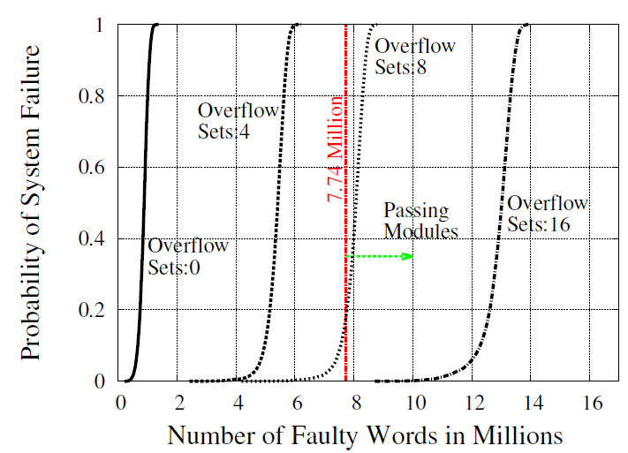
Monte Carlo Simulation
Probability that a structure is unable to handle given number of errors (in million). We recommend the structure with 16 overflow sets to tolerate 7.74 million errors in DIMM.

Slide 29
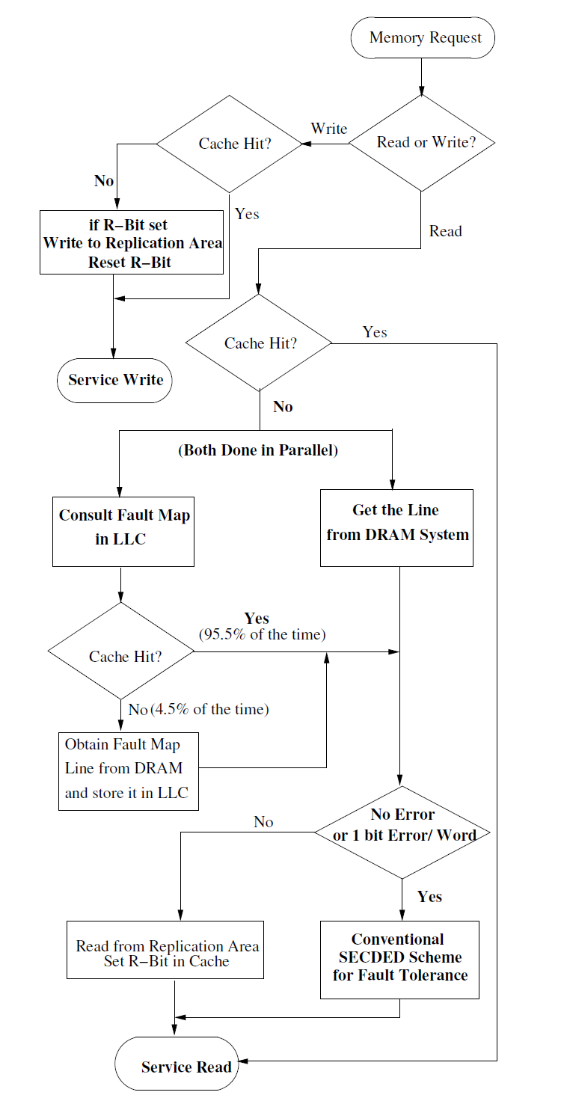
ArchShield FlowChart
Entries in bold are frequently accessed

Slide 30
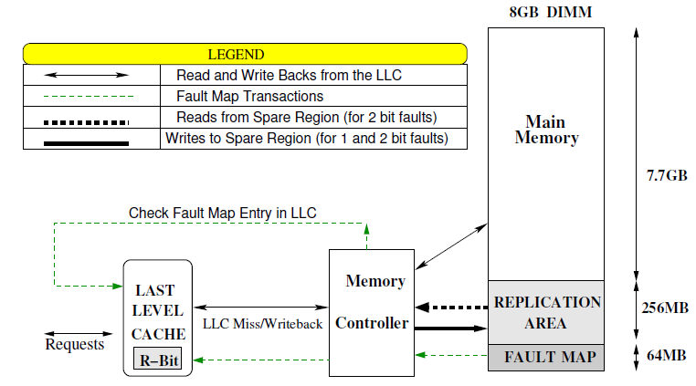
Memory System with ArchShield

Slide 31
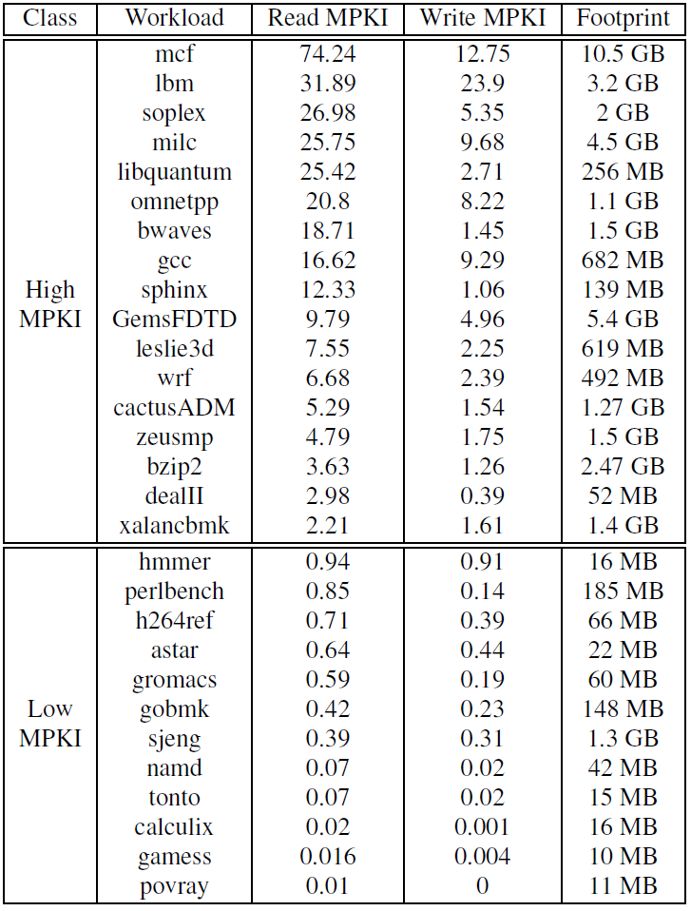
Memory Footprint

Slide 32
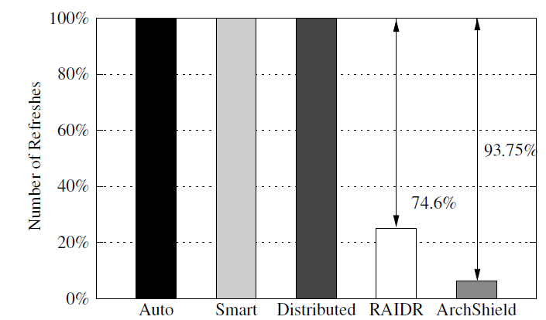
ArchShield compared to RAIDR

