Slide 1
Fundamental Latency Trade-offs in Architecting DRAM Caches
Moinuddin K. Qureshi
ECE, Georgia Tech
Gabriel H. Loh, AMD
MICRO 2012

Slide 2
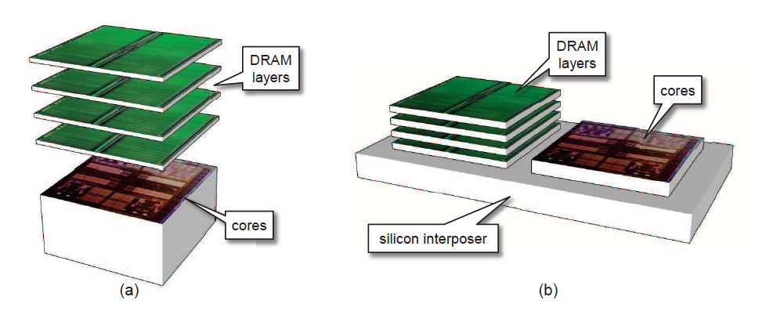
3-D Memory Stacking
3D Stacking for low latency and high bandwidth memory system
- E.g. Half the latency, 8x the bandwidth [Loh&Hill, MICRO’11]
Source: Loh and Hill MICRO’11
Stacked DRAM: Few hundred MB, not enough for main memory
Hardware-managed cache is desirable: Transparent to software
3-D Stacked memory can provide large caches at high bandwidth

Slide 3
Problems in Architecting Large Caches
Organizing at cache line granularity (64 B) reduces wasted space and wasted bandwidth
Problem: Cache of hundreds of MB needs tag-store of tens of MB
E.g. 256MB DRAM cache needs ~20MB tag store (5 bytes/line)
Option 1: SRAM Tags
Fast, But Impractical
(Not enough transistors)
Option 2: Tags in DRAM
Naïve design has 2x latency
(One access each for tag, data)
Architecting tag-store for low-latency and low-storage is challenging

Slide 4
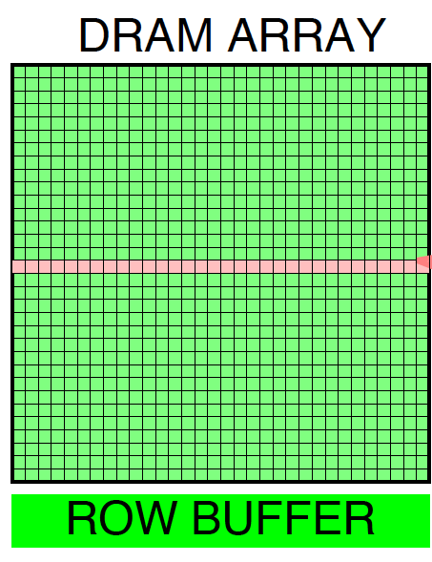
Loh-Hill Cache Design [Micro’11, TopPicks]
Recent work tries to reduce latency of Tags-in-DRAM approach
2KB row buffer = 32 cache lines
Tags
Data lines (29-ways)
Miss
Map
Cache organization: A 29-way set-associative DRAM (in 2KB row) Keep Tag and Data in same DRAM row (tag-store & data store)
Data access guaranteed row-buffer hit (Latency ~1.5x instead of 2x)
Speed-up cache miss detection:
A MissMap (2MB) in L3 tracks lines of pages resident in DRAM cache
LH-Cache design similar to traditional set-associative cache

Slide 5
Cache Optimizations Considered Harmful
DRAM caches are slow ➔ Don’t make them slower
Many “seemingly-indispensable” and “well-understood” design choices degrade performance of DRAM cache:
Serial tag and data access
High associativity
Replacement update
Optimizations effective only in certain parameters/constraints
Parameters/constraints of DRAM cache quite different from SRAM
E.g. Placing one set in entire DRAM row ➔ Row buffer hit rate ≈ 0%
Need to revisit DRAM cache structure given widely different constraints

Slide 6
Outline
Introduction & Background
Insight: Optimize First for Latency
Proposal: Alloy Cache
Memory Access Prediction
Summary
Notes:
Give a brief overview of the presentation. Describe the major focus of the presentation and why it is important.
Introduce each of the major topics.
To provide a road map for the audience, you can repeat this Overview slide throughout the presentation, highlighting the particular topic you will discuss next.

Slide 7
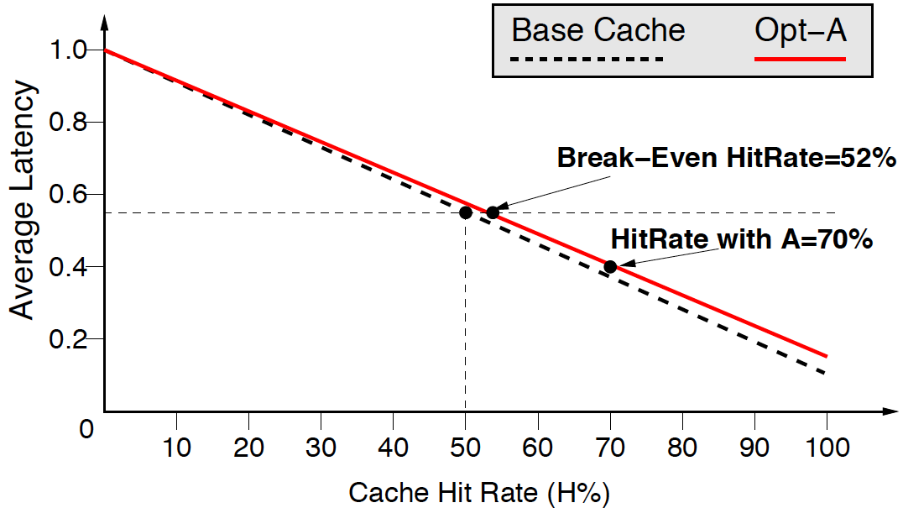
Simple Example: Fast Cache (Typical)
Consider a system with cache: hit latency 0.1 miss latency: 1
Base Hit Rate: 50% (base average latency: 0.55)
Opt A removes 40% misses (hit-rate:70%), increases hit latency by 40%
Base Cache
Opt-A
Break Even
Hit-Rate=52%
Hit-Rate A=70%
Optimizing for hit-rate (at expense of hit latency) is effective

Slide 8
Simple Example: Slow Cache (DRAM)
Consider a system with cache: hit latency 0.5 miss latency: 1
Base Hit Rate: 50% (base average latency: 0.75)
Opt A removes 40% misses (hit-rate:70%), increases hit latency by 40%
Break Even
Hit-Rate=83%
Base Cache
Opt-A
Hit-Rate A=70%
Optimizations that increase hit latency start becoming ineffective

Slide 9
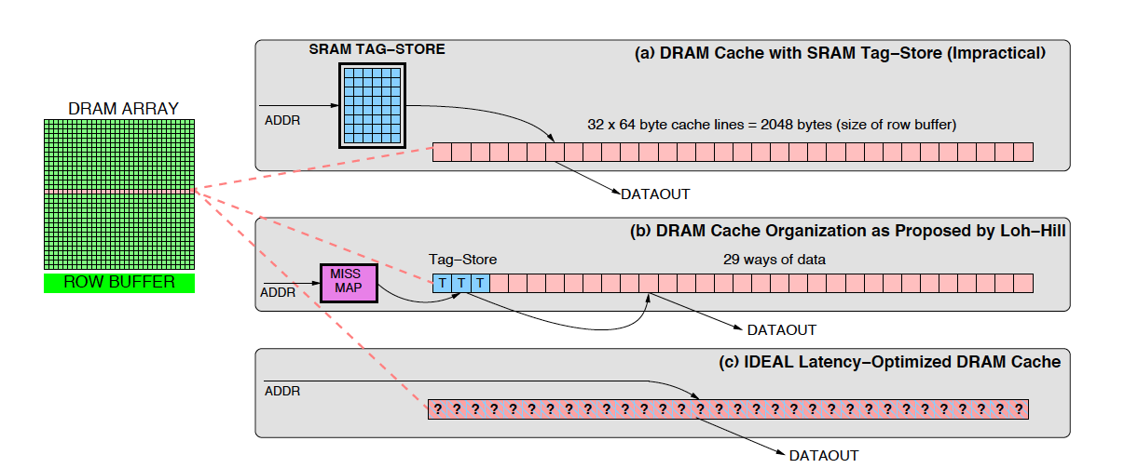
Overview of Different Designs
For DRAM caches, critical to optimize first for latency, then hit-rate
Our Goal: Outperform SRAM-Tags with a simple and practical design

Slide 10
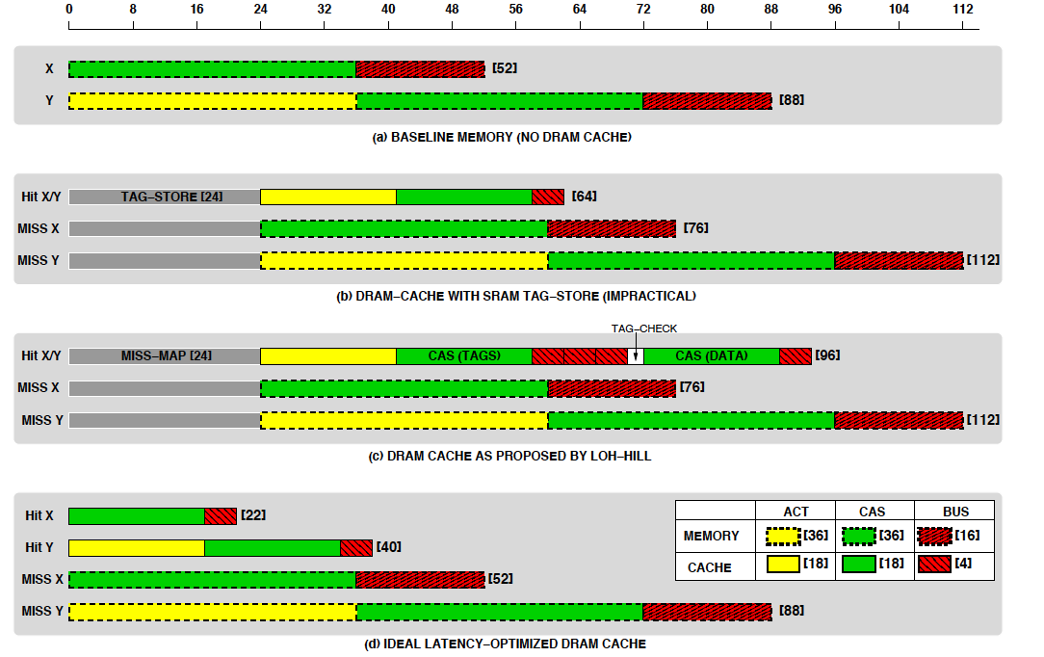

What is the Hit Latency Impact?
Consider Isolated accesses: X always gives row buffer hit, Y needs an row activation
Both SRAM-Tag and LH-Cache have much higher latency ➔ ineffective

Slide 11
How about Bandwidth?
For each hit, LH-Cache transfers:
3 lines of tags (3x64=192 bytes)
1 line for data (64 bytes)
Replacement update (16 bytes)
Configuration | Raw Bandwidth | Transfer Size on Hit | Effective Bandwidth
Main Memory | 1x | 64B | 1x
DRAM$(SRAM-Tag) | 8x | 64B | 8x
DRAM$(LH-Cache) | 8x | 256B+16B | 1.8x
DRAM$(IDEAL) | 8x | 64B | 8x
LH-Cache reduces effective DRAM cache bandwidth by > 4x

Slide 12
Performance Potential
8-core system with 8MB shared L3 cache at 24 cycles
DRAM Cache: 256MB (Shared), latency 2x lower than off-chip
LH-Cache
SRAM-Tag
IDEAL-Latency Optimized
Speedup(No DRAM$)
LH-Cache gives 8.7%, SRAM-Tag 24%, latency-optimized design 38%

Slide 13
De-optimizing for Performance
LH-Cache uses LRU/DIP ➔ needs update, uses bandwidth
LH-Cache can be configured as direct map ➔ row buffer hits
Configuration | Speedup | Hit-Rate | Hit-Latency (cycles)
LH-Cache | 8.7% | 55.2% | 107
LH-Cache + Random Repl. | 10.2% | 51.5% | 98
LH-Cache (Direct Map) | 15.2% | 49.0% | 82
IDEAL-LO (Direct Map) | 38.4% | 48.2% | 35
More benefits from optimizing for hit-latency than for hit-rate

Slide 14
Outline
Introduction & Background
Insight: Optimize First for Latency
Proposal: Alloy Cache
Memory Access Prediction
Summary
Notes:
Give a brief overview of the presentation. Describe the major focus of the presentation and why it is important.
Introduce each of the major topics.
To provide a road map for the audience, you can repeat this Overview slide throughout the presentation, highlighting the particular topic you will discuss next.

Slide 15
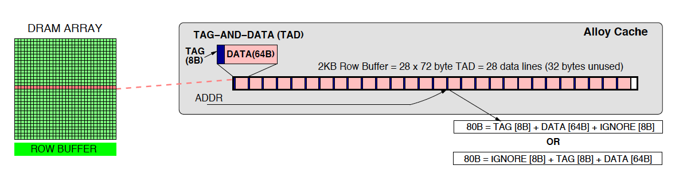
Alloy Cache: Avoid Tag Serialization
No need for separate “Tag-store” and “Data-Store” ➔ Alloy Tag+Data
One “Tag+Data”
No dependent access for Tag and Data ➔ Avoids Tag serialization
Consecutive lines in same DRAM row ➔ High row buffer hit-rate
Alloy Cache has low latency and uses less bandwidth

Slide 16
Performance of Alloy Cache
Alloy Cache
Alloy+MissMap
Alloy+PerfectPred
SRAM-Tag
Speedup(No DRAM$)
Alloy Cache with no early-miss detection gets 22%, close to SRAM-Tag
Alloy Cache with good predictor can outperform SRAM-Tag

Slide 17
Outline
Introduction & Background
Insight: Optimize First for Latency
Proposal: Alloy Cache
Memory Access Prediction
Summary
Notes:
Give a brief overview of the presentation. Describe the major focus of the presentation and why it is important.
Introduce each of the major topics.
To provide a road map for the audience, you can repeat this Overview slide throughout the presentation, highlighting the particular topic you will discuss next.

Slide 18
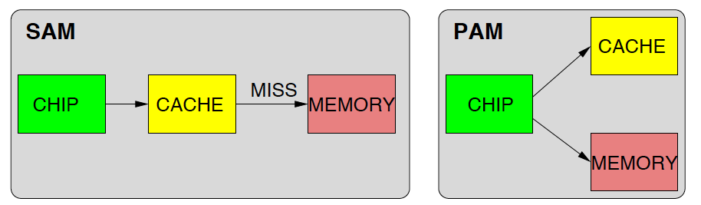
Cache Access Models
Serial Access Model (SAM) and Parallel Access Model (PAM)
Higher Miss Latency
Needs less BW
Lower Miss Latency
Needs more BW
Each model has distinct advantage: lower latency or lower BW usage

Slide 19
To Wait or Not to Wait?
Dynamic Access Model: Best of both SAM and PAM
When line likely to be present in cache use SAM, else use PAM
Prediction =
Cache Hit
Use SAM
L3-miss
Address
Memory Access
Predictor (MAP)
Prediction =
Memory Access
Use PAM
Using Dynamic Access Model (DAM), we can get best latency and BW

Slide 20
Memory Access Predictor (MAP)
We can use Hit Rate as proxy for MAP: High hit-rate SAM, low PAM
Accuracy improved with History-Based prediction
History-Based Global MAP (MAP-G)
Single saturating counter per-core (3-bit)
Increment on cache hit, decrement on miss
MSB indicates SAM or PAM
2. Instruction Based MAP (MAP-PC)
Have a table of saturating counter
Index table based on miss-causing PC
Table of 256 entries sufficient (96 bytes)
Table
Of
Counters
(3-bit)
Miss PC
MAC
Proposed MAP designs simple and low latency

Slide 21
Predictor Performance
Accuracy of MAP-Global: 82% Accuracy of MAP-PC: 94%
Alloy+NoPred
Alloy+MAP-Global
Alloy +MAP-PC
Alloy+PerfectMAP
Speedup(No DRAM$)
Alloy Cache with MAP-PC gets 35%, Perfect MAP gets 36.5%
Simple Memory Access Predictors obtain almost all potential gains

Slide 22
Alloy Cache Improves Hit Latency greatly at small loss of Hit Rate
Hit-Latency versus Hit-Rate
DRAM Cache Hit Latency
Latency | LH-Cache | SRAM-Tag | Alloy Cache
Average Latency (cycles) | 107 | 67 | 43
Relative Latency | 2.5x | 1.5x | 1.0x
DRAM Cache Hit Rate
Cache Size | LH-Cache (29-way) | Alloy Cache (1-way) | Delta Hit-Rate
256MB | 55.2% | 48.2% | 7%
512MB | 59.6% | 55.2% | 4.4%
1GB | 62.6% | 59.1% | 2.5%
Alloy Cache reduces hit latency greatly at small loss of hit-rate

Slide 23
Outline
Introduction & Background
Insight: Optimize First for Latency
Proposal: Alloy Cache
Memory Access Prediction
Summary
Notes:
Give a brief overview of the presentation. Describe the major focus of the presentation and why it is important.
Introduce each of the major topics.
To provide a road map for the audience, you can repeat this Overview slide throughout the presentation, highlighting the particular topic you will discuss next.

Slide 24
Summary
DRAM Caches are slow, don’t make them slower
Previous research: DRAM cache architected similar to SRAM cache
Insight: Optimize DRAM cache first for latency, then hit-rate
Latency optimized Alloy Cache avoids tag serialization
Memory Access Predictor: simple, low latency, yet highly effective
Alloy Cache + MAP outperforms SRAM-Tags (35% vs. 24%)
Calls for new ways to manage DRAM cache space and bandwidth

Slide 25
Acknowledgement:
Work on “Memory Access Prediction” done while at IBM Research.
(Patent application filed Feb 2010, published Aug 2011)
Questions

Slide 26
Potential for Improvement
Design | Performance Improvement
Alloy Cache + MAP-PC | 35.0%
Alloy Cache + Perfect Predictor | 36.6%
IDEAL-LO Cache | 38.4%
IDEAL-LO + No Tag Overhead | 41.0%

Slide 27
Size Analysis
LH-Cache + MissMap
SRAM-Tags
Alloy Cache + MAP-PC
Speedup(No DRAM$)
Proposed design provides 1.5x the benefit of SRAM-Tags
(LH-Cache provides about one-third the benefit)
Simple Latency-Optimized design outperforms Impractical SRAM-Tags!

Slide 28
How about Commercial Workloads?
Data averaged over 7 commercial workloads
Cache Size | Hit-Rate (1-way) | Hit-Rate (32-way) | Hit-Rate Delta
256MB | 53.0% | 60.3% | 7.3%
512MB | 58.6% | 63.6% | 5.0%
1GB | 62.1% | 65.1% | 3.0%

Slide 29
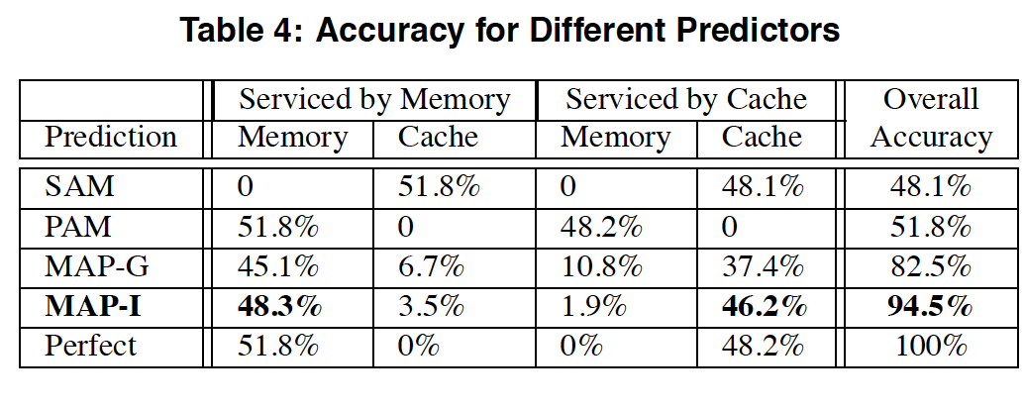
Prediction Accuracy of MAP
MAP-PC

Slide 30
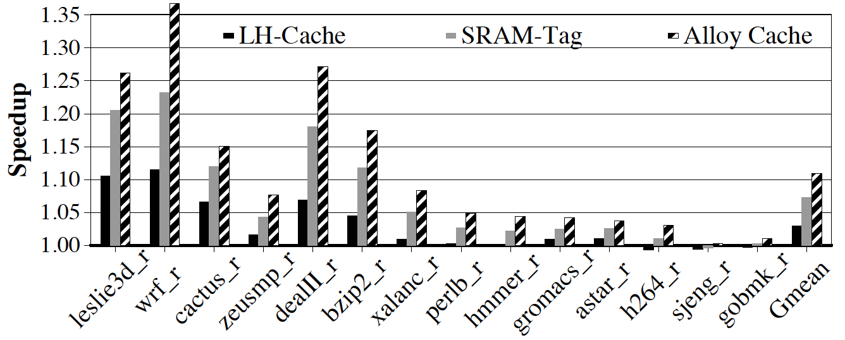
What about other SPEC benchmarks?

Slide 31
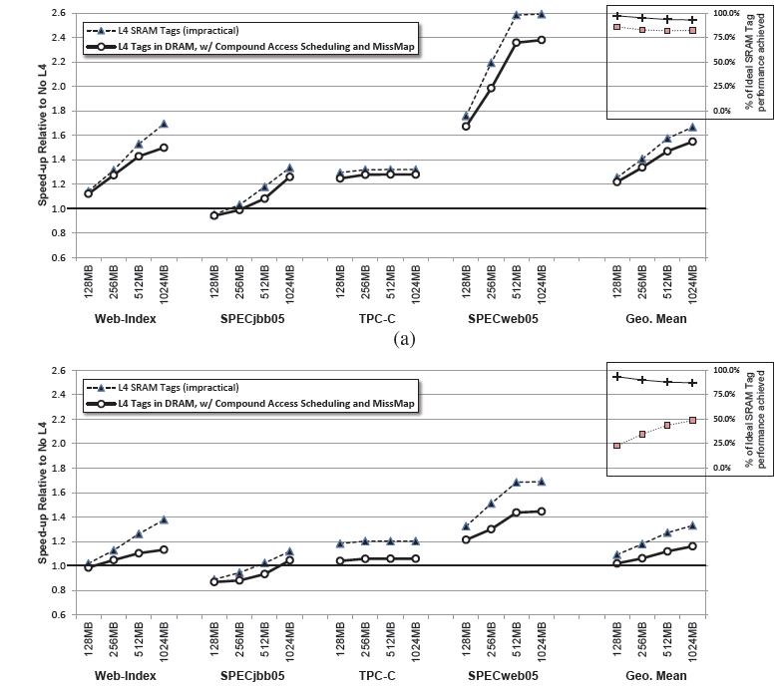
LH-Cache Addendum: Revised Results
http://research.cs.wisc.edu/multifacet/papers/micro11_missmap_addendum.pdf

Slide 32
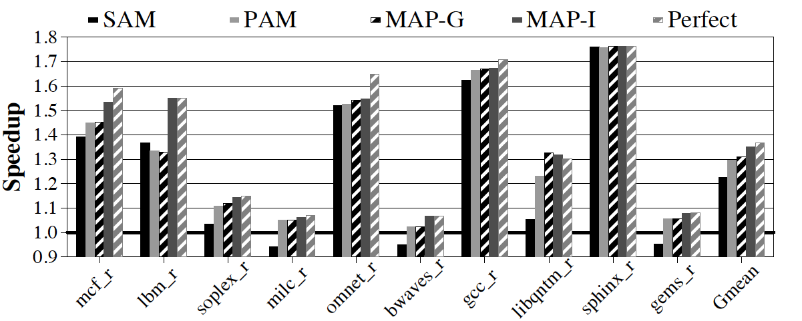
SAM vs. PAM

