Slide 1



CANDY: Enabling Coherent DRAM Caches for Multi-node Systems
MICRO 2016
Taipei, Taiwan
Oct 18, 2016
Chiachen Chou, Georgia Tech
Aamer Jaleel, NVIDIA
Moinuddin K. Qureshi, Georgia Tech

Slide 2
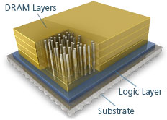
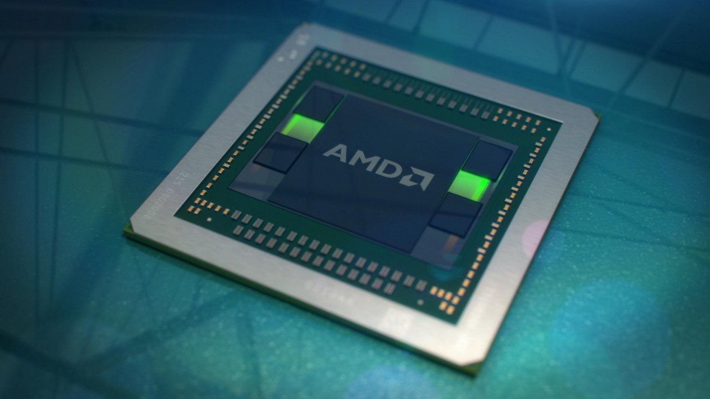
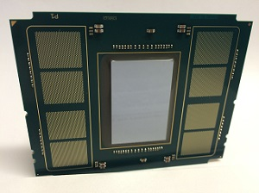
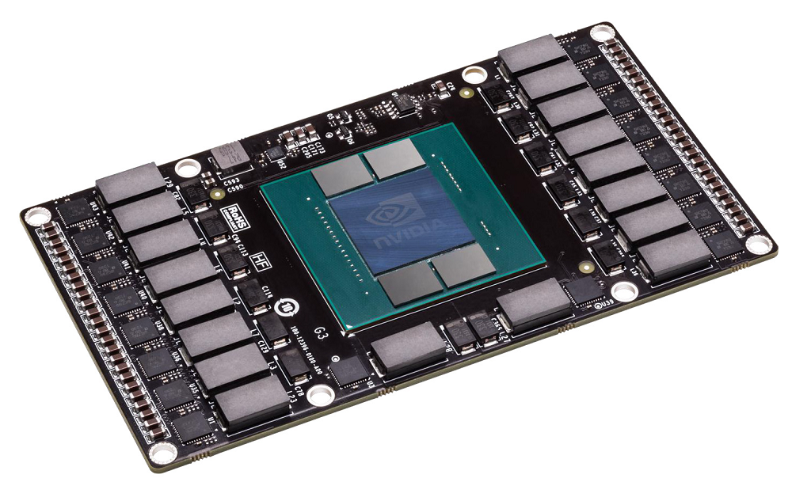
3D-DRAM Helps Mitigate Bandwidth WALL
3D-DRAM: High Bandwidth Memory (HBM)
P
P
L1
L1
L3$
3D-DRAM
DRAM Cache
Off-chip DRAM
Compared to DDR, 3D DRAM as a cache (DRAM Cache) transparently provides 4-8X bandwidth
AMD Zen
Intel Xeon Phi
NVIDIA PASCAL
courtesy: Micron, AMD, Intel, NVIDIA

Slide 3
dram caches for multi-node systems
Prior studies focus on single-node systems
Node 0
Node 1
P
P
P
P
P
P
P
P
P
P
P
P
L3$
L3$
L3$
DRAM$
DRAM$
DRAM$
long-latency
inter-node network
Off-chip DRAM
Off-chip DRAM
Off-chip DRAM
We study DRAM caches for Multi-Node systems

Slide 4

Memory-Side Cache (MSC)
Implicitly coherent, easy to implement
Node 0
Node 1
P
P
P
P
P
P
P
P
L3
L3
DRAM$
local
local
DRAM$
long-latency
interconnect
Memory-Side Cache is implicitly coherent and simple to implement

Slide 5

shortcomings of Memory-Side Cache
Implicitly coherent, easy to implement
Cache only local data, long latency of remote data
Node 0
Node 1
P
P
P
P
P
P
P
P
L3
L3
~4MB
✘
DRAM$
remote
DRAM$
~1GB
long-latency
interconnect
A L3 cache miss of remote data incurs a long latency in Memory-Side Cache

Slide 6
Coherent DRAM caches (CDC)
Cache local/remote data, save remote miss latency
Need coherence support
Node 0
Node 1
P
P
P
P
P
P
P
P
L3
L3
✔
remote
DRAM$
DRAM$
Coherent DRAM Cache saves the L3 miss latency of remote data but needs coherence support

Slide 7
Potential Performance improvement
4-node system, each node has 1GB DRAM$
AVG: 1.3X
Ideal-CDC outperforms Memory-Side Cache by 30%

Slide 8
Agenda
The Need for Coherent DRAM Cache
Challenge 1: A Large Coherence Directory
Challenge 2: A Slow Request-For-Data Operation
Summary

Slide 9
Directory-Based Coherence Protocol
Coherence Directory (CDir): Sparse Directory*, tracking cached data in the system
Node 0
Node 1
P
P
P
P
P
P
P
P
LLC
LLC
Coherence
Directory
Coherence
Directory
CDir
CDir
Memory
Memory
On a cache miss, the home node accesses the CDir information
*Standalone inclusive directory with recalls

Slide 10
Large Coherence Directory
Coherence directory size must be proportional to cache size
Memory-Side Cache
Coherent DRAM Cache
P
P
P
P
P
P
P
P
8MB
L3
L3
On-Die CDir for L3
DRAM$
1GB
1MB
DRAM$
Coherence
Directory
64MB
Memory
Memory
For giga-scale DRAM cache, the 64MB coherence directory incurs storage and latency overheads

Slide 11
Where to place Coherence Directory?
Options:
1. SRAM-CDir: place the 64MB CDir on die (SRAM)
2. Embedded-CDir: embed the 64MB CDir in 3D-DRAM
DRAM$
miss
P
P
P
P
P
P
P
P
L3
L3
SRAM
CDir
64MB
L3
DRAM$
DRAM$
L4$
3D-DRAM
CDir 64MB
SRAM-CDir
Embedded-CDir
CDir Entry
Embedding CDir avoids the SRAM storage, but incurs long access latency to CDir

Slide 12
DRAM-cache Coherence Buffer (DCB)
Caching the recently used CDir entries for future references
in the unused on-die CDir of L3 coherence
Memory-Side Cache
Coherent DRAM Cache
DRAM$
miss
P
P
P
P
P
P
P
P
L3
DRAM$
✘
On-Die CDir for L3
On-Die CDir for L3
DRAM-cache
Coherence Buffer
1MB
1MB
Unused
Hit
Miss
CDir
3D-DRAM
CDir Entry
64MB
DCB mitigates the latency to access embedded CDir

Slide 13
Design of Dram-cache coherence buffer
One access to CDir in 3D-DRAM returns 16 CDir entries.
insert
SRAM
DCB
miss
=
=
=
=
Demand
CDir
3D-DRAM
64B
(16 CDir entries)
Set
S
S+1
S+2
S+3
4-way set-associative
The hit rate of DCB is 80% with the co-optimization of DCB and embedded-CDir

Slide 14
Effectiveness of DCB
4-node system, each node has 1GB DRAM$
DRAM-cache Coherence Buffer (DCB): 21%

Slide 15
Agenda
The Need for Coherent DRAM Cache
Challenge 1: A Large Coherence Directory
Challenge 2: A Slow Request-For-Data Operation
Summary

Slide 16
Slow Request-For-Data (RFD)
RFD (fwd-getS): read the data from a remote cache
cache
miss
Home Node
Remote
Coherence
Directory
DRAM$
L3
Request-For-Data
MSC:
SRAM$
Read
CDC:
DRAM$
Read
extra latency
In Coherent DRAM Cache, Request-For-Data incurs a slow 3D-DRAM access

Slide 17
Sharing-aware bypass
Request-For-Data accesses only read-write shared data
cache
miss
Home Node
Owner
Coherence
Directory
P
P
P
P
M
L3
M
DRAM$
Request-For-Data
Read-write shared data bypass DRAM caches and are stored only in L3 caches
Notes:
.

Slide 18
Performance improvement of CANDY
DRAM Cache for Multi-Node Systems (CANDY)
AVG: 1.25X
CANDY: 25% improvement (5% within Ideal-CDC)

Slide 19
Summary
Coherent DRAM Cache faces two key challenges:
Large coherence directory
Slow Request-For-Data
DRAM Cache for Multi-Node Systems (CANDY)
DRAM-cache Coherence Buffer with embedded coherence directory
Sharing-Aware Bypass
CANDY outperforms Memory-Side Cache by 25% (5% within Ideal Coherent DRAM Cache)

Slide 20


CANDY: Enabling Coherent DRAM Caches for Multi-node Systems
Thank you
MICRO 2016
Taipei, Taiwan
Oct 18, 2016
Chiachen Chou, Georgia Tech
Aamer Jaleel, NVIDIA
Moinuddin K. Qureshi, Georgia Tech
Computer Architecture and Emerging Technologies Lab, Georgia Tech

Slide 21
Backup Slides

Slide 22
DCB Hit RatE

Slide 23
Operation breakdown

Slide 24
Inter-node Network Traffic reduction
Compare to MSC, CANDY reduces 65% of the traffic

Slide 25
Performance (NUMA-Aware systems)

Slide 26
Sharing-Aware Bypass (1)
(1) Detecting read-write shared data
(2) Enforcing R/W shared data to bypass caches
cache
request
Home Node
Coherence
Directory
CDir Entry
M
1
RWS
Memory Read
Invalidate
Request-For-Data
Flush
Read-write shared data,
set Read-Write Shared (RWS) bit
Sharing-Aware Bypass detects read-write shared data at run-time based on coherence operations

Slide 27
Sharing-Aware Bypass (2)
(1) Detecting read-write shared data
(2) Enforcing R/W shared data to bypass caches
L4 cache miss and L3 dirty eviction
BypL4 bit
BypL4 bit
+ Data
Requester
Home Node
cache
miss
RWS
1
L3
M
M
1
1
Dirty Eviction
Yes
BypL4?
BypL4
No
BypL4?
Yes
DRAM$
Data
No
Sharing-Aware Bypass enforces R/W shared data to be stored only in L3 caches

Slide 28
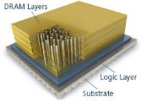

methodology
P
P
P
P
4-Node
DRAM$
Off-chip DRAM
4-Node, each node:
4 cores 3.2 GHz
2-wide OOO
4MB 16-way L3 shared cache
 | DRAM Cache | DRAM Memory
Capacity | 1GB | 16GB
Bus | DDR3.2GHz, 64-bit | DDR1.6GHz, 64-bit
Channel | 8 channels, 16 banks/ch | 2 channels 8 banks/ch
Evaluation in Sniper simulator, baseline: Memory-Side Cache
13 parallel benchmarks from NAS, SPLASH2, PARSEC, NU-bench

