Slide 1
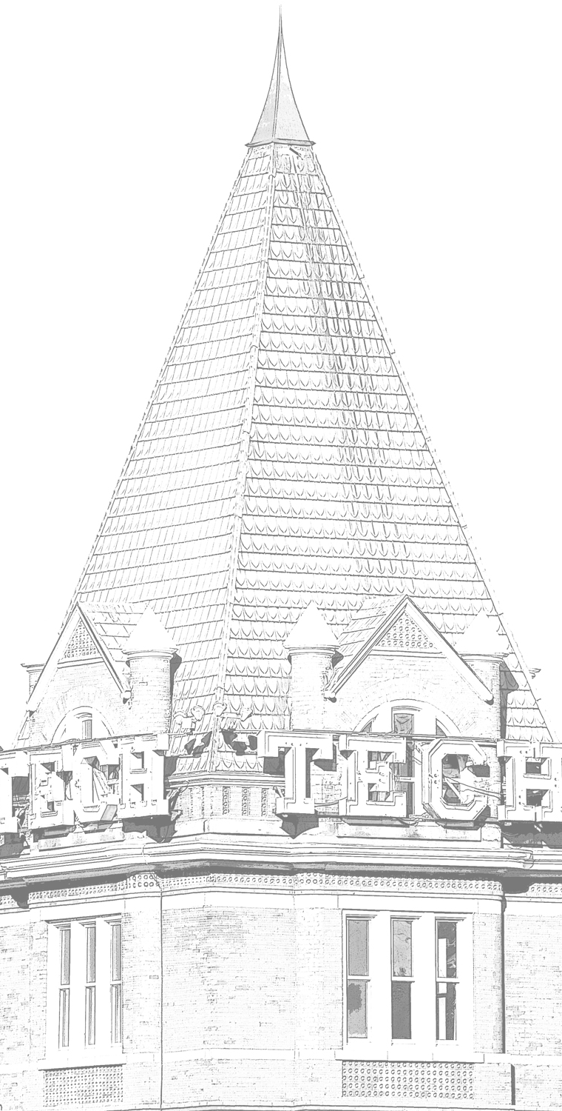

DEUCE: Write-Efficient Encryption for PCM
March 16th 2015
ASPLOS-XX Istanbul, Turkey
Vinson Young
Prashant Nair
Moinuddin Qureshi
Notes:
Good morning, I will be talking about “DEUCE: Write-Efficient Encryption for Phase Change Memory.”
I am Vinson Young.
This work is in collaboration with my labmate Prashant Nair and my advisor Moinuddin Qureshi.

Slide 2
Executive Summary
Bit flips expensive in Phase Change Memory (PCM)
Affects Lifetime, Power, and Performance
PCM system optimized to reduce bit flips (~12%)
PCM more vulnerable to attacks ➔ stolen module
Secure PCM with encryption
Problem: Encryption increases bit flips 12%➔50%
Goal: Encrypt PCM without causing 4x bit flips
Insight: re-encrypt only modified words
DEUCE: write-efficient encryption scheme
Result: bit flips reduced 50%➔23% (27% speedup)
Notes:
“Phase change memory (PCM) is an emerging memory technology.”
“Writes are expensive in PCM.”
Writing causes bits to flip, which affects lifetime, power, and performance.
Therefore, PCM systems are “write-optimized” and write only bits that have changed.
Fortunately, a typical write operation only causes 12% of bits to flip.
PCM is non-volatile, which means, if someone steals a PCM DIMM, they can easily retrieve sensitive data.
We can protect PCM by encryption
But, by design, encryption will cause 50% of bits to flip, regardless of what is being written. “The extra bit flips degrade lifetime, power, and performance.”
The goal of our paper is to do encryption on PCM, without causing too many bit flips.
Our proposed design, DEUCE, reduces bit flips for secure memory by re-encrypting only the modified words in a line.
DEUCE reduces bit flips from 50% to 23%, which also provides a speedup of 27%.

Slide 3
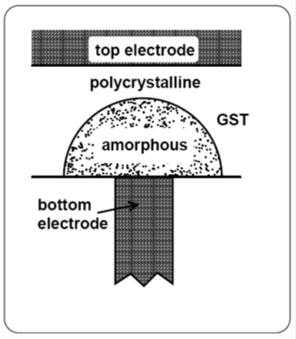
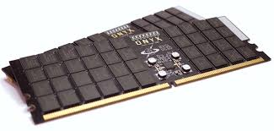
PCM as main memory
Phase Change Memory (PCM)
Improved scaling + density
Non-volatile (no refresh)
Key Challenge
Writes: Limited endurance (10-100 million writes)
Writes: Slow and limited throughput
Writes: Power-hungry
PCM systems are designed to reduce writes
Notes:
Phase change memory (PCM) is an upcoming alternative to DRAM for main memory.
In particular,
1. it has improved scaling and density over DRAM, and
2. it is non-volatile, so it avoids the refresh problem in DRAM.
One of the biggest challenges in PCM is how you handle the writes,
Because writes have limited endurance, writes are slow, and writes are power-hungry.
Therefore, ➔PCM systems need to be designed to reduce write operations

Slide 4
Typical Write optimizations in pcm
Data-Comparison-Write
Flip-N-Write
Write only flipped bits
Invert if too many bit flips
Cache
Cache
Comparison Write
Flip-N-Write
Optimizations reduce bit-flips per write to 10-12%
Notes:
“In fact, several proposals have looked at making PCM write-efficient.”
For example,
Data-comparison-write (DCW), reduces the number of bits written to PCM by ➔writing only modified bits.
Here, ➔red shows the modified bits in a cache line being written to PCM.
With Data-comparison-write, we will only write ➔these bits to PCM.
Another proposal, ➔Flip-N-Write, further reduces bit flips by inverting the word if more than half of the bits of that word are modified.
For example, here➔, rather than writing 3➔bits for a 4-bit word, we will invert ➔and write the word to get fewer bit flips.
These schemes are quite effective in practice, and they ➔reduce the bit flips per write to about 10-12% on average.
“These optimizations are critical--- to be able to use PCM and get the benefits of scalability and non-volatility”

Slide 5




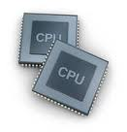

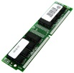
SECURITY vulnerability of PCM
Non-volatility: Power savings Security
More vulnerable to stolen-memory attack
Stolen memory attack
Bus snooping attack also possible
We want to protect PCM from both
“stolen memory attack” and “bus snooping attack”
Notes:
PCM Non-volatility is great, it saves refresh power.
But it’s not so great for security---, because someone could steal ➔a memory module, and they have ➔ all the time to retrieve sensitive information.
(HW probing/monitoring. Cold Boot. DMA Attacks)
2. PCM is also vulnerable to other traditional memory attacks, such as bus snooping➔,
where an attacker can read communication between cpu and main memory
In fact➔, bus snooping was used to crack the encryption scheme used in Xbox.
➔We want to protect PCM from both ‘stolen memory attack’ and ‘bus snooping attack’

Slide 6
Encryption on PCM
Protect PCM using memory encryption
Encryption causes 50% bit flips on each write
1 bit flip in line ➔ 50% bit flips in encrypted line
Cache
Encrypted PCM
Avalanche Effect
Encryption causes 50% bit flips ➔ Write-intensive
Notes:
We can protect PCM against these attacks by encrypting memory
But, the problem ➔is that “encryption” causes 50% of bits to flip on every write, even if a single bit in the line is modified.
This is commonly referred to as the avalanche effect
➔Thus encryption is write-intensive
“What happens to all of the schemes that we talked about for reducing bit flips, when we have encrypted PCM?“

Slide 7
encryption on pcm costly
4x
Encryption increases bit flips from 12% to 50% (4x!)
Notes:
“They don’t work as well”
This graph shows % of bit flips per memory write for the two schemes, Data-Comparison-Write and Flip-N-Write, for both unencrypted memory, and encrypted memory.
For the baseline system without encryption, these schemes are very effective, and cause only about 10-12%➔ of the bits to flip
➔but with encryption, the bit flips increase to about 50%
Thus, encryption increases ➔bit flips by a factor of almost 4, which causes almost a 4x reduction in lifetime, higher power consumption, and lower performance.

Slide 8
GOAL: write-efficient encryption
Goal: How do we implement memory encryption, without increasing bit flips by 4x?
Notes:
“We want to do encryption for PCM, but without the extra bit flips”

Slide 9
outline
Introduction to PCM and encryption
Background on Counter-mode Encryption
DEUCE
Results
Summary
Notes:
Before I discuss our solution, let me first describe how memory encryption is currently done

Slide 10
Why pad-based encryption?
Direct Decryption
Pad-based Decryption
Encrypted Data
Encrypted Data
PCM
PCM
XOR in critical path
AES in critical path!
AES
AES
Key
AES
Key
Pad
+
Data
Data
Cache
Cache
Pad-based decryption has low-latency
Notes:
“We want to do encryption, but not affect memory latency significantly, which means we want algorithms that allow for fast decryption.”
If we encrypt the data directly with AES➔, then we have to read ➔the data then pass it through the AES engine for decryption.
This means the ➔AES latency is in the critical path for memory reads, which is undesirable.
➔Pad-based encryption allows you to do encryption without having AES latency in the critical path.
Pad decryption uses the key with AES to generate a ➔Pad in parallel with memory access.
Decryption➔ is performed by simply XORing the memory content with the Pad, which incurs negligible latency overhead.

Slide 11
need for unique pads
(0000) ⊕ Pad = Pad
Attack! Insecure if pad learned
PAD
PAD
ZEROES
ZEROES
PAD
+
PAD
PAD
DATA
+
ENCRYPTED
ENCRYPTED
Secure pad encryption cannot re-use pads
Notes:
“We cannot use the same pad for the entire memory, as this makes the memory vulnerable to attacks”
For example, an attacker could snoop a data line that is supposed to contain all ZEROES➔. Therefore, after encryption, this line will store the PAD.
The attacker can read this PAD➔, and use it to decrypt the entire memory.

Slide 12
CounTeR-mode ENCRYPTION
Different pad per line address
Different pad per write to same line➔per-line counter
PAD1
PAD1
PAD2
PAD2
Line1
Line1
ENCRYPT1
+
Line2
Line2
ENCRYPT2
+
PAD-ctr3
PAD-ctr2
PAD-ctr1
Line1 Time1
Secured!
Line1 Time2
ENCRYPT1
Line1 Time3
ENCRYPT2
+
Pad changes every write ➔ 50% bit flips every write
Notes:
The problem of ensuring unique pads is solved by “CTR-mode-encryption”
To prevent an attacker from using pad obtained from one line to read data from another line, this scheme generates a different pad for each line by using the line address. ➔
Furthermore➔, to ensure unique pads for consecutive writes to the same line, it uses a per-line counter that gets incremented on every write. ➔
“Thus, Ctr-mode-encryption uses line address, and a counter, to generate unique pads, not only for each line, but also for different writes to the same line.”
So, regardless of how many bits flip in the line being written, every time it will get ➔XORed with a different random pad, causing 50% bit flips.

Slide 13
outline
Introduction to PCM and encryption
Background on Counter-mode Encryption
DEUCE
Results
Summary
Notes:
Counter-mode encryption causes 50% bit flips because it re-encrypts the entire line on every write
To reduce the bit flips, what if we…

Slide 14
Insight 1
What if we re-encrypt only modified words?
Cache
Remains encrypted
Encrypted PCM
0
1
0
Re-encrypted
Re-encrypted
Reduce bit flips by re-encrypting only modified words
Notes:
…we re-encrypt only the modified words?
//Here, ➔red shows the modified bits in a cache line being written to encrypted PCM.
Remember, in the baseline, if we write ➔to encrypted PCM, we will cause 50% of the bits to flip.
➔But if we re-encrypt ➔ONLY the modified words, then we will cause 50% bit flip, but only for this word, reducing bit flips.
“How would you do ‘partial re-encryption’?
In fact, it’s quite easy with counter-mode-encryption.
We can have a different counter for the modified word, and the modified word would use the pad generated by this counter. All other words could continue to use the pad generated by the older counter and remain encrypted, so all the contents of the line remain secure.”

Slide 15
Insight 2: Efficient implementation
Naïve implementation needs per-word counters/pads
Reduce storage overhead by using only two counters
0
0
0
0
0
0
0
0
1
0
0
0
0
0
0
0
1
2
0
1
2
3
4
5
6
7
8
0
0
0
0
1
2
3
4
5
0
0
0
0
0
1
2
3
4
0
0
0
0
0
0
1
2
3
0
0
0
1
2
3
4
5
6
0
0
1
2
3
4
5
6
7
Encrypted PCM
Expensive!
0
0
0
0
0
0
0
0
8
0
0
0
0
0
0
0
7
8
0
1
2
3
4
5
6
7
8
0
0
0
0
4
5
6
7
8
0
0
0
0
0
5
6
7
8
0
0
0
0
0
0
6
7
8
0
0
0
3
4
5
6
7
8
0
0
2
3
4
5
6
7
8
Encrypted PCM
Do efficient partial re-encryption with only two counters
Notes:
“But, any word can be modified at any time➔, so you would need a counter per word➔, which would be quite costly”
As each counter is, say, 2-bytes, having a 2-byte counter➔ for every 2-byte word would be prohibitively expensive.
We can reduce the storage overhead, ➔by using only two counters. One, for the reference line➔. The other,➔, for the words that are modified relative to the reference line.”
“Notice that all the modified words use the same counter.
Instead of using separate counters, we just need a single bit to tell which counter to use.
However, after enough writes, ➔every word becomes “modified” at some point, so we should also reset the reference line every so often.”
“Bear with me for a bit, we will explain this all shortly”
Thus, we do efficient partial re-encryption with only two counters.
---------------------------
For example, if we keep writing to the line, we will continue re-encrypting modified words, while incrementing the per-word counter. ➔➔”Note that, whenever even a single bit in the word gets modified, the entire word gets re-encrypted. So, we want the word size to be small, say 2 bytes➔➔. Requiring each 2-byte word have a per-word counter that in itself could be larger than 2 bytes would be prohibitively expensive.”

Slide 16

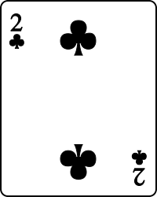
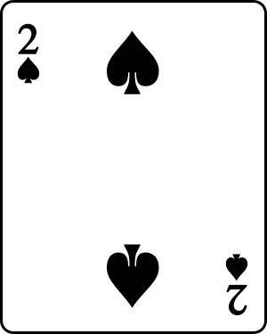
DEUCE: Dual Counter Encryption
Each line has two counters:
Leading counter (LeadCTR): incremented every write
Trailing counter (TrailCTR): updated every N writes (Epoch)
“Modified” bit per word to choose between counters
16
Notes:
We propose a scheme called Dual-Counter Encryption, or “DEUCE”.
Each line has two counters, a LeadingCTR that is incremented on every write (for encrypting “modified” words), and a TrailingCTR that is updated every N writes, in a write interval called Epoch, (for encrypting the reference “unmodified” words). //(Re-encrypting the whole line with TrailingCTR additionally allows us to reset the “modified” bits, explained next.)
2. Each line has a “modified” bit per-word to choose which counter to use.
-----------------------------------------------
//“Unmodified” words can be encrypted with an less frequently-updated counter.
//“Modified” words can be re-encrypted with a frequently-updating counter.

Slide 17
DEUCE: operation
On a write
Epoch Start
Between Epoch
TrailCTR=LeadCTR
Re-encrypt ALL words
Reset “modified” bits
LeadCTR++
Re-encrypt words modified since Epoch
Set “modified” bits
DEUCE re-encrypts only words modified since Epoch
Notes:
On epoch start:
➔We re-encrypt ALL words in the line with TrailingCTR, and reset the “modified” bits, as all words use our reference state.
“This is expensive, but it only happens every N writes”
Between epochs:
➔We increment LeadingCTR, and re-encrypt only words that have been modified since the start of the Epoch with this LeadingCTR. We then update “modified” bits.
➔Thus, DEUCE re-encrypts only words modified since Epoch start.
-----------
If the write happens on an epoch start:
➔We update TrailingCTR to LeadingCTR’s next value, and use it to re-encrypt ALL words in the line, and reset the “modified” bits as this is our reference state.
“This is expensive, but it only happens every N writes”
On a write, if it is between epochs:
➔We increment LeadingCTR, and use it to re-encrypt words that have been modified since the start of the last Epoch. We then update the “modified” bits to record which words have been encrypted with LeadingCTR.
/* */

Slide 18
DEUCE: EXAMPLE (EPOCH = 4 writes)
Encrypted Words
ALL
W0
W7
W0
W4
W7
W0
W4
W7
ALL
W2
W4
LCTR
0
1
2
3
4
5
TCTR
0
0
0
0
4
4
Get TrailCTR by masking 2 LSB off LeadCTR
DEUCE needs only one physical counter per line
X
Modified Words in Write
W0,W7
W4
W7
W2,W4
0
1
2
3
4
5
DEUCE does partial re-encryption between Epochs
Notes:
For example,
The line on bottom represents writes to an 8-word line. Here, the epoch is chosen to be every 4 writes.
The top shows which words must be re-encrypted as a result of the writes.
➔On Write 0, the start of an Epoch, the ➔whole line is encrypted and “modified” bits reset.
➔On Write 1, Word0 and Word7 are written, so ➔LeadingCTR is incremented and used to re-encrypt Word0 and Word7. The “modified” mask is now Word0 and Word7.
➔On Write 2, Word4 is written. Here, we re-encrypt not only Word4, but also Word0 and Word7, as they had been modified previously in this epoch. We have to re-encrypt Word0 and Word7 as we do not keep track of individual counters. The “modified” mask is now Word0, Word4, and Word7.
➔On Write 3, Word7 is written again, and we re-encrypt Word0, Word4, and Word7.
➔On Write 4, the start of another Epoch, ➔TrailingCTR is updated to LeadingCTR, and all words are re-encrypted.
➔On Write 5, Word2 and Word4 are written, and thus ➔re-encrypted
➔DEUCE saves bit flips by doing partial re-encryption between Epochs.
➔Note that you can get TrailingCTR by masking 2 LSB off LeadingCTR.
DEUCE needs only one physical counter per line, which is same as baseline system.
-------------------------------
➔On Write 0, the start of an Epoch, the ➔whole line is encrypted, and TrailingCTR is updated to LeadingCTR to 0.
➔On Write 1, Word0 and Word7 are written, so ➔LeadingCTR is incremented and used to re-encrypt Word0 and Word7. The “modified” mask is now Word0 and Word7.
➔On Write 2, Word4 is written, so ➔LeadingCTR is incremented and used to re-encrypt not only Word4, but also Word0 and Word7, to prevent pad re-use. The “modified” mask is now Word0, Word4, and Word7.
➔On Write 3, Word7 is written again, and ➔LeadingCTR is incremented and used to re-encrypt Word0, Word4, and Word7.
➔ On Write 4, the start of another Epoch, ➔TrailingCTR is updated to LeadingCTR, and all words are re-encrypted with TrailingCTR.
➔On Write 5, Word2 and Word4 are written, and ➔ they are thus re-encrypted with LeadingCTR of 5.

Slide 19
DEUCE: how to Decrypt?
DEUCE generates two pads with LCTR and TCTR
Which pad to use decided by the “Modified” bits
Line counter
1
0
0
1
1
0
0
0
AES
Encrypted Line
LCTR
Pad - LCTR
Mask
4 LSB
Pad - TCTR
AES
TCTR
Combined
Decrypted Line
Notes:
DEUCE decrypts data by generating two pads at once,
based on LeadingCTR➔, and TrailingCTR➔, both derived from the line counter.
➔Which pad is used to decrypt each word is decided by the ➔“modified” bits.
➔ “modified” words are decrypted with LeadingCTR
➔ “unmodified” words are decrypted with TrailingCTR.
and the decrypted words are combined to form the decrypted line.

Slide 20
outline
Introduction to PCM and encryption
Background on Counter-mode Encryption
DEUCE
Results
Summary
Notes:
Next, evaluation.

Slide 21
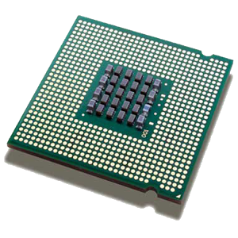
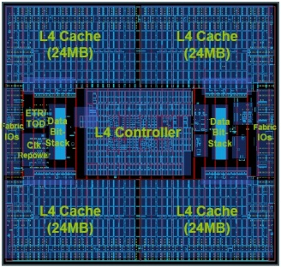
methodology
Shared L4 Cache
Phase Change Memory
CPU
Core Chip
8 cores, each 4GHz 4-wide core
L1/L2/L3➔32KB/256KB/1MB
Notes:
We simulated an 8-core system, each core 4GHz and 4-wide.

Slide 22
methodology
Shared L4 Cache
Phase Change Memory
CPU
Shared L4 Cache:
64 MB capacity
50 cycle latency
Notes:
The cores access a shared L4 cache, 64MB in size and with 50 cycle latency.

Slide 23
methodology
Shared L4 Cache
Phase Change Memory
CPU
Phase Change Memory [Samsung ISSCC’12]
4 ranks, each 8GB ➔ 32GB total
Read latency 75ns
Write latency 150ns (per 128-bit write slot)
Notes:
L4 misses access a PCM system, modeled after Samsung’s prototype in [ISSCC ‘12]
Our PCM system has 4 ranks, each 8GB,
has read latency of 75ns, and
has write latency of 150ns.
—IMPORTANT—
PCM chips typically do not have enough power to write all the bits in the line in one shot.
They can only write about 128 bits.
So, if a line needs to write more than 128 bits, it needs multiple write slots, which means higher write latency, and reduced performance.

Slide 24
methodology
Shared L4 Cache
Phase Change Memory
CPU
Workloads
SPEC2006: High MPKI, rate mode
4 billion instruction slice
DEUCE: Epoch=32; Word size=2B
Notes:
We simulated high MPKI workloads from SPEC2006, and ran 4 billion instructions each, in rate mode.
We show results for DEUCE using an epoch interval of 32 writes, and at a granularity of 2 bytes.

Slide 25
RESULTS: Bit flip analysis
DEUCE eliminates two-thirds of the extra bit flips caused by encryption
Notes:
This graph shows % of bit flips per memory write, for 3 schemes:
Encrypted PCM using Flip-N-Write,
➔Unencrypted PCM using Flip-N-Write.
➔Encrypted PCM using DEUCE
DEUCE reduces bit flips across a wide range of benchmarks. Encrypted has 42% bits flipped, unencrypted has 10%, and DEUCE has 23%.
Thus, ➔DEUCE eliminates two-thirds of the additional bit flips caused by encryption.

Slide 26
RESULTS: SPEEDUP&POWER analysis
Speedup
Energy-Delay-Product
+27%
-43%
FNW
DEUCE
Unencrypted
Bit flip reduction improves speedup and EDP
Notes:
We evaluate the effect of bit flips on speedup and energy,
Normalized to Encrypted PCM.
DEUCE reduces bit flips, which reduces number of write slots consumed on average.
As writes can indirectly delay reads and affect performance, Deuce’s reduction in bit flips gives a ➔27% speedup over encrypted PCM.
➔The reduction in write slots used also reduces Energy-Delay-Product, by ➔43%.

Slide 27
RESULTS: Lifetime analysis
Heavily-written bits still heavily-written with DEUCE
Solution: Zero-cost “Horizontal” Wear Leveling
+100%
DEUCE
with HWL
Lifetime improvement of 2x
Notes:
Notice, we have not talked about lifetime.
Even though DEUCE reduces bit flips from 50% to 23%, we do not see improvement in lifetime because:
Using DEUCE, heavily-written bits are still heavily-written.
Our paper describes ➔“Horizontal” Wear Leveling, that rotates bits within a line, to make the wearout within the line uniform. “We also have a zero-storage-overhead solution that leverages existing structures to do Horizontal Wear Leveling. I refer you to the paper for details.”
With horizontal wear leveling, DEUCE increases lifetime to➔ 2x encrypted memory.

Slide 28
outline
Introduction to PCM and encryption
Baseline–Counter-mode Encryption
DEUCE
Results
Summary
Notes:
In summary, …

Slide 29
Executive Summary
Bit flips expensive in Phase Change Memory (PCM)
Affects Lifetime, Power, and Performance
PCM system optimized to reduce bit flips (~12%)
PCM more vulnerable to attacks ➔ stolen module
Secure PCM with encryption
Problem: Encryption increases bit flips 12%➔50%
Goal: Encrypt PCM without causing 4x bit flips
Insight: re-encrypt only modified words
DEUCE: write-efficient encryption scheme
Result: bit flips reduced 50%➔23% (27% speedup)
Notes:
“Phase change memory (PCM) is an emerging memory technology.”
“Writes are expensive in PCM.”
Writing causes bits to flip, which affects lifetime, power, and performance.
Therefore, PCM systems are “write-optimized” and write only bits that have changed.
Fortunately, a typical write operation only causes 12% of bits to flip.
PCM is non-volatile, which means, if someone steals a PCM DIMM, they can easily retrieve sensitive data.
We can protect PCM by encryption
But, by design, encryption will cause 50% of bits to flip, regardless of what is being written. “The extra bit flips degrade lifetime, power, and performance.”
The goal of our paper is to do encryption on PCM, without causing too many bit flips.
Our proposed design, DEUCE, reduces bit flips for secure memory by re-encrypting only the modified words in a line.
DEUCE reduces bit flips from 50% to 23%, which also provides a speedup of 27%.

Slide 30
Thank you
Notes:
That brings me to the end of my presentation. Thank you for your attention. I'd be glad to answer any questions you might have.

Slide 31
EXTRA SLIDES

Slide 32
Deuce FOR OTHER nvm
In-place writing NVM
RRAM
STT-MRAM

Slide 33
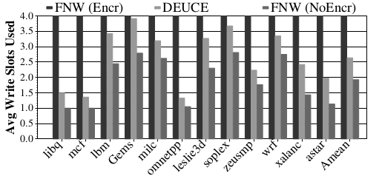
Write slots
PCM is power-limited
Write-slot of 128 Flip-N-Write-enabled bits (64 bit flips)
Average number of write slots used per write request. On average, DEUCE consumes 2.64 slots whereas unencrypted memory takes 1.92 slots out of the 4 write slots

Slide 34
IMPROVING PCM WEAR LEVELING
Vertical Wear Leveling (Start-gap)—Inter-line leveling
Horizontal Wear Leveling—Intra-line leveling
0
A
⬅START
0
C Rot3
B Rot4
1
B
D Rot3
1
C Rot4
2
C
A Rot2
⬅START
2
D Rot4
3
D
A Rot3
3
B Rot2
GAP ➔
4
GAP ➔
4
B Rot3
Vertical Wear Leveling
Horizontal Wear Leveling
Re-use vertical wear leveling to level inside line
Notes:
There is a form of wear-leveling (start-gap) already proposed for PCM that moves cachelines in memory to better level the wear in PCM. This can be thought of as vertical wear leveling, as cachelines are moved up and down for wear leveling.
The idea is that a Gap cacheline is moved through the cache to rotate cachelines in memory. We will see in the example that as gap moves up the memory, the lines are shifted down. After a full rotation, all lines are moved.
The indices can be calculated by a simple function of the “Start” and “Gap” registers.
We propose to augment start-gap with a rotation amount based on the start register. As we can see in the example, as gap moves through each cacheline, the rotation amount in each cacheline is updated. This rotates the cacheline “horizontally” to improve wear leveling.
Thus, we re-use vertical wear leveling hardware to perform horizontal wear leveling within a cacheline.

Slide 35
QUESTION: IS it secure?
Aren’t you re-using the pad?
AES-CTR-mode
Unique full pad per ever write.
DEUCE
Epoch start, uses unique full pad
Between epochs, uses a unique full pad per write, to re-encrypt modified words. Unmodified words simply not touched
➔whole line is always encrypted, and pads are not re-used

Slide 36
minimum re-encrypt
Words modified
0
0
0
0
0
0
0
0
Value of Leading Counter (Epoch=4)
W2
1
W7
2
W6
3
4
4
4
4
4
4
4
4
W0, W4, W5
4
4
4
5
5
5
W0
4
6
W0, W3, W4
4
7
4
7
4
7
8
8
8
8
8
8
8
8
Notes:
W1 W3, W2, W1, (baggage. Then)
-> “4 write ops. Each modifying subset of words. First write … Re-encrypt this. Second write, re-encrypt this.
Continuing with the previous example on the left.
We have added yellow to correspond with encrypting with pad/(ctr=2).
Remember that we have a goal of not repeating pads used.
If we modify an unmodified region, we can simply re-encrypt with pad/(ctr=1). However, if we modify a previously modified pad/(ctr=1) region, we have to increment the counter and use pad/(ctr=2).
To read/decrypt the data, now you need to generate the pads for ctr=0, ctr=1, and ctr=2 before you can proceed. As time goes on, you might need 32 simultaneous pad generations, and have a storage overhead of 32 counters per cacheline.
This is clearly very inefficient.
Our second insight is, an efficient implementation, in both storage and computation.
In the example on the right, we instead limit the number of distinct ctr/states to 2, to only need 2 pad generations on decryption. As shown in the animation, additional modifications

Slide 37
DEUCE re-encrypt
Words modified
0
0
0
0
0
0
0
0
Value of Leading Counter (Epoch=4)
W2
0
1
W7
0
2
0
2
W6
0
3
0
3
0
3
4
4
4
4
4
4
4
4
W0, W4, W5
4
4
4
5
5
5
W0
4
6
4
6
4
6
W0, W3, W4
4
7
4
7
4
7
4
7
8
8
8
8
8
8
8
8
Notes:
W1 W3, W2, W1, (baggage. Then)
-> “4 write ops. Each modifying subset of words. First write … Re-encrypt this. Second write, re-encrypt this.
Continuing with the previous example on the left.
We have added yellow to correspond with encrypting with pad/(ctr=2).
Remember that we have a goal of not repeating pads used.
If we modify an unmodified region, we can simply re-encrypt with pad/(ctr=1). However, if we modify a previously modified pad/(ctr=1) region, we have to increment the counter and use pad/(ctr=2).
To read/decrypt the data, now you need to generate the pads for ctr=0, ctr=1, and ctr=2 before you can proceed. As time goes on, you might need 32 simultaneous pad generations, and have a storage overhead of 32 counters per cacheline.
This is clearly very inefficient.
Our second insight is, an efficient implementation, in both storage and computation.
In the example on the right, we instead limit the number of distinct ctr/states to 2, to only need 2 pad generations on decryption. As shown in the animation, additional modifications

Slide 38
QUESTION: IS it secure?
What about information leak?
AES-CTR-mode
Can tell when a line is modified
DEUCE
Can tell when a line is modified, and
Can sometimes tell when a word is modified
Similar information leakage

Slide 39
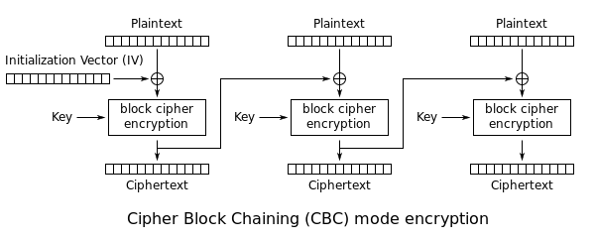
Cipher Block Chaining

Slide 40
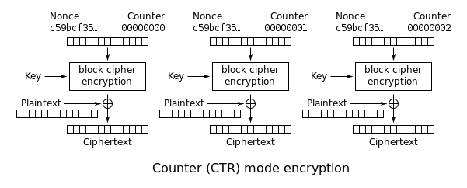
Counter-mode encryption
Security bounds no worse than CBC (NIST-approved)
Weakness to input is accepted to due to the underlying block cipher and not the mode of operation

Slide 41
RESULTS: Bit flip analysis
DEUCE eliminates two-thirds of the extra bit flips caused by encryption
Notes:
This graph shows % of bit flips per memory write, for 3 schemes:
Encrypted PCM using Flip-N-Write,
➔Unencrypted PCM using Flip-N-Write.
➔Encrypted PCM using DEUCE
DEUCE reduces bit flips across a wide range of benchmarks.
Notably, ➔DEUCE eliminates two-thirds of the additional bit flips induced by encryption.
In libquantum➔,
The unencrypted system modifies very few bits. DEUCE cannot reduce bit flips below ~5% because DEUCE 1. Fully re-encrypts on every Epoch, and DEUCE 2. re-encrypts at a 2-byte granularity. However, it still reduces the number of bit flips significantly from a baseline Encrypted memory.
Another interesting set of examples are ➔Gems and soplex.
For these benchmarks, DEUCE has more bit flips than Flip-N-Write. This is likely because the system is frequently modifying all words in a line, making DEUCE ineffective. We have developed a dynamic policy to decide between using FNW or DEUCE to make up for these cases. Please refer to our paper for more details.

