Slide 1

DICE: Compressing DRAM Caches for Bandwidth and Capacity
Vinson Young
Prashant Nair
Moinuddin Qureshi
Notes:
I am Vinson Young. This work is done with my collaborator Prashant Nair, and advisor Moinuddin Qureshi.
My working is on DICE: Compressing DRAM caches for bandwidth and capacity.

Slide 2


MOORE’s LAW HITS BANDWIDTH WALL
Moore’s scaling encounters Bandwidth Wall
Notes:
To continue moore’s law, we have been scaling the number of cores. This increases memory pressure. Memory system scaling has not kept up. Especially with today’s massively scaling workloads.
Memory vendors saw this problem, and have proposed a new memory technology to mitigate the bandwidth wall.

Slide 3
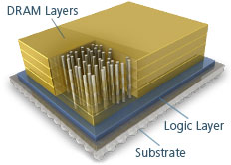
3D-DRAM MITIGATES BANDWIDTH WALL
3D-DRAM
Hybrid Memory Cube (HMC) from Micron,
High Bandwidth Memory (HBM) from Samsung
3D-DRAM improves bandwidth, but does not have capacity to replace conventional DIMM memory
Notes:
The new memory technology uses 3D stacking and through silicon via to provide high memory bandwidth.
//To differentiate, I will refer to this kind of memory as 3D DRAM through out the talk.

Slide 4
3D-DRAM as a CACHE (3D-DRAM CACHE)
CPU
CPU
fast
L1$
L1$
L2$
L2$
3D-DRAM Cache
L3$
Memory Hierarchy
System Memory
MCDRAM from Intel,
HBC from AMD
slow
OS-visible Space
Architecting 3D-DRAM as a cache can improve memory bandwidth (and avoid OS/software change)
Notes:
One way to use the high-bandwidth memory is to architect as a cache, between system memory and L3, to invisibly speed up applications.
Note that this type of organization is already used in today’s Intel Knights Landing MCDRAM (Multi-Channel DRAM), and AMD’s High-Bandwidth Cache.
Improving DRAM caches would have practical impacts on today’s large-scale systems.

Slide 5
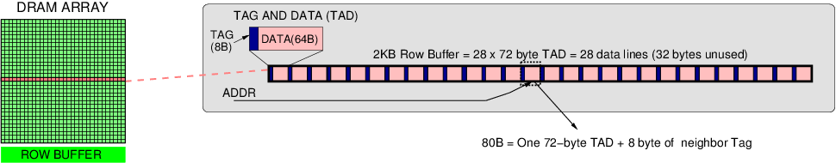
PRACTICAL 3D-DRAM CACHE: ALLOY CACHE
Tags “part-of-line” ➔ Alloy Tag+Data ➔ Avoid Tag Serialization
One “Tag+Data”
Similar to DRAM Cache in KNL: Direct-mapped, Tags in ECC
Practical DRAM cache: low latency and bandwidth-efficient
Notes:
However, a DRAM cache organization would need tags to differentiate the multiple lines that could map into it.
A way to add tags without needing multiple accesses is to store tags alongside each data (like in Alloy cache), and always read this TAG-AND-DATA together
This organization avoids the serialized request for tag then data. And, as requests can be serviced with just one DRAM access, such an organization achieves low hit-latency and efficient bandwidth usage.
We use this organization as our baseline, as the DRAM Cache in Knights Landing is similarly designed—with 72B Tag+Data+ECC.

Slide 6
3D-DRAM Cache Bandwidth is important
On 8-CPU, 1GB DRAM Cache configuration
22%
10%
2x-capacity cache improves performance by 10%.
And, additional 2x bandwidth increases speedup to 22%.
Improving both bandwidth and capacity is valuable.
Notes:
DRAM caches already allow one to invisibly speed up memory accesses significantly (Intel Knights Landing and AMD High-Bandwidth Cache).
We want to see what the potential benefit is if we further improve the systems in terms of capacity and bandwidth, with, say, compression.
Y-axis is speedup.
X-axis is geomean of workloads. SPEC RATE is 8-core spec workloads, SPEC MIX refers to 8-core multi-programmed spec workloads, GAP refers to graph workloads, and ALL26 is the geomean of all workloads tested in our study.
We show a 2x-capacity DRAM cache (from 1 to 2GB)to see potential improvements from capacity.
And we show a 2x Capacity, 2x Channel system to see potential from doubling both capacity and bandwidth.
If we could improve capacity to 2x, we could achieve 10% speedup.
But if we could also improve bandwidth, we could achieve up to 22% speedup.
As such, we aim to use compression to improve not only capacity, but bandwidth as well, to achieve the higher 22% potential.

Slide 7
INTRODUCTION: DRAM CACHE
Baseline: Direct-Mapped, One Data Block in an access
A
B
C
D
A
A
A
B
A
B
B
C
D
C
C
C
W
X
W
D
D
Y
Z
Y
Baseline
Traditional
Compression
(Incompressible)
Spatial Indexing
(Compressible)
Spatial
Indexing
(Incompressible)
7
Notes:
As previously stated, practical DRAM caches are direct-mapped for hit-latency and bandwidth.
If we access lines A,B,C,D, they would map to set 0,1,2,3 in the DRAM cache.
If we want to read the lines, we would need 4 accesses.

Slide 8
INTRODUCTION: COMPRESSED DRAM CACHE
Compression: Adds capacity, improve bandwidth?
A
B
C
D
A
W
A
A
B
A
B
X
B
C
D
C
C
Y
C
W
X
W
1x
Bandwidth
D
Z
D
Y
Z
Y
Traditional
Compression
(Compressible)
Traditional
Compression
(Incompressible)
Spatial Indexing
(Compressible)
Spatial
Indexing
(Incompressible)
Notes:
If we could compress all lines to half the size. We could fit an additional line in every physical location. For example, we could additionally fit lines W, X, Y, and Z.
And, when we read A, we get both lines A and W. However, W is from a different context and is unlikely to be used shortly after so this type of compression is purely for capacity.

Slide 9
INTRODUCTION: COMPRESSED DRAM CACHE
Compression: Adds capacity, improve bandwidth?
A
B
C
D
A
W
A
A
B
A
B
X
B
C
D
C
C
Y
C
W
X
W
1x
Bandwidth
D
Z
D
Y
Z
Y
Traditional
Compression
(Compressible)
Traditional
Compression
(Incompressible)
Spatial Indexing
(Compressible)
Spatial
Indexing
(Incompressible)
Notes:
And, when lines are incompressible, we do no worse than the baseline as we could still fit our lines A,B,C, and D.
This is how cache compression has been proposed traditionally.

Slide 10
INTRODUCTION: COMPRESSED DRAM CACHE
Compression: Adds capacity, improve bandwidth?
A
B
C
D
A
W
A
A
B
A
4 accesses
@
1x-2x Capacity
B
X
B
C
D
C
C
Y
C
W
X
W
D
Z
D
Y
Z
Y
Traditional
Compression
(Compressible)
Traditional
Compression
(Incompressible)
Spatial Indexing
(Compressible)
Spatial
Indexing
(Incompressible)
Notes:
Thus, this type of cache compression achieves 1-2x capacity of an uncompressed cache.

Slide 11
INTRODUCTION: COMPRESSED DRAM CACHE
Compression: Adds capacity, improve bandwidth?
A
B
C
D
A
W
A
A
B
A
B
X
B
C
D
C
C
Y
C
W
X
W
2x
Bandwidth
D
Z
D
Y
Z
Y
Traditional
Compression
(Compressible)
Traditional
Compression
(Incompressible)
Spatial Indexing
(Compressible)
Spatial
Indexing
(Incompressible)
Notes:
So, how do we improve bandwidth?
We notice that the prior scheme read out two lines at once: A and W.
If both of the lines that were read out were useful if installed. In one access, you could get two useful lines. This would improve your effective bandwidth.
So, if you say compressed adjacent lines together, in a Spatial Indexing scheme. You could read A, and B, in one access; C and D, in another. You can read out your 4 lines in half the number of accesses, for 2x effective bandwidth. And also capacity.

Slide 12
INTRODUCTION: COMPRESSED DRAM CACHE
Compression: Adds capacity, improve bandwidth?
A
B
C
D
B,D?
A
W
A
A
B
A
B
X
B
C
D
C
C
Y
C
W
X
W
< 1x
Bandwidth
D
Z
D
Y
Z
Y
Traditional
Compression
(Compressible)
Traditional
Compression
(Incompressible)
Spatial Indexing
(Compressible)
Spatial
Indexing
(Incompressible)
Notes:
But, the problem is what happens when lines are incompressible.
If we tried to compress A and B together, but they do not fit in a physical location, only one of either A or B could be resident at a time.
This would mean half of your accesses (say for lines B and D) would need to go to memory, which would degrade your performance significantly.

Slide 13
INTRODUCTION: COMPRESSED DRAM CACHE
Compression: Adds capacity, improve bandwidth?
Traditional Compression
Spatial Indexing
1x
Bandwidth
1x
Bandwidth
2x
Bandwidth
< 1x
Bandwidth
Compressible
Incompressible
Compressible
Incompressible
Notes:
Thus we have our static indexing schemes.
One traditional compression sustains bandwidth under different compressibility.
And one spatial indexing scheme that improves bandwidth under compressible workloads, but degrades performance under incompressible workloads.

Slide 14
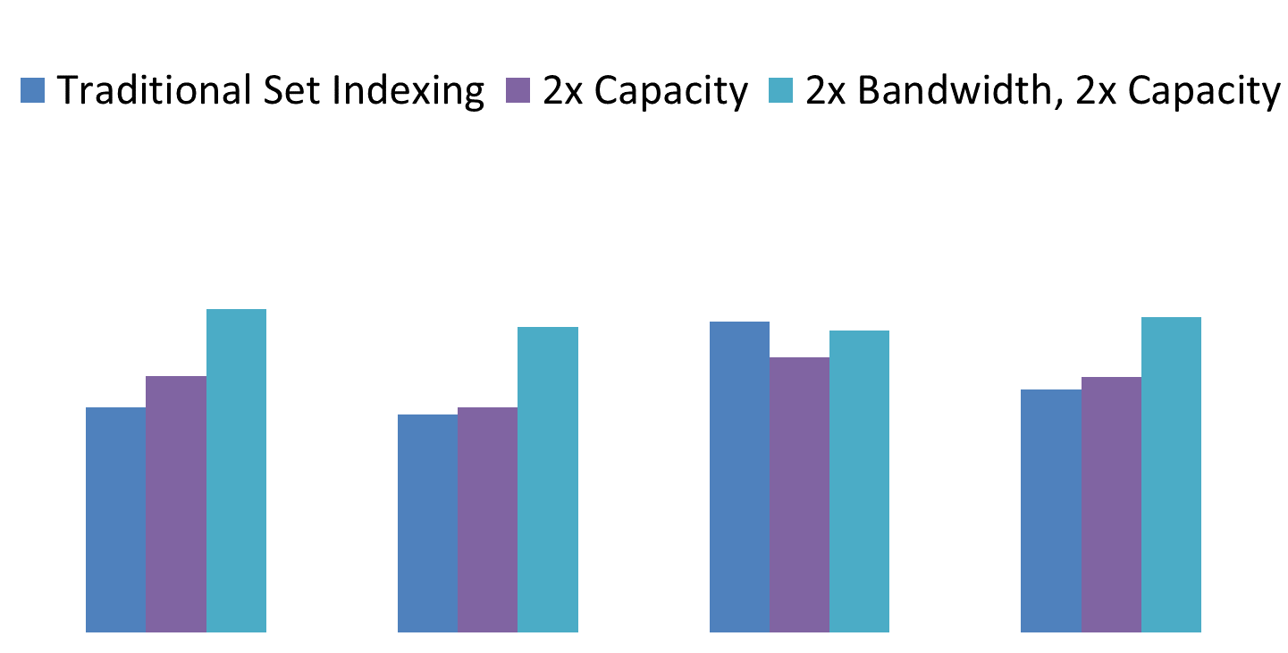
INTRODUCTION: Traditional Compression
Improves Capacity
No degradation
Little speedup (7%)
Compression for capacity (TSI) sees little speedup (7%)
due to diminishing returns on giga-scale caches
Notes:
Here is the performance of traditional cache compression for DRAM cache.
Blue is traditional set indexing compression. Purple, on the right is an organization with 2x-capacity 2x-bandwidth DRAM cache.
Some workloads benefit from the increased capacity. But many workloads see see diminishing returns on already-giga-scale caches.
However, we do note that is little slowdown. As such, this is a good baseline indexing scheme.
Compression for purely capacity achieves 7% speedup, short of the 10% we hoped to achieve from 2x capacity, as not all lines are compressible.
To achieve higher performance, we aim to additionally improve bandwidth

Slide 15
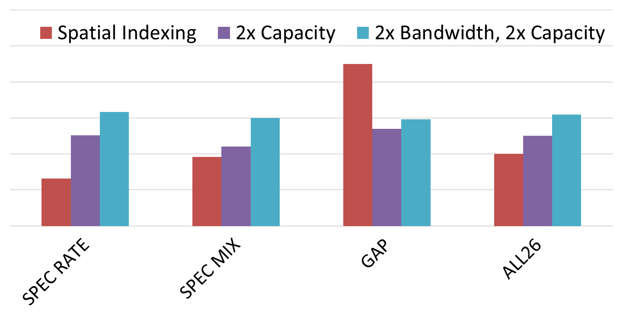
INTRODUCTION: SPATIAL Indexing
Improves Bandwidth
Can degrade
No speedup
Spatial Indexing compression gets both benefits of bandwidth and capacity when lines are compressible. But, it hurts performance when lines are incompressible
Notes:
Graph workloads see significantly improvement due to both bandwidth and capacity improvements.
However, many SPEC workloads have lines that do not have good compressibility ratio. As such, SPEC workloads see significant degradation in performance.
In total, this spatial indexing scheme provides no benefit on average.

Slide 16

INTRODUCTION: COMPRESSED DRAM CACHE
Goal: Compression for Capacity AND Bandwidth
Traditional Compression
Spatial Indexing
1x
Bandwidth
1x
Bandwidth
2x
Bandwidth
< 1x
Bandwidth
Compressible
Incompressible
Compressible
Incompressible
DICE (Dynamic Index) → 19% Speedup + 36% EDP
Notes:
Our goal is to effectively switch between the two schemes to achieve
bandwidth benefits when lines are compressible, and
Sustain bandwidth when lines are incompressible.
Our dynamic scheme achieves 19% speedup (close to 22% possible from 2x bandwidth and capacity cache) and 36% reduction in energy-delay-product.

Slide 17
DICE OVERVIEW
Compressed DRAM Cache Organization
Flexible Mapping for Quick Switching
Dynamic Indexing ComprEssion (DICE)
Insertion Policy
Index Prediction
Notes:
First, we talk about how to design a compressed DRAM Cache Organization.

Slide 18
PRACTICAL DRAM CACHE COMPRESSION
L3 Cache
On-chip
Read
Write
Decompression Logic
Compression Logic
Writeback
L4 Cache Controller
Install
DRAM Cache (compressed)
DRAM Cache
Memory
Off-chip
Compression: Simple changes within the controller
Notes:
Here we have an L3 cache, main memory, and a DRAM Cache between them.
The off-chip DRAM Cache is accessed by an on-chip cache controller. All reads and writes to DRAM cache are managed by this cache controller.
We notice that we can implement cache compression simply by adding compression logic before every write, and decompression logic after every read. Thus, we can implement compression with changes local to the cache controller (does not need changes to HBM or bus protocols).
But how do we handle the tags in such a case.

Slide 19
DRAM CACHE TAG format
Tag Boundary
Data
8 Bytes
64 Bytes
Tag A
Data A
Cache controller receives 72B of tag+data. It can flexibly interpret bits as tag bits or data bits.
Notes:
We note that every access to the DRAM cache reads 72B from the DRAM Array.
Current organizations interpret 8-Bytes of it as Tag, and 64-Bytes of it as Data.
However, we note that it is up to the controller to determine them as either tag or data bits. We can actually have it flexibly interpret bits as tag or data bits as needed.

Slide 20
PROPOSED FLEXIBLE TAG FORMAT
Tag Boundary
Data
Is Tag?
Is Tag?
Is Tag?
Not Tag
A
B
X
I
X
B
A
We create Tag space as needed, for up to 28 lines. Achieves 1.6x effective capacity.
Notes:
As such, we can dynamically create allocate space for tags, by using data space. We can simply keep a bit per tag, telling us whether or not to interpret the next couple bytes as Tag, or Data.
This enables us to store as many as 14-28 lines in every physical location.
In practice, we see 1.6x effective capacity in our workloads.

Slide 21
DICE OVERVIEW
Compressed DRAM Cache Organization
Flexible Mapping for Quick Switching
Dynamic Indexing ComprEssion (DICE)
Insertion Policy
Index Prediction
Notes:
So now we have our Compressed DRAM Cache Organization.
Now, in our to implement our dynamic compression scheme, we need to be able to switch quickly between the two policies.

Slide 22
Flexible Mapping (TSI or BAI)
0
4
0
1
0
1
1
5
2
3
4
5
2
6
4
5
2
3
3
7
6
7
6
7
Traditional Set Indexing (TSI)
Naïve Spatial Indexing
Bandwidth-Aware Indexing (BAI)
Bandwidth-Aware Indexing (BAI) facilitates quick switching between two indices TSI and BAI.
Notes:
Traditional Set Indexing maps adjacent lines in adjacent sets.
Naïve spatial Indexing maps 2 adjacent lines to every 1.
However, it shifts nearly every line from its original position (only first and last entry in same location).
Instead, we choose to shift half of each pair of lines, to their neighbor. For example, stuff 0 and 1, into set 0. stuff 2 and 3, into set 2. We still get the bandwidth benefits of Spatial Indexing. But, in addition, only half of the lines are shifted from their original position.
Switching can be done efficiently as only half of lines need to move. And entries are guaranteed to be in the same row buffer.

Slide 23
Flexible Mapping (TSI or BAI)
0
4
0
4
0
1
1
5
1
5
4
5
2
6
2
6
2
3
3
7
3
7
6
7
Traditional Set Indexing (TSI)
Naïve Spatial Indexing
Bandwidth-Aware Indexing (BAI)
Bandwidth-Aware Indexing (BAI) facilitates quick switching between two indices TSI and BAI.
Notes:
Traditional Set Indexing maps adjacent lines in adjacent sets.
Naïve spatial Indexing maps 2 adjacent lines to every 1.
However, it shifts nearly every line from its original position (only first and last entry in same location).
Instead, we choose to shift half of each pair of lines, to their neighbor. For example, stuff 0 and 1, into set 0. stuff 2 and 3, into set 2. We still get the bandwidth benefits of Spatial Indexing. But, in addition, only half of the lines are shifted from their original position.
Switching can be done efficiently as only half of lines need to move. And entries are guaranteed to be in the same row buffer.

Slide 24
Flexible Mapping (TSI or BAI)
0
4
0
1
0
1
4
1
5
2
3
1
4
5
2
6
4
5
2
3
6
3
7
6
7
3
6
7
Traditional Set Indexing (TSI)
Naïve Spatial Indexing
Bandwidth-Aware Indexing (BAI)
Bandwidth-Aware Indexing (BAI) facilitates quick switching between two indices TSI and BAI.
Notes:
Traditional Set Indexing maps adjacent lines in adjacent sets.
Naïve spatial Indexing maps 2 adjacent lines to every 1.
However, it shifts nearly every line from its original position (only first and last entry in same location).
Instead, we choose to shift half of each pair of lines, to their neighbor. For example, stuff 0 and 1, into set 0. stuff 2 and 3, into set 2. We still get the bandwidth benefits of Spatial Indexing. But, in addition, only half of the lines are shifted from their original position.
Switching can be done efficiently as only half of lines need to move. And entries are guaranteed to be in the same row buffer.

Slide 25
DICE OVERVIEW
Compressed DRAM Cache Organization
Flexible Mapping for Quick Switching
Dynamic Indexing ComprEssion (DICE)
Insertion Policy
Index Prediction
Notes:
Next, we talk about our dynamic indexing scheme.

Slide 26
DICE: Dynamic-indexed Compressed Cache
DRAM Cache
Compressibility Based Insertion
Cache Index Prediction
?
Traditional Set Index
?
Install
Read
Bandwidth-Aware Index
TSI = BAI
DICE: Dynamic-Indexing Cache comprEssion,
decides index on install, and predicts index on read
Notes:
DICE: Dynamic-Indexed Compressed Cache Overview.
Decide index on install.
Predict index on read.
Because if you check both. You waste the bandwidth benefits offered by compressed cache organization.
We limit our scheme to only affect eviction and installs (and do not do explicit swaps, to save bandwidth and keep controller simple).

Slide 27
Compressibility-based Insertion
DRAM Cache
Compressibility Based Insertion
But checking both wastes bandwidth
> ½-size
Traditional Set Index
?
Install
Read
Bandwidth-Aware Index
<= ½-size
No explicit swaps. Eviction and install decides policy
TSI = BAI
Compressibilty-based insertion uses Bandwidth-Aware Indexing when lines are compressible, and TSI otherwise
Notes:
DICE Overview:
We want to use Bandwidth-Aware Indexing (our spatial indexing) when lines are compressible, and Traditional Set Indexing when lines are incompressible.
As such, we have a simple index decision policy.
If a line compresses to greater than half of a line size, assume it cannot compress with neighbor and insert in TSI. This way, it is likely to do no harm.
If a line compresses to less than half of a line size, assume neighbor also compresses to less than half so they can compress together.
With compressibility-based insertion, we can install opportunistically into bandwidth-aware index, to get both benefits of bandwidth and capacity.
And fallback to traditional set indexing when lines are incompressible.
Note that installs are done independently of neighbor to reduce dependency on adjacent lines and simplify cache organization.
But checking both indices wastes the bandwidth we worked so hard to get.
We do prediction to still get the line in one access.

Slide 28
SIMILAR INTRA-Page COMPRESSIBILITY
Indices seen in a Compressible Page
Bandwidth-Aware Index
Install
Read BAI
Bandwidth-Aware Index
<= ½-size
Lines within a page have similar compressibility
Bandwidth-Aware Index
DICE is likely to install lines of a page into similar index
Notes:
DICE Overview:
We want to use Bandwidth-Aware Indexing (our spatial indexing) when lines are compressible, and Traditional Set Indexing when lines are incompressible.
As such, we have a simple index decision policy.
If a line compresses to greater than half of a line size, assume it cannot compress with neighbor and insert in TSI. This way, it is likely to do no harm.
If a line compresses to less than half of a line size, assume neighbor also compresses to less than half so they can compress together.
With compressibility-based insertion, we can install opportunistically into bandwidth-aware index, to get both benefits of bandwidth and capacity.
And fallback to traditional set indexing when lines are incompressible.
Note that installs are done independently of neighbor to reduce dependency on adjacent lines and simplify cache organization.
But checking both indices wastes the bandwidth we worked so hard to get.
We do prediction to still get the line in one access.

Slide 29
SIMILAR INTRA-Page COMPRESSIBILITY
Indices seen in an Incompressible Page
Traditional Set Index
Traditional Set Index
Install
Read TSI
Traditional Set Index
> ½-size
Lines within a page have similar compressibility
Traditional Set Index
2nd access only on mispredict
Bandwidth-Aware Index
Thus, page-based last-time prediction of index
can be accurate (94%)
Notes:
DICE Overview:
We want to use Bandwidth-Aware Indexing (our spatial indexing) when lines are compressible, and Traditional Set Indexing when lines are incompressible.
As such, we have a simple index decision policy.
If a line compresses to greater than half of a line size, assume it cannot compress with neighbor and insert in TSI. This way, it is likely to do no harm.
If a line compresses to less than half of a line size, assume neighbor also compresses to less than half so they can compress together.
With compressibility-based insertion, we can install opportunistically into bandwidth-aware index, to get both benefits of bandwidth and capacity.
And fallback to traditional set indexing when lines are incompressible.
Note that installs are done independently of neighbor to reduce dependency on adjacent lines and simplify cache organization.
But checking both indices wastes the bandwidth we worked so hard to get.
We do prediction to still get the line in one access.

Slide 30
PAGE-based Cache INDEX PREDICTOR (CIP)
0 = Traditional Set Index
1 = Bandwidth-Aware Index
Demand Access
Last-Time Table (LTT)
1
0
1
Page #
Hash
0
Predict Traditional Set Index
0
1
0
1
Page-based last-time prediction exploits similar intra-page compressibility, to achieve high prediction accuracy (94%)
Notes:
Predict index on read.
If check both. You waste bandwidth benefits offered by compressed cache organization.
How do we predict?
We notice that lines within a page are likely to have similar compressibility. If we see a line from a page was previously installed in BAI, we assume the other lines in that page were also installed in BAI. As such, we can predict that future accesses to the page will likely find the line in the BAI index.
We implement this by having a last-time table that tracks a last index seen for a particular page. We hash this into a structure to save space. <1KB.

Slide 31
DICE OVERVIEW
Compressed DRAM Cache Organization
Flexible Mapping for Quick Switching
Dynamic Indexing (DICE)
Insertion Policy
Index Prediction
Results

Slide 32
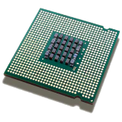
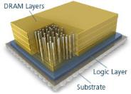

Methodology (1/8th Knights Landing)
Stacked DRAM
Commodity DRAM
CPU
Core Chip
3.2GHz 4-wide out-of-order core
8 cores, 8MB shared last-level cache
Compression
FPC + BDI
Notes:
8-cores (1/8th of 64 KNL core-count)
8MB shared last-level cache
Compression algorithms used in this study were Frequent Pattern Compression and Base-Delta Immediate Compression. Algorithm used is orthogonal to study as any can be substituted.

Slide 33
Methodology (1/8th Knights Landing)
Other sensitivities in paper
Stacked DRAM
Commodity DRAM
CPU
 | Stacked DRAM | Commodity DRAM
Capacity | 1GB | 32GB
Bus | DDR1.6GHz, 128-bit | DDR1.6GHz, 64-bit
Channels | 4 channels | 1 channel
Bandwidth | 100 GBps | 12.5 GBps
Latency | 35ns | 35ns
Notes:
1GB stacked DRAM.
4 channels, with 128-bit bus-width. ~100 GBps (1/8th of KNL bandwidth)
Iso-latency with DRAM, given current HBM products.
32GB DIMM-based DRAM

Slide 34
DICE RESULTS
Performs as Spatial
Indexing
Performs as Traditional
Indexing
DICE outperforms both
DICE improves performance over both Spatial Indexing and Traditional Indexing with fine-grain decision (19%)
Notes:
DICE is able to use Bandwidth-Aware-Indexing when workload is compressible.
And Traditional-Set-Indexing, when workload is incompressible.
But, it often improves performance over both as it can aggressively use BAI for compressible portions of workloads, and fallback to TSI when lines are compressible. As such, workloads with mixed levels of compressibility see huge improvements under DICE.
DICE achieves 19% speedup, close to the ideal 2x capacity, 2x bandwidth DRAM cache.

Slide 35
INTRODUCTION: COMPRESSED DRAM CACHE
Goal: Compression for Capacity AND Bandwidth
Traditional Compression
Spatial Indexing
1x
Bandwidth
1x
Bandwidth
2x
Bandwidth
< 1x
Bandwidth
Compressible
Incompressible
Compressible
Incompressible
DICE (Dynamic Index) → 19% Speedup + 36% EDP
Notes:
DICE: Dynamic-indexing compression achieves 2x bandwidth when workloads are compressible, and does not degrade performance when workloads are incompressible.
DICE improves performance by 19%, close to the 22% speedup offered by a 2x-capacity 2x-channel system.
Thank you

Slide 36

Thank you

Slide 37
Extra SLIDES
Extra Slides

Slide 38
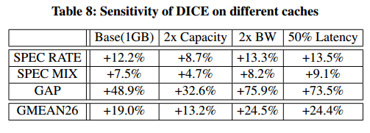
DIFFERENT CACHE SENSITIVITIES
Notes:
Better latency accesses.
2x channels. More of a memory bandwidth bottleneck. Capacity benefits are more pronounced.

Slide 39
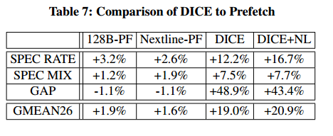
Comparison to prefetch

Slide 40
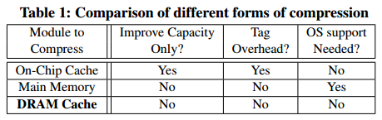
Comparison to sram /memory compression

Slide 41
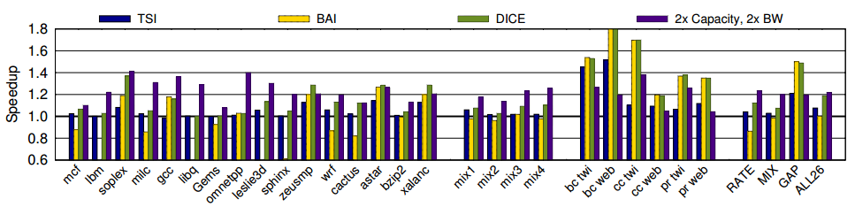
FULL RESULTS (mixed compressibility)

Slide 42
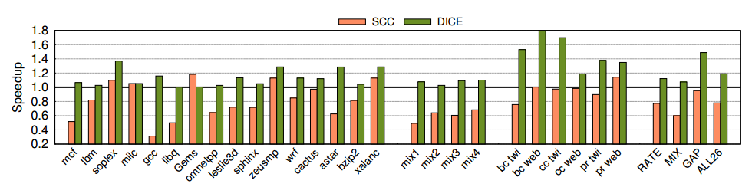
SRAM Cache compression on DRAM CACHE

Slide 43
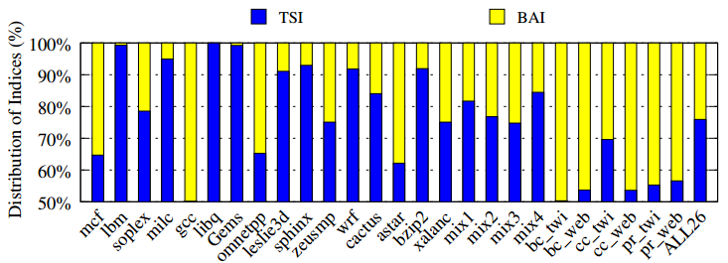
Distribution for index decision

Slide 44
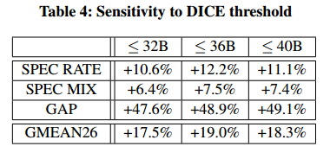
DICE INSERTION threshold

Slide 45
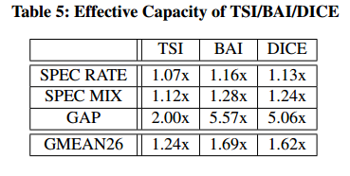
EFFECTIVE CAPACITY

Slide 46
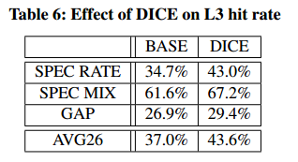
L3 hit rate improvement

Slide 47
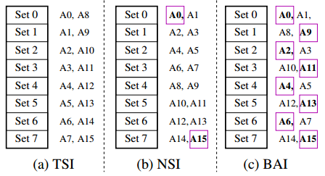
Larger TSI vs. BAI example

