Slide 1
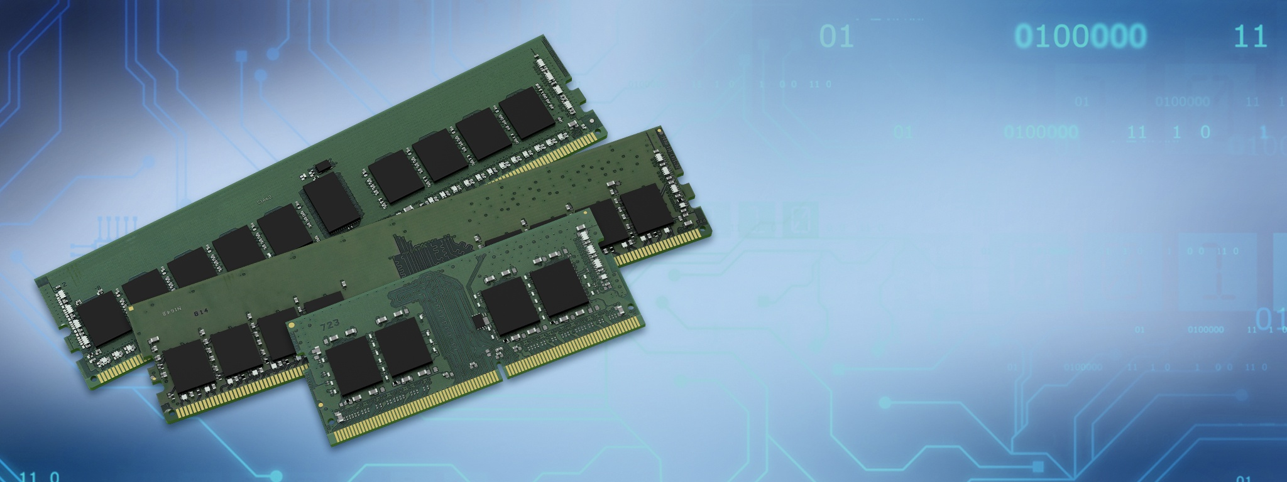







Randomized Row-Swap: Mitigating Row Hammer By Breaking Spatial Correlation Between Aggressor and Victim Rows
Gururaj Saileshwar
Bolin Wang, Moinuddin Qureshi, Prashant Nair

Slide 2
Rowhammer Attacks on DRAM
DRAM Scaling for Increased Capacity
DRAM
(old)
DRAM
(new)
Notes:
- With DRAM Scaling for increased capacity, DRAM cells are so close that activity on cells in one DRAM row causes charge leakage from cells in neighboring rows.
Rowhammer attacks exploit this phenomenon by accessing a DRAM row rapidly in a short window of time, that ends up causing bit-flips in neighboring rows. Essentially, this allows an adversarial software to flip bits in memory without accessing them.
Adversarial software can gain kernel-level privileges, by tampering the page-tables [Orig], or sensitive binaries like the sudo binary [Another-Flip], and even infer data in neighboring rows based on whether they flip or not [RamBleed].

Slide 3

Rowhammer Attacks on DRAM
DRAM Scaling for Increased Capacity
More Inter-Cell Interference
DRAM
(old)
DRAM
(new)

Slide 4
Rowhammer Attacks on DRAM
DRAM Scaling for Increased Capacity
More Inter-Cell Interference
DRAM
(old)
Row of Cells (8KB)
Row
Row
Row
DRAM
(new)
DRAM

Slide 5
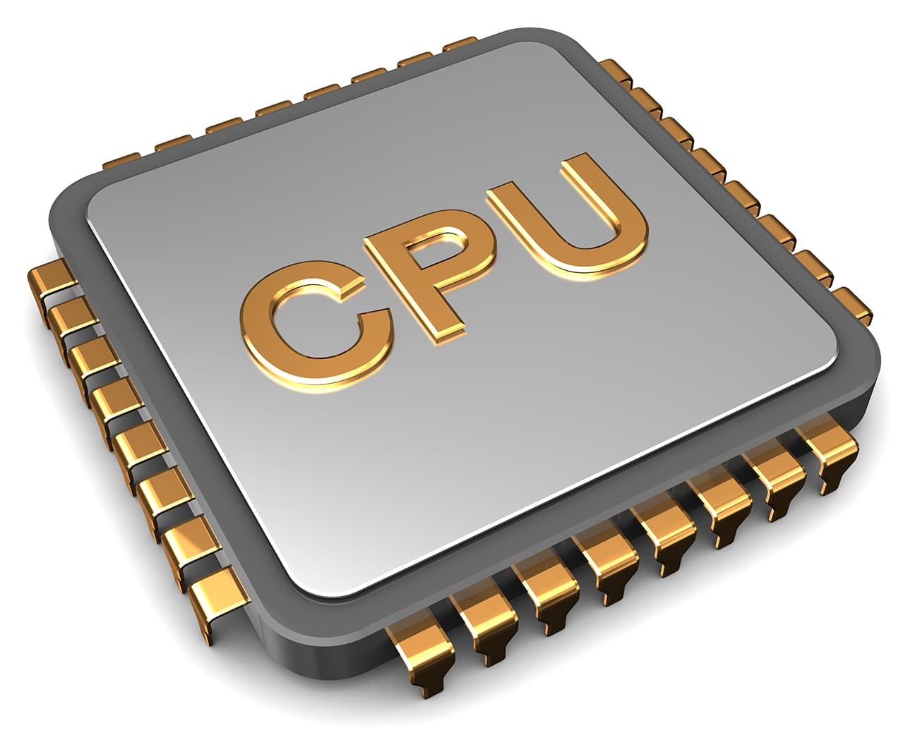
Rowhammer Attacks on DRAM
DRAM Scaling for Increased Capacity
More Inter-Cell Interference
DRAM
(old)
Row of Cells (8KB)
Row
Row
8 Byte
Row
DRAM
(new)
DRAM

Slide 6

Rowhammer Attacks on DRAM
DRAM Scaling for Increased Capacity
More Inter-Cell Interference
DRAM
(old)
Row of Cells (8KB)
Row
Row
8 Byte
Row
Refresh
Every 64ms
DRAM
(new)
DRAM

Slide 7

Rowhammer Attacks on DRAM
DRAM Scaling for Increased Capacity
More Inter-Cell Interference
Rowhammer Attack
DRAM
(old)
Row of Cells (8KB)
Row
Rapid
Accesses
Row
Row
DRAM
(new)
DRAM
Bit-Flips in Neighboring Rows
[Kim+, ISCA’15]
Notes:
- With DRAM Scaling for increased capacity, DRAM cells are so close that activity on cells in one DRAM row causes charge leakage from cells in neighboring rows.
Rowhammer attacks exploit this phenomenon by accessing a DRAM row rapidly in a short window of time, that ends up causing bit-flips in neighboring rows. Essentially, this allows an adversarial software to flip bits in memory without accessing them.
Adversarial software can gain kernel-level privileges, by tampering the page-tables [Orig], or sensitive binaries like the sudo binary [Another-Flip], and even infer data in neighboring rows based on whether they flip or not [RamBleed].

Slide 8
Rowhammer Attacks on DRAM
DRAM Scaling for Increased Capacity
More Inter-Cell Interference
Rowhammer Attack
DRAM
(old)
Row of Cells (8KB)
Aggressor Row
Row
Rapid
Accesses
Row
Victim Row
Aggressor Row
Row
DRAM
(new)
DRAM
Bit-Flips in Neighboring Rows
[Kim+, ISCA’15]

Slide 9
Rowhammer Attacks on DRAM
Rowhammer Attack
loop:
mov (X), %eax
mov (Y), %ebx
clflush (X)
clflush (Y)
mfence
jmp loop
Row of Cells (8KB)
Aggressor Row
Row
Rapid
Accesses
Row
Victim Row
Aggressor Row
Row
Software Adversary Can Flip Bits in Page Tables &
Gain Kernel Privileges (Take Over a System)
DRAM
Bit-Flips in Neighboring Rows
[Seaborn+, Blackhat’15]
[Kim+, ISCA’15]
Notes:
- With DRAM Scaling for increased capacity, DRAM cells are so close that activity on cells in one DRAM row causes charge leakage from cells in neighboring rows.
Rowhammer attacks exploit this phenomenon by accessing a DRAM row rapidly in a short window of time, that ends up causing bit-flips in neighboring rows. Essentially, this allows an adversarial software to flip bits in memory without accessing them.
Adversarial software can gain kernel-level privileges, by tampering the page-tables [Orig], or sensitive binaries like the sudo binary [Another-Flip], and even infer data in neighboring rows based on whether they flip or not [RamBleed].

Slide 10
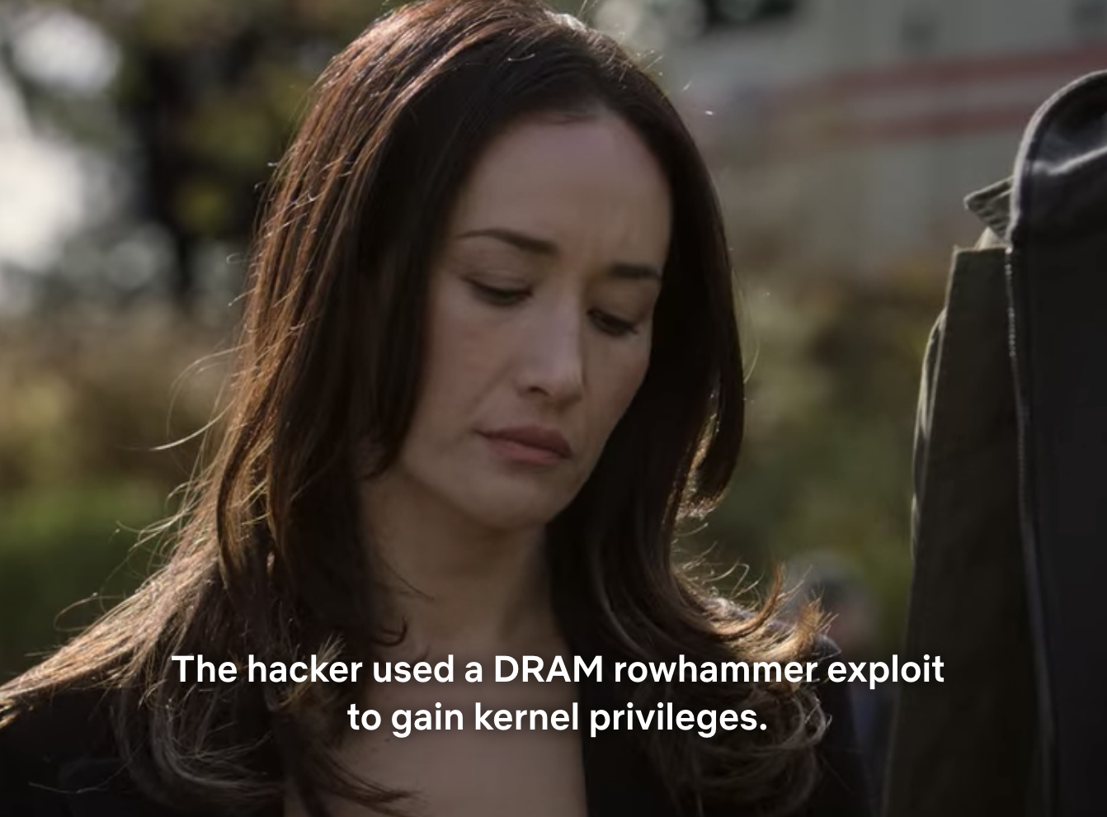


Notes:
Even the folks at Netflix seem to know about Rowhammer and are using it as a plot construct in of their TV Shows.

Slide 11
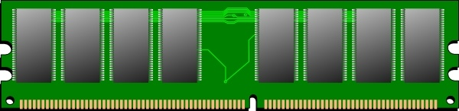
Mitigation in Commercial DDR4
Targeted Row Refresh (TRR) in DDR4 (2015)
Victim Row
Aggressor Row
Victim Row
DRAM

Slide 12
Mitigation in Commercial DDR4
Targeted Row Refresh (TRR) in DDR4 (2015)
Track Aggressor Rows
1
Victim Row
Aggressor Row
Victim Row
DRAM

Slide 13
Mitigation in Commercial DDR4
Targeted Row Refresh (TRR) in DDR4 (2015)
Track Aggressor Rows
Mitigative Action
1
2
Victim Row
Refresh
Aggressor Row
Victim Row
DRAM

Slide 14
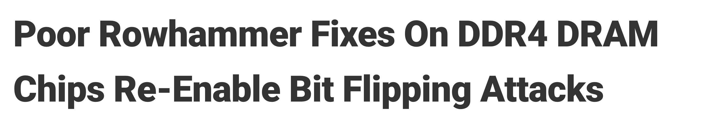
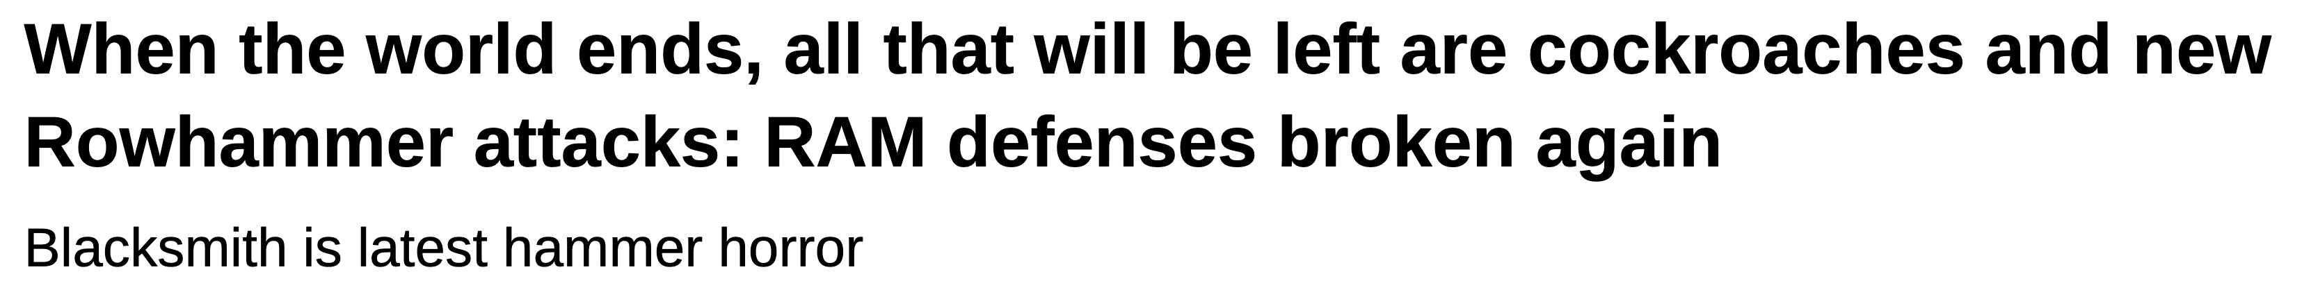
Mitigation in Commercial DDR4: Broken!
Targeted Row Refresh (TRR) in DDR4 (2015)
Track Aggressor Rows
Mitigative Action
1
2
TRResspass Breaks TRR Tracker [Frigo+, SP’20]
Victim Row
Refresh
Aggressor Row
Source: The Hacker News
Victim Row
Blacksmith Attack: All DRAM Shown Vulnerable [Jattke+, SP’22]
DRAM
Source: The Register

Slide 15

Recent Victim Focused Mitigations
Track Aggressor Rows
Mitigative Action
1
2
Principled Tracking
Graphene [MICRO’20]
TWICE [ISCA’19]
CRA [CAL’14]
and others …
Victim Row
Refresh
Aggressor Row
Victim Row
DRAM

Slide 16

Recent Victim Focused Mitigations
Track Aggressor Rows
Mitigative Action
1
2
Victim Row
Refresh
Aggressor Row
Victim Row
DRAM

Slide 17
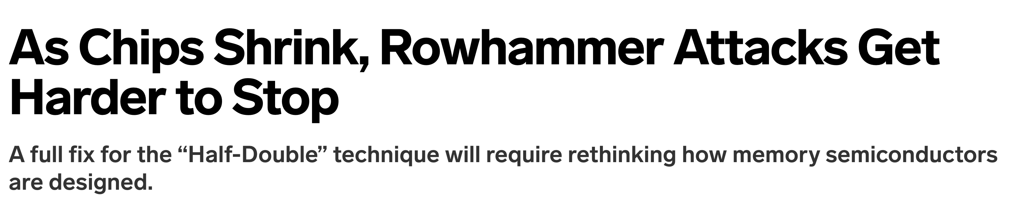
Recent Victim Focused Mitigations
Track Aggressor Rows
Mitigative Action
1
2
Victim Row
Google’s Half-Double Attack:
Exploits Mitigative Refresh [2021]
Refresh
Aggressor Row
Victim Row
DRAM
Source: ArsTechnica

Slide 18
Recent Victim Focused Mitigations
Track Aggressor Rows
Mitigative Action
1
2
Distance-2
Victim Row
Google’s Half-Double Attack:
Exploits Mitigative Refresh [2021]
Refresh
Aggressor Row
Victim Row
DRAM
Distance-2
Source: ArsTechnica

Slide 19
Recent Victim Focused Mitigations
Track Aggressor Rows
Mitigative Action
1
2
Distance-2
Victim Row
Google’s Half-Double Attack:
Exploits Mitigative Refresh [2021]
Refresh
Aggressor Row
Victim Row
DRAM
Distance-2
Source: ArsTechnica
Need New Mitigative Action Resilient to Current and Emerging Attack Patterns
(preferably without requiring knowledge of DRAM mapping function)

Slide 20
Aggressor Focused Mitigation: Randomized Row-Swap
Key Idea: Remap Aggressor Rows to Break Spatial Correlation with Victim Rows
.
.
Row-X
Victim
Aggressor
Victim
Notes:
To mitigate Rowhammer in a future proof manner, we focus on a new mitigative action that aggressor-focused (not victims).
The key idea is to track aggressor rows and remap them to break the spatial correlation between agressors and victims.
So the key idea of Row-Swap is to break the spatial co-relation between aggressor rows and victim rows pre-emptively. If a row crosses T = TRH/k, we simply swap it with a randomly selected row in same bank of the DRAM.
Now the aggressor row is mapped to some other random row, and a random virtual address is mapped to the row that is already attacked. Because there are 100s of thousands of rows in a DRAM and adversary can attack at most 1.36 / 800 rows and cause 1700 rows to swap, it is not easy for the adversary to identify rows that have already been swapped. And even if it does, the row would be swapped again after T activations.
With this design, we provide the guarantee that no row can be activated more than TRH times, With a TRH of 4.8K, that is lower than all known attacks (single-sided, double-sided, half-double), we can prevent all known attacks in a principled manner.

Slide 21
Aggressor Focused Mitigation: Randomized Row-Swap
Key Idea: Remap Aggressor Rows to Break Spatial Correlation with Victim Rows
.
.
Row-X
Victim
Aggressor
Victim
Notes:
To mitigate Rowhammer in a future proof manner, we focus on a new mitigative action that aggressor-focused (not victims).
The key idea is to track aggressor rows and remap them to break the spatial correlation between agressors and victims.
So the key idea of Row-Swap is to break the spatial co-relation between aggressor rows and victim rows pre-emptively. If a row crosses T = TRH/k, we simply swap it with a randomly selected row in same bank of the DRAM.
Now the aggressor row is mapped to some other random row, and a random virtual address is mapped to the row that is already attacked. Because there are 100s of thousands of rows in a DRAM and adversary can attack at most 1.36 / 800 rows and cause 1700 rows to swap, it is not easy for the adversary to identify rows that have already been swapped. And even if it does, the row would be swapped again after T activations.
With this design, we provide the guarantee that no row can be activated more than TRH times, With a TRH of 4.8K, that is lower than all known attacks (single-sided, double-sided, half-double), we can prevent all known attacks in a principled manner.

Slide 22
Aggressor Focused Mitigation: Randomized Row-Swap
Key Idea: Remap Aggressor Rows to Break Spatial Correlation with Victim Rows
.
.
Aggressor
Random
Row
Swap
Victim
Row-X
T activations
Victim

Slide 23
Aggressor Focused Mitigation: Randomized Row-Swap
Key Idea: Remap Aggressor Rows to Break Spatial Correlation with Victim Rows
Row-Y
.
.
Aggressor
Victim
Row-X
Victim

Slide 24
Aggressor Focused Mitigation: Randomized Row-Swap
Key Idea: Remap Aggressor Rows to Break Spatial Correlation with Victim Rows
Aggressor
Random
Row
Swap
.
.
Row-Y
T activations
Victim
Row-X
Victim

Slide 25
Aggressor Focused Mitigation: Randomized Row-Swap
Key Idea: Remap Aggressor Rows to Break Spatial Correlation with Victim Rows
Refresh
Every 64ms
Aggressor
Security Guarantee: No Row Crosses Rowhammer Threshold Activations within 64ms
.
.
Row-Y
Victim
Row-X
Victim

Slide 26
Aggressor Focused Mitigation: Randomized Row-Swap
Key Idea: Remap Aggressor Rows to Break Spatial Correlation with Victim Rows
Refresh
Every 64ms
Aggressor
Security Guarantee: No Row Crosses Rowhammer Threshold Activations within 64ms
.
.
Row-Y
Lower T (Swap Threshold) → Better Security
Victim
Row-X
Victim

Slide 27
Security Analysis
TRH=4800 → Minimum Activations in 64ms on Row for Rowhammer via Any Pattern (Single-sided, Double-Sided, Half-Double)
Notes:
To mitigate Rowhammer in a future proof manner, we focus on a new mitigative action that aggressor-focused (not victims).
The key idea is to track aggressor rows and remap them to break the spatial correlation between agressors and victims.
So the key idea of Row-Swap is to break the spatial co-relation between aggressor rows and victim rows pre-emptively. If a row crosses T = TRH/k, we simply swap it with a randomly selected row in same bank of the DRAM.
Now the aggressor row is mapped to some other random row, and a random virtual address is mapped to the row that is already attacked. Because there are 100s of thousands of rows in a DRAM and adversary can attack at most 1.36 / 800 rows and cause 1700 rows to swap, it is not easy for the adversary to identify rows that have already been swapped. And even if it does, the row would be swapped again after T activations.
With this design, we provide the guarantee that no row can be activated more than TRH times, With a TRH of 4.8K, that is lower than all known attacks (single-sided, double-sided, half-double), we can prevent all known attacks in a principled manner.

Slide 28
Security Analysis
TRH=4800 → Minimum Activations in 64ms on Row for Rowhammer via Any Pattern (Single-sided, Double-Sided, Half-Double)
.
.
Aggressor
Random
Row
Swap
Victim
Row-X
T activations
Victim

Slide 29
Security Analysis
TRH=4800 → Minimum Activations in 64ms on Row for Rowhammer via Any Pattern (Single-sided, Double-Sided, Half-Double)
.
.
Aggressor
Random
Row
Swap
Random
Guess?
Victim
Row-X
T activations
Victim

Slide 30
Security Analysis
TRH=4800 → Minimum Activations in 64ms on Row for Rowhammer via Any Pattern (Single-sided, Double-Sided, Half-Double)
Buckets and Balls Problem
Random
Swaps in 64 ms
Rows in a
DRAM Bank
(128K)
.
.
Balls
Aggressor
Random
Buckets
Row
Swap
Random
Guess?
Victim
Row-X
T activations
Victim

Slide 31
Security Analysis
TRH=4800 → Minimum Activations in 64ms on Row for Rowhammer via Any Pattern (Single-sided, Double-Sided, Half-Double)
Buckets and Balls Problem
Random
Swaps in 64 ms
Rows in a
DRAM Bank
(128K)
.
.
Balls
Aggressor
Random
Buckets
Row
Swap
Swap Every T Activations | Attack Time
T = TRH/5 | 6.9 days
T = TRH/6 | 3.8 years
T = TRH/7 | 762 years
Random
Guess?
Victim
Row-X
T activations
Victim

Slide 32
Security Analysis
TRH=4800 → Minimum Activations in 64ms on Row for Rowhammer via Any Pattern (Single-sided, Double-Sided, Half-Double)
Buckets and Balls Problem
Random
Swaps in 64 ms
Rows in a
DRAM Bank
(128K)
.
.
Balls
Aggressor
Random
Buckets
Row
Swap
Swap Every T Activations | Attack Time
T = TRH/5 | 6.9 days
T = TRH/6 | 3.8 years
T = TRH/7 | 762 years
Random
Guess?
Victim
Row-X
T activations
Victim
Continuous Remapping of Aggressor Rows Provides Principled Security for Years of Attack

Slide 33
Implementation of Randomized Row Swap
Swapped
RRS Structures
Row
Row
DRAM Access
Row Indirection Table (RIT)
Row
Not Swapped
Row
Hot Row Tracker (HRT)
[Graphene, MICRO’20]
Row
Row
Row
Memory Controller
DRAM
Notes:
We manage the swap structure with a indirection table, and similarly have a tracking structure using the Misra-Gries algorithm similar to Graphene. We design scalable structures for these in the paper. Take a look in the paper.

Slide 34
Collision Avoidance Table (CAT) for RIT and HRT
Problem: The tracking structures can be overwhelmed by repeated accesses
A
B
C
D
Sets
Ways

Slide 35
Collision Avoidance Table (CAT) for RIT and HRT
Problem: The tracking structures can be overwhelmed by repeated accesses
A
B
C
E
D
Sets
Ways

Slide 36
Collision Avoidance Table (CAT) for RIT and HRT
Problem: The tracking structures can be overwhelmed by repeated accesses
E
B
C
D
A
Conflicts in tracking structures → targeted row addresses to be expelled → Lose tracking of some rows

Slide 37
Collision Avoidance Table (CAT) for RIT and HRT
Solution: Leverage Power of Two Choices [MIRAGE – USENIX SEC’21]
A
B
U
C
W
D
X
V
hash1
hash2
E
Additional Ways + Multiple Hashes + Load Balancing + Random Replacement

Slide 38
Collision Avoidance Table (CAT) for RIT and HRT
Solution: Leverage Power of Two Choices [MIRAGE – USENIX SEC’21]
A
B
U
C
W
E
D
X
V
hash1
hash2
Additional Ways + Multiple Hashes + Load Balancing + Random Replacement

Slide 39
Collision Avoidance Table (CAT) for RIT and HRT
Solution: Leverage Power of Two Choices [MIRAGE – USENIX SEC’21]
A
B
U
C
W
E
D
X
V
hash1
hash2
Additional Ways + Multiple Hashes + Load Balancing + Random Replacement
RIT and HRT use the CAT to avoid collisions → Prevents Conflict-Based Attacks

Slide 40
Collision Avoidance Table (CAT) for RIT and HRT
Solution: Leverage Power of Two Choices [MIRAGE – USENIX SEC’21]

Slide 41
Collision Avoidance Table (CAT) for RIT and HRT
Solution: Leverage Power of Two Choices [MIRAGE – USENIX SEC’21]
With 14 Demand Ways and 6 Extra Ways → 10³⁰ installs are needed to create a conflict

Slide 42
Implementation of Randomized Row Swap
Swapped
RRS Structures
Row
Row
DRAM Access
Row Indirection Table (RIT)
Row
Not Swapped
Row
Hot Row Tracker (HRT)
[Graphene, MICRO’20]
Row
Row
Row
Memory Controller
DRAM
Notes:
We manage the swap structure with a indirection table, and similarly have a tracking structure using the Misra-Gries algorithm similar to Graphene. We design scalable structures for these in the paper. Take a look in the paper.

Slide 43
Implementation of Randomized Row Swap
Swapped
RRS Structures
Row
Row
DRAM Access
Row Indirection Table (RIT)
Row
Not Swapped
Row
Hot Row Tracker (HRT)
[Graphene, MICRO’20]
Row
Row
Row
Memory Controller
DRAM
SRAM Storage Overheads (RIT, HRT) → 45 KB Per DRAM Bank x 16 Banks → 720 KB of SRAM

Slide 44
Performance Impact of Row Swaps
Frequency of Row Swaps Per 64ms
(1.5 microseconds per swap)
< 100 Swaps Per 64ms
Notes:
Overall, in terms of performance, the impact is negligible primarily because the frequency of swaps is negligible.
Storage overhead is modest ~40KB per memory bank (16 banks in DDR4).

Slide 45
Performance Impact of Row Swaps
Frequency of Row Swaps Per 64ms
(1.5 microseconds per swap)
Negligible Performance Impact
(0.4% slowdown on average)
< 100 Swaps Per 64ms

Slide 46
Performance Impact of Row Swaps
Frequency of Row Swaps Per 64ms
(1.5 microseconds per swap)
Negligible Performance Impact
(0.4% slowdown on average)
< 100 Swaps Per 64ms
Randomized Row Swap has negligible performance impact due to infrequent swaps
Saileshwar et al. Randomized Row-Swap: Mitigating Row Hammer by Breaking Spatial Correlation. In ASPLOS 2022

Slide 47
Comparison with Prior Aggressor Focused Mitigation
Blockhammer [HPCA’21]
Rate-Throttles Aggressors at Blacklist Point (Earlier Than RTH) For Entire 64ms

Slide 48
Comparison with Prior Aggressor Focused Mitigation
Blockhammer [HPCA’21]
Rate-Throttles Aggressors at Blacklist Point (Earlier Than RTH) For Entire 64ms
Randomized Row Swap Incurs Much Lower Worst-Case Slowdowns vs Blockhammer
(mitigation is less expensive and hence adds less overheads in benign workloads)

Slide 49
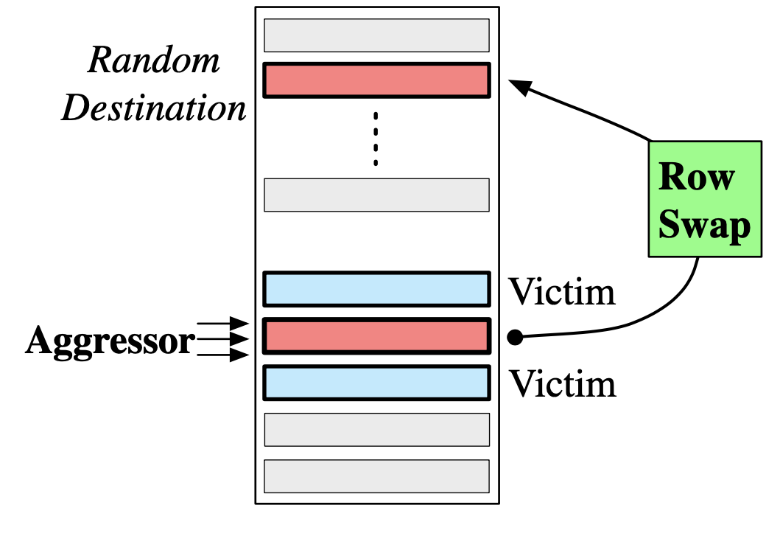
Takeways from Randomized Row Swap
Row
Swap
New Aggressor-Focused Mitigation – Swaps Aggressors with Random Destinations & Successively Remaps --> No Row Crosses Rowhammer Threshold
Randomized Row Swap incurs modest costs (0.4% slowdown, ~40KB SRAM/bank) while providing security against years of continuous attack
Resilient to TRResspass [SP’20], Half-Double (2021), Blacksmith [SP’22] attacks
& potentially future attacks?

Slide 50

Thank You
Gururaj Saileshwar
Assistant Professor

