Slide 1

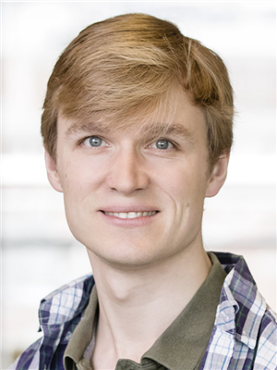



Streamline: A Fast, Flushless Cache Covert-Channel Attack by Enabling Asynchronous Collusion
3x -6x higher bit-rate vs state-of-the-art covert-channel attacks
ASPLOS-2021
Gururaj Saileshwar¹,
Christopher Fletcher², Moinuddin Qureshi¹
¹
²
Note: The authors reserve all rights to this presentation. Fair use for educational purposes is permissible.

Slide 2





What are Covert-Channels? Why Important?
Sandbox
Trojan
Spy
Last-Level Cache (LLC)
Core-0
Core-1
1, 0, 1 ..
Hit, Miss, Hit ..
Cache Covert-Channel [Perceival’05]:
Trojan transmits bits covertly to Spy via Cache Contention
Importance of Bit-rate: Determines Payload Size & Transmission Time

Slide 3
State-of-the-art Covert-Channels
Flush+Reload Attack [USENIX-SEC’14]
CORE-0
(Trojan)
CORE-1
(Spy)
LLC
Limitations:
Flush
1
1. Synchronous Operation
Bit-rate limited to < 500KB/s
Load → ‘1’,
No-Load → ‘0’
B
2
Reload:
Hit/Miss → ‘1’ / ‘0’
3
2. Applicable to certain ISAs (x86) Requires unprivileged usage of Cacheline Flush Instruction (clflush)
Wait & Repeat
Wait & Repeat
Shared Address
(Read-only)
Q. Real Upper Bound on Bit-rate for Cache Covert-Channels?
Q. How to make these Universally Applicable to all ISAs?

Slide 4
Goal: Fast and Universal Covert-Channel
Key Idea of Streamline Attack – Make it Asynchronous and Flushless!
LLC
Asynchronous
FIFO-like Operation
S
R
Benefits
Fast: Bit-rate depends only on
load execution-rate
Does not require explicit flushes: Applicable to all ISAs
Sender
Receiver
Load → ‘1’,
No-Load → ‘0’
LLC-Hit → ‘1’,
LLC-Miss → ‘0’
Cache-Thrashing Evicts Previous Lines
Shared Array
Larger than LLC
However, Asynchronous Channels Face Many Challenges
For Low Error-Rates!

Slide 5

Challenges for Asynchronous Channels
1. Rate-Matching
Sender & Receiver
2. Fooling
Prefetcher
3. Fooling Replacement-Policy
LLC
LLC
LLC
R
S
S
S
Prefetched
Evicted by
Replacement policy
Challenges for Streamline & All Future Asynchronous Channels

Slide 6
Contribution-1: Rate-Matching Sender & Receiver
Rate-Matching
Sender
Bit
Receiver
Remove Payload-Dependent Rate-Variation
with PRNG Channel-Encoding
Tx-i = Payload-i ^ PRNG-i;
Payload-i = Rx-i ^ PRNG-i;
2. Match Sender & Receiver Operations
Add timer instruction (rdtscp) to Sender & throttle its rate to match the Receiver
3. Coarse-Grain Synchronization Every 200K bits (using any Covert-Channel)
LLC-Miss 1 LLC-Hit
LLC-Miss 1 LLC-Hit
Skipped 0 LLC-Miss
Skipped 0 LLC-Miss
LLC
R
S
PRNG-Modulation
+ Throttling Sender
+ Coarse-Grain Sync

Slide 7
Contributions-2,3: Fooling Prefetcher, Repl-Policy
Fooling
Prefetcher
Fooling Replacement-Policy
LLC
LLC
S
2x
S
2x
2x
2x
Repl-Policy
Prefetcher
Re-access LLC addresses
to update reuse bits
Stride of 3 across 2 pages

Slide 8
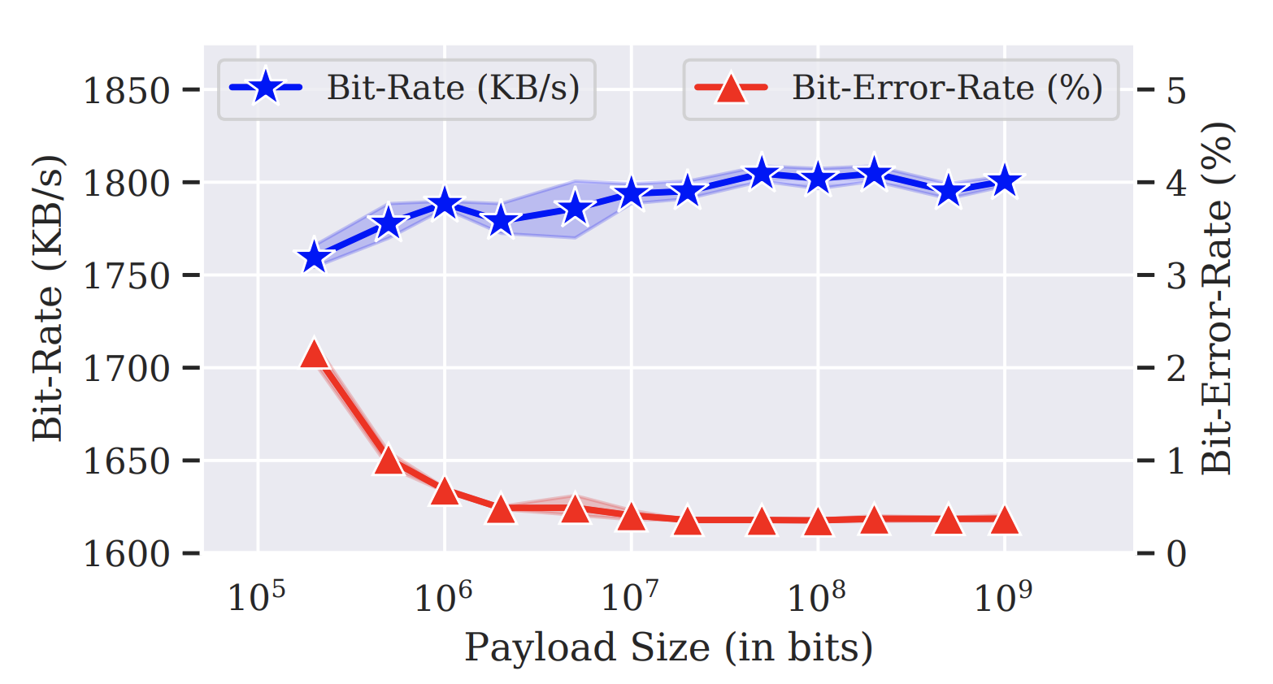
Results - Streamline Bit-Rate and Error-Rate
Results on Intel Xeon E3-1270 (Skylake)
(Also tested on i5/i7, Kaby-Lake/Coffee-Lake)
Comparisons with Prior Attacks
Attack | Bit-Rate | Error-Rate
Streamline (LLC) | 1800 KB/s | 0.4%
Flush-Flush (LLC)¹ | 496 KB/s | 0.8%
Flush-Reload (LLC)¹ | 298 KB/s | <0.1%
Take-a-Way (L1)² | 588 KB/s | 1 - 3%
Prime-Probe (L1)³ | 400 KB/s | Not evaluated
Bit-rate 1800 KB/s
Bit-error-rate 0.4%
1. [DIMVA’16], 2. [ASIACCS’20], 3. [BSDCan’05]
Takeaways: 1. Fastest Cache Covert-Channel (3x vs FlushFlush, 6x vs FlushReload)
2. Flush-less → applicable to all CPUs/ISAs.

Slide 9
Results – Resilience to Noise
Streamline error-rate under noise from co-running applications (Stress-NG Benchmarks)
(averaged over 5 runs)
15%
Sync-Period - 200,000 bits
Sync-Period - 50,000 bits
0.8%
At Smaller Synchronization Periods, Streamline uses smaller sized FIFOs in LLC to buffer bits and achieves Noise Resilience

Slide 10


Mitigation Strategy
Restricting usage of flush instructions as a defense (SHARP-ISCA’17, ARM-ISA) does not prevent Streamline
Noise injection as a defense provides limited protection, as Streamline can be made noise-resilient
Detection based defenses (e.g. using Perf-Counters) also is limited in applicability: False positives and negatives
Disabling Shared Memory or Partitioning Shared Caches (e.g. DAWG-MICRO’18) fully mitigates Streamline

Slide 11
Limitation: New Bottleneck in Covert Channels
Measurement Bottleneck: Fundamentally Limits Bit-Rate of Streamline & Future Attacks
Inability to Execute & Measure Latency of Multiple Loads in Parallel
Overcoming this bottleneck and measuring load-latency of multiple loads in parallel, can unlock ~10x increase in bitrate of covert-channel
Using rdtscp [Intel SW Developer’s Manual]
Using Counting-Thread [DIMVA’17]
rdtscp //read timer
load x
rdtscp //read timer
Thread-0
load ctr
load x
load ctr
--------
load ctr
load y
load ctr
Thread-1
while(1){
ctr++;
}
--------
rdtscp //read timer
load y
rdtscp //read timer
Serialized due to Fence-like semantics of rdtscp
Serialized due to
TSO ordering in Intel CPUs

Slide 12
Conclusion
Streamline Attack
Streamline is flushless attack with broad applicability (all uarch, ISA)
Covert-channel bit-rate 3x-6x higher than prior attacks
Eliminates Synchronization Bottleneck in prior attacks
Measurement bottleneck limits all future attacks
Addressing this can considerably increase bit-rates
S
R
Trojan
Spy
Sender
Receiver
Processor Cache

