Slide 1


SYNERGY: Rethinking Secure-Memory Design for Error-Correcting Memories
HPCA-2018
Vienna, Austria
Gururaj Saileshwar¹
Prashant Nair¹
Prakash Ramrakhyani²
Wendy Elsasser²
Moinuddin Qureshi¹
¹
²

Slide 2
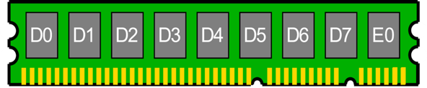
Designing Resilient Memories for Servers
Resilient Memories
Security
Security
by Malicious Attacks
Co-Design
Server memories need protection against data corruption
Reliability
Reliability
by Natural Errors
Attack Resilience – Memory Security
Error Resilience – ECC-DIMM
SYNERGY
Co-Design of
Security-Reliability
Better Performance – 20%
Better Reliability – 185X
Maintaining Security
No Extra Storage
SGX
(Software Guard Extensions)
ECC

Slide 3
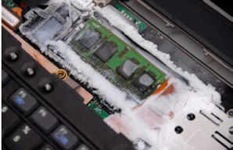
Threat Model for Memory Modules
Unauthorized Reads
Unauthorized Writes
Replay Attack
Cores
System
Memory
Cache
Cold Boot Attack
DMA Attack
Man-in-the-middle Attack
Secure memory needs to protect against these attacks !

Slide 4
How Do Secure Memories Work ?
Unauthorized Reads
Counter Mode Encryption
Data
Encrypted Data
Counter Mode Encryption
+1
Counter
Unauthorized Writes
Cryptographic
Hash
Intel SGX
Data
Signature / MAC
Message Authentication Code
Message Authentication Code
Secure Root On-Chip
Signatures
Integrity-Tree
Replay Attack
Integrity-Tree
Counter-Based
Data
Counters

Slide 5
Problem: Metadata Accesses Consume Memory Bandwidth
Secure Memory can require 4+ memory accesses for each Data access
Access Number
1
Data Cacheline
3
MAC Cacheline
Prevents Data Tampering
MAC
Memory Access Bloat
Cacheable On-Chip
2
Encryption Counter Cacheline
Used to Encrypt Data
Ctr
4
.
Integrity-Tree Counter Cacheline
Prevents Replay-Attacks
.
Ctr
.
Memory Access Bloat due to Security Metadata can lead to Performance Overheads

Slide 6
Dissecting Overheads For Secure Memory
Performance - Secure vs Non-Secure Memory
Cause: Memory access bloat due
to metadata accesses
Goal:
Reduce MAC access bloat to improve secure memory performance
2X Gap
MACs
Counters
Data
SGX_O – Enhanced Baseline for Secure Memory
(SGX with LLC shared by Counters & Data)
MACs cause 0.9x additional accesses – focus of this paper !

Slide 7

Insight: Leverage ECC-DIMM To Reduce MAC Overheads
ECC-DIMM for Reliability
Security with MAC
ECC
ECC
DATA
ECC
MAC
ECC
MAC
Fetched
Same Access as Data
Separate Access
Replace
Co-Design
Detects
Corrects
Any Modifications
2-Bit Errors
1-Bit Error
Rare
Still need ECC for Correction!

Slide 8
Agenda
Introduction & Background
Synergy Design
Evaluation

Slide 9

SYNERGY Co-locates MAC & Data for Performance
Data Cachelines
MAC Cachelines
ECC Cachelines
DATA
ECC
ECC
MAC
ECC
MAC
ECC
MAC
ECC
MAC
ECC
MAC
ECC
MAC
ECC
MAC
ECC
MAC
ECC
MAC
ECC
Non-Secure
- 1 access
Secure Memory
- 2 accesses
1 access for reads
SYNERGY
, unless error (rare)
2 accesses for writes
Synergy avoids extra MAC lookups and improves performance,
without any additional storage

Slide 10
SYNERGY uses MAC for Error Detection
ERROR
Data + MAC Cachelines
ECC Cachelines – for correction
DATA
ECC
ECC
ECC
ECC
ECC
ECC
ECC
ECC
ECC
MAC
ECC
HASH
MATCH
MISMATCH
Baseline ECC (SECDED) provides
single-bit error correction
MACs have strong error detection ability
Can We Achieve Stronger Error-Correction with Co-Design?

Slide 11
Parity Can Reconstruct Chip With Failure
Data + MAC Cachelines
ECC Cachelines – for correction
FAILURE
D0
DATA
D1
D2
D3
D4
D5
D6
D7
ECC
ECC
ECC
ECC
ECC
ECC
ECC
ECC
ECC
P
P
P
P
P
P
P
P
ECC
ECC
MAC
P
⊕
⊕
⊕
⊕
⊕
⊕
⊕
⊕
⊕
How to identify chip with failure?
CHIP-WISE PARITY
Parity Can Correct Large-Granularity Failures,
If Chip With Failure Known

Slide 12
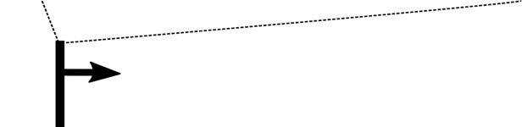


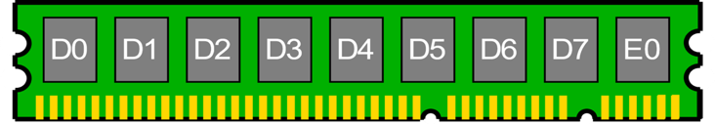
SYNERGY uses MAC + Parity for Error Correction
DATA
MAC
MAC can detect when
data cacheline is free from error
HASH
MATCH
MISMATCH
?
?
MAC
⊕
⊕
⊕
⊕
⊕
⊕
⊕
⊕
⊕
Try
Try
Try
PARITY
PARITY
How to identify chip with failure?
Try & reconstruct each chip till MAC matches!
Synergy can tolerate 1 chip with failure out of 9 chips, much stronger reliability than SECDED (Baseline)

Slide 13
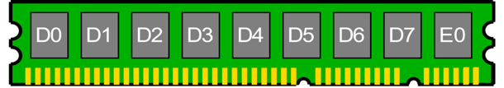
Tolerating Errors in Other Metadata
Data Cacheline
MAC
Errors can occur in any metadata stored in memory
Parity Cacheline
P_{P}
P
SYNERGY stores Parity with
each metadata to correct errors
Encryption Counters Cacheline
P_{C}
Ctr
Integrity-Tree Counters Cacheline
P_{T}
Level-wise Error Correction
Algorithm
Ctr

Slide 14
Agenda
Introduction & Background
Synergy Design
Evaluation

Slide 15
Benefit-1: Reduced Memory Traffic
Reads
Writes
Overall
56% ↓
~
36% ↓
SYNERGY Reduces Metadata Accesses by 36%

Slide 16
Benefit-2: Better Performance
Performance of SYNERGY normalized to SGX_O
SYNERGY improves performance of secure memory by 20%,
without any additional storage

Slide 17

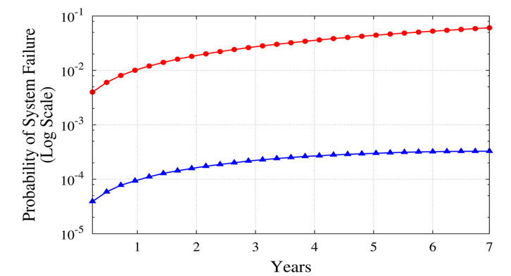
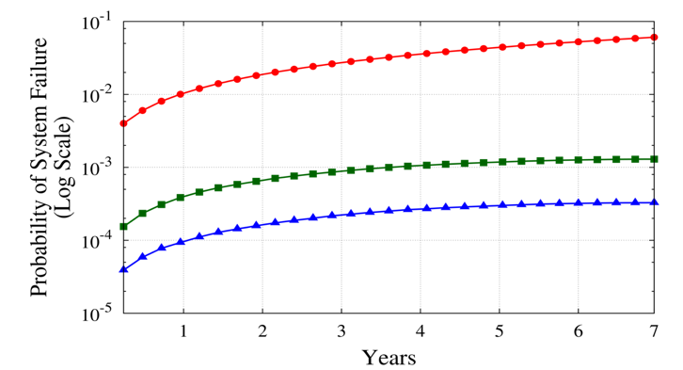
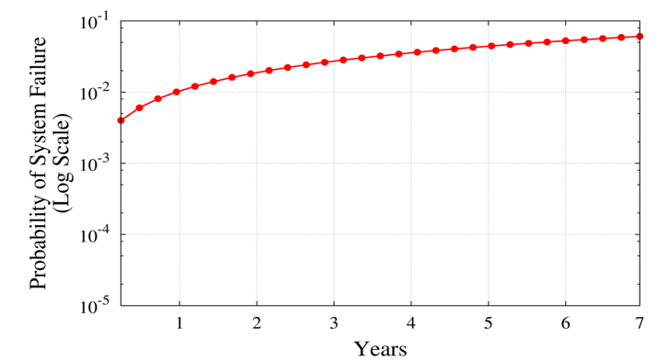
Benefit-3: Stronger Reliability
SGX_O – SECDED (9 chip x 2 ranks)
Chipkill (18 chips x 1 ranks)
Synergy (9 chips x 2 ranks)
SECDED only tolerates single-bit errors
185X
Probability of System Failure
(Log Scale)
Chipkill tolerates 1 chip failure out of 18 chips
4X
SYNERGY tolerates 1 chip failure out of 9 chips
Years
SYNERGY has 185x higher reliability than Baseline ECC-DIMM

Slide 18
Conclusion
Co-Design
Security (MAC)
Reliability (ECC)
Synergy (MAC + Parity)
SYNERGY improves Performance by 20% and Reliability by 185x

Slide 19

Thanks and Questions
“The whole is greater than the sum of its parts” - Aristotle
Synergy

