Slide 1


Morphable Counters: Enabling Compact Integrity Trees for Low-Overhead Secure Memories
MICRO-2018
Gururaj Saileshwar¹
Prashant Nair¹
Prakash Ramrakhyani²
Wendy Elsasser²
Jose Joao²
Moinuddin Qureshi¹
¹
²

Slide 2
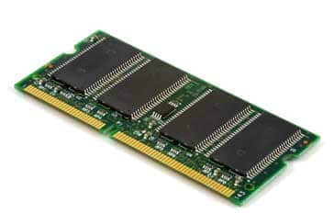

Securing Main-Memory against Physical Attacks
Unauthorized Reads
Unauthorized Writes
Replay Attack
Data Verification
Processor
Memory
deadbeef
4af28c09
Hash
ac348bf0
Data0,
Hash0
Data1, Hash1
Tamper
Can force re-use of keys,
repeat sensitive transactions etc.
Data Encryption
Cryptographic Signatures
Replay attack protection - focus of this work

Slide 3
Replay Attack Protection with Integrity-Trees
Secure Root
Stored On-Chip
Integrity
Tree
Ctr
Hash
4
Verifying Every Level On Each Data Access
Prevents Replay
3
Ctr
Ctr
Hash
Ctr
Ctr
Hash
2
Hashes
Ctr
Ctr
Ctr
Hash
1
Causes Extra Memory Accesses
& Slowdown
Encrypted Data
Counters
Hash

Slide 4
This Talk: Designing Compact Integrity Trees
Integrity
Tree
Integrity-Tree Counters
…
Integrity
Tree
C1
…
C2
C3
C1
C2
C3
C4
C5
C6
Shorter Height
Encryption Counters
…
Base of the Integrity Tree
Smaller Base
…
C1
C2
C3
C1
C2
C3
C4
C5
C6
Goal: Pack more Counters per Cacheline for Low-Overhead Integrity Trees

Slide 5
This Talk: Designing Compact Integrity Trees
Integrity
Tree
Integrity
Tree
Benefits of Our Design
8.5x smaller vs VAULT¹
4x smaller vs Baseline
13.5% vs VAULT¹
6.3% vs Baseline
Shorter Height
Tree-Size
Speedup
Base of the Integrity Tree
Smaller Base
1. VAULT - Taassori et al., ASPLOS, 2018.
Goal: Pack more Counters per Cacheline for Low-Overhead Integrity Trees

Slide 6
Agenda
Introduction
Background and Motivation
Design
Results

Slide 7
Split-Counters - More Counters/Cacheline
Naïve Counters
512 bit cache line
C1
C2
C3
C4
C5
C6
C7
C8
8 counters x 64b

Slide 8
Split-Counters - More Counters/Cacheline
Split Counters¹ (Share Significant Bits)
512 bit cache line
64 x 7-bit minor counters
7-bit Minor Counters Can Overflow
.
.
.
.
.
.
.
.
.
.
.
.
.
.
.
.
.
.
.
.
.
.
.
.
.
.
Major
Counter
.
Major
Counter +1
Major
Counter
C1
0
128
C2
0
34
C64
0
C3
17
0
23
Increment shared
Major counter
Changes values of ALL counters!
Major | Minor = Counter
1. Re-encrypt 64 Data Lines (128 reads/writes)
2. Update 64 Hashes (128 reads/writes)
64-ary Design
Trade-off: Packing more Counters vs Overflow Updates !
1. Yan et al., ISCA, 2006

Slide 9
Impact of Packing More Counters
Overflow
Counters
90%
10%
1
State of the art
Baseline
Performance Increases, then Decreases!
Benefits (counter accesses),
outweighed by costs (overflows)
Goal: Pack more counters/cacheline, but fewer overflows !
1. VAULT - Taassori et al., ASPLOS, 2018.

Slide 10
Agenda
Introduction
Background and Motivation
Design
Results

Slide 11
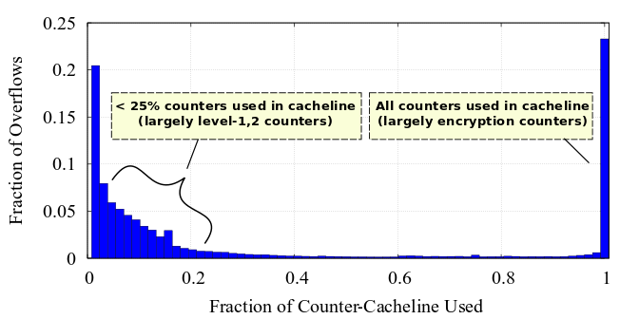
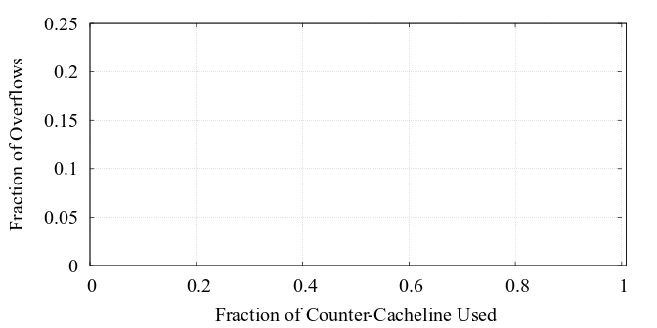
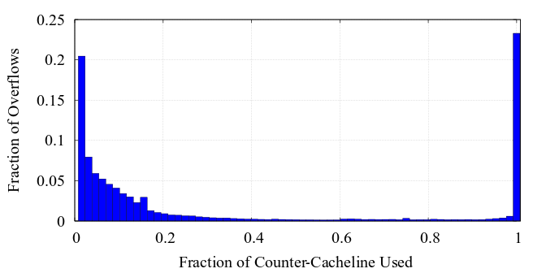
Analysis of Counter Overflows
Counter Usage at the Time of Overflow.
Few counters used
in cacheline
(tree-counters)
All counters used
in cacheline
(encryption counters)
Fraction of Overflows
~75% of overflows
~25% of overflows
Fraction of Counter Cacheline Used
Insight: Bimodal pattern in overflows ➔ Morphable Counters
with customized formats to reduce overflows

Slide 12
Few Counters Used: Compress Zero Counters
512-bit Counter Cacheline
Major Counter
Minor Counters (384-bit)
Hash
ZCC
(<= 64 non-zero ctrs)
Is-NZ?
Bit Vector
Non-Zero Counters
Non-Zero Counters | Counter Size
<=16 ctrs | 16-bits/ctr
<=32 ctrs | 8-bits/ctr
Insight: When few counters non-zero,
allocate bits only to them
128-bit
256-bit
Uniform
(>64 non-zero ctrs)
128 x 3-bit Counters
ZCC provides large overflow-tolerant counters,
when less than 25% counters are used out of 128

Slide 13
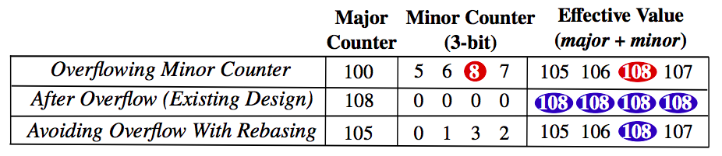
Avoiding Overflows When All Counters Used
Instead of conventional (Major II Minor)
Major
Counter
Minor Counter
(3-bit)
Effective Value =
(Major + Minor)
Overflowing Minor Counter
Rebase Counters (Avoid Overflow)
+5
-5
Reset Counters (Existing Design)
Subtract that value from all
Counters changed
– re-encryption needed
Add smallest minor counter
No change;
No re-encryption;
Rebasing avoids counter overflow and overheads,
when all counters used

Slide 14
Agenda
Introduction
Background and Motivation
Design
Results

Slide 15
Reduction in Overflows
SC-64 (Baseline)
SC-128 - 7.4x
MorphCtr-128 (ZCC-only) - 1.4x
MorphCtr-128 (ZCC+Rebasing) - 1.6x
MorphCtr-128 packs 2x Counters / Cacheline,
Still, 1.6x Fewer Overflows vs SC-64

Slide 16
Performance Benefits
Overflow
Counters
1%
13.5%
12%
6.4%
MorphCtr-128 reduces counter accesses, without a bloat in overflow updates
6.4% speedup vs Baseline,
13.5% vs state-of-the-art
Note: 4 Cores, 8MB LLC, 16GB Secure Memory, 128KB Dedicated Counter Cache

Slide 17
Storage Benefits
Configuration | Encryption Counter Storage
VAULT | 1.6%
SC-64 | 1.6%
MorphCtr-128 | 0.8%
Configuration | Encryption Counter Storage | Integrity-Tree
 |  | Storage | Levels Accessed (From Memory)
VAULT | 1.6% | 0.050% | 4
SC-64 | 1.6% | 0.025% | 3
MorphCtr-128 | 0.8% | 0.006% | 2
Encryption counter storage reduced by 2X,
Integrity-tree size reduced by 4x vs Baseline, 8.5X vs VAULT

Slide 18
Conclusion
Morphable Counters ➔ reducing overheads of secure memory
2x Compact & 1.6x Less Overflow-Rate vs Split Counters
For Practically Free ➔ Only Encoding Change, No Loss in Security
Closed 1/3rd gap between State-of-the-Art & Non-Secure
13.5% Speedup with 8.5x Smaller Integrity-Tree than VAULT
Thank You! Questions?

