Slide 1



CleanupSpec: An “Undo” Approach to Safe Speculation
MICRO-2019
Gururaj Saileshwar and Moinuddin Qureshi
Georgia Institute of Technology
Notes:
2-minutes => Intro (Performance Optimizations, Security Threat, Our Undo Approach)
3-minutes => Motivation & Goal (Threat Model, Problem, Redo vs Undo)
6-minutes => Design (Scope, L1,L2,Directory, Putting it together)
5-minutes => Evaluation (Security Analysis, Spectre-V1, Performance & Related Work, Conclusion)
Total – 15 minutes. (2 minutes for buffer)

Slide 2



Processor Optimizations → Performance Gains
Speculation
Caching
Goal
Fast -$
Slow
Mem
Computer Architects

Slide 3





Processor Optimizations → Security Threat!
Speculation
Caching
Speculation-Based Attacks
Fast -$
Slow
Mem
Attacks breach SW confidentiality
Defenses have high slowdown
Mis-speculation allows Access to Secret
Timing Side-channel
Leaks Secret

Slide 4


Our Work CleanupSpec : An Undo-Based Mitigation
Cleanup on Mis-Speculation
Speculation
Caching
Fast -$
Slow
Mem
CleanupSpec
Cleanup Speculative Cache Changes
Pipeline State Flushed
Enables a low-cost mitigation: ~5% slowdown & <1KB storage

Slide 5
Agenda
Introduction
Background & Motivation
Design
Evaluation

Slide 6
Threat Model
Any speculative load can leak information via side-channels
Channels of Information Leakage: Data Cache Hierarchy
L1-Dcache, L2 Cache, LLC, Directory
Side-Channels Out Of Scope:
Port & Functional Unit Contention
Branch Predictor, TLB, I-Cache
Main-Memory

Slide 7
Problem: Cache Exploit by Speculation Attacks
Speculative Execution
Processor
Non-Speculative
Secret Encoded as
Cache Address
Mis-speculation
Detected
Secret
Leak Secret
Core
Core
Cache State Retained
Cache
Cache
Install Array[Secret] in Cache
Cache Hit on Array[Secret]
Need to Prevent Speculative Cache Changes Leaking Information

Slide 8




Prior Work vs Our Approach - To Do or Not to Do?
Prior Work InvisiSpec – Redo based
Our Approach – Undo Based
No Leakage of
Information
Speculative
Non-Speculative
Speculative
Core
Core
Core
Core
Mis-
Speculation
Correct
Speculation
Correct
Speculation
Mis-
Speculation
No Leakage of
Information
Cache
Cache
Cache
Cache
(Uncommon)
(Common)
(Common)
No Cache
Change
2nd Load to
Update Cache
Install + Evict
Cleanup Changes
Goal: Enable a Undo-Based Mitigation without
Buffering, OS-Support, SW-Rewrite
[Yan+, MICRO-2018]
Low-overhead => only on Mis-speculation
Slowdown due to Double Loads
8

Slide 9
Agenda
Introduction
Background & Motivation
Design of CleanupSpec
Evaluation

Slide 10
Cache Changes that Need to be Undone
L1 Cache
L2 Cache
Directory
Core
Core
Install
(Miss)
C0
C1
L1-Cache
L1-Cache
Dirty
Install
Evict
Cache
Evict
Repl-state
Update (Hit)
L2-Cache
Exclusive
=> Shared
[Yao+, HPCA-18]
Evict
Evict
Need to Undo Changes to L1 cache, L2/LLC and Coherence State

Slide 11
L1-Cache Cleanup → Invalidate Install, Restore Eviction
L1 Cache Changes (Speculative)
Cleanup On Mis-speculation
Core
Core
Install
(Miss)
Repl-state
Update (Hit)
Invalidate
1
Random
Repl-Policy
(stateless)
L1-Cache
L1-Cache
Evict
2
Restore
L2-Cache
Random-Replacement incurs <1% Slowdown;
Cleanup needed only on Mis-Speculation + L1-Cache Miss

Slide 12
L2/LLC – Invalidate Install & Randomize Evictions
L2/LLC Evictions Complex & Leak Info
L2 Cache Changes
L2/LLC Evictions Complex ➔ Randomize
Core
Line
Address
Set
Index
Randomizing
Function
L1-Cache
Dirty
N-lower bits
Evict
Install
Evict
Install
L2-Cache
Invalidate
Cache
Evict
Evict
[CEASER, MICRO-18] and others
Evictions are Benign; Cleanup Only Requires Invalidation of L2/LLC lines

Slide 13


Restoring Coherence State Changes
PARSEC/SPLASH-2 on SniperSim (4-Core system)
Coherence State Changes on Get-S | Fraction of Total Loads
Local Cache: M/E/S → S
97%
Restore
Remote Cache: S → S
Remote Cache: M/E → S
2%
Delay
DRAM Access: I → S
1%
Restore
CleanupSpec uses “GetS-Safe” to delay Remote-Downgrades until Non-Speculative

Slide 14
Putting it together: CleanupSpec Mitigations
L1 Cache
L2 Cache
Coherence Downgrades
(Exclusive => Shared)
Core
Core
C0
C1
L1-Cache
L2-Cache
Cache
L2-Cache
Invalidate + Restore
Invalidate + Randomize
Delay till Non-Speculative
Metadata in Cache MSHR & Load-Queue entries track Cache Changes; Storage Overhead <1KB/Core

Slide 15
Agenda
Introduction
Background & Motivation
Design
Evaluation

Slide 16
Security Analysis
Concern: Adversary gets Cache-Hit
Concern: Correct-Path Loads
get Cache Hit
Concern: Adversary infers cache hit/miss on Correct-Path
t = t₀
t = t₁
t = t₂
t = t∞
Speculative
Install
Mis-speculation Detected
Cleanup
Completed
Redressal: Detected by metadata in Cache MSHRs & serviced as Cache-Miss
Redressal: Pipeline stalled till
Cleanup completes
Redressal: Lines invalidated,
restored or randomized
Transient Window < 650 cycles for 99% loads
Key Security Property:
After Mis-speculation, Cache State Restored or Randomized

Slide 17
Evaluating Proof of Concept Defense
Avg. access time for Secret-Inference in Spectre-V1
Array Index (in multiples of 512)
CleanupSpec has no latency difference for (secret) entry installed on wrong-path

Slide 18
Performance Overheads
Normalized Execution Time for CleanupSpec vs Non-Secure
(Evaluations on Gem5-SE: 1-Core OOO, L1-Cache 64KB, L2-Cache – 2MB)
Branch Mis-prediction Rate: > 5%
L1-D Cache Miss-Rate: 3%-6%
Avg. Slowdown
5.1%
Slowdown
Decreasing Order of Branch Mis-prediction Rate
In comparison, InvisiSpec-2019 has 15% slowdown – 3x more than CleanupSpec (5%)

Slide 19
Conclusion
Problem: Mitigate speculation-attacks leveraging cache as a channel
Existing Solutions: Have high overheads (15% or more)
Key insights: Undoing speculative changes or Randomizing them
CleanupSpec is practical → <1KB / core storage & 5% slowdown
Core
Cache
Thanks! Questions ?

Slide 20
Backup

Slide 21
Prefetching + CleanupSpec
Train Prefetcher on Non-Speculative Access Stream
Approach 1 – Simple Prefetchers
Approach 2 – Complex Prefetchers
E.g. Next Line Prefetchers
Issue Prefetch on Speculative Load
Track & Cleanup Cache
E.g. Irregular / Pattern-based Prefetchers
Issue Prefetch on Non-Speculative Load
Increase Degree to ensure timeliness

Slide 22
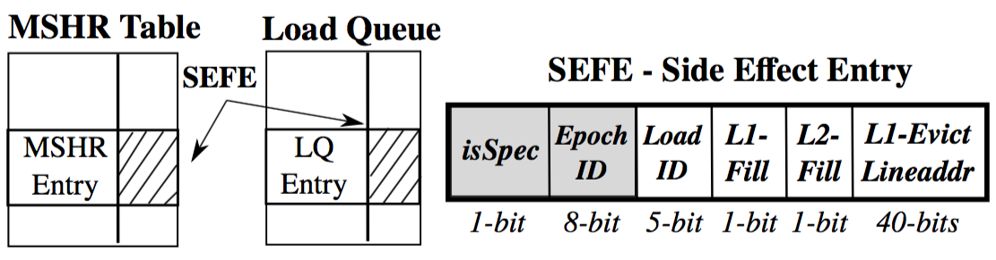
Metadata for Tracking Load Side-Effects on Cache
5 – 7 bytes metadata
per LQ & MSHR entry
Cleanup Epoch
Load completion order
Whether Line Filled
Evicted Line Address
Total Storage Overhead < 1KB / core
(for 32 LQ Entries & 64 L1/L2 MSHR entries)

Slide 23
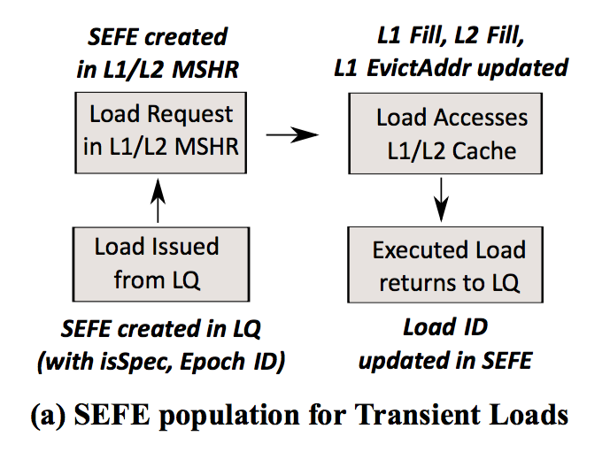
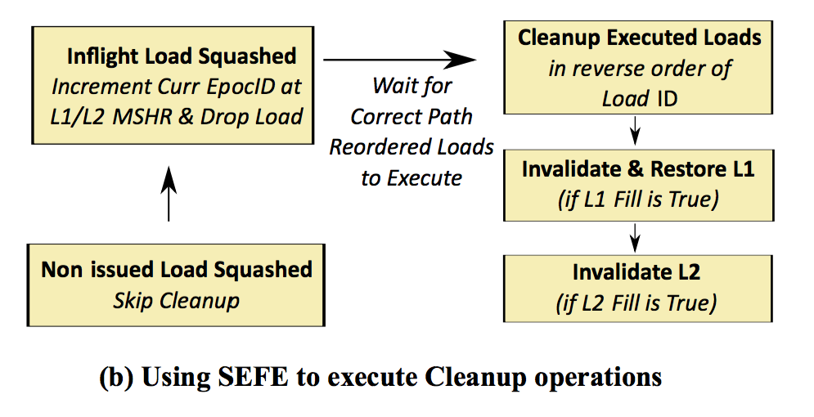
How SEFE Enables Cleanup Operations

Slide 24
Performance Evaluation Methodology
Simulator: Gem5 in native execution
Benchmarks: SPEC-CPU2006 (500 Million instruction slices)
System Configuration :
1-Core Out-of-Order
LQ – 32 Entry
L1-DCache – 64KB
L2-Cache (our LLC) – 2MB/core
Notes:
Delete

Slide 25
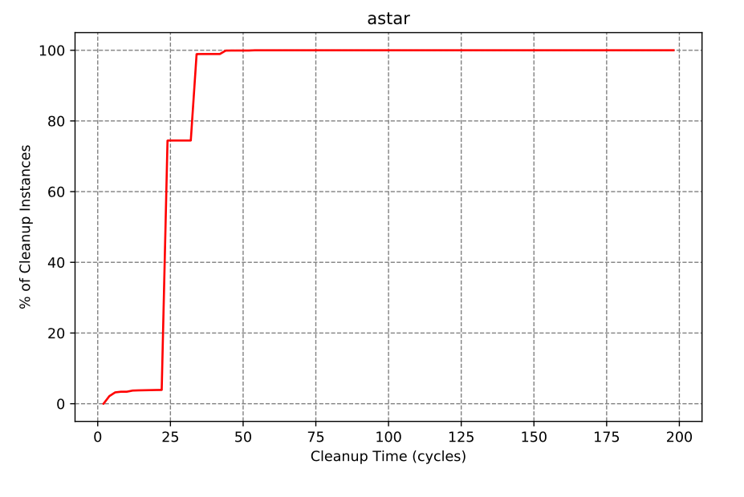
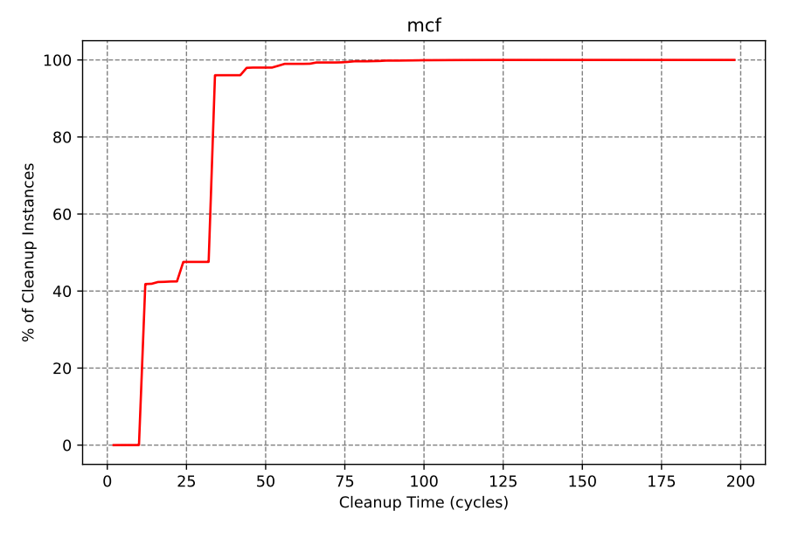
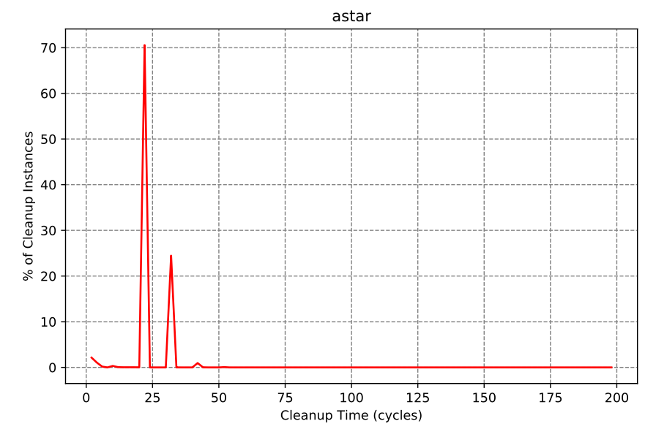
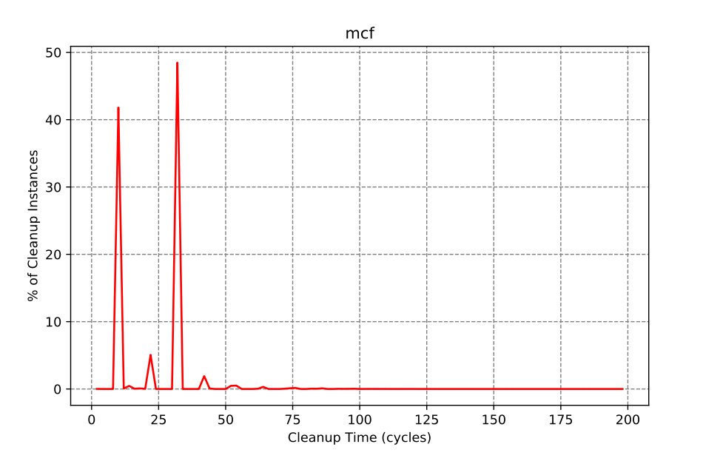
Time for Actual Cleanup Operations
CDF
PDF

Slide 26
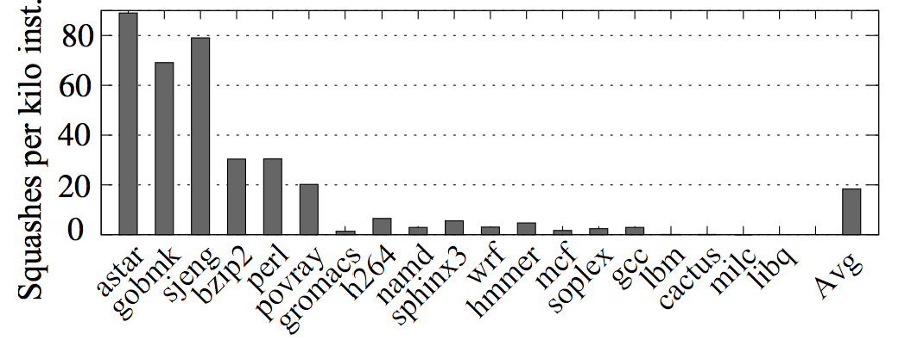
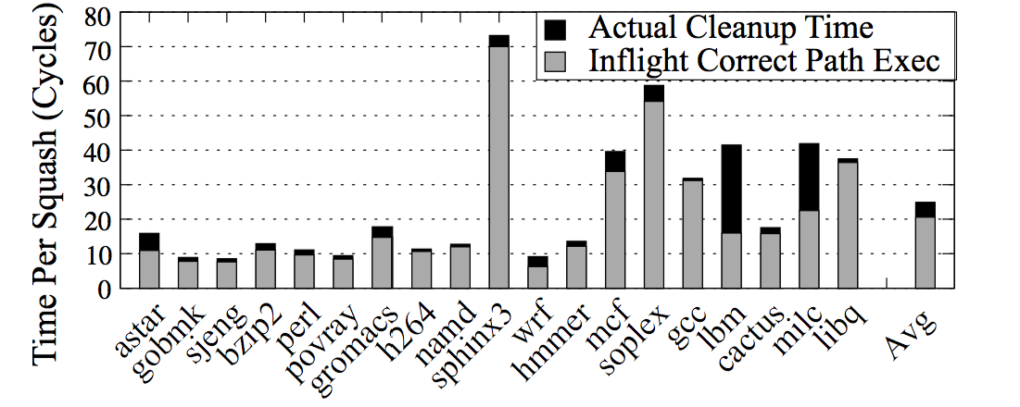
Characterizing Cleanup on Mis-Speculations
Frequency of Pipeline Squash
(Avg. 20 squashes per 1000 Inst)
Stall-Time Per Pipeline Squash
(Avg. 25 cycles/squash,
Avg. 5 cycles for cleanup)

Slide 27
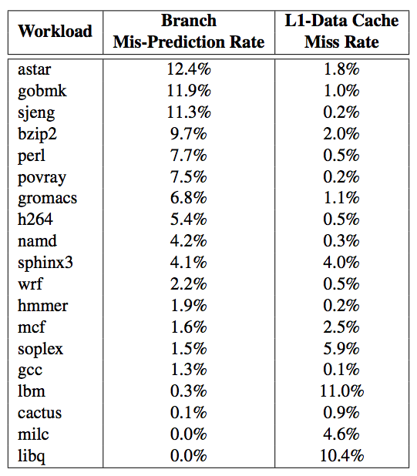
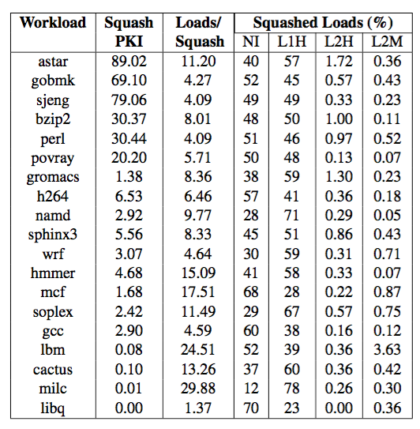
Statistics for Loads Requiring Cleanup
Workload Characteristics
Statistics for Squashed Loads

