Slide 1
Mentoring Opportunities in Computer Architecture: Analyzing the Past to Develop the Future
Elba Garza Texas A&M University elba@tamu.edu
Gururaj Saileshwar Georgia Tech gururaj.s@gatech.edu
Udit Gupta Harvard University ugupta@g.harvard.edu
Tianyi Liu University of Texas at San Antonio tianyi.liu@utsa.edu
Abdulrahman Mahmoud Harvard University mahmoud@g.harvard.edu
Saugata Ghose University of Illinois at Urbana-Champaign ghose@illinois.edu
Joel Emer MIT / NVIDIA emer@csail.mit.edu
Computer Architecture Student Association info@comparchsa.org
Link to Full Paper
Notes:
Full paper can be found here: https://drive.google.com/file/d/1o9g2WsxZ_oM2xnKSzOWQ80Z-CwQHrMcf/view?usp=sharing

Slide 2
Mentoring & Computer Architecture
Common yet powerful tool to support, engage, & retain students
Definition: Entity in a senior position taking on a supporting role of oversight and encouragement of a less experienced entity
Computer architecture community hosts assortment of mentoring programs geared toward:
women & historically marginalized students
junior graduate students
undergraduates
COVID-19 ➔ Disadvantaging newer, younger members of community…
Mentoring programming more important than ever
Notes:
Academic mentoring programming has become a common tool for helping engage and maintain students in their respective fields
While a common and easily understood concept, academic scholars still argue over the precise definition of mentorship and what activities it entails.
A generally agreed-upon (yet non-academically rigorous) definition of mentorship entails a person in a senior position taking on a supportive role of oversight and encouragement of a less experienced person.
In recent years, mentorship programs have also become an important channel to encourage and retain diverse talent in the computer architecture community.
Several workshops providing mentorship opportunities for underrepresented groups in our community including women and marginalized groups [10], undergraduates [32], and junior graduate students [34] have been organized regularly.
The worldwide COVID-19 pandemic has increased the importance of such mentorship programs.
Because in-person conferences have now become virtual, everyone’s ability to meet and interact with their community has been impacted.
However, the shift to virtual conferences has particularly disadvantaged newer, younger members of the community lacking the pre-existing connections to their newfound research community.
Such new members would traditionally rely on in-person interactions during conferences to develop their network.

Slide 3
Current Mentoring Programming
Mentoring Program | Year Established | Co-located or Host Conference | Target Mentoring Population
Career Workshop for Women and Minorities in Computer Architecture (CWWMCA) | 2014 | MICRO | Women & historically underrepresented groups
Young Architect Workshop (YArch) | 2019 | HPCA, ASPLOS | Junior graduate students (1st/2nd year PhD & Masters)
Undergraduate Architecture Mentoring Workshop (uArch) | 2019 | ISCA | Undergraduate & Masters students
Meet-a-Senior-Architect/Student (MaSA/MaSS) | 2016/2020 | ISCA, MICRO, ASPLOS | Students at all levels
All programs are short-term by nature
Notes:
Within computer architecture, there are a handful of community- wide mentoring opportunities currently available.
These mentoring-focused programs listed are those known to be currently active by the authors.
Note that they tend to be short-term by design, existing as one- or half-day workshops or the duration of a conference (i.e., 3-5 days) in the case of Meet-a-Senior-Architect and Meet-a-Senior-Student.
However, preliminary feedback from these two latter mentorship activities conducted by the authors thus far indicates that students seek longer engagements with their mentors, long after a conference.

Slide 4
Long-Term Mentoring
Aren’t students’ PhD advisors also their mentors? Not necessarily.
Mentors offer various forms of support:
Instrumental
Psychosocial
Networking
Transition from advisor-advisee to
mentor-mentee relationship takes time.
Notes:
Now, you might think that’s okay–students, especially graduate students have their PhD advisors for long term mentoring! That is not necessarily the case…
According to mentoring research, mentors are those which are defined to offer their mentees at least the first two listed forms of support, [and in best scenarios, all three.] On the other hand, an advisor-advisee relationship usually requires the first type of support, only. Mentoring literature stresses the need for time in forming mentoring relationships, especially when beginning as an advising relationship.
Only when a relationship transitions from an advisor-advisee relationship to that of mentor-mentee (through the introduction of the ever-important psychosocial support) can a mentee receive the full multifaceted benefits of mentoring.

Slide 5
In this work…
Outline current state of mentoring programming opportunities in Computer Architecture
Describe organization of two author-run programs: Meet-a-Senior-Architect (MaSA) and Meet-a-Senior-Student (MaSS)
Analyze feedback and use relevant mentoring research literature to make case for developing longer-term mentoring for Computer Architecture community
Notes:
[From the abstract]
In this work, we describe the current state of mentoring opportunities for students in computer architecture.
In addition to summarizing various mentoring programs (e.g., CWWMCA, YArch, and uArch), this work details the organization and feedback from two programs (MaSA and MaSS) that the authors currently run and organize.
Based on feedback from these short-term mentoring programs, along with relevant mentoring research literature, we identify opportunities for developing more productive longer-term mentoring programming for the computer architecture community.
Following mentoring literature, this work makes a strong case for offering both short-term and long-term mentoring programs in the future; in particular, mentoring literature show the need for time in forming mentoring relationships for mentees to receive the multifaceted benefits of mentoring.

Slide 6
Meet-a-Senior-Architect (MaSA)
Short-term at-conference mentoring program between senior members and current students
Program expectation: 20-30 minute informal meeting
Conceived by Joel Emer; basing on similar program at University of Chicago
Sponsored by SIGARCH, held continuously at ISCA since 2016. Extended to MICRO and ASPLOS in 2020-2021.
Notes:
The mentees were asked to contact their mentors and coordinate a time (and place when in-person) to meet during the conference.
Subsequently, during the conference, the mentee and the mentor meet up for roughly 30 minutes.
Mentees are advised to chat about any topic they would like a senior mentor’s perspective on, including their research, career growth, managing work-life balance in academia, etc., but not including soliciting job offers.

Slide 7
Meet-a-Senior-Student (MaSS)
Offshoot of MaSA, organized by Computer Architecture Student Association (CASA) with help from Joel Emer for MICRO-53
Also a short-term at-conference mentoring program, but between senior (3rd+ year PhD Students) and junior (1st/2nd year PhD and Masters) students
Similar program expectations (i.e. 20-30 minute meeting), anticipating student-focused topics and conversation
Notes:
The motivation for pairing junior students with those senior is that there may be topics a student may not be comfortable discussing with a senior member, but more likely comfortable sharing with a fellow student.

Slide 8
Organizing MaSA and MaSS
Mentor/Mentee sign-up has varied over the years:
Mentees solicited from those receiving travel grants (2016)
Mentees solicited during registration (2017)
Mentors solicited individually by organizer (2016 & 2017)
Mentors/Mentees solicited during registration (2018-current)
Mentor selection by mentees has also evolved:
Ranked-choice of 10 mentors from list (2017-2019)
Select from either academia or industry (2017-2019, ASPLOS 2021)
Select from list of research areas (ASPLOS 2021)
Notes:
During the conference registration, each attendee is offered the chance to sign up for either of these programs: junior students can sign up as mentees for both MaSS and MaSA, senior PhD students as mentors for MaSS and mentees for MaSA, and faculty or industry participants are allowed to sign up as mentors for MaSA.

Slide 9
Organizing MaSA and MaSS
Given information, set of Python scripts implements a variant of the stable marriage problem to match students to mentors; matches are emailed
Mentees advised to contact mentors, coordinating time (and place) to meet for 20-30 minutes
Suggested discussion topics: research, career growth, managing work-life balance in academia, etc.
Notes:
Given this information a set of Python scripts that implemented a variant of the stable marriage problem was used to match students and mentors.
Given the results of that analysis, emails to both mentors and mentees were sent to inform them of the matches.
The mentees were asked to contact their mentors and coordinate a time and place to meet during the conference.
Subsequently, during the conference, the mentee and the mentor meet up for roughly 30 minutes, either virtually or in person.
Mentees are advised to chat about any topic they would like a senior mentor’s perspective on, including their research, career growth, managing work-life balance in academia, etc., but not including soliciting job offers.

Slide 10
MaSA General Feedback
ISCA MaSA | Written Feedback
2017 | “This program was a wonderful opportunity to meet with a senior member of the architecture community who I doubt I would have had the nerve to speak to otherwise! It speaks to the value placed on maintaining the architecture community, so thank you to all of those who put their time into organizing it and participating as mentors!"
2018 | “It is a good idea to match a first time student attendee with another student as well. It is a good start point for networking and finding friends in conferences."
2018 | “It would be great to have someone in my field and continue this relationship in the future. I believe this is a great opportunity for young computer architects like me to talk with senior architects and learn from their experiences. Thank you so much for organizing this!"
2019 | “I think in the mentor selection process (the Google form), it would have been nice to see the research topic of each mentor, in addition to where they work. That would have been very helpful."
2019 | “Every conference of our area should provide this opportunity."
2019 | “This was a great program! I have benefited from this two years in a row. I have a suggestion: how about taking this mentorship experience throughout the year? Instead of meeting our chosen mentor once a year, perhaps we can set up 4 phone/video calls a year with the same mentor. It will be useful to have a continued relationship and will also help mentors see the impact of their mentorship better."
Notes:
This table offers a select assortment of feedback on MaSA from 2017 to 2019.
It shows the general positive attitude to MaSA (2017), along with constructive criticism that helped later evolve the program (e.g., matching by area (2019-1), and expand beyond ISCA (2019-2) and a prescient proposition in 2018 for a MaSS-like program (2018-1).
There are also initial suggestions for a long-term mentoring program. (2018-2, 2019-3)

Slide 11
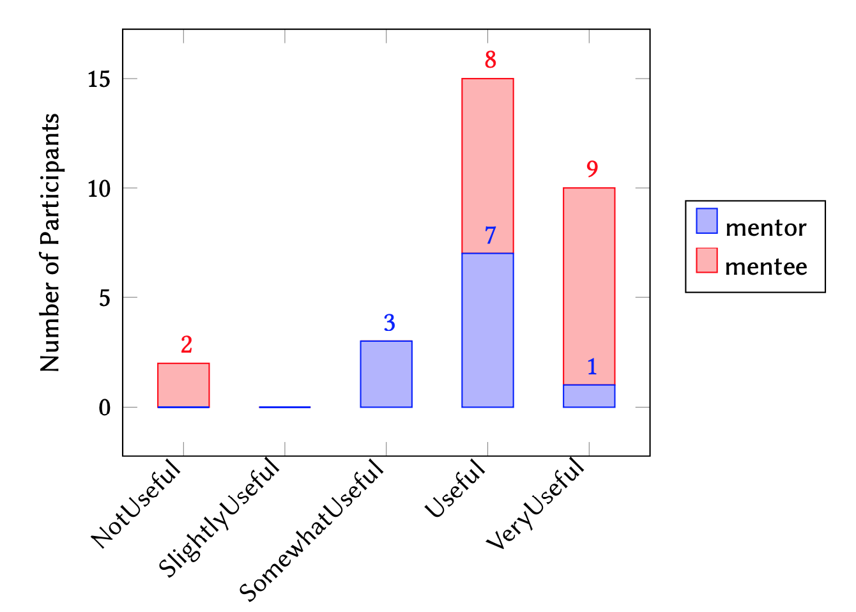
MaSS @ MICRO 2020 Feedback
Anonymous survey, 11 mentors and 19 mentees
73% of mentors
90% of mentees
All mentors and mentees indicate they would participate in future MaSS iterations
“MaSS interactions are (very) useful!”
Notes:
The figure to the right illustrates how survey participants felt about the overall usefulness of the MaSS program.
We find about 73% of mentors and 90% of mentees found the interactions either useful or very useful.
The strong feedback highlights the need for facilitating interactions among junior and senior students across the research community. Furthermore, all mentors and mentees indicated they would participate in future iterations of MaSS.

Slide 12
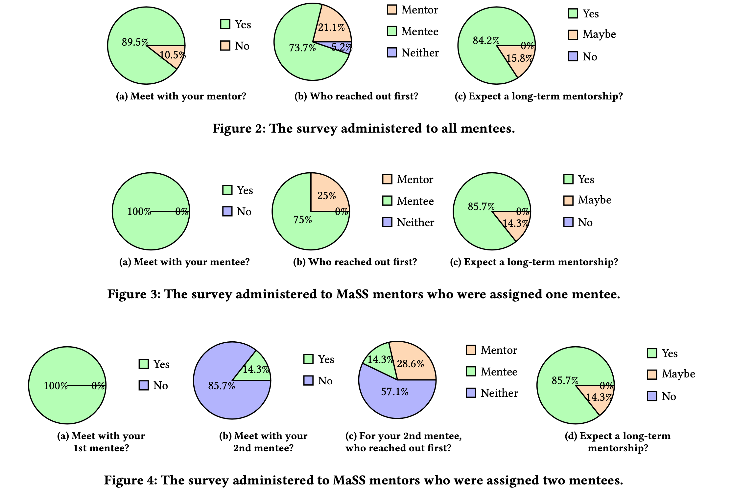
MaSS @ MICRO 2020 Feedback
Notes:
The feedback from mentees is shown in Figure 2.
Similarly, Figure 3 and Figure 4 show the feedback from mentors with one and two mentees respectively.
The feedback highlights three key aspects: (1) did the mentor and mentee meet?; (2) who reached out first to initiate the interaction?; and, (3) would they participate in a long-term mentorship program?
Figure 2a shows approximately 90% of mentees successfully met with their mentors; 10% were unable to meet. To maximize the success of mentorship programs, it is crucial to ensure everyone’s time and commitments are honored and reduce the number of mentees who did not meet their corresponding mentors.
To understand potential opportunities, we look at the breakdown of mentors that had one versus two mentees.
In particular, from the mentors participating in the survey, Figure 3a shows all mentors with a single mentee connected and met with their mentees.
While all responding mentors with two mentees met with their first mentee (Figure 4a), only 14% of them met with their second mentee (Figure 4b). Though the sample size of mentors is small (20% of all student mentors in MaSS), the significant distinction between mentors connecting with their first and second mentees is an important gap to close.
One way of closing this gap is by increasing the number of mentors via community engagement and awareness, as well as facilitating conversations between mentors and mentees.

Slide 13
MaSS Suggestions
Suggestion | Written Feedback
#1 | “I can’t remember what the registration as a mentor was like, so excuse me if this was already done. I think it might be useful for the mentors to broadly select their fields (e.g. security, GPUs, microarch, etc.) and then the mentees could select which field they’d like to match with."
#2 | “Please ask mentees to schedule at least 30 minute long slots. Any shorter, and the conversation is not productive."
#3 | “MASS was an amazing initiative and I will continue to participate in it in future conferences as much as possible. Another addition (not modification) to MASS can be Meet a Group of Students - where 4 students are paired and they get to have a group chat, this essentially provides an opportunity to network with more people at once (it may or may not be based on mutual interests as architecture itself is the mutual interest)."
Notes:
Common feedback includes mentors and mentees preferring to connect with students in similar or adjacent research areas of interest. (Sample feedback appears in both tables for MaSA (2019-1) and for MaSS. (#2))
Acting on this feedback, the matching process for the subsequent iteration of MaSS and MaSA at ASPLOS 2021 provided research-area-based matching for mentees with such a preference.
Furthermore, students expressed interest in group activities (#3) and networking opportunities where 3 to 5 students are grouped together.
While MaSS focuses on one-on-one mentorship opportunities, following the interest in group interactions, CASA has organized a regular series of virtual social hours called ArchChat Social Hours.

Slide 14
Organizational Challenges & Learnings
Automation: For scalability and wide adoptability, it’s crucial to minimize administrative effort to organize programming
Matching Interests: For best engagement, it’s critical to match mentees with mentors of their preference, and with overlapping interests
Maintaining Engagement: Each iteration had shortage of mentors; more awareness about MaSA is necessary in community. With a match, even simple nudges mid-way through conferences also help meetings happen!
Notes:
After organizing two iterations of mentorship programs (at MICRO- 53 and ASPLOS 2021), we identified three key challenges that we subsequently attempted to address: (1) ensuring high levels of automation, (2) effectively matching interest of mentees and mentors, and (3) maintaining community engagement and awareness.
Automation: To make mentorship programs scalable and easily adoptable in future conferences, it is crucial to minimize the administrative effort in organizing them, via a high level of automation. The first iteration of MaSS in MICRO-53 matched mentors and mentees using Excel spreadsheets manually, while matching for MaSA was performed with Python scripts which accepted mentor and mentee inputs in a specific format; both processes required much manual effort, which was a pain-point especially when the process needed to be repeated. To streamline this process, the subsequent iteration of MaSS and MaSA in ASPLOS 2021 incorporated automated matching scripts in Python using pandas to directly process the data from the registration data-dump and written in a jupyter notebook for easy visualization. This ensured that the matches were finalized at the latest possible date (i.e., the weekend before the conference) to allow the maximum number of attendees to participate. The jupyter notebooks with the matching scripts for MaSS and MaSA are publicly available on GitHub and the process workflow is documented in detail in a public Google Doc 3 to enable future conference organizers to easily organize such a program. Even further automation could be useful in the long term. For example, a web server could maintain information on mentor’s and mentee’s contact information, background and preferences, and perform matching and email distribution with even less manual intervention.
Matching Interests: For the best engagement between mentees and their mentors, it is critical to match mentees with mentors of their preference with whom they have overlapping interests. Recent iterations of MaSA and MaSS (including at MICRO-53) matched mentors and mentees in a random manner predominantly, while ensuring no institutional overlaps, due to the limitation of the manual matching process.
In the most recent iteration of these programs at ASPLOS 2021, a more sophisticated mentor-mentee matching process was deployed incorporating mentee preferences. All attendees were requested to indicate their research areas via check-boxes listing common research areas in the registration form. Mentees were also asked whether they would like a mentor in their research area: more than 80% indicated that they would prefer this in both MaSS and MaSA. Additionally, for MaSA, mentees were asked if they would prefer a mentor specifically from industry, from academia, or if they had no preference: 66% of mentees indicated a specific preference of an industry or an academia mentor. The automated matching scripts used greedy algorithms to provide mentors with at least one overlapping research area and from the appropriate background (industry or academia) for more than 99% of the mentees who indicated such a preference. With such intelligent matching, mentees were able to interact with mentors who were better suited to their requirements, thus leading to more fruitful interactions.
Maintaining Engagement: One of the challenges of organizing a large and distributed mentorship program is building awareness and sustaining engagement. For instance, in every iteration of MaSA, we faced a shortage of mentors and even after personal email solicitations for more mentors, we were sometimes unable to accommodate all students who signed up to be a part of the program. While MaSA at ASPLOS 2021 did see significant participation from industry and academia (almost 40% of senior attendees signed up as mentors and committed to mentor two students each on average), more awareness about MaSA in the community can encourage more of the senior conference attendees to volunteer as mentors. Additionally, we notice that a fraction of meetings for MaSS fail to happen if neither the mentor or mentee overcomes the inertia to send an introductory email. We attempted to address this at ASPLOS 2021 by sending out reminder emails to mentors and mentees, at the mid-way point during the conference, encouraging them to connect if they had not done so already: these emails were anecdotally helpful in initiating connections that may otherwise not have happened. However, more quantitative studies of community awareness and engagement (inclination to mentor, meeting success rates, subsequent interactions, etc.) are needed to address this problem in future iterations.

Slide 15
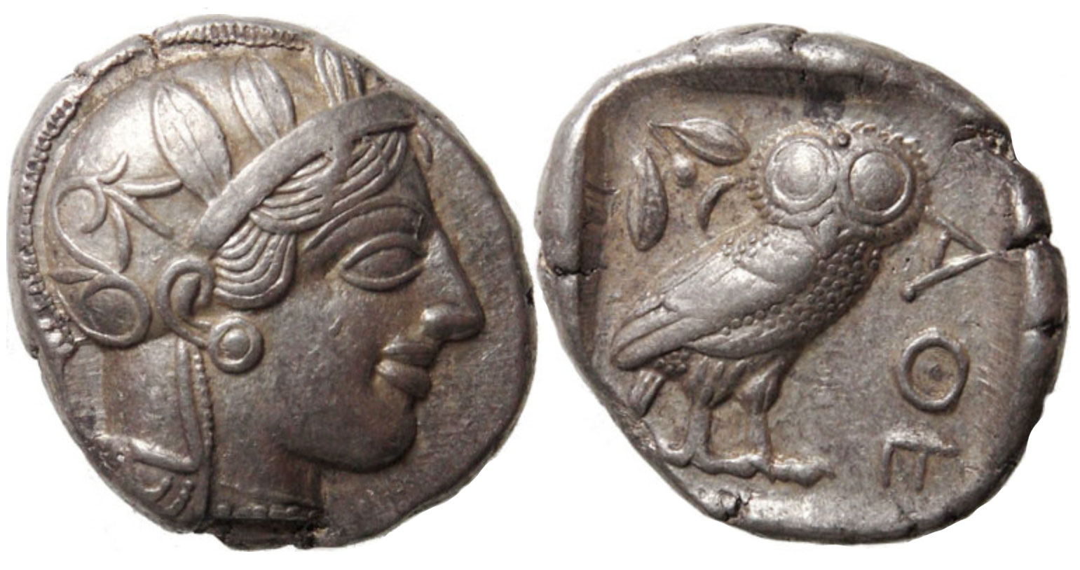
What is Mentoring?
Intuitive, yet difficult to define… over 50 differing academic definitions!
Via Etymology: Mentoring is act between two people where the more experienced counsels the less experienced, usually younger, party
Ubiquitous; found to be beneficial in business, academics, and personal development
Athena and her wise owl on a Greek tetradrachm

Slide 16
Mentoring Benefits for Academia
Correlates with presenting at conferences, publishing articles/book chapters, & securing postgraduate funding
Generates cycle of mentorship for later student generations
Especially crucial for underrepresented and marginalized students:
Increased scholarly submissions, paper acceptances, conference attendance
Higher resulting GPAs, increased completed credit-hours, reduced attrition

Slide 17
Types of Mentoring Support
Instrumental Support: Concrete activities to help build mentee’s knowledge—raises mentee’s academic competence in field
Psychosocial Support: Personal encouragement, counseling, and emotional support—builds mentee’s sense of competence and belonging
Networking Support: Advocating for, expanding and including in academic network—creates opportunities for mentee in field
Notes:
In her seminal work on mentoring [23], Kathy Kram identifies two forms of support mentors may give to mentees: instrumental support and psychosocial support.
Instrumental support includes concrete activities done by a mentor to help the mentee build knowledge [30]. An example in our community could be a mentor introducing the mentee to a new simulator or toolchain or recommending specific articles to read on a given research topic. The benefit of such support is obvious as it expands mentees’ knowledge and competence in their field.
Psychosocial support, on the other hand, involves a mentor’s personal encouragement, counseling, and emotional support for their mentee [19]. Such support helps mentees develop their sense of competence (i.e., self-efficacy) and feeling of belonging within their chosen field or profession [14]. This support is found to be particularly important to women and other underrepresented or marginalized student populations [7, 9]. Understandably, such psy- chosocial support is more likely to require more time to develop in a mentoring relationship, compared to instrumental support which is easier to establish from the start [20].
Networking support, is a third form of support that a mentor can provide, as identified in later research. Such support involves advocating for a mentee such as introducing them to one’s network of academic connections for the purpose of expanding the mentee’s own network and academic opportunities [9, 21].
All these forms of mentoring support may not be provided in a single mentoring relationship and a mentee may naturally identify multiple mentors, with each providing a different type of support.

Slide 18
Need for Long-Term Mentoring
Implicit assumption that academic research advisor is, by virtue of position, their advisees’ mentor. Not so fast!
It’s fully possible for advisor-advisee relationship to fail to manifest psychosocial support while still being academically successful!
If student does not have mentorship with advisor (or even lacks advisor), she/he may look elsewhere to develop connection…
There is a need for longer-term mentoring in our community!
Notes:
There may be an implicit assumption that an academic research advisor is, by virtue of her/his position, their advisees’ mentor. Scholars stress this may not necessarily be the case [28, 29, 31].
It is possible that an advisor-advisee relationship can fail to manifest psychosocial support while still being academically successful [28, 29].
In fact, researchers highlight that only when an advisor-advisee relationship “evolves into a more connected, active, and reciprocal relationship and when the advisor begins to offer a range of both career-enhancing and emotional or psychosocial functions, the advising relationship becomes a mentorship" [20].
In the event a student is unable to build such a mentoring relationship (in particular one covering all the facets of mentorship) with their advisor, the student may look elsewhere to identify such mentors. Community-level mentoring programs such as MaSS and MaSA, for example, serve as an avenue for a student to develop such mentoring connections.
However, Kram [23] warns that time-delineated mentoring programming may result in insufficient time for mentoring relationships to develop into one with both instrumental and psychosocial support.
This is a drawback of both MaSS and MaSA, and most other mentoring programs currently active in our community, as they are primarily co-located with conferences and short-term by design. Thus, there is a need for a longer-term mentoring program in our community, where students can develop deeper, more meaningful mentoring relationships.

