Slide 1




AMuLeT:
Automated Design-Time Testing of Secure Speculation Countermeasures
Bo Fu*
University of Toronto
Leo Tenenbaum*
University of Toronto
David Adler
University of Toronto
Assaf Klein
Technion – Israel Institute of Technology
Arpit Gogia
IMDEA Software Institute
Alaa R. Alameldeen
Simon Fraser University
Marco Guarnieri
IMDEA Software Institute
Mark Silberstein
Technion – Israel Institute of Technology
Oleksii Oleksenko
Azure Research, Microsoft
Gururaj Saileshwar
University of Toronto
*Bo and Leo contributed equally as lead authors for this paper
Notes:
We present AMuLeT, the automated microarchitectural leak tester

Slide 2
Executive Summary
Speculative execution attacks (e.g. Spectre) have been difficult to robustly mitigate: Many countermeasures have been shown insecure within 2 to 3 years
No practical frameworks to test security of countermeasures at design-time: RTL or in-silicon testing is often too late; Formal modeling of countermeasures is not scalable
We propose AMuLeT, a tool for testing countermeasures early in the design phase on microarchitectural simulators like gem5: Automated testing, Easy to integrate & deploy
AMuLeT found 3 known and 6 new vulnerabilities in 4 hardware countermeasures in seconds to minutes; Enables rapid prototyping of future countermeasures
Notes:
Speculative execution attacks such as Spectre have been difficult to robustly mitigate
Many countermeasures have been shown insecure in only 2 to 3 years
We believe this is because no practical frameworks exist to test security of countermeasures at design-time
RTL () testing is often too late, and formal modeling of countermeasures is not scalable
We propose AMuLeT, a tool to test countermeasures early in the design phase on microarchitectural simulators ()
Amulet enables automated testing, and can be easily integrated and deployed on existing countermeasures
AMuLeT has been able to find 3 known and 6 new vulnerabilities in seconds to minutes, and enables rapid prototyping of future countermeasures

Slide 3

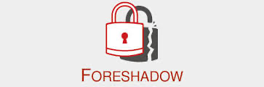
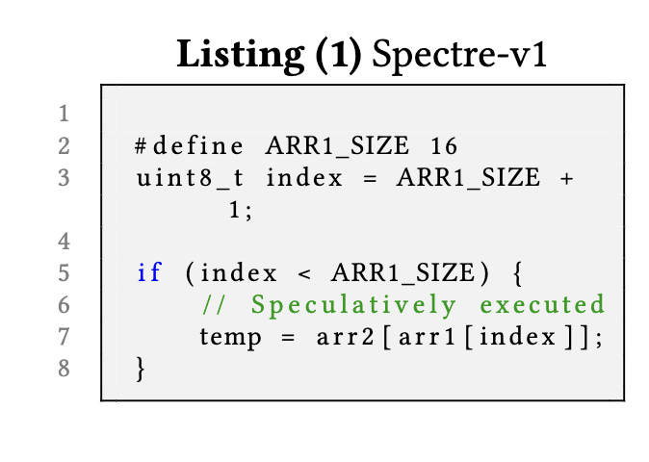


Background: Speculative Execution Attacks
Processor Speculation Can Leak Secret Data that is Not Accessible from Architectural Registers
Meltdown
…
Exploits Branch Prediction
Many CPU prediction mechanisms -> 20+ attacks in last 6 years
Notes:
For some background, speculative execution attacks which can leak secret data have proven to be a consistent problem, with many new variants routinely discovered

Slide 4
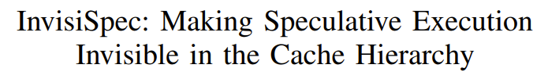
Many PRIOR Countermeasures …
Making speculative loads invisible:
MICRO’18
Undo mis-speculated changes:
MICRO’19
Taint speculative changes & delay until safe:
MICRO’19
Notes:
To address this issue, many prior countermeasures have been proposed…

Slide 5



Many PRIOR Countermeasures …SHOWN TO BE insecure
Making speculative loads invisible:
Attacks
MICRO’18
ASPLOS’21
Undo mis-speculated changes:
MICRO’19
HPCA’22
Taint speculative changes & delay until safe:
MICRO’19
SEC’21
Notes:
…But most have shown to be insecure often only a few years later

Slide 6

NEW countermeasures BEING proposed
Attacks
Buffer speculative cache misses in Line-Fill Buffer (LFB):
SEC’24
?
Should we wait several years to discover a new countermeasure is insecure?
Can we detect leakage in countermeasures at design time?
Notes:
In addition, new countermeasures are still being developed today…
Which begs a few questions, such as:
1 - Should we always wait several years to discover a new countermeasure is insecure?
And
2 - Can we detect leakage in countermeasures at design time?

Slide 7
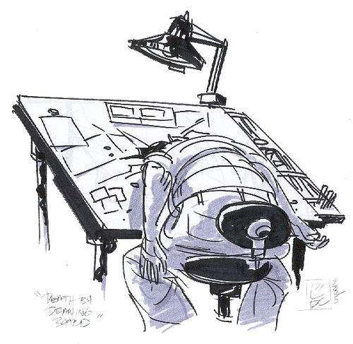
Why Are COUNTERMEASURES SHOWN INSECURE?
No method to test robustness of proposed countermeasures
Corner cases remain causing breakdown(s) in security
We need tools to test security of countermeasures at design time.
Notes:
Thus, we attempt to analyze the root cause of this issue: Why are countermeasures eventually shown to be insecure?
We believe it is because there exists no method to test robustness of countermeasures,
And that corner cases are easily overlooked
Therefore, we must have tools to test security of countermeasures early-on at design time

Slide 8

State-of-the-art TESTING TOOl - Revizor
Revizor [ASPLOS ‘22] is a tool for finding speculation vulnerabilities in commercial CPUs.
It fuzz tests a target CPU against a Speculation Contract [S&P ’21] to detect speculative leakages.
Generates & runs random test cases
For any two test cases (A and B):
Test Case
1. If their expected behavior from the contract is the same
Program
2. But their actual behavior on the CPU is different
RNG
Input
Contract Trace A
Contract Trace B
Speculation Contract
(Emulator)
Real CPU
New Speculative
Leakage!
BUT
Captures Expected Leakage
(Contract Trace)
Observed Leakage
(Hardware Trace)
Hardware Trace A
Hardware Trace B
Notes:
We discover Revizor to be the current state of the art testing tool for finding speculative vulnerabilities.
Revizor fuzz tests a target CPU against a speculation contract, implemented as an executable model which represents allowed data leakage
To do this…
1 - First, test cases are randomly generated and run.
2, 3 - Execution traces collected from both models
4 - For any two test cases
5 - If their expected behavior from the speculation contract is the same
6 - But their actual behavior on the real CPU is different
7 - Then the user will know that some unexpected leakage has occurred

Slide 9
State-of-the-art TESTING TOOl - Revizor
Revizor [ASPLOS ‘22] is a tool for finding speculation vulnerabilities in commercial CPUs.
It fuzz tests a target CPU against a Speculation Contract [S&P ’21] to detect speculative leakages.
Generates & runs random test cases
For any two test cases (A and B):
Test Case
1. If their expected behavior from the contract is the same
Program
2. But their actual behavior on the CPU is different
RNG
Input
Problem: ONLY applicable to commercial CPUs; Vulnerabilities found post-silicon are hard to address!
Contract Trace A
Contract Trace B
Speculation Contract
(Emulator)
Real CPU
New Speculative
Leakage!
BUT
Captures Expected Leakage
(Contract Trace)
Observed Leakage
(Hardware Trace)
Hardware Trace A
Hardware Trace B
Notes:
However, Revizor can only be used on real CPUs!
Any vulnerabilities it can find will be difficult to address

Slide 10
DRAWBACKS of PRIOR APPROACHES
State-of-the-art testing tools not applicable early-on in design phase
Revizor [ASPLOS’22] only applicable to commercial CPUs
RTL testing (e.g., WhisperFuzz [SEC‘24]) also too late to address µarch vulnerabilities
Design-time tools using formal methods not currently practical
Pensieve [ISCA ‘23] requires extensive manual modeling
We seek an (1) automated testing tool to test security of countermeasures, (2) applicable early-on in design phase on µarch simulators for rapid prototyping, that is (3) easy to integrate with minimal developer effort
Notes:
In addition, other related prior work contain similar issues
As mentioned, Revizor is only applicable to commercial CPUs
1 - RTL testing tools such as WhisperFuzz find issues too late to practically address
2 - Formal methods such as Pensieve can be even more impractical, and require extensive manual modeling to be effective
3 – To address these issues, we seek an automated testing tool to test security of countermeasures, which is applicable early-on in the design phase on simulators for rapid prototyping, and is easy to integrate into existing countermeasures with minimal developer effort
(is not scalable (beyond 10+ cycles))

Slide 11


amulet
AMuLeT is a testing tool that can detect speculative leakage in microarchitectural simulator-based countermeasures
Test Case
RNG
Program
AMuLeT extends Revizor’s testing framework to work on µarch simulators, detecting leakage in countermeasures at design-time.
Input
Speculation Contract
Target Countermeasure
(Simulator)
Notes:
Therefore, we present AMuLeT, which can detect speculative leakage in simulator-based countermeasures
1 - AMuLeT extends Revizor’s testing framework to work on simulators, allowing us to detect leakage in countermeasures where they are originally designed

Slide 12
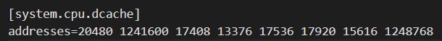
amulet
AMuLeT is a testing tool that can detect speculative leakage in microarchitectural simulator-based countermeasures
Test Case
RNG
Program
Testing Methodology:
Input
Generate and run random test cases
Define the leakage model (Speculation Contract) for a given countermeasure
Speculation Contract
Target Countermeasure
(Simulator)
Collect execution traces
Test the contract trace against the countermeasure’s µarch trace
Contract Trace
µarch trace
Notes:
To perform testing…
1 - We generate and run random test cases
2 - We define the allowed speculation contract for our given countermeasure, and implement it onto our leakage model
3 - We collect execution traces from our runs on both the given countermeasure and our leakage model
4 - We test for leakage by comparing the contract trace, collected from the speculation contract, against the microarchitectural trace, collected from the countermeasure

Slide 13
amulet
For any two test cases (single program, two inputs):
1. If contract traces (expected leakage) is the same
Test Case
Contract Trace A
Contract Trace B
RNG
Program
Input
2. But µarch traces from countermeasure are different
µarch Trace A
µarch Trace B
Speculation Contract
Target Countermeasure
(Simulator)
Contract Trace
µarch trace
Unexpected Leakage in Countermeasure!
Notes:
To discover leakage, we take two test cases, such that they are the same program, with different input:
If the expected contract traces are the same
1 – But the actual collected microarchitectural traces are different
2 – Then we can determine that there is an unexpected leakage in the target countermeasure

Slide 14
Challenges
Moving from commercial CPUs to simulators presents some unique challenges
Simulators provide access to all the microarchitectural state. What should be included in the μarch trace to capture the attacker’s observations?
CPU simulators are orders of magnitude slower than silicon. How can we find vulnerabilities quickly?
As the search space is large, can we improve the chance of finding vulnerabilities with randomized testing?
Notes:
Leo takes
Convey why realistic traces are necessary & why it is a challenge (not realistic if too many uarch states need to be read (Mark’s argument))
E.g. Order of cache state changes, instead of just a snapshot
(Exec summary of main challenges)
(What are the problems when you replace hw with simulator?)
(Slow; How do we actually search whilst dealing with slow sim?)
(What we see that is interesting for each increased attacker model)
(Gradient of realistic to unrealistic observations)
(Comically Unrealistic: Need to tap into memory bus to see sequence of transitions clearly? Why not just read the transactions then?)

Slide 15
HOW TO PICK microarchitectural traces?
Can include the entire microarchitecture state, but this leads to “leakages” which are not exploitable in practice
Easy to observe
for an attacker
Hard to observe for an attacker
Cache tags
TLB tags
Cache replacement state
Branch predictor state
MSHR status
Order of memory requests
Register file contents
Final Cache + TLB Tags in the μarch trace are sufficient to find a large proportion (~80%) of leakages in a simulated CPU; many defenses also only mitigate these channels.
Other μarch state (BP state or sequence of memory requests) can be added to find additional leakages with some impact to speed
Notes:
Leo takes
Convey why realistic traces are necessary & why it is a challenge (not realistic if too many uarch states need to be read (Mark’s argument))
E.g. Order of cache state changes, instead of just a snapshot
(Exec summary of main challenges)
(What are the problems when you replace hw with simulator?)
(Slow; How do we actually search whilst dealing with slow sim?)
(What we see that is interesting for each increased attacker model)
(Gradient of realistic to unrealistic observations)
(Comically Unrealistic: Need to tap into memory bus to see sequence of transitions clearly? Why not just read the transactions then?)

Slide 16
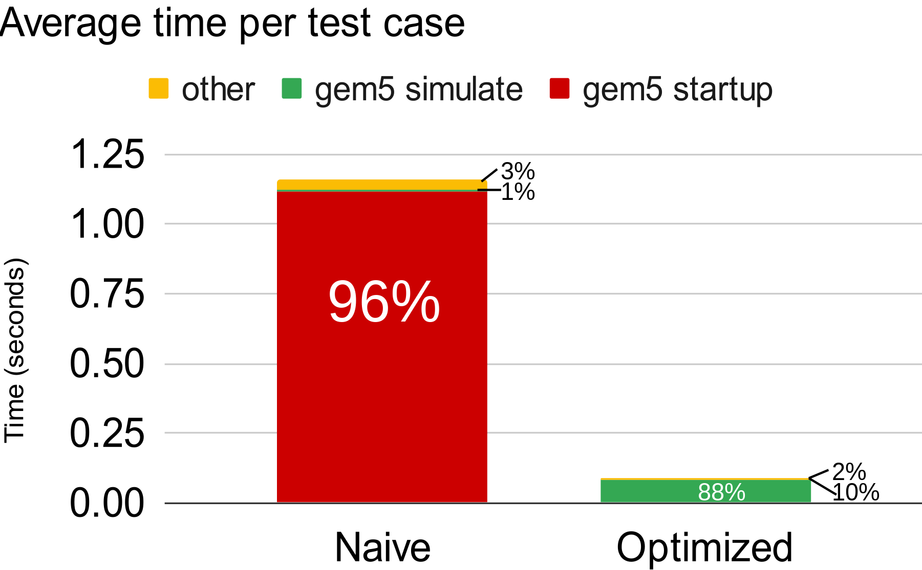
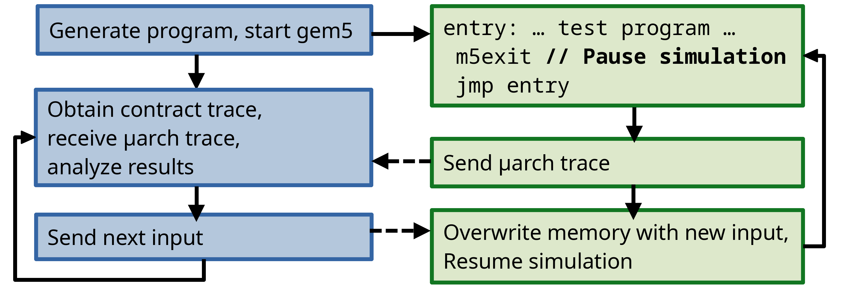
addressing Slow TESTING speed
Naively, gem5 runs one executable and then exits.
Problem: gem5's startup time (~1 second) dominates compared to simulation time (~0.1s).
Avg. Time per Test Case
gem5 startup
other
simulation
1.1 s
12x
Time (seconds)
0.09 s
Solution: An Optimized framework that can run multiple inputs without restarting gem5
Result: Reduces average time per test case from 1.1s to 0.09s (12x speedup);
1.7x increase in violations due to increased diversity of μarch states
Notes:
Leo takes
EXPLAIN verbally : Intuition behind increase in vios : Using prior test cases’s uarch state
- This is how we are increasing “diversity” of uarch states
Explain What is naïve impl.?; What is opt impl?
Why was naïve slow? Just because poor engineering or actual issue?
(Draw attention to 96% number (highlighted box?))
(Bar graph instead of table)
(Exec summary should also mention tim
(Green color diff is great!)

Slide 17
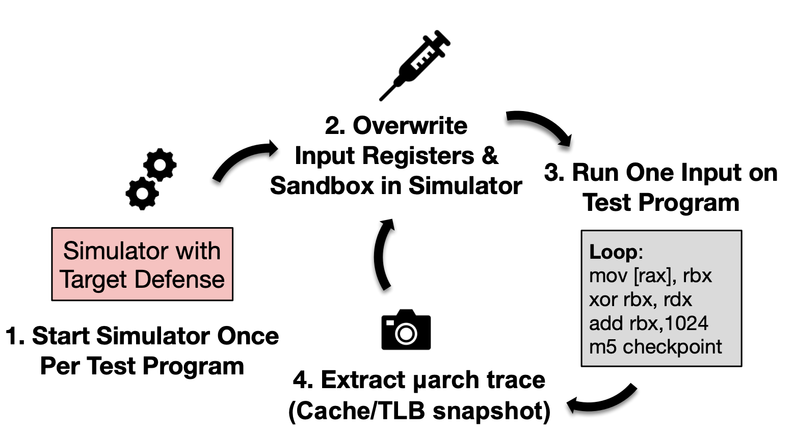
addressing Slow TESTING speed
Problem: gem5's startup time (~1 second) dominates compared to simulation time (~0.1s).
Solution: An Optimized framework that can run multiple inputs without restarting gem5
Avg. Time per Test Case
gem5 startup
other
simulation
1.1 s
12x
Time (seconds)
0.09 s
Result: Reduces average time per test case from 1.1s to 0.09s (12x speedup);
1.7x increase in violations due to increased diversity of μarch states
Notes:
Leo takes
EXPLAIN verbally : Intuition behind increase in vios : Using prior test cases’s uarch state
- This is how we are increasing “diversity” of uarch states
Explain What is naïve impl.?; What is opt impl?
Why was naïve slow? Just because poor engineering or actual issue?
(Draw attention to 96% number (highlighted box?))
(Bar graph instead of table)
(Exec summary should also mention tim
(Green color diff is great!)

Slide 18
Leakage amplification
Problem: With randomized testing, some vulnerabilities can be hard to find.
Insight: Side-channel requires μarch contention → decrease μarch structure sizes to increase μarch contention in tests
Higher chance of a vulnerability surfacing in limited number of short tests
Result: For one of the defenses tested, InvisiSpec, 256 MSHRs → 2 MSHRs resulted in 0 violations in 20 minutes → 1+ violations per minute
Notes:
Leo takes
Start to see increased contention; Want to showcase that decr size -> incr contention
--Perf improvement is since less cache priming needed; Not the primary goal of decr structures
(Merge this with 2? Optimization to allow for otherwise prohibitively computationally expensive test cases on simulator)
(Will be asked: Is this possible/necessary on revizor?)

Slide 19

Results: Systematic TESTING campaign
Campaign of 100 parallel runs × 200 test programs × 140 inputs (20 mins – 1 day based on defense)
Defense | InvisiSpec [MICRO’18] | CleanupSpec [MICRO’19] | STT [MICRO’19] | SpecLFB [SEC’24]
# of Unique Vulnerabilities | 1 | 3 | 1 | 1
Mean time to violation | 2.1 seconds | 1.1 seconds | 2 hr 52 min | 1.6 seconds
AMuLet discovers 3 known & 6 unknown leaks in defenses in few seconds to hours.
First to show that SpecLFB’s implementation is insecure.
Notes:
Leo takes
Patched: InvisiSpec Speculative load 1-D eviction patch
(Highlight some key takeaways from the slide: What do we actually care about?)
(Remove time taken row?)
(Highlight: Mean time to find these leakages are only in seconds)
(Highlight speclfb)
(Animate each row to appear one by one?)
(Another row: Total number of violations?)

Slide 20
Types of VulnerabiLITIes discovered
AMuLeT found 3 known and 6 unknown vulnerabilities in the 4 defense implementations we tested
SpecLFB: First load unprotected
Protections Unimplemented (on certain paths)
InvisiSpec - Unprotected I-Cache
STT - Speculative Stores Leak via TLB
CleanupSpec - Speculative Stores Not Cleaned
CleanupSpec - Split Requests Not Cleaned
Implementation Bugs
InvisiSpec - Speculative L1D evictions
Undocumented & Insecure Perf Optimizations
SpecLFB - First Spec Load Unprotected
Fundamental design issues
CleanupSpec - UnXpec
CleanupSpec - Too Much Cleaning
InvisiSpec - Same-Core Speculative Interference
CleanupSpec: Split Requests Not Cleaned
if (!inst->isPrevNoUnsafe()) {
// only if prior unsafe loads exist:
// reallyUnsafe = 1
inst->setreallyUnsafe();
}
...
// removes protection if not reallyUnsafe.
if (!inst->isreallyUnsafe() &&
inst->isSpeclfbStalled()) {
inst->clearSpeclfbStalled();
}
if (loadQueue[load_idx]->isSplitReq()) {
++lsqSquashedLoadsSplitReq;
// TODO: Cleanup For SplitReq
loadQueue[load_idx]->setSquashBuffered(false);
// Cleanup Done
}
CleanupSpec - UnXpec: Cleanup operations take variable amount of time → impacts total execution time and I-Cache state
CleanupSpec - Too Much Cleaning: A nonspeculative load gets cleaned up if it is reordered with a speculative load to the same address
InvisiSpec - Same-core speculative interference attack: Speculative load address leaked through timing of non-speculative loads on the same core based on MSHR contention
// Test case that leaks
register int secret;
if (false) {
// first speculative load not protected!
load foo[secret * 64]
}
Notes:
Leo takes
(Maybe remove some of the ones we don’t show code for)
(Spec L1d evictions: Just show what’s happening?)
(List all but just show 2-3 in code (def speclfb))
Known in green, unknown in red
Pics (In order):
STT - Speculative Stores Leak via TLB
SpecLFB - First Load Unprotected
CleanupSpec - Too Much Cleaning
InvisiSpec - Same-Core Speculative Interference
- Do a bit of verbal explanations per vuln
Visualization appears and disappears for each bullet as its shown
---------------
TODO: InvisiSpec - Speculative L1D evictions (?)

Slide 21

Conclusion
AMuLeT is the first tool to test countermeasures for speculative leaks in microarchitectural simulators, with minimal manual intervention.
AMuLeT detects 3 known and 6 new leaks in countermeasures in seconds/minutes, and shows SpecLFB (SEC’24) implementation is insecure.
AMuLeT reduces the risk of insecure deployments of countermeasures, enabling developers to test the robustness of defenses at design-time.
AMuLeT is open source: https://github.com/sith-lab/amulet
Notes:
(Brian takes)
AMuLeT is the first tool to test countermeasures for speculative leaks in microarchitectural simulators, with minimal manual intervention.
AMuLeT detects 3 known and 6 new leaks in countermeasures in seconds/minutes, and shows SpecLFB (SEC’24) implementation is insecure.
AMuLeT reduces the risk of insecure deployments of countermeasures, enabling developers to test the robustness of defenses at design-time.

Slide 22
BACKUP

Slide 23
