Slide 1
K-NN: IRRELEVANT ATTRIBUTES
Jerry Bonnell Gururaj Shriram Lloyd Beaufils
(Group #5)

Slide 2
The theory goes…
“Objects are similar if the geometric distance between the vectors describing them is small.” – Miroslav Kubat An Introduction to Machine Learning

Slide 3
But…
“If the vast majority of the attributes have nothing to do with the class…then the geometric distance will become almost meaningless.” – Miroslav Kubat An Introduction to Machine Learning

Slide 4
Irrelevant attributes distort and dominate the geometric distances between examples.
We can expect k-NN performance to be poor, perhaps worse than random, with the addition of irrelevant attributes.

Slide 5
Well, does experience agree?

Slide 6
Building the Classifier
Python
Algorithm: Textbook (Table 3.2) and SciKit Learn
70% training set / 30% testing set
Training set may not be representative Random subsampling
Measure by accuracy rate

Slide 7
Adding irrelevant attributes…
Irrelevant attribute values should mimic realistic domains
Values should not dominate the dataset.
How to? Normal distribution
Start with μ = 10, σ = 1
Increase parameters as groups are added

Slide 8
Setting up…
Control group: 0 irrelevant attributes
Add in groups of two until 10 groups are reached
Repeat the process for 1-NN, 3-NN, 5-NN, …, 9-NN.
Now, the datasets…

Slide 9
🌸 dataset
4 numeric attributes:
Sepal length in cm
Sepal width in cm (negative correlation)
Petal length in cm
Petal width in cm
Classes: setosa, versicolor, virginica
Class distribution: 33.3% for each class
→ Modified!

Slide 10
🐰 dataset (synthetic)
2 numeric attributes
Height in ft
Body length in ft
Classes: giraffe, elephant, tiger, rabbit, dog
40 examples per class

Slide 11
🐰 dataset (synthetic)
Snapshot…
Height | Body Width | Class
14.27 | 11.43 | Giraffe
12.8 | 11.25 | Giraffe
6.2 | 8.53 | Elephant
7.48 | 13.33 | Elephant
4.19 | 4.86 | Tiger
3.63 | 6.55 | Tiger
0.68 | 1.3 | Rabbit
0.7 | 1.99 | Rabbit
1.82 | 4.25 | Dog
2.6 | 3.69 | Dog
…

Slide 12
The results!

Slide 13
🌸 Dataset

Slide 14
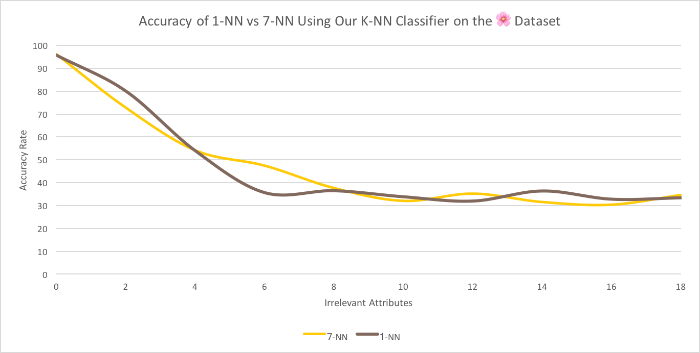

Slide 15
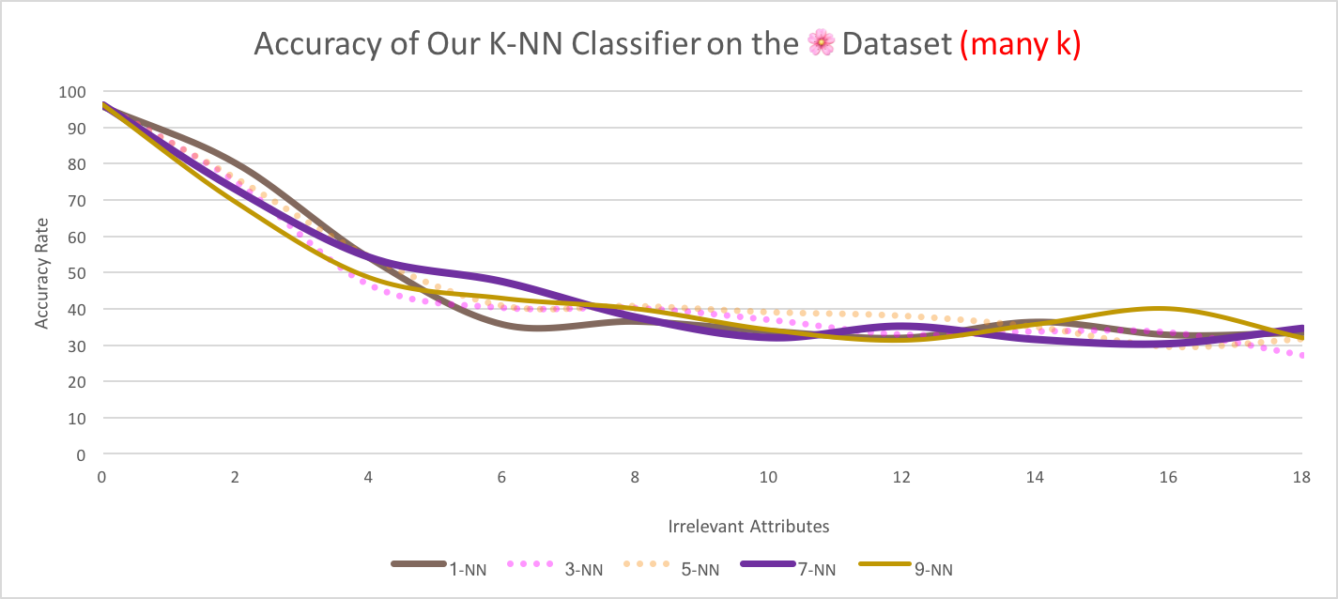

Slide 16
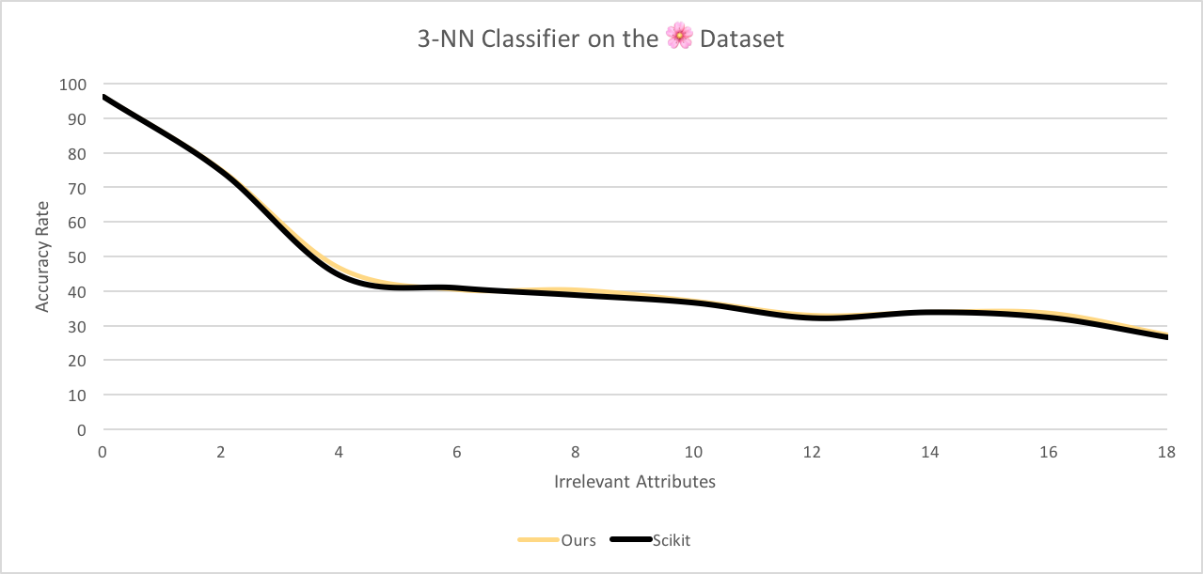

Slide 17
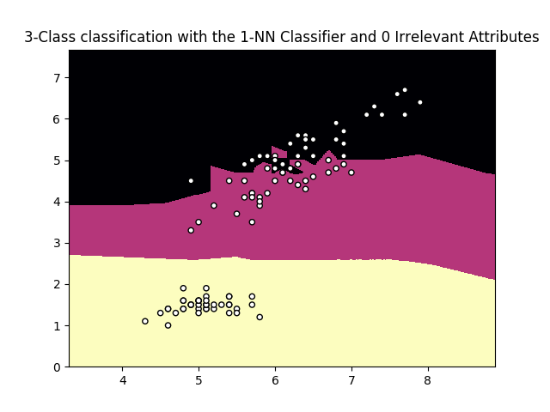
🌸 Dataset

Slide 18
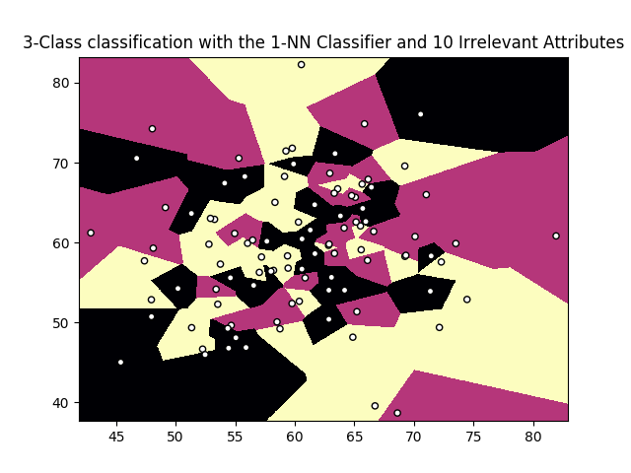
🌸 Dataset

Slide 19
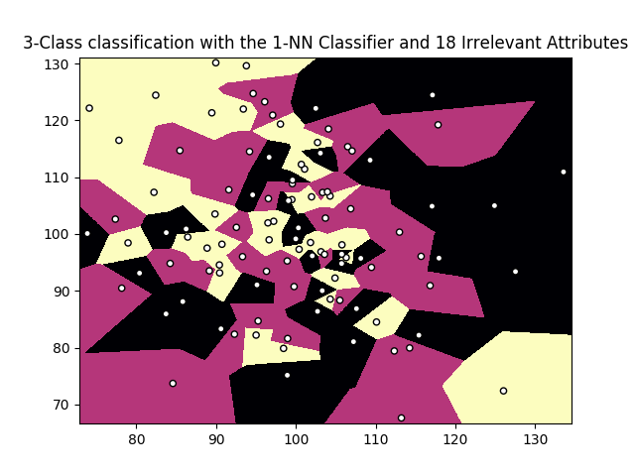
🌸 Dataset

Slide 20
🐰 Dataset

Slide 21
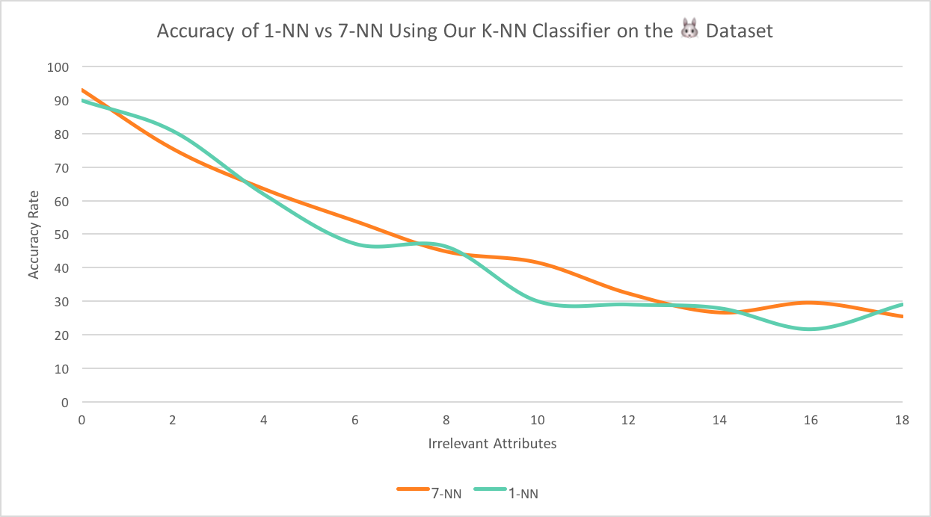

Slide 22
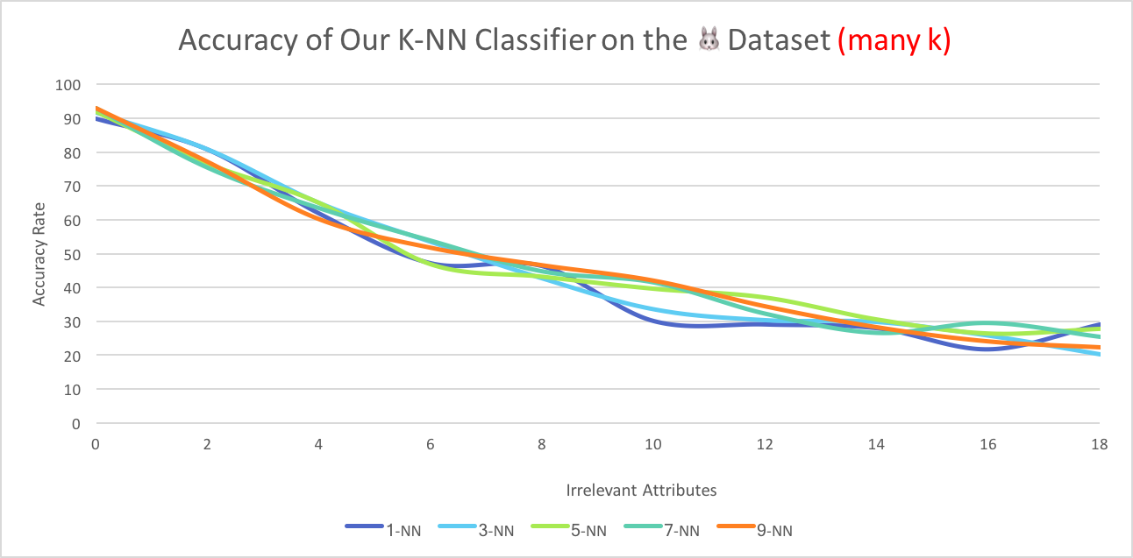

Slide 23
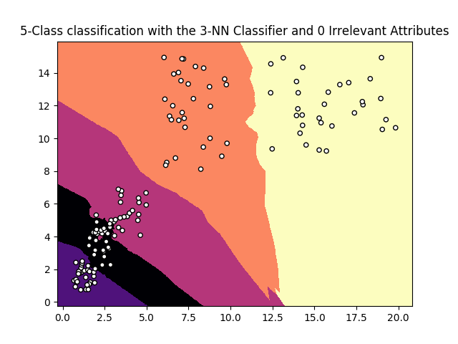
🐰 Dataset

Slide 24
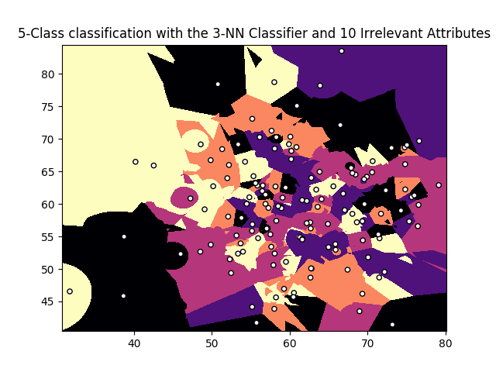
🐰 Dataset

Slide 25
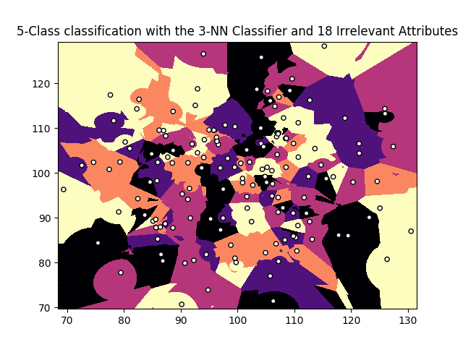
🐰 Dataset

Slide 26
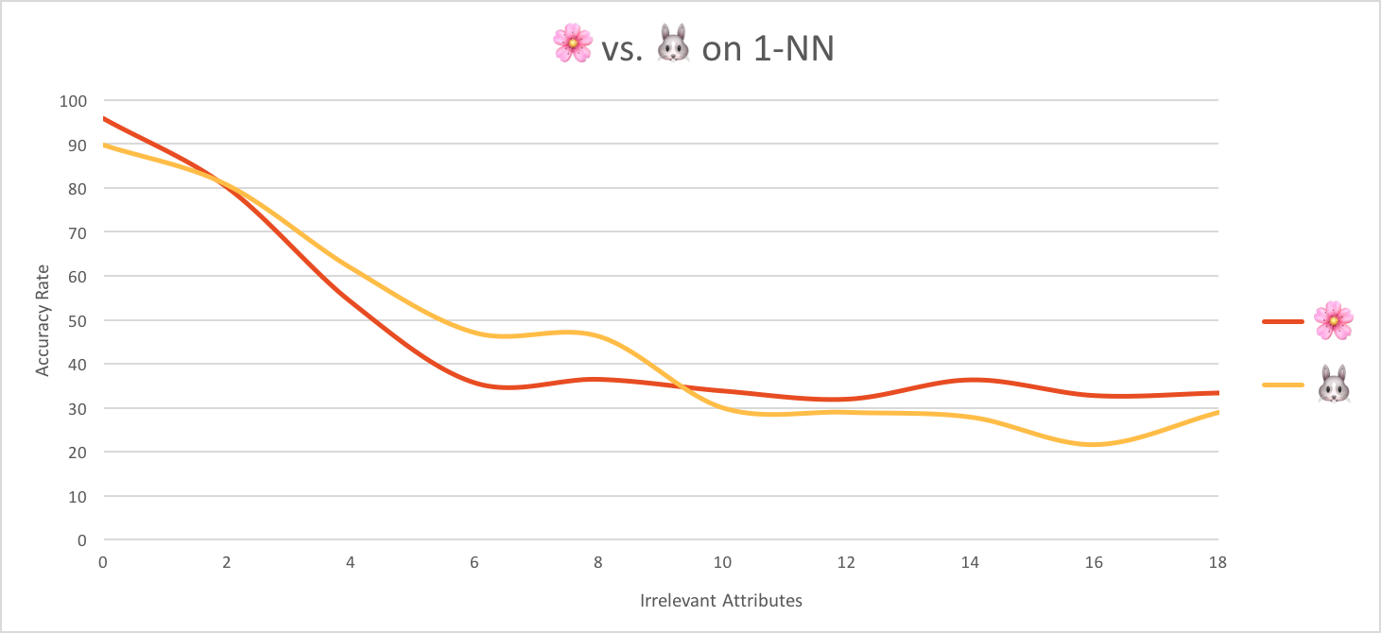

Slide 27
Bonus: how does the addition of relevant attributes affect classification?

Slide 28
🍷 Dataset (Modified!)
13 numeric attributes
Removed: (5) magnesium and (6) total phenols
3 classes: roughly equally represented
Add attributes in groups of two…

Slide 29
🍷 DATASET

Slide 30
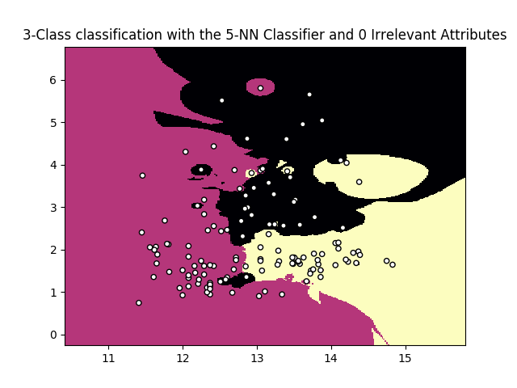
🍷 Dataset (2 relevant)

Slide 31
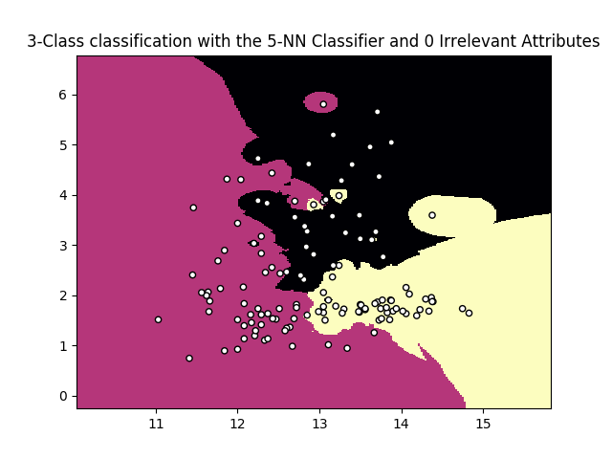
🍷 Dataset (8 relevant)

Slide 32
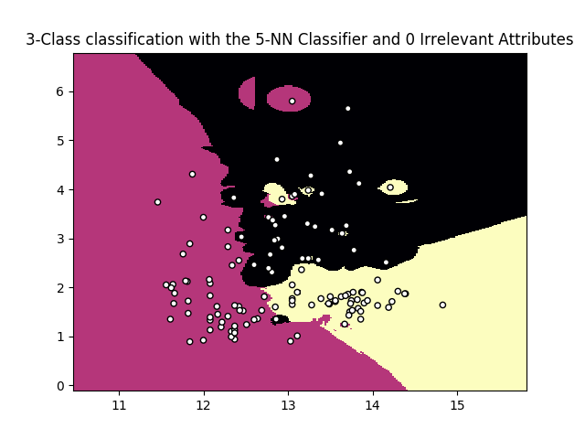
🍷 Dataset (12 relevant)

Slide 33
Conclusion
Irrelevant attributes are detrimental.
How to combat domains with great many irrelevant attributes?
Synthetic domain showed dramatic decline.
Performance differences between naïve implementation and SciKit
Breaking ties
Adding relevant attributes generally enhances performance.
Discrete domains?

Slide 34
Questions?

