Slide 1
Javascript
A Client side Scripting Language

Slide 2
What is JavaScript?
Was designed to add interactivity to HTML pages
Is a scripting language (a scripting language is a lightweight programming language)
JavaScript code is usually embedded directly into HTML pages
JavaScript is an interpreted language (means that scripts execute without preliminary compilation)

Slide 3
What can a JavaScript do?
JavaScript gives HTML designers a programming tool
JavaScript can put dynamic text into an HTML page
JavaScript can react to events
JavaScript can read and write HTML elements
JavaScript can be used to validate input data
JavaScript can be used to detect the visitor's browser
JavaScript can be used to create cookies

Slide 4
How to put a JavaScript into an HTML page
Use the <script> tag (also use the type attribute to define the scripting language)
<html>
<head>
<script type="text/javascript">
...
</script>
</head>
<body>
<script type="text/javascript">
...
</script>
</body>
</html>

Slide 5
The Language - JavaScript
JavaScript Variable
You create a variable with or without the var statement
var strname = some value
strname = some value
When you declare a variable within a function, the variable can only be accessed within that function
If you declare a variable outside a function, all the functions on your page can access it
The lifetime of these variables starts when they are declared, and ends when the page is closed
Continued…

Slide 6
The Language - JavaScript
Conditional statement
if,
if.. else,
switch
Loop
for loop,
while loop
Continued…

Slide 7
The Language - JavaScript
JavaScript Popup Boxes
Alert box
User will have to click "OK" to proceed
alert("sometext")
Confirm box
User will have to click either "OK" or "Cancel" to proceed
confirm("sometext")
Prompt box
User will have to click either "OK" or "Cancel" to proceed after entering an input value
prompt("sometext","defaultvalue")
Continued…

Slide 8
The Language - JavaScript
A JavaScript function contains some code that will be executed only by an event or by a call to that function
To keep the browser from executing a script as soon as the page is loaded, you can write your script as a function
You may call a function from anywhere within the page (or even from other pages if the function is embedded in an external .js file).
Functions can be defined either <head> or <body> section
Continued…

Slide 9
The Language - JavaScript
Events & Event Handlers
Every element on a web page has certain events which can trigger invocation of event handlers
Attributes are inserted into HTML tags to define events and event handlers
Examples of events
A mouse click, A web page or an image loading, Mousing over a hot spot on the web page, Selecting an input box in an HTML form, Submitting an HTML form, A keystroke
Continued…

Slide 10
The Language - JavaScript
Events
onabort - Loading of an image is interrupted • onblur - An element loses focus
onchange - The content of a field changes • onclick - Mouse clicks an object
ondblclick - Mouse double-clicks an object • onkeydown - A keyboard key is pressed
onfocus - An element gets focus • onkeypress - A keyboard key is pressed or held down
onkeyup - A keyboard key is released • onload - A page or an image is finished loading
onmousedown - A mouse button is pressed • onmousemove - The mouse is moved
onmouseover - The mouse is moved over an element
onmouseup - A mouse button is released • onreset - The reset button is clicked
onresize - A window or frame is resized • onselect - Text is selected
onsubmit - The submit button is clicked • onunload - The user exits the page
onerror - An error occurs when loading a document or an image

Slide 11
HTML DOM
The HTML DOM defines a standard set of objects for HTML, and a standard way to access and manipulate HTML documents.
All HTML elements, along with their containing text and attributes, can be accessed through the DOM.
The contents can be modified or deleted, and new elements can be created.
The HTML DOM is platform and language independent
It can be used by any programming language like Java, JavaScript, and VBScript.
Continued…

Slide 12
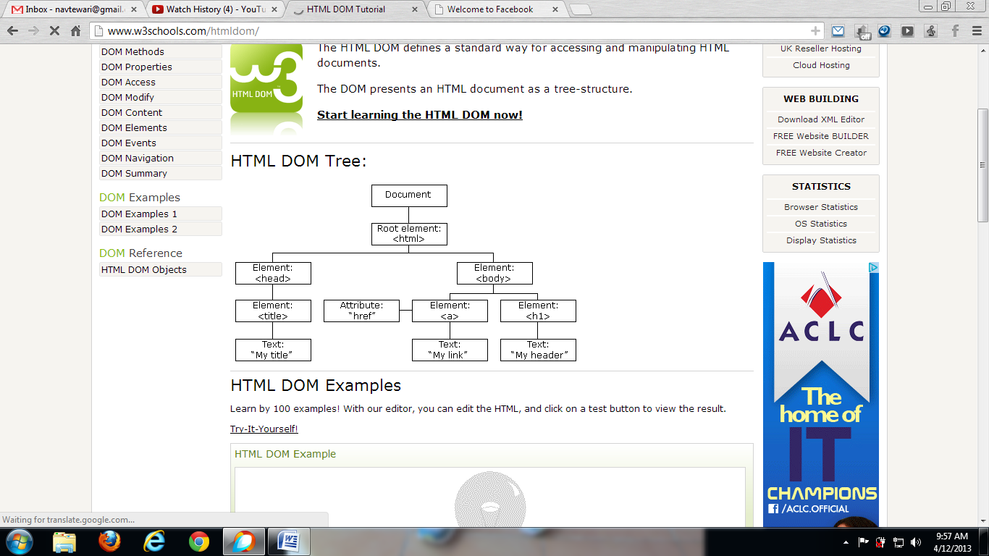
HTML DOM

Slide 13
Scope left after JavaScript
We can’t manage the data at server-side via client-
side scripting.
We can’t interact with database at client side.
We can only validate the data at the client side.
THANK YOU

