Slide 1
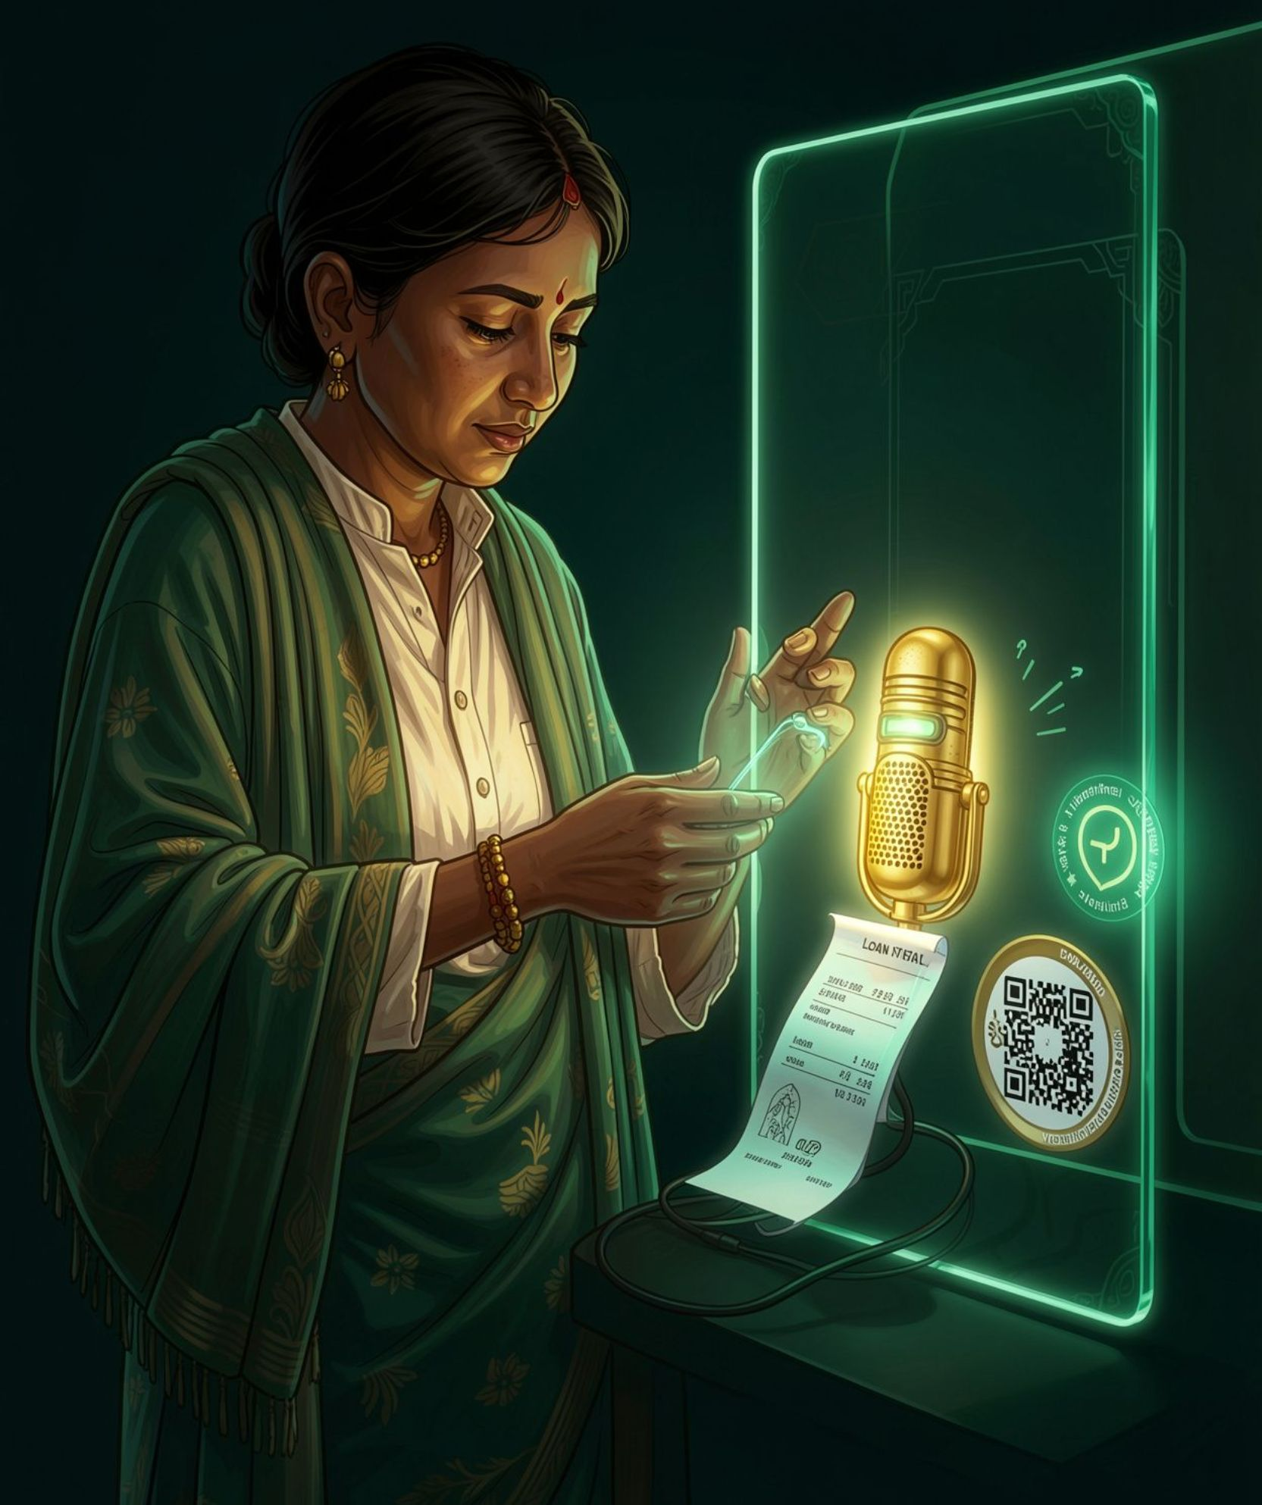
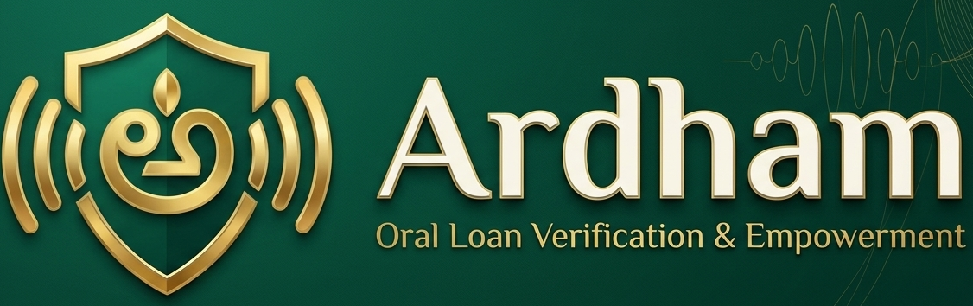
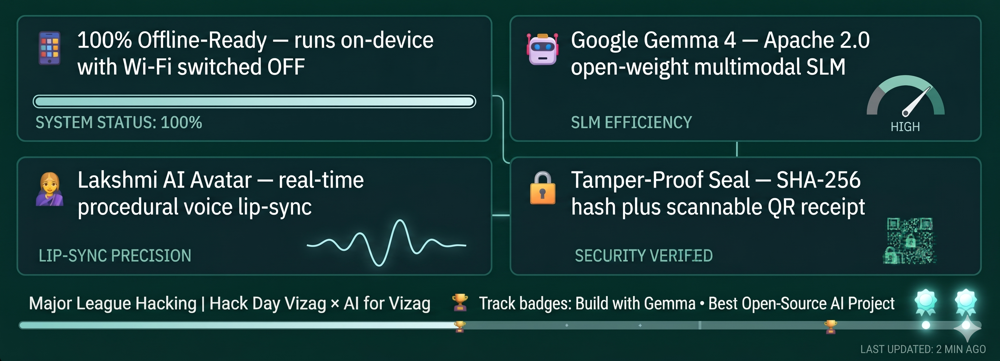


VOICE-FIRST LOAN COMPREHENSION VERIFICATION ON GOOGLE GEMMA 4
A signature is proof of consent. Ardham is proof of comprehension.
Ardham (అర్థం) | Hacktoberfest × AI for Vizag | MLH | Track: Build with Gemma & Best Open-Source AI

Slide 2

The Rural Lending Crisis
Signed, But Never Understood
Ardham (అర్థం) | Hacktoberfest × AI for Vizag | MLH | Track: Build with Gemma & Best Open-Source AI

Slide 3
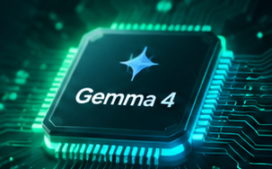
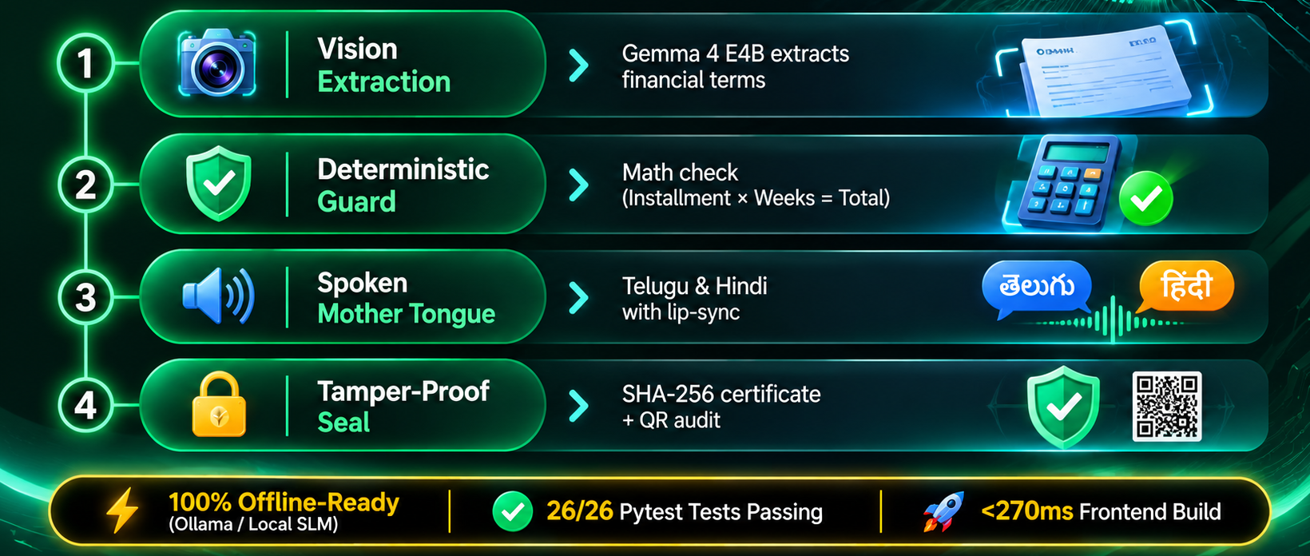
Technical Core
Gemma 4 On-Device Pipeline & Deterministic Guard
Ardham (అర్థం) | Hacktoberfest × AI for Vizag | MLH | Track: Build with Gemma & Best Open-Source AI

Slide 4
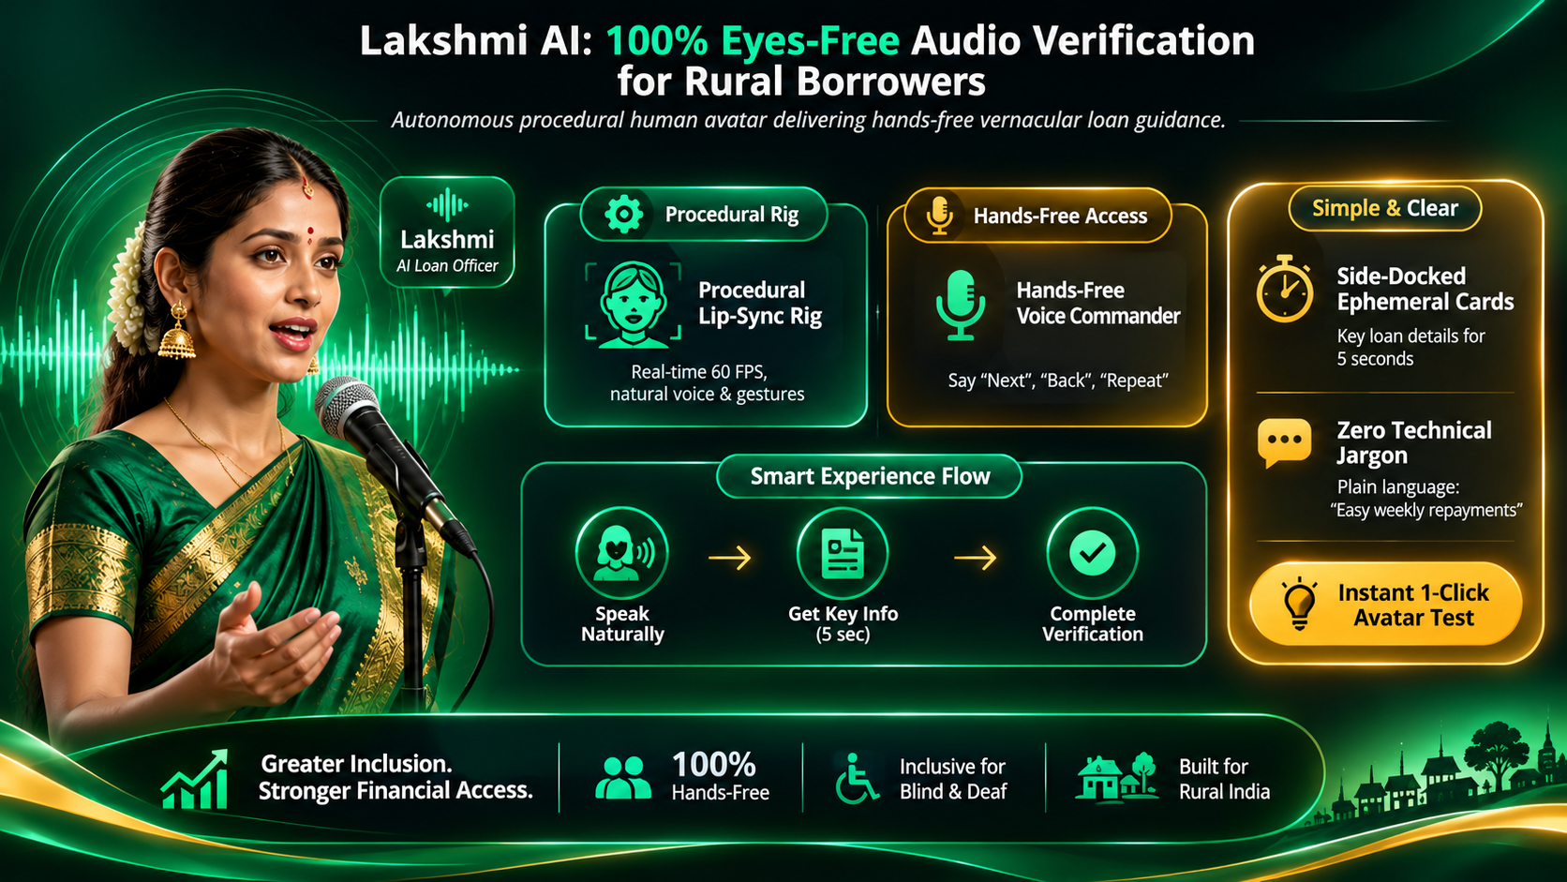
Lakshmi AI Avtar
100% Eyes-Free Audio Verification for Blind Borrowers

Slide 5
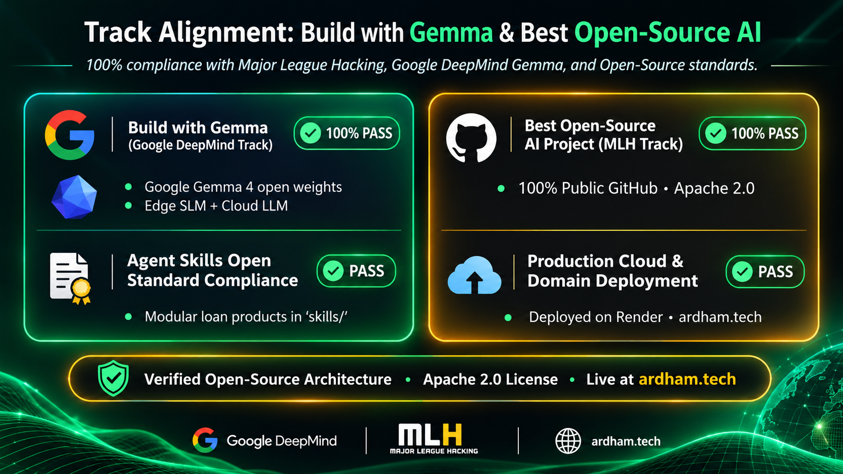
Track Alignment
Build with Gemma & Best Open-Source AI
Ardham (అర్థం) | Hacktoberfest × AI for Vizag | MLH | Track: Build with Gemma & Best Open-Source AI

Slide 6
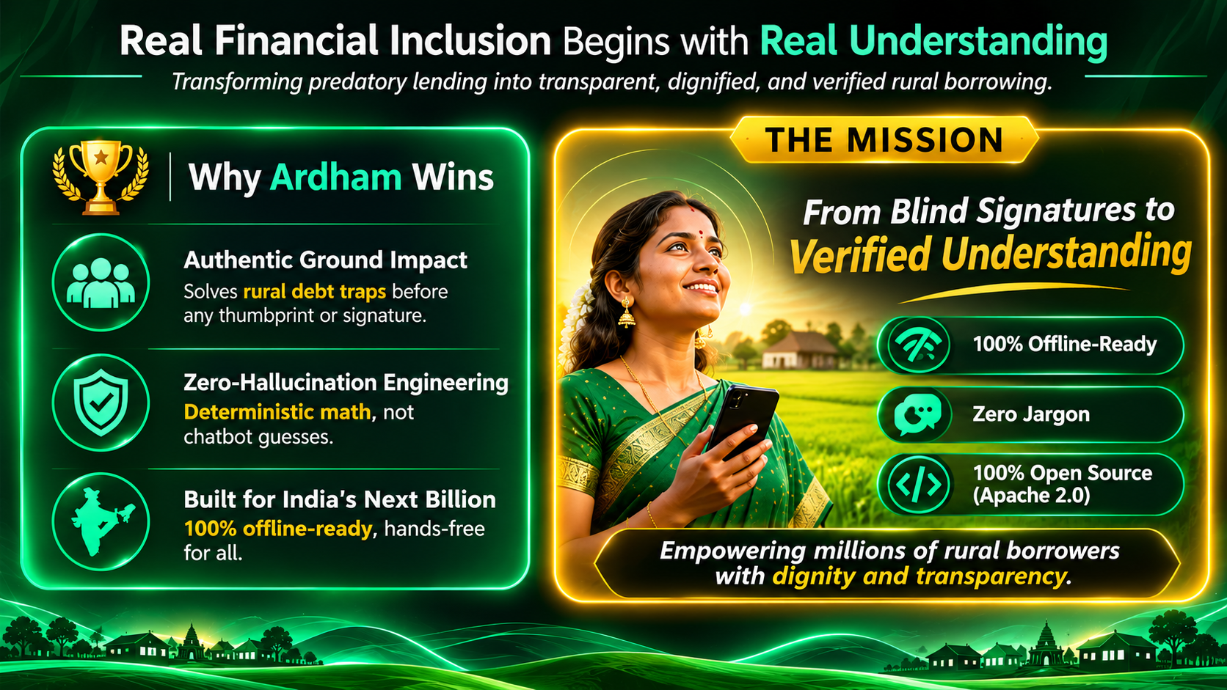
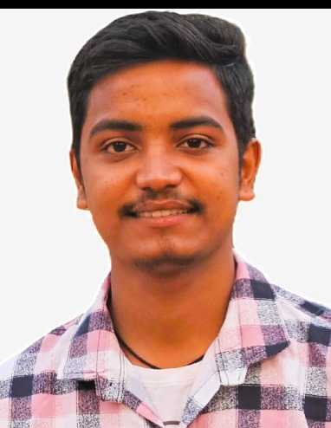
Team - Ardham
Guru Sai Sumith
CEO – Ardham
Full Stack
AI-ML
Production - Live

