Slide 1
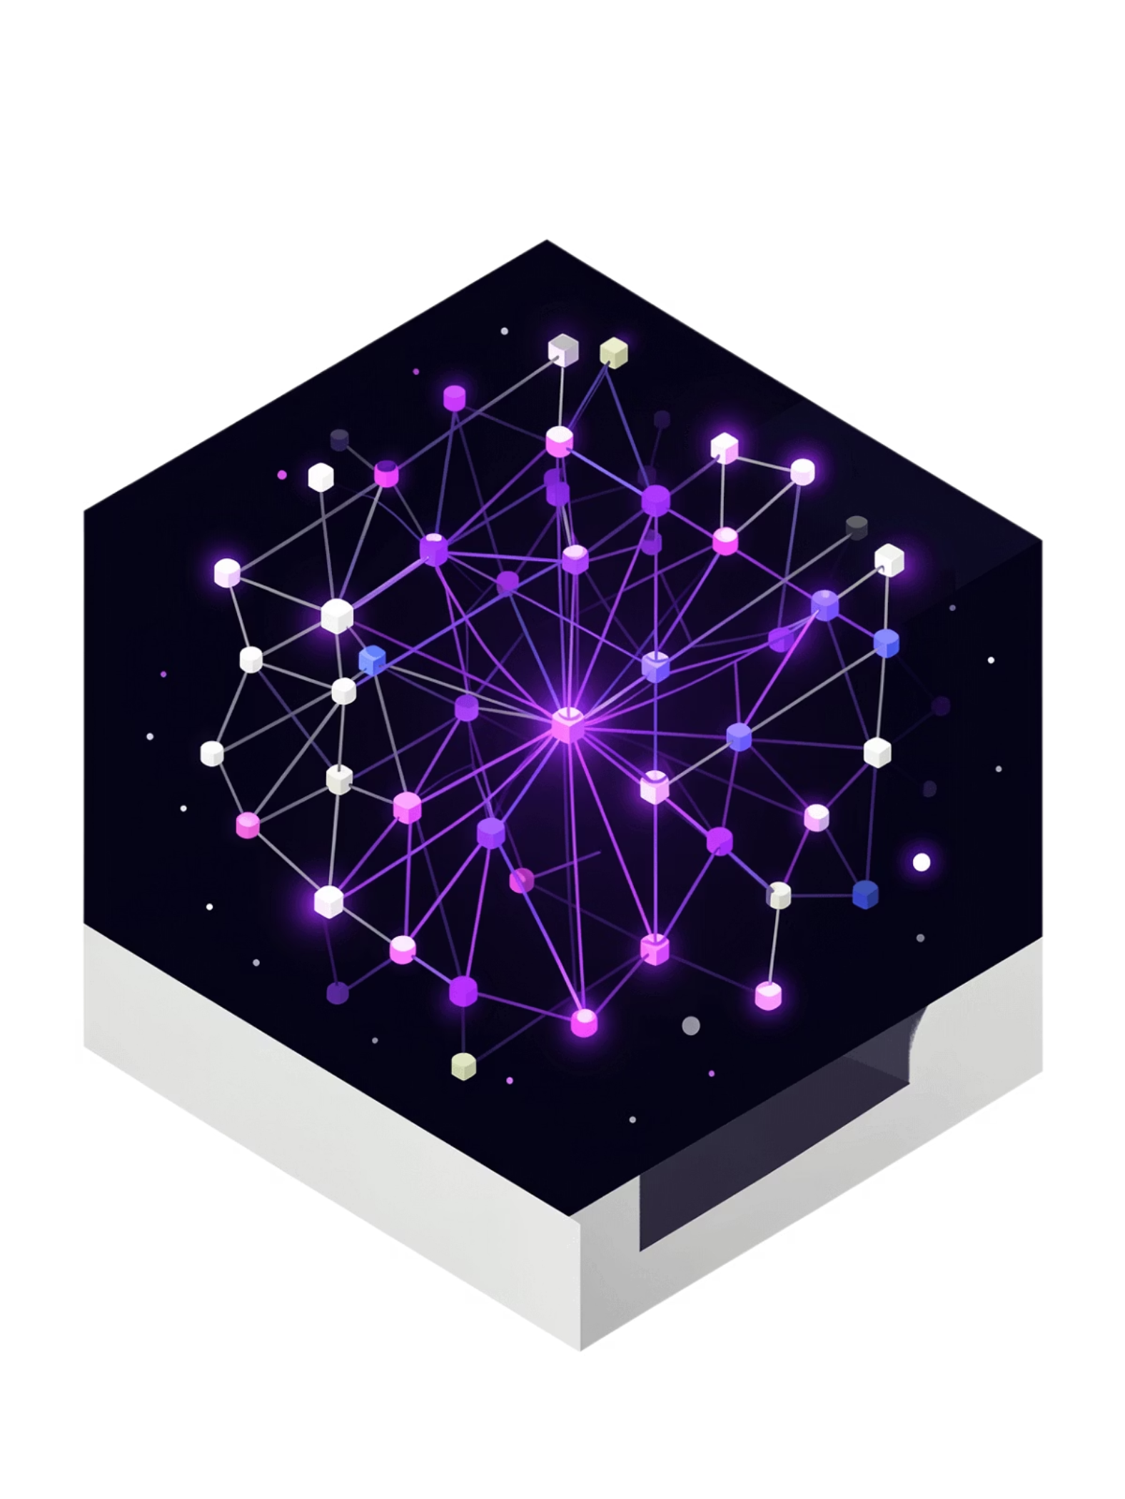
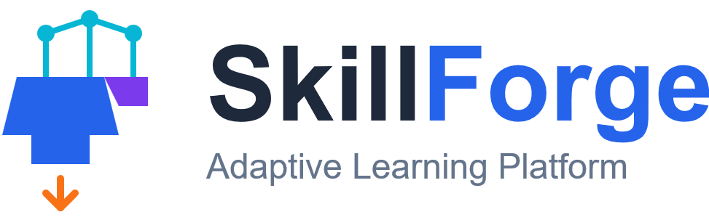
HACKAP 2026 · AGENTIC AI . AI4AP
SkillForge
.
9 AI Agents
Real-Time Adaptation
⚙️ Agentic Pipeline
🎯 Adaptive Learning
📜 Auto Certification
🧠 LLM-Powered

Slide 2
The Problem
Learning Is Broken
87%
$400B
73%
Abandonment Rate
Wasted Annually
Skill Gap Crisis
Learners quit before completing — content is generic, not goal-driven. MOOC Research, 2024
Corporate training that fails to close skill gaps. Companies pay for content, not outcomes.
McKinsey, 2024
Engineering teams report skill gaps causing project delays. No diagnostic baseline exists.
Stack Overflow, 2024
Root Causes
No personalization — same curriculum for everyone
No feedback loop — courses don't adapt
No accountability — certificates, not proof of skill
No autonomy — requires human teachers at every step

Slide 3
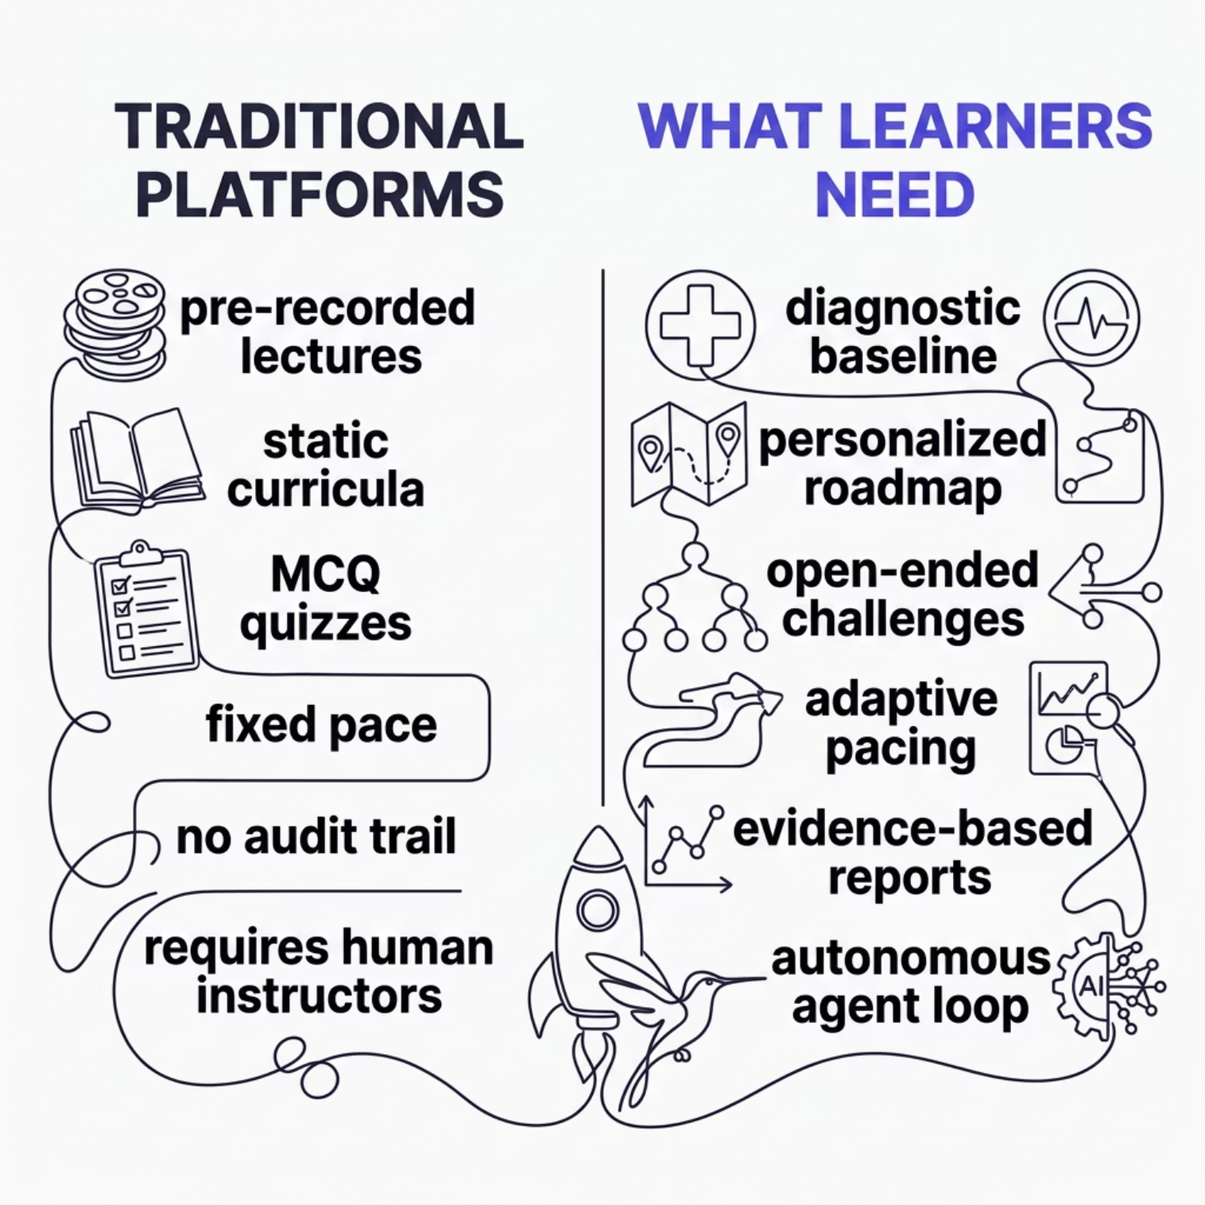

Root Cause Analysis
Why Every Learning Platform Fails the Same Way
The root cause: Learning platforms are content delivery systems, not intelligence systems. Built for scale, not individual skill mastery.
SkillForge replaces the entire delivery model with an autonomous agent loop — diagnosing, planning, practicing, evaluating, and certifying without human intervention.

Slide 4
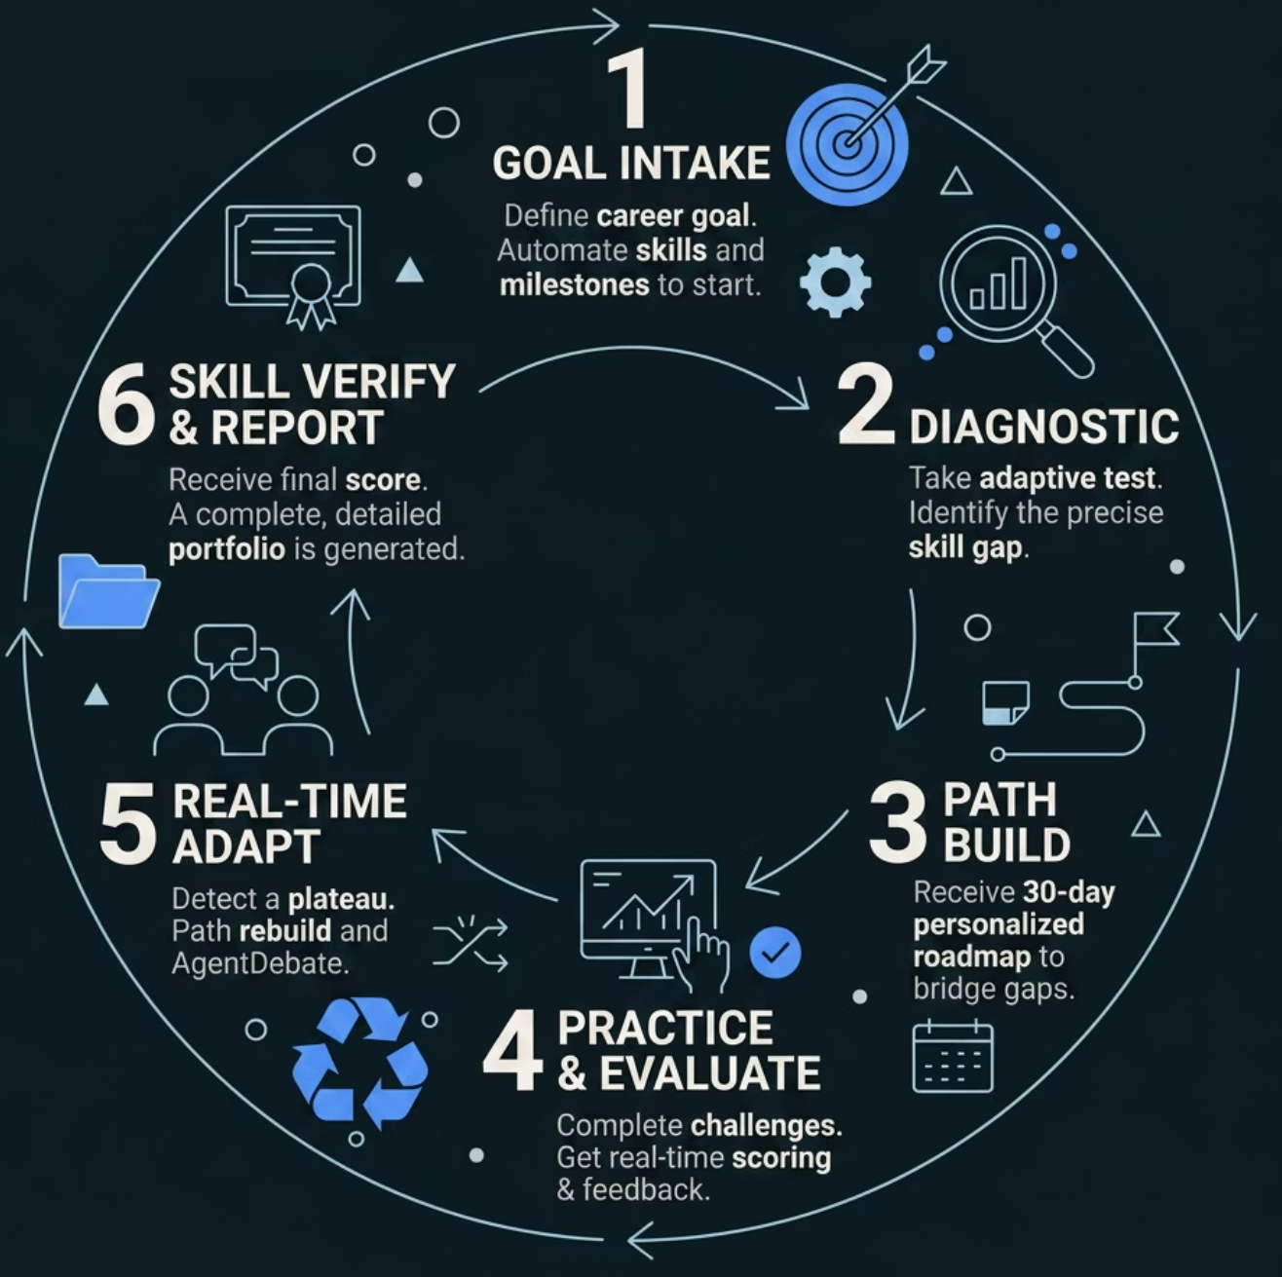
The Solution
SkillForge AI — Not a Course. An Agent.
🔍 Diagnose
1
Decomposes your goal into a skill tree, generates targeted open-ended questions, scores proficiency baseline per skill — in minutes.
📋 Plan
2
Builds a sequenced day-by-day roadmap — weakest skills first, strongest compressed. Every day has a specific objective and challenge.
⚔️ Practice
3
Daily challenges require reasoned, written responses. Struggling? Plan adapts. Excelling? Plan accelerates. Real evaluation, not MCQ.
📜 Certify
4
Full competency report: skill mastery radar chart, session trends, agent decision log, and narrative summary — shareable proof of skill.

Slide 5


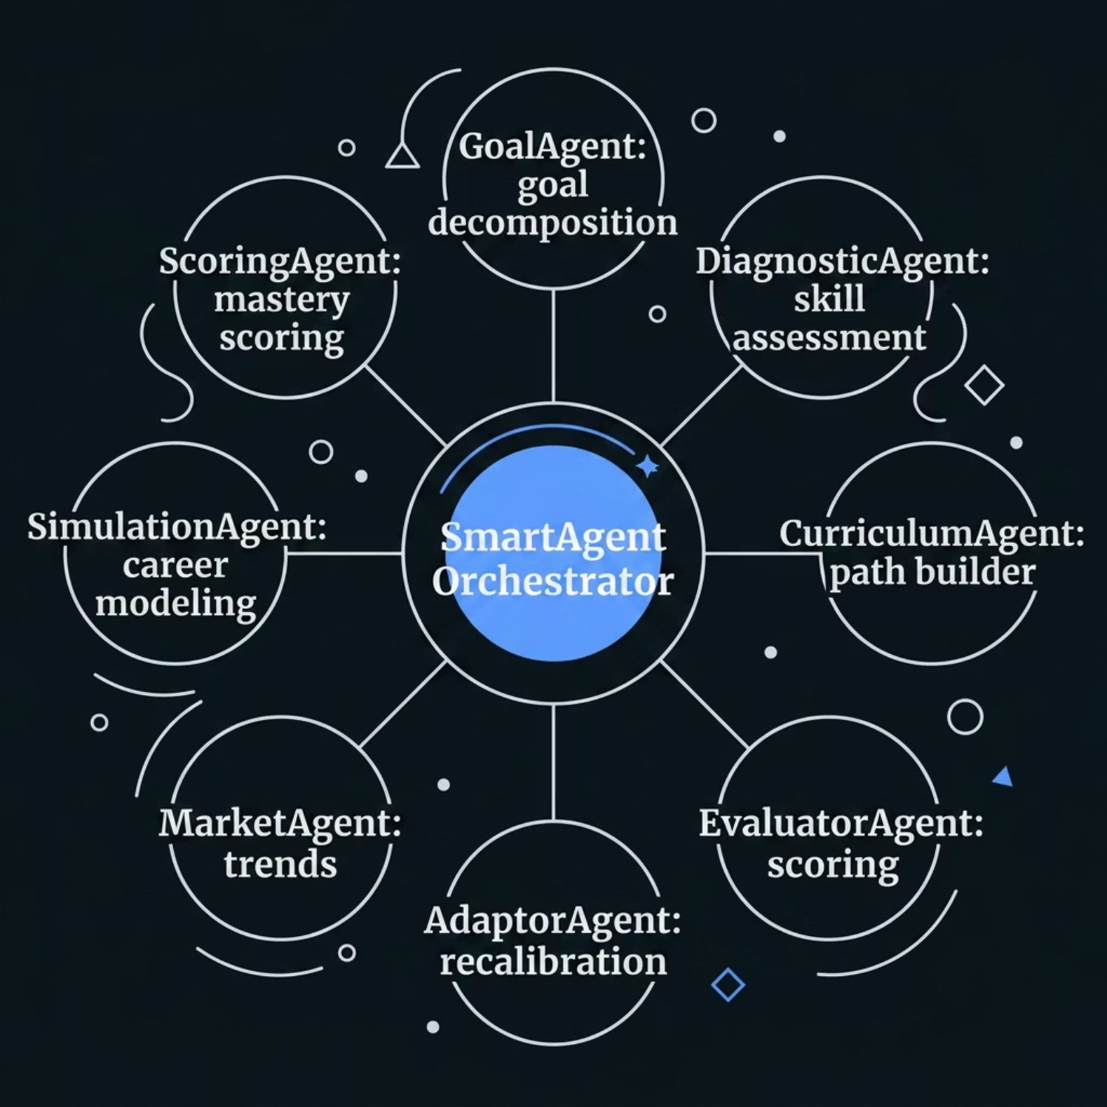
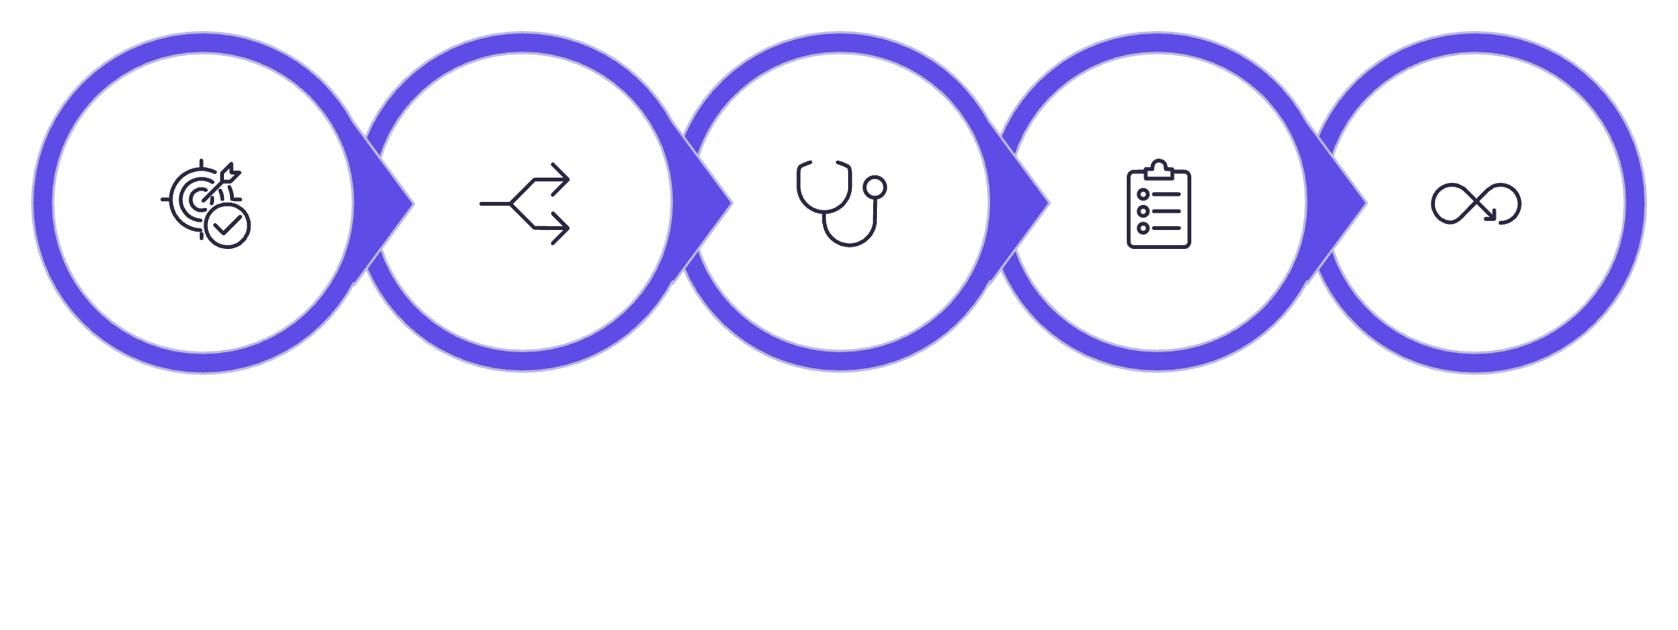

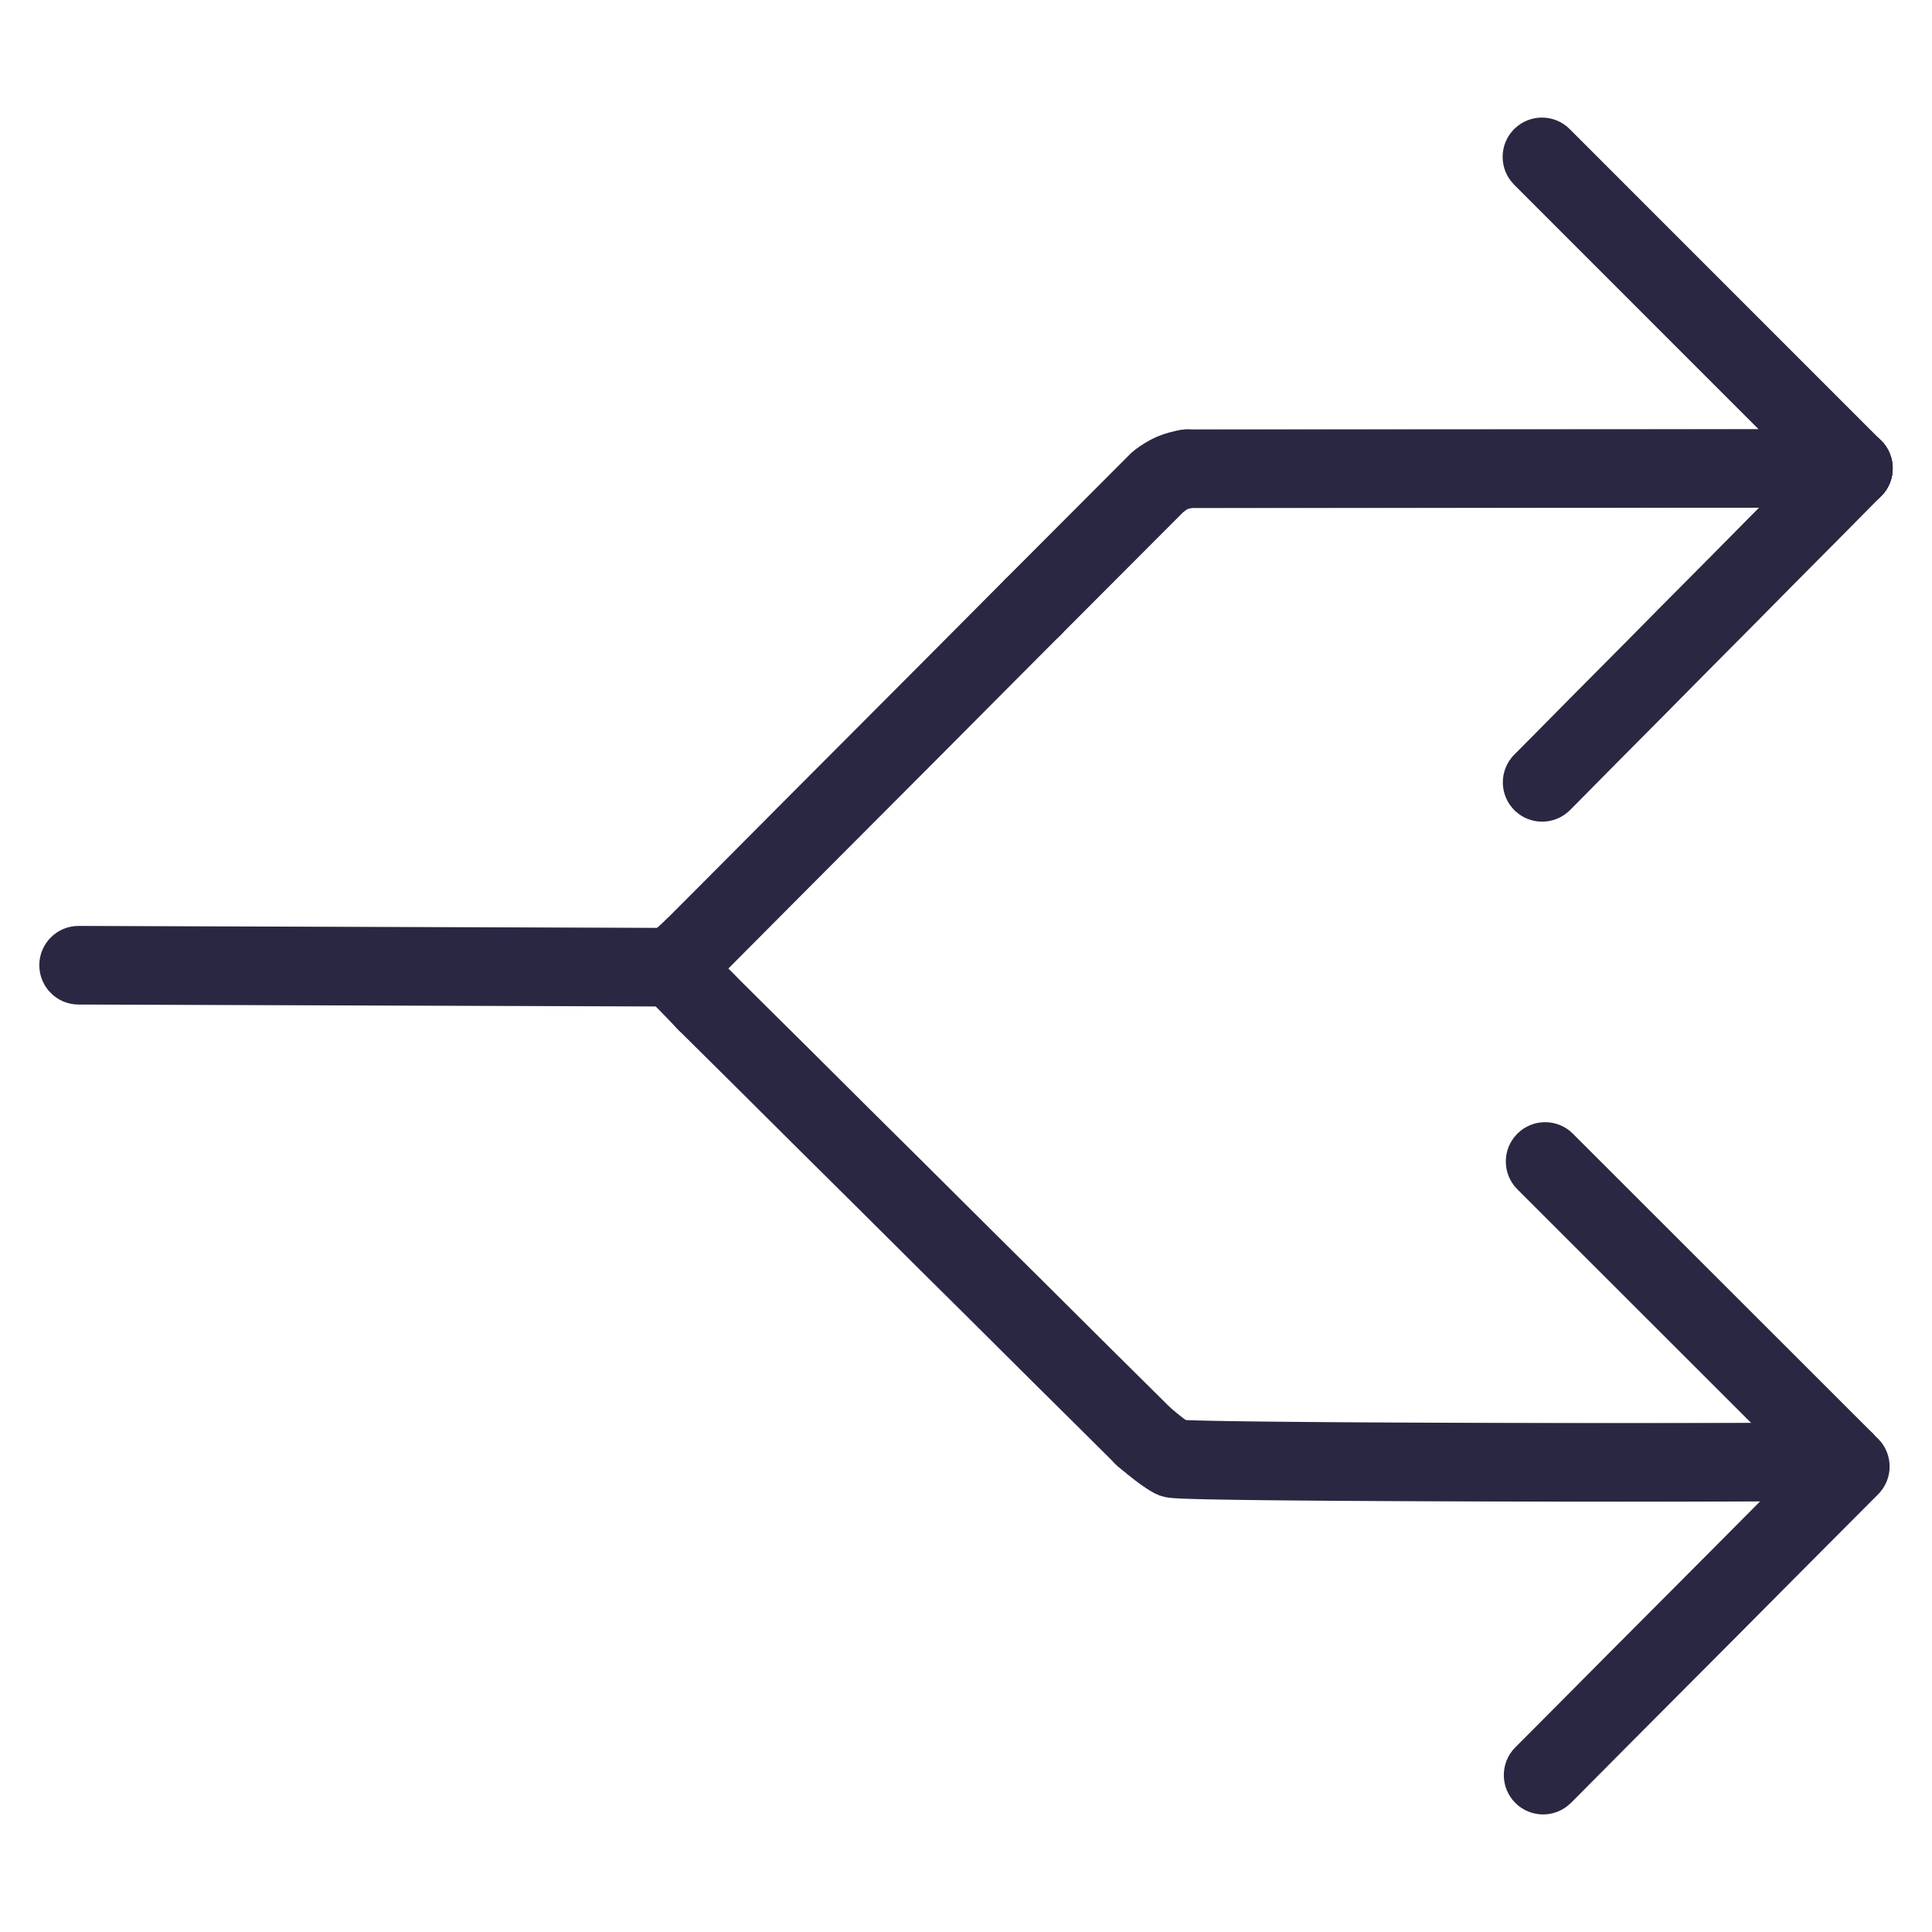



Agentic Architecture
The Full Autonomous Agent Loop
Why This Architecture Wins
Parallel agents + shared memory + autonomous decisions = true agentic intelligence
——
Goal Input
Skill Decompose
Diagnostic
Plan Builder
Session Loop
Every decision is made by the agent — no human input required after the initial goal. The Adaptor creates a closed feedback loop between session performance and the learning plan.
LLM + Fallback — Gemini primary, Groq fallback
Shared Memory System — persistent context across all agents
Parallel Execution — agents run concurrently, not sequentially

Slide 6
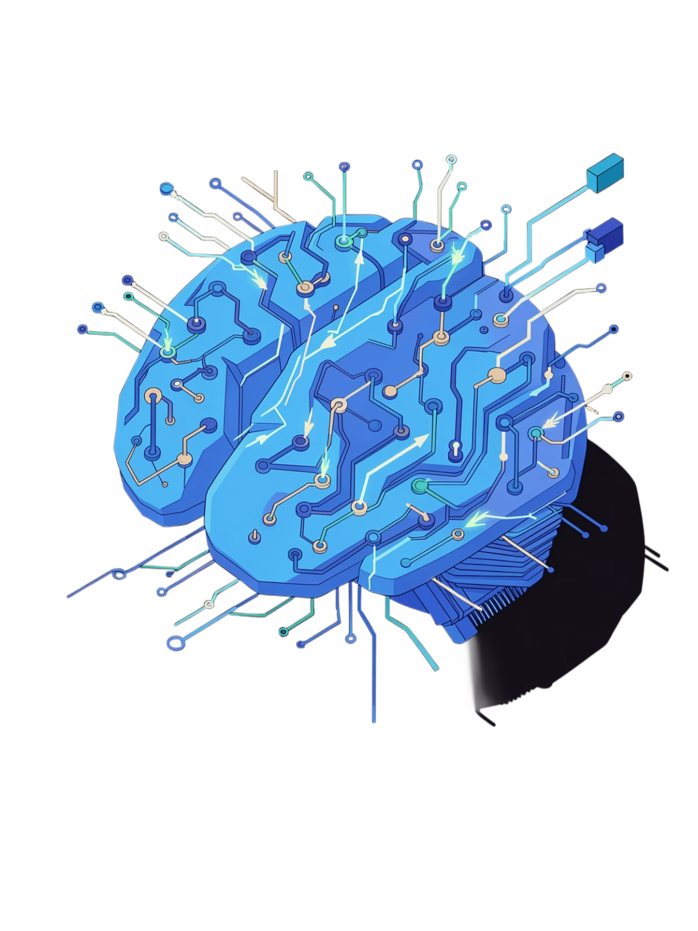


AGENTIC INTELLIGENCE
Frontier Agentic Behaviour
Persistent Memory
AgentDebate Protocol
Failure Recovery
Multi-agent voting ensures verified, high-confidence decisions
Auto model switching —
self-healing system with
LLM fallback
Tracks all user progress, evolves the learner model over time
CurriculumAgent
AdaptorAgent
Autonomous Dashboard
Decision: Recalibrate learning path
Evidence: Multiple low scores detected
Real-time progress and AI decision tracking
MarketAgent
Career Digital Twin
Decision: Update skill priorities
Evidence: Industry demand analysis shift
Simulates career trajectories based on current skills
Every agent decision tagged with reasoning and confidence score

Slide 7
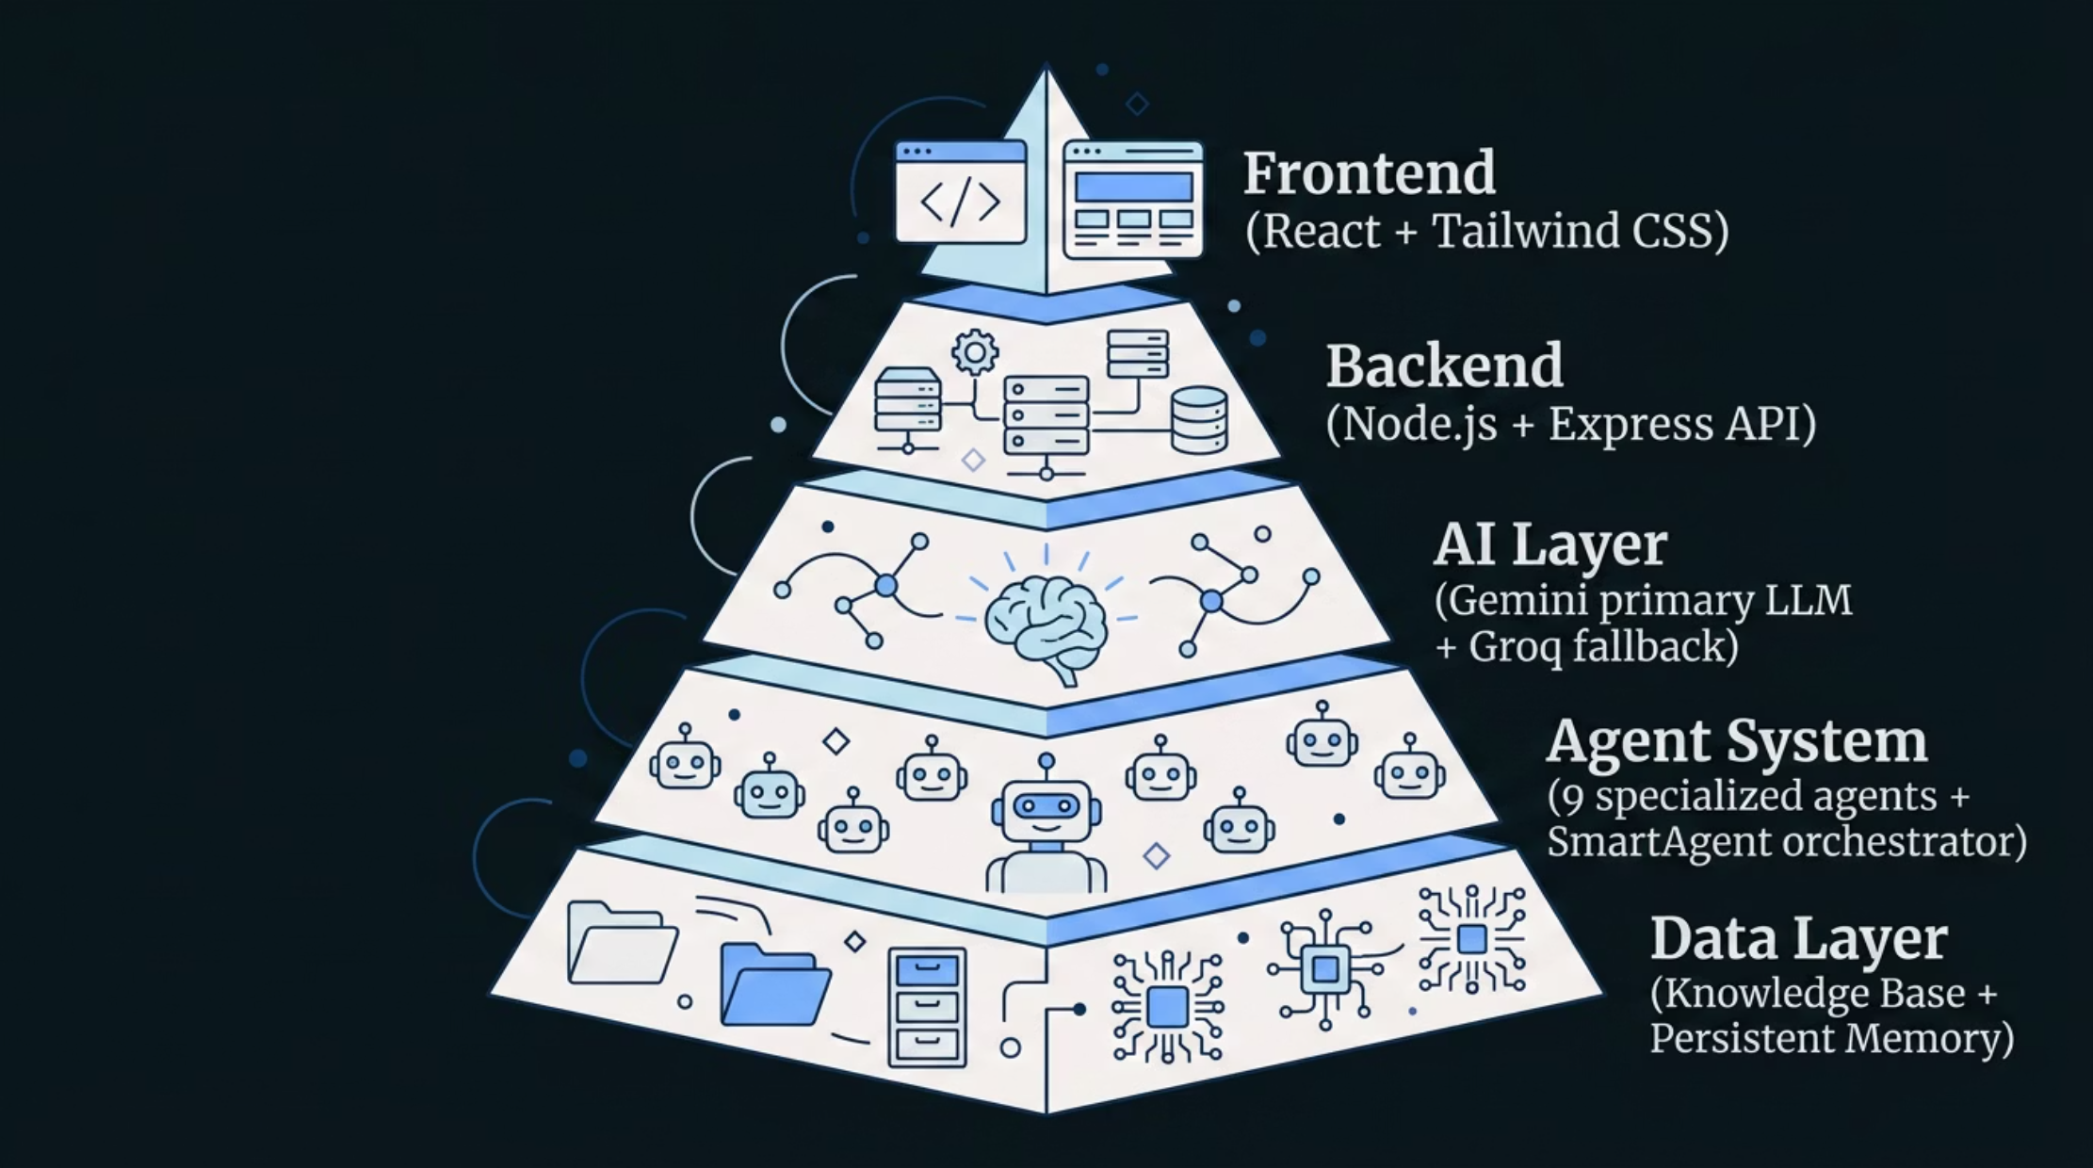
Tech Stack
Production-Grade Infrastructure
Performance Benchmarks
<90s
Full Pipeline Run
99.9%
Uptime
2x
LLM Redundancy
Dual LLM reliability — Gemini primary + Groq fallback
ZERO - Single point of failure.
System self-heals and continues autonomously.
<90s

Slide 8
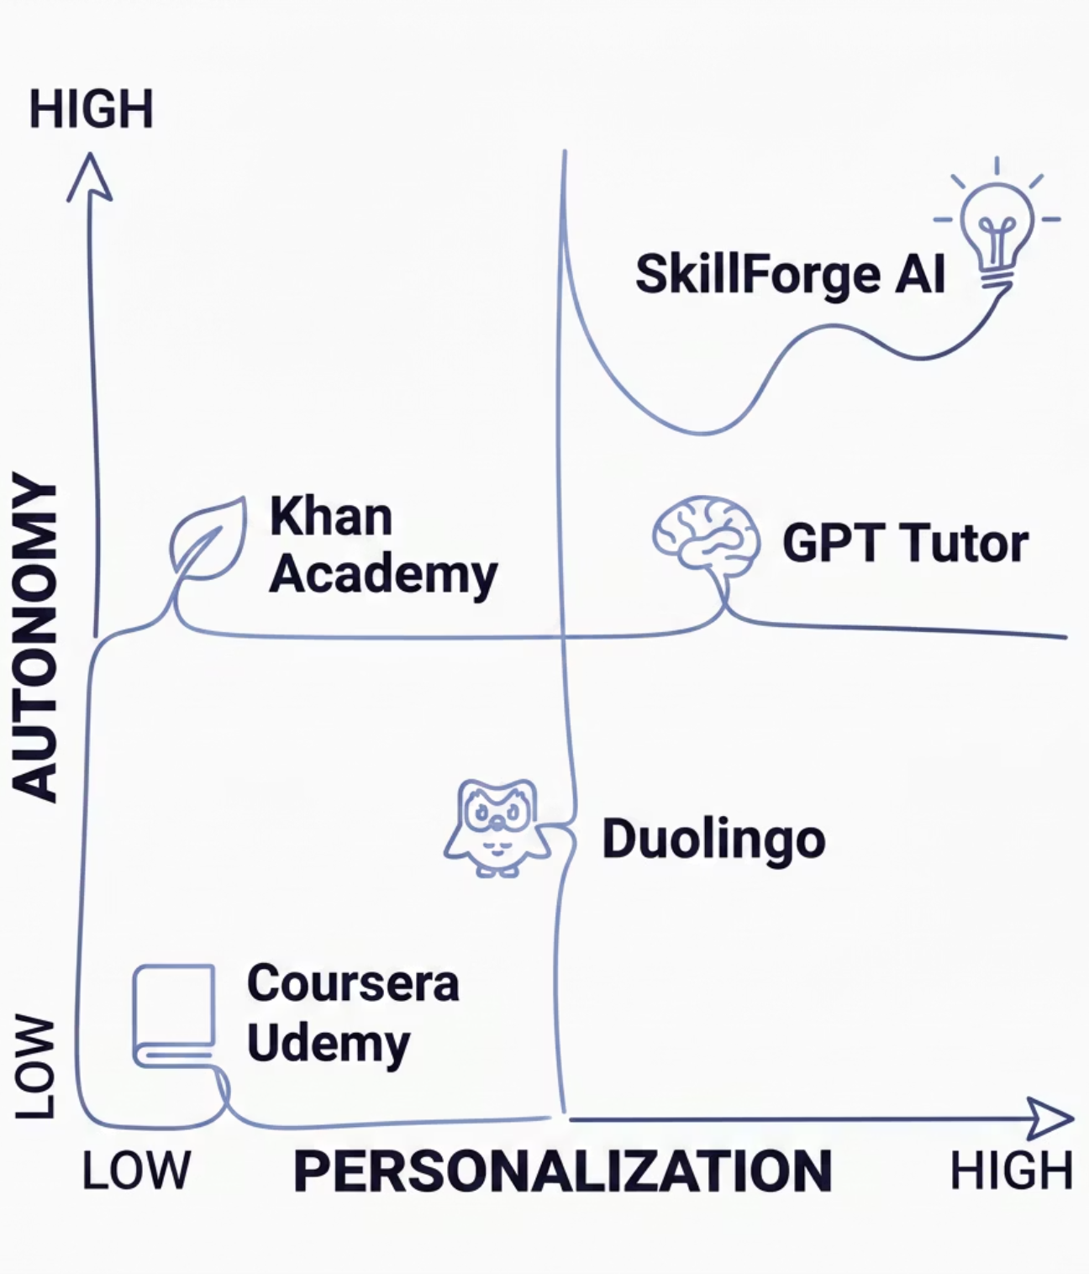
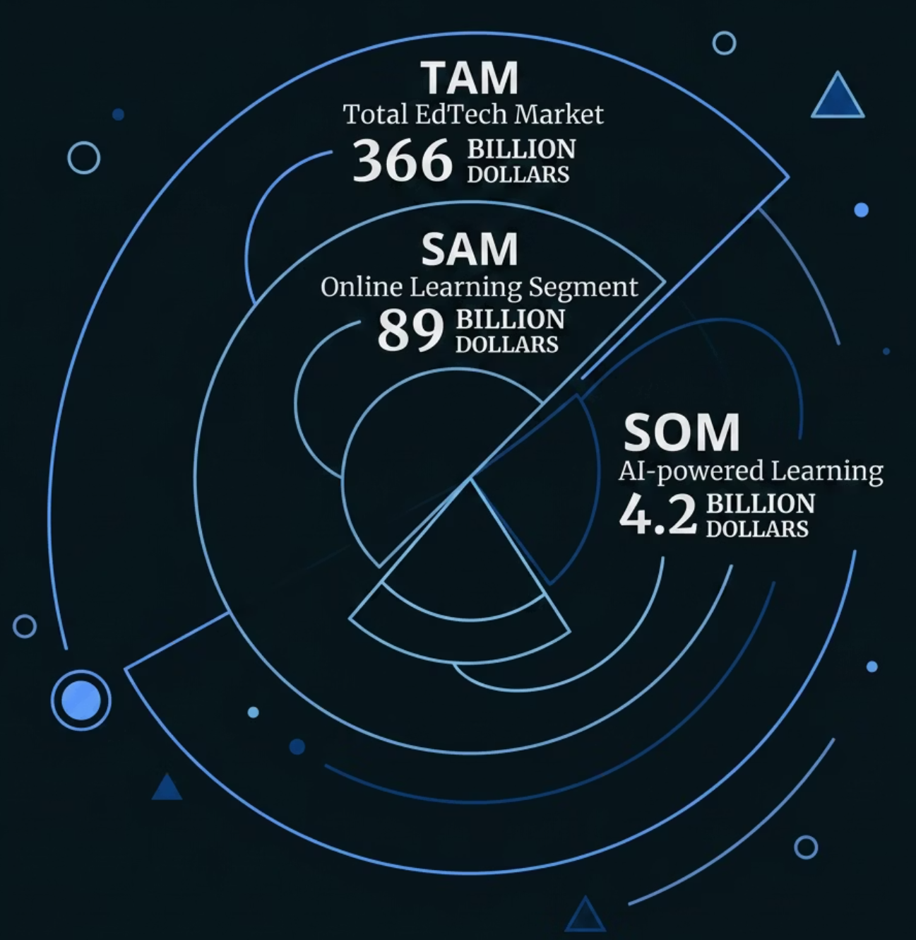

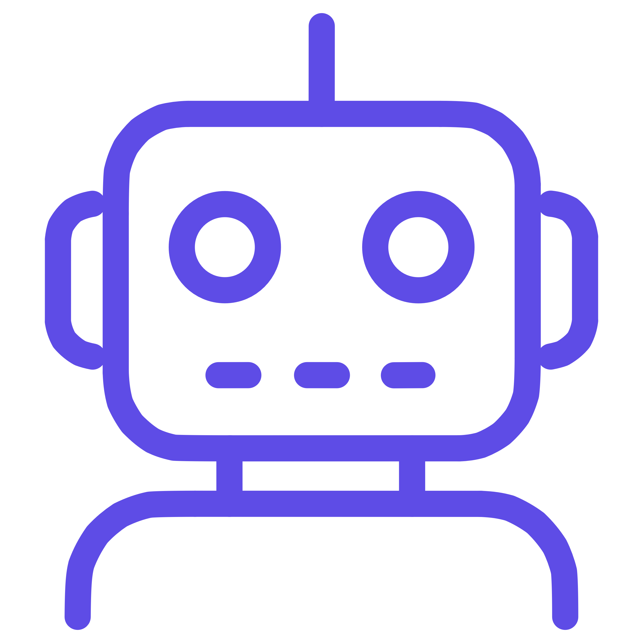


Market Positioning
We Own the Quadrant No One Else Is In
Full Personalization
Every skill tree, question, and plan built for
each learner's specific goal and diagnosed gaps.
Full Autonomy
No human teacher or coach needed.
The agent runs the entire loop independently.
Real-Time Adaptation
Mid-journey plan modification based on
live session performance
Full Explainability
Every agent decision logged with reasoning
— a transparency layer even GPT tutors lack.

Slide 9




Innovation Highlights
Four Things That Make SkillForge Unique
Dynamic Domain Detection
Mid-Journey Adaptive Planning
Works for any learning goal. Keyword scoring detects domain from natural language; dynamic builder creates custom skill trees for unknown domains.
Continuously monitors performance and modifies the active plan. Rolling avg above 88%? Compress. Below 50%? Reinforce. A genuine control loop.
Agent Transparency Layer
LLM-Enhanced + Offline Fallback
Every decision captured with type, title, detail, and human-readable reasoning. Full audit trail — no black box.
GPT-4o-mini enriches skill trees, questions, challenges, and reports when online. Rule-based fallbacks ensure full functionality offline.

Slide 10

The Future of Skill Mastery Is Agentic.
SkillForge AI proves a single autonomous agent can diagnose, plan, teach, evaluate, adapt, and certify — replacing an entire learning institution's workflow with a loop that runs without human instruction.
What We've Built
9-agent autonomous pipeline, fully functional agentic loop
Session adaptive learning journey
Skill improvement demonstrated
Platform – With Closed Loop AI
🤝 Connect With Us
9110341228 | gsssai2005@gmail.com | LinkedIn
Let's talk about the future of learning
SkillForge · Team AI4AP · HackAP Hackathon – Agentic AI

