Slide 1
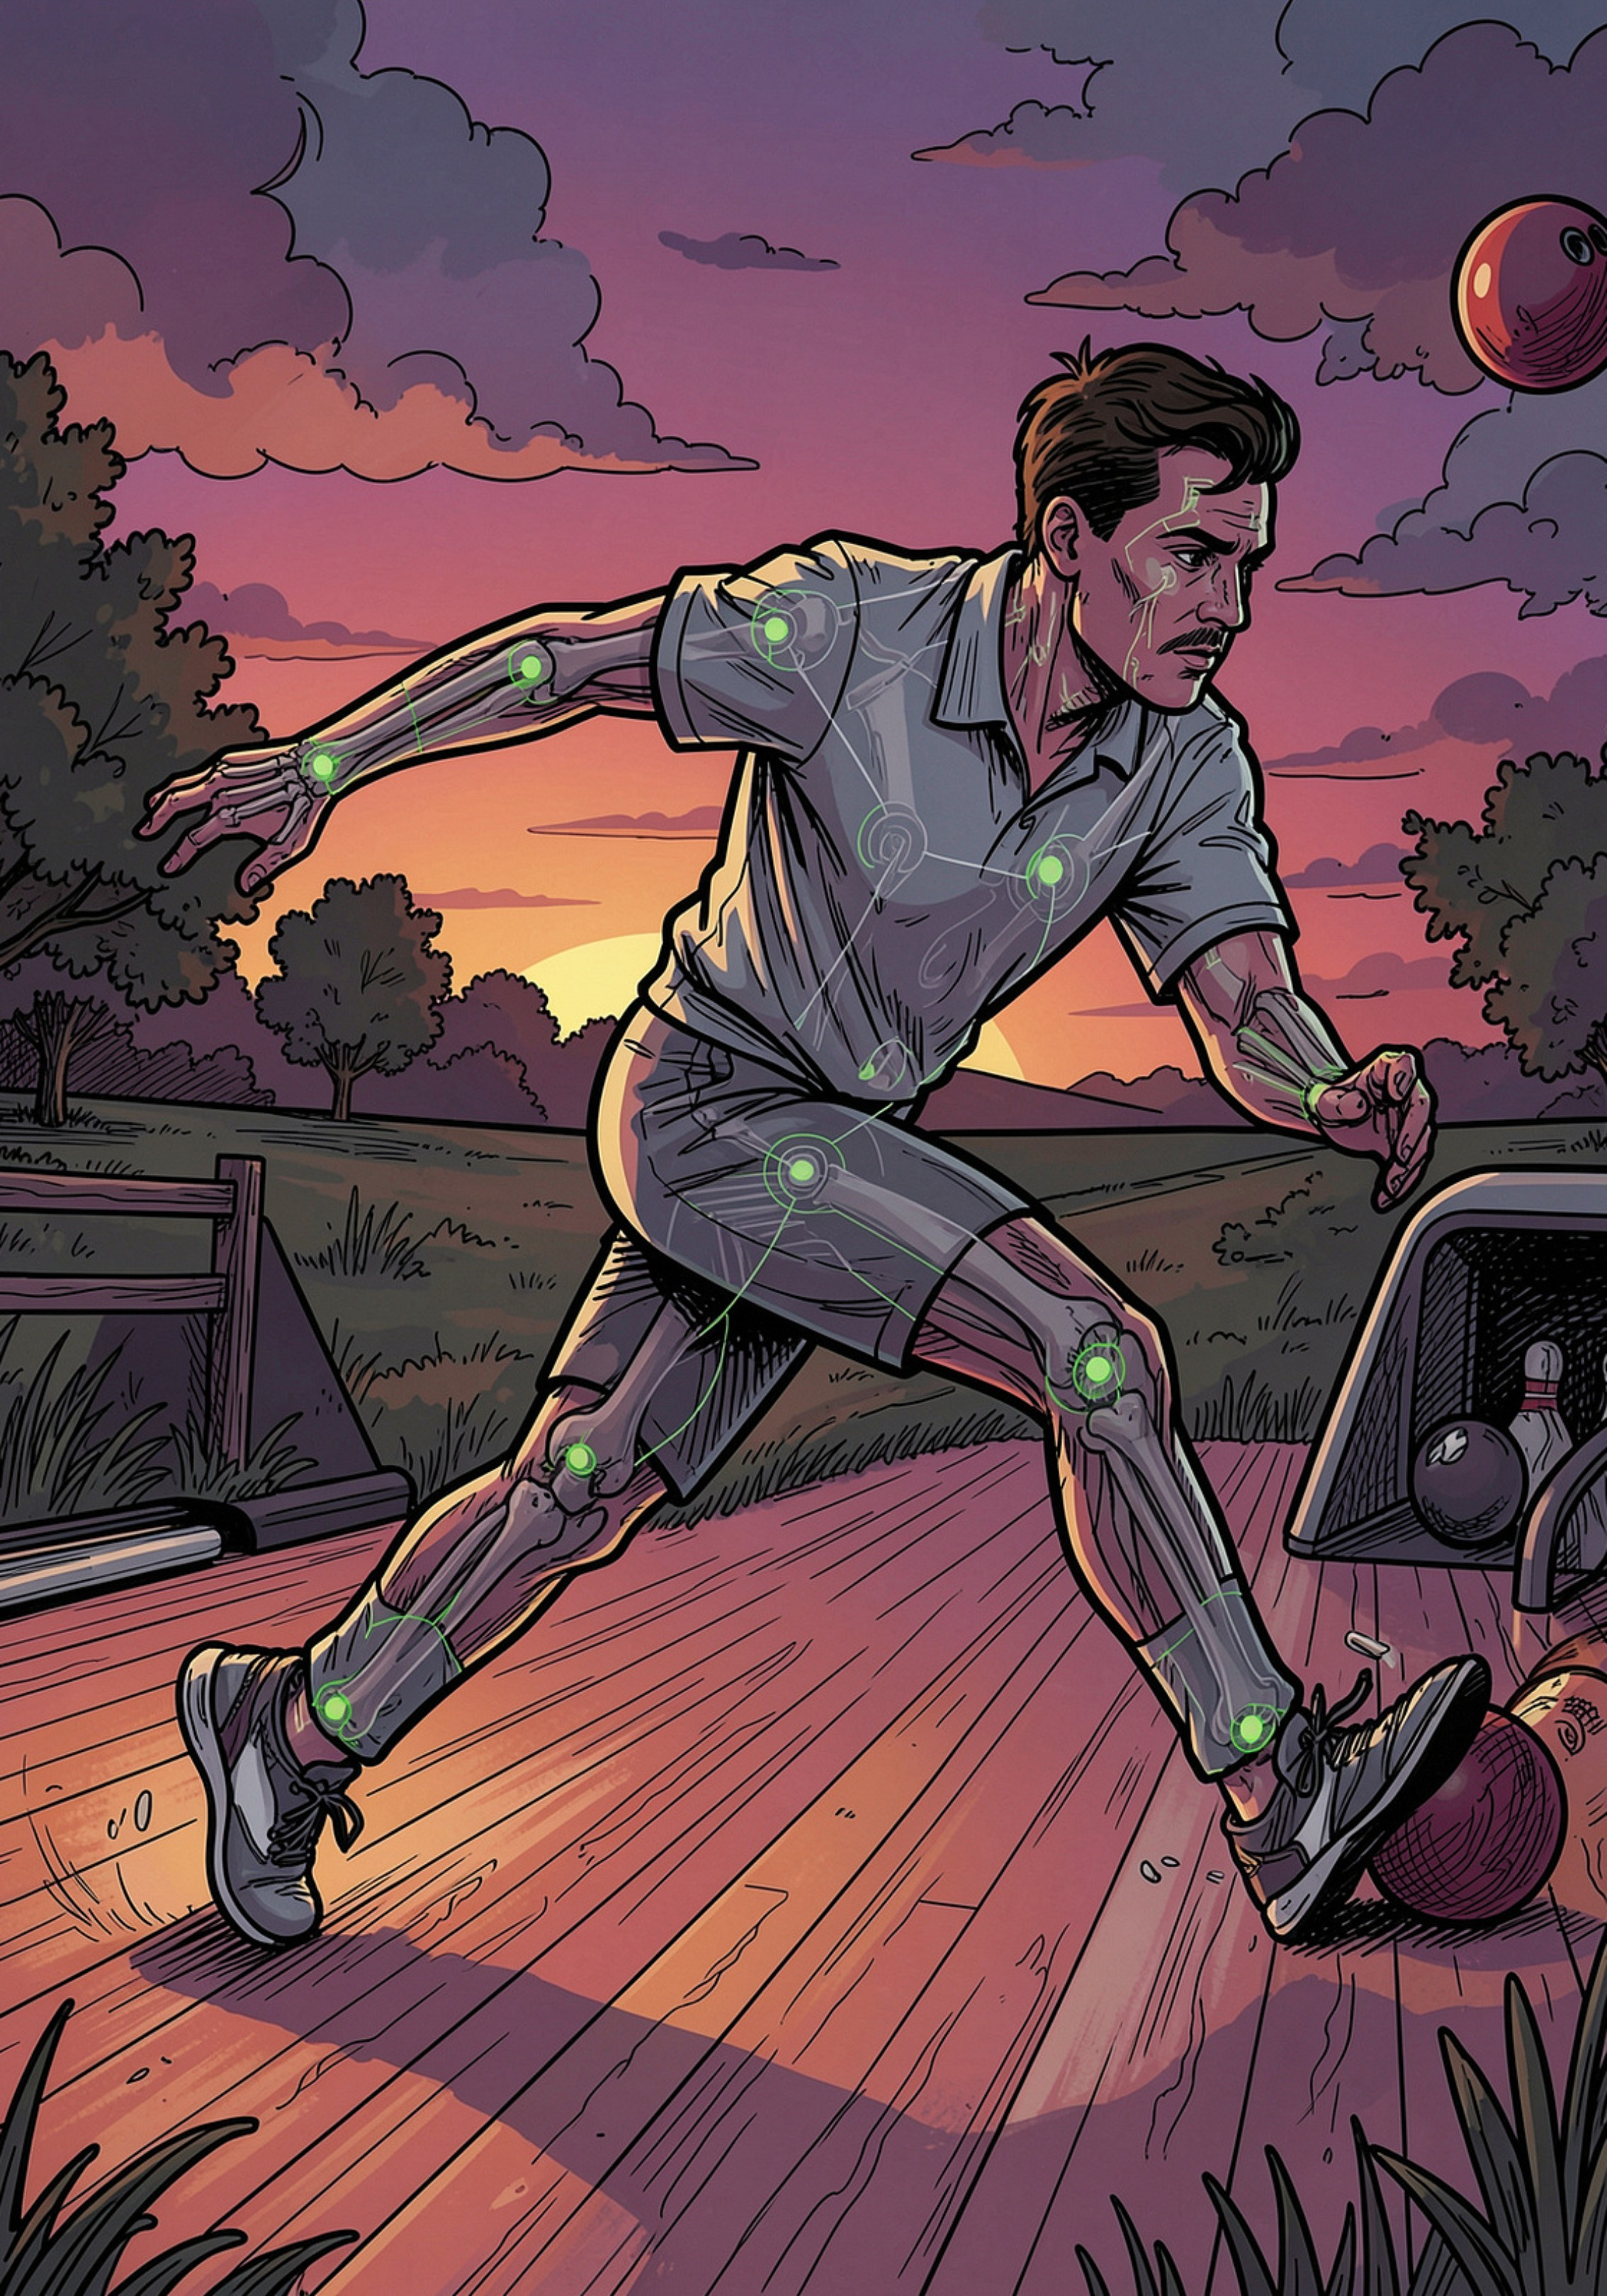

DrishtiSport AI
Turning Every Rural Playground Into a Biomechanics Lab
Samsung Solve for Tomorrow 2026 | Theme 3: Sport & Tech
Project Name: DrishtiSport AI
Team Name : Samsung4all
Solo Builder: Guru Sai Sumith
Theme 3: Sport & Tech

Slide 2
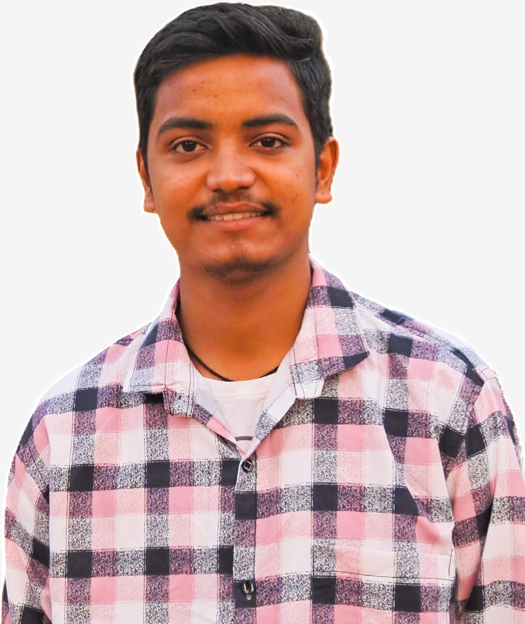



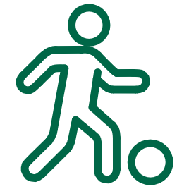
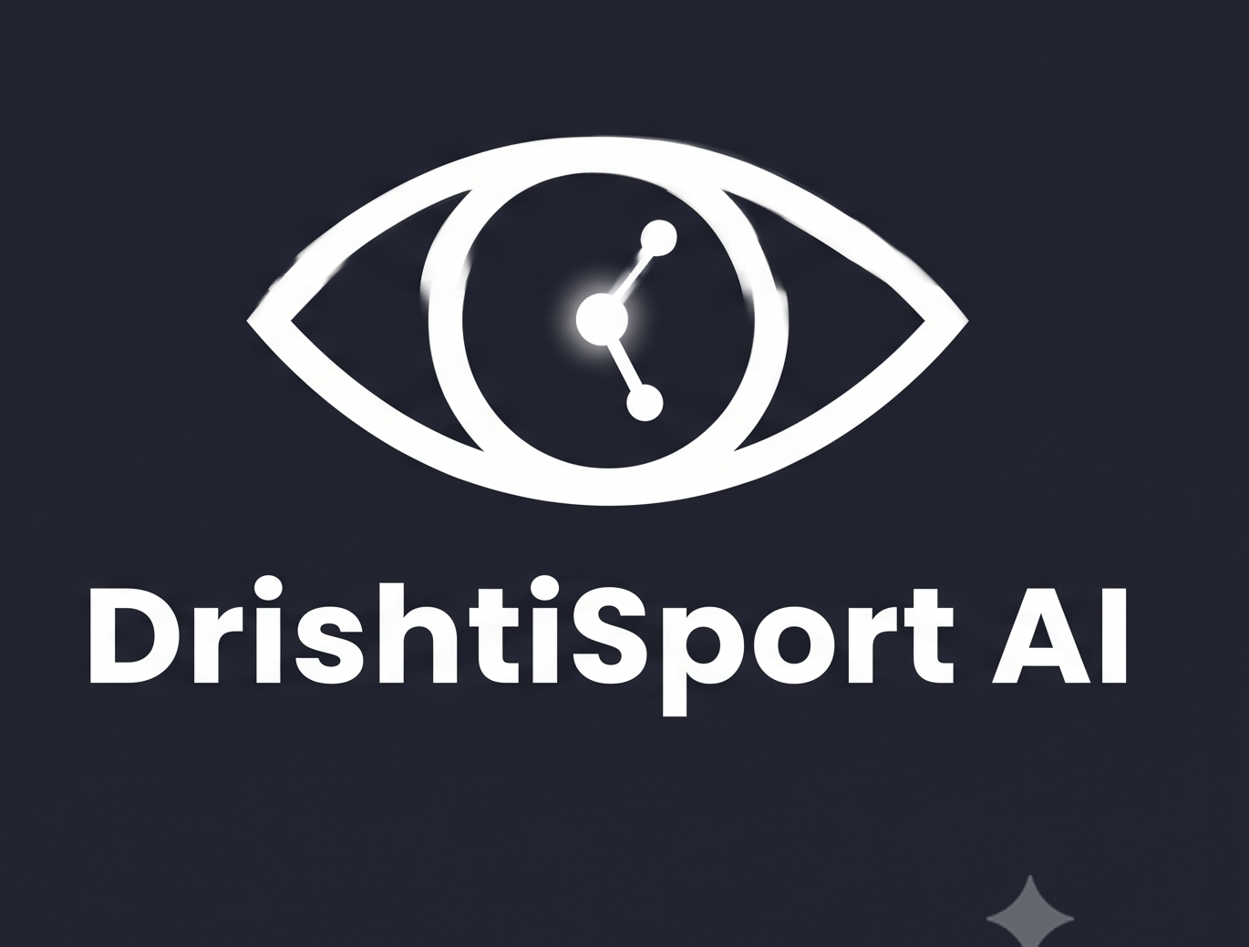
Introduction / Team
Vision: "One builder, one mission - put elite biomechanics in every rural coach's pocket for Bharat's 98% underserved athletes "
Backed by structured mentorship: FITT-IIT Delhi design-thinking sessions
[Abhishek Maurya, Arpan Kansal,
Vaibhav Singh Parihar, Vanita Vasudeva, Dhruvi Sharma]
Guru Sai Sumith
Solo Founder & Builder
Gayatri Vidya Parishad College of Engineering
Full Stack AI-ML Engineer
Flutter / Mobile App Development
Grassroots Sport Practice
Computer Vision & ONNX model
Pose estimation, model quantization,
on-device inference pipelines.
Cross-platform app, offline-first UX,
local audio alerts and logging.
Hands-on coaching experience and contextualised thresholds for rural use.
Samsung Solve for Tomorrow 2026 | FITT, IIT Delhi | Samsung4all | Theme 3: Sport & Tech

Slide 3
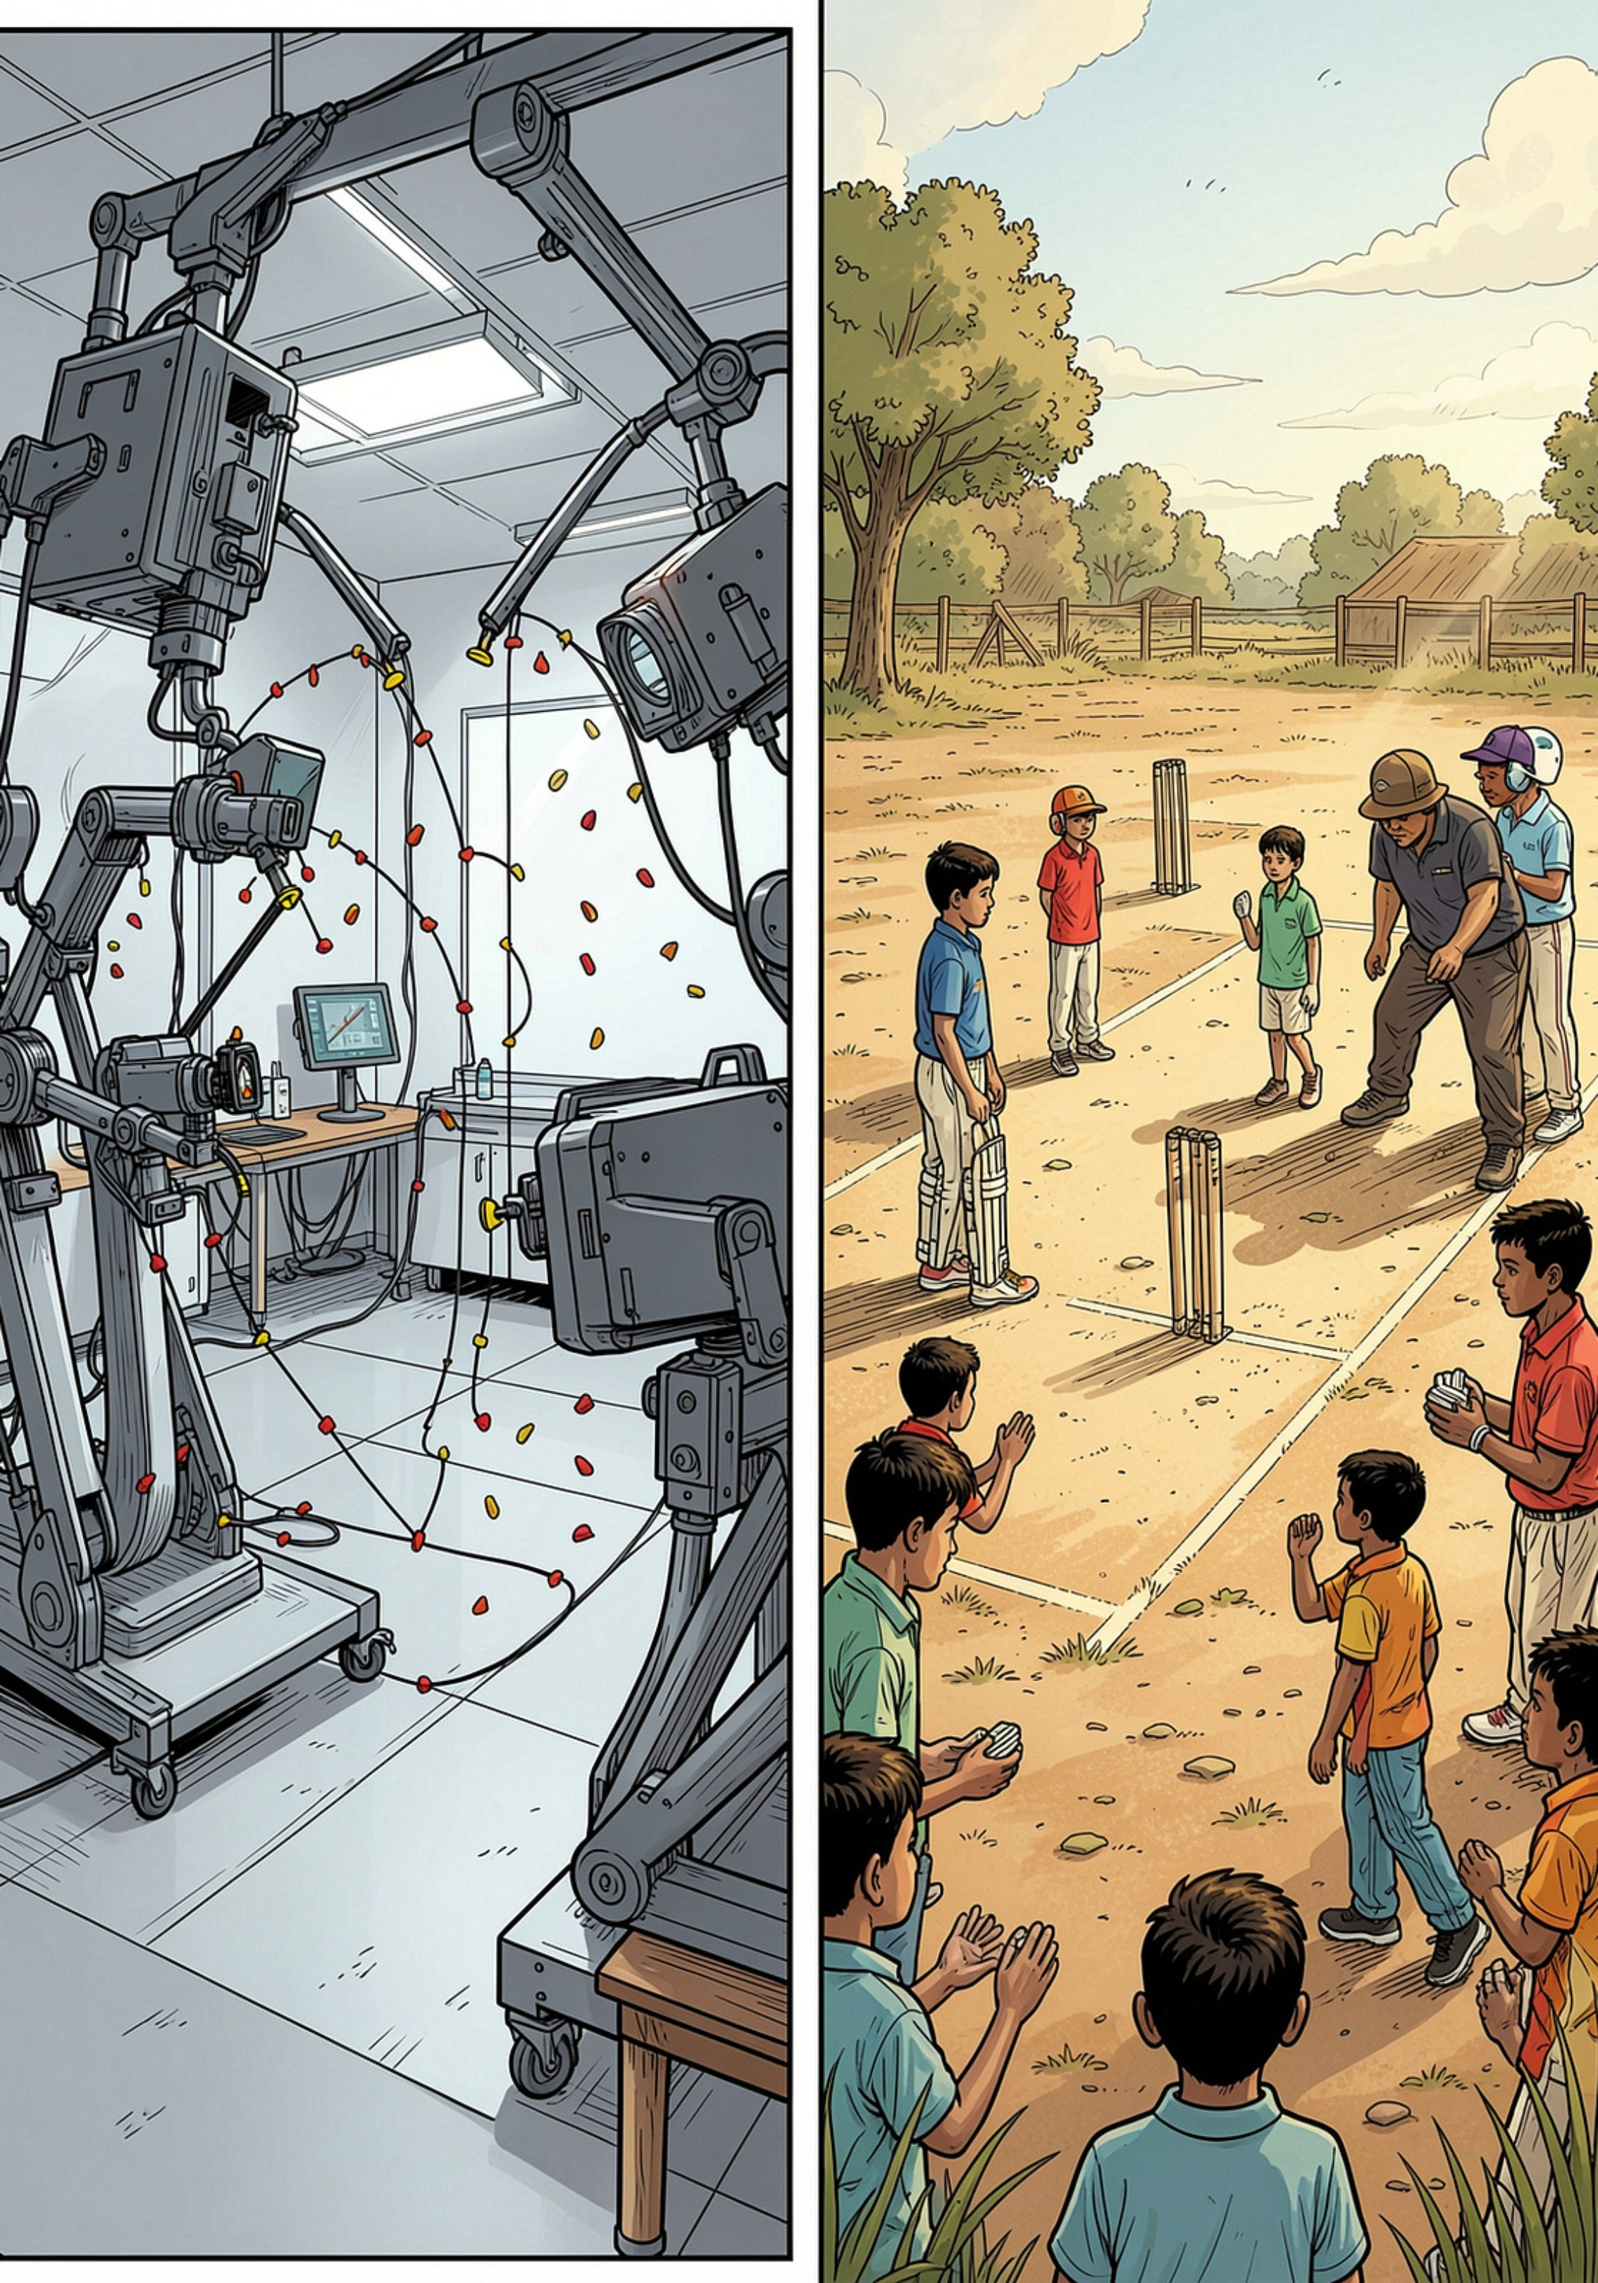
Problem
A Biomechanics Gap No One Is Pricing For
Access Gap
Cost Barrier
98% of rural Indian athlete's train with zero biomechanical analysis - the difference between raw talent and injury-free performance.
Elite motion-capture labs cost ₹5,000+/hour - restricted to national academies, unreachable for Tier 2/3 coaches.
Detection Barrier
ICC Law 24.3 sets a 15° elbow-extension limit for bowling legality - rural umpires/coaches lack objective tools; bowlers can be called out unfairly or injured.
Samsung Solve for Tomorrow 2026 | FITT, IIT Delhi | Samsung4all | Theme 3: Sport & Tech

Slide 4

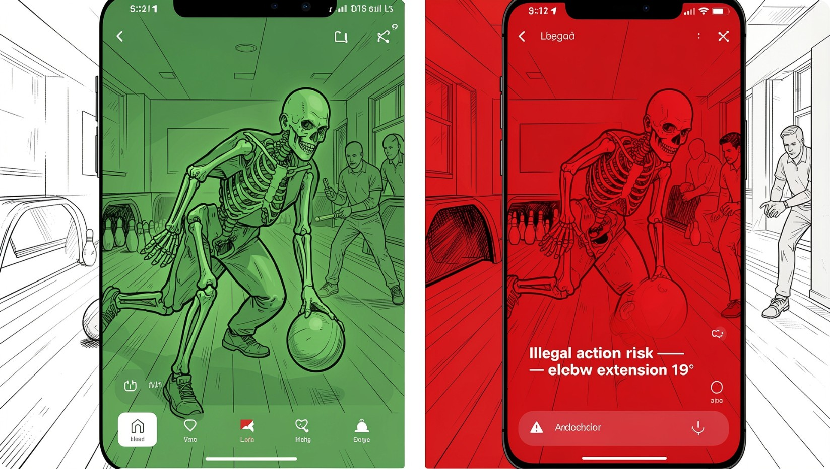
MediaPipe detects keypoints for angle analysis.
Solution
DrishtiSport AI: Biomechanics in Every Pocket
Visual/audio alerts and verified local logging.
Pose Extraction
Alert & Log
Phone Camera
Capture live video frames for processing.
ONNX Angle Model
On-device model computes joint angles offline.
Free, 100% offline smartphone app converting any budget camera into a real-time biomechanics coach - no wearables, no lab, no internet.
User benefit: instant objective feedback, early fault detection,
timestamped performance logs for scouts.
Flagship
On-device Tech: Core Engine
MVP Stage
Free 100% Offline
Cricket bowling-action analysis;
flags illegal elbow extension vs ICC 15°
local-language audio alert
MediaPipe pose
lightweight ONNX angle model
on-device pose estimation
frame-by-frame
Working prototype (POC)
live demo follows
Add start-position analysis
Squat/landing risk modules
Samsung Solve for Tomorrow 2026 | FITT, IIT Delhi | Samsung4all | Theme 3: Sport & Tech

Slide 5
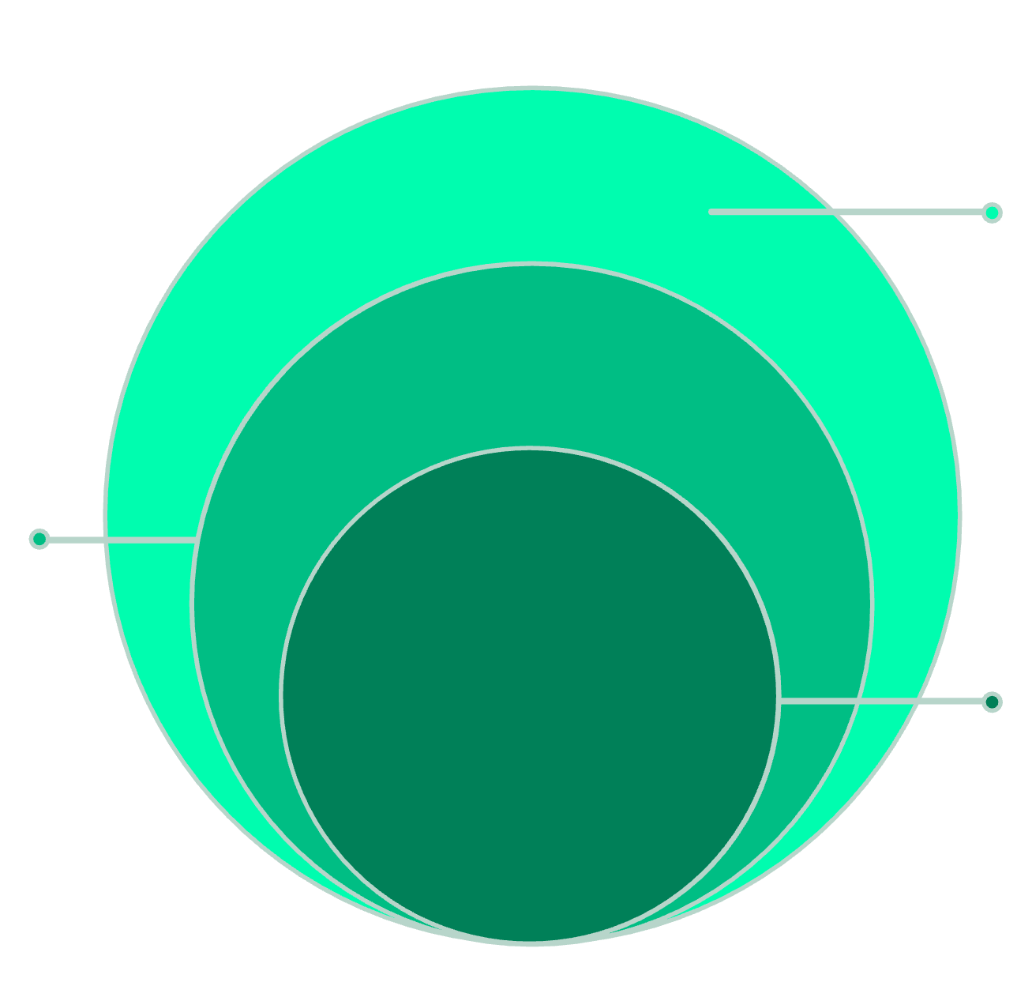
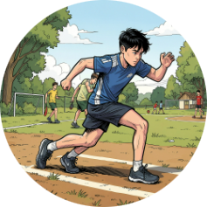

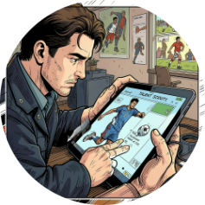
Customer Segment
Customers
Who This Is For
TAM
All grassroots youth participants to verify
Current customer segment (target now)
SAM
Individual grassroots athletes and their local coaches/PE teachers
in Tier 2/3 cities and rural India
Reachable schools and academies in target regions
SOM
Initial pilot accounts for trial schools
Future customer segment (where this grows)
State-level and private sports academies and sports federations
(as a paid B2B customer, via the scouting/analytics dashboard
Aspiring Athletes (10–22)
PE Teachers & Grassroots Coaches
Talent Scouts & Sports Bodies
Tier 2/3 youth who lack access to professional coaching or lab feedback.
Manage large groups with zero specialised equipment or biomechanics training.
Need objective, tamper-proof performance data vs subjective judgement.
Samsung Solve for Tomorrow 2026 | FITT, IIT Delhi | Samsung4all | Theme 3: Sport & Tech

Slide 6

Competition
Why DrishtiSport AI Wins on the Ground
Product
Cost
Hardware
Offline
Rule Accuracy
Unique Value Proposition --- Why the moat holds:
Elite motion
capture labs
High
Extensive
No
High
Zero extra hardware - scales to whole academies with one shared phone.
Sport-specific, rule-grounded thresholds (e.g., ICC Law 24.3) - not vague scores.
Tamper-proof verified performance logs target scouting bias and corruption.
Wearable sensor kits
Medium–High
Per-athlete
Partial
Variable
Generic fitness-form apps
Low
None
Yes
Low (vague)
DrishtiSport AI
Free
/ Low
Phone only
Yes 100% offline
Rule-specific, tamper-proof
The "Anti-Bias Verification" capability is unique - a clear differentiator judges can evaluate.
Samsung Solve for Tomorrow 2026 | FITT, IIT Delhi | Samsung4all | Theme 3: Sport & Tech

Slide 7
Impact
Beyond the App
Injury Prevention
Catch unsafe or illegal technique before it causes long-term joint damage or forced early retirement.
Equal Access
A rural academy with one phone gets the same technical feedback quality as a national training centre.
Coach Empowerment
PE teachers gain a diagnostic tool requiring zero biomechanics training to operate.
Policy Alignment
Supports Khelo India, Fit India and UN SDG 3 & SDG 10 - measurable social and national development impact.
Impact cards above are focused measurable outcomes judges can map to program objectives and evaluation rubrics.
Samsung Solve for Tomorrow 2026 | FITT, IIT Delhi | Samsung4all | Theme 3: Sport & Tech

Slide 8
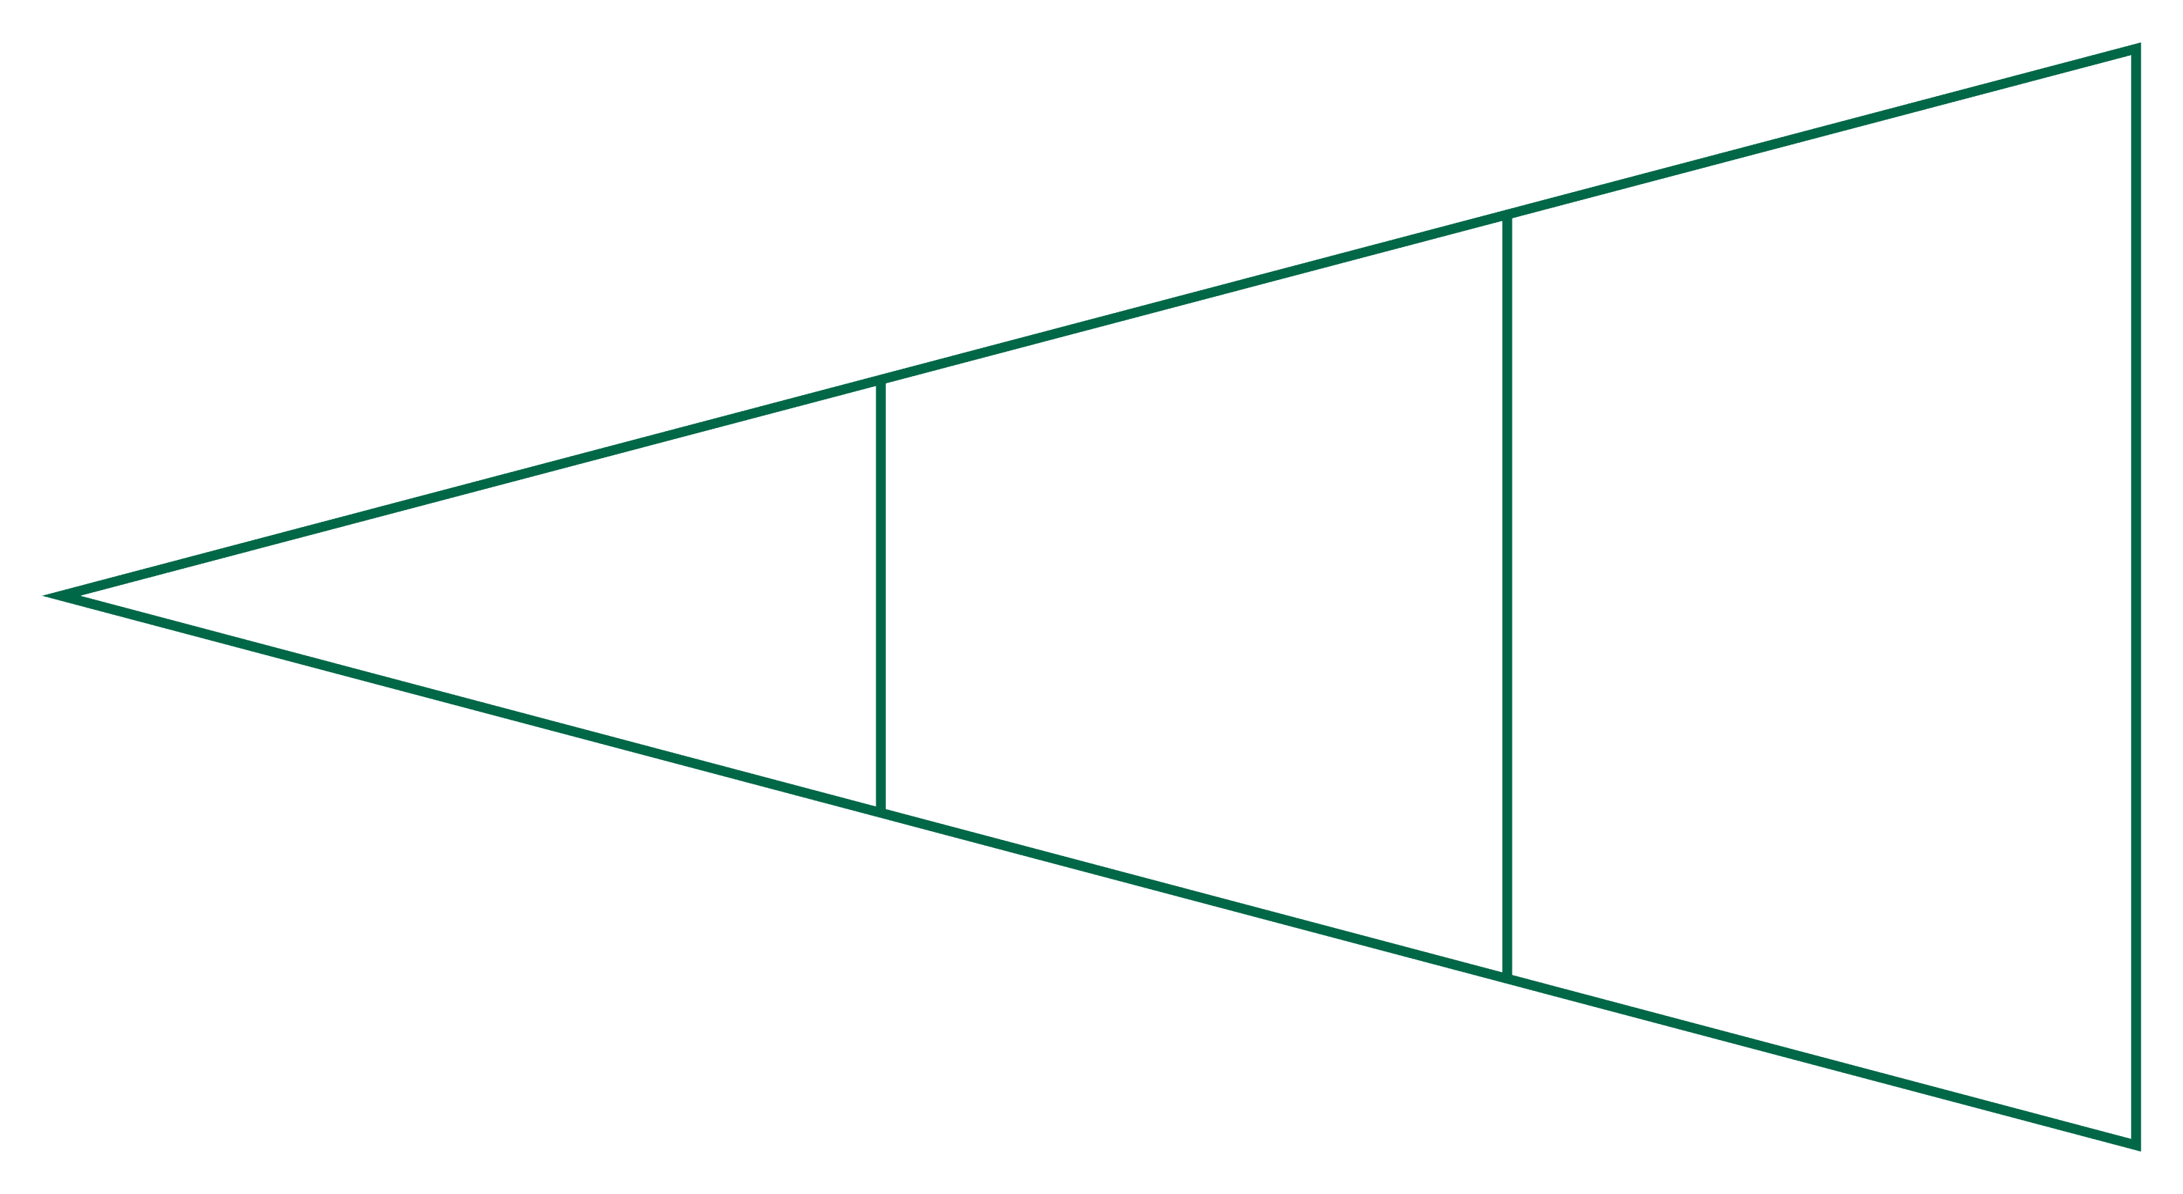
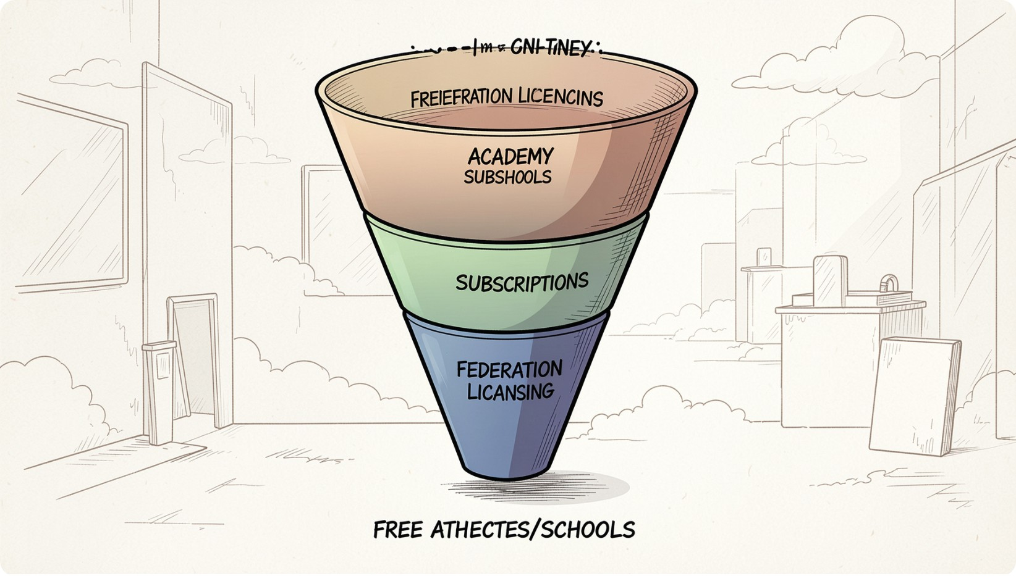

Revenue Model
How This Sustains Itself
Free Athlete Tier
B2B Academy Subs
Federation Data License
Steady Inflow
Recurring Revenue
Alternative
Free Forever
B2B Subscriptions
Data Licensing
Adoption engine:
athletes, schools,
rural academies
Individuals
Academies pay
multi-athlete tools
State and private
sports academies
Anonymized analytics
Aggregated performance
licensed to sports bodies
Government tie-ups
Revenue mix built for stability:
recurring annual academy subscriptions
for steady inflow; federation licensing
for higher-value contracts.
No hidden cost to the athlete - monetization sits at institutional layer only.
Samsung Solve for Tomorrow 2026 | FITT, IIT Delhi | Samsung4all | Theme 3: Sport & Tech

Slide 9
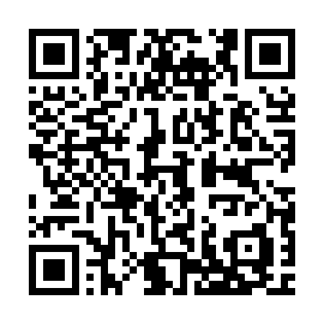
Thank You
DrishtiSport AI - every rural playground deserves a coach.
This makes sure it gets one.
Contact
Direct Ask
Samsung4all
Guru Sai Sumith
9110341228
gurusumithss2005@gmail.com
LinkedIN
Requesting FITT-IIT Delhi lab access to validate the elbow-angle model against certified biomechanics equipment, and mentorship on scaling to additional sports.
Demo - Link
QR code links to a 2-minute demo video (placeholder).
Judges: live demo follows the narrated 4-minute video - prototype ready for validation.
Samsung Solve for Tomorrow 2026 | FITT, IIT Delhi | Samsung4all | Theme 3: Sport & Tech

