Slide 2
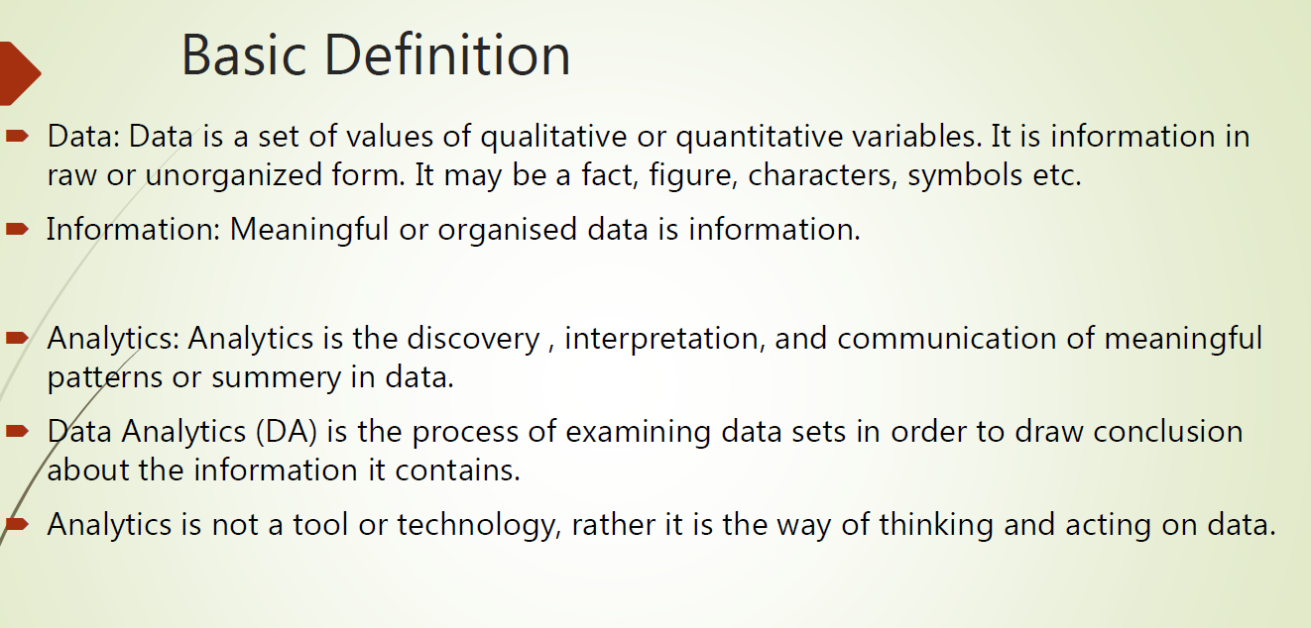

Slide 3
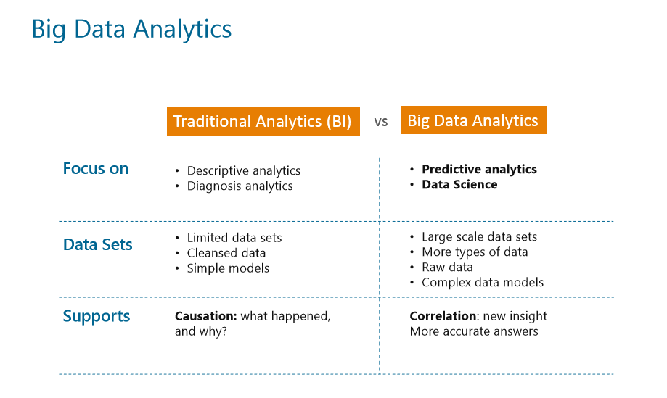

Slide 4
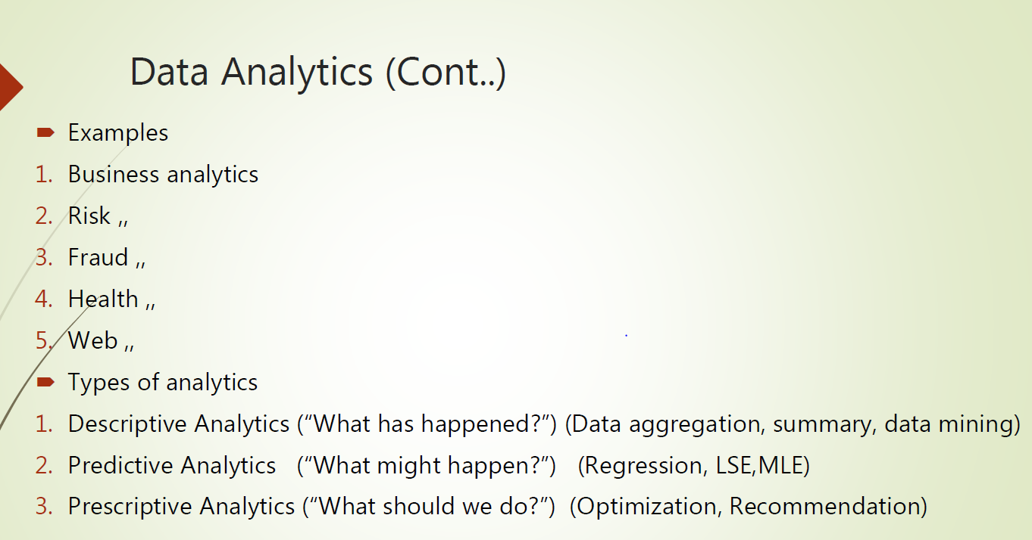

Slide 5
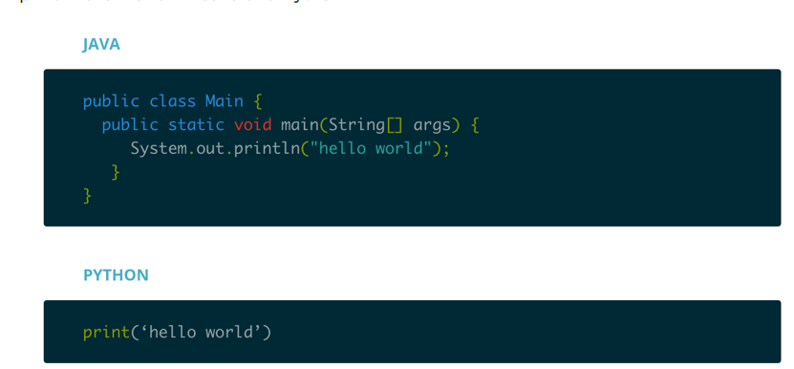
Reason why we need to learn Python

Slide 6
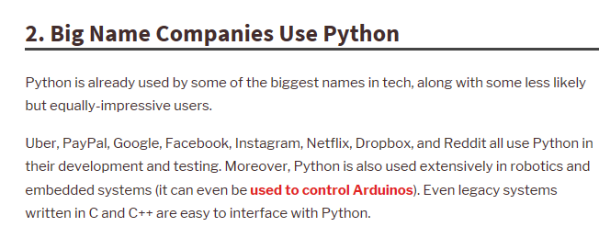
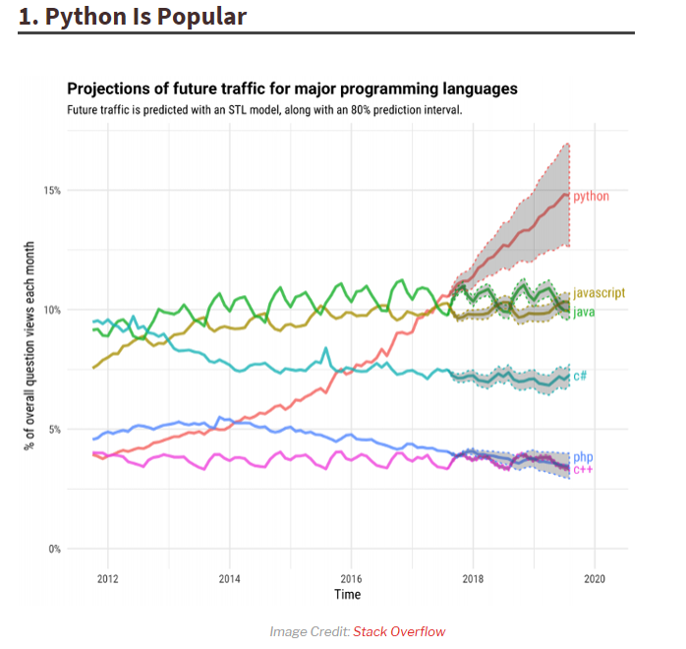
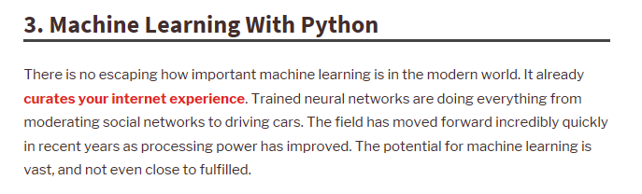
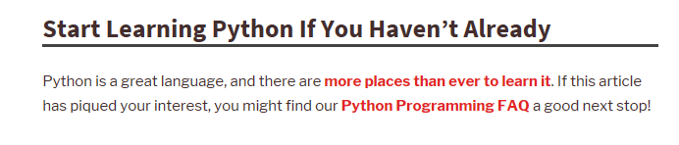
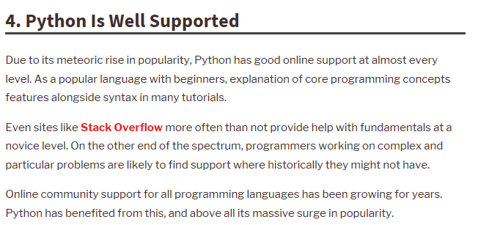
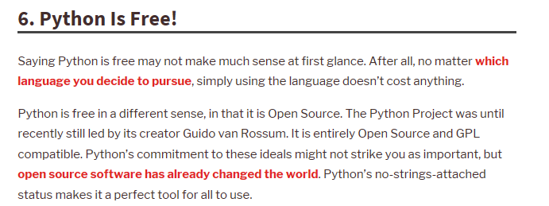
Reason why we need to learn Python

Slide 7
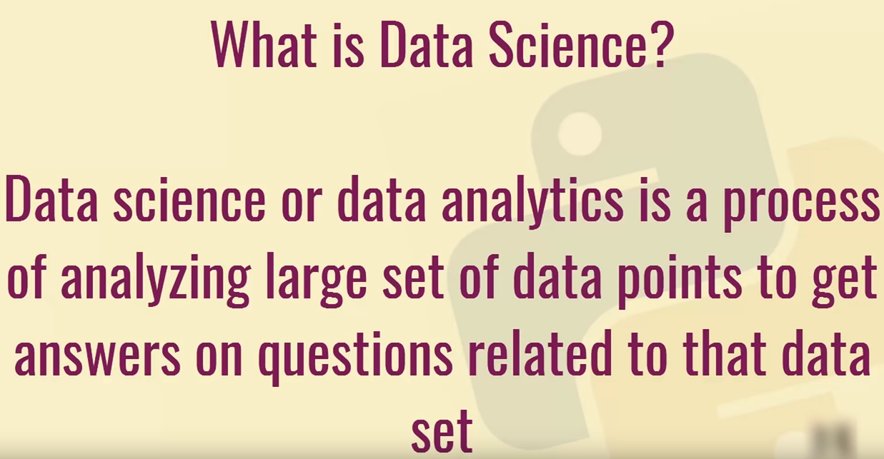
https://www.datacamp.com/courses/intro-to-python-for-data-science

Slide 8
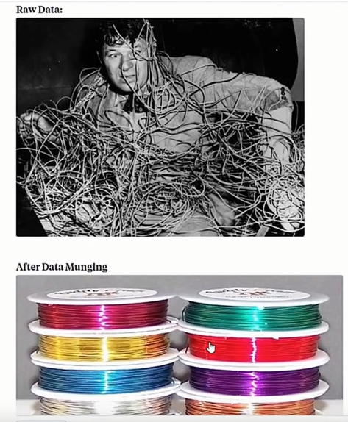

Slide 9
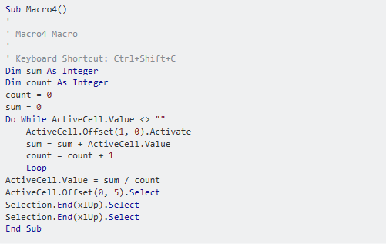
Sub Macro4() ' ' Macro4 Macro ' ' Keyboard Shortcut: Ctrl+Shift+C Dim sum As Integer Dim count As Integer count = 0 sum = 0 Do While ActiveCell.Value <> "" ActiveCell.Offset(1, 0).Activate sum = sum + ActiveCell.Value count = count + 1 Loop ActiveCell.Value = sum / count ActiveCell.Offset(0, 5).Select Selection.End(xlUp).Select Selection.End(xlUp).Select End Sub

