Slide 1

TFIP

Slide 2
Machine Learning, NLP Projects
Projects
Front office
BackOffice
Global users
Singapore office
Middle Office
Regional users

Slide 3
Aiming Deployment s

Slide 4
Innovation Team
The mission is to serve as a focal point for innovation programs and activities for Digital Strategy to build Corporate Digital Bank in 3 to 5 years
Foster collaboration for creative ideation
Build new products or services innovatively making significant impact to the overall business Digitally with latest technologies
Forge strategic partnerships
Connect with FinTechs
Develop an innovation culture
Test new technologies
Rethink customer experience
Become a leader in the innovation space
Encourage exciting collaborations academia, start-ups, vendors etc.

Slide 5
Expectation
Inspiring to Innovate
Bring passion in all our colleague to innovate. Organize talks and demos from leaders and vendors in various fields so that Mizuho employees can get new information and learn about topics they may not be familiar with.
Changing Mind set
AOAD innovation lab helps to change the employees‘ mindset by allowing them to experiment with new & disruptive ideas
Game-changing ideas
By having a dedicated innovation lab, SG Team sets aside resources to encourage these ground-breaking ideas and see them come to fruition.

Slide 6
Team
Team Size
Machine Learning Developer, Data Scientist, Full Stack Developers, RPA developers, Cloud specialist
We are gradually expanding
Current Projects in incubation
AI/Data Analytics
NLP Natural Language Processing

Slide 7

Hardware Used - Development
AWS Cloud for development
In house PC - Development while training will be in a high spec – i9, 10th Gen, 64GB RAM, 10 core processor
GPU RTX 2080 Ti - Training the deep learning
GitHub Enterprise Device in Linux
Anaconda Enterprise for Development, Production in Linux

Slide 8
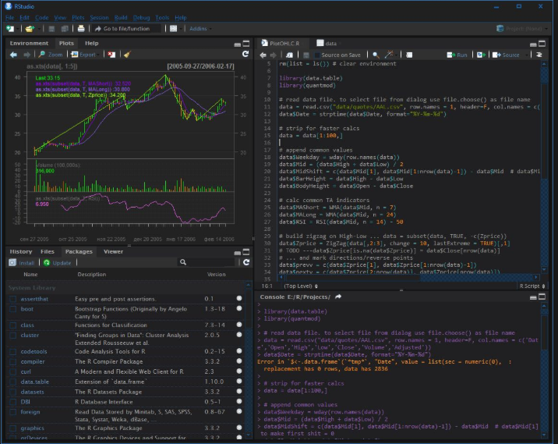


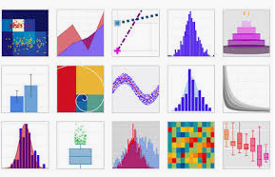

Software Used- Development
AWS Cloud – ASW IAsS
R Programming
R Studio
Anaconda
Python using Spyder
Dash
Plotly
Tableau (Licensed)
QlikView, PowerBI
BigData Infrastructure(Development only)
Libraries
Numpy
Pandas
TensorFlow
Sci-kitLear
NLP
Keras, PyTorch, Hugging Face, BERT, SPACY

