Slide 1
AI
Guru S. Anand

Slide 2
Why AI
What is AI
Classification Example
Recommendations

Slide 3
Why AI?
Anything if we describe in terms of What? We won’t get the essence of it. Rather try to get to know why?
See what is happening in the world> One thing happening in the world is change which is happening faster and faster. Anything to be alive it has to be in a flow.
Learning is going too important than knowing. Means? Company that built with knowledge is going to die. The expert is going to die. Be’coz we’ll stop asking questions when you are an experts rather if we constantly learn from all
around the ecosystem then company will be just above the ordinary.

Slide 4
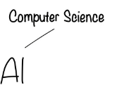

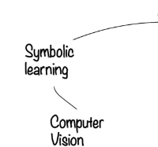

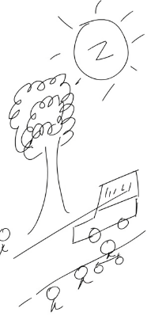




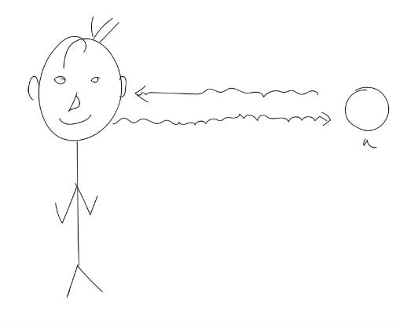

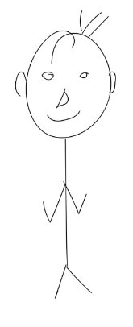



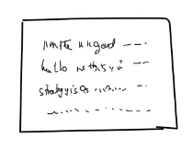
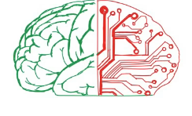
What is AI?
In the context of human.
Goal : To work intelligently and independently

Slide 5


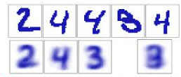
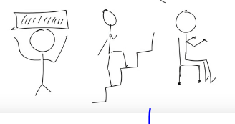
What is AI?
In the context of human.
Goal : To work intelligently and independently

Slide 6
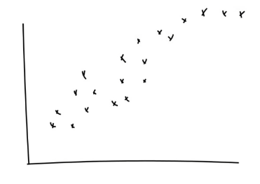
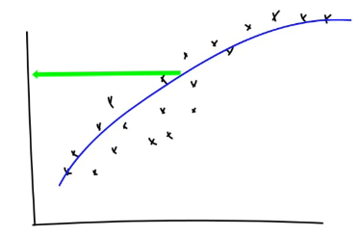
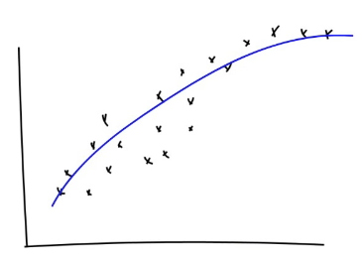
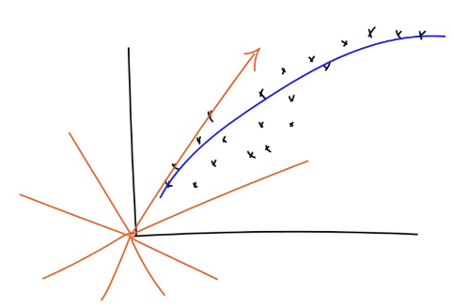
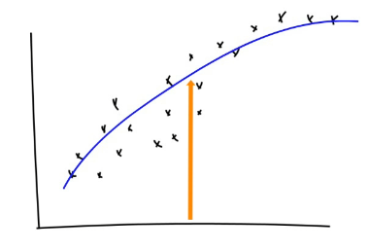
Classification

Slide 7



More in general about Machine Learning
Learn from Experience
Question is ?
Can Computer
Learn from experience too?
Follow Instructions

Slide 8
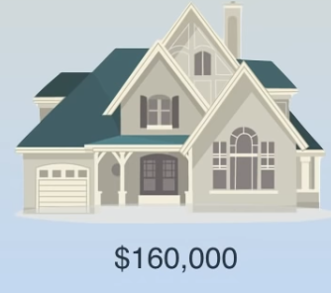


More in general about Machine Learning

Slide 9
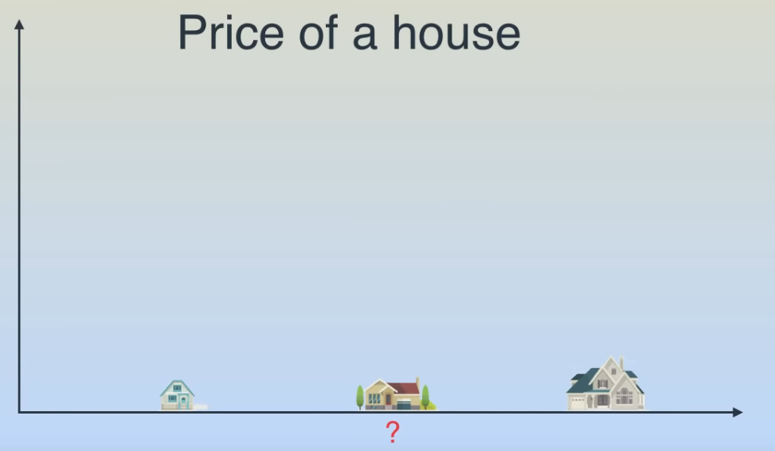
More in general about Machine Learning

Slide 10
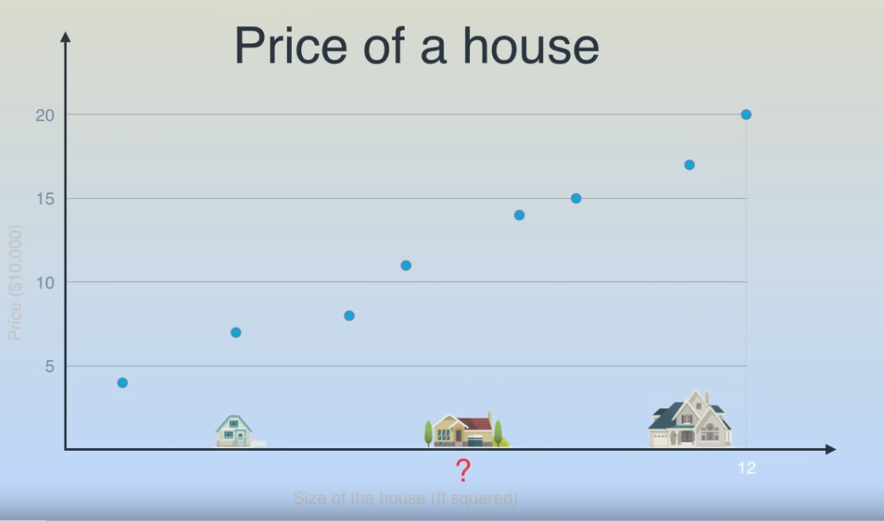
More in general about Machine Learning

Slide 11
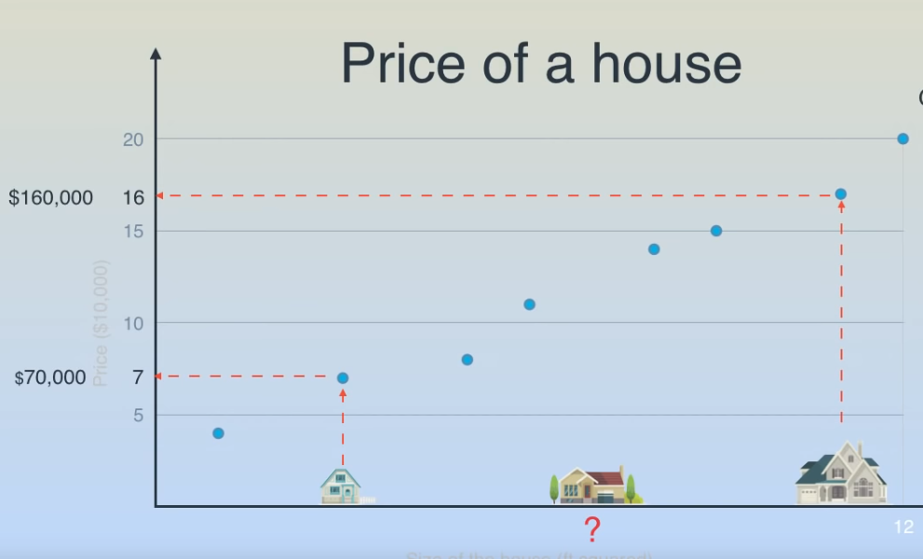
More in general about Machine Learning

Slide 12
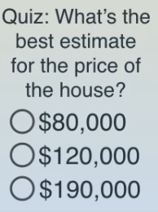
More in general about Machine Learning

Slide 13
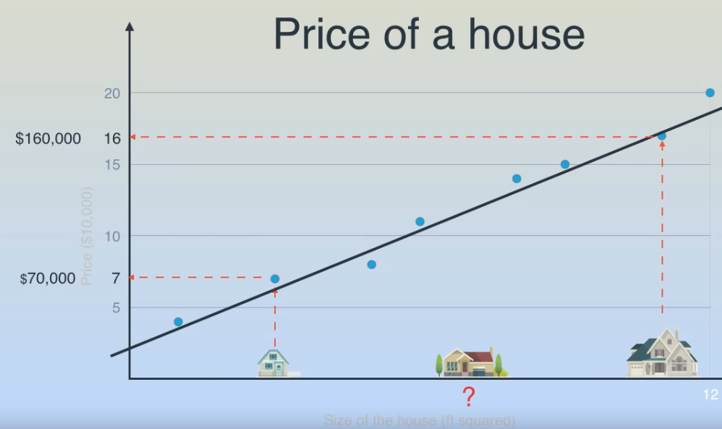
More in general about Machine Learning

Slide 14
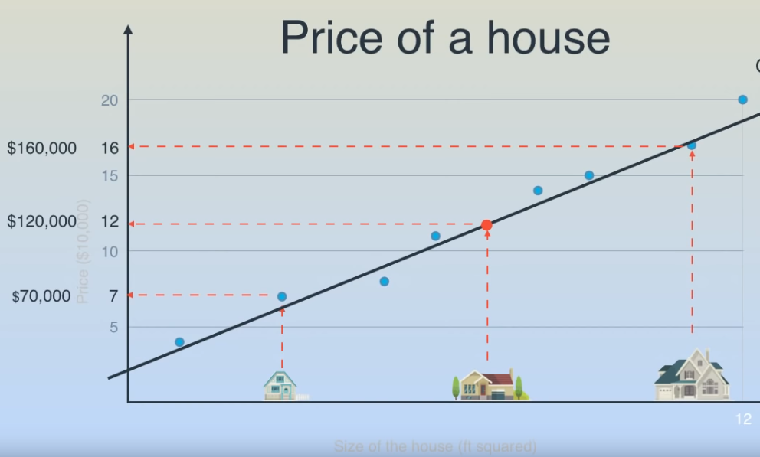
More in general about Machine Learning

Slide 15
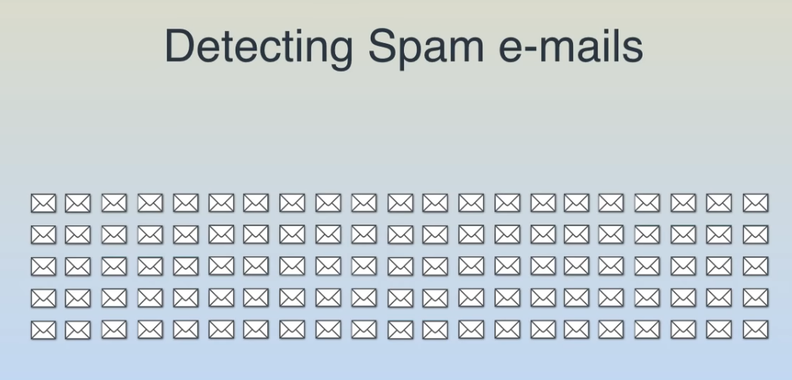
More in general about Machine Learning

Slide 16
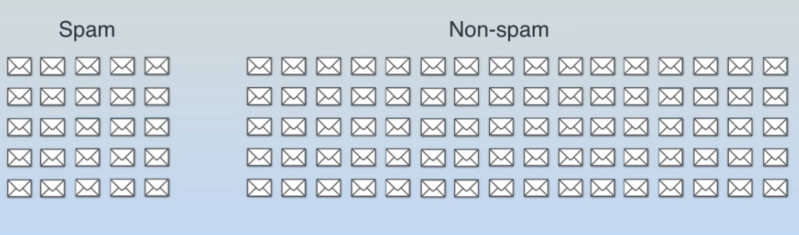
More in general about Machine Learning

Slide 17


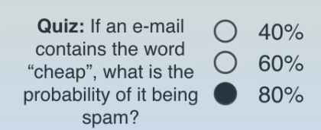
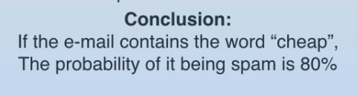
More in general about Machine Learning

Slide 18
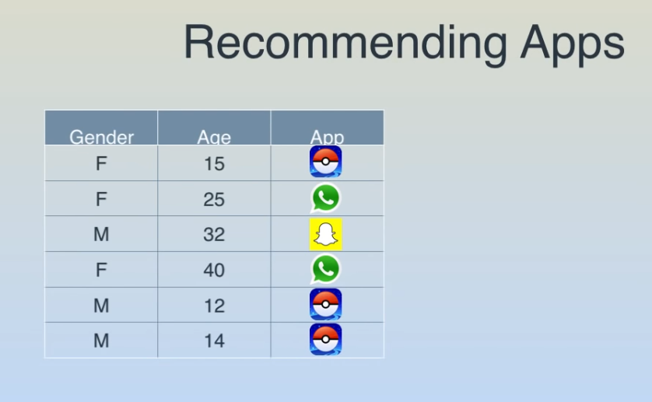
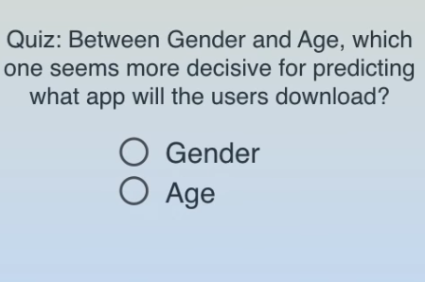
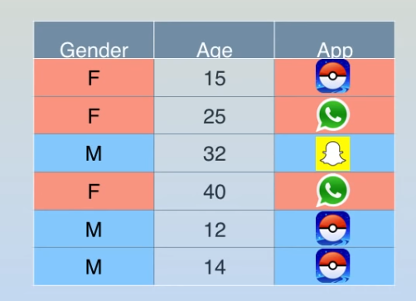

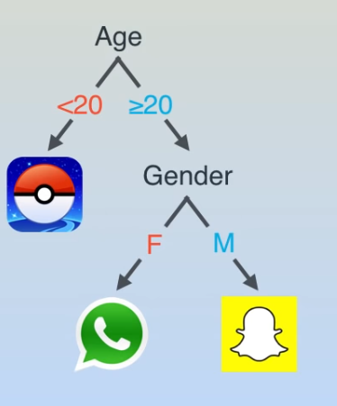
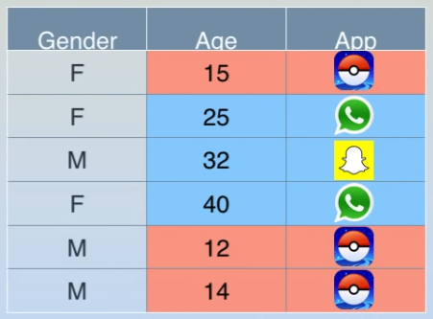
Example 2

Slide 19

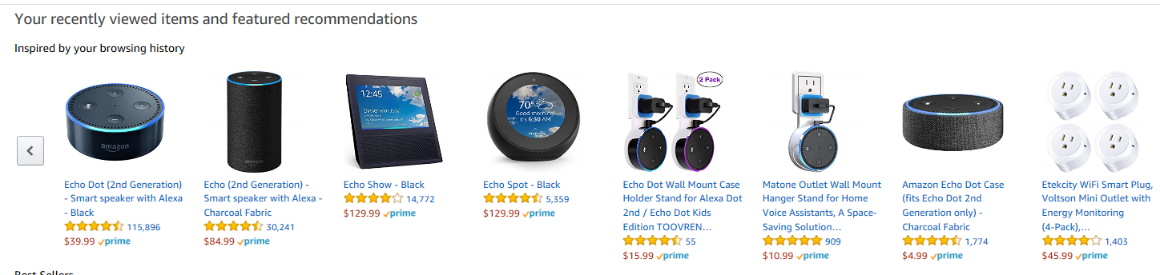
More in general about Machine Learning
Notes:
https://www.amazon.com/dp/B075RS7RGY/ref_=fs_ods_fs_aucc_sr

Slide 20
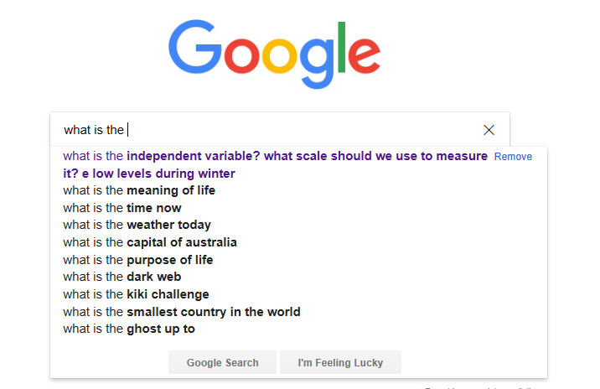
More in general about Machine Learning

Slide 21
More in general about Machine Learning
https://www.youtube.com/watch?v=sENv5vlXiu4

Slide 22
More in general about Machine Learning

