Slide 1
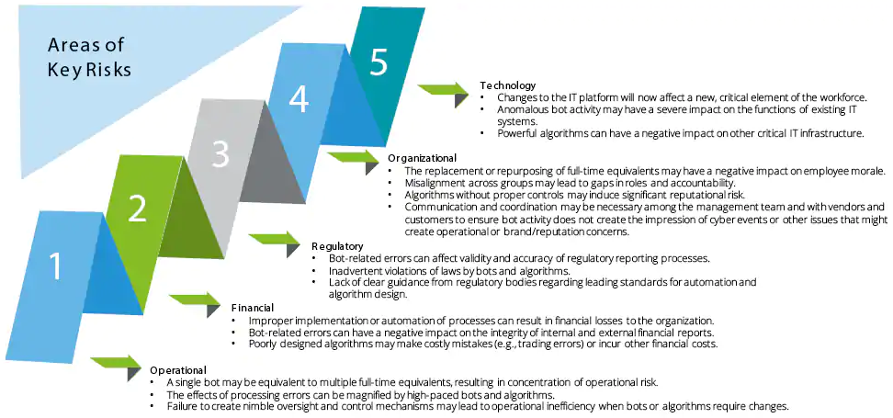
https://www2.deloitte.com/us/en/pages/audit/articles/financial-reporting-rpa-risks-and-controls.html

Slide 2
Robotic process automation (RPA) can help your company guard security processes as vigilantly and as faithfully as
the company doberman. But it is the employee who has the last say, who has to listen to that voice inside their head and not open an unfamiliar link. RPA can be an effective way at keeping corporate digital security guards in the “on” position in case human error happens
Artificial intelligence (AI) powered cognitive RPA bots deliver multiple advantages for reducing errors, improving employee productivity and cost-savings when compared to the alternatives.
https://www.automationanywhere.com/sg/blog/automation-anywhere-news/how-to-increase-security-while-reducing-risk-to-fraud-in-banking-with-rpa

Slide 3
Automation amplifies well-known security challenges in ways banking executives may feel unprepared to face, including controls, data integrity, user privileges, privacy, system availability, regulator insight and inherent bias.
Fortunately, all of these issues are manageable. Banks can address them via a disciplined approach to governance that stresses these actions:
Document the process to be automated.
Work across the bank’s internal functions to identify security, risk and compliance needs.
Deploy supervisory bots to detect and alert for unusual activity or errors.
Have a well-rehearsed contingency plan.
Create an audit trail of the specific actions each bot carries.
Run periodic test cases to show how well the automation model works.”

Slide 4
Tips from Gartner: Overcoming 5 Common IT Process Automation Challenges
Challenge #1: Shortage of Both People and Skills
Challenge #2: Lack of Existing Documentation
Challenge #3: Cultural Resistance to Change
Challenge #4: Lack of Process Standards, Discipline and Governance
Challenge #5: Lack of Traction and Loss of Focus

Slide 5
The Pros of RPA
1) Highly compatible to any applications - RPA is compatible with virtually any system that a human uses on a computer.
Robots recreate the same activities people do everyday like copy & paste, navigating the internet,
using banking applications and of course Microsoft Excel.
With incredible speed, a bot can move between applications to get more work done, faster.
The Cons of RPA
Employee Resistance
Process Selection
Managing Expectations
Navigating Obstacles

Slide 6
Securing RPA requires protecting the data itself as well as who has access to it.
Therefore, RPA security is much like protecting any other tools used in the business.
companies new to RPA to start small and scale up.
In order to implement RPA securely, firms need to make sure the data flow is understood.
day-to-day users of desktop automation need to be trained on data policies and fully refreshed every six months.
At the same time, data should be encrypted. And of course, identity and access management are important
Make sure no one could take over that access and use it.
If it’s an in-house RPA platform, you need to introduce DevSecOps and ensure the right involvement from the team, making sure penetration testing is part of it.

