Slide 1
AI
Guru S. Anand

Slide 2
Why AI ?
What is AI ?
Classification Example
Recommendations

Slide 3






Why AI?
Anything if we describe in terms of What? We won’t get the essence of it. Rather try to get to know why?
See what is happening in the world> One thing happening in the world is change which is happening faster and faster. Anything to be alive it has to be in a flow.
Learning is going too important than knowing. Means? Company that built with knowledge is going to die. The expert is going to die. Be’coz we’ll stop asking questions when you are an experts rather if we constantly learn from all
around the ecosystem then company will be just above the ordinary.
1. Inability to Innovate – Unable to produce new, noteworthy and fruit producing ideas.
2. Inability to Stay Ahead of The Times – Only look at the here and now, no forward thinking.
3. No Adjustments – Not adjusting to the market place or technology of competitors.
4. Unwillingness To Change – They simply want things to be the way that they used to be
5. Reluctance to Take Risks – Playing it safe for a prolonged a period of time can be detrimental. Most brand success stories have many instances of taking risks.

Slide 4
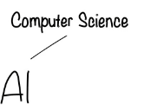


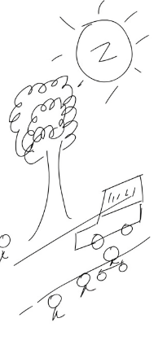
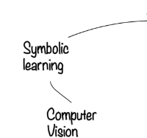




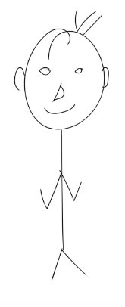

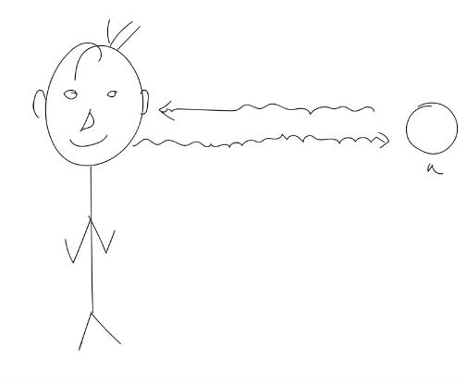


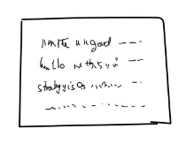


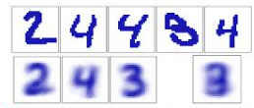
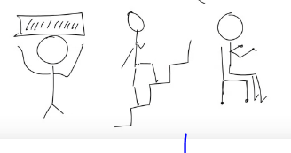
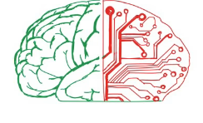
What is AI?
In the context of human.
Goal : To work intelligently and independently

Slide 5



More in general about Machine Learning
Learn from Experience
Question is ?
Can Computer
Learn from experience too?
Follow Instructions

Slide 6
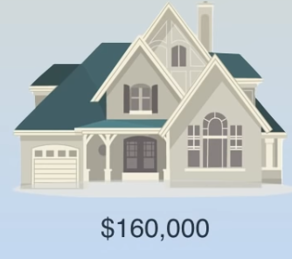


More in general about Machine Learning

Slide 7
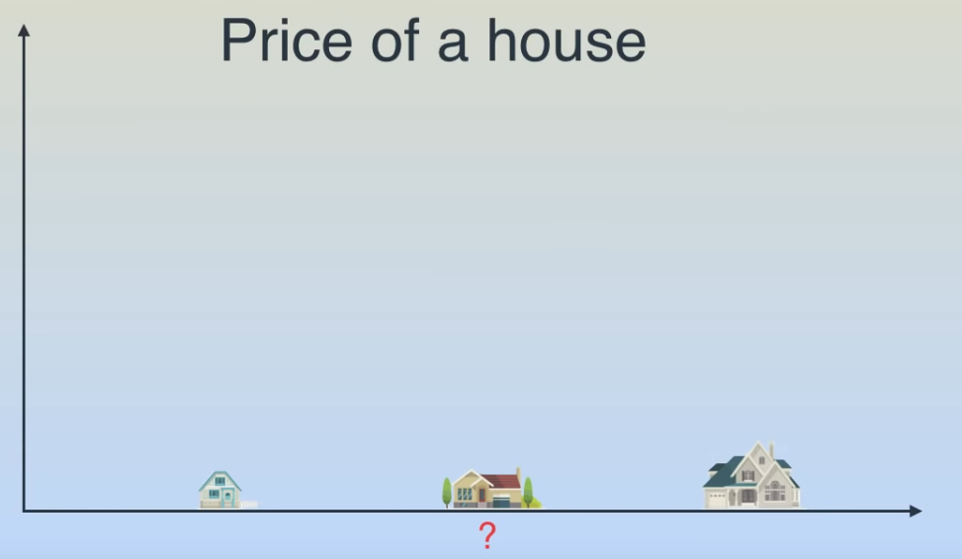
More in general about Machine Learning

Slide 8
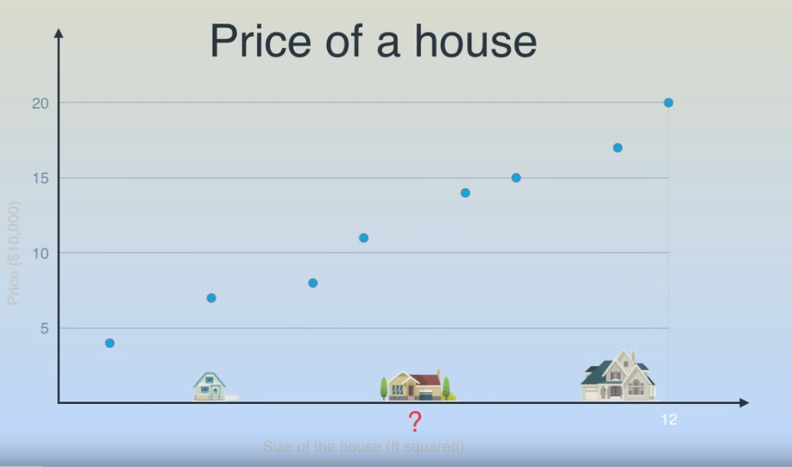
More in general about Machine Learning

Slide 9
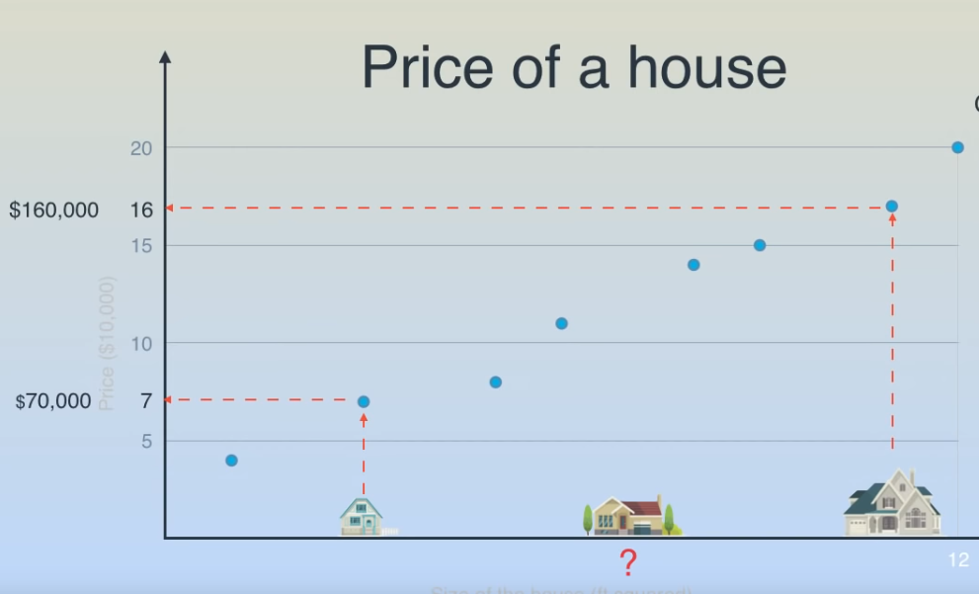
More in general about Machine Learning

Slide 10
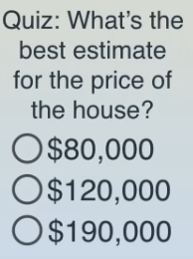
More in general about Machine Learning

Slide 11
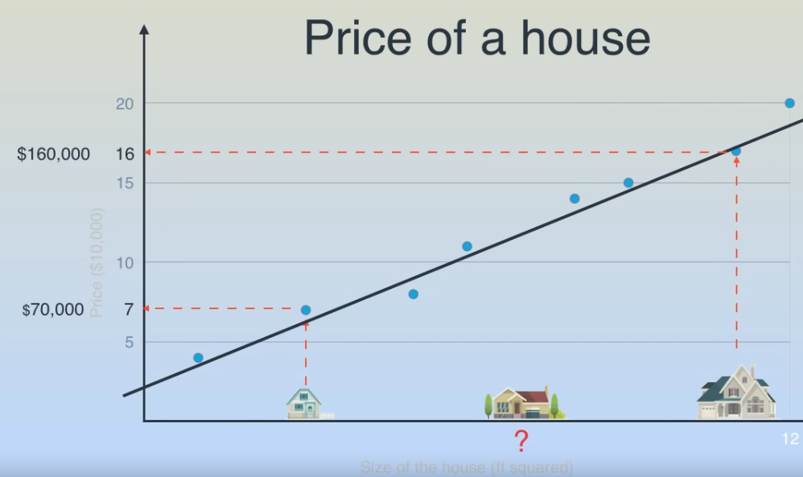
More in general about Machine Learning

Slide 12
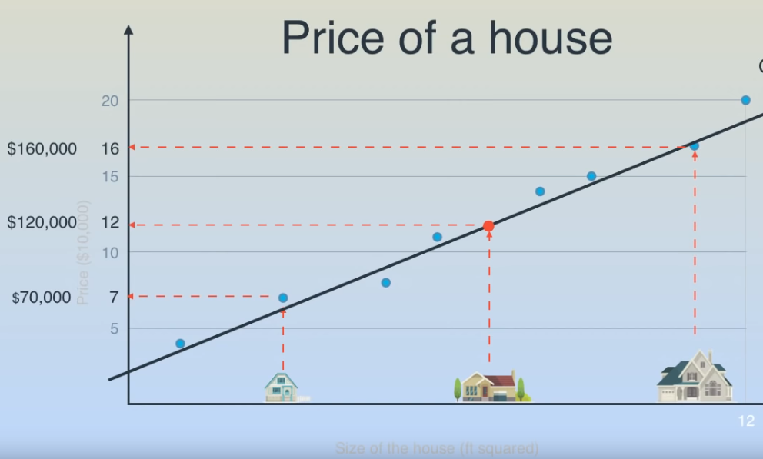
More in general about Machine Learning

Slide 13
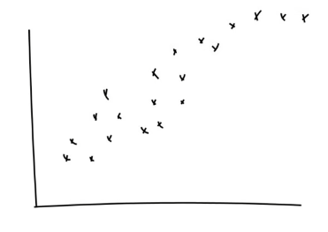
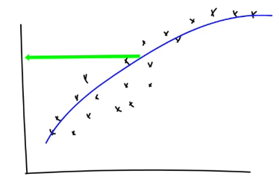
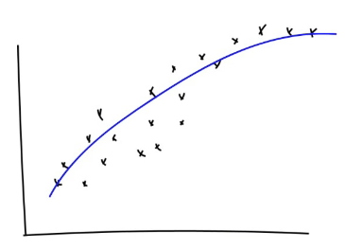
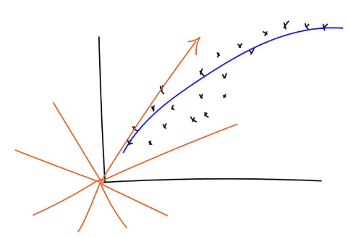
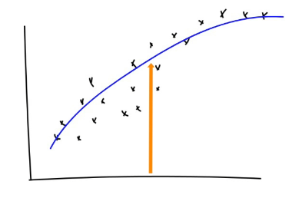
Classification

Slide 14
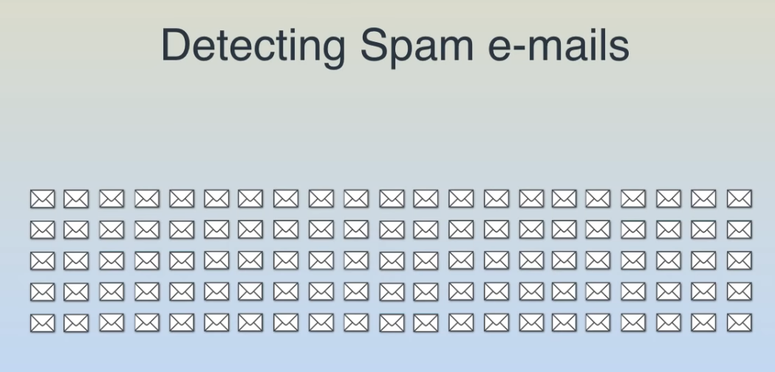
Classifying using Text mining - NLP

Slide 15
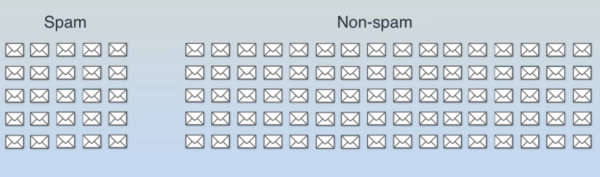
More in general about Machine Learning

Slide 16

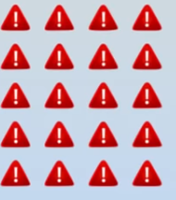
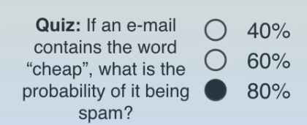
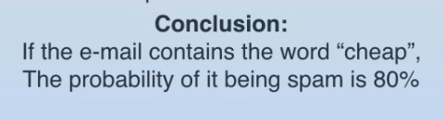
More in general about Machine Learning

Slide 17
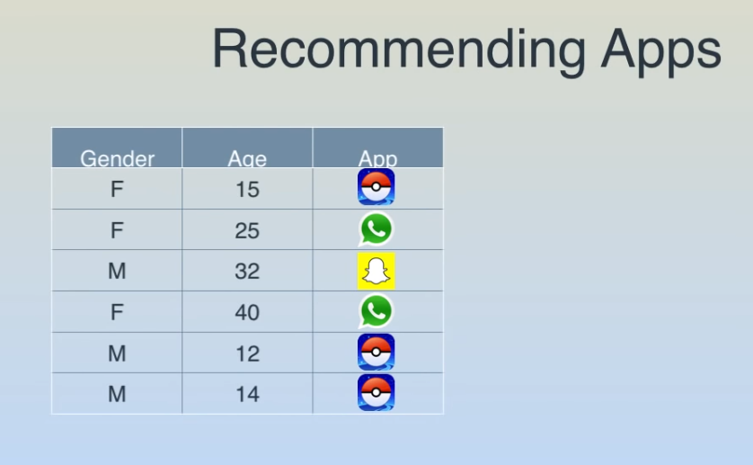
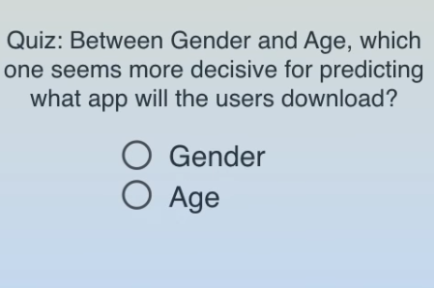
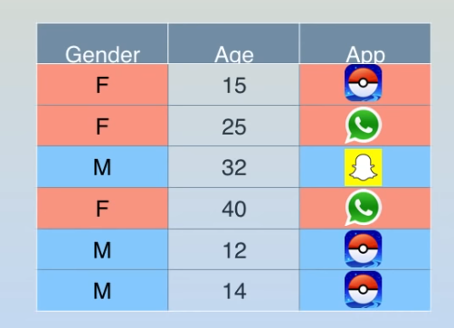

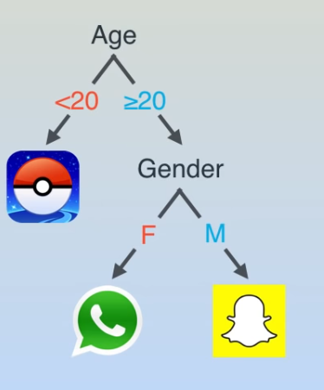
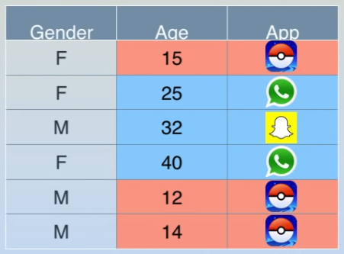
Example 2

Slide 18

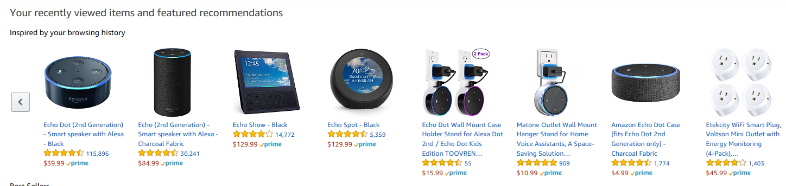
More in general about Machine Learning
Notes:
https://www.amazon.com/dp/B075RS7RGY/ref_=fs_ods_fs_aucc_sr

Slide 19
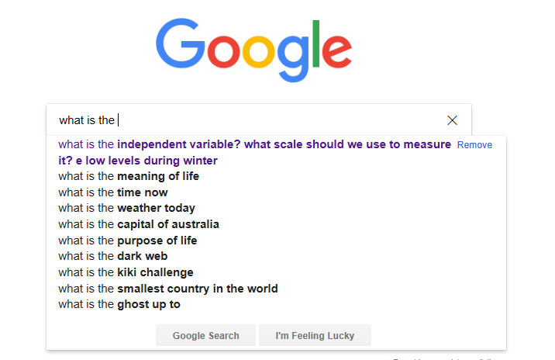
More in general about Machine Learning

Slide 20
More in general about Machine Learning
https://www.youtube.com/watch?v=sENv5vlXiu4

Slide 21
More in general about Machine Learning

