Slide 1
AI
Guru S. Anand

Slide 2
Why AI ?
What is AI ?
Classification Example
Recommendations

Slide 3
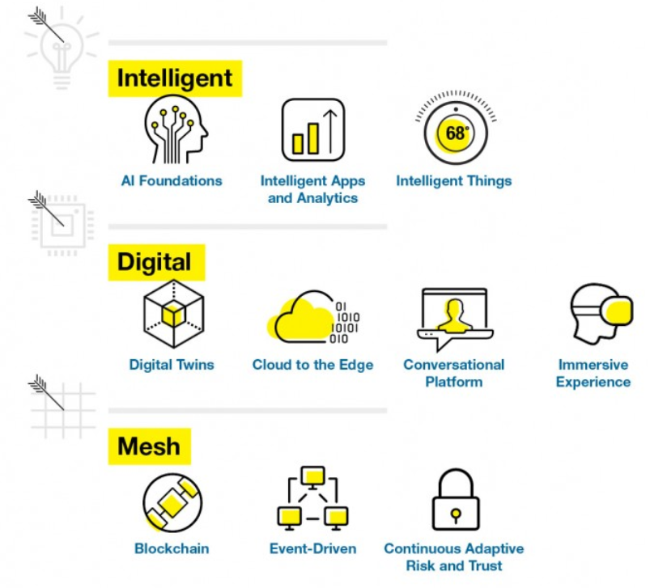
Gartner Top 10 Strategic Technology Trends for 2018
AI is seeping into virtually every technology and with a defined, well-scoped focus it can allow more dynamic, flexible and potentially autonomous systems.
Blending the virtual and real worlds to create an immersive digitally enhanced and connected environment.
The connections between an expanding set of people, business, devices, content and services to deliver digital outcomes.

Slide 4


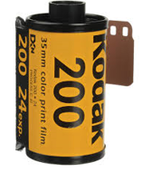



Why AI?
Anything if we describe in terms of What? We won’t get the essence of it. Rather try to get to know why?
See what is happening in the world> One thing happening in the world is change which is happening faster and faster. Anything to be alive it has to be in a flow.
Learning is going too important than knowing. Means? Company that built with knowledge is going to die. The expert is going to die. Be’coz we’ll stop asking questions when you are an experts rather if we constantly learn from all
around the ecosystem then company will be just above the ordinary.
1. Inability to Innovate – Unable to produce new, noteworthy and fruit producing ideas.
2. Inability to Stay Ahead of The Times – Only look at the here and now, no forward thinking.
3. No Adjustments – Not adjusting to the market place or technology of competitors.
4. Unwillingness To Change – They simply want things to be the way that they used to be
5. Reluctance to Take Risks – Playing it safe for a prolonged a period of time can be detrimental. Most brand success stories have many instances of taking risks.

Slide 5
More in general about Machine Learning
https://www.youtube.com/watch?v=sENv5vlXiu4

Slide 6
Definition of AI?
AI Foundation – Techniques to build systems that learn, adapt and potentially act autonomously
Machine learning, Natural language processing
Intelligent Apps and Analytics- App, application and service will incorporate some level of AI
Chatbots, virtual assistants and recommendation engines on e-commerce sites are just some examples of intelligent applications.
Intelligent Things - Physical things that go beyond the execution of rigid programming models to exploit AI. They are objects that incorporate autonomous technology.
Transportation - Bicycle lanes that automatically size for traffic patterns
Farms - A farming robot that responds to the health of each individual plant.
Travel - Smart suitcase follows you around on your travels

Slide 7
AI Types
AI Types
Weak AI
Strong AI
Machine or software that mimics some aspect of human intelligence
No genuine intelligence, no self-awareness
Simulation of cognitive process
Focus on solving specific real-life problems
Narrow range of abilities
Examples: Siri, Google’s Alpha Go, IBM’s Watson
Machine or software that mimics all aspects of human intelligence
Thinks like humans, understands, perceives, has beliefs, and exhibits other cognitive states normally ascribed to human beings
Focus on solving general problems and pure research
Wide range of abilities
Examples: ??
Video: Sophia the Robot

Slide 8
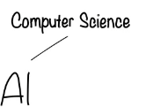


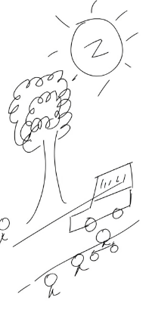
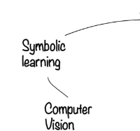




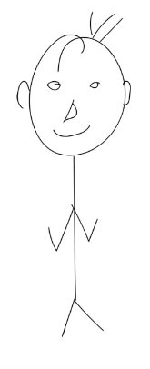

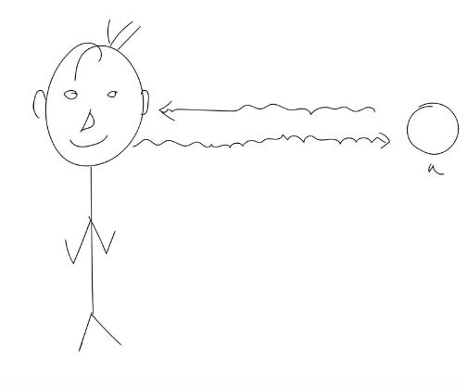


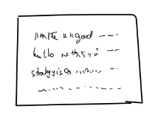


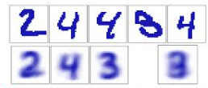
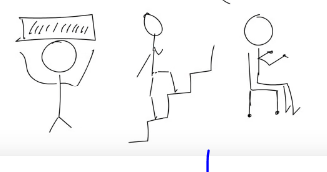
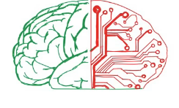
What is AI?
In the context of human.
Goal : To work intelligently and independently

Slide 9



More in general about Machine Learning
Learn from Experience
Question is ?
Can Computer
Learn from experience too?
Follow Instructions

Slide 10
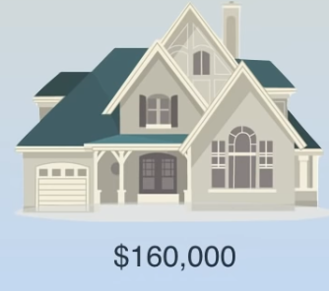
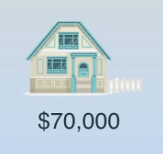

More in general about Machine Learning

Slide 11
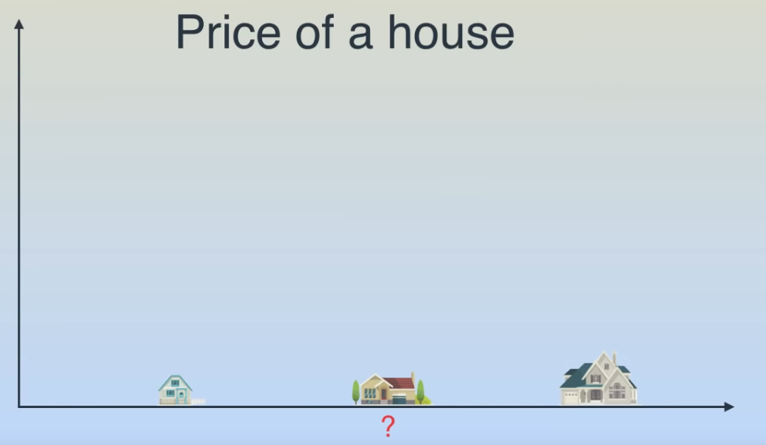
More in general about Machine Learning

Slide 12
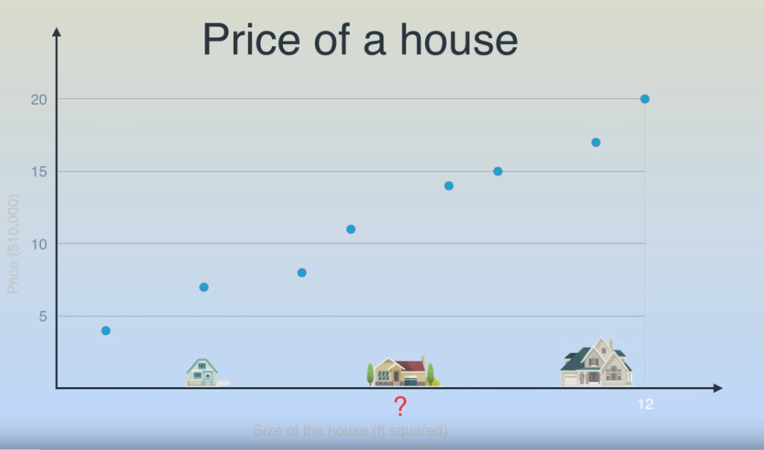
More in general about Machine Learning

Slide 13
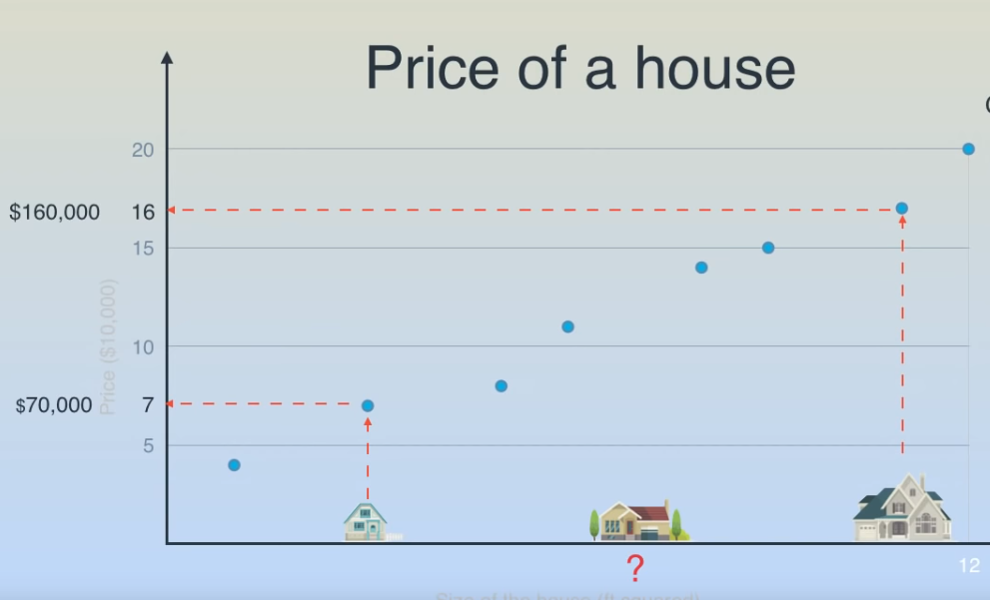
More in general about Machine Learning

Slide 14
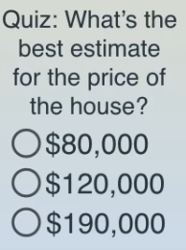
More in general about Machine Learning

Slide 15
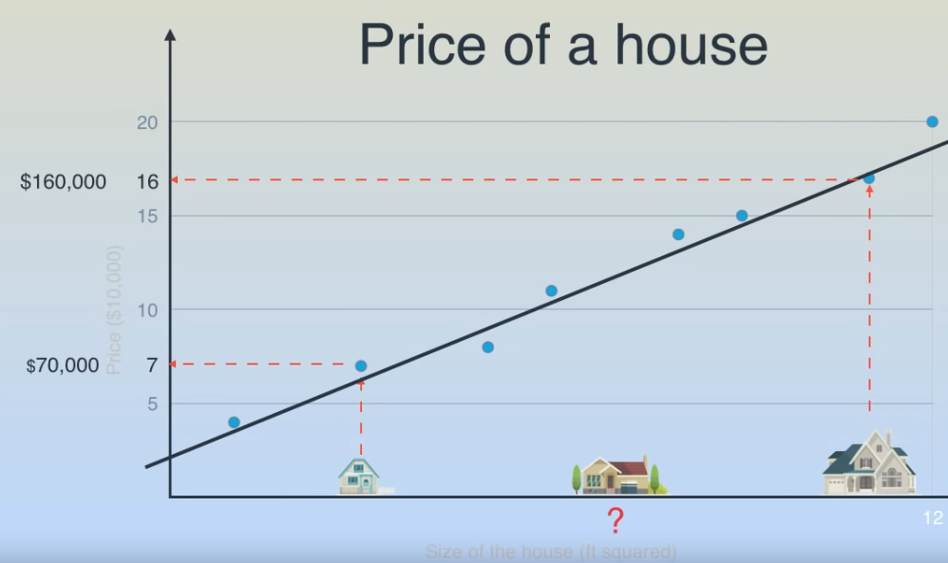
More in general about Machine Learning

Slide 16
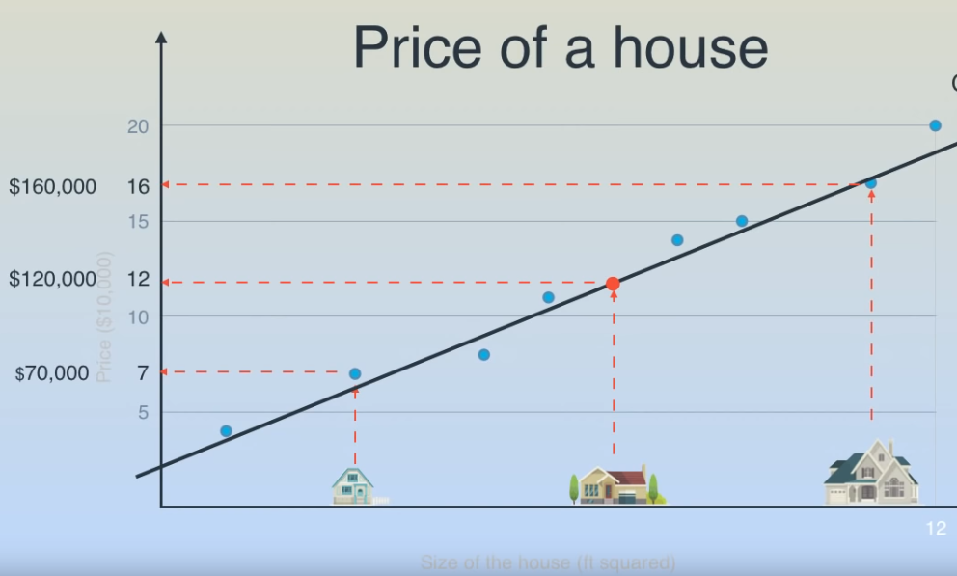
More in general about Machine Learning

Slide 17
AI in Finance
AI in Finance - Platform Components - Summary
Product Innovation
Social Networking
Big data
Simulations
Text and geometry Content
SOA
Integrated Unification,Analytics, Machine Learning
Cloud

Slide 18
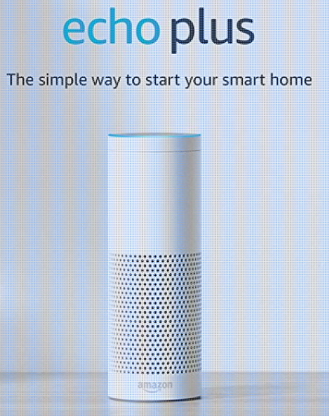
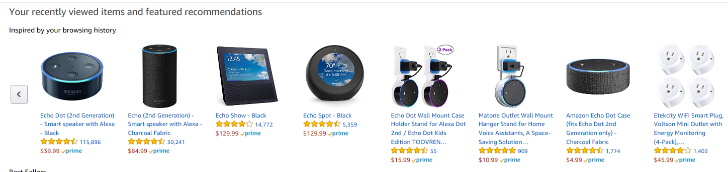
More in general about Machine Learning
Notes:
https://www.amazon.com/dp/B075RS7RGY/ref_=fs_ods_fs_aucc_sr

Slide 19
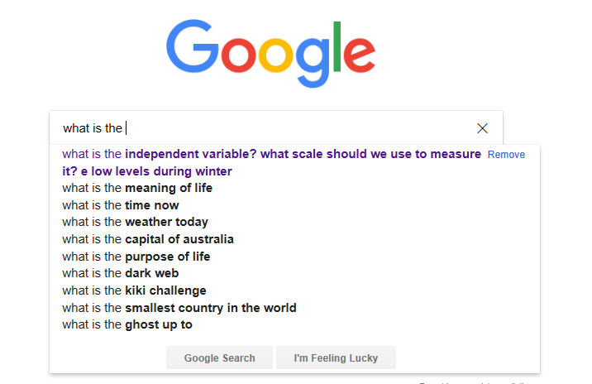
More in general about Machine Learning

Slide 20
More in general about Machine Learning

