Slide 1
Innovation

Slide 2
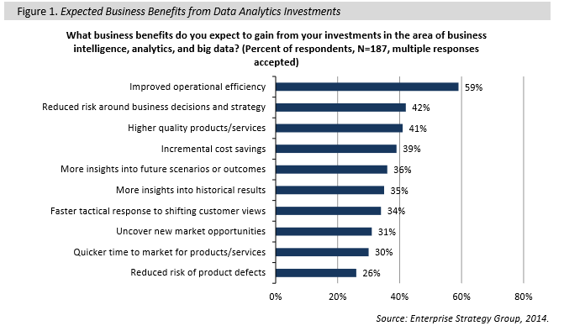
Customer Centric Organization
Notes:
https://twitter.com/PetiotEric

Slide 3
Customer Centric Organization
In order to make such a comparison, we will need a model project, and here are the assumptions for our theoretical medium-size, enterprise-class big data project:
• Users: 200 end-users: 150 business end-users, 50 data scientist/analysts. • Analytics Consumption: 1/3rd ad-hoc, 1/3rd daily, 1/3rd monthly.
• Servers: Enterprise grade with newer chipsets, backup power supply, high storage density (to ensure, for example, that Hadoop doesn't become storage-bound), plenty of cores to support parallelization with more cores in the name node, plenty of memory to handle complex queries, and columnar-based analytics.
• Storage: Total raw data capacity of 864 TB, in a balanced mix of refreshes (i.e., monthly, weekly, daily, realtime); note that in the example in Table 1, the math suggests more terabytes (18 nodes * 48 TB/node = 864 TB), but one has to account for replication (3x replication in pure Hadoop for example), peaks, compression, and sharding. We will use a usability rate of 30%, which in this case, rounded up, yields about 260 terabytes.
• Network: Dedicated and particularly fast bandwidth, with multiple switches to deal with contention; given the amount of replication and data movement associated with, for example MapReduce, a big data infrastructure needs to ensure it doesn't become network-bound.
• Queries: A set that spans from simple select statements to complex joins. • Integration and Information Management: Five new points of integration/transformation; in the process of design, additional data sources will be added in addition to, for example, a data warehouse. Those sources will require integration/transformation and information management work, and related licenses and hardware.
• Project Time: Six months total running, which includes one month for architecture, design, procurement; one month for hardware/network configuration/implementation; two months for various development elements, MapReduce queries (assuming the use of Hive), statistics, user experience, integration, training, etc.; one month for final integrated/system testing and go live; one month for slack and over-runs.
For a full listing of all the resulting elements of cost associated with the theoretical project, see Appendix, Table 5.
Specific Costs for Build versus Buy Comparison
Notes:
https://twitter.com/PetiotEric

Slide 4
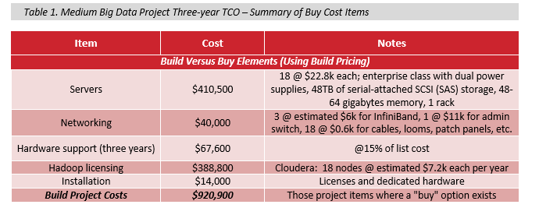
Customer Centric Organization
Notes:
https://twitter.com/PetiotEric

Slide 5
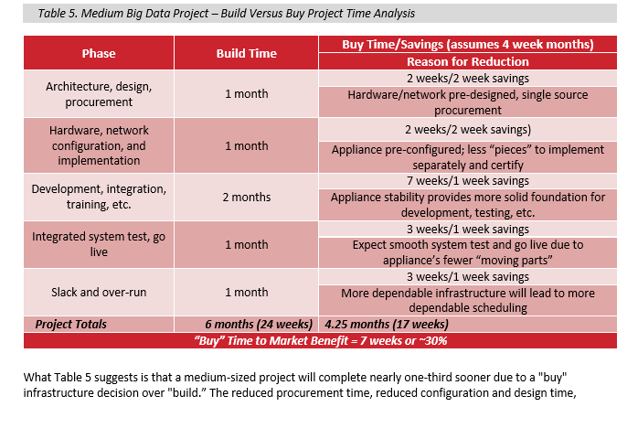
A Model for Hadoop Big Data Infrastructure Cost Analysis: Build Versus Buy
Notes:
http://www.oracle.com/us/corporate/analystreports/esg-getting-real-bigdata-2228170.pdf

