Slide 1
Leveraging automation across the banking process
Digital Transformation
https://www.linkedin.com/in/gurusanand/

Slide 2
Agenda
01
What is the current state today?
02
Why Automation?
03
RPA Statistics and some success stories
04
Assessing the scope
05
Challenges
.

Slide 3



What is happening now?
Transformation
Digital Transformation
Humans stopped learning!!
Machines started learning now!!

Slide 4




What is happening now?
Digital Transformation
Earlier humans instructed machines
But now machines are instructing humans

Slide 5

Why we talk Automation in Banking?
Freeing employees to focus on higher-value tasks, enabling us to do more quality work and projects
Automation in a smarter way is required in banking
RPA
The use of automated systems such as bots and virtual assistance helps to enhance business process, customer experience.
Tools
We not only want the tool to automate but we want the tool to act like human → to take its own decision
Digital Transformation
Scripts
It was all along there. But now we are looking into smarter way of automation with latest available tools
Not New
Automation is not new to everyone

Slide 6
Automation is no longer that we see in the movies Something really starting in business
Current Status of Automation
Science Fiction
Science Facts
Business
Facts
Digital Transformation

Slide 7





Why Automation in Banks?
Many banks are rushing to deploy the latest automation technologies in the hope of delivering the
next wave of Digital Transformation
01
02
03
04
05
05
Digital Transformation
Improve and create
more Products
Productivity
Cost savings
Improvement in customer experiences
Improve services

Slide 8
RPA Automation in Banking
02
03
01
04
80%
60%
50%
40%
01
RPA implementation
02
Exploring RPA
03
RPA Readiness
04
RPA Journey
Some 35% RPA implementation are present as of today
Some 50% exploring to use RPA
Some 55% already started using RPA
By 2020 RPA implementation is expected to grow to 80%
Source: http://www.deloite.com/us/rpasurvey

Slide 9
Assessing the scope for automation: to what extent can all areas of banking be automated - Right way?
The right way to look at the automation or the right way to look at the potential for automation is to look at the level of individual activities and not the entire process or job.
As per Mckinsey → Look at every single activity for which we pay people to do the activity
- 45% of the job activities could be automated
But that doesn't mean that 45% of jobs right now could be completed automated.
Quarter of the CEO’s time could be completely automated.
When we say to this to the CEO, he/she will love that saying that they need the time back to do more high
value things.
This applies across the all the banking process.

Slide 10
Leveraging automation across the banking process
RPA
RPA
RPA
RPA
RPA
RPA
Onboarding
Verification/Customer service
Trade Finance
Customer Onboarding – New Account set up for corporate clients across deposits, lending, trade and investment products, set up included legal entity information, bank,counterparty set up, etc
Application Submission /Reviews - Verification of Loan application documents
Service Fulfilment - Auto indexing and resolution of the customer queries received through emails
Trade Finance - Set up and validation of Letter of Credits/Bank Guarantees
KYC
Credit Assessment
Loans
Institutional KYC -Identify the customer, Sanctions, Screening and Capturing Identify the Customer
Credit Assessment - Financial Spreading & analysis based on client documents
Approval and Pricing - Payment for business loans

Slide 11

RPA – Success Stories
JPMorgan
Using bots to respond to internal IT requests, including resetting employee passwords. The bots are expected to handle 1.7 million IT access requests at the bank this year, doing the work of 40 full-time employees.
Fukoku Mutual Life Insurance, a Japanese insurance company
IBM’s Watson Explorer used to do the work of 34 insurance claim workers since beginning January 2017.
The Australia and New Zealand Banking Group
Robotic process automation (RPA) at scale and is now seeing annual cost savings of over 30 percent in certain functions. In addition, over 40 back office processes have been automated, enabling staff to focus on higher-value and more rewarding tasks.
Barclays
Accounts receivable and fraudulent account closure, reducing its bad-debt provisions by approximately $225 million per annum and saving over 120 FTEs
Top Japanese Bank
Successfully implemented 50 over back office process
https://www.mckinsey.com/industries/financial-services/our-insights/the-transformative-power-of-automation-in-banking

Slide 12
Steps to Implement RPA
Create detailed roadmaps
Carefully choose the first pilot area
Focus on human resources.
.
Set up a small central team
Develop the end state vision and strategy
Ensure IT is a partner
Notes:
Successful banks develop a bank-wide vision for the future, reimagining how they will be organized and how work will get done
2) Putting a well-run center of excellence (COE) in place early is critical to the long-term automation effort.
A COE administers the enterprise-wide approach to transformation, and plays a number of critical roles, from managing vendor relationships to building capabilities and interfacing with the business and critical support functions—in particular IT and human resources.
Not only technical capabilities, but those needed to reimagine groups and organizations, redefine how people will work with technology, work with multiple stakeholders across the bank, and translate new ways of working into measurable efficiencies. These capabilities will enable the bank to adopt—and adapt to—future technologies.
3) In most cases, automation at scale needs to be sponsored by each individual business and function, but a close partnership with IT is particularly important. IT designs the overall systems lifecycle, manages the rollout against IT priorities, supports development, and performs ongoing maintenance. A successful partnership thus requires early and ongoing engagement with IT through a program steering committee and governance structures.
4) The people changes associated with implementing automation at scale—and realizing its full value—are substantial. New automation technologies will touch on many different roles within the bank, and employees will need to learn new ways of working. While automation can have significant benefits in terms of risk, revenues, and client experience, many efforts will also automate work that is currently being done by people. HR therefore plays an essential role, creating new workforce-management practices, proactively managing changes, and using analytics to plan and coordinate the redeployment and reskilling of employees. Working closely with HR from the beginning is thus essential.

Slide 13


RPA Implementation – Process selections
Repetitive Data Entry/High Volume.
IT Support, Ticketing
Rule based application manipulation.
RPA
Prone to Human Errors data entry with some calculations
Repetitive task like triggering some jobs, copying some file. Upload the data into some local host/website etc.
.
Stitching with OCR we can add value using RPA
Some use cases selection

Slide 14


End To End Automation
Stitch various technologies to have an end to end automation
Databases
OCR
API or Python Code
RPA
ML

Slide 15
Benefits of RPA
RPA provides 24/7/365 transaction processing ability – robots can work afterhours with no overtime. Expect a reduction in transaction processing time of 50 percent.
RPA reduces human errors when moving data by 100%
Productivity
Quality
No new major infrastructure investment – RPA acts as a layer on top of already existing core asset management applications
.
Robots can be implemented in as little as two weeks once the use case has been properly scoped out. No more waiting for years for implementation.
Speed
Infrastructure
When you implement RPA in your operations, you can expect these key benefits.
Notes:
When you implement RPA in your operations, you can expect these key benefits:
No new infrastructure investment – RPA acts as a layer on top of already existing core asset management applications
Higher quality work and data – RPA reduces human errors when moving data by 100%
Increased productivity – RPA provides 24/7/365 transaction processing ability – robots can work afterhours with no overtime. Expect a reduction in transaction processing time of 50 percent.
Decreased costs – Robotics can reduce processing costs by up to 80 percent.
Increased implementation speed – Robots can be implemented in as little as two weeks once the use case has been properly scoped out. No more waiting for years for implementation.
Higher levels of staff satisfaction – RPA frees staff from redundant and boring processing work at lets them focus on core value generating tasks like assisting customers.

Slide 16
Challenges
Change
Training
People should start understand the changes
Cultural Resistance to Change
A
T
How do you prepare for agility?
Shortage of Both People and Skills
How we re-train?.
Adapt
Train
Learn new
THREATS
Learning
L
T
THREATS
Learn how to adopt
Choosing the correct business process for automation.
Cyber security
Data security and access security
Securing RPA requires protecting the data itself as well as who has access to it.
In order to implement RPA securely, firms need to make sure the data flow is understood.

Slide 17
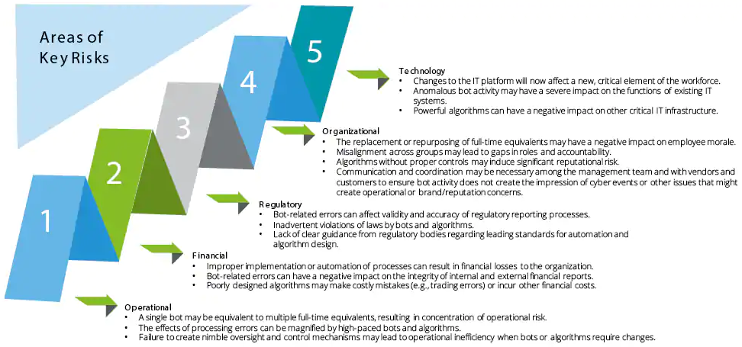
Key Risk
https://www2.deloitte.com/us/en/pages/audit/articles/financial-reporting-rpa-risks-and-controls.html

Slide 18
Key Risk
Regulatory
Financial
Bot related errors can affect regulatory reports
Organizational
Improper implementation can lead to financial loss
Replacement of full time bots may have negative impact on employee
Operational
Technology
Failure in Control mechanism lead to operational error
Autonomous bots may have severe impacts on IT systems unexpectedly.

Slide 19
RPA in Cloud
RPA in cloud is – SaaS (Software as Service)
Still the data and information has to be processed in the cloud environment which most of the banks are not ready for this.
This is not yet completely matured in Banking

Slide 20


