Slide 1
Next steps in digital transformation

Slide 2



Facts
Humans stopped learning!!
So machines started learning now!!

Slide 3

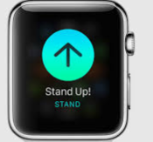
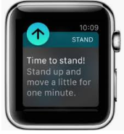
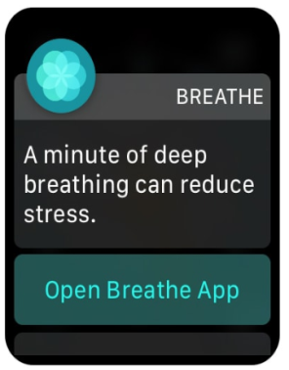
Facts
Earlier Humans instructed machines
But now machines are instructing humans

Slide 4
Agenda
Leveraging automation across the banking process.
Assessing the scope for automation: to what extent can all areas of banking be automated
Achieving end-to-end automation across organizational silos
in the cloud: overcoming security concerns

Slide 5
Agenda
Institutional KYC -Identify the customer, Sanctions/PEP Screening and Capturing Identify the
Customer Onboarding – New Account set up for corporate clients across deposits,lending, trade and investment products, set up included legal entity information, correspondent bank, counterparty set up,
Credit Assessment - Financial Spreading & analysis based on client documents
Aplication Submission /Reviews - Verification of Loan application documents
Aplication Submission /Reviews - Past Credit Behaviour for Business Loans
Approval and Pricing - Payment simulation for business loans
Service Fulfillment - Auto indexing and resolution of the customer queries received through emails
Trade Fiannce - Set up and validation of Letter of Credits/Bank Guarantees

Slide 6
Agenda
Achieving end-to-end automation across organizational silos

Slide 7
Agenda
RPA in the cloud: overcoming security concerns using UiPath

