Slide 1

DETECTION OF LEG FRACTURE IN X-RAY IMAGES USING HOUGH TRANSFORM
Department of Electronics and Communication Engineering
Presented By
B. Deva Harshitha-316126512004
D.V. Guru saran-316126512013
Y. Ravi teja-316126512060
E. Manohar-316126512017
Under The Guidance Of
Mr. A. SIVA KUMAR M.Tech., (Ph.D)
Assistant professor
Department of ECE, ANITS

Slide 2
OUTLINE
Abstract
Motivation
Introduction
Methodology
Software Tools used
Results
Conclusion & Future work
References
Paper publication details

Slide 3
ABSTRACT
The Bone fracture is a common problem in human beings and it occurs when high pressure is applied on bone or because of simple accident and also due to osteoporosis and bone cancer. The image processing techniques are very useful for many applications such as biology, security, satellite imagery, personal photo, medicine, etc. The main aim of this project is to detect human leg bone fracture from X-Ray images. The Project involves three steps, namely, preprocessing, segmentation, and fracture detection. In feature extraction step, we use Hough transform technique for finding the fractured area in the image and it is the main task of the project. The Results obtained from a set of input x-ray images show that the proposed process is very accurate and efficient.

Slide 4
MOTIVATION
The Purpose of this Project is to determine the leg fractures in the bone using Digital Image Processing and this helps the doctors to rectify the errors caused by human vision by providing clear and crystal view of the X-ray image.
Advantages:
Saves time for patients
Provides accurate result
to lower the workload of doctors by screening out the easy case
Disadvantages:
Works only on good quality images

Slide 5
INTRODUCTION:
The main goal of this project is to detect the lower leg bone fracture from X-Ray images using MATLAB software.
The lower leg bone is the second largest bone of the body. It is made up of two bones, the tibia and fibula.
The fibula bone is smaller and thinner than the tibia. However, the tibia fracture is most commonly occurs due to it carries a significant portion of the body weight
Structure of Lower Leg Bone

Slide 6
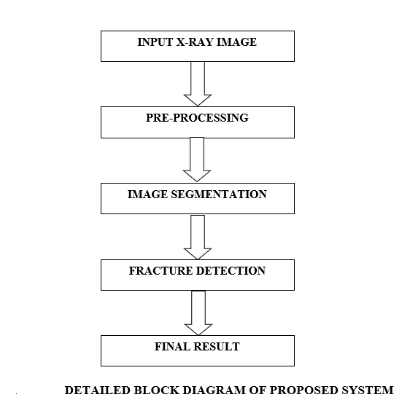
METHODOLOGY

Slide 7
SOFTWARE USED
IMAGE PROCESSING TOOLBOX IN MATLAB 2013A :
This toolbox provides a comprehensive set of reference-standard algorithms and workflow apps for image processing ,analysis visualization and algorithm development. We can perform image enhancement ,noise reduction ,image segmentation and Hough Transform.
X-RAY IMAGE :
Used as input image and also for comparison with the MATLAB output image.

Slide 8
PRE PROCESSING
Noisy image Gray Scale image
(f (x, y)) (passed through
Gaussian filter)
g (x, y) + η (x, y)
Where g (x, y) is the original image and η (x, y) is the noise present in the image.
The Noisy image is firstly converted into the gray scale image to speed up processing time and less computation.
Now it is passed through gaussian filter to remove noise from the image.
After filtering, this system is performed adjusting image brightness and color to distinct the desired object or bone shape from the image

Slide 9
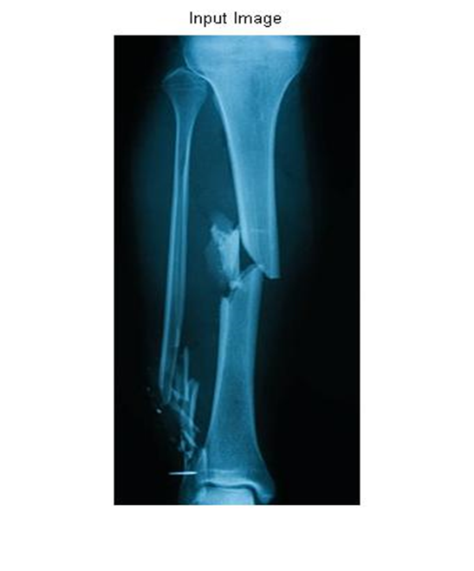
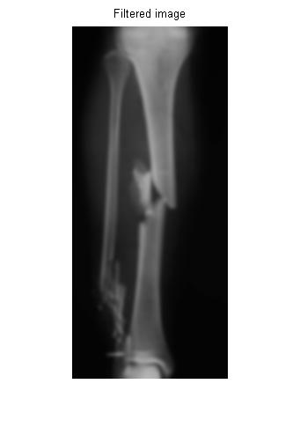
PRE-PROCESSING

Slide 10
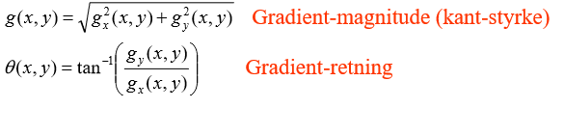
EDGE DETECTION BY CANNY EDGE ALGORITHM
The algorithmic steps are as follows:
• Convolve image f(r, c) with a Gaussian function to get smooth image
f^(r, c).
f^(r, c)=f(r, c)*G(r,c,6)
• Apply first difference gradient operator to compute edge strength then edge magnitude and direction are obtained as before.

Slide 11
EDGE DETECTION BY CANNY EDGE ALGORITHM
Apply non-maximal or critical suppression to the gradient magnitude.
Apply threshold to the non-maximal suppression image.
Canny operator is rather than other edge detectors. The edge boundaries of Sobel and Prewitt edge detectors are not continuous and do not show the important information because most of them lost the important structure.
In Robert edge detector, the pixel of the image is noisy and the edges are not smooth and thin. In this project, Canny method is used to produce good view of the bone structure.

Slide 12
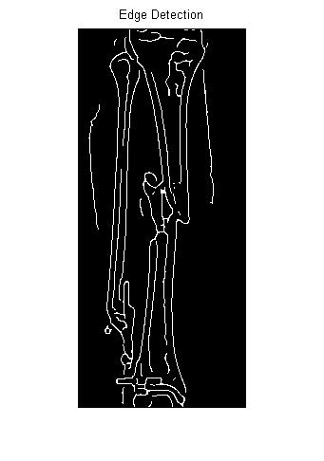
EDGE DETECTION BY CANNY EDGE ALGORITHM

Slide 13
HOUGH TRANSFORM
The Hough transform (HT) can be used to detect lines, circles or other parametric curves.
It was introduced in 1962 (Hough 1962) and first used to find lines in images a decade later (Duda 1972).
The goal is to find the location of lines in images.
It can give robust detection under noise and partial occlusion.
The input image to Hough Transform must be a thresholded edge image.
The magnitude results computed by the Sobel operator can be thresholded and used as input.

Slide 14
HOUGH TRANSFORM ALGORITHM USING POLAR REPRESENTATION OF LINES
Partition the ρθ-plane into accumulator cells A [ρ, θ], ρ∈ [ρmin, ρmax]; θ∈ [θmin, θmax].
The range of θ is ±90°
– Horizontal lines have θ=0°, ρ≥0 ,
– Vertical lines have θ=90°, ρ≥0
The range of ρ is ±N√2 if the image is of size NxN.
The discretization of θ and ρ must happen with values δθ and δρ giving acceptable precision and sizes of the parameter space.
The cell (i, j) corresponds to the square associated with parameter values (θ_{j}, ρi).
Initialize all cells with value 0.
For each foreground point (x_{k}, y_{k}) in the thresholded edge image
Let θj equal all the possible θ-values.
Solve for ρ using ρ=x cos θ_{j} +y sin θ_{j.}
Round ρ to the closest cell value, ρ_{q}.
Increment A (i, q) if the θ_{j} results in ρ_{q}.
After this procedure, A (i, j) = P means that P points in the xy space lie on the line
ρ_{j} =x cos θ_{j} +y sin θ_{j.}
Find line co-ordinates where A (i, j) is above a suitable threshold value.

Slide 15
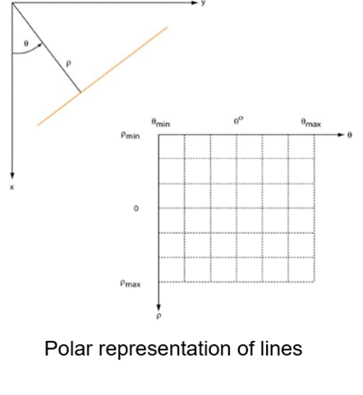
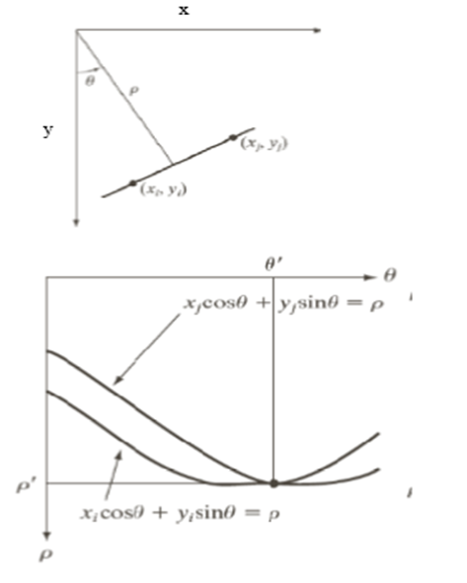
HOUGH TRANSFORM

Slide 16
HOUGH TRANSFORM
Hough Peaks-Plot
Hough Lines
Two peaks indicates that there is a fracture present

Slide 17

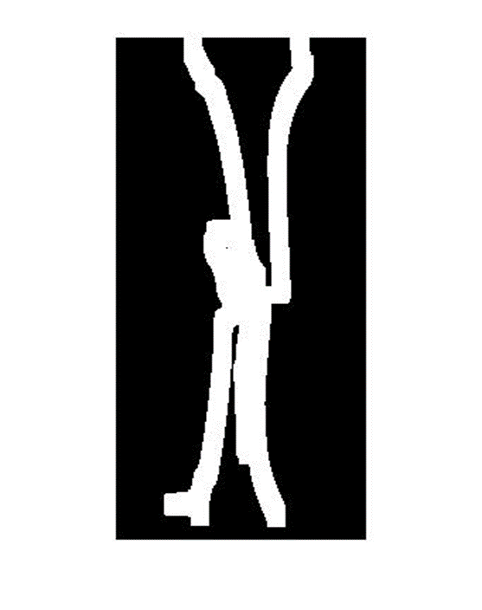
HOUGH TRANSFORM
Area where Break line Tolerance is Crossed

Slide 18

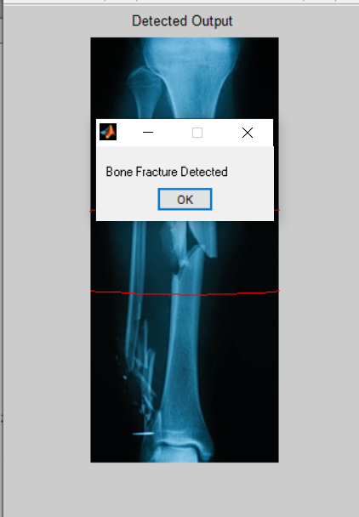
FINAL RESULT

Slide 19
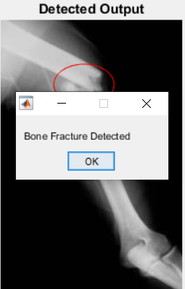
RESULTS a)Applied on Fractured Bone:
Two Peaks detection indicates a fracture present

Slide 20
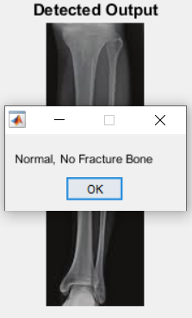
b)Applied on Non-Fractured Bone:
Only one peak is detected .It means there is no fracture

Slide 21
CONCLUSION AND FUTURE WORK
This project presents the image processing technique to detect the bone fracture. The fully automatic detection of fractures in leg bone is an important but it is a difficult problem. This method is not applicable for blur images. According to the test results, the system has been done to detect the bone fracture. A conclusion can be made that the performance of the detection method affected by the quality of the image. The better the image quality, the better the result system got. In future work, focusing on other works like detecting on smaller bone, ankle fractures, etc. may be considered

Slide 22
REFERENCES:
[1] Shubhangi D.C, Raghavendra S. Chinchansoor, P.S Hiremath, Edge Detection of Femur Bones in X-ray images – A Comparative study of Edge Detectors, Department of Computer Science, Poojya Doddappa Appa College of Engineering, Gulbarga – 585103 India, Volume 42-No.2, March 2012.
[2] Mahmoud Al-Ayyoub, Iamail Hmeidi, Haya Rababaha, Detecting Hand Bone Fractures in X-Ray Images, Jordan University of Science and Technology Irbid, Jordan, Volume 4. No.3, September 2013.
[3] S.K. Mahndran, S. Santhosh BaBoo, An Enhanced Tibia Fracture Detection Tool Using Image Processing and Classification Fusion Techniques in X-Ray Images, Sankara College of Science and Commerce, Coimbatore, Tamil Nadu, India, Online ISSN: 0975-4172 &Print ISSN: 0975-4350, Volume 11 Issue 14 Version 1.0 August 2011.
[4] S.K. Mahndran, S. Santhosh BaBoo, An Ensemble Systems for Automatic Fracture Detection, IACIT International Journal of Engineering and Technology, Vol.4, No. 1, February 2012.
[5] Rashmi, Mukesh Kumar, and Rohini Saxena, Algorithm and Technique on Various Edge Detection: A Survey, Department of Electronics and Communication Engineering, SHIATS- Allahabad, UP. -India, Vol. 4, No. 3, June 2013

Slide 23
PUBLICATION DETAILS
Alochana Chakra Journal(ISSN: 2231-3990) is a Monthly peer reviewed Multi disciplinary journal that publish original and high-quality articles covering a wide range of topics in Engineering, dedicated to promoting high standards in the creation and dissemination of scientific knowledge. This multidisciplinary international journal accepts research and review papers in the field of Engineering and other fields on the basis of its originality, importance and interdisciplinary interest. Articles that simply replicate known knowledge or techniques and do not add anything new or unique to the science will normally be rejected. With its high standards of scientific quality, the Alochana Chakra Journal (ISSN: 2231-3990) provides a meeting ground for researchers who investigate the newest problems related to Multidisciplinary fields.

Slide 24
Thank You

