Slide 1

Detection of leg fracture in x-ray images
Department of Electronics and Communication Engineering
Presented By
B. Deva Harshitha-316126512004
D.V. Guru saran-316126512013
Y. Ravi teja-316126512060
E. Manohar-316126512017 Under The Guidance Of
Mr. A. SIVA KUMAR M.Tech., (Ph.D)
Assistant professor
DepARtMENt of ECE, ANITS

Slide 2
OUTLINE
Abstract
Motivation
FEATURES
Methodology
Software Tools/Components used
Monthly Work Plan(SEM-I&II)
References

Slide 3
ABSTRACT
The bone fracture is a common problem in human beings occurs due to high pressure is applied on bone or simple accident and also due to osteoporosis and bone cancer.
The image processing techniques are very useful for many applications such as biology, security, satellite imagery, personal photo, medicine, etc. The main aim of this research is to detect human lower leg bone fracture from X-Ray images. The proposed system has three steps, namely, preprocessing, segmentation, and fracture detection. In feature extraction step, this paper uses Hough transform technique for line detection in the image. Feature extraction is the main task of the system. The results from various experiments show that the proposed system is very accurate and efficient.

Slide 4
Motivation
The Purpose of this Project is to determine the fractures in the bone using Digital Image Processing and this helps the doctors to determine the errors by providing clear and crystal view of the X-ray image.
Advantages:
Saves Time
Provides accurate result
to lower the workload of doctors by screening out the easy case
Disadvantages:
Works only on good quality images

Slide 5
FEATURES:
Orthopedic Surgeon must provide the image of bone fracture. System will use image processing tools and remove all unwanted images from the objects.
System will detect whether the bone fracture or not.
This system saves time of the orthopedic surgeon and he can treat the patient faster.

Slide 6
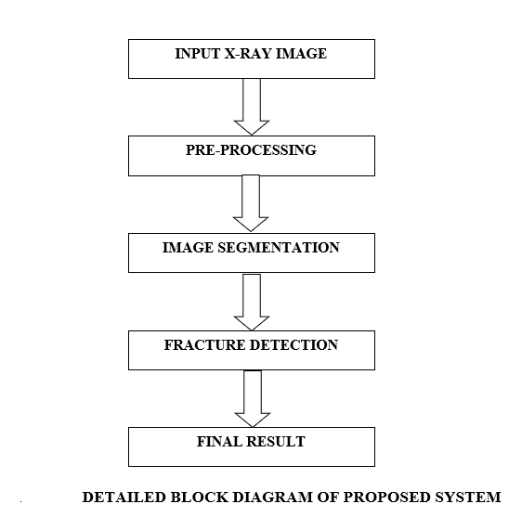
Methodology

Slide 7
Software used:
Image Processing Toolbox in MATLAB 2013a :
This toolbox provides a comprehensive set of reference-standard algorithms and workflow apps for image processing ,analysis visualization and algorithm development. We can perform image enhancement ,noise reduction ,image segmentation and Hough Transform.
X-ray image :
Used as input image and also for comparison with the MATLAB output image.

Slide 8
Pre Processing
Noisy image Gray Scale image
(f (x, y)) (passed through
Gaussian filter)
g (x, y) + η (x, y)
Where g (x, y) is the original image and η (x, y) is the noise present in the image.
After filtering, this system is performed adjusting image brightness and color to distinct the desired object or bone shape from the image.
Then, the adjusted image is converted into the gray scale image to speed up processing time and less computation

Slide 9
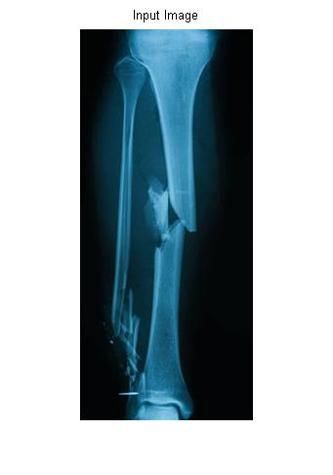
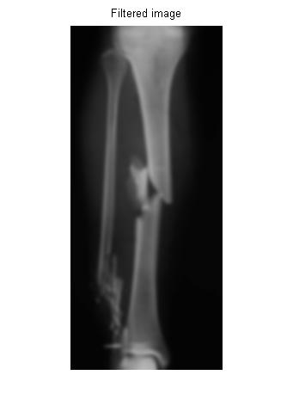
Pre Processing

Slide 10
Edge Detection by canny edge algorithm
The algorithmic steps are as follows:
• Convolve image f(r, c) with a Gaussian function to get smooth image f^(r, c).
f^(r, c)=f(r,c)*G(r,c,6)
• Apply first difference gradient operator to compute edge strength then edge magnitude and direction are obtained as before.
• Apply non-maximal or critical suppression to the gradient magnitude.
• Apply threshold to the non-maximal suppression image.
Unlike Roberts and Sobel, the Canny operation is not very susceptible to noise. If the Canny detector worked well it would be superior

Slide 11
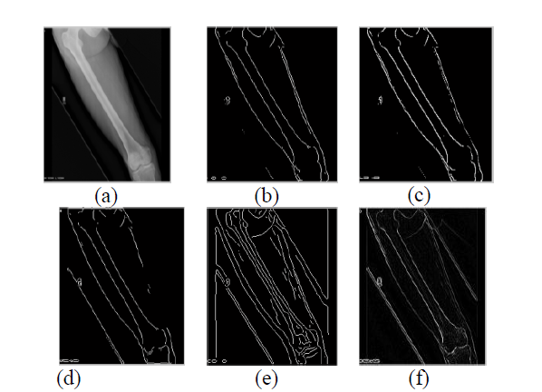
(a) Original X-Ray input image and corresponding resultant edge detected images by using (b) Roberts, (c) Sobel, (d) Prewitt, (e) Canny, and (f) Log operators.

Slide 12
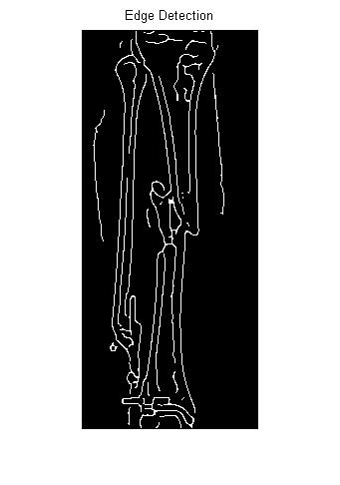
Edge Detection by canny edge detector

Slide 13
Hough transform
The Hough transform (HT) can be used to detect lines, circles or other parametric curves.
It was introduced in 1962 (Hough 1962) and first used to find lines in images a decade later (Duda 1972).
The goal is to find the location of lines in images.
It can give robust detection under noise and partial occlusion.
The input image to Hough Transform must be a thresholded edge image.
The magnitude results computed by the Sobel operator can be thresholded and used as input.

Slide 14
HOUGH TRANSFORM – ALGORITHM :
• Quantize the parameter space (a ,b), that is, divide it into cells.
• This quantized space is often referred to as the accumulator cells.
• In the following figure a_{min} is the minimal value of a etc.
• Count the number of times a line intersects a given cell.
– For each point (x ,y) with value 1 in the binary image, find the values of (a,b) in the range [[a_{min}, a_{max}],[ b_{min} ,b_{max}]] defining the line corresponding to this point.
– Increase the value of the accumulator for these [a¹,b¹] point.
– Then proceed with the next point in the image.
• Cells receiving a minimum number of “votes” are assumed to correspond to lines in (x ,y) space.
– Lines can be found as peaks in this accumulator space.

Slide 15
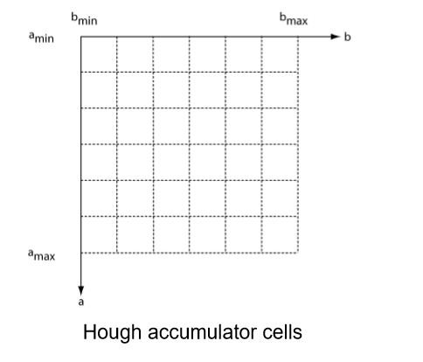

Slide 16
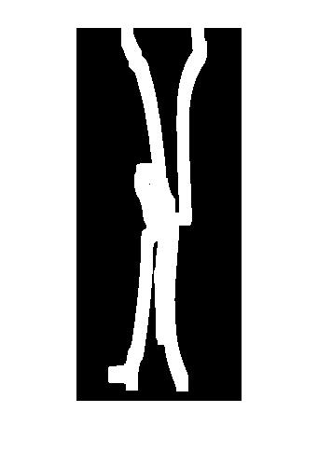
Hough thresholded image

Slide 17

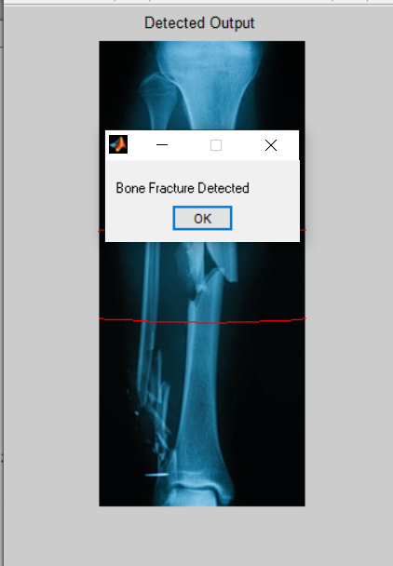
Final result

Slide 18
PROJECT WORKOUT PLAN
Month | Activity | Status
July | Project Selection | Completed
August | literature Survey | Completed
September | Study of MATLAB for our project | Completed
October | Methods involved in Project | Completed
November | Design of Code | Completed
December | Design of Code | Completed
January and February | Results (estimation) | Completed

Slide 19
References:
[1] Shubhangi D.C, Raghavendra S. Chinchansoor, P.S Hiremath, Edge Detection of Femur Bones in X-ray images – A Comparative study of Edge Detectors, Department of Computer Science, Poojya Doddappa Appa College of Engineering, Gulbarga – 585103 India, Volume 42-No.2, March 2012.
[2] Mahmoud Al-Ayyoub, Iamail Hmeidi, Haya Rababaha, Detecting Hand Bone Fractures in X-Ray Images, Jordan University of Science and Technology Irbid, Jordan, Volume 4. No.3, September 2013.
[3] S.K. Mahndran, S. Santhosh BaBoo, An Enhanced Tibia Fracture Detection Tool Using Image Processing and Classification Fusion Techniques in X-Ray Images, Sankara College of Science and Commerce, Coimbatore, Tamil Nadu, India, Online ISSN: 0975-4172 &Print ISSN: 0975-4350, Volume 11 Issue 14 Version 1.0 August 2011.
[4] S.K. Mahndran, S. Santhosh BaBoo, An Ensemble Systems for Automatic Fracture Detection, IACIT International Journal of Engineering and Technology, Vol.4, No. 1, February 2012.
[5] Rashmi, Mukesh Kumar, and Rohini Saxena, Algorithm and Technique on Various Edge Detection: A Survey, Department of Electronics and Communication Engineering, SHIATS- Allahabad, UP. -India, Vol. 4, No. 3, June 2013

Slide 20
Thank You

