Slide 1

Detection of Bone Fractures using GLCM and It’s Classification using cnn
Department of Electronics and Communication Engineering
Presented By
B.Deva Harshitha-316126512004
D.V.Guru saran-316126512013
Y.Ravi teja-316126512060
E. Manohar-316126512017 Under The Guidance Of
Mr. A. SIVA KUMAR
Assistant professor
DepARtMENt of ECE, ANITS

Slide 2
OUTLINE
Abstract
Motivation
FEATURES
Methodology
Software Tools/Components used
Monthly Work Plan(SEM-I&II)
References

Slide 3
ABSTRACT
The Aim of this project is to develop an image processing based efficient system for a quick and accurate classification of bone fractures based on the information gained from the X-ray / CT images. Images of the fractured bone are obtained from hospital and processing techniques like pre-processing (Median Filter), edge detection (Sobel Edge Detection) ,segmentation (K-Means Clustering Techniques) and feature extraction methods like GLCM are adopted. GLCM is used in image texture analysis. The processed images will be further classified into fractured and non-fractured bones .

Slide 4
Motivation
The Purpose of this Project is to determine the fractures in the bone using Digital Image Processing and this helps the doctors to determine the errors by providing clear and crystal view of the X-ray image.
Advantages:
Saves Time
Provides accurate result
Disadvantages:
Works only on good quality images

Slide 5
FEATURES:
Orthopedic Surgeon must provide the image of bone fracture. System will use image processing tools and remove all unwanted images from the objects.
System will provide appropriate number of cracks occurred on bone due to bone fracture.
System will detect whether the bone fracture or not.
This system saves time of the orthopedic surgeon and he can treat the patient faster.

Slide 6
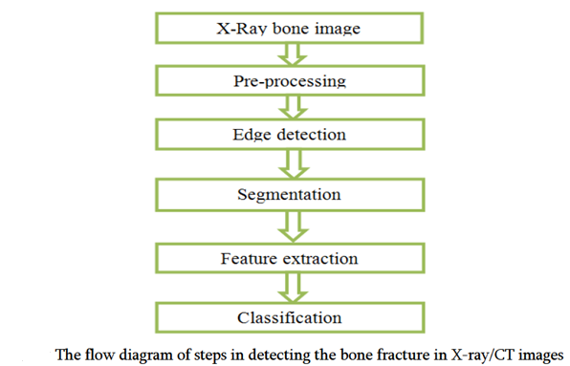
Methodology

Slide 7
Software used:
Image Processing Toolbox TM :
This toolbox provides a comprehensive set of reference-standard algorithms and workflow apps for image processing ,analysis ,visualization and algorithm development. We can perform image enhancement ,noise reduction ,geometric transformations ,image registration and 3D image processing.
X-ray image :
Used as input image and also for comparison with the MATLAB output image.

Slide 8
Pre Processing
Noisy image Gray Scale image
(f (x, y)) (passed through
MEDIAN filter)
g (x, y) + η (x, y)
Where g (x, y) is the original image and η (x, y) is the noise present in the image.
Salt and pepper is one of the common types of noise present in x-ray images.

Slide 9
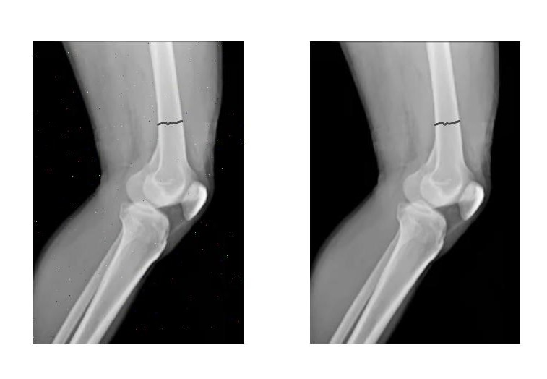
Pre Processing

Slide 10
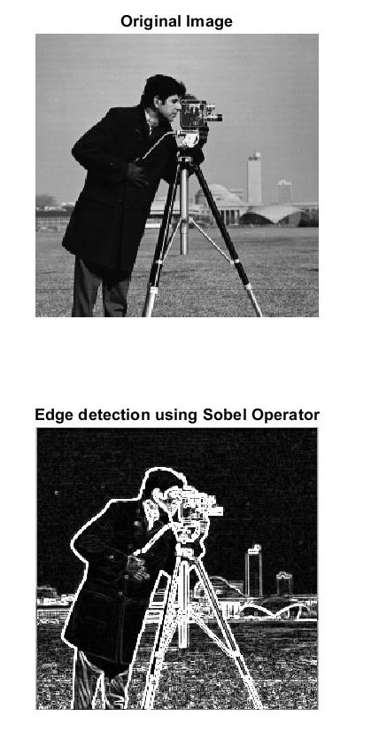
Edge Detection by Sobel edge detector
-1 | -2 | -1
0 | 0 | 0
1 | 2 | 1
G_{x}
-1 | 0 | 1
-2 | 0 | 2
-1 | 0 | 1
G_{y}

Slide 11
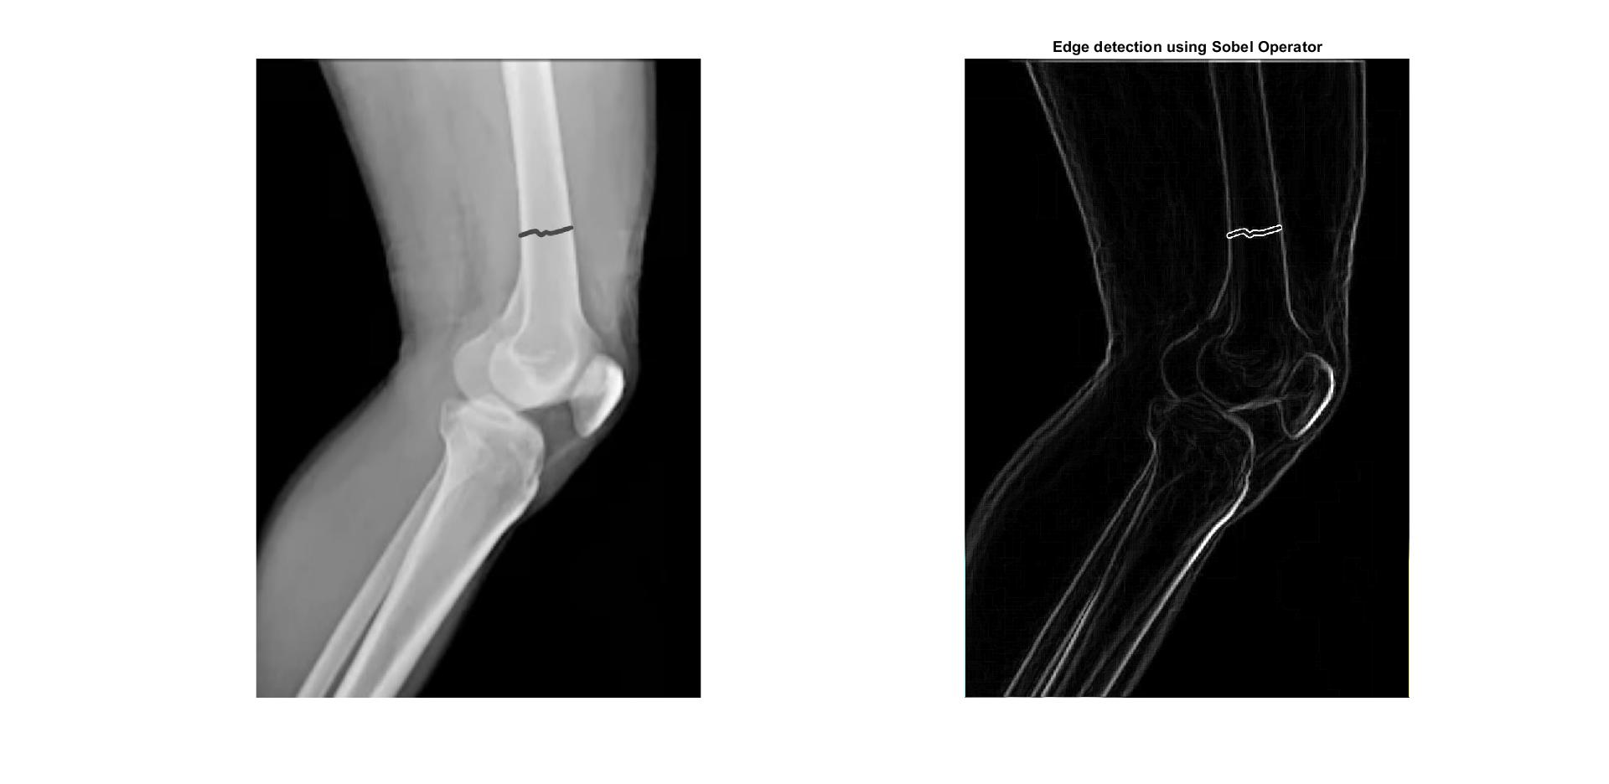
Edge Detection by Sobel edge detector

Slide 12
Segmentation
K-means clustering is used for segmentation and in this process involves the following steps:
Step-1:select ‘K’ random points in the space that actually represents the initial group of centroids.
Step-2:each and every pixel is now assigned with the group that has same centroid.
Step-3:once after assigning ,recalculate the positions of ‘K’ centroids.
Step-4:repeat steps 2 and 3 until centroids become stationary.

Slide 13
Algorithm
I - Input Image, i=1 to M, j=1 to N
I_{ij} - Intensity of i^{th}row and j^{th}column pixel on the input image
CS - Cluster centres k=1 to K
C_{k} - k^{th} cluster centres
D - a matrix distance between input image I, and cluster centroids
D_{ijk} = distance between i^{th}row and j^{th}column pixels and k^{th} cluster centroid
ML - members label
ML_{ij} - label of i^{th} row and j^{th} column pixel of Input image
T - maximum number of iterations
set T=50, eps=1e-5; set nc=4;
CS =random-initialize;
while ( t < T && cmx > eps )
D = find-distance(I,CS)
ML = cluster-labelling(D)
CS = update-cluster- centroid(ML)
cmx = max( abs( pCS - CS) )
t= t+1
pCS = CS

Slide 14
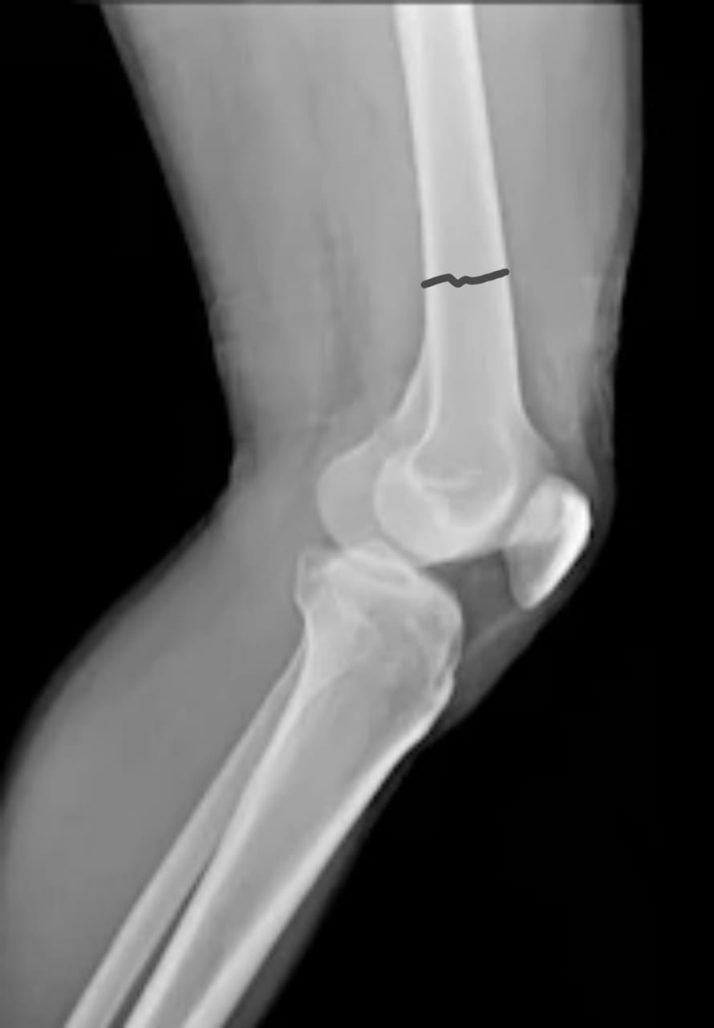
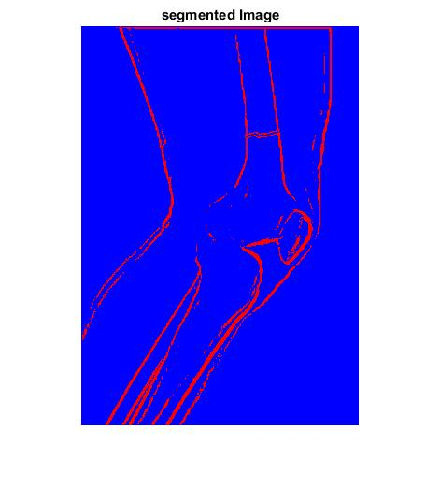
SEGMENTATION

Slide 15
Feature Extraction:
The statistics can be calculated from the co-occurrence matrix.
It will be used in describing the image texture.
It is a suitable way to indicate the image texture and structure by statistically sampling the pattern of the gray- significance value.

Slide 16
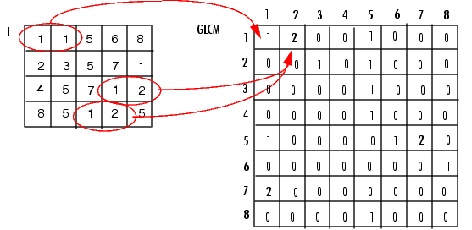
GLCM(The Gray Level Co-occurrence Matrix)
GLCM also called the Gray Tone Spatial Dependency Matrix.
The function creates a gray-level co-occurrence matrix (GLCM) by calculating how often a pixel with the intensity (gray-level) value i occurs in a specific spatial relationship to a pixel with the value j

Slide 17
After creating the GLCM, using gray co matrix, we can derive several statistics from them using gray co props. These statistics provide information about the texture of an image. The following table lists the statistics.
Statistic | Description
Contrast | Measures the local variations in the gray-level co-occurrence matrix.
Correlation | Measures the joint probability occurrence of the specified pixel pairs.
Energy | Provides the sum of squared elements in the GLCM. Also known as uniformity or the angular second moment.
Homogeneity | Measures the closeness of the distribution of elements in the GLCM to the GLCM diagonal.

Slide 18
graycoprops' properties values for output image
Statistic | Values
Contrast | 0.0592
Correlation | 0.8510
Energy | 0.8861
Homogeneity | 0.9901

Slide 19
Classification of bone fractures

Slide 20
PROJECT WORKOUT PLAN
Month | Activity | Status
July | Project Selection | Completed
August | literature Survey | Completed
September | Study of MATLAB for our project | Completed
October | Methods involved in Project | Pending
November | Design of Code | Pending
December | Results (estimation) | Pending
January and February | Preparation Of Project Book | Pending

Slide 21
References:
“Digital Image Processing” by Rafael C.Gonzalez, Richard E.Books ,2nd edition.
“Digital Image Processing” by S.Jayaraman ,S.Esakkirajan,
T.Veerakumar.
Mallikarjunaswamy and Rajesh Raman , “ National Conference on Power Systems and Indusrial Automation”,International Journal of Computer Applications,2015 .
Dhiraj B. Bhakare,Prajwal A.Jawalekar,Sumit D.Korde, “ Bone Fracture Detection using Image Processing”,International Research Journal of Engineering and Technology,2018.

Slide 22
Thank You

