Slide 1

Detection of Bone Fractures using GLCM and It’s Classification by Neural Networking
Department of Electronics and Communication Engineering
Presented By
B.Deva Harshitha-316126512004
D.V.Guru saran-316126512013
Y.Ravi teja-316126512060
E. Manohar-316126512017 Under The Guidance Of
Mr. A. SIVA KUMAR
Assistant professor
Dept. of ECE, ANITS

Slide 2
OUTLINE
Abstract
Motivation
Introduction
Methodology
Software Tools/Components used
Monthly Work Plan(SEM-I&II)
References

Slide 3
ABSTRACT
The Aim of this project is to develop an image processing based efficient system for a quick and accurate classification of bone fractures based on the information gained from the X-ray / CT images. Images of the fractured bone are obtained from hospital and processing techniques like pre-processing (Median Filter), edge detection (Sobel Edge Detection) segmentation (K-Means Clustering Techniques), and feature extraction methods like GLCM are adopted. GLCM is used in image texture analysis. The processed images will be further classified into fractured and non-fractured bone and compare the accuracy of different methods.

Slide 4
Motivation
Several hair line & minor fractures may get un-noticed in the X-ray image by the Doctor. In such cases Digital Image Processing helps doctors to determine those errors by providing clear and crystal view of the image.

Slide 5
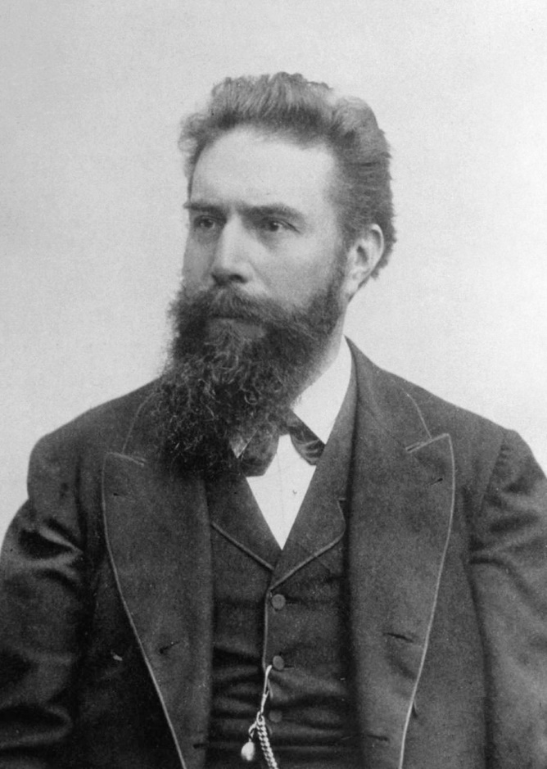
Introduction
Since x-rays were invented in 1895 by Wilhelm Conrad Roentgen, a German scientist, it has been used as a main medical imaging modality especially in orthopedic diagnosis due to the fact that it is a relatively safe method of investigation as the radiation exposure is relatively low.

Slide 6
How Fracture occurs?
Fracture is a discontinuity in the bony matrix, which may be due to any external force on the bone or due to stress. The external force must be stronger than the tensile strength of the bone. Fractures commonly happen because of road accidents, sports injuries.

Slide 7
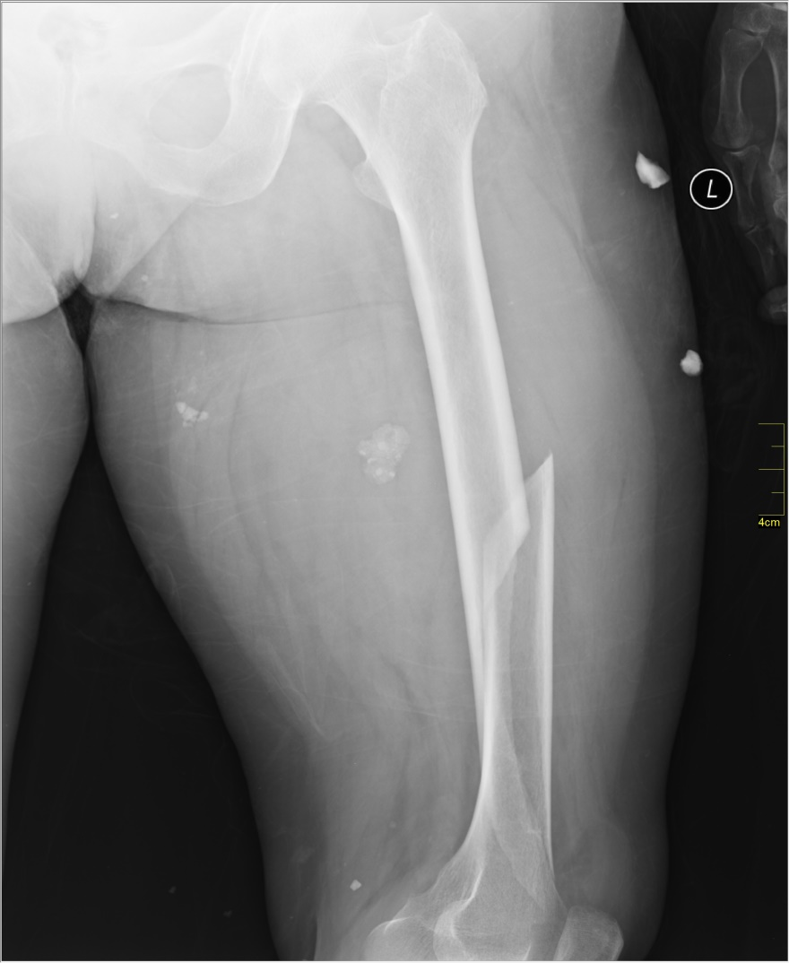
Objective
This project discusses the development of a system which can differentiate the fractured bone from the non-fractured bone and other objective includes classification of specific type of fractured femur. This will focus on femur shaft fracture detection.

Slide 8
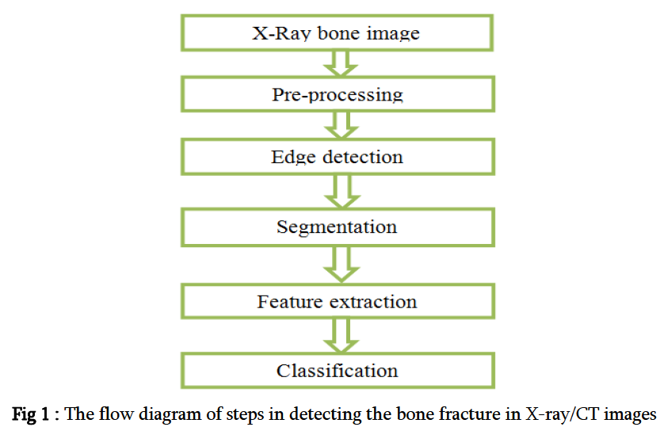
Methodology

Slide 9
Pre Processing
Noisy image Gray Scale image
(f (x, y)) (passed through
MEDIAN filter)
g (x, y) + η (x, y)
Where g (x, y) is the original image and η (x, y) is the noise present in the image.
Salt and pepper is one of the common types of noise present in x-ray images.

Slide 10
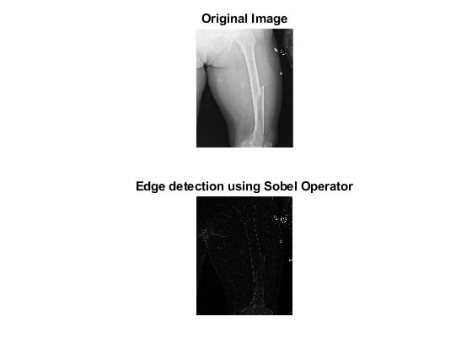
Edge Detection by Sobel edge detector
-1 | -2 | -1
0 | 0 | 0
1 | 2 | 1
G_{x}
-1 | 0 | 1
-2 | 0 | 2
-1 | 0 | 1
G_{y}

Slide 11
Segmentation

Slide 13
Feature Extraction
The statistics can be calculated from the co-occurrence matrix.
It will be used in describing the image texture.
It is a suitable way to indicate the image texture and structure by statistically sampling the pattern of the gray- significance value.

Slide 14
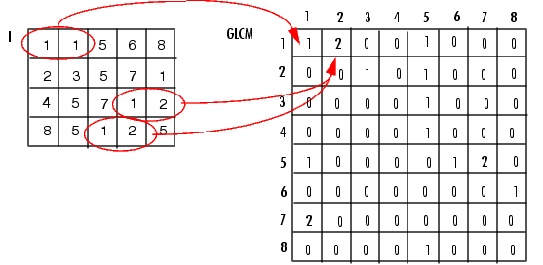
GLCM(The Gray Level Co-occurrence Matrix)
GLCM also called the Gray Tone Spatial Dependency Matrix.
The function creates a gray-level co-occurrence matrix (GLCM) by calculating how often a pixel with the intensity (gray-level) value i occurs in a specific spatial relationship to a pixel with the value j

Slide 15
After you create the GLCMs, using gray co-matrix, you can derive several statistics from them using gray co props. These statistics provide information about the texture of an image. The following table lists the statistics.
Statistic | Description
Contrast | Measures the local variations in the gray-level co-occurrence matrix.
Correlation | Measures the joint probability occurrence of the specified pixel pairs.
Energy | Provides the sum of squared elements in the GLCM. Also known as uniformity or the angular second moment.
Homogeneity | Measures the closeness of the distribution of elements in the GLCM to the GLCM diagonal.

Slide 16
MONTHLY WORK PLAN
Month | Activity | Status
July
August
September
October
November
December
January
February
March

Slide 17
References:

