Slide 1
70-535 Design Azure Resource Manager (ARM) Networking
Monitoring
Azure DNS
Security
Azure
Networking
Hybrid Connection
Express Route
Network Services
Bruce M. Cosden
Cloud Solution Architect
brcosden@Microsoft.com
Notes:
Welcome – 70-535 Certification Event
Thank you – Networking Session
Between you and the beautiful cocktails
Introduce yourself
Introduce Dan McGuigan – Regional Sales Manager at Attunix
Questions -
Enterprise grade Azure deployments
70-533 and 70-534 – Retired on Dec 31 2017
Weights 15-20% of the exam
If that is a good number, concentrate more on Update from Ignite 2017 - https://azure.microsoft.com/en-us/blog/azure-networking-announcements-for-ignite-2017/

Slide 2
70-535 Exam Network Objectives (15% - 20%)
Design Azure virtual networks
Design solutions that use Azure networking services: design for load balancing using Azure Load Balancer and Azure Traffic Manager; define DNS, DHCP, and IP strategies; determine when to use Azure Application Gateway; determine when to use multi-node application gateways, Traffic Manager and load balancers
Design external connectivity for Azure Virtual Networks
Determine when to use Azure VPN, ExpressRoute and Virtual Network Peering architecture and design; determine when to use User Defined Routes (UDRs); determine when to use VPN gateway site-to-site failover for ExpressRoute
Design security strategies
Determine when to use network virtual appliances; design a perimeter network (DMZ); determine when to use a Web Application Firewall (WAF), Network Security Group (NSG), and virtual network service tunneling
Design connectivity for hybrid applications
Design connectivity to on-premises data from Azure applications using Azure Relay Service, Azure Data Management Gateway for Data Factory, Azure On-Premises Data Gateway, Hybrid Connections, or Azure Web App’s virtual private network (VPN) capability; identify constraints for connectivity with VPN; identify options for joining VMs to domains

Slide 3
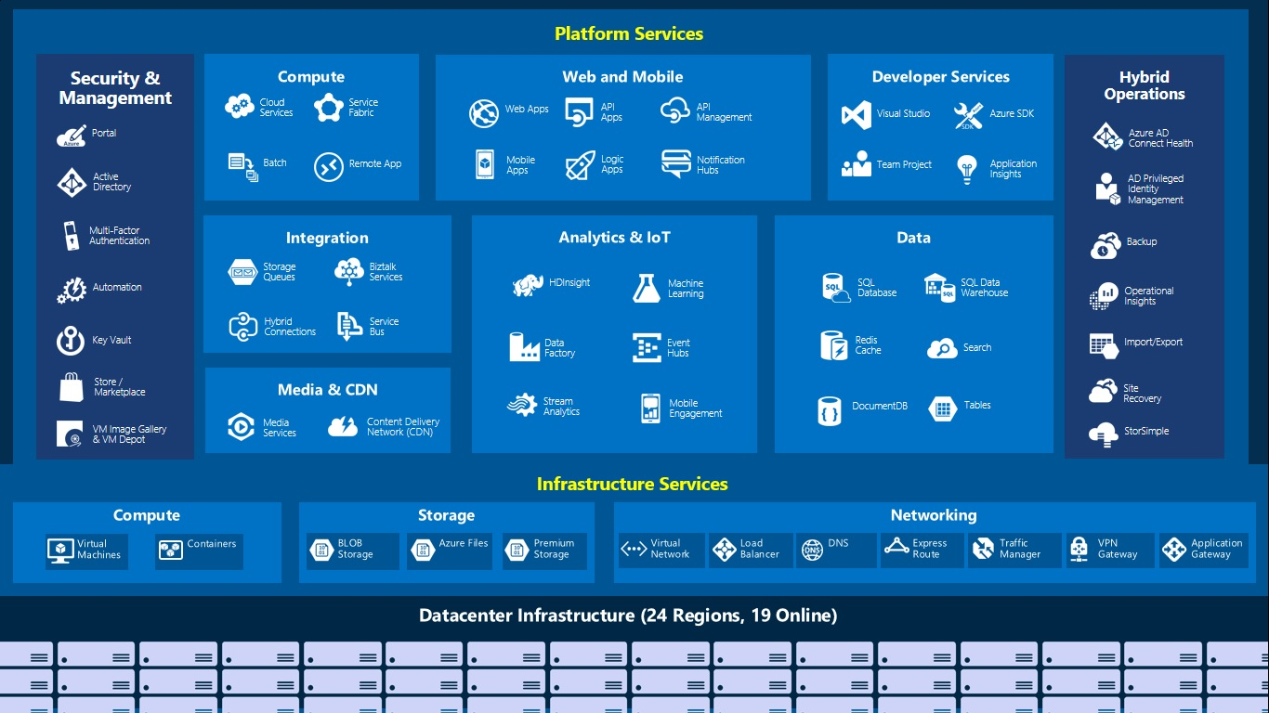
36 GA Regions
+ 6 Announced Regions
Notes:
Treat to the eyes
Networking part under infrastructure services
Different services under Networking.
Broke down into 4 –
Design Azure Virtual Networks
Design External connectivity for Azure Virtual Networks
Design Security Strategies
#Design connectivity for Hybrid Applications.
Lets see what each session got for us ☺
Seeing all the Azure services in one slide is like a treat to my eyes and in this session we will be focusing on the Networking part in Infrastructure services which is highlighted on the screen.
We will talk about Virtual Networks, Network services like Load balancers, Application Gateway, Traffic Manager, How to connect your Azure Vnet to you On-perm and Azure services also about Network security.

Slide 4
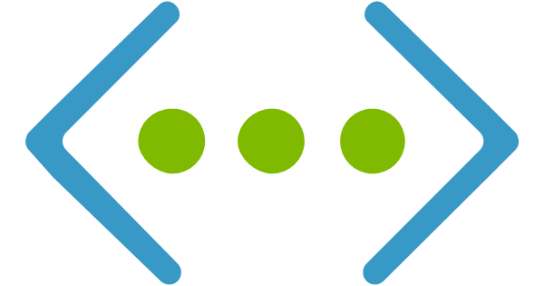
Design Azure Virtual Networks
Notes:
In this sessions we will focus on –
Azure virtual networks
load balancing using Azure Load Balancer, Application Gateway and Azure Traffic Manager;
Define DNS, DHCP, and IP strategies;

Slide 5
Azure Virtual Network Overview
What Azure locations will you use to host VNets?
Do you need to provide communication between these Azure locations?
Do you need to provide communication between your Azure VNet(s) and your on-premises datacenter(s)?
How many Infrastructure as a Service (IaaS) VMs, cloud services roles, and web apps do you need for your solution?
Do you need to isolate traffic based on groups of VMs (i.e. front end web servers and back end database servers)?
Do you need to control traffic flow using virtual appliances?
Do users need different sets of permissions to different Azure resources?
Isolated
50/1000 Virtual Networks per Region per Subscription
Up to 500K Concurrent TCP connections per NIC per VM
9/25 DNS servers per Vnet
20 custom DNS servers per Vnet
Internet Connected by default
Use Public IP address Ranges and Private IP Address ranges
Some IP address Ranges are not allowed:
224.0.0.0/4 (Multicast)
255.255.255.255/32 (Broadcast)
127.0.0.0/8 (loopback)
169.254.0.0/16 (link-local)
168.63.129.16/32 (Internal DNS)
Vnet properties
Name
Location
Address Space
Subnets
DNS server
Subnet properties
Name
Address Prefix
IP Configuration
Network Security Groups
Route Tables
https://docs.microsoft.com/en-us/azure/azure-subscription-service-limits
Notes:
All software defined
Basis for networking is a Virtual Network
equivalent to a Vlan in on-perm environment
Bring your own network
Specify your own Address Space –
define your own subnets
No IP Conflict
Bring your own DNS or use Azure provided DNS
Example of Dev and Prod environments
Lets now see how to setup communication between two Virtual networks that are in Azure by using Virtual network peering feature
___________________________________________________________________________-
Front end Piece –
End customers connecting to public endpoints of your service
Private End –
Connect offices or datacenters via private link to Azure which can be either internet based (IPSEC VPN) or dedicated link called ExpressRoute – which we cover in little more detail in this session
Secure with network security group ACLs
Control traffic with User Defined Routes (UDR’s)
Ask Allan for Cloud vs ON-prem Network differences

Slide 6
A slight but worthwhile aside
Notes:
In this sessions we will focus on –
Azure virtual networks
load balancing using Azure Load Balancer, Application Gateway and Azure Traffic Manager;
Define DNS, DHCP, and IP strategies;

Slide 7

Azure Regions

Slide 8
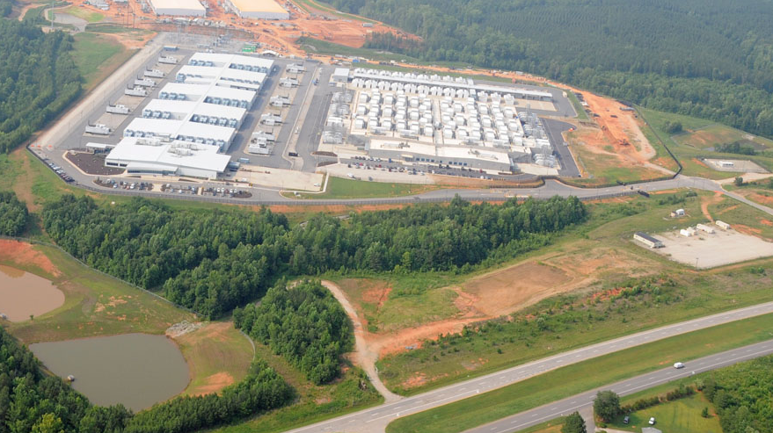

Slide 9
Azure Regional Hierarchy
Cloud
Public Azure
Azure Government
Azure in China operated by 21Vianet
Geo
Jurisdiction
Tax
Data Residency
Region
Customer Proximity
Disaster Isolation
Fault Domain
Fault Isolation

Slide 10
And we’re back
Notes:
In this sessions we will focus on –
Azure virtual networks
load balancing using Azure Load Balancer, Application Gateway and Azure Traffic Manager;
Define DNS, DHCP, and IP strategies;

Slide 11


Azure Virtual Network Peering
10.0/16
ARM VNet10.1/16
ARM VNet10.2/16
VPN
Peering
On-Premises
Gateway transit via Peering
Direct and bidirectional L3 connectivity between VNet's in same region
High throughput, low latency connectivity
Bypass gateway, no bandwidth bottleneck
Supports Gateway Transit (ARM-to-ARM only)
10/50 Vnet Peering per Virtual network
Peer ASM and ARM VNet's
Peer across subscriptions
NSGs and UDRs will work across the link
Public preview – Global Vnet Peering
Notes:
Layer 3 connectivity
Connect Vnets that are in same region
Gateway Transit in ARM
ASM + ARM
Global Vnet Peering

Slide 12



Azure Network Services Overview
works at the transport layer (Layer 4).
It provides network-level distribution of traffic across instances
of an application running in the same Azure data center.
Azure Load Balancer
works at the application layer (Layer 7) It acts as a reverse-proxy service, terminating the client connection and forwarding requests to back-end endpoints.
Azure Application Gateway
works at the DNS level. It uses DNS responses to direct end-user traffic to globally distributed endpoints. Clients then connect to those endpoints directly.
Azure Traffic Manager
Notes:
Layer -4 (Transport Layer)
Network level traffic distribution
Layer – 7 (Application Layer)
SSL offloading
Reverse-proxy service -
DNS Level
Quick responses from HA applications
Customers from different Geo-locations
A reverse proxy server is a type of proxy server that typically sits behind the firewall in a private network and directs client requests to the appropriate backend server. A reverse proxy provides an additional level of abstraction and control to ensure the smooth flow of network traffic between clients and servers.

Slide 13
Basic Load Balancer
Public and Private Load Balancers
Hash-based distribution – 5-tuple Hash
source IP, source port, destination IP, destination port, and Protocol
Availability Set
Port forwarding
Service monitoring
Guest agent probe
HTTP custom probe
TCP custom probe
NAT
Support for multiple load-balanced IP addresses for virtual machines
100/1000 Load balancers per subscription
150/250 rules per Basic Load Balancer
100 Backend pools with VMs on single Availability Set
10 Frontend IP’s
Notes:
5- Tuple hash distribution
Availability set explain Fault domain and Update domain
Port Forwarding
Monitoring – Health probes
NAT
Multiple Load balanced IP Addresses
Customer Story – On availability sets

Slide 14
Standard Load Balancer
Preview
VM need not be deployed in a Availability Set
Cross-Zone load balancing
Limited to region and not supported in peered networks
NIC or Subnet level NSG is mandatory
Migration from basic to standard SKU
High availability using HA ports
100/1000 Load balancers per subscription
1250/1500 rules per Basic Load Balancer
1000 Backend pools with VMs on single VNet
10 Frontend IP’s
Need to signup for preview
East US 2, Central US, North Europe, West Central US, West Europe, and Southeast Asia
Notes:
Customer Story on adding VM that is not in Availability set
No Availability sets needed
Features –
Low Latency
High throughput
Cross-Zone load balancing
Limited to region
not supported in peered networks
NSG is required on the NIC associated with Standard load balancer
Provides Diagnostic Insights using Azure Monitor

Slide 15
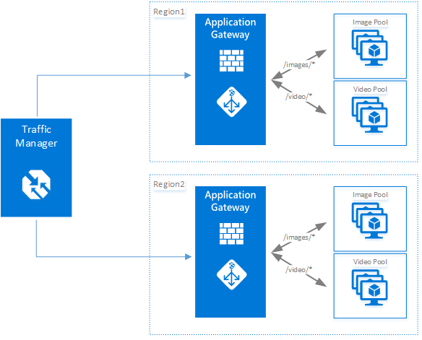
Application Gateway + WAF
Layer 7 Load balancer (HTTP/S) with Web Application Firewall
Ability to host multiple websites behind an Application Gateway
Round robin distribution of incoming traffic
cookie-based session affinity
URL path-based routing
End to end SSL
HTTP to HTTPS redirect
Protection against SQL injection, HTTP Protocol Violations
Multi-Site Routing
50/100 Per Subscription
2 frontend IP’s (Public and Private)
20 HTTP Listeners and 1 SSL cert and 1 site per listener
200 load balancing rules
20 backend address pools and 200 backend servers per each pool
10 Instances per gateway
Notes:
Layer 7 HTTP and HTTPS load balancing
Multiple Websites (20)
Round Robin
Session affinity
End-to-End Encryption – SSL offload
Drop CA certificate on the App GW external interface
And use self signed certificate to encrypt the outbound traffic
Redirect
WAF – SQL Injection
HTTP Protocol violations
2 Frontend IP – Public & Private
Listeners – Ports

Slide 16
Traffic Manager
www.contoso.com
Notes:
Priority -
Weighted
Performance
Geographic

Slide 17
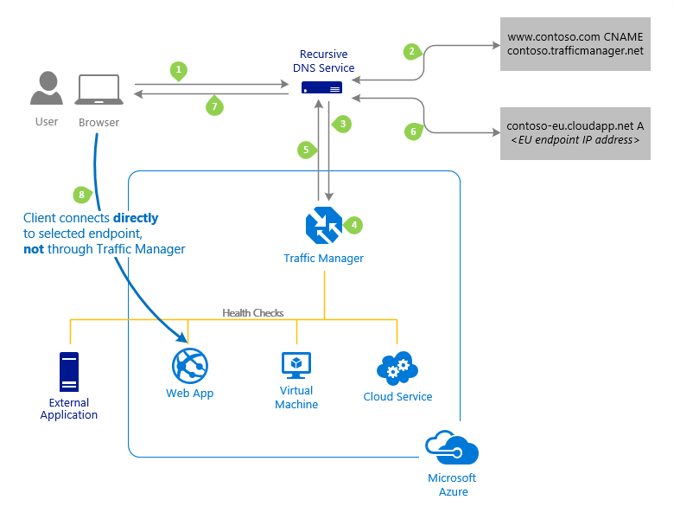
Traffic Manager
control the distribution of user traffic for service endpoints
Uses DNS to route traffic based on traffic routing method –
Priority
Weighted
Performance
Geographic
Endpoint monitoring
Benefits –
Improve availability of critical applications
Improve responsiveness for high performance applications
Perform service maintenance without downtime
100 profiles per subscription and 200 Endpoints per profile
Notes:
Service Endpoints - Azure VMs, Web Apps, and cloud services.
#You can also use Traffic Manager with external, non-Azure endpoints.
Working – uses Domain Name System (DNS) to direct client requests to the most appropriate endpoint based on a traffic-routing method and the health of the endpoints.
Priority - For backup and DR
Weighted - distribute traffic across a set of endpoints, either evenly or according to weights, which you define
Performance - "closest" endpoint in terms of the lowest network latency.
Geographic - geographic location their DNS query originates from

Slide 18
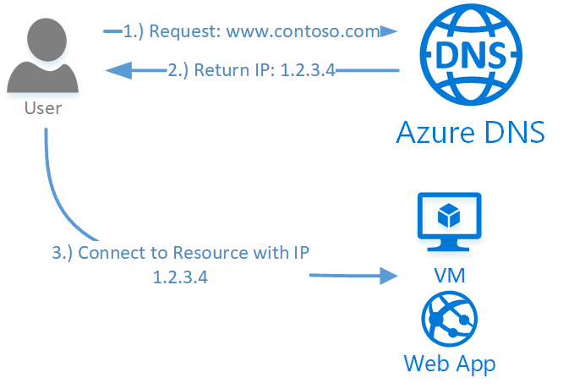
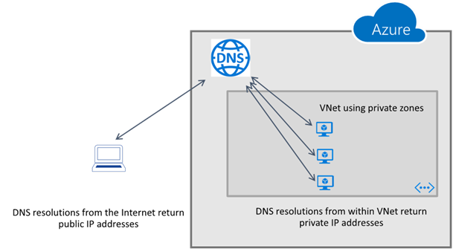
Azure DNS
Supports all common DNS record types
Azure DNS for private domains – Preview
No Configuration and is Highly Available
DNS service to manage and resolve domain names in a virtual network
WINS and NetBIOS not supported
Removes the need of custom DNS solutions
Split-horizon DNS support
Import or Export DNS zone files to and from Azure
99.99% SLA
100 DNS zones per subscription
5000 record sets per zone
20 records per record set
Notes:
DNS Record types
Private domains
Private to the Vnet
No WINS or NetBIOS
No Custom DNS
Split Horizon – Private and Internet
DNS Zone Files
99.99% SLA on Azure DNS
Forwarded DNS Requests are sent to reserved IP 168.63.129.16
20/100 DNS servers per Vnet

Slide 19

Design External Connectivity for Azure Virtual Networks

Slide 20
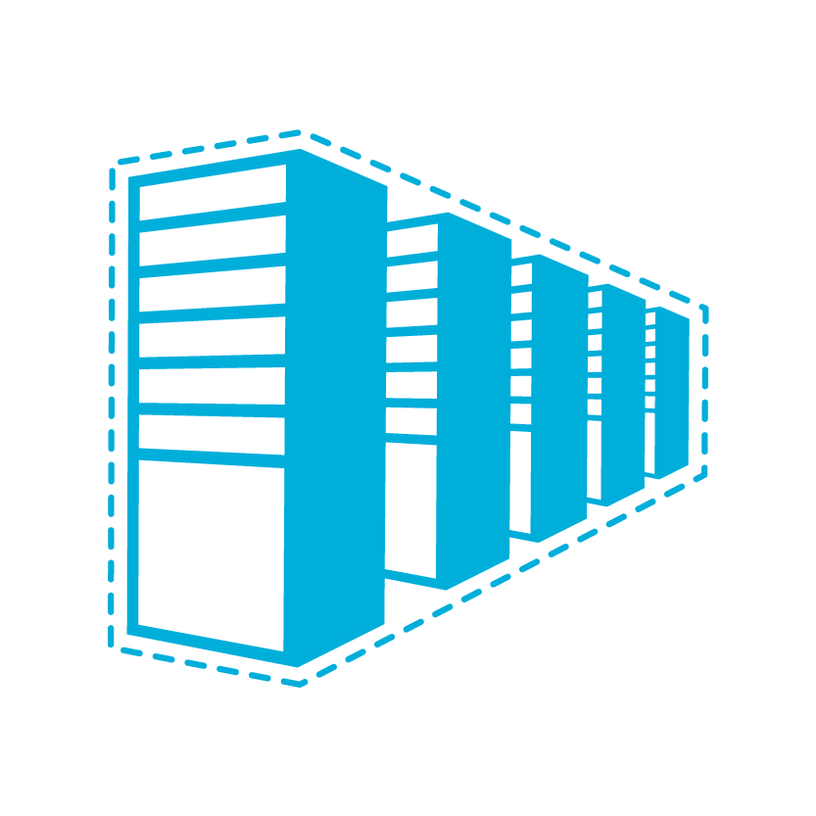
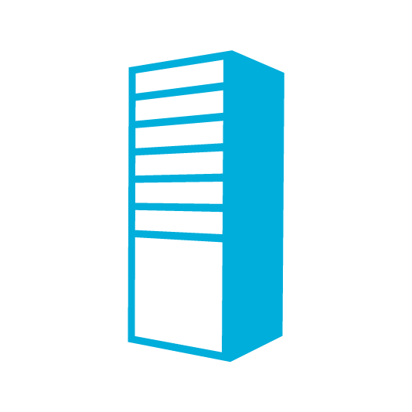

Connectivity Options and Hybrid Offerings
Cloud
Customer
Segment and workloads
Consumers
Access over public IP
DNS resolution
Connect from anywhere
Internet Connectivity
Developers
POC Efforts
Small scale deployments
Connect from anywhere
Secure point-to-site connectivity
SMB, Enterprises
Connect to Azure compute
Secure site-to-site
VPN connectivity
SMB & Enterprises
Mission critical workloads
Backup/DR, media, HPC
Connect to Microsoft services
ExpressRoute private connectivity
Notes:
When we look at cloud and you have different connectivity options,
These are the four different connectivity options.
We will go in depth on each one of them in a minute
It is clear that if you are choosing public cloud, the first type of connectivity that we can choose is internet based connectivity – Nothing really special to talk about
Its mainly about this other three that are valuable.
Point-to-site: Not a production or enterprise class solution
Site-to-Site:
You will have a gateway in Azure Vnet and you have device on-premises and basically we will be creating IPSec tunnel between both of them
Look into supported list of devices while designing a solution for yourself or for any of your customers
Support for both IKEv1 and IKEv2 tunnels
Maximum bandwidth in a Site-to-Site tunnel is 1.25 GBPS
If you want to go above that and want security (private link) then you need to look into the ExpressRoute option –
Has anybody hear had the joy of setting up ExpressRoute
Basic-
Route-based VPN: 10 tunnels with P2S; no RADIUS authentication for P2S; no IKEv2 for P2S Policy-based VPN: (IKEv1): 1 tunnel; no P2S
VpnGw1, VpnGw2, and VpnGw3-
Route-based VPN: up to 30 tunnels (*), P2S, BGP, active-active, custom IPsec/IKE policy, ExpressRoute/VPN co-existence

Slide 21
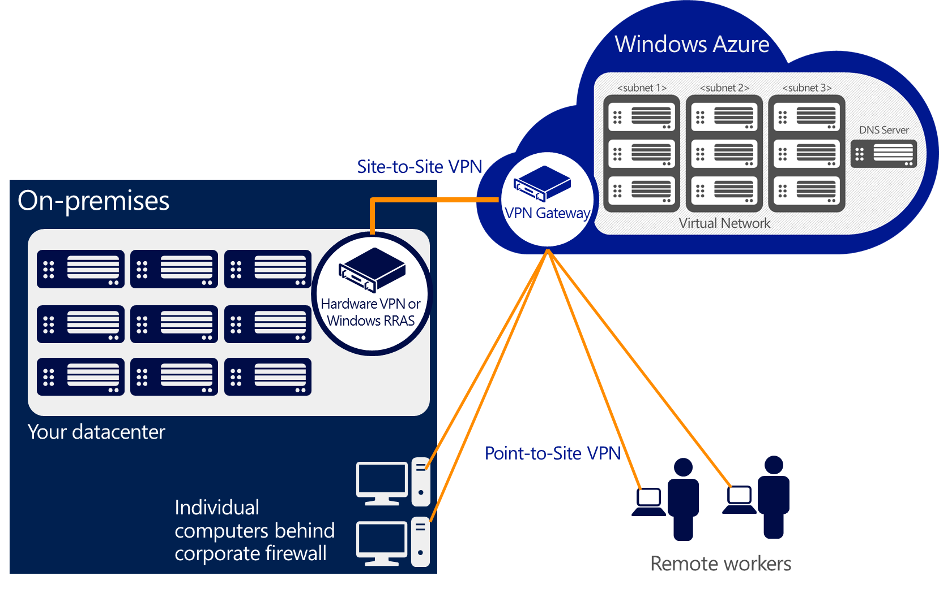
Virtual Private Network
At a high level, most hybrid configurations require 5 resources:
VNET
Gateway Subnet
Virtual Network Gateway (Route/Policy Based)
Local Network Gateway
Connection
Route Based SKU | S2S/VNet-to-VNet Tunnels | P2S Connections | Aggregate Throughput Benchmark
VpnGw1 | Max. 30 | Max. 128 | 650 Mbps
VpnGw2 | Max. 30 | Max. 128 | 1 Gbps
VpnGw3 | Max. 30 | Max. 128 | 1.25 Gbps
Basic | Max. 10 | Max. 128 | 100 Mbps
Notes:
Route Based – Dynamic Routing VPN – IPSec Tunnel
Basic – 10
GW1,2,3 – 30 Tunnels
Policy Based – Static Routing VPN – Customer defined policy (access list) – VPN Client
1 S2S VPN
IKEv1 and IKEv2
Resources for VPN
Pre Shared Key

Slide 22
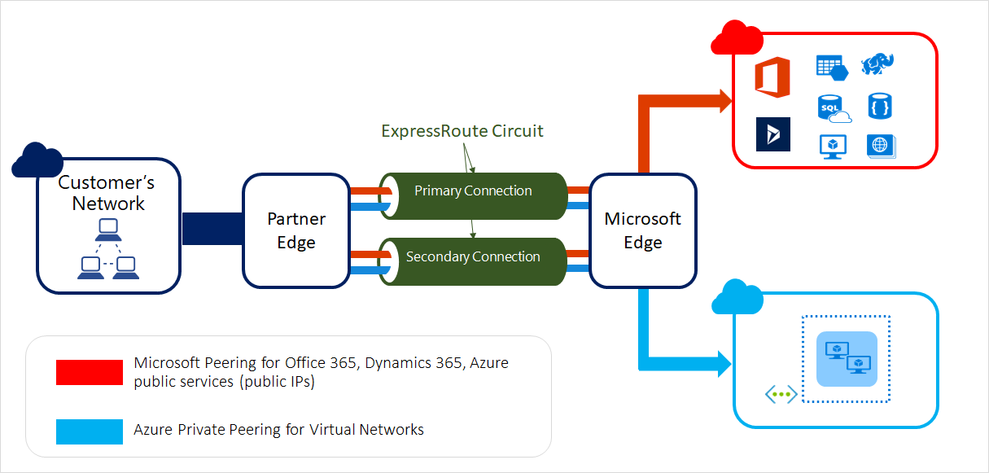
Express Route
Layer 3 connectivity between your on-premises and Azure
Dynamic routing between your network and Microsoft by leveraging BGP
Built-in redundancy
Range of bandwidth options
Flexible billing models
Unlimited data
Metered data
Premium add-on
Prerequisites
Azure Account
Connectivity Providers
Network Requirements
Notes:
Microsoft MPLS network
Public and Private peering
Built in Redundancy
Dynamic Routing
--
Private line through a connectivity provider
Not on public internet
More Reliable , Faster speed, low latency, high security
Billing
Billed monthly
Free inbound , Billed Outbound with per GB of data Transfer
Prerequisites NW requirements–
NAT – Public Peering only accepts traffic from public IP
Redundancy – Redundant BGP sessions setup between MS routers and peering routers

Slide 23
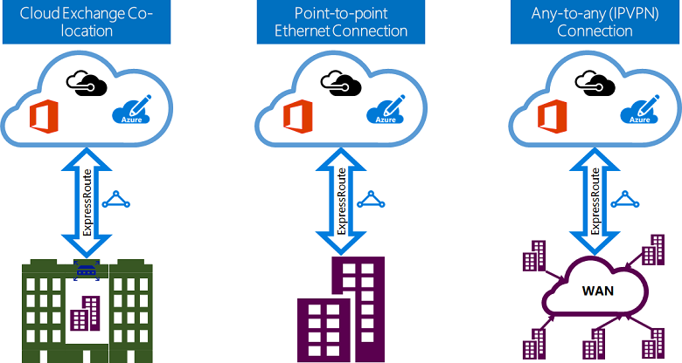
Express Route Connectivity Models
Notes:
Co-lo
Infrastructure deployed at Colo
Provider set up layer 2 of layer 3 connection from Colo to Azure
Point-to-Point
Connect your HQ to Azure and route all the Branch office traffic to HQ and from HQ to Azure
IP VPN – MPLS VPN
The Microsoft cloud can be interconnected to your WAN to make it look just like any other branch office.

Slide 24
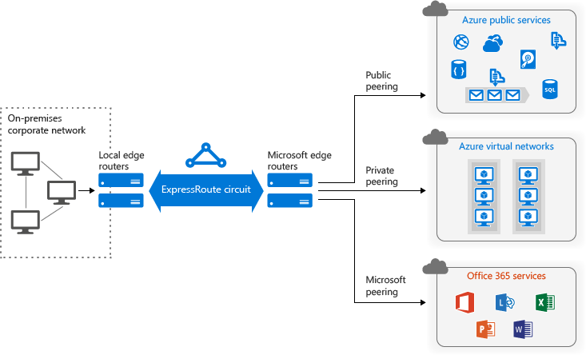
Express Route: Routing Domains (Peerings)
Notes:
Public – Azure Public Services
Microsoft – Office 365
Private – Vnet

Slide 25
Express Route Standard vs Premium Add-on
Number of Routes | Express Route | Premium add-on
Private Peering | 4,000 | 10,000
Public Peering | 200 | 200
Microsoft Peering | 200 | 200
Circuit Size | Number of VNet links for standard | Number of VNet Links with Premium add-on
50 Mbps | 10 | 20
100 Mbps | 10 | 25
200 Mbps | 10 | 25
500 Mbps | 10 | 40
1 Gbps | 10 | 50
2 Gbps | 10 | 60
5 Gbps | 10 | 75
10 Gbps | 10 | 100
Global connectivity for services - An ExpressRoute circuit created in any region
(excluding Azure China, Azure Germany, and Azure Government cloud)
will have access to resources across any other region in the world.
Notes:
Increased no of Vnet links
Increased route limits
Global connectivity with premium add-on–
Link Vnet in West Europe to Express Route provisioned in West US

Slide 26
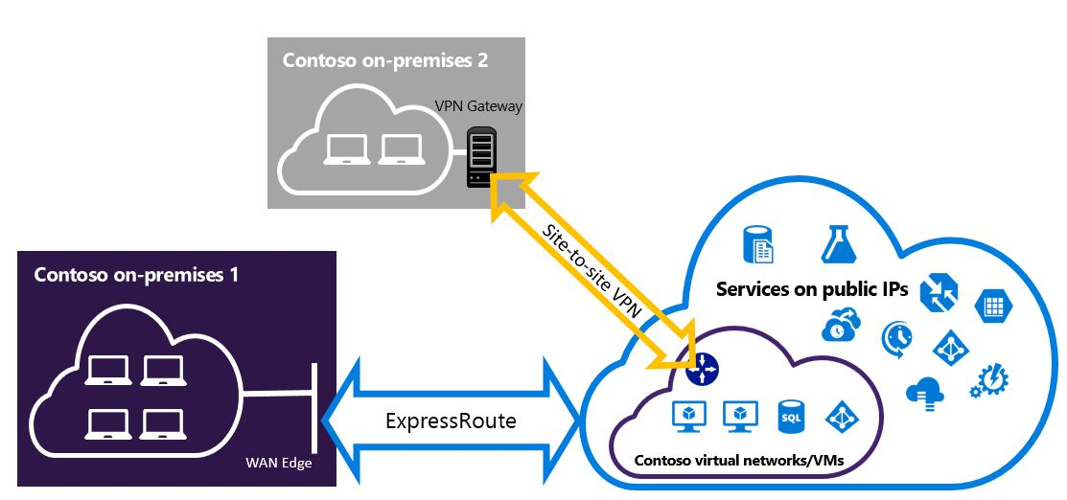
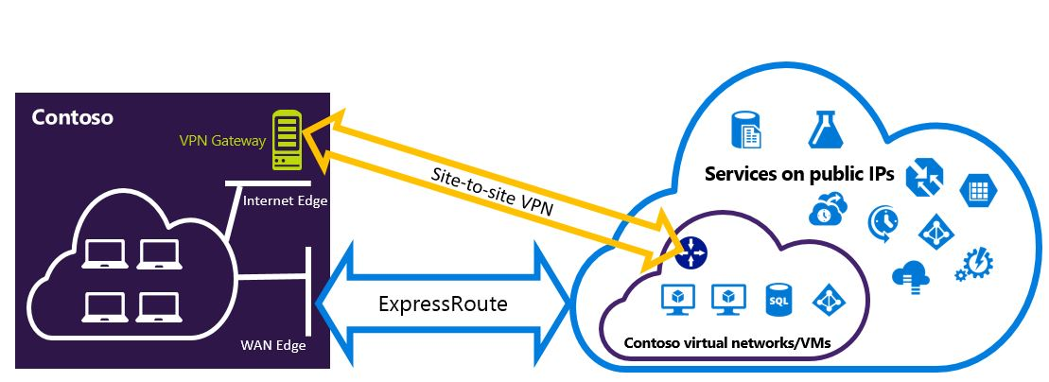
Express Route and Site-to-Site Co-Exist
Notes:
S2S is backup for Express Route
Add a new branch using S2S tunnel
Same gateway that we use for Express Route

Slide 27
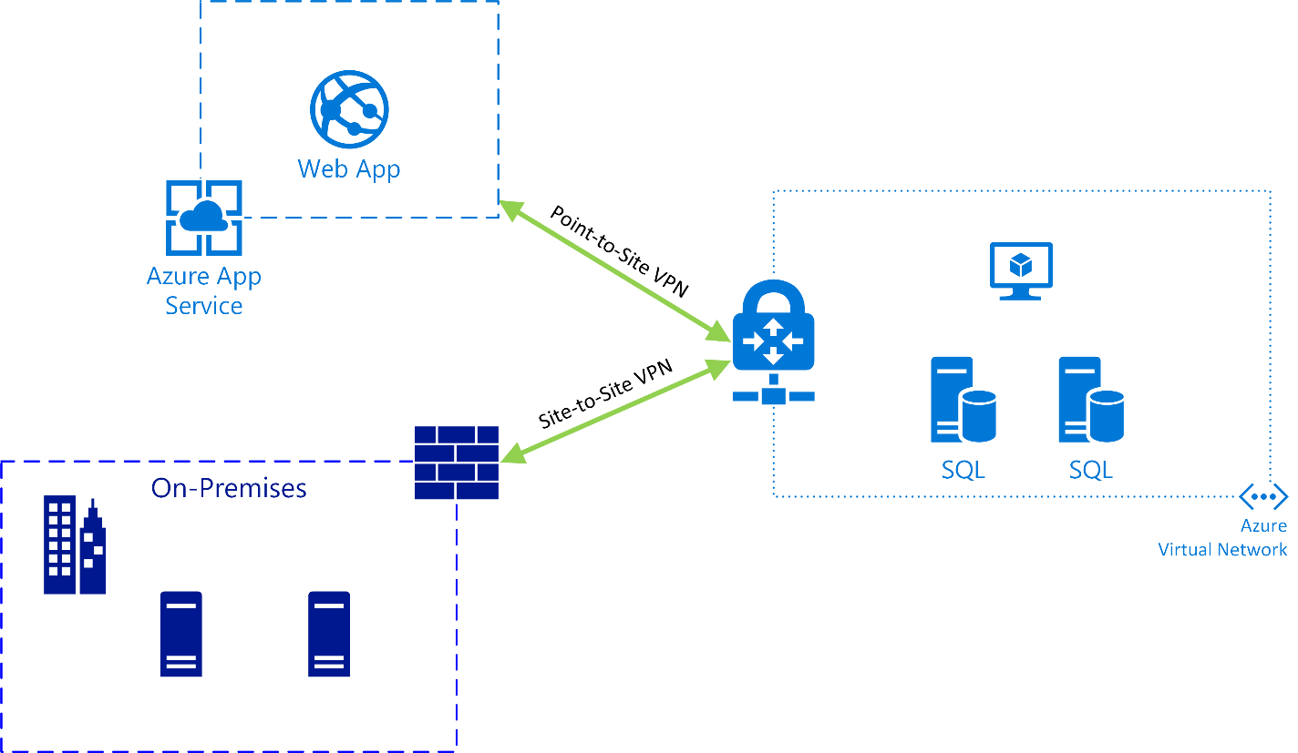
Integrating Web App with Virtual Network

Slide 28
 | Point-to-Site | Site-to-Site | ExpressRoute
Azure Supported Services | Cloud Services and Virtual Machines | Cloud Services and Virtual Machines | Services list
Typical Bandwidths | Typically < 100 Mbps aggregate | Typically < 1 Gbps aggregate | 50 Mbps, 100 Mbps, 200 Mbps, 500 Mbps, 1 Gbps, 2 Gbps, 5 Gbps, 10 Gbps
Protocols Supported | Secure Sockets Tunneling Protocol (SSTP) | IPsec | Direct connection over VLANs, NSP's VPN technologies (MPLS, VPLS,...)
Routing | Route Based (dynamic) | We support Policy Based (static routing) and Route Based (dynamic routing VPN) | BGP
Connection resiliency | active-passive | active-passive or active-active | active-active
Typical use case | Prototyping, dev / test / lab scenarios for cloud services and virtual machines | Dev / test / lab scenarios and small scale production workloads for cloud services and virtual machines | Access to all Azure services (validated list), Enterprise-class and mission critical workloads, Backup, Big Data, Azure as a DR site

Slide 29

Design Security Strategies
Notes:
Add network Watcher
Flow verify traffic
TS NSG logs
Packet captures
Enable NW
Add extension to the VM

Slide 30
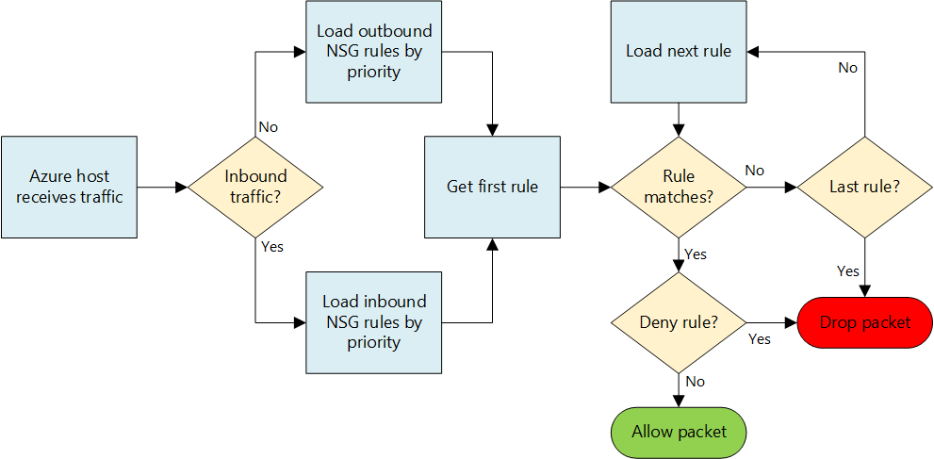
Network Security Groups
Control inbound and outbound traffic on a NIC or subnet level
Configure rules in NSG
Name
Source address
Source port
Protocol (TCP/UDP/ICMP)
Destination address
Destination port
Direction
Action (Allow/Deny)
Augmented Rules
100/200 NSG’s per subscription
200/400 Rules per NSG
Notes:
NIC or Subnet Level
Inputs to configure rules
Augmented rules = Large & Complex network policies with less rules on a NSG
multiple ports and IPs on a single rules

Slide 31
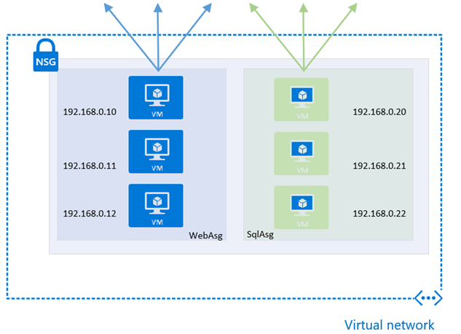
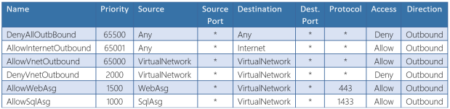
Application Security Groups
Preview
network security as a natural extension of an application’s structure
network interfaces of VMs are assigned to an application security group
application security group are provided as the source and destination in a security rule
The platform handles the complexity of explicit IP addresses and multiple rule sets
Notes:
Security as extension on application level
NIC of VM to ASG
ASG as source or destination on NSG
Reduce –
Complexity of explicit IP addresses
Multiple rule sets

Slide 32
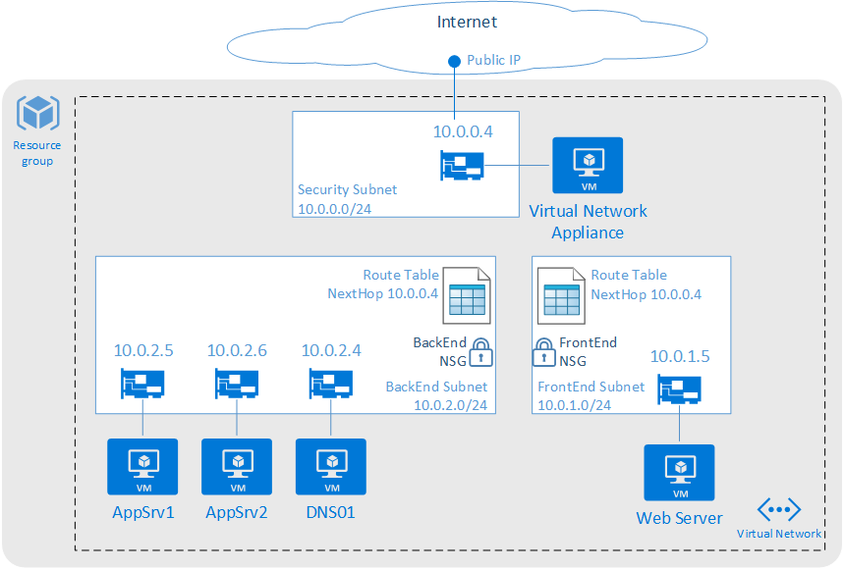
Route Tables
User defined routes
Routes to overwrite Azure system routes
Associated to subnets
Specify next hop
Virtual Appliance
Virtual Network Gateway
None
Virtual Network
Internet
Configure routes in route table
Route Name
Address Prefix (Destination Address)
Next hop type
Next hop address (Virtual Appliance)
100/200 Route Tables per subscription
100/400 routes per Route Table
Notes:
User Defined Routes
Ability to control traffic flow
Imagine we have two subnets within one Vnet
By default all machines in a Vnet can communicate with each other so there is full routed network between them
You don’t want your front end subnet communicate directly with your back end subnet
You want to have your own firewall appliance or an IDS system in between the traffic flow to accomplish that solution we can use User Defined Routes to force the traffic coming to backend subnet that is coming from front end subnet through the firewall instance
You can configure UDR’s for both internal traffic and the traffic leaving your Azure network

Slide 33
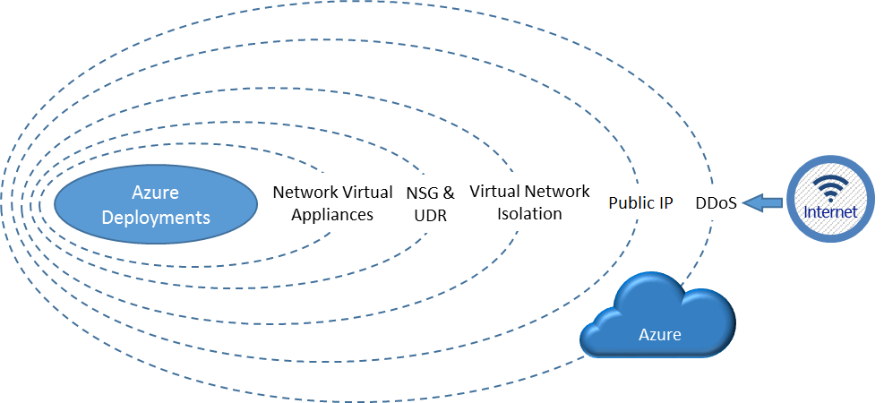
Azure DDOS Protection
Two tiers of DDOS protection
Basic – Free with Azure
Standard – Preview
Always-on monitoring and real-time mitigation
Standard DDOS will help you protect resources in a virtual Network and also Public IP’s associated to Azure VMs.
Mitigates attacks like -
Volumetric attacks
Protocol attacks
Application layer attacks
Automatic DDOS mitigation
Notes:
Defines the traffic threshold on the DDOS policy
Auto-trigger DDOS mitigation
Redirected to the DDOS protection service
Standard - Protection policies are tuned through dedicated traffic monitoring and machine learning algorithms and applied to public IP addresses associated to resources deployed in virtual networks, such as Azure Load Balancer, Azure Application Gateway
Volumetric - flood the network layer with a substantial amount of seemingly legitimate traffic
Protocol - target inaccessible by exploiting a weakness in the layer 3 and layer 4 protocol stack
Application – HTTP protocol violation , SQL injection
Interact with the client to check if the traffic is a spoofed traffic
Customer simulating their own DDOS attack
Ask MS support to execute the DDOS attack

Slide 34

Design Connectivity for Hybrid Applications

Slide 35
Thank You

Slide 36
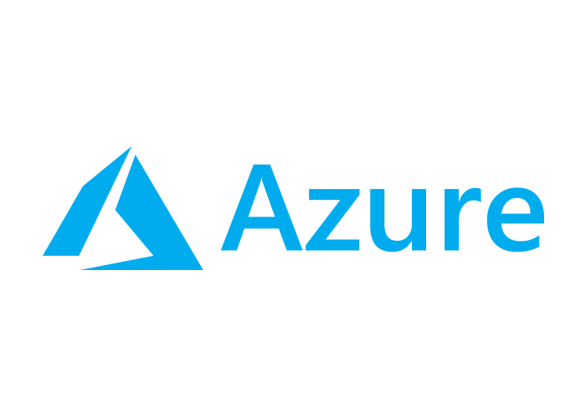
Design Connectivity for Hybrid Applications

