Slide 1

Linux On Azure Preparation Training Network configuration & DNS
Mohd Mishal
Clouds Consultant | MCT

Slide 2
Linux Foundation Certified System Administrator
Essential Commands
User and Group Management
Operations of Running Systems
Networking
Service Configuration
Virtualization
Storage Management
Speaker Information:
https://training.linuxfoundation.org/certification/lfcs
Notes:
20533D
1: Introduction to Microsoft Azure

Slide 3
Session Agenda
Basic network configuration in Linux
DNS operation in Linux – bind / nsswitch.conf
Setting up a caching nameserver

Slide 4
Basic Network Configuration in Linux: Hostname management
A hostname is a computer network label which helps to distinguish it from other network devices
For DNS purposes, hostnames are appended with a period and a domain name, in order to obtain Fully Qualified Domain Name (FQDN)
Example:
Hostname: webserver01-westus
Domain: microsoft.com
FQDN: webserver01-westus.microsoft.com

Slide 5
Basic Network Configuration in Linux: Hostname management
Check hostname in Linux:
1. It’s usually part of the shell prompt:
[radim@webserver01-westus ~]$
2. Get current hostname by command:
$ hostname
webserver01-westus
3. From the config file /etc/hostname
$ cat /etc/hostname
webserver01-westus

Slide 6
Basic Network Configuration in Linux: Hostname management
Set hostname in Linux:
1. Only temporarily by next reboot, using hostname command:
$ sudo hostname webserver01-eastus
2. Permanently, by editing config file /etc/hostname
# echo "webserver01-eastus" > /etc/hostname
# cat /etc/hostname
webserver01-eastus
=> Reboot the system to apply hostname from config file
3. Permanently by invoking hostnamectl utility on systemd enabled OS:
# sudo hostnamectl set-hostname webserver01-eastus
4. Permanently, by using Network manager tools (nmtui, nmcli), which will be discussed later.

Slide 7
Basic Network Configuration in Linux: Network device naming
For network devices, there are not special device files, such as device nodes in /dev
Network devices consist of a type identifier followed by a sequential number such as:
eth0, eth1, eno1, eno2 for Ethernet devices
wlan0, wlan1, br0 for Wireless devices
br0, br1, br2 for Bridge devices
vmnet0, vmnet1, vmnet2 for virtual networking devices
Please note there are also other naming schemes for network devices, which provide consistent and predictable device naming unlike this most common one but legacy. Check the documentation:
https://docs.fedoraproject.org/en-US/Fedora/25/html/Networking_Guide/ch-Consistent_Network_Device_Naming.html

Slide 8
Basic Network Configuration in Linux: IP network management
The ip utility is preferred swiss army knife to show/manipulate system IP configuration with common following common examples:
Show information for all network interfaces
[radim@centos72hv01 ~]$ ip address
1: lo: <LOOPBACK,UP,LOWER_UP> mtu 65536 qdisc noqueue state UNKNOWN
link/loopback 00:00:00:00:00:00 brd 00:00:00:00:00:00
inet 127.0.0.1/8 scope host lo
valid_lft forever preferred_lft forever
inet6 ::1/128 scope host
valid_lft forever preferred_lft forever
2: eth0: <BROADCAST,MULTICAST,UP,LOWER_UP> mtu 1500 qdisc pfifo_fast state UP qlen 1000
link/ether 00:15:5d:94:29:00 brd ff:ff:ff:ff:ff:ff
inet 10.0.0.2/24 brd 10.0.0.255 scope global eth0
valid_lft forever preferred_lft forever
inet6 fe80::215:5dff:fe94:2900/64 scope link
valid_lft forever preferred_lft forever

Slide 9
Basic Network Configuration in Linux: IP network management
Show stats info for the eth0 network interface
$ ip –s link show eth0
Set the IP address for eth0 until the next reboot
$ sudo ip addr add 192.168.1.7 dev eth0
Bring eth0 down / up
$ sudo ip link set eth0 down ; $ sudo ip link set eth0 up
Configure the network route until the next reboot
$ sudo ip route add 192.168.2.0/24 via 192.168.1.1
$ ip route

Slide 10
Basic Network Configuration in Linux: IP network management
The ifconfig utility is deprecated tool to show/manipulate system IP configuration with common following common examples:
Show information for all network interfaces
$ ifconfig
Set the IP address and netmask for eth0 until the next reboot
$ sudo ifconfig eth0 192.168.1.7
$ sudo ifconfig eth0 netmask 255.255.255.0
Bring eth0 down
$ sudo ifconfig eth0 down
Set the MTU (Max. Transfer Unit) to 1480 Bytes for interface eth0 until the next reboot
$ sudo ifconfig eth0 mtu 1480

Slide 11
Basic Network Configuration in Linux NIC (Network Interface Card) configuration Files
Since ip / ifconfig utilities do not configure the network stack permanently, Linux has a set of files and directories which are used to write permanent network stack configuration. As usually, these are distribution dependent ☺
Red Hat
/etc/sysconfig/network
/etc/sysconfig/network-scripts/ifcfg-ethX
/etc/sysconfig/network-scripts/route-ethX
Debian
/etc/network/interfaces
SESE
/etc/sysconfig/
On modern Linux systems, these files are modified using Network Manager tool rather than directly.

Slide 12
Basic Network Configuration in Linux NIC configuration Files – Example of DHCP autoconfiguration
[root@centos72hv02 etc]# cat /etc/sysconfig/network-scripts/ifcfg-eth0
TYPE="Ethernet"
BOOTPROTO=dhcp
DEFROUTE="yes"
IPV4_FAILURE_FATAL="no"
IPV6INIT=no
IPV6_AUTOCONF="yes"
IPV6_DEFROUTE="yes"
IPV6_FAILURE_FATAL="no"
NAME="eth0"
UUID="67aaf618-2f18-4864-9cda-45d374675135"
DEVICE="eth0"
ONBOOT="yes"
IPV6_PEERDNS=yes
IPV6_PEERROUTES=yes
PEERDNS=yes
PEERROUTES=yes

Slide 13
Basic Network Configuration in Linux NIC configuration Files – Example of manual configuration
[root@centos72hv02 etc]# cat /etc/sysconfig/network-scripts/ifcfg-eth0
TYPE="Ethernet"
BOOTPROTO=none
DEFROUTE="yes"
IPV4_FAILURE_FATAL="no"
IPV6INIT=no
IPV6_AUTOCONF="yes"
IPV6_DEFROUTE="yes"
IPV6_FAILURE_FATAL="no"
NAME="eth0"
UUID="67aaf618-2f18-4864-9cda-45d374675135"
DEVICE="eth0"
ONBOOT="yes"
IPV6_PEERDNS=yes
IPV6_PEERROUTES=yes
IPADDR=10.0.0.2
PREFIX=24
GATEWAY=10.0.0.1
DNS1=10.221.24.10
DNS2=8.8.8.8

Slide 14
Basic Network Configuration in Linux: Network Management
Network manager still uses network configuration files, but the administrator can avoid
directly manipulating them and its use is almost the same on every system.
There is Text based GUI network manager interface for shell:
# nmtui
or pure CLI based network manager interface:
# nmcli
or other full GUI Network Manager frontends built in Gnome, KDE, etc.

Slide 15
Basic Network Configuration in Linux: CLI based Network Manager ~ nmcli
Network Manager installation (typically available by default), useful manual pages and references:
# sudo yum install NetworkManager
# systemctl enable NetworkManager
# systemctl start NetworkManager
$ man nmcli-examples
$ nmcli –help
https://fedoraproject.org/wiki/Networking/CLI
[root@centos72hv01 radim]# nmcli device status
DEVICE TYPE STATE CONNECTION
eth0 ethernet connected eth0
lo loopback unmanaged --
[root@centos72hv02 ~]# nmcli dev show eth0
GENERAL.DEVICE: eth0
GENERAL.TYPE: ethernet
GENERAL.HWADDR: 00:15:5D:94:29:00
GENERAL.MTU: 1500
GENERAL.STATE: 100 (connected)
GENERAL.CONNECTION: eth0
[root@centos72hv01 radim]# nmcli general hostname webserver02-eastus

Slide 16
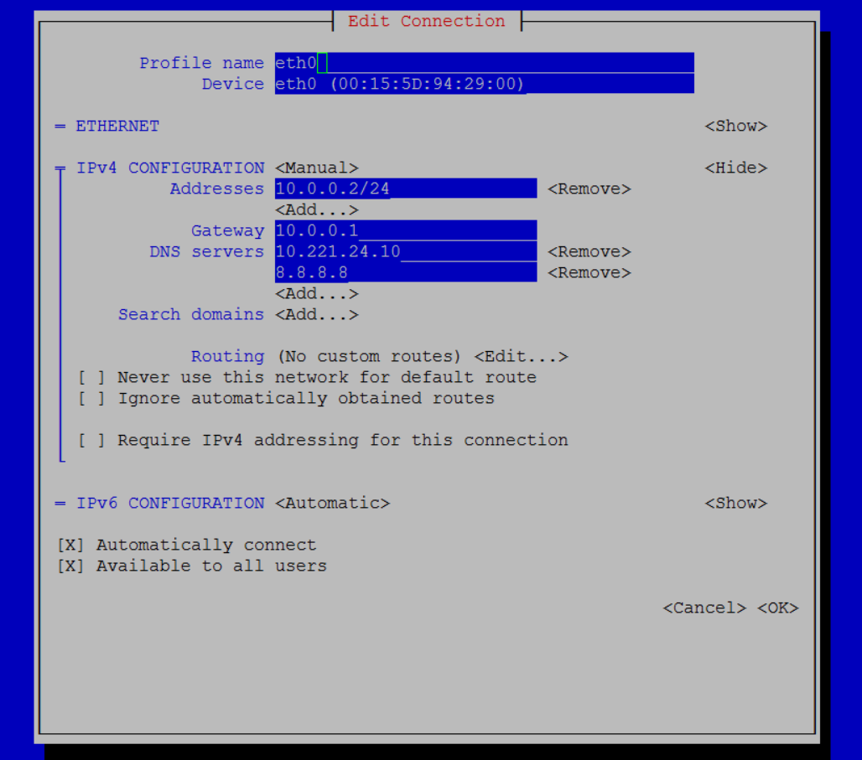
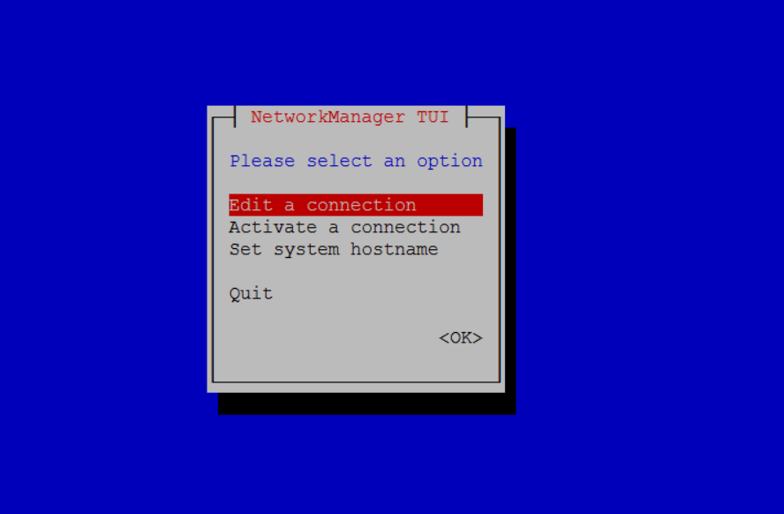
Basic Network Configuration in Linux Text based GUI Network Manager for shell ~ nmtui
Install nmtui if not already present on your system:
# yum NetworkManager-tui
# nmtui

Slide 17
Basic Network Configuration in Linux Routing
Routing is the process of selecting paths in a network along which to send network traffic. The routing table is a list of routes to other networks managed by the system. It defines paths to all networks and hosts.
[radim@centos72hv01 ~]$ ip route
default via 10.0.0.1 dev eth0 proto static metric 100
10.0.0.0/24 dev eth0 proto kernel scope link src 10.0.0.2 metric 100
172.17.0.0/16 dev docker0 proto kernel scope link src 172.17.0.1
192.168.122.0/24 dev virbr0 proto kernel scope link src 192.168.122.1
[radim@centos72hv01 ~]$
or similar depracated command:
[radim@centos72hv01 ~]$ route -n
Kernel IP routing table
Destination Gateway Genmask Flags Metric Ref Use Iface
default 10.0.0.1 0.0.0.0 UG 100 0 0 eth0
10.0.0.0 0.0.0.0 255.255.255.0 U 100 0 0 eth0
172.17.0.0 0.0.0.0 255.255.0.0 U 0 0 0 docker0
192.168.122.0 0.0.0.0 255.255.255.0 U 0 0 0 virbr0

Slide 18
Basic Network Configuration in Linux Routing and Default Route
A default Route defines the way packets are sent when there is no other match in the routing table for reaching the specified destination:
[radim@centos72hv01 ~]$ route
Kernel IP routing table
Destination Gateway Genmask Flags Metric Ref Use Iface
default 10.0.0.1 0.0.0.0 UG 100 0 0 eth0
10.0.0.0 0.0.0.0 255.255.255.0 U 100 0 0 eth0
172.17.0.0 0.0.0.0 255.255.0.0 U 0 0 0 docker0
192.168.122.0 0.0.0.0 255.255.255.0 U 0 0 0 virbr0
[radim@centos72hv01 ~]$
Default route is configured using:
Through route or ip route command which modifies routing table at run time only:
$ sudo route add default gw 10.0.0.3 eth0
$ sudo ip route del default via 10.0.0.5
Through nmtui or nmcli utility, which is persistent change:
# nmcli con mod eth0 ipv4.gateway 10.0.0.4
# nmcli con up eth0
On Red Hat based systems, by writing GATEWAY=X.X.X.X into /etc/sysconfig/network or alternatively into /etc/sysconfig/network-scripts/ifcfg-ethX configuration file

Slide 19
Basic Network Configuration in Linux Routing and Static Routes – at run time configuration
Static Routes are used to control packet flow to destination when there is a need for specific route prioritization on systems with multiple interfaces/routes
Modify routing table at run time which is not persistent beyond OS service restart.
[root@centos72hv01 network-scripts]# ip route add 172.16.1.0/24 via 10.0.0.8 metric 1000
[root@centos72hv01 network-scripts]# route -n
Kernel IP routing table
Destination Gateway Genmask Flags Metric Ref Use Iface
default gateway 0.0.0.0 UG 100 0 0 eth0
10.0.0.0 0.0.0.0 255.255.255.0 U 100 0 0 eth0
172.16.1.0 10.0.0.8 255.255.0.0 UG 100 0 0 eth0
172.17.0.0 0.0.0.0 255.255.0.0 U 0 0 0 docker0
192.168.122.0 0.0.0.0 255.255.255.0 U 0 0 0 virbr0

Slide 20
Basic Network Configuration in Linux Routing and Static Routes – persistent configuration changes
Persistent routing table changes are typically done by editing /etc/sysconfig/network-scripts/route-eth0 , where ip route add arguments are provided, e.g.
[root@centos72hv01 network-scripts]$ echo '192.168.5.0/24 via 10.0.0.12' >> /etc/sysconfig/network-scripts/route-eth0
[root@centos72hv01 network-scripts]$ cat /etc/sysconfig/network-scripts/route-eth0
[root@centos72hv01 network-scripts]$ systemctl restart network
or by updating /etc/sysconfig/network-scripts/ifcfg-eth0, which can be also done by nmcli command:
[root@centos72hv01 network-scripts]$ sudo nmcli conn mod eth0 -ipv4.routes "192.168.5.0/24 10.0.0.12“
[root@centos72hv01 network-scripts]$ sudo nmcli conn up eth0
Persitent Static route can be removed again via nmcli or by editing /etc/sysconfig/network-scripts/route-eth0, or /etc/sysconfig/network-scripts/ifcfg-eth0
[root@centos72hv01 network-scripts]$ sudo nmcli conn mod eth0 -ipv4.routes "192.168.5.0/24 10.0.0.12“
[root@centos72hv01 network-scripts]$ sudo nmcli conn up eth0

Slide 21
Basic Network Configuration in Linux Name resolution essentials
Name resolution is a process of translating hostnames to the IP addresses of their hosts. Hosts/servers may represent multiple hostnames, e.g. the host with IP address 77.78.30.11 may represent several different hostnames at the same time (web.domain.com, ftp.domain.com, email.domain.com)
Hostnames are usually resolved either with help of static local file /etc/hosts or dynamically using DNS service.
Name resolution is checked using either of the commands:
$ dig ftp.microsoft.com
$ host ftp.microsoft.com
$ nslookup ftp.microsoft.com 8.8.8.8
For reverse lookup (IP -> hostname):
$ dig –x 77.75.79.39
$ nslookup 77.75.79.39
$ host 77.75.79.39

Slide 22
Basic Network Configuration in Linux Name resolution using /etc/hosts
The name resolution service is typically configured to search in local file /etc/hosts first and then use DNS as second.
/etc/hosts holds a local database of hostnames and IP addresses. It contains a set of records, which map single IP address with corresponding hostnames and aliases.
Example of /etc/hosts file which is typically edited directly (nano , vi or vim):
[root@centos72hv01 network-scripts]# cat /etc/hosts
127.0.0.1 localhost localhost.localdomain localhost4 localhost4.localdomain4
::1 localhost localhost.localdomain localhost6 localhost6.localdomain6
10.208.11.23 marry-pc server01 print-server
10.208.11.26 joe-notebook backup-server
Name resolution logic order can be modified using the file /etc/nsswitch.conf

Slide 23
Basic Network Configuration in Linux Name resolution control through /etc/nsswitch.conf
/etc/nsswitch.conf is the Name Service Switch configuration file which controls the sources/resolution mechanisms and order from which to obtain name-service information for most common configuration databases
Most common database names controlled by NSS are :
aliases
group
hosts
passwd
And there approx. 10+ other databases
[root@centos72hv01 network-scripts]# cat /etc/nsswitch.conf
passwd: files sss
shadow: files sss
group: files sss
#initgroups: files
hosts: files dns myhostname
# Example - obey only what nisplus tells us...
#services: nisplus [NOTFOUND=return] files
#networks: nisplus [NOTFOUND=return] files
In case of this specific file, /etc/hosts will be used for hostname resolution as first, followed by DNS. Last option myhostname is used to resolve local system hostname to any locally configured IP address.

Slide 24
Basic Network Configuration in Linux Name resolution using DNS
A query is sent towards DNS (Domain Name System) if name resolution cannot be done using local file /etc/hosts file.
DNS servers were typically configured in /etc/resolv.conf file. However it is now auto-generated on most modern Linux systems based on Network Manager configuration, which saves DNS server names to the file /etc/sysconfig/network-scripts/ifcfg-ethX or is provided by DHCP
[root@centos72hv01 network-scripts]# cat /etc/sysconfig/network-scripts/ifcfg-eth0
...
DNS1="10.221.24.10"
DNS2="8.8.8.8"
…
[root@centos72hv01 network-scripts]# cat /etc/resolv.conf
# Generated by NetworkManager
nameserver 10.221.24.10
nameserver 8.8.8.8

Slide 25
Basic Network Configuration in Linux Network Diagnostics and Troubleshooting
Most principles apply from other Operating Systems when troubleshooting network connectivity
Inspect physical/link connectivity
Inspect IP protocol configuration (check whether DHCP or static configuration is applied for ethX interfaces)
Inspect faulty IP service configuration (DNS, SSH, Webserver, Bind, etc.)
Frequently used sources to gather information about network configuration:
$ ip addr
$ nmcli
$ route
$ dmesg | grep netw
$ netstat –ln or ss –l4n
$ cat /var/log/messages | grep netw
Frequently used tools to inspect operation of network services:
$ ping www.microsoft.com
$ traceroute 23.195.9.95
$ mtr www.linuxfoundation.org
$ dig/host/nslookup www.redhat.com
$ sudo tcpdump –i eth0 tcp port 22 –w capturefile.pcap

Slide 26
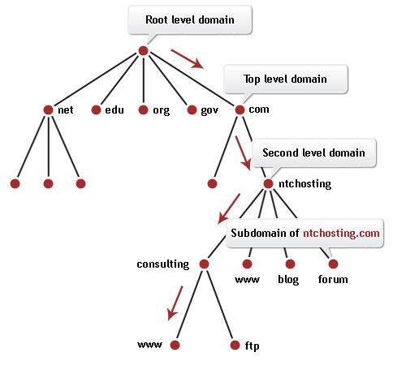
DNS (Domain Name System) How it works ?
FQDN (Fully Qualified Domain Names) are resolved using DNS service, which is hierarchically distributed naming system that resolves domain names to IP addresses for the purpose of network traffic routing.
The service is provided through hierarchical system of DNS name servers which hold DNS records for assigned domains. If they don’t know the answer, the query is recursively processed by the root, top level and then second level name servers, until the domain authoritative server is found and query is resolved.
Each domain has at least one authoritative DNS name server that publishes information about that domain and other name servers follow it.
The service is client-server based service using UDP/DNS protocol where DNS name server responds with DNS answers to queries based on its local database.
In UNIX/Linux world, DNS server functionality is provided by BIND (Berkeley Internet Name Domain) SW package.

Slide 27
Installing BIND (Berkeley Internet Name Domain) server
For comprehensive documentation to BIND, please refer to:
http://www.linuxhomenetworking.com/wiki/index.php/Quick_HOWTO_:_Ch18_:_Configuring_DNS#.WGY-9IWcGwp
Installation process on Red Hat based system with systemd (RHEL 7.x, CentOS 7.x):
# yum install bind
# systemctl status named
● named.service - Berkeley Internet Name Domain (DNS)
Loaded: loaded (/usr/lib/systemd/system/named.service; disabled; vendor preset: disabled)
Active: inactive (dead)
# systemctl enable named
# systemctl start named
# systemctl status named
● named.service - Berkeley Internet Name Domain (DNS)
Loaded: loaded (/usr/lib/systemd/system/named.service; enabled; vendor preset: disabled)
Active: active (running) since Thu 2016-12-29 21:06:54 CET; 9s ago
Process: 10974 ExecStart=/usr/sbin/named -u named $OPTIONS (code=exited,

Slide 28
Managing BIND server Essential operational commands
Commands to manage BIND instance:
# systemctl enable/disable named
# systemctl status/restart/start/stop named
Typical BIND configuration artefacts are the following:
/etc/named.conf The main configuration file.
/etc/named/ An auxiliary directory (e.g. zone files) for configuration files that are included in the main configuration file.
Typical operational artefacts (statistics, cache dump, etc.) are stored in:
/var/named
Quick logfile inspection through:
# cat /var/named/data/named.run
# cat /var/log/messages | grep named
Remember, that if configuration files are faulty, the BIND daemon won’t start. Thus it’s good practice to check the syntax of configuration files before you restart the BIND daemon.
To do so, run: $ named-checkconf

Slide 29
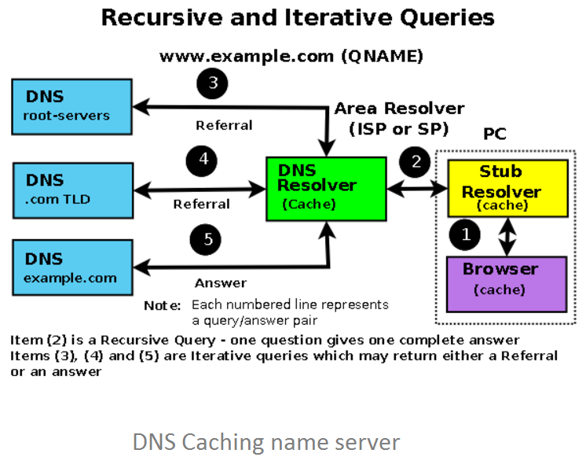
Setting up BIND as Caching server (Resolver) What is a Caching server ?
Caching DNS server (aka resolver) handles recursive sequential queries towards root, top level, second level and sub domain authoritative servers on behalf of clients and stores answers in local cache.
This simplifies and improves client’s DNS query complexity because recursive queries are done by caching server and answers become available to other clients too
Once DNS caching server is setup, all relevant clients (PCs, Handhelds) should be usually configured to use it
Common example of DNS caching servers are the DNS servers assigned using DHCP for dynamically configured IP addresses. Even your home router may act both as a DHCP server and DNS caching server.

Slide 30
Setting up BIND as Caching server (Resolver) Configuration part
Most current BIND packages in Red Had base deploy the Caching server configuration by default. In order to validate the configuration, review main BIND configuration file:
/etc/named.conf
for the following configuration options while keep the rest in default:
options {
. . .
recursion yes; # enables recursive queries to be run by this BIND instance
allow-query { localhost; localnets }; # defines access list for clients, which can use this name server
. . .
}
/* localhost matches all the IP address(es) of the server on which BIND is running but only when accessed from the same host (internal). For example, if the server has a single interface with an IP address of 192.168.2.3 then localhost will match 192.168.2.3 and 127.0.0.1 (the loopback address is always present) when issued from the same host, but if any external request arrives on 192.168.2.3 it will not match.
localnets matches all the IP address(es) and subnetmasks of the server on which BIND is running. For example, if the server has a single interface with an IP address of 192.168.2.3 and a netmask of 255.255.255.0 (or 192.168.2.2/24) then localnets will match 192.168.2.0 to 192.168.2.255 and 127.0.0.1 (the loopback is always present and has a single address, that is a netmask of 255.255.255.255). */
If any changes have been made to the configuration, make sure you validate the configuration and restart the daemon.

Slide 31
Setting up BIND as Caching server (Resolver) Testing the caching name server functionality
Use local BIND DNS caching server to resolve the hostname query:
[radim@centos72rci ~]$ dig @localhost www.msdn.com
…
;; Query time: 58 msec
Retry the query to the local BIND in order to compare the query times.
[radim@centos72rci ~]$ dig @localhost www.msdn.com
…
;; Query time: 0 msec
Use default DNS server to resolve the hostname query:
[radim@centos72rci ~]$ dig www.msdn.cz
;; Query time: 43 msec

Slide 32

Live Demonstrations
Please standby as we switch to the live demonstrations which compliment the applications / concepts just taught
Notes:
hostname
Cat /etc/hostname
Hostnamectl set-hostname anyname
Nmutil
Nmcli dev show
Ip route or route –n
Configure caching server
Yum –y install bind
Systemctl enable named ; systemctl start named
Systemctl status named
vi /etc/named.conf
Named-checkconf error fix it
Systemctl restart named
Tail /var/log/message
Dig @localhost www.msdn.com notice the time
Run it again. So 0 time
Dig www.msdn.com will use the default azure dns

Slide 33
Homework Assignment
Hostname manipulation
Get current hostname of your Linux computer …
as a substring of your shell prompt
by CLI command
Identify a persistent hostname of your Linux computer which is stored in the configuration file and will be applied after reboot
Modify current (temporary) hostname to your choice and display it.
Modify permanent and current hostname to your choice using CLI command and display it.

Slide 34
Homework Assignment
Network device configuration and routing
List all network devices, their state (UP/DOWN) and assigned IP address which are registered on your Linux system.
Using nmtui inspect the networking configuration and modify your computer hostname.
Using nmcli display IP configuration of eth0 or other physical network device which is on your system
Define a static temporary route 172.31.254.0/30 via any IP on your subnet. (Let’s say your IP is 192.168.1.2 and you are connected to 192.168.1.0/24 subnet through eth0, then route destination can be anything between 192.168.1.1-192.168.1.254)
Check, the routing table has been updated
Remove the recently created static route from the routing table
List routing table and pinpoint the default route. What network device is it using and what is the route metric ?

Slide 35
Homework Assignment
Name resolution and network diagnostics
What is the IP address of the server which handles www.microsoft.com website in your location ?
What is the FQDN which has allocated the IP address 77.75.77.53 ?
Create an alias name “foo-computer” for your local Linux system and check if you can ping that alias.
What are the DNS servers your Linux system is using ?
Compare a DNS query to www.msdn.com using your default DNS server and public DNS server 8.8.8.8 in terms of query time. Use dig command to do so. (Note: Query of public DNS queries may be blocked from MS network)
Find what are the mechanisms and their order which are used to resolve hostnames on your system ?
Get all IPv4 open ports on your system.
Capture HTTP traffic to terminal on your system.

Slide 36
Homework Assignment
Working with BIND
Install BIND package on your system
Enable BIND package to be run as a daemon at system startup
Inspect the configuration and make sure it works as caching name server
Query www.microsoft.com using your local BIND instance using dig command
Retry www.microsoft.com query and compare the query time with first attempt. Why is there a major difference ?
Inspect BIND log file to see the operational logs.
* Please note, BIND operation which is configured as caching server may be affected on MS network due to corporate firewall rules. However Azure VM usually works fine ☺

