Slide 1


Linux On Azure Preparation Training Advanced Linux Configuration
Mohd Mishal
Clouds Consultant | MCT

Slide 2
Linux Foundation Certified System Administrator
Essential Commands
User and Group Management
Operations of Running Systems
Networking
Service Configuration
Virtualization
Storage Management
Speaker Information:
https://training.linuxfoundation.org/certification/lfcs
Notes:
20533D
1: Introduction to Microsoft Azure

Slide 3

Session Agenda
GRUB2 (Bootloader) Configuration
Tuning the kernel
KVM Virtualization
Network File System Shares(NFS)
Samba File System Shares (CIFS)
Configuring sudo and /etc/sudoers
Setting process priorities
Setting up an anonymous FTP server
Configuring SSH keys & SSH Tunneling
LUKS encryption
X-Windows
LFCS Requirements Recap
The Final Session!

Slide 4
GRUB2 (Bootloader) Configuration
GNU GRUB is the boot loader used in popular Linux distributions
GRUB = GRand Unified Bootloader
Default configuration is stored in `/etc/default/grub`
After configuration is modified, the raw grub configuration must be generated using the grub2-mkconfig command: `grub2-mkconfig -o /boot/grub2/grub.cfg`
In the event a host cannot boot, you can re-install the bootloader using the `grub2-install` command followed by the name of the boot disk, typically /dev/sda
Notes:
Very powerful application that passes you into the Linux system when it loads

Slide 5
Tuning the Kernel
RHEL tunables are persistently set in “/etc/sysctl.conf”
If the file is empty, all of the default values are used
Default kernel tunable values can be listed using the `sysctl –a` command
The kernel can be tuned for many things including the network stack, swap files, virtual memory, file systems and scheduling
Significant performance changes can occur by changing the default values; Research what you are doing!
To immediate apply any changes added to “/etc/sysctl.conf”, run the command `sysctl –p`

Slide 6
KVM Virtualization
RHEL / CentOS 7 hosts can act as hypervisors; VMs are called “domains”
Presently, nested virtualization is not supported within Azure
To configure virtualization, install the following package: qemu-kvm qemu-img libvirt
The “libvirtd” service must be started and persistently enabled
Most interaction with the hypervisor is done via the `virsh` command which can be run on the command line or invoked as a shell
Individual virtual machine configuration files can also be edited using virsh as follows: `virsh edit <guestname>`; Files located in “/etc/libvirt/qemu”
Host consoles can be accessed using the `virsh console <guestname>` command
Notes:
nested virtualization using the Dv3 and Ev3 VM sizes. We will continue to expand support to more VM sizes in the coming months.

Slide 7
Network File System Shares (NFS)
NFS is a client/server application that allows files to be shared across multiple hosts
The file system type for NFS is “nfs” in your “/etc/fstab” file
Ensure that you always use the “0 0” directive to prevent fsck failures
Packages must be installed and enabled to configure NFS
nfs-utils
rpcbind
NFS shares are configured via the “/etc/exports” file
After the “/etc/exports” file has been modified, it must be “re-exported” using the command `exportfs -rav`
Notes:
0 0 or will attempt to check the stability of the remote file system and hang your boot

Slide 8
Network File System Shares (NFS)
Appropriate firewall rules must be created on the NFS server to allow connections from any NFS clients
Both the “nfs-utils” and “rpcbind” packages must be present on all servers and clients
On NFS servers, the “rpcbind” service and the “nfs-server” service must be started and enabled in systemd to persist across reboots
`man` continues to be your friend; Be sure to look at pages for:
exports
nfs
nfsd
If you forget these names, always remember the `apropos` command

Slide 9
Samba File System Shares (CIFS)
Is an implementation of server message block (SMB) which has since been renamed to CIFS (Common Internet File System)
Samba is an implementation; CIFS is the protocol which Samba uses
CIFS shares are configured in the /etc/samba/smb.conf file
Specific SELinux contexts are required for Samba ; Always test your configuration toggling SELinux on/off with `setenforce 0|1`
/etc/fstab entries are written in the format of Windows file shares
CIFS mounts must be mapped to a specific user on the remote host
A number of ports must be opened to allow SMB traffic: 137, 138, 139, 445
Notes:
Practice the syntax

Slide 10
Samba File System Shares (CIFS)
The following packages must be installed on the samba server:
Package group “file-server”: `yum -y groupinstall “file-server”`
The policycoreutils-python RPM: `yum -y install policycoreutils-python`
The following packages must be installed on the samba client:
The cifs-utils RPM: `yum -y install cifs-utils`
The samba service, like any other, must be enabled persistently in systemd
Both the “smb” and the “nmb” service must be configured in systemd

Slide 11
Configuring sudo and /etc/sudoers
SUDO is just as its name implies “Super-User ‘do’”
Used to invoke a single command as the root user without becoming root
The sudo configuration file is located at “/etc/sudoers”
To edit the sudo configuration file, use the `visudo` command
You may use the nano editor, simply run `export EDITOR=nano` prior to running `visudo`.
Many examples are provided in /etc/sudoers for easy configuration
Users or groups can be configured to run privileged commands and will be forced (or not) to enter a password when running the command using “sudo” based on the directives in the configuration file

Slide 12
Setting Process Priorities
Processes run at different priorities on every Linux host
More important processes run with higher priorities
These values can be set manually, as necessary, for applications with high priority requirements
The “NICE” value, determines the process priority
-20 = Highest priority
0 = Default priority
19 = Lowest Priority
Viewing the NICE value is done by: `ps -fl -C <processname>`

Slide 13
Setting Process Priorities
To launch an application with a nice value of 15 (very low priority), you would type `nice -15 program-name` (note single-dash)
To launch an application with a nice value of -10 (high priority), you would type `nice --10 program-name` (note double-dash)
Due to the potential for system failures, only the root user is able to set “high priority” (less than zero) NICE values for processes
To change the NICE value of a running process, the `renice` command is used: `renice -n <new priority> -p <processID>`

Slide 14
Configuring an Anonymous FTP Server
Non-encrypted ftp is provided by the “vsftpd” package
Ports 20 / 21 / 1024 need to be opened in iptables to allow ftp access
“Anonymous” FTP
On Azure, FTP must be configured with endpoints due to the nature of the data traffic communication
Not used widely any longer

Slide 15
Configuring SSH Keys (Password-less SSH) & SSH Tunneling
SSH keys are used to provide password-less access from one host to another
Often used when servers need to communicate with one another using the “root” account in an automated fashion where interactive mode isn’t possible
Widely used in HPC environments
Initially, an SSH key must be generated: `ssh-keygen -b 2048 -t rsa`
All default values may be accepted with no passphrase
The SSH key must then be copied to the remote server manually: `ssh-copy-id -i ~/.ssh/id_rsa.pub root@<ip-of-remote-server>`

Slide 16
Linux Unified Key Setup (LUKS) Encryption
Used to encrypt partitions for security; Partitions are encrypted unless mounted on the host in question
Available presently in Azure for DATA disks only; This is in the process of being changed (being driven by me!)
LUKS encryption is managed by the “cryptsetup” RPM
Steps to Configure:
Create a new partition / logical volume
Format the partition using luksFormat
Open the partition using luksOpen
Create a standard ext4 filesystem
Create the /etc/crypttab file
Notes:
Partition is encrypted, the mount point is not

Slide 17
Linux Unified Key Setup (LUKS) Encryption
Enter the passphrase into the specified file
Add the passphrase to the LUKS volume
Beyond this, the /etc/fstab file will need to be modified to auto-mount the file system in question

Slide 18
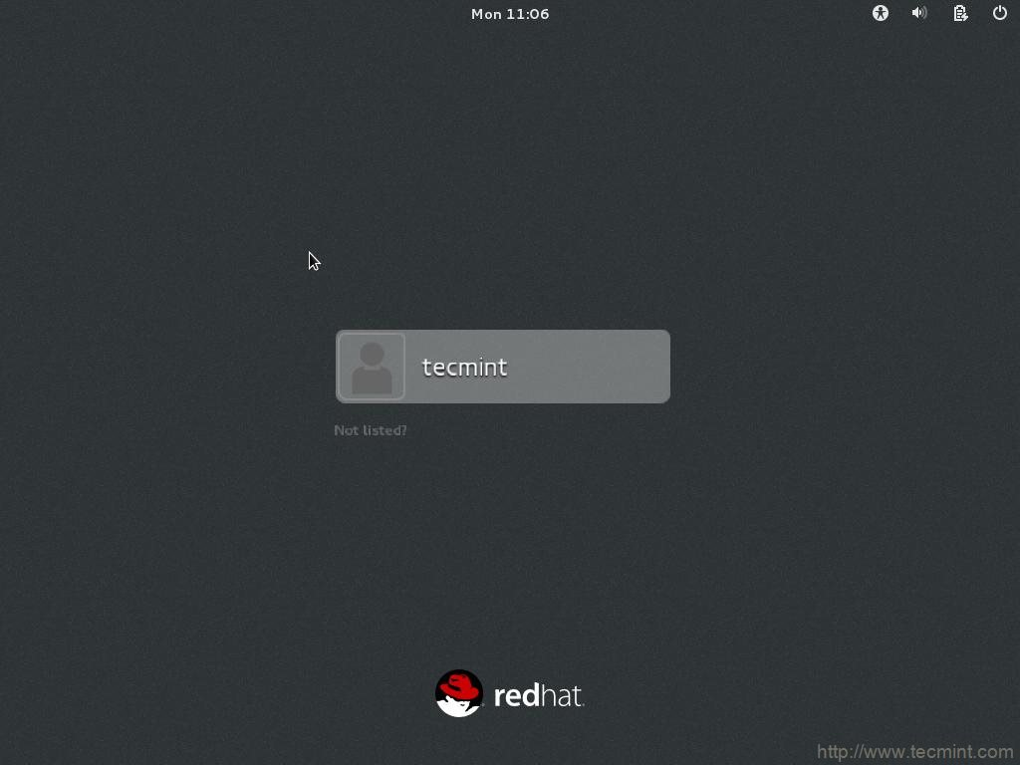
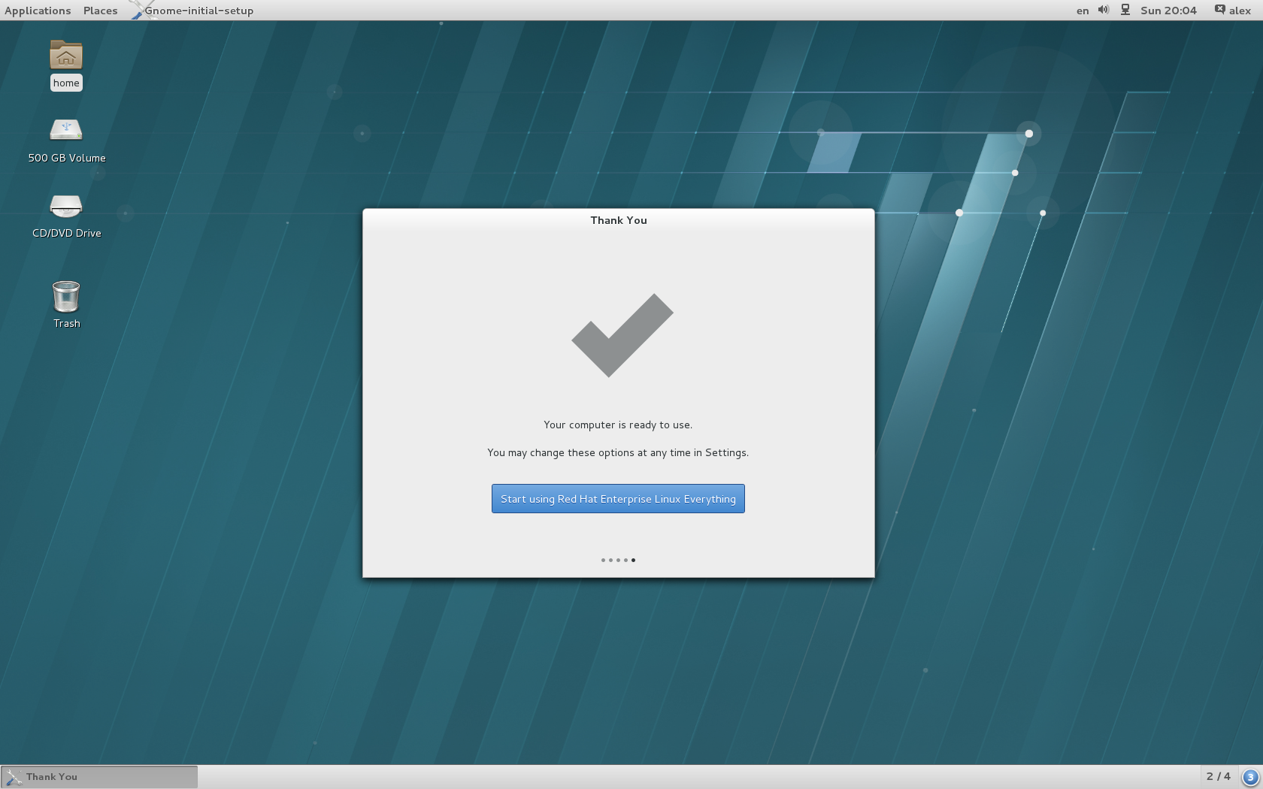
The X-Windows System
Provides a graphical front-end to a Linux host
Never used on enterprise/production servers; Huge waste of space/memory
Can be installed as a yum group: `yum -y groupinstall ‘Server with GUI’`
After X-Windows is installed, the default system target must be changed from multi-user to graphical: `systemctl set-default graphical.target`
You can check what the default system target is: `systemctl get-default`

Slide 19
LFCS Requirements Recap
Essential Commands 25 % Sessions: 1, 2, 3, 5, 10
Operation of Running Systems 20 % Sessions: 2, 4, 5, 10, 12
User & Group Management 15 % Sessions: 8, 9
Networking 15 % Sessions: 11
Service Configuration 10 % Sessions: 4, 5, 11, 12
Virtualization 5 % Sessions: 12
Storage Management 10% Sessions: 6, 7
Review specific exam requirements (domains & competencies) here:
https://training.linuxfoundation.org/certification/lfcs

Slide 20

Live Demonstrations
Please standby as we switch to the live demonstrations which compliment the applications / concepts just taught
Notes:
cd /etc/default
Ls –la
Nano grub
Grub2-mkconfig
Man grub2-mkconfig
Grub2-mkconfig –o /boot/grub2/grub.cfg
Nano /boot/grub2/grub.cfg
Cd /etc
Ls –la sysctl.conf
More sysctl.conf
Man sysctl.conf

Slide 21
Homework Assignment
Create two CentOS virtual machines named CentOS1 & CentOS2
Configure both hosts to use iptables instead of firewalld
Install the “nfsutils” and “rpcbind” packages on CentOS1 & your RHEL Host
Create a directory named “/mynfs” on CentOS1 to be your file share
Create a 10MB file named “mynfsfile.txt” in the “/mynfs” directory on CentOS1
Create an /etc/exports file to share the “/mynfs” directory to your RHEL host only
Start rpcbind on CentOS1, configure it to start across reboots & Verify it is running
Start NFS on CentOS1, configure it to start across reboots & Verify it is running
Configure iptables on CentOS1 to allow access to the proper port for NFS persistently
Create a mount-point on your RHEL Host named “/nfsmount”
Create a persistent mount on your RHEL Host to mount the CentOS1 NFS share
Verify access to the “mynfsfile.txt” file from the RHEL Host in the “/nfsmount” directory

Slide 22
Homework Assignment
Use yum to install the “file-server” package group on CentOS2
Use yum to install the package “policycoreutils-python” on CentOS2
Create a directory named “/mycifs” on CentOS2 to be your file share
Create a 10MB file named “mycifsfile.txt” in the “/mycifs” directory on CentOS2
Edit the /etc/samba/smb.conf file to create a new share named “mycifs” accessible only to the “mycifs” user; Use the “testparm” application to verify your syntax
Start and enable both “smb” and “nmb” on CentOS2 & Verify they are running
Configure the Samba ports 137, 138, 139 & 445 in iptables as persistent on CentOS2
Restart iptables on CentOS2 and verify that the above listed ports are open
Create a user named “mycifs” on CentOS2
Use the smbpasswd binary to create a smbuser named “mycifs” & password “mycifs”
Configure SELinux on CentOS2 to allow SMB shares from “/mycifs”

Slide 23
Homework Assignment
Create a mount-point on your RHEL Host named “/cifsmount”
Install the “cifs-utils” RPM on your RHEL Host
Create the /etc/fstab entry that will persistently mount your SMB share the RHEL host
Mount the SMB (CIFS) share using /etc/fstab
Configure your RHEL Host as a KVM hypervisor
Start libvirtd and make it persistent
Display all CPU Models for x86_64 architectures
Create a user named “special” on your RHEL Host
“su” to the “special” user and verify that the user cannot get any valuable output from the “fdisk –l” or “lvdisplay -v” commands; Try running them with “sudo”; Return to root
Using `visudo` edit the sudoers file so the “special” user can run both of these commands without being prompted for a password

Slide 24
Homework Assignment
Once again “su” to the “special” user and verify that the user cannot get any valuable output from the “fdisk –l” or “lvdisplay -v” commands
Now attempt to run the same commands preceded by “sudo” and observe the results. Return back to root’s shell when finished.
View the NICE value of the httpd process on your RHEL Host
Change the NICE value of the httpd process owned by root on your RHEL host to -10
Confirm that the NICE value has been changed
Install the vsftpd package on your RHEL host; Start it & Make it persistent
Set a password for the root account on hosts CentOS1 & CentOS2
Generate an ssh-keypair for the root account on hosts CentOS1 & CentOS2
Copy the ssh-id from CentOS1 to CentOS2 to enable passwordless logins to CentOS2
Copy the ssh-id from CentOS2 to CentOS1 to enable passwordless logins to CentOS1

Slide 25
Homework Assignment
SSH as the root user from CentOS1 to CentOS2; No password should be required
Create a new logical volume of 500MB named “testcrypt” in any volume group with space on your RHEL host
Install the “cryptsetup” RPM and add the module for “dm_crypt”
Convert the new logical volume to the LUKS format
Open the new logical volume in LUKS
Format the new logical volume as an ext4 filesystem
Echo your passphrase into a file called “/root/luks.key”
Create the /etc/crypttab file showing the mapping to the passphrase file
Add the passphrase file to the LUKS logical volume
Create a mountmount named /mycrypt on your RHEL Host
Add an appropriate entry into “/etc/fstab” for the encrypted logical volume; Test

