Slide 1

LFCS Preparation Training Session X: Basic Shell Scripting & Web Server Configuration
Stuart R. Kirk, MCSA: Linux On Azure, RHCA
Technology Solutions Professional
Global Black Belt Team - Open Source Azure Incubation

Slide 2


Session X Agenda
Basic Shell Script Creation
Environment Variables
I/O Manipulation
Symbolic Links Review
Installing a Webserver
Adding & Restricting Access to Webserver Content

Slide 3
Basic Shell Script Creation
A shell is a program that takes commands and gives them to the operating system to be executed.
A terminal is a program that allows us as end users to interact with the shell.
The BASH shell stands for Bourne Again Shell and is the GNU Project’s default shell.
It incorporates useful features from the Korn shell (ksh) and C-Shell (Csh), offering several improvements at the same time.

Slide 4
Basic Shell Script Creation
A shell script is nothing more than a text file turned into an executable program (script) that combines commands that are executed by the shell one after another
To create a shell script, you simply invoke your favorite text editor as such: `nano myshellscript.sh`
Shell scripts typically end with a .sh extension
Appropriate permissions must be set such that the user is able to EXECUTE the script
To invoke a shell script in your current directory, you simply type its name preceded by the path designator

Slide 5
Basic Shell Script Creation
For example, if you create a script called “myshellscript.sh” in your home directory, you may execute the shell script a number of different ways:
`$HOME/myshellscript.sh`
`/home/<username>/myshellscript.sh`
However it is most easiest to execute a script in the current directory as follows:
`./myshellscript.sh`
The first line of a shell script must always specify how the script is to be interpreted.
A BASH script would start with: #!/bin/bash
A PERL script would start with: #!/usr/bin/perl

Slide 6
Basic Shell Script Creation
As you can see below, the shell script begins with the designation of the interpreter, and then is followed by one or more commands to perform various “scripted” tasks on the host
#!/bin/bash
yum -y update
yum -y install httpd php mysql-server php-mysqlnd
systemctl start httpd
systemctl enable httpd
useradd lfcsuser1
groupadd www
usermod -a -G www lfcsuser1
chown -R root:www /var/www
chmod 2775 /var/www
find /var/www -type d -exec chmod 2775 {} +
find /var/www -type f -exec chmod 0664 {} +
echo “This is my webserver" > /var/www/html/index.html

Slide 7
Environment Variables
As with Windows, Linux also has a number of environment variables which are set for each user logged in to the host.
The system path, for example, is an environment variable; The default system path is maintained in the file: `/etc/profile`
All environment variables can be viewed using the `printenv` command
To globally change the path for all users, the file above would need to be edited to reflect the change
To append text to an existing environment variable which is valid only for the current session, use the command `export PATH=$PATH:/opt/bin`

Slide 8
I/O Manipulation
Manipulation of I/O is an invaluable tool in administering a Linux host
There are many ways to manipulate I/O:
Redirection
Appending
Standard Input
Standard Output
Standard Error
Pipes

Slide 9
I/O Manipulation
It is important to understand the difference between “redirection” and “appending”
Redirection creates a “NEW” file based on the output of your command
Appending concatenates the content of your output to an “EXISTING” file
When appending, if no file exists, a new file is created
Standard Input (stdin) is stream data (usually text) which is being directed into a program
Standard Output (stdout) is the stream where a program displays its output data
All output that we see displayed in the Linux shell is displayed in ‘stdout’

Slide 10
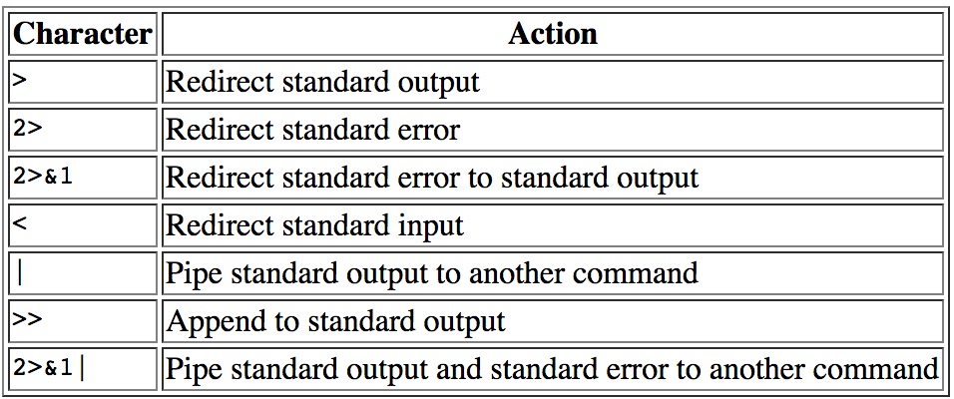
I/O Manipulation
Standard Error (stderr) is another output stream typically used by programs to output error messages or diagnostics
Standard Error output is typically not immediately visible within the shell output; It is a stream independent of stdout and can be separately redirected

Slide 11
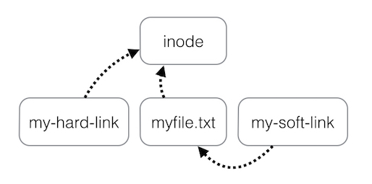
Review of Symbolic Links
ln = Make links between files
Two types of links - hard / symbolic links
Hard links are files pointing to the same inode as the original file
Symbolic links are pointers to existing files
Symlinks can create links
between directories & can
cross filesystem boundaries.
Hard links cannot.
`echo “abc123” > myfile.txt`
`ln myfile.txt my-hard-link`
`ln -s myfile.txt my-soft-link`
If the filename “myfile.txt” changes, “my-hard-link” continues to display the file text since it points to the original inode; my-soft-link will fail

Slide 12
Adding & Restricting Web Server Content
The .htaccess file controls specific, directory-level access to areas of your web sever “DocumentRoot” environment
Many functions can be performed using a .htaccess file including
Restricting access based on IP address
Allowing access based on IP address
Prompting the user to authenticate with a login name and password
Redirecting the user to another site

Slide 13
Adding & Restricting Web Server Content
To allow access from only a specific IP address to a directory’s contents, the following text must be inserted into the .htaccess file
# Allow by IP
<Limit GET POST>
order deny,allow
deny from all
allow from <YOUR IP ADDRESS>
</Limit>

Slide 14
Adding & Restricting Web Server Content
To deny access from only a specific IP address to a directory’s contents, the following text must be inserted into the .htaccess file
# Deny by IP
<Limit GET POST>
order allow,deny
allow from all
deny from <YOUR IP ADDRESS>
</Limit>

Slide 15
Adding & Restricting Web Server Content
Valid IP Addresses
IP addresses are in the form xxx.xxx.xxx.xxx and each of these four numbers is from 0-255.
You can enter partial addresses to restrict larger blocks of addresses:
1.2.3.4 Blocks one specific IP address
1.2.3. Blocks IP address in the range 1.2.3.0 to 1.2.3.255 (ie.. 1.2.3.xxx)
1.2. Blocks IP address in the range 1.2.xxx.xxx
1.2 Blocks IP address in the range 1.2xx.xxx.xxx

Slide 16
Adding & Restricting Web Server Content
The .htaccess file can also force users to authenticate to the web server prior to displaying the contents of a directory
The .htaccess file is configured to point to a special password file which is generated and maintained by the `htpasswd` command
All usernames and password combinations which are part of the special password file will be allowed access to the contents of the directory
The special password file is generated as follows: `htpasswd -c <NameOfPasswordFile> <NameOfUser>`
To add users to the password file, you would invoke the same command with the absence of the “-c” switch which is used to create a new password file

Slide 17
Adding & Restricting Web Server Content
To enable an authenticated web directory, the .htaccess file should contain text similar to the following:
AuthUserFile /full/path/to/your/password/file/created/by/htpasswd
AuthType Basic
AuthName "My Secure Area"
Require valid-user

Slide 18
Adding & Restricting Web Server Content
Prior to ANY changes being permitted by .htaccess, the web server must be configured to allow “Overrides”
This is done by editing the apache configuration file: `nano /etc/httpd/conf/httpd.conf`
Within the section named: <Directory "/var/www/html">
Change the directive: AllowOverride None
To: AllowOverride All
After the change is made, the web server must be restarted in order for the changes to take effect: `systemctl restart httpd`
Do not forget to ensure that appropriate holes are knocked in your firewall for ports 80 and 443 !

Slide 19

Live Demonstrations
Please standby as we switch to the live demonstrations which compliment the applications / concepts just taught

Slide 20
Homework Assignment
Create a directory within your home directory entitled “scripts”
Change to the newly created directory
Create a script entitled “mytest.sh” to perform the following actions:
Output the text “Microsoft <3 Linux”
Output the current path using environment variables
Output the full-user name (not login name) for the sshd user
Configure the script with appropriate permissions so it can be executed
Run the script and verify it is performing as expected
Duplicate this script to create a new file called mytest2.sh

Slide 21
Homework Assignment
In addition to the existing commands in this script, have the script also:
ping www.bing.com a total of three times
Display the number of currently installed RPM packages
Display the current status of SELinux
Install the “kernel-doc” RPM package if it isn’t already installed
Determine the number of times the word “the” appears in the file: “/usr/share/doc/kernel-doc-3.10.0/Documentation/workqueue.txt”
Display the number of currently listening tcp (not tcp6) sockets
Find the location of the apache web server configuration file “httpd.conf” using RPM

Slide 22
Homework Assignment
Configure your apache webserver to allow “All” overrides for your “DocumentRoot”
Restart your web server
Create the directory “ipaddress” in your web server document root
Create the directory “securepass” in your web server document root
For the “ipaddress” directory, set the default web page to display the text “This directory is filtered by IP Address”
For the “securepass” directory, set the default web page to display the text “This directory is password protected”
Ensure that your SELinux contexts are set properly in your DocumentRoot

Slide 23
Homework Assignment
Verify you are able to access the web servers home page
Verify you are able to access content in the “ipaddress” directory
Verify you are able to access content in the “securepass” directory
Determine what your current IP address is
Block access to the “ipaddress” directory using the .htaccess file
Configure the “securepass” directory such that its .htaccess file searches for a username/password file in the same directory named “.mysecrets”
Create the “.mysecrets” file and create a user named “docbrown” with a password of “88mph”
Verify you are NOT able to access content in the “ipaddress” directory

Slide 24
Homework Assignment
Verify you MUST authenticate to access content in the “securepass” directory
Create another user named “mcfly” and set the password to “thatsheavy”
Close your browser windows to clear the password cache then re-launch your browser to the “securepass” directory. Verify that “mcfly” can authenticate

Slide 25



http://…

