Slide 1

LFCS Preparation Training Session III: Deep Dive on Basic Linux Commands
Stuart R. Kirk, MCSA: Linux On Azure, RHCA
Technology Solutions Professional
Global Black Belt Team - Open Source Azure Incubation

Slide 2

Session III Agenda
find / xargs
sed / awk / grep / cut / tr
cd / mv / rm / ls / cp / ln
apropos / man
whoami
diff / cmp / file
chmod
mount / umount
tail / head / nano / vi
setenforce / getenforce
tar / gzip / bzip2

Slide 3
find / exec / xargs
Search for files in a directory hierarchy
Very powerful for searching
Can filter searches based on many criterion:
Name ( -name )
Type (File / Directory) ( -type f / -type d )
Permissions ( -perm ### )
Last Modified / Access Time ( -mtime ## / -atime ## )
User / Group ( -user jdoe / -group foo )
Size ( -size ##M ) or ( -size +aaM -size -bbM ) to search > aaMB & < bbMB
Can perform actions on all of the files found in a search using the “exec” or “xargs” directives `find $HOME -type f -name *.tmp -size +10M -exec rm {} \;`
Notes:
Many different ways to find files, but this is the most efficient way
Find all files in the home directory files that are greater than 10M, type files, end with tmp, rm for remove

Slide 4
sed / awk / cut / grep / tr
sed = stream editor
Replace all instances of “old” with “new” in a file
`sed “s/old/new/g” file.txt` replaces “old” with “new” - output to console
`sed -i “s/old/new/g” file.txt` replaces “old” with “new” - commit to file
awk = pattern scanning and processing language
Show a list of running processes with their resident set size (RSS) value only
`ps aux |awk '{ print "PS:"$11" RSS:"$5}' | sort`
cut = remove sections from each line of files
Show a list of all users and their corresponding login shells only
`cat /etc/passwd |cut -d: -f1,7`

Slide 5
sed / awk / cut / grep / tr
grep = pattern matching (or not) tool
Output all lines with the word “disk” from the kernel docs devices.txt file
`yum -y install kernel-doc` Install the kernel docs - Not there by default
`grep -i disk /usr/share/doc/kernel-doc-3.10.0/Documentation/devices.txt`
Output all lines without the word “disk” from the same file
`grep -iv disk /usr/share/doc/kernel-doc-3.10.0/Documentation/devices.txt`
Output all open files owned by “root” and change “root” to “Admin”
`lsof | grep root | sed “s/root/Admin/g”`
tr = translate or delete characters
Display the “/var/log/secure” file in “ALL CAPS”
`cat /var/log/secure | tr [a-z] [A-Z]`
Notes:
-I

Slide 6


cd / mv / rm / ls / cp / ln -- All relative to `pwd`
cd = Change Directory
Return to Home Directory `cd ~` or `cd $HOME` or `cd`
Go to the Root Directory `cd /`
mv = Move or Rename files / directories
Move foo.txt from home directory to “LFCS” `mv ~/foo.txt ~/LFCS `
Rename foo.txt to file.txt `mv ~/foo.txt ~/file.txt`
rm = Remove files from
Delete the file foo.txt `rm foo.txt` or `rm -f foo.txt` (Root will be prompted)
Delete the directory “deleteme” and all files within `rm -rf ~/deleteme`
Be VERY careful using the “-rf” switch with `rm` as disasters can happen!

Slide 7
cd / mv / rm / ls / cp / ln -- All relative to `pwd`
ls = List files within a directory - ls will show files & directories (use find)
List files in a directory `ls`
Long list files in a directory & show permissions `ls -l`
Long list files and hidden files in a directory & display permissions `ls -la`
List all files in a directory one file at a time `ls -1` (useful for scripting!)
List all files in all directories below /etc recursively `ls -R /etc`
cp = Copy a file from one location to another
Copy file from home dir to LFCS `cp ~/foo.txt ~/LFCS`
Copy /etc/bashrc to home dir and be verbose `cp -v /etc/bashrc ~`
Copy /etc/sudoers to home dir & preserve perms `cp -p /etc/sudoers ~`
Copy all files in & under /etc/sysconfig to ~/LFCS, preserve permissions & be verbose `cp -rvp /etc/sysconfig ~/LFCS`

Slide 8
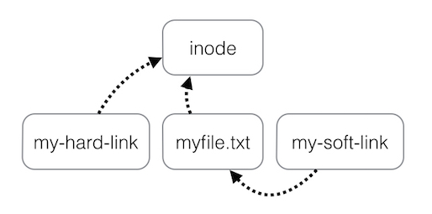
cd / mv / rm / ls / cp / ln -- All relative to `pwd`
ln = Make links between files
Two types of links - hard / symbolic links
Hard links are files pointing to the same inode as the original file
Symbolic links are pointers to existing files
Symlinks can create links
between directories & can
cross filesystem boundaries.
Hard links cannot.
`echo “abc123” > myfile.txt`
`ln myfile.txt my-hard-link`
`ln -s myfile.txt my-soft-link`
If the filename “myfile.txt” changes, “my-hard-link” continues to display the file text since it points to the original inode; my-soft-link will fail

Slide 9
apropos / man
“Man” pages are one of the only sources of information made available to you during the LFCS exam - The other is the `/usr/share/doc` directory
Invoked by entering `man <section> <command>`
`man httpd` will show Section 8 of the httpd man pages - That’s all there is!
`man crontab` will show Section 1 of the crontab man pages
`man 5 crontab` will show Section 5 of the crontab man pages
Different information is contained in each section!
You may also use the `man -k <keyword>` or `apropos <keyword>` commands to perform a keyword search to recall a command you may have forgotten such as: `man -k apache` or `apropos apache`
Don’t forget `rpm -qd <packagename>` will list all docs for an RPM package

Slide 10
whoami / id
`whoami` prints the user name of the current effective user ID
The current user name & ID can also be determined by the `id` command
Linux user ID values (UIDs) from usually 1000 to 60000
User ID values greater than “0” and less than “1000” are usually system / application / services accounts
Normal unprivileged users typically have a user ID greater than 1000
User ID ranges are stored in the `/etc/login.defs` file
The `id` command and `echo $USER` will also show the current user name
Using the `printenv` command will display current environment variables
The root user of any Linux host is always holds user id “UID 0” (zero)

Slide 11
diff / cmp / file / strings
diff = Compare files line by line
`diff -y file1.txt file2.txt`
cmp = Compare files byte by byte
`cmp /usr/bin/passwd /usr/bin/bash`
file = Determine file type
`file /usr/bin/seq`
strings = Print the strings of printable characters in files
`strings /usr/bin/seq`

Slide 12
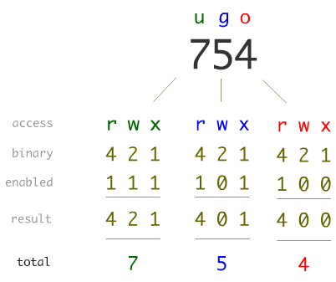
Linux Permissions (review)
Basic Linux permissions broken up into 3 permissions groups: user, group, others
Permissions can be set in each group for read, write, execute
Permissions manipulated with the `chmod` command.
Can be set using binary references or explicitly:
chmod u+x foo.txt; chmod g+r foo.txt
chmod 644 foo.txt
---------- /etc/shadow
-r--r----- /etc/sudoers
-r--r--r-- /etc/machine-id
-rw------- /etc/crypttab
-rw-r----- /etc/brlapi.key
-rw-r----- /etc/chrony.keys
-rw-r--r-- /etc/chrony.conf
-rw-r--r-- /etc/cron.deny
-rw-rw-r-- /etc/fstab
-rw-rw-r-- /etc/hostname
-rwx--x--x /usr/bin/testapp

Slide 13
mount / umount
Allows additional block devices to be mounted to a Linux hosts
Block devices can be mounted natively or provisioned as LVM PVs
You must `mkfs` or “Make a file system” on a block device prior to `mount`
File systems are attached to “mount points” which are empty directories
There are many different types of file systems: ext4, xfs, btrfs, etc
All file systems to be mounted are defined in the file `/etc/fstab`
Can be defined by the path to the block device, label, or UUID
Assign a label to an ext4 FS to allow easy reference in fstab `e2label <device> <label>`
View a file system’s UUID using blkid `blkid` or `blkid -o list`

Slide 14
mount / umount
Become root
Create required subdirectories for filesystems and mount points
`mkdir ~/fs-files ; mkdir ~/fs-mount{1..3}`
Create 3 x 20MB file to be used as filesystems
`for i in {1..3}; do dd if=/dev/zero of=~/fs-files/fs$i count=40960; done`
Format the first as an ext4 filesystem
`mkfs -t ext4 ~/fs-files/fs1` (Answer yes to ‘proceed anyway’ question)
Mount the first filesystem under the first mount point & verify
`mount ~/fs-files/fs1 ~/fs-mount1`
`df -h`

Slide 15
mount / umount
Create an empty file in this file system named “myfile-USERNAME” substituting with a variable & verify its creation
`touch ~/fs-mount1/myfile-$USER`
`ls ~/fs-mount1`
Un-mount the first filesystem
`umount ~/fs-mount1`
Verify the empty file no longer exists
`ls ~/fs-mount1`

Slide 16
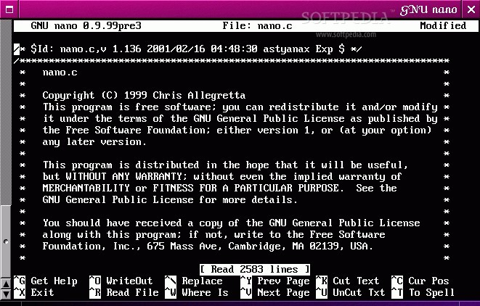
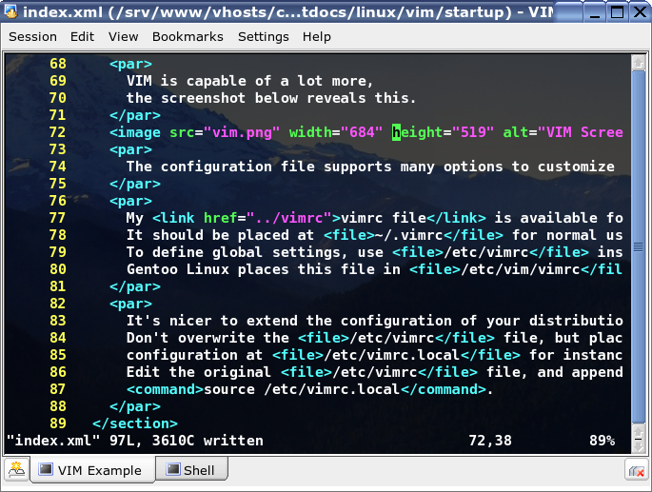
tail / head / nano / vi
tail = Output the last part of files (10 lines by default)
head = Output the first part of files (10 lines by default)
nano = A TUI-based text editor
vi = A terse, but widely used and powerful, text editor

Slide 17
tail / head / nano / vi
Output the last 5 lines of /var/log/messages & /var/log/secure
`tail -n 5 /var/log/messages /var/log/secure`
Follow the /var/log/messages file & generate output to it
`tail -f /var/log/messages`
`for i in {1..20}; do logger Hi number $i ; done` (In a new window)
Print the first two lines of the /etc/passwd file
`head -n 2 /etc/passwd`
Print only lines 15 through 20 of the /etc/passwd file
`head -n 20 /etc/passwd | tail -n 5`

Slide 18
setenforce / getenforce
Part of the SELinux software portfolio
SELinux = Security Enhanced Linux
Three states: Enforcing / Permissive / Disabled - use `getenforce` to check
If something isn’t working, try switching SELinux to “Permissive” mode
`setenforce 0` <Try your action again> `setenforce 1` to resume Enforcing
View security contexts using the `ls -Z <filename>` command
If permissive SELinux is successful, and enforcing SELinux fails, review security contexts to determine if the correct context is set on file/directory
Reset security contexts on the files / directories that are set incorrectly
`restorecon -r /path/to/recursively/change` or `restorecon <file>`
When in doubt, always assume exams are graded “Enforcing”

Slide 19
tar / gzip / bzip2
Compression in Linux is centered around tar / bzip
tar = Tape Archive - Archives often referred to as a “tarball”
gzip = Compress or expand files (Quickest & small memory footprint)
Create a tarball of /etc & compress with gzip `tar cvfz ~/etc.tar.gz /etc/*`
Uncompress the file just created `gunzip ~/etc.tar.gz` (produces ~/etc.tar)
View the contents of the tarball `tar tvf ~/etc.tar`
Extract the tarball `tar xvf ~/etc.tar`
Copy all files from /var/log into ~/varlog `tar cf - /var/log | (cd ~/varlog; tar xvf -)`
Other applications exist for bulk copy beyond tar such as `rsync`

Slide 20
tar / gzip / bzip2
bzip2 = Block Sorting File Compressor (Typically better compression)
bzip2 will compress individual files; It will not archive; Use tar to archive 1st!
Extension is typically .bz2
Create a tarball of /etc & compress with bzip2
`tar cvfj ~/etc.tar.bz2 /etc/*`
Uncompress the file just created
`bunzip2 ~/etc.tar.gz` (produces ~/etc.tar)
Find all non-current log files, files that have been log-rotated, and bzip them
`ls -1 /var/log/*2016* | while read name ; do bzip2 $name; done`

Slide 21

Live Demonstrations
Please standby as we switch to the live demonstrations which compliment the applications / concepts just taught

Slide 22

Poll #2 - Format

Slide 23
Homework Assignment
Find all read-only files in /etc
Create 150 dummy files in ~/dummydir named “dummyfile1” to “dummyfile150”
Remove “dummyfile80” to “dummyfile89”
Set the permissions of all files named “dummyfile70” to “dummyfile79” to “rwxrwxrwx”
Output the last 10 lines of the password file into the file “dummyfile1”
Output the top 150 lines of the messages log file into the file “dummyfile2”
Find all files in /usr that are greater than 3MB
How many empty files are present in your home directory?
Copy the /etc/bashrc file to dummyfile5
Replace all instances of the word “if” with the word “MICROSOFT” in this file
Determine the command to display the routing table

Slide 24
Homework Assignment
Display only the third column of the last three lines of the routing table
Show a list of all users and their home directories and redirect to “dummyfile6”
Copy the contents of the httpd configuration file to “dummyfile7”
Output all lines that contain the word “the” or “The” in “dummyfile7” to “dummyfile8 “
Output all contents of “dummyfile8” into “dummyfile9” making sure all lower case
Create a hard-link to /etc/redhat-release from ~/hardVersion
Create a symbolic link to /etc/redhat-release from ~/symVersion
Output your username to “dummyfile99”
View a side-by-side comparison of the “/etc/passwd” and “/etc/shadow” files
Make sure “dummyfile40” can be read/written/executed by anyone
Make sure “dummyfile41” can only be read by root – and nothing else.

Slide 25
Homework Assignment
View the SELinux contexts of “dummyfile66”
Move “dummyfile66” to the ServerRoot directory found in the httpd config file
View the SELinux contexts of “dummyfile66” in the httpd config directory
Fix (restore) the SELinux contexts of “dummyfile66” appropriate for web content
Preserving original file permissions and in a single command, create a gzip’d tarball named ~/myarchive.tar with contents from all of the following:
/etc/sysconfig/network-scripts
/var/lib/yum/repos
“dummyfile90” .. “dummyfile99” under the “dummydir” directory
Repeat #27 but instead compress with bzip2
BONUS: Count the number of files in /etc which haven’t been accessed this year
BONUS: Add the values in the 5th column of the last 4 rows of the routing table up

Slide 26
Poll #3 – Depth of Content

