Slide 1

LFCS Preparation Training Session V: Service execution and control
Khaled Elbedri: RHCA
Technology Solutions Professional
Global Black Belt Team – Open Source Azure Incubation

Slide 2

Objectives
Historical overview on Linux system startup services
Learn how systemd starts up system daemons and network services
Learn how to manage services and the boot-up process using sysemctl
Control and troubleshoot system boot using systemd targets

Slide 3
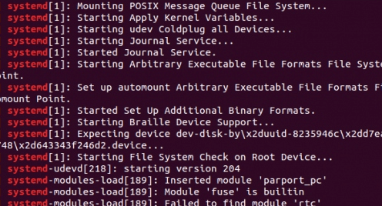
The boot process
BIOS, POST, initialize the hardware
Find bootable devices (MBR)
Read and pass control to the boot loader
Load the kernel and initramfs in RAM
Hand-over to the kernel
Initialize the hardware and executes first process /sbin/init (ID=1)
On Red Hat Entreprise Linux 7, systemd is replacing init

Slide 4

Daemons & services
Daemon: is a process that wait or run in the background performing various tasks. To listen for connections, a daemon uses a socket. Sockets may be created by daemons or may be separated from the daemon and be created by another process, such as systemd, which then passes the socket to the daemon when a connection is established by a client.
Service: often refers to one or more daemons, but starting or stopping a service may instead make a one-time change to the state of the system (for example, to configure network interfaces), which does not involve leaving a daemon process running afterward.

Slide 5

A bit of history
For many years, process ID 1 of Linux and UNIX systems has been the init process.
This process was responsible for activating other services on the system.
Frequently used daemons were started on systems at boot time with System V and Linux Standard Base (LSB) init scripts.
Less frequently used daemons were started on demand by another service, such as initd or xinetd.
Runlevels: Configuration or operating state of the system that defines the status of each System V service.

Slide 6
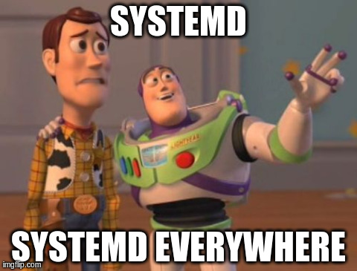
systemd
Init has several limitations, which are addressed with systemd.
systemd is a system program used to bootstrap the user space and manage all processes.
With systemd, shell-based service scripts are used only for a few legacy services

Slide 7
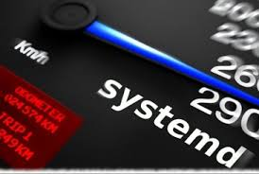
Systemd, benefits
Parallelization capabilities, which increase the boot speed of a system.
Automatic service dependency management prevents long timeouts, such as not starting a network service when the network is not available.

Slide 8
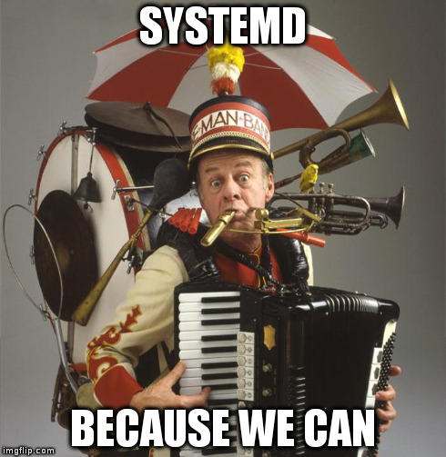
Systemd, benefits
On-demand starting of daemons without requiring a separate service.
A method of tracking related processes together using Linux control groups.

Slide 9
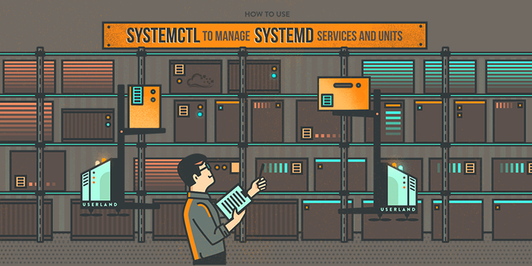
systemctl
systemctl is a command used to introspect and control the state of the systemd system and service manager.
systemctl is used to manage different types of systemd objects, called units.
Systemd is compatible with System V
Example:
[root@azurevm ~] ~]$ service httpd status
Redirecting to /bin/systemctl status httpd.service

Slide 10
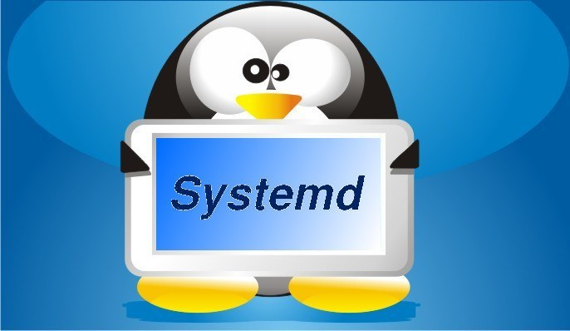
systemctl and systemd units
A list of available unit types can be displayed with systemctl -t help
Common unit types:
Service units have a .service extension and represent system services.
Socket units have a .socket extension and represent inter-process communication (IPC) sockets.
Path units have a .path extension and are used to delay the activation of a service until a specific file system change occurs.

Slide 11

Service states
The status of a service can be viewed with systemctl status name.type.
If the unit type is not provided, systemctl will show the status of a service unit, if one exists.
[root@azurevm ~]# systemctl status sshd.service
[root@azurevm ~]# systemctl is-active sshd
[root@azurevm ~]# systemctl is-enabled sshd

Slide 12
Service states
State | Description
Loaded | Unit configuration file has been processed
Active (running) | Running with one or more continuing processes.
Active (exited) | Successfully completed a one-time configuration
Active (waiting) | Running but waiting for an event. inactive Not running.
Enabled | Will be started at boot time
Disabled | Will not be started at boot time
Static | Cannot be enabled, but may be started by an enabled unit automatically

Slide 13

Managing services at run time
Starting, stopping, restarting, reloading, and verifying status are common actions performed when administering services
systemctl start|stop|restart|reload| unit.service
Services may be started as dependencies of other services.
systemctl list-dependencies unit
To prevent an administrator from accidentally starting a service, a service may be masked
systemctl mask unit

Slide 14

Managing service at boot
Services are started at boot time when links are created in the appropriate systemd configuration directories.
These links are created and removed with systemctl commands
Enable the service
systemctl enable name.service
Disable the service
systemctl disable name.service
Verify the status of the service after boot
systemctl is-enabled name.service

Slide 15
Demo

Slide 16
Summary of systemctl commands
Command | Description
systemctl status UNIT | View detailed information about a unit state.
systemctl stop UNIT | Stop a service on a running system.
systemctl start UNIT | Start a service on a running system.
systemctl restart UNIT | Restart a service on a running system.
systemctl reload UNIT | Reload configuration file of a running service.
systemctl mask UNIT | Completely disable a service from being started, both manually and at boot.
systemctl unmask UNIT | Make a masked service available.
systemctl enable UNIT | Configure a service to start at boot time.
systemctl disable UNIT | Disable a service from starting at boot time.
systemctl list-dependencies UNIT | List units which are required and wanted by the specified unit.

Slide 17
Systemd targets
A systemd target is a set of systemd units that should be started to reach a desired state. Important targets are listed in the following table.
An overview of all available targets can be viewed with:
[root@azure-vm ~]# systemctl list-unit-files --type=target --all
Target | Description
graphical.target | System supports multiple users, graphical and text-based logins
multi-user.target | System supports multiple users, text-based logins only
rescue.target | sulogin prompt, basic system initialization completed.
emergency.target | sulogin prompt, initramfs pivot complete and system root mounted on / read-only

Slide 18

Selecting a target
At run time
systemctl isolate name.target
As a default
systemctl get-default
systemctl set-default name.target

Slide 19

Exam objectives
https://training.linuxfoundation.org/certification/lfcs
Boot, reboot, and shut down a system safely
Boot systems into different runlevels manually
Manage the startup process and services
Configure network services to start automatically at boot
Start, stop, and check the status of network services
Query and modify the behavior of system services at various run levels

Slide 20

Homework Assignment I
Query the state of all units to verify a system startup.
Query the state of only the service units.
Investigate any units which are in a failed or maintenance state.
List the active state of all loaded units.
View the enabled and disabled settings for all units.
View only failed services.

Slide 21
Homework Assignment II
Ssh into an rpm based linux host (RedHat, Centos, Fedora…)
If not installed, install the required packages to run Apache
Create an index.html file in /var/www/html
Verify the status of httpd service, then start it. Use a web client to verify that the file content is available at http://localhost
Display the status of the httpd service. Note the process ID of the daemon.
Restart the httpd service and view the status. Has the process ID of the daemon changed?
Display the status of sshd service. Note the process ID of the daemon.

Slide 22
Homework Assignment II
Reload the sshd service and view the status. Has the process ID of the daemon changed? Did the ssh connection get interrupted?
Determine if httpd is enabled at system boot
Disable httpd from starting at system boot. Reboot the system and verify the status of httpd
Start httpd and reboot the system, again. What is the status of httpd after reboot?
Enable httpd and verify that the service is up at the next boot.
Now that you have done a great job, you deserve a special treat ☺
# yum install sl -y
# sl

Slide 23

Questions?

