Slide 1

LFCS Preparation Training Session VII: Deep Dive – LVM / RAID / Swap
Stuart R. Kirk, MCSA: Linux On Azure, RHCA
Technology Solutions Professional
Global Black Belt Team - Open Source Azure Incubation

Slide 2

Introduction
This is a new program designed by Linux experts for all Microsoft FTEs
Sessions will be one hour in length, recorded, and will be delivered in a slide + live demonstration format
Recordings will be posted at http://aka.ms/linuxlfcsprep
Instructors will be members of the Open Source GBB team and other Linux experts at Microsoft
The training material of the program will be focused on the areas tested in the LFCS exam
This training program will not guarantee that you pass the LFCS exam; Significant practice and comfort with the concepts taught is required prior to taking the examination

Slide 3

Session VII Agenda
Creating & Manipulating LVM
Creating PVs / VGs / LVs
Extending LVs & Online resize
LVM Discovery & Forensics
Reducing File Systems / LVs
Other LVM Commands
Software RAID
mdadm
Creating & Manipulating swap
swapon

Slide 4
LVM Refresher - Traditional Linux File System Layout
/ (root)
/home
/usr
/var/log
/dev/sdb1
/dev/sdb2
/dev/sdb3
/dev/sdb5
10GB
Free
0GB
10GB
80GB
40GB
20GB
40GB
30GB
100GB
/dev/sdb
100GB
How do we increase the size of /usr ?
Can we move space from /home to /usr ?
We forgot to create a /var/tmp partition which can lead to DoS. Now what?

Slide 5
LVM Layout
Available Space
In rootvg
100GB
20GB
0 GB
100GB
20GB
0 GB
File Systems
/ (root)
/home
/usr
/var/log
20GB
20GB
40GB
50GB
100GB
30GB
10GB
Logical
Volumes (LV)
rootlv
homelv
usrlv
varloglv
Volume
Groups (VG)
rootvg
rootvg
Physical
Volumes (PV)
/dev/sdb1
/dev/sdb2
/dev/sdc1
Partitions
/dev/sdb1
/dev/sdb2
/dev/sdc1
Physical Drives
/dev/sdb
100GB
/dev/sdc
100GB

Slide 6
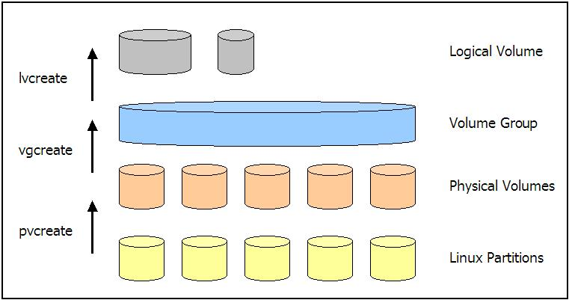
Physical Volumes
Used as the raw physical layer for Logical Volume Management (LVM)
Set up new partitions with `fdisk`
Use `t` to change to type `8e` inside fdisk
Use the `pvcreate` command to initialize the newly created partitions
Verify that physical volumes exist using either the `pvscan` or `pvs` commands

Slide 7
Volume Groups
Volume groups are the “pools” which are created and backed by physical volumes
Multiple VGs can exist on a host
Use `vgcreate` followed by the name of the VG and a list of the backing PVs to create the VG
Verify important information on VGs using either the `vgscan` or `vgs` commands
VGs can be extended or reduced as needed and with mounted file systems*
* = XFS file systems can only be expanded and not reduced in size. ext4 file systems can be both grown and shrunk. This is a known issue to Red Hat under BZ#1062667

Slide 8
Logical Volumes
Logical Volumes are the actual “slices” of disk or “volumes” that will host the file systems and subsequent data
Use the `lvcreate` command followed by the name of the LV, size, and VG it should belong to in order to initialize a new LV
Verify that LVs exist using either the `lvscan` or `lvs` commands
Remember to create a file system after you create the LV. `mkfs –t ext4 /dev/vgname/lvname`

Slide 9
Extending a Logical Volume & Resizing a File System
To increase the size of an ext4 file system, you must first increase the size of its LV. For example:
`lvextend -L +1G /dev/vgname/lvname` would increase the LV “lvname” by 1GB
`lvextend -L 5G /dev/vgname/lvname` would increase the LV “lvname” to a total of 5GB. This assumes the current size is less than 5GB
`lvextend -l +100%FREE /dev/vgname/lvname` would take all of the free extents available in “vgname” and add them to the LV “lvname”
If there is not enough space in the VG to extend, then additional PVs must be added to the VG to increase the size of the “pool” as shown in the animation

Slide 10

Extending a Logical Volume & Resizing a File System
After the LV is extended, the filesystem itself must also be extended.
This is done by the `resize2fs` command for ext4 file systems as shown: `resize2fs /dev/vgname/lvname`

Slide 11
Shrinking File Systems & Reducing Logical Volumes
Not available with XFS file systems; Data *should* be backed up!
First the file system must be unmounted using the `umount` command
It is recommended to run a file system check on the LV and repair any inconsistencies found: `e2fsck –f /dev/vgname/lvname`
The filesystem must first be reduced in size to the size specified: `resize2fs /dev/vgname/lvname 10G`
The LV can now be reduced by the same amount: `lvreduce –L 10G /dev/vgname/lvname`
Re-check the shrunk file system: `e2fsck –f /dev/vgname/lvname`
The filesystem should be re-sized once more due to rounding of physical extended `resize2fs /dev/vgname/lvname` (note no size is specified)

Slide 12
Other LVM Commands
`rpm –ql lvm2` for a list of all commands
Useful commands:
`vgsplit`
`pvmove`
`lvconvert`
The config file for LVM is stored at `/etc/lvm/lvm.conf`
Logical Volume Management can also employ striping, mirroring, snapshotting (with rollback!) and other redundancy
The end result is a highly flexible file system that allows for quick space remediation and disaster recovery

Slide 13
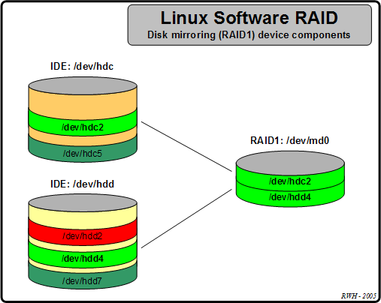
Linux Software RAID
RAID devices in Linux are managed by the `mdadm` command (multiple device)
The “EXAMPLES” section of the `mdadm` man page provides a wealth of knowledge!
RAID devices in Linux can be of type 0, 1, 4, 5, 6, 10 and can include hot spares
d

Slide 14
Creating RAID Volumes
Partitions which are intended to be part of a RAID array must be set to type “fd” within `fdisk`
As with LVM, RAID devices are backed by raw physical partitions
A RAID 5 striped volume would be created by typing: `mdadm --create /dev/md0 --level=5 --raid-devices=3 /dev/sdc1 /dev/sdc2 /dev/sdc3` or much shorter: `mdadm -C /dev/md0 -l=5 -n=3 /dev/sdc[1-3]`
You can view information on current RAID configuration with the commands: `cat /proc/mdstat` and `mdadm –detail /dev/<devicename>`
After the RAID device is created, in the same manner after you create a logical volume, a filesystem must be created: `mke2fs –t /dev/mdX`

Slide 15
Create & Add a Swap Partition
Linux swap devices should exist regardless of how much memory is on an individual host and can be either raw partitions or files in a file system
Recommended swap sizes were presented in the last session, however an application vendor may also mandate a certain amount of swap
Swap partitions are set in `fdisk` as type “82”
They must also be entered into “/etc/fstab” to be persistent. Both the mount point and the file system type can be specified as “swap”
After the new swap partition is defined, it must be formatted as such: `mkswap /dev/sdcX`
The swap device must also be activated: `swapon /dev/sdcX`
View information about existing swap configuration using `cat /proc/swaps`

Slide 16

Live Demonstrations
Please standby as we switch to the live demonstrations which compliment the applications / concepts just taught

Slide 17
Homework Assignment
Add a 5G disk to your RHEL virtual machine using the Azure CLI
Verify the disk has been added – It should be added as /dev/sdc
Create 8 partitions all of size 500MB as follows:
4 x Linux LVM
3 x Linux RAID Autodetect
1 x Linux Swap
Create 4 LVM physical volumes on partitions 1, 2, 3, and 5
Verify the physical volumes exist
Create a volume group called “datavg” using partitions 1, 2 and 3
Verify the new volume group exists and verify the amount of space available

Slide 18
Homework Assignment
Create 3 logical volumes of 400MB each called “lv1” “lv2” and “lv3”
Format the three logical volumes as ext4 file systems
Create the directory “/testmounts” with the mount-points “mp1” through “mp4” inside
Set a filesystem label named “mount1” on the “lv1” logical volume
Determine the UUID of the “lv2” logical volume
Set the “lv1” LV to mount persistently using the label set in Q11 to “/testmounts/mp1”
Set the “lv2” LV to mount persistently using the UUID from Q12 to “/testmounts/mp2”
Set the “lv3” LV to mount persistently using the raw path to “/testmounts/mp3”
Mount all of the new file systems and verify success
Attempt to create another 400MB logical volume named “lv4” in the same VG.
Fix the problem by adding the unused LVM PV to the VG

Slide 19
Homework Assignment
Attempt to create the LVM once again
Increase the size of the “lv1” logical volume by 200MB without unmounting it
Increase the size of the ext4 fs on “lv1” to the new capacity without unmounting it
Verify the “lv1” file system is now roughly 600MB in size
Add the rest of the free space in the “datavg” VG to the “lv2” LV
Increase the size of the ext4 fs on “lv2” to the new capacity without unmounting it
Verify that the “lv2” file system is now just over 550MB in size
Verify that there is no more space left in the “datavg” VG
Create a RAID 1 Mirror on the first two RAID partitions you created in Q3
Verify the existence of the RAID 1 Mirror
Create an ext4 fs on the new RAID 1 Mirror device

Slide 20
Homework Assignment
Set the RAID mirror to mount persistently using the its UUID to “/testmounts/mp4”
Mount the new file system and verify success
Add the last of the RAID partitions you created in Q3 as a hot spare to the RAID1 array
Verify the hot spare has been added to the RAID 1 array
Create a 300MB file in “/testmounts/mp4” called myraidfile
Determine the md5sum of the “myraidfile” file which you just created in Q34
Mark the first RAID partition that makes up the array as “failed”
Immediately watch the detail of the RAID array and notice the “Rebuilding” directive
Remove the failed RAID partition from the array
Add the RAID partition you removed in Q38 back into the array to be the new spare
Verify the hot spare has been added to the RAID 1 array w/ the different partition #

Slide 21

Homework Assignment
Verify the md5sum of the “myraidfile” file has not changed
View the amount of available swap space
Format the new swap partition which you created in Q3
Enable the new swap partition
Set the new swap partition to mount persistently
Verify the new swap space is available to the host

