Slide 1

LFCS Preparation Training Session VIII: Deep Dive System Configuration I
Khaled Elbedri: RHCA
Technology Solutions Professional
Global Black Belt Team – Open Source Azure Incubation

Slide 2

Objectives
2
Setting the hostname
Adding, removing users
Configuring user templates
Aging, expiring user accounts
Security limits

Slide 3
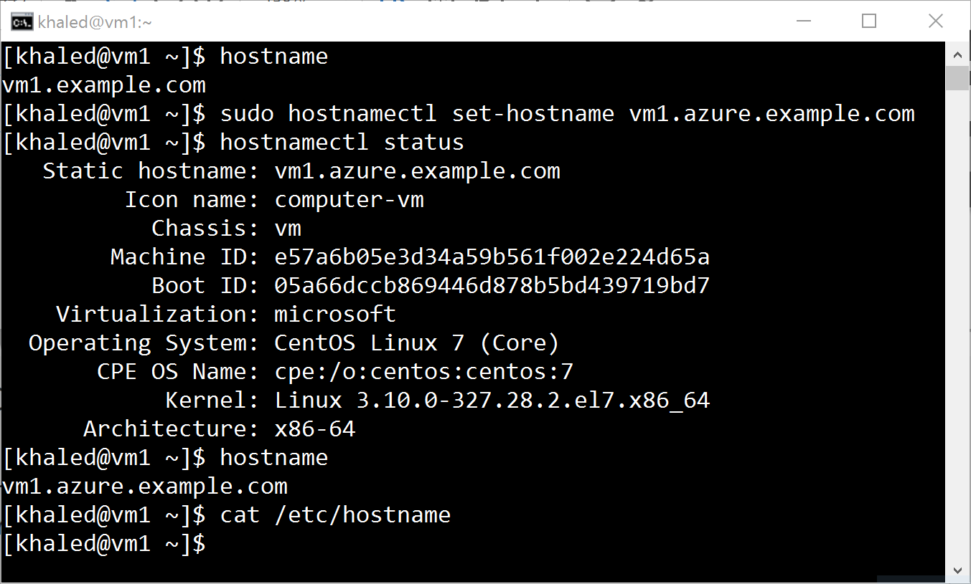
Configuring Hostnames
3
The hostname command displays or temporarily modifies the system's fully qualified host name
The static host name is stored in /etc/hostname (previously /etc/sysconfig/network )
The hostnamectl command is used to modify this file and may be used to view the status of the system's fully qualified hostname

Slide 4
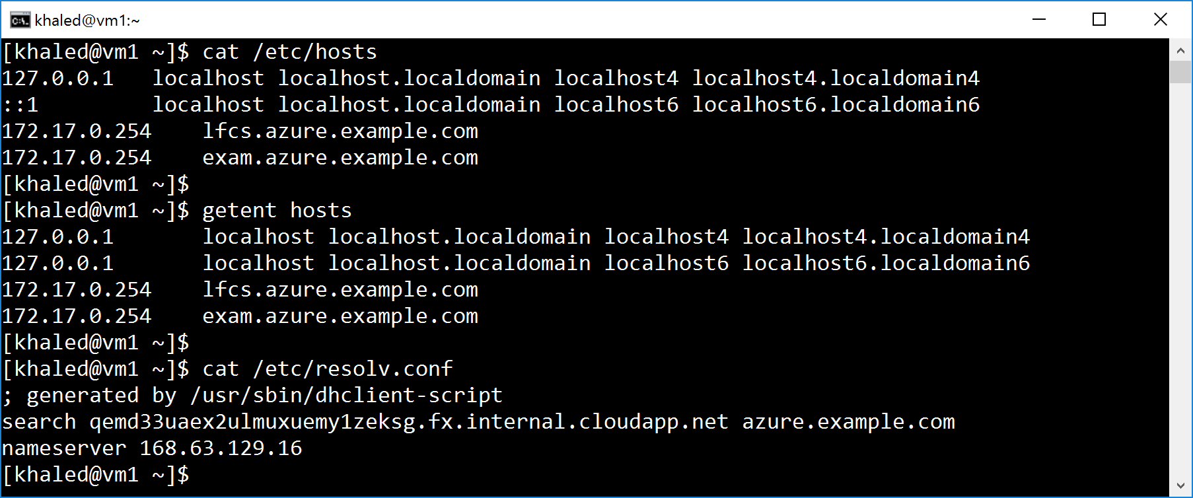
Configuring Name Resolution
4
Stub resolver converts host name to IP@ or the reverse
/etc/hosts is checked first (use getent hosts to test local hostname resolution)
If no local file, the stub resolver looks at DNS from /etc/resolv.conf

Slide 5
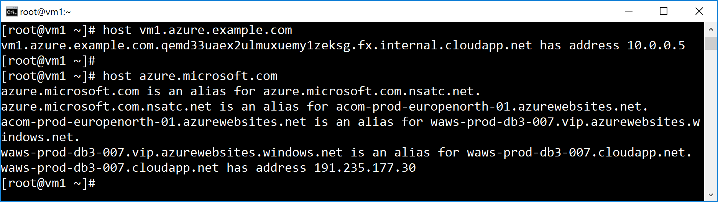
Configuring Name Resolution
5
The hostname command can be used to test DNS server connectivity
If DHCP is in use, /etc/resolv.conf is automatically rewritten as interfaces are started, unless you specify PEERDNS=no
The change can also be made with nmcli

Slide 6
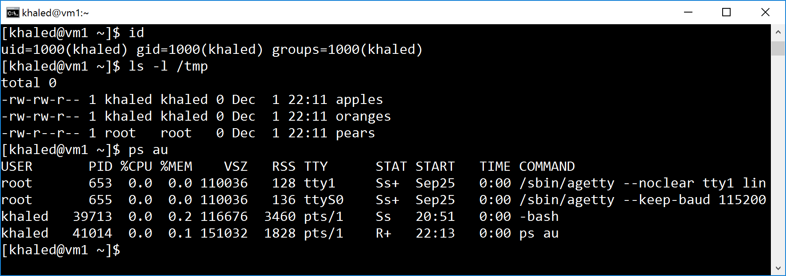
Managing local Linux Users
6
The id command shows logged-in user
The ls –l shows the user associated with a file or a directory
The ps –au shows the processes associated with a user

Slide 7
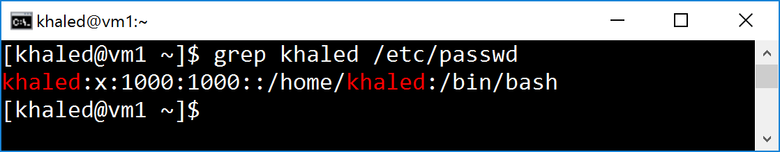
Managing local Linux Users
7
The operating system tracks users by a UID number
By default, systems use a simple "flat file," the /etc/passwd file, to store information about local users
Passwords are kept in encrypted format in /etc/shadow

Slide 8
Managing local Linux Users
8
Username: a mapping of a UID to a human name.
Password: where, historically, passwords were kept in an encrypted format. Today, they are stored in a separate file /etc/shadow.
UID: a user ID number that identifies the user.
GID: the user's primary group ID number.
GECOS: arbitrary text, which usually includes the user's real name.
/home/dir: the location of the user's personal data and configuration files.
Shell: a program that runs as the user logs in. For a regular user, this is normally the program that provides the user's command line prompt.

Slide 9
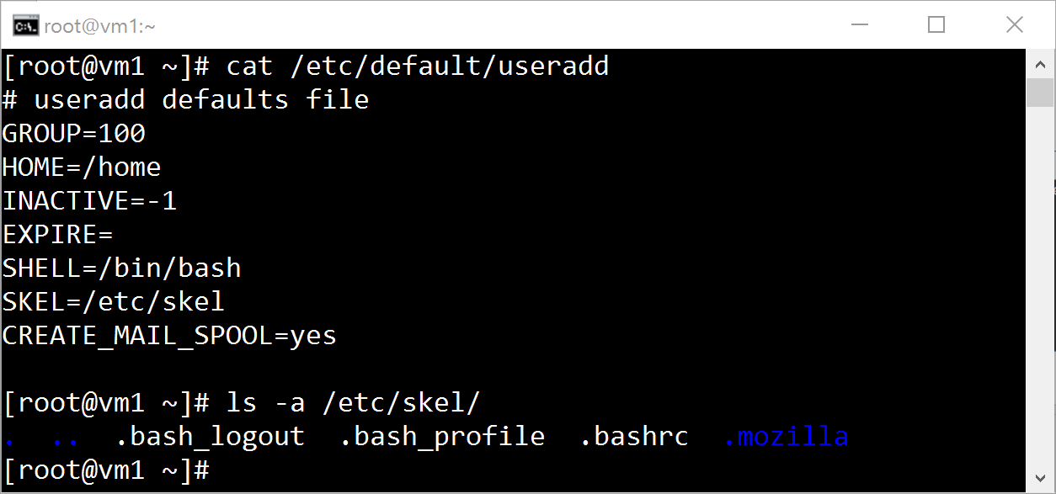
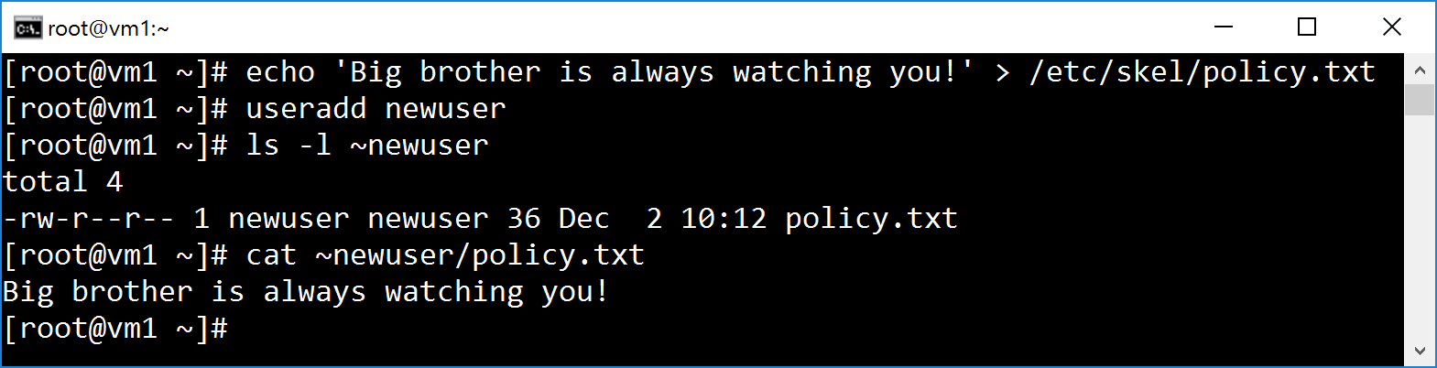
Configuring users template
9
User account default settings are defined in /etc/default/useradd
The /etc/skel directory contains files and directories that are automatically copied over to a new user's home directory when such user is created by the useradd command

Slide 10
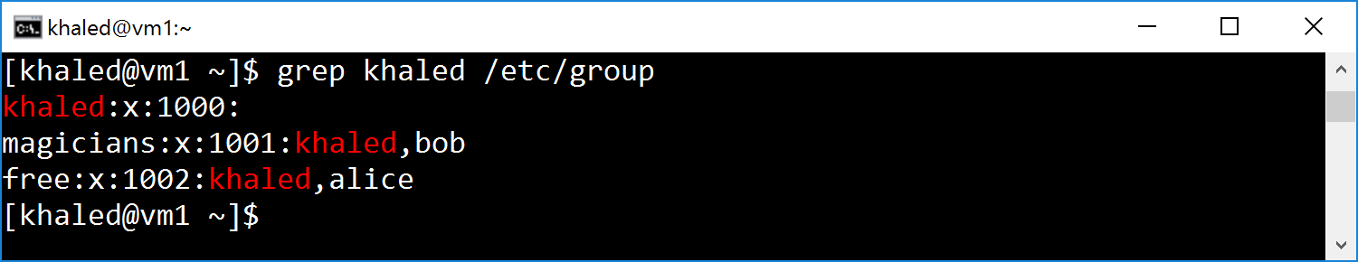
Managing local Linux Groups
10
Like users, groups have a name and a number (GID)
Local groups are defined in /etc/group
Every user has exactly one primary group

Slide 11
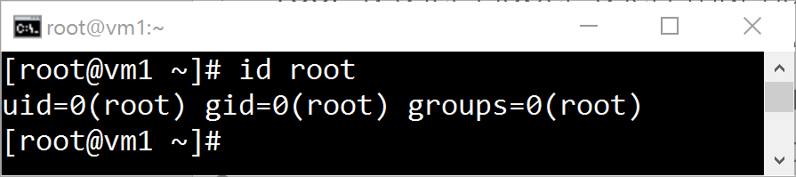
Gaining Super User Access
11
root: a user (super-user) that has all power over the system
Used to manage and administer the system
Equivalent to local Administrator account on Windows
root has unlimited power to damage the system!

Slide 12
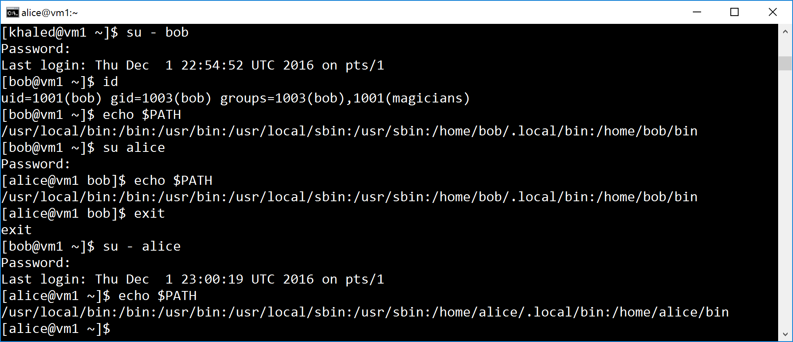
Switching Users With SU
12
The su [-] <username> command allows a user to switch to a different user account
The command su username starts a non-login shell, while the command su – username starts a login shell
Linux Policykit equivalent to Windows User Account Control

Slide 13
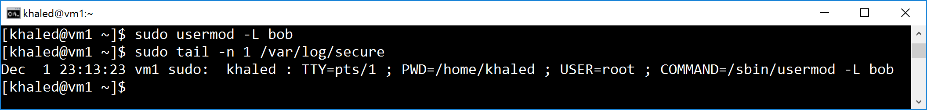
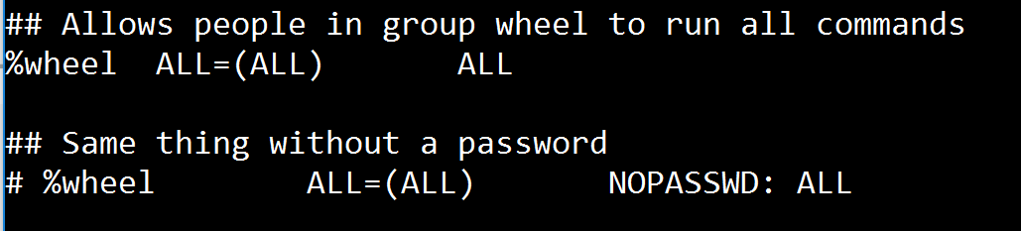
Running commands as root with sudo
13
Run command as root, based on settings in the /etc/sudoers file (visudo)
sudo requires users to enter their own password for authentication, not the password of the account they are trying to access
Commands executed using sudo are logged by default to /var/log/secure
visudo edits the /etc/sudoers file in a safe fashion

Slide 14
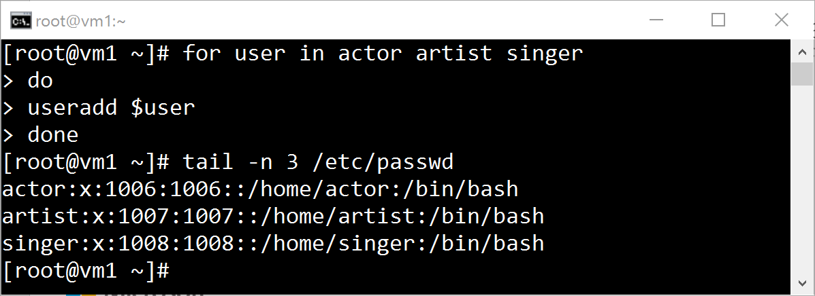
Managing Local User Accounts
14
The useradd command creates new users
The useradd command does not set any valid password by default.
useradd --help displays the basic options that can be used to override the defaults
Some defaults, such as the range of valid UID numbers and default password aging rules, are read from the /etc/login.defs file (at creation)

Slide 15
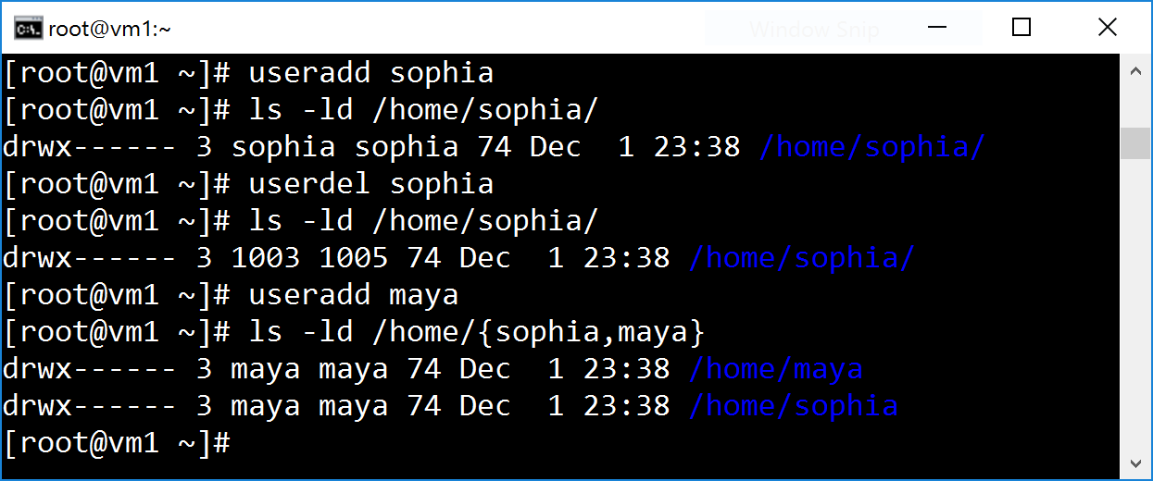
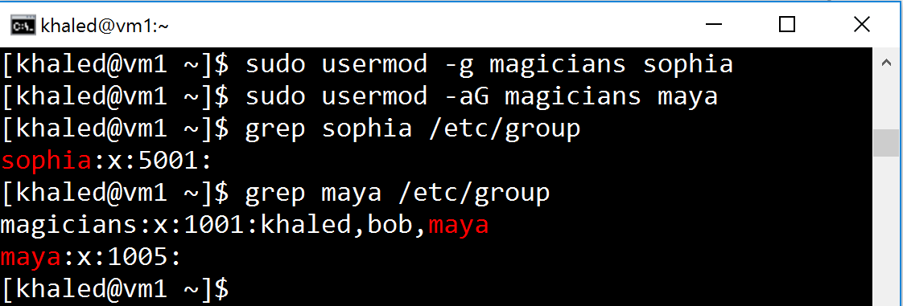
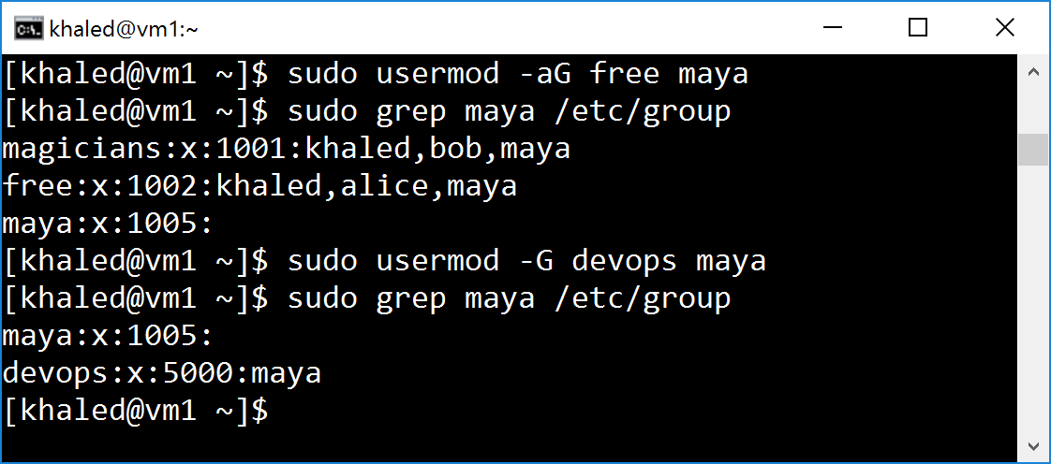
Managing Local User Accounts
15
The usermod modifies existing users
usermod --help will display the basic options that can be used to modify an account. Some common options included in the next slide
userdel [-r] username removes the user from /etc/passwd
find / -nouser -o -nogroup 2> /dev/null

Slide 16
Managing Local User Accounts
16
usermod
-c, --comment COMMENT | Add a value, such as a full name, to the GECOS field.
-g, --gid GROUP | Specify the primary group for the user account.
-G, --groups GROUPS | Specify a list of supplementary groups for the user account.
-a, --append | Used with the -G option to append the user to the supplemental groups mentioned without removing the user from other groups.
-d, --home HOME_DIR | Specify a new home directory for the user account.
-m, --move-home | Move a user home directory to a new location. Must be used with the -d option.
-s, --shell SHELL | Specify a new login shell for the user account.
-L, --lock | Lock a user account.
-U, --unlock | Unlock a user account.

Slide 17
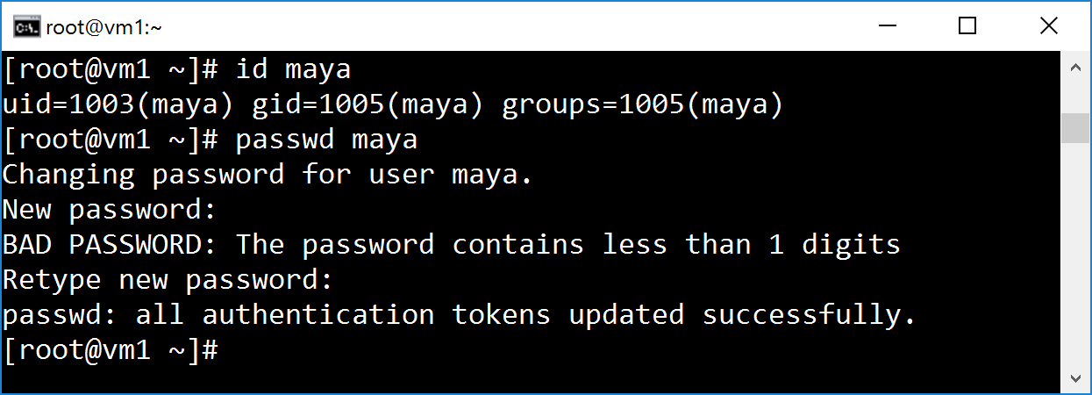
Manage passwords and UIDs
17
The id username command displays user information, including the user's UID number and group memberships.
passwd username can be used to either set the user's initial password or change that user's password.
The root user can set a password to any value
A regular user must choose a password which is at least 8 characters in length and is not based on a dictionary word, the username, or the previous password.
root: UID 0
System users: 0<UID<1000
Regular users: 999<UID

Slide 18
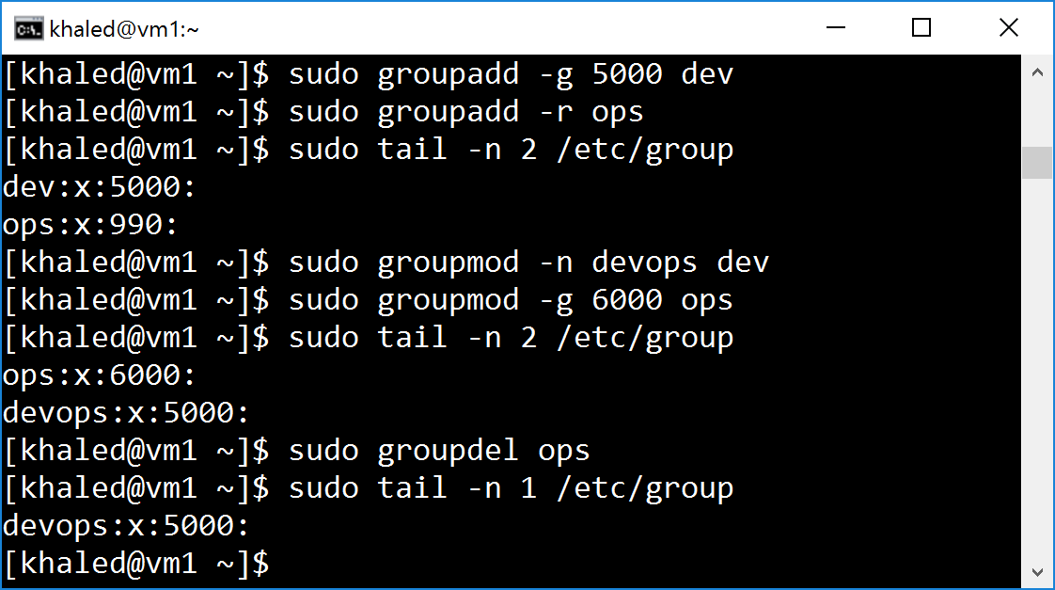
Managing Local Group Accounts
18
groupadd goupname creates groups
The -g GID option is used to specify a specific GID
-r option creates a system group using a GID from the range of valid system GID numbers listed in the /etc/login.defs
groupmod modifies existing groups
groupdel command remove a group
usermod alters group membership

Slide 19
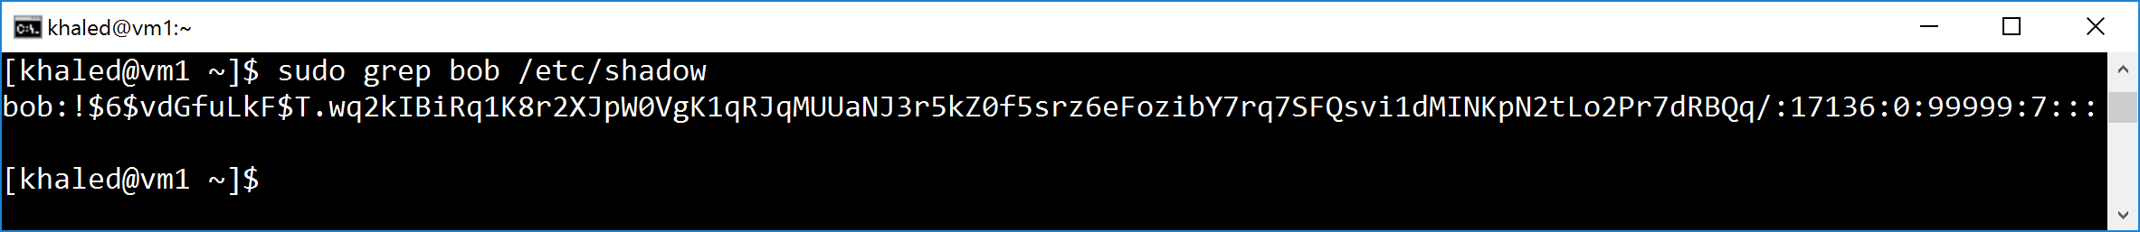
Managing Users Password
19
User encrypted passwords are stored in /etc/shadow
There are three pieces of information stored in a modern password hash:
The hashing algorithm 6 indicates 512 hash. 1 indicates MD5 hash
The salt used to encrypt the hash: vdGfuLkF
The encrypted hash: T.wq2kIBiRq1K8r2XJpW0VgK1qRJqMUUaNJ3r5kZ0f5srz6eFozibY7rq7SFQsvi1dMINKpN2tLo2Pr7dRBQq/

Slide 20
Managing Users Password
20
The login name. This must be a valid account name on the system.
The encrypted password. ! means that the password is locked.
The date of the last password change (number of days since 1970.01.01).
The minimum number of days before a password may be changed.
The maximum number of days before a password must be changed.
The warning period that a password is about to expire. 0 = no warning
The number of days an account remains active after password expiration.
The account expiration date (number of days since 1970.01.01).
This blank field is reserved for future use.

Slide 21
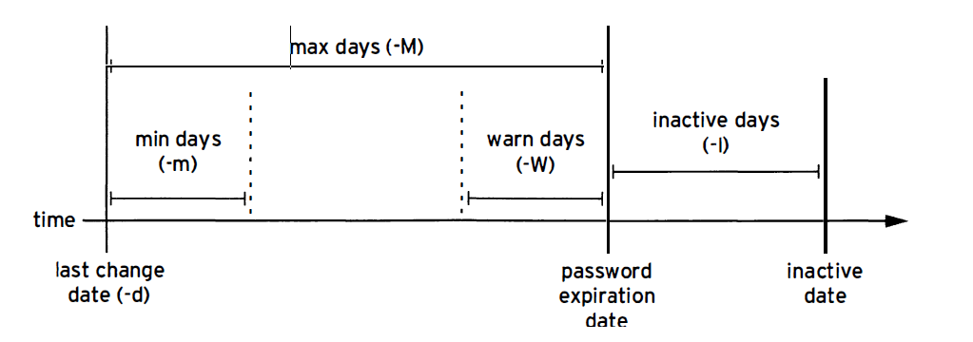
Password Aging
21
chage implements a password-aging policy
chage -d 0 username forces a password update on next login
chage -E YYYY-MM-DD username expires an account on a specific day

Slide 22
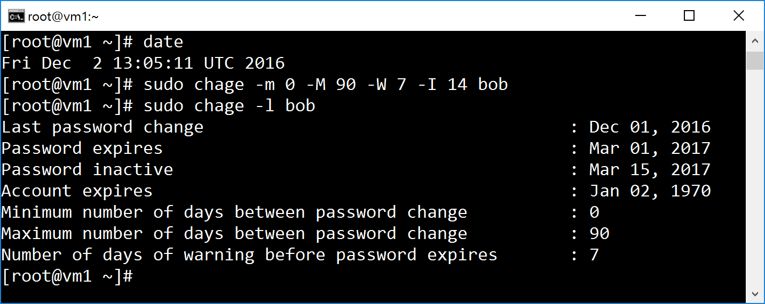
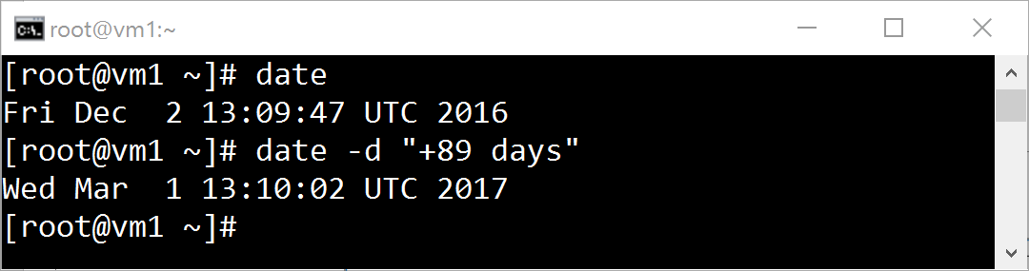
Password Aging
22
chage -l username lists username's current settings.
The date command can be used to calculate specific date

Slide 23
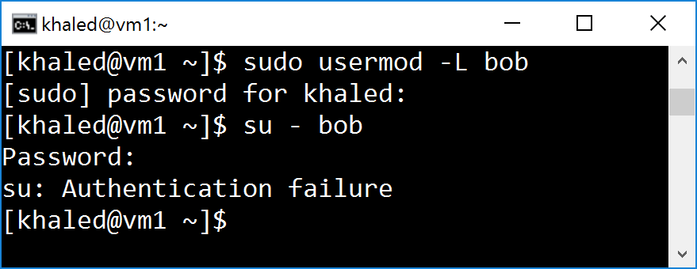
Restricting Access
23
The usermod command can "lock" an account with the -L option
The date must be given as the number of days since 1970.01.01
the account can later be unlocked with usermod -U USERNAME. If the account was also expired, be sure to also change the expiration date.

Slide 24
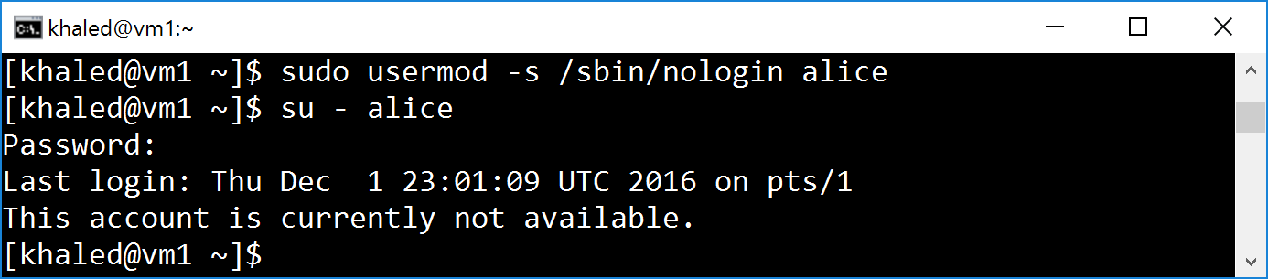
The nologin shell
24
Use of the nologin shell prevents interactive use of the system.
But does not prevent all access!
A user may still be able to authenticate and upload or retrieve files through applications

Slide 25
Security limits
25
/etc/security/limits.conf sets the resource limits for the users logged in
Example: Limit the student group to have four simultaneous logins
man 5 limits.conf for more examples.
The command ulimit provides control over the resources available to the shell and to processes started by it.
Limits can be placed on a user or group
Limit can be soft: may be exceeded by the affected user
Limit can be hard: may not be exceeded.

Slide 26
Demo

Slide 27

Exam objectives
27
https://training.linuxfoundation.org/certification/lfcs
Configure networking and hostname resolution statically or dynamically
Create, delete, and modify local user accounts
Create, delete, and modify local groups and group memberships
Manage template user environment
Manage access to the root account
Configure user resource limits

Slide 28
Homework Assignment I
28
Display the current host name
Display the host name status
Set a static host name ms-loves-linux.example.com
View the configuration file providing the host name at network start
Display the host name status
Temporarily change the host name with the command hostname to temphost.azure.example.com and display the current host name
View the configuration file providing the host name at network start
Reboot the system and display the current host name
Find the public IP of bing.com, add the following local nickname to the IP search.azure.example.com. Verify your configuration by pinging the host

Slide 29
Homework Assignment II
29
Become the root user at the shell prompt
Create an empty readme.txt file and make sure all newly created users get automatically a copy of that file in their home directories.
Add the user juliet.
Confirm that juliet has been added by examining the /etc/passwd file.
Use the passwd command to initialize juliet's password.
Continue adding the next users and set initial passwords: romeo, hamlet, reba, dolly, elvis.
Create a supplementary group called shakespeare with a group ID of 30000.
Create a supplementary group called artists.

Slide 30
Homework Assignment II
30
9. Confirm that shakespeare and artists have been added by examining the /etc/group file.
Add the juliet user to the shakespeare group as a supplementary group.
Confirm that juliet has been added using the id command.
Add romeo and hamlet to the shakespeare group
Add reba, dolly, and elvis to the artists group.
Verify the supplemental group memberships by examining the /etc/group file.
Lock the romeo account and attempt to login in as Romeo
Unlock the romeo account

Slide 31

Homework Assignment II
31
Change the password policy for romeo to require a new password every 90 days.
Additionally, force a password change on the first login for the romeo account.
Log in as romeo and change the password to forsooth123.
Determine a date 180 days in the future and set account to expire at
Apply a limit to the user romeo such that he is not allowed to start more than 5 processes on the system and validate that the limit you have configured works as you would expect.

Slide 32

Questions?

